Slide 1
LUNA migration
by Mira Basara 02/22/2016

Slide 2
LUNA – limitations we are happy to lose
Behind current trends
Complexity of application support
Difficulty to synchronize Oracle database in LUNA with source data for large dynamic collections
- Pictor database for large slide collection (slide 8)
- TMS for Museum collection (slide 9)
Building new collections
No bulk data replacement
2-3 years ago LUNA stopped supporting Oracle; now uses MySQL

Slide 3
LUNA – advantages we also lose
Annotations
Groups and Presentations
PDF Book Reader
Greater compatibility with various browsers
More granular permissions (per user or per collection)
Mobile device support
Vendor support

Slide 4
Destination – ARTstor/Shared Shelf
2005 ARTstor added to CUL repository landscape
Hosted platform
Large community with cross collections search
2009 CUL began development partnership with ARTstor Shared Shelf.
Building new collections, management, and cataloging are very easy
Publishing options (slide 11)

Slide 5
Migration plan (completed 1/2016)
Outreach to stakeholders and community (VRWG)
Resource migration
  Herbert F. Johnson Museum of Art collection in eMuseum
  Collecting master files for SS upload
  Retrieve derivatives from LUNA server for missing master files
Metadata migration (very difficult)
  Many different metadata schemas
  No bulk export
  XML export from LUNA not useful
  Transforming VRA relational database to flat (slide 12)
  XLSX normalization for Shared Shelf upload (slide 13)
Updating websites, libguides, resolvers, handles

Slide 6
LUNA migration - phase 2 (underway)
Shut down Luna test server (done)
Create subgroups with key people that will QC migrated LUNA collections
Preservation of original metadata for future reference
Documentation – Finding Aids
Goal: the end of Spring 2016 to decommission Luna production server

Slide 7
Questions? Comments?
(slides from this point are supplementary material)

Slide 8
Slide borrowed from Gale Halpern presentation, (2007), https://ecommons.cornell.edu/handle/1813/8420

Slide 9
Slide borrowed from Gale Halpern presentation, (2007), https://ecommons.cornell.edu/handle/1813/8420

Slide 10
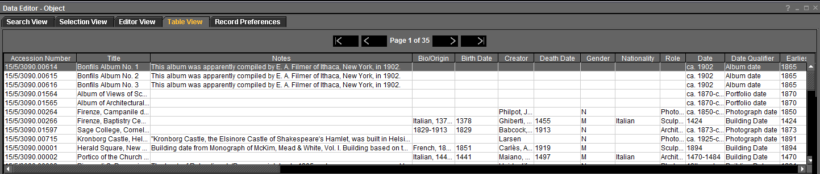
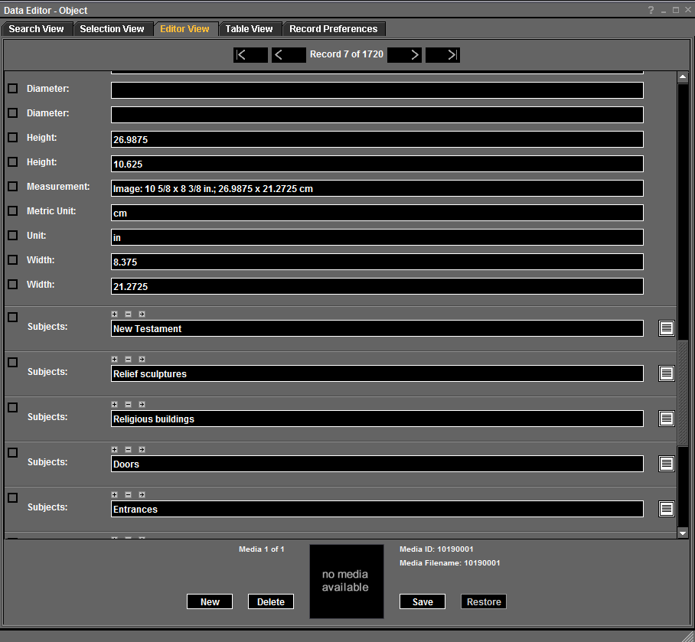
Metadata preview in Luna client/Inscribe

Slide 11
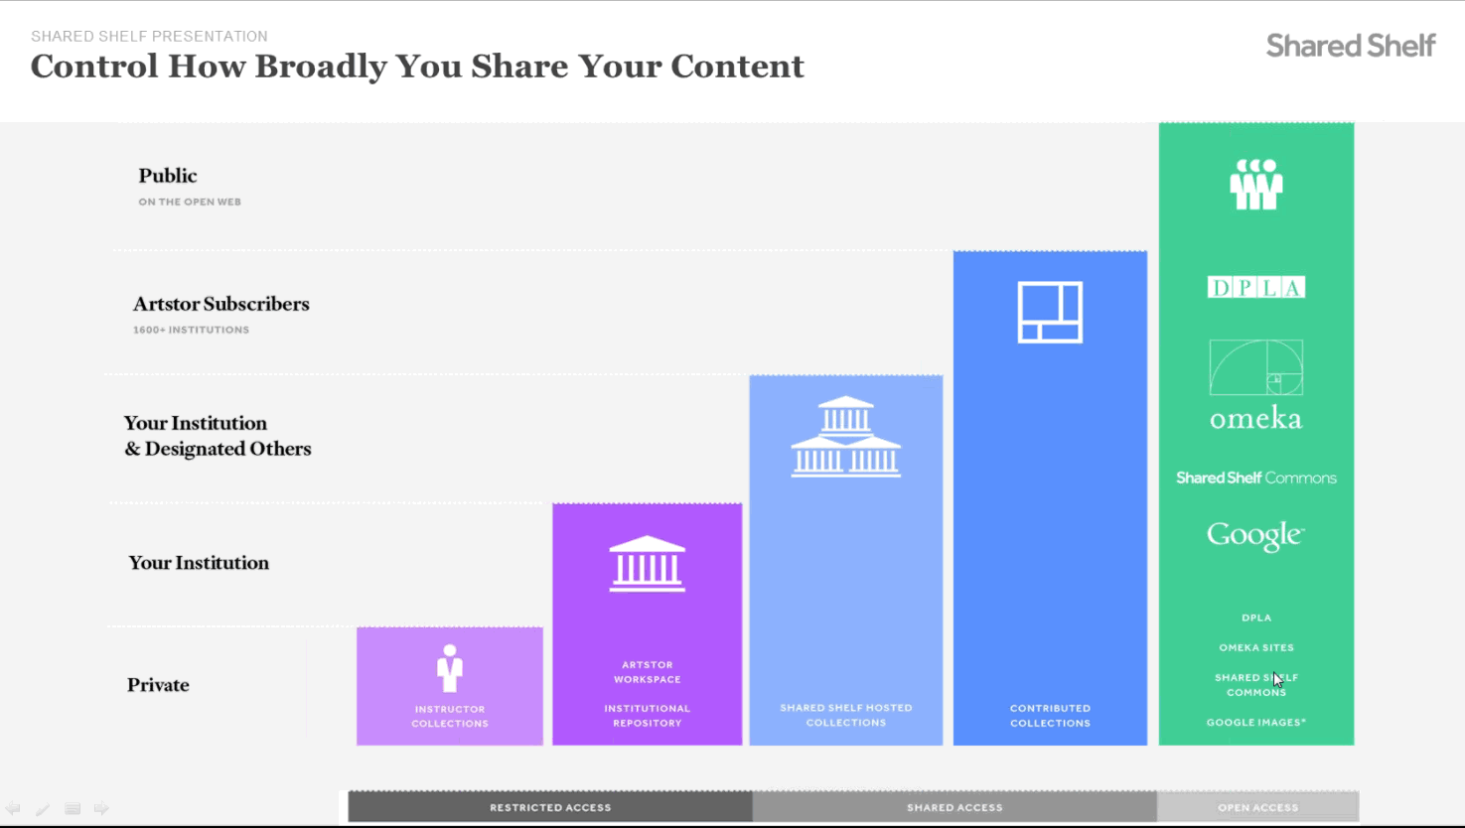
Borrowed from Shared Shelf training presentation, 2/18/2016

Slide 12
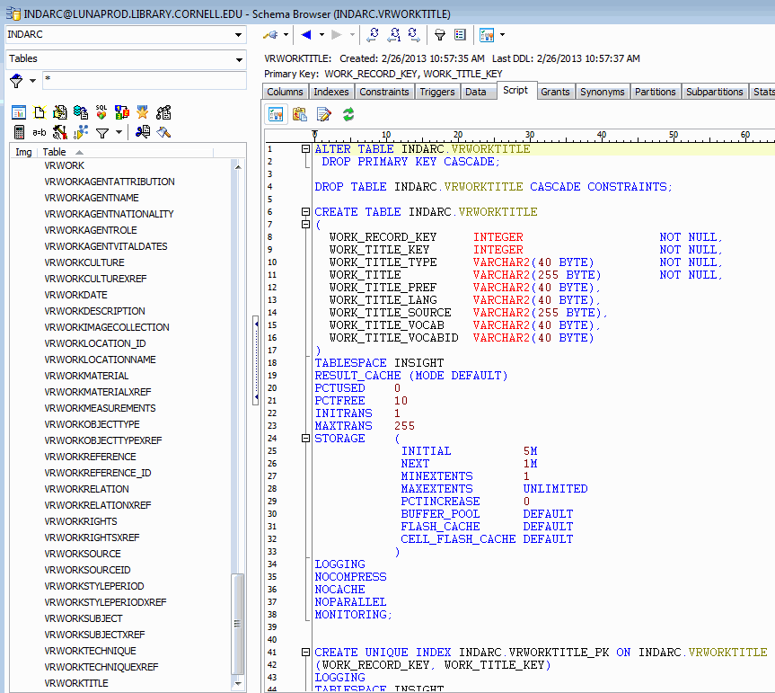
Notes:
Customized VRA Core 4.0 metadata schema and SQL view of vrworktitle table in Oracle

Slide 13
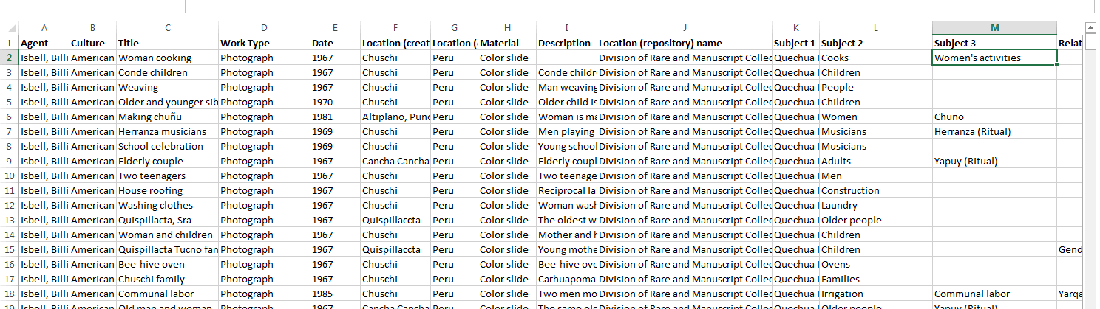
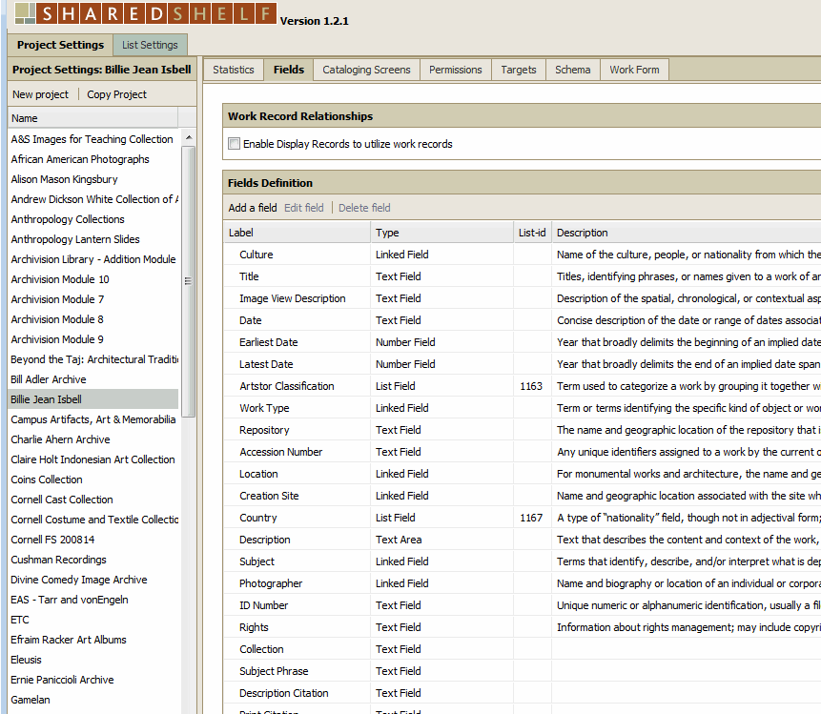
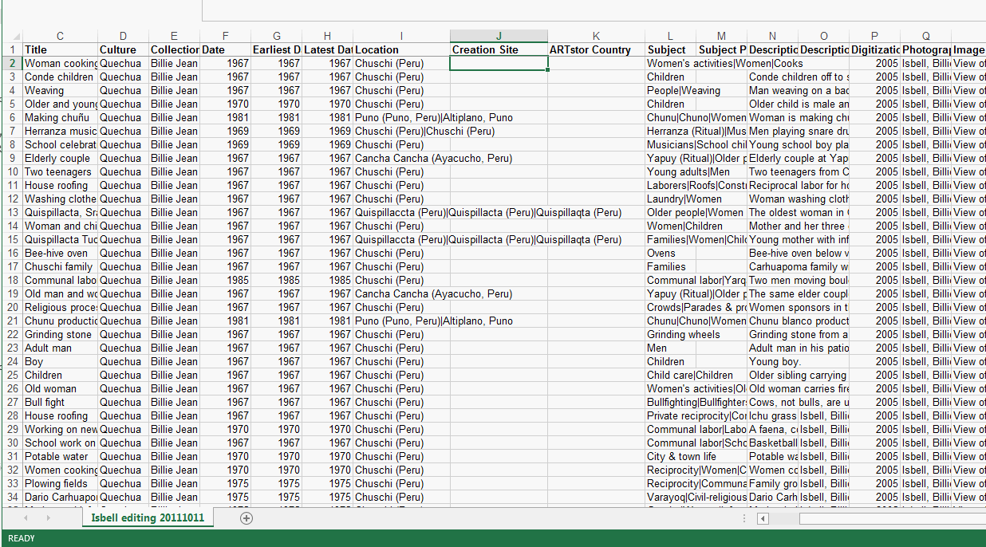
Metadata LUNA export converted into spreadsheet and normalized metadata for Shared Shelf import

