Slide 1
Floc Hopper Probe
Fall 2015
Miguel Castellanos
John Lopez

Slide 2
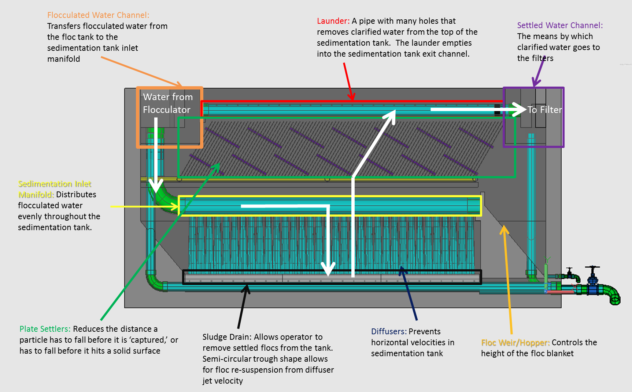
Sedimentation
What we know:
Flocs created in the flocculator settle out here forming a fluidized blanket.
Due to the slight density difference the floc settle out over a weir into the floc hopper.
This hopper has a valve to let sludge flow out of.
and

Slide 3
The Issues
What’s going on in here!?
and

Slide 4
Goals
We want to create a device that is easy to use and can help the operator know where the top of the sludge blanket is in the floc hopper, so the operator can adjust the flow out of the floc hopper to remove sludge.

Slide 5
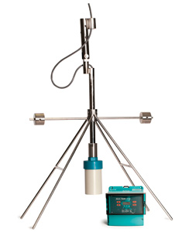
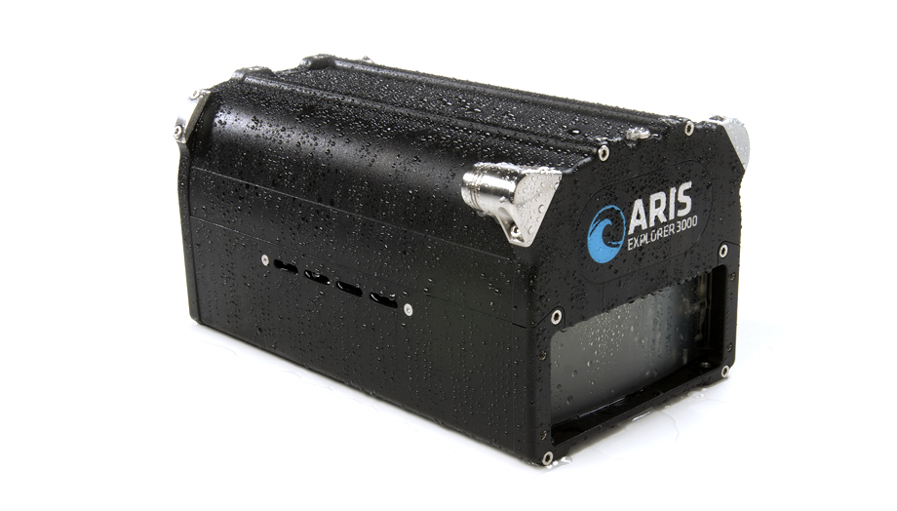
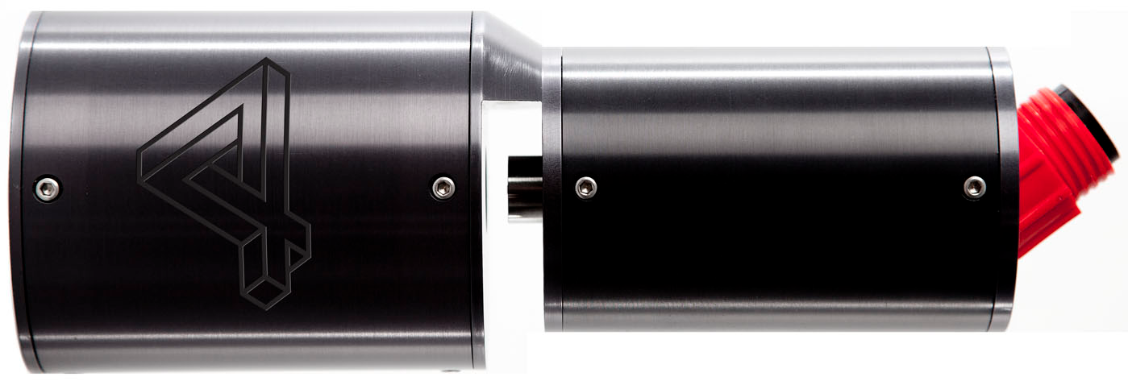
Past Work
Underwater Sonar Video Camera
Sultan Sonar System
Submersible Microscope

Slide 6
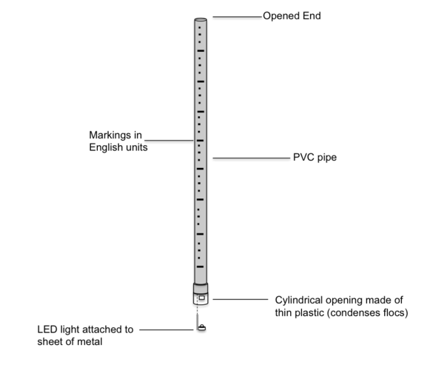
Probes

Slide 7
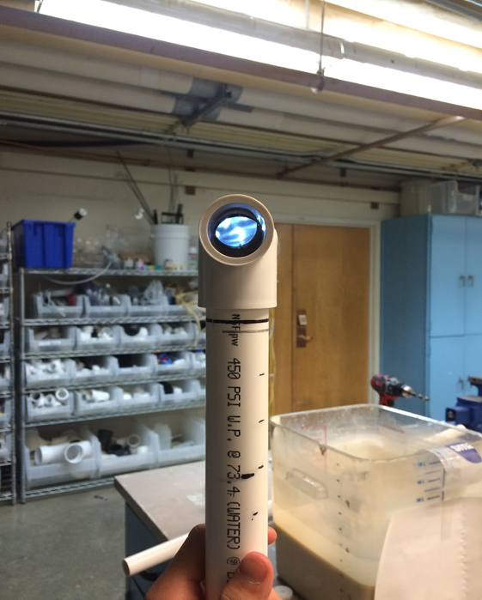
Results (whats new?)
We have recently added a periscope attachment and begun development on an attachment to prevent dropping the probe into the hopper. This is to increase usability of this device for the operators.
We have also marked off measurements on the probe itself as of now.

Slide 8
Manual
We have inscribe detailed instructions on how to create what we did so that we can have something to help people in Honduras understand how to build this as well as to leave detail for future teams. We wanted who ever picks this team up to really understand what we did, and how to do it again. As of new translation is in progress.

Slide 9
Moving Forward
Continue testing designs and develop standard
Test prototype in Honduras.
Finish guide translation?
Make our attachments safer and more usable
Test new designs… always be innovating

Slide 10

Questions?
Suggestions?

