Slide 1
Spectrophotometer: December 2015 Final Presentation

Slide 2
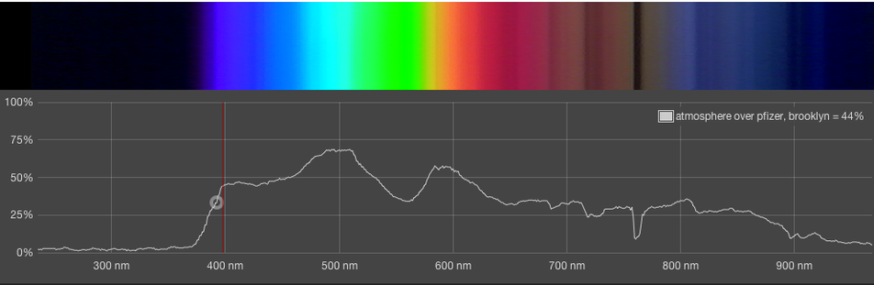
What is Spectrophotometry?

Slide 3
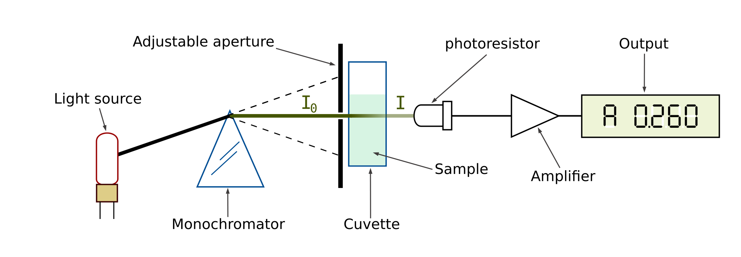
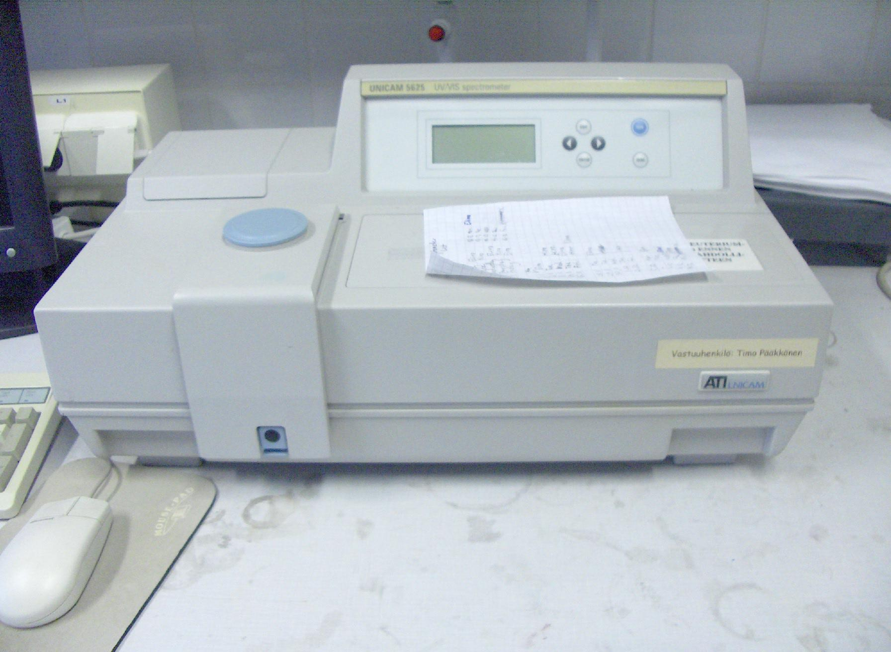
Traditional Spectrophotmetry
Expensive

Slide 4
Goals
Build an inexpensive spectrophotometer device to measure concentration.
Start with Red Dye 40, as this is a substance that can be used in the lab to test our AguaClara water treatment apparatuses.

Slide 5
Previous Work
Arduino-based device
“Color Sensor” integrated circuit used as main detector
Inaccurate, imprecise.
  For the same sample, widely varying values obtained.
  For vastly different samples, the same values were sometimes obtained.

Slide 6
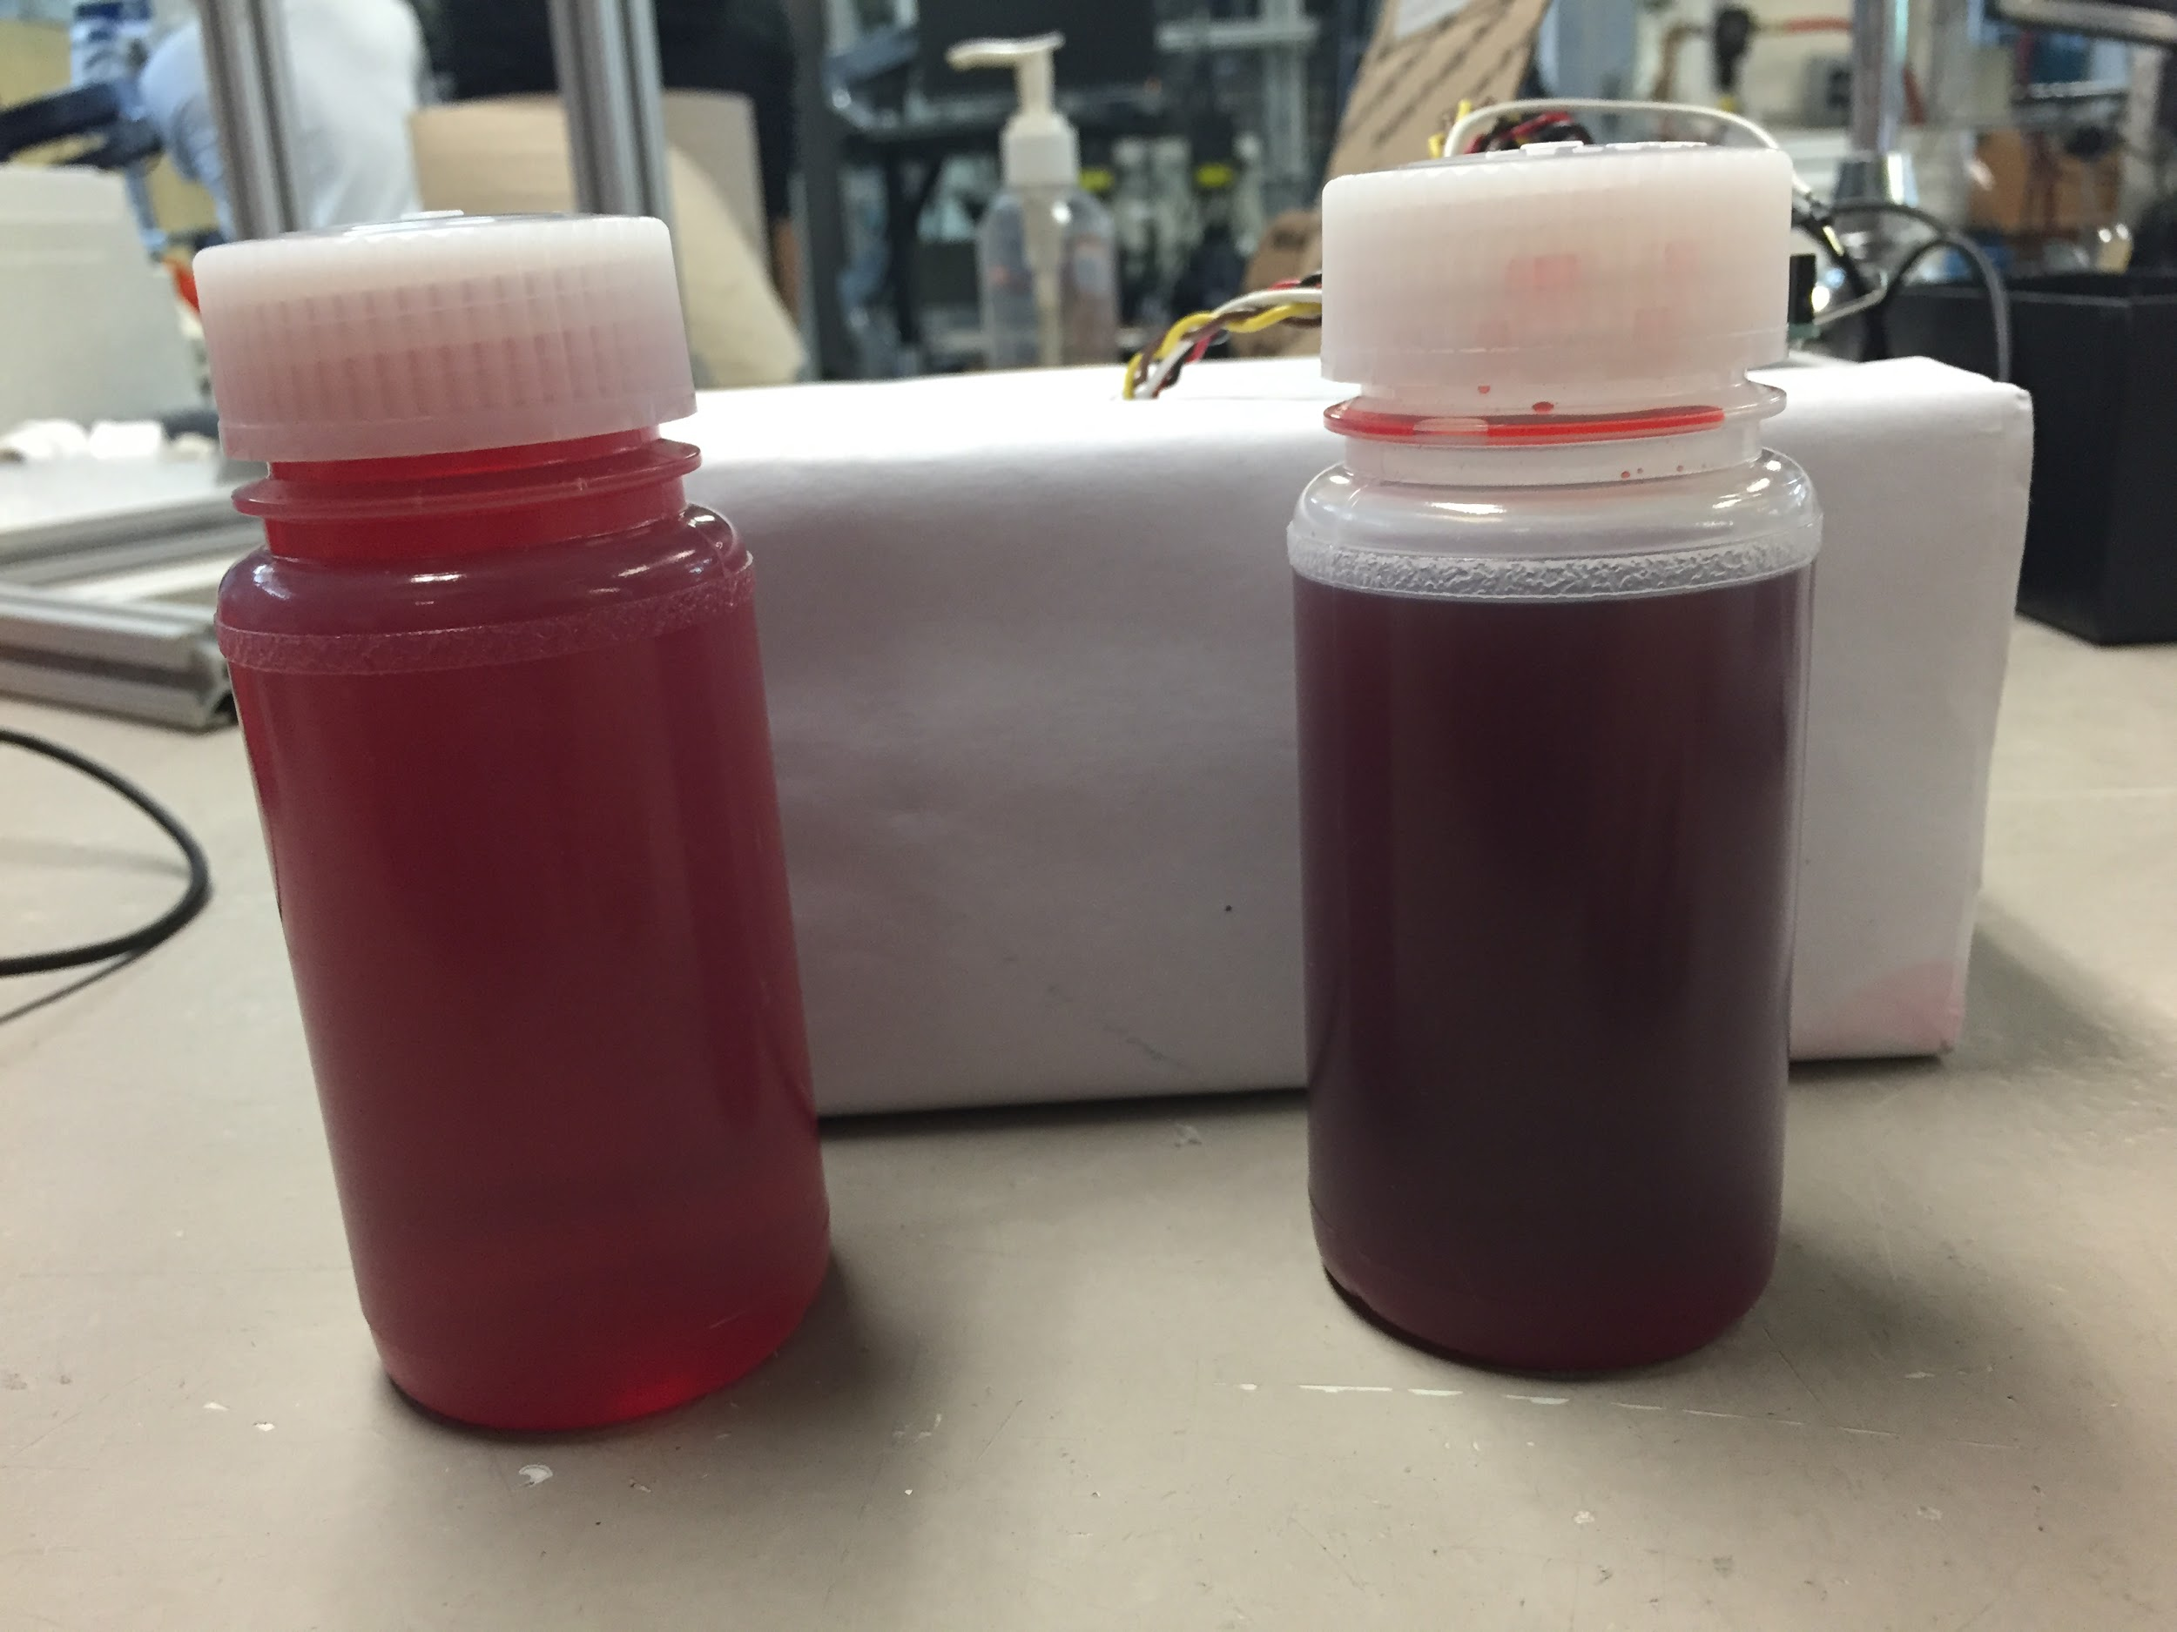
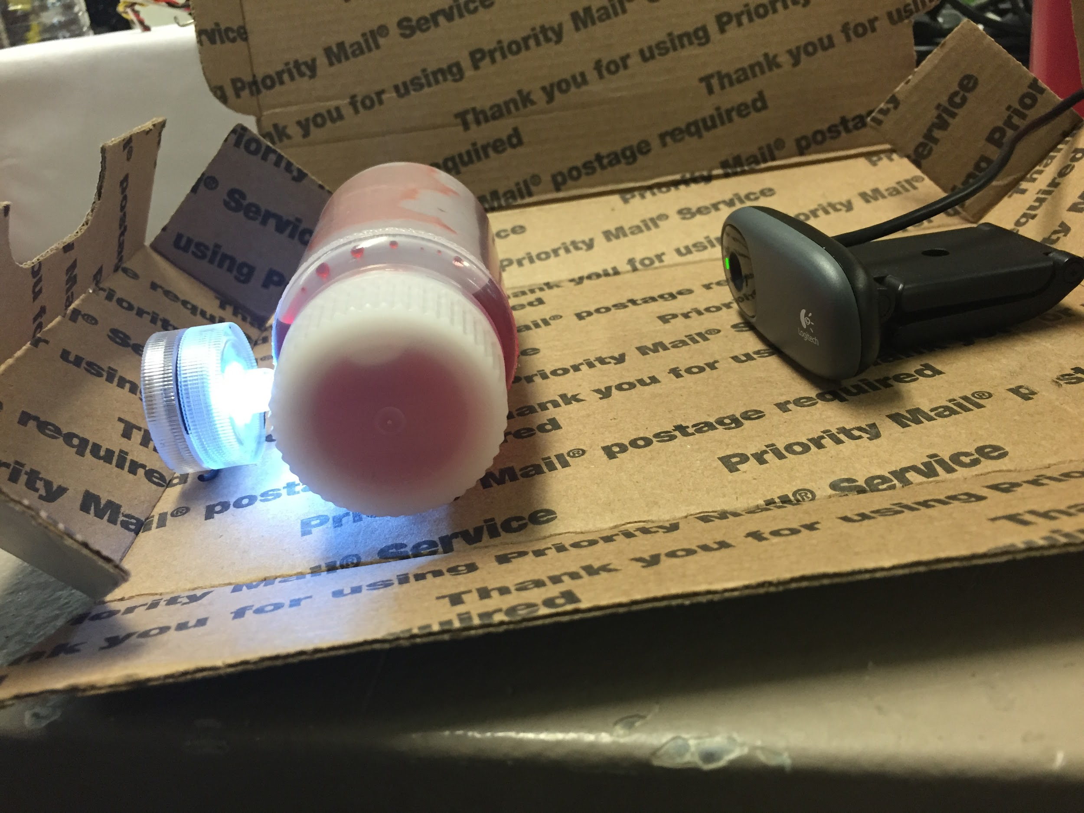
Initial Tests

Slide 7
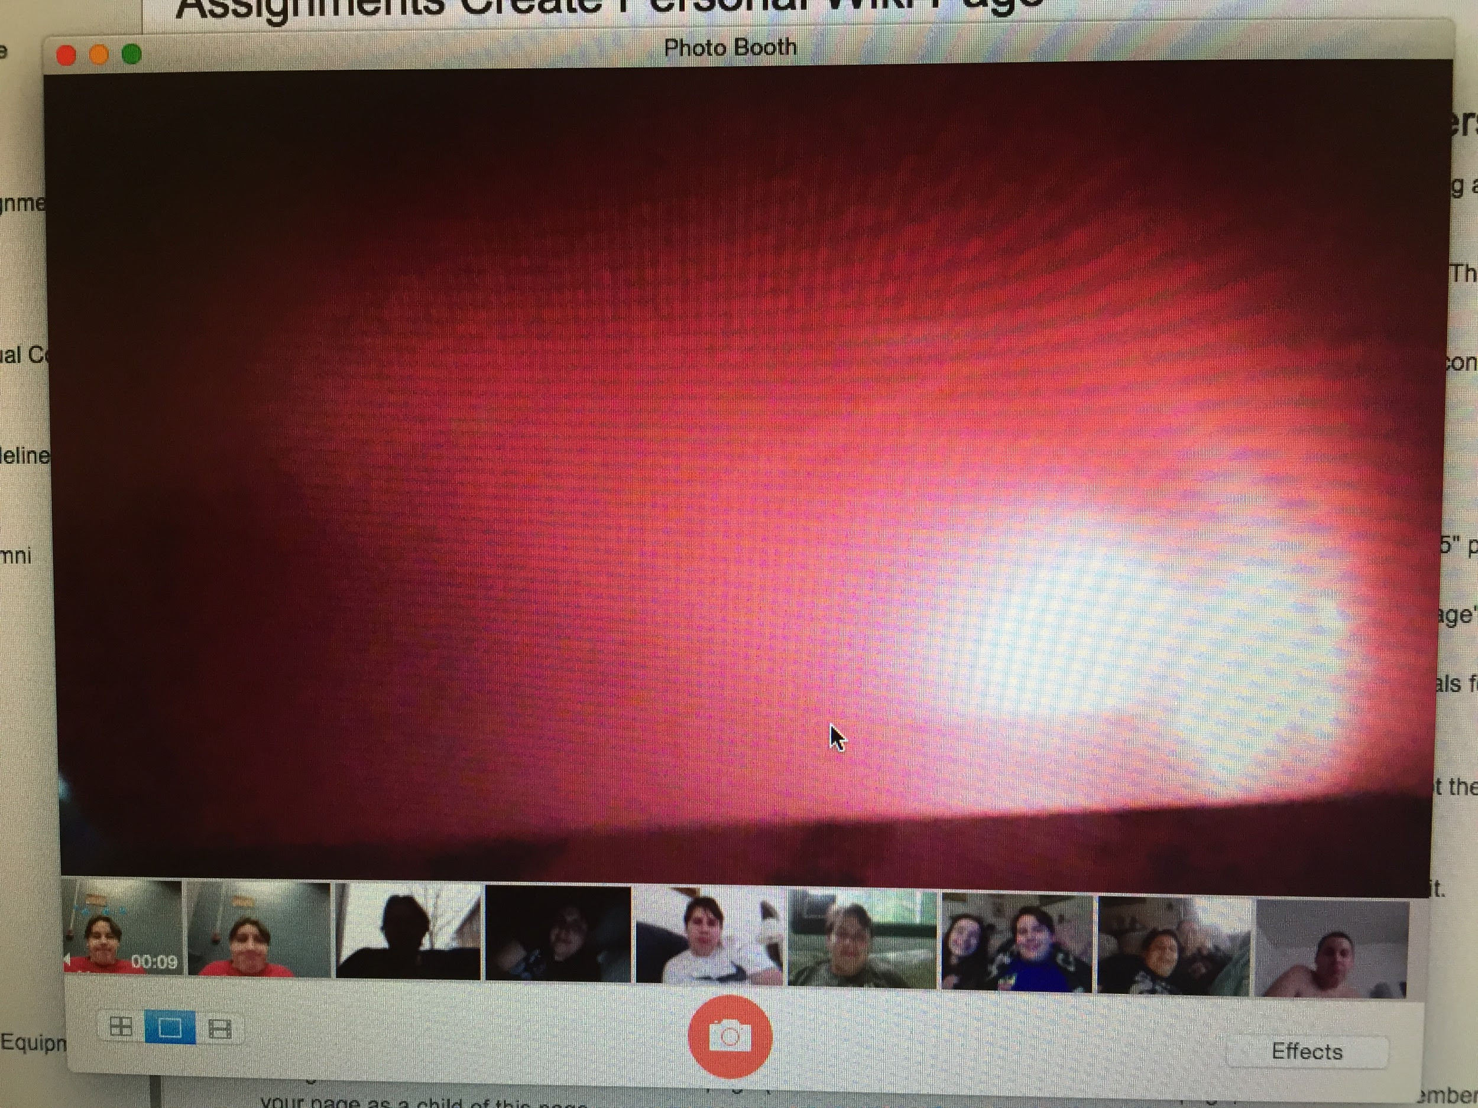
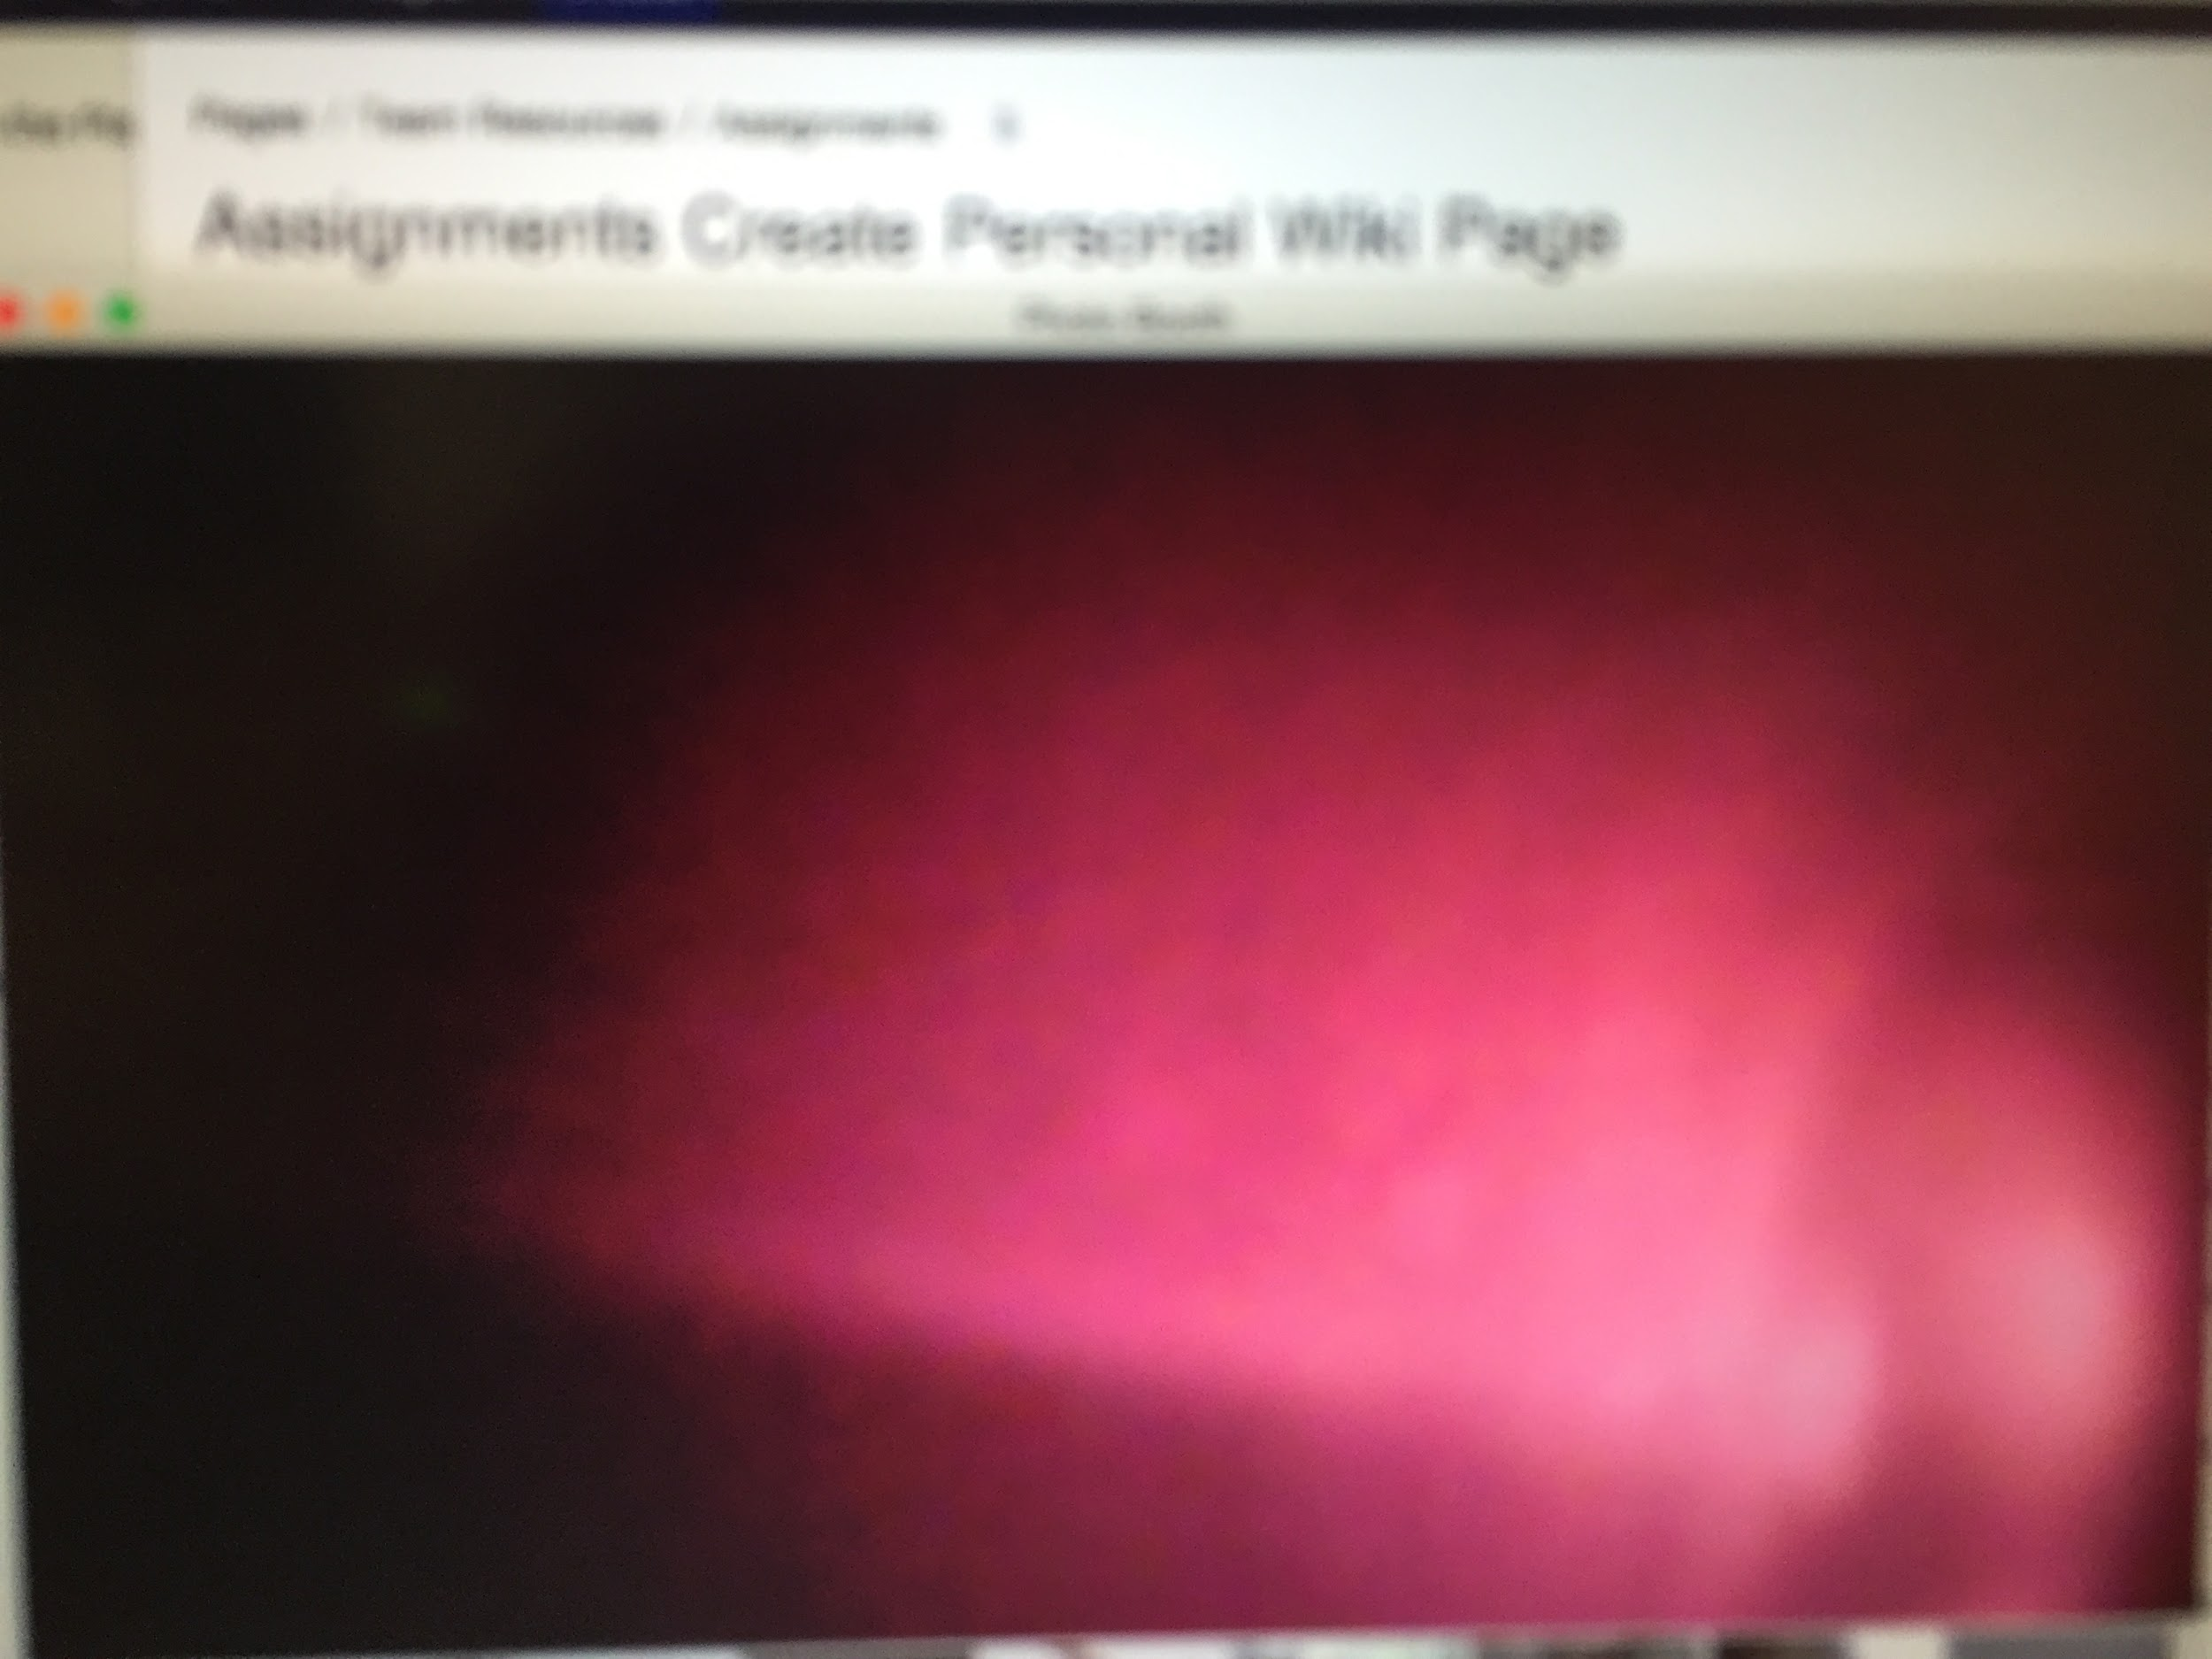
Initial Tests

Slide 8
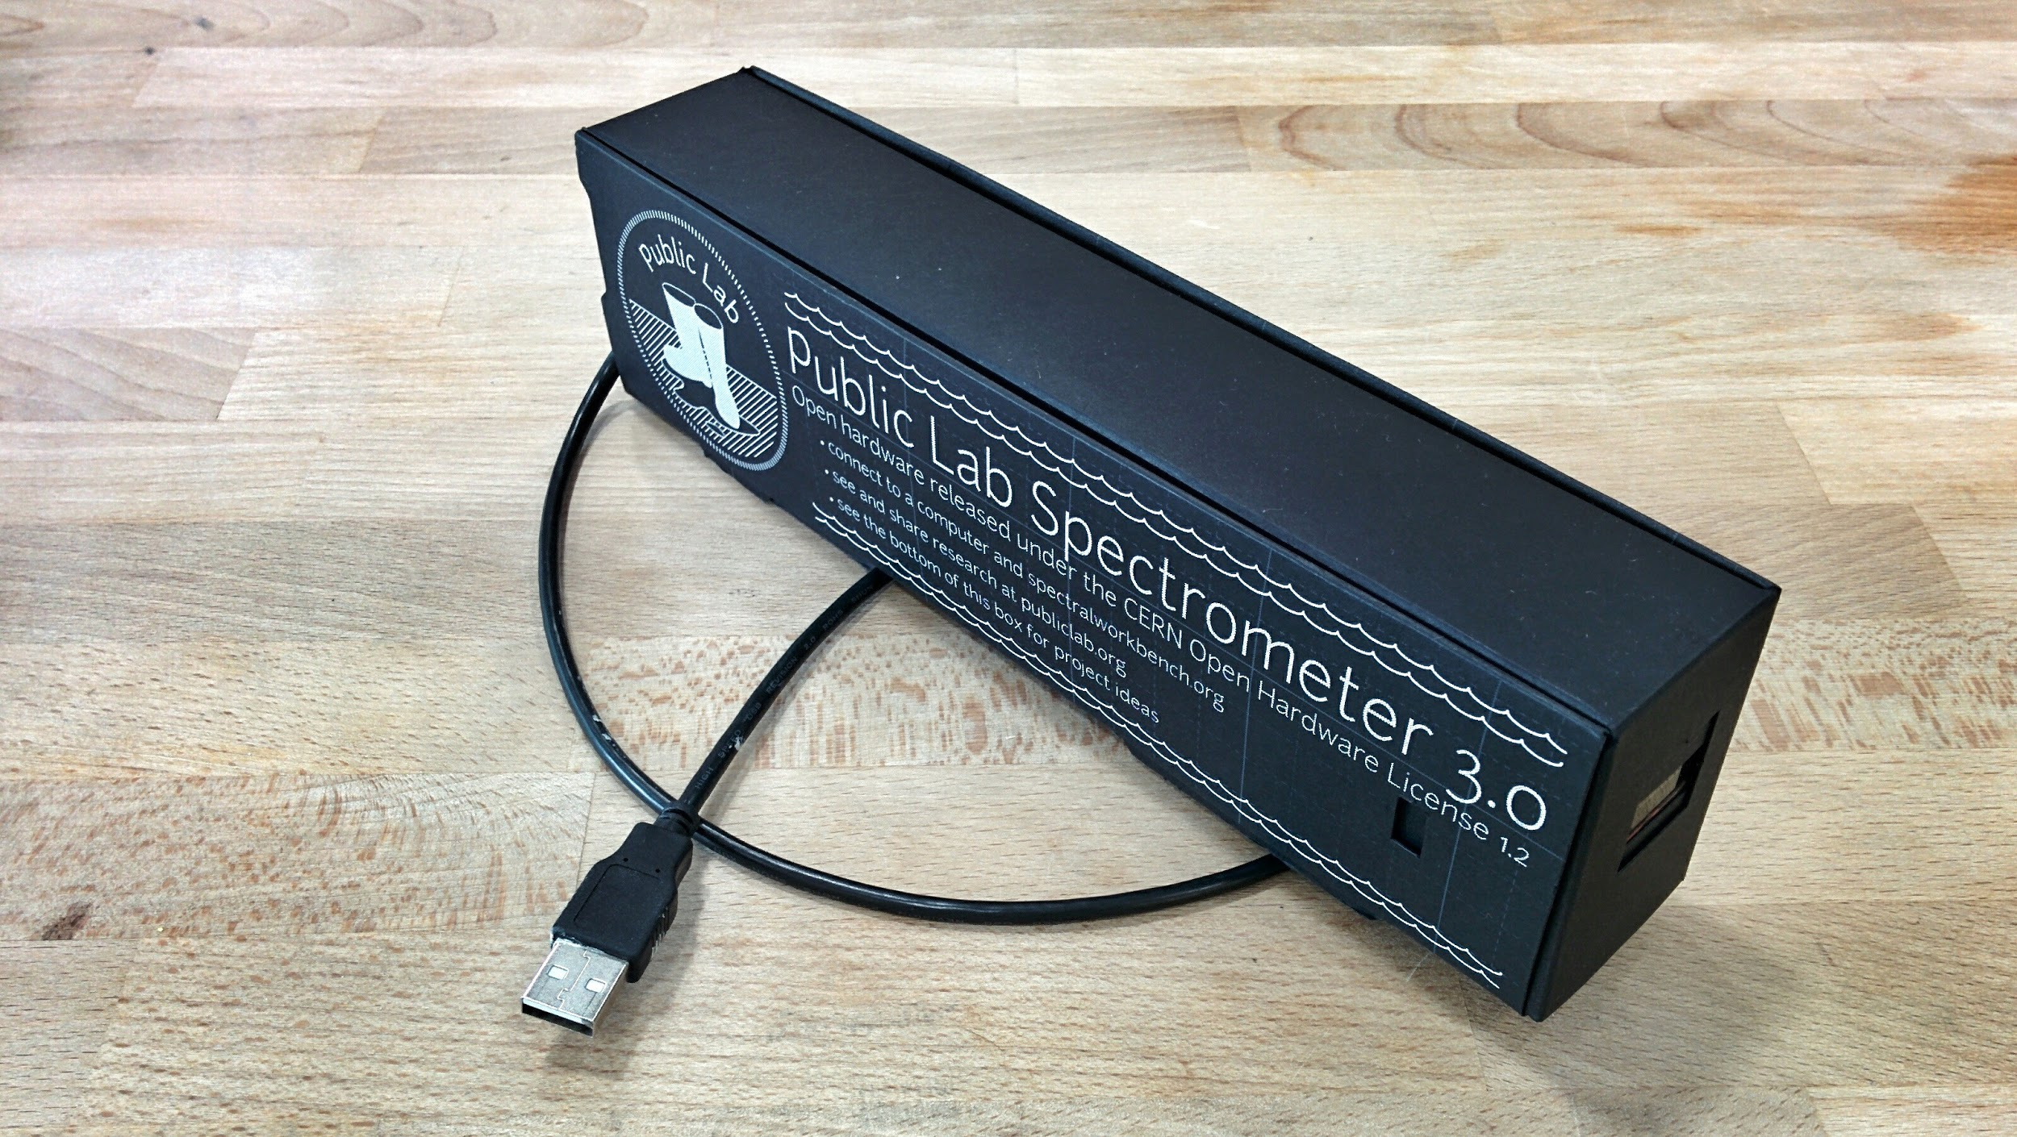
New Approach

Slide 9
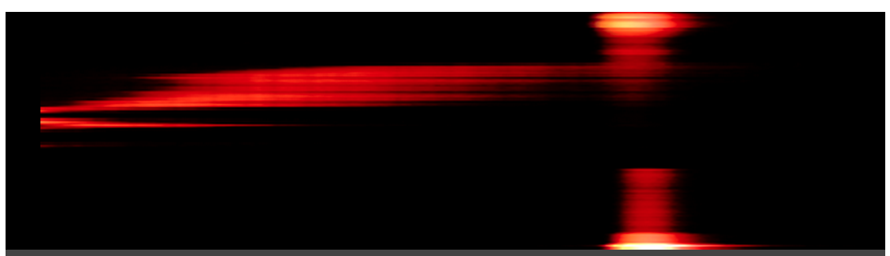
Kit Experiments

Slide 10
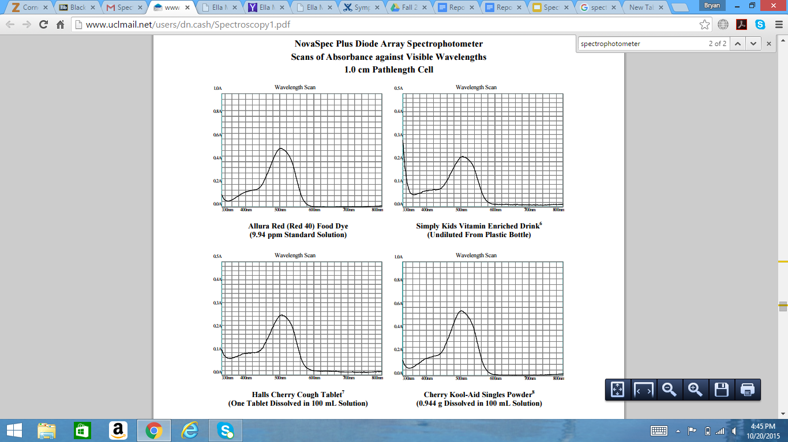
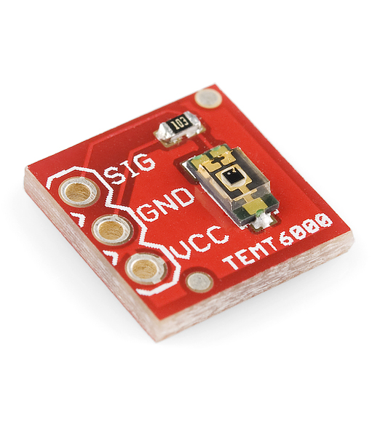
New Approach 2

Slide 11
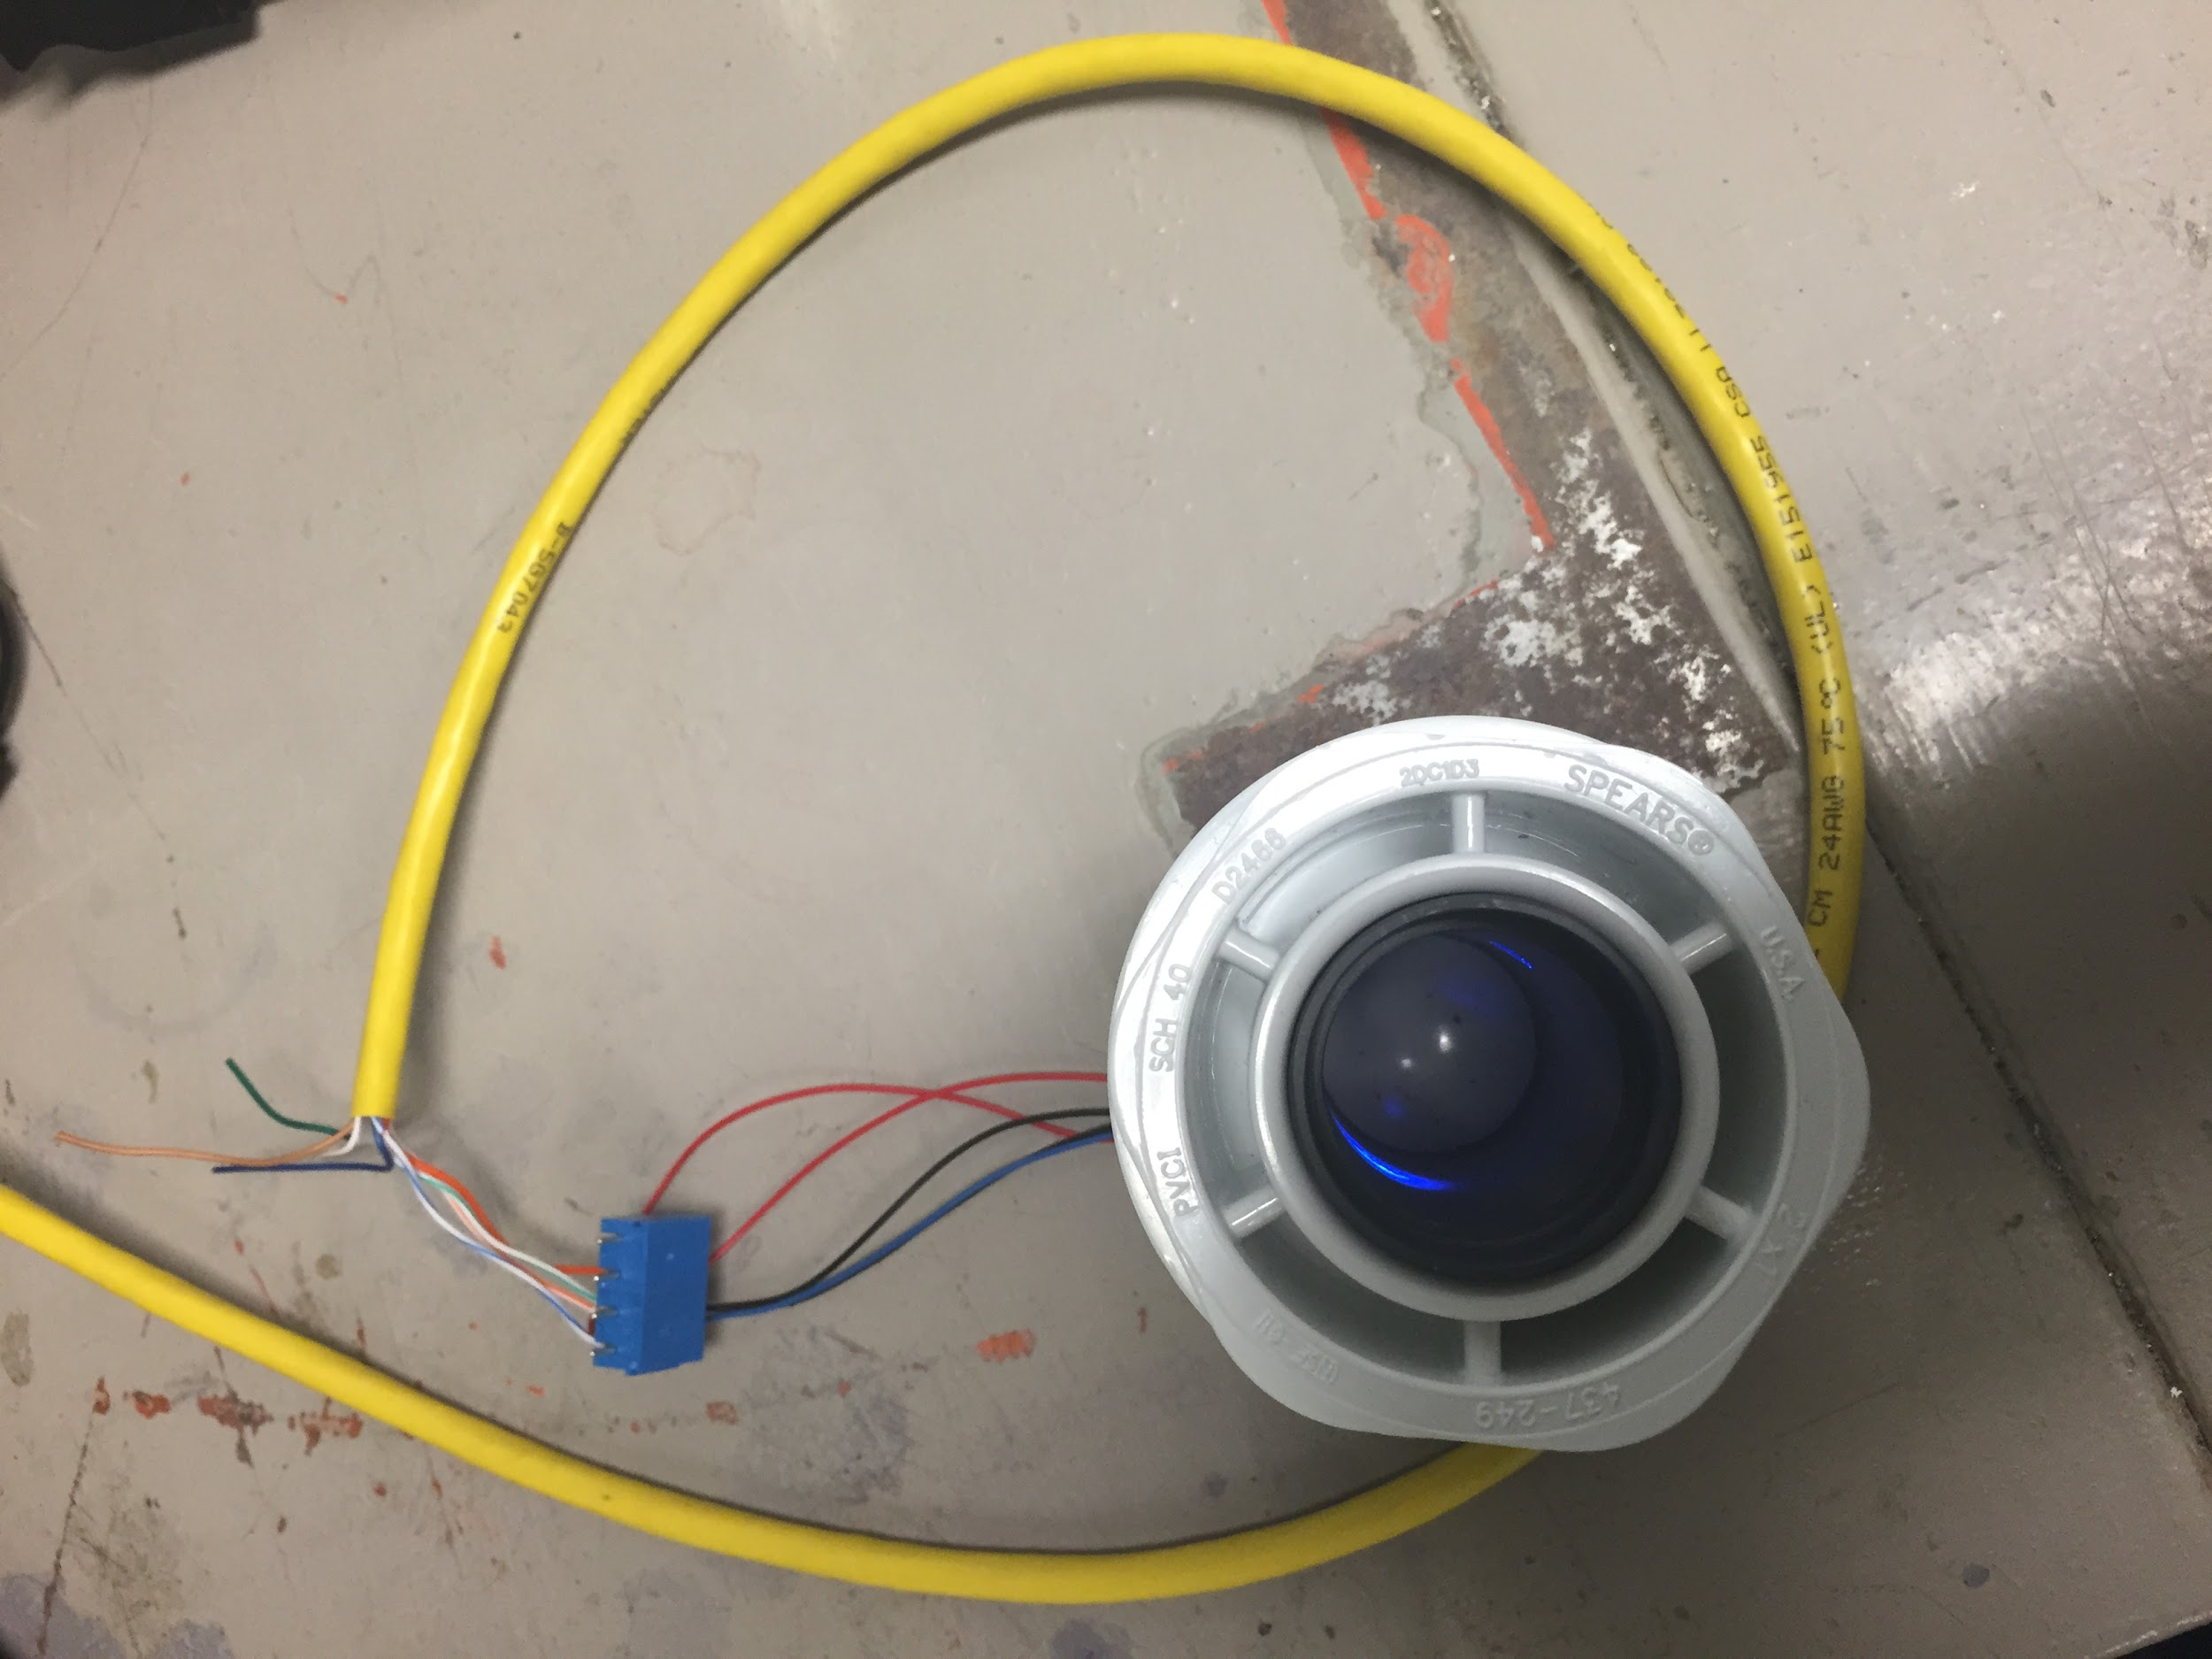
Ambient Light Photosensor

Slide 12
Calibration Data
Table 1: Calibrated Data for Sample Concentrations
Concentration (mg/L) | Voltage | Measured Concentration
0 | 4.48 | 0
10 | 2.405 | 10
25 | 0.247 | 23.24
50 | 0.122 | 24.13
100 | 0.104 | 24.26

Slide 13
Calibration Data
Table 2: Calibrated Data for Sample Concentrations up to 25 mg/L
Concentration (mg/L) | Voltage | Measured Concentration
0 | 4.48 | 0
5 | 3.62 | 3.9
15 | 1.24 | 16.7
20 | 0.673 | 20.3
25 | 0.241 | 23.3

Slide 14
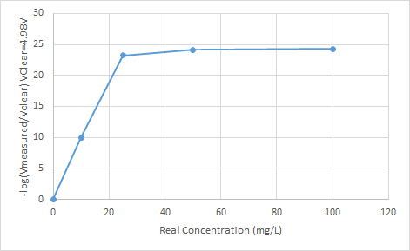
Graphed Results
Figure 1: Real Concentration vs. Measured Concentration

Slide 15
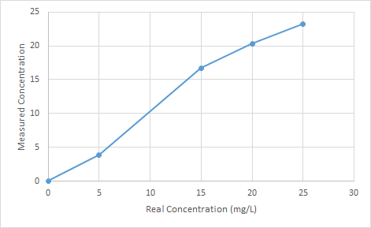
Graphed Results
Figure 2: Real Concentration vs. Measured Concentration up to 25 mg/L

Slide 16
Latest Data
Table 3: Data for Latest Measured Concentrations
Expected Concentration (mg/L) | Voltage | Voltage-Offset (Offset=0.09V) | Vsamp/Vclear | LOG10 | Calculated Concentration
0 | 3.42 | 3.33 | 1 | 0 | 0
5 | 1.69 | 1.6 | 2.081 | 0.318 | 5.05
10 | 0.871 | 0.781 | 4.264 | 0.630 | 10
15 | 0.503 | 0.413 | 8.063 | 0.906 | 19.463
20 | 0.288 | 0.198 | 16.818 | 1.226 | 14.394
25 | 0.182 | 0.092 | 36.196 | 1.559 | 24.749
30 | 0.124 | 0.034 | 97.941 | 1.991 | 31.613
35 | 0.102 | 0.012 | 277.500 | 2.443 | 38.795

Slide 17
Photosensor Parts
Table 4: 254 nm Photo sensor Parts
Part | Estimated Cost ($) | Use
254nm Fluorescent Light (Generic Brand) | $25 | Light Source
254nm LED | Around $236-274 | Light Source
OSI Optoelectronics UV Photodiode | Unsure, found one model for sale in the UK for 90 GBP (~$135) | Main Sensor Device
HF Scientific UV Flowcell (Quartz) Part # 24232S | List price is $318.00-Cornell receives 50% off, cost is $159.00 | Flowcell
Quartz Tube | Found one for $25; unsure if adequate | Flowcell

Slide 18
Questions?

