Slide 1
High Rate Sedimentation
Yuqi Yu
Oge Anyene
Larry Ge

Slide 2
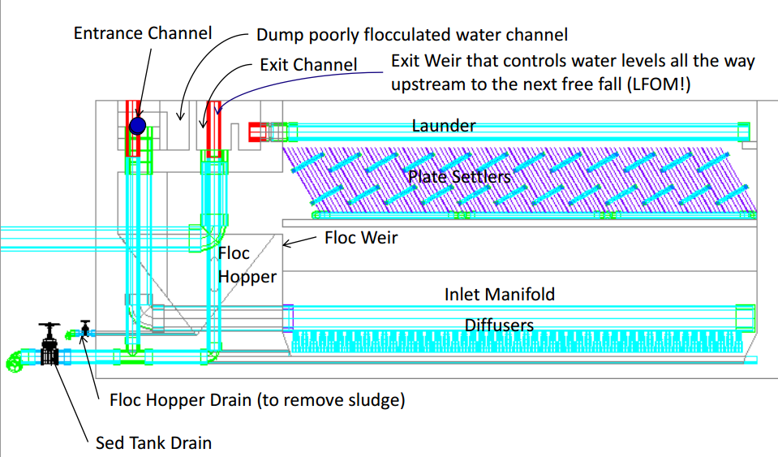
Current Sedimentation Tank

Slide 3
Motivation
The residence time of the current model of the sedimentation tank is 24 minutes making it the slowest process in the flocculation, sedimentation, filtration treatment train.
A decrease in the plan view area of the sedimentation tank and increase of the upflow velocity will lead to a direct decrease in plant construction costs.

Slide 4
Subteam Goals & Tasks
Increase upflow velocity in the sedimentation tank by a factor of 2 to 10 without degrading the function of the floc blanket
Sketch several geometries for a new reactor for a 20 L/s sedimentation tank
Determine the possible configurations of plate settlers that will be submerged in the floc blanket

Slide 5
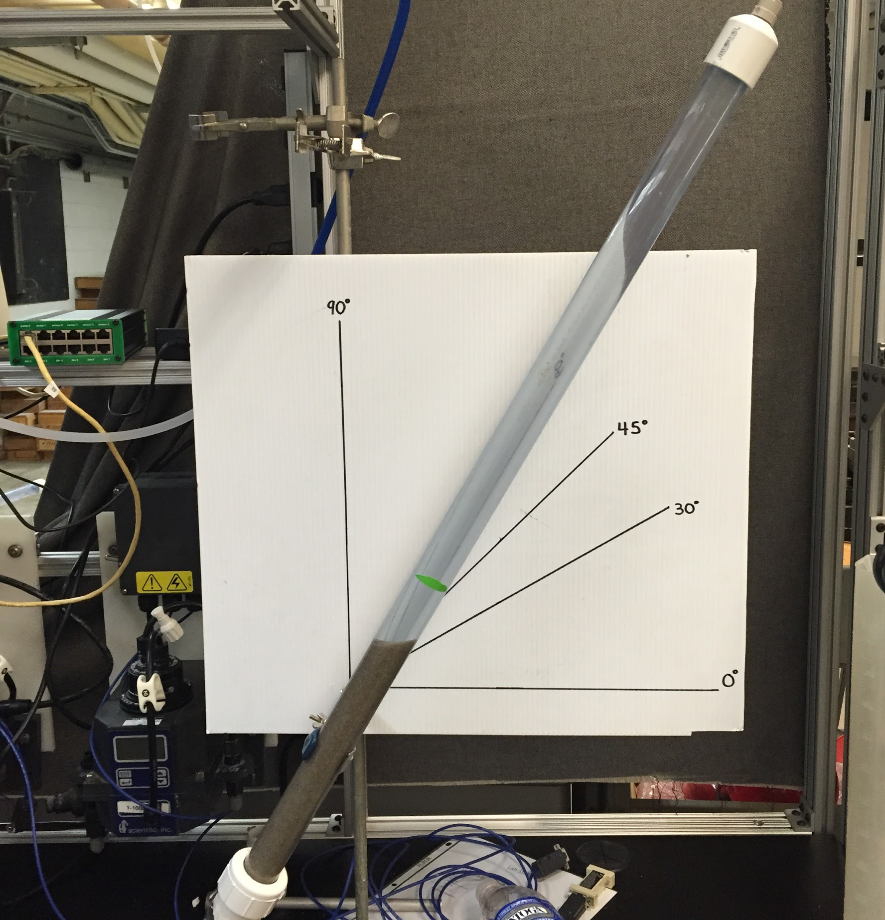
Sand Column Experiment
Results
The velocity profile and maintenance of the fluidized sand bed is very dependent on a 60⁰ (from horizontal) slant angle
Fluidized bed height decreases as the sand column is slanted
For each slant angle, after a certain RPM there was no significant change in fluidized bed height
Figure 1. The sand column slanted at a 60 degree angle from the horizontal

Slide 6
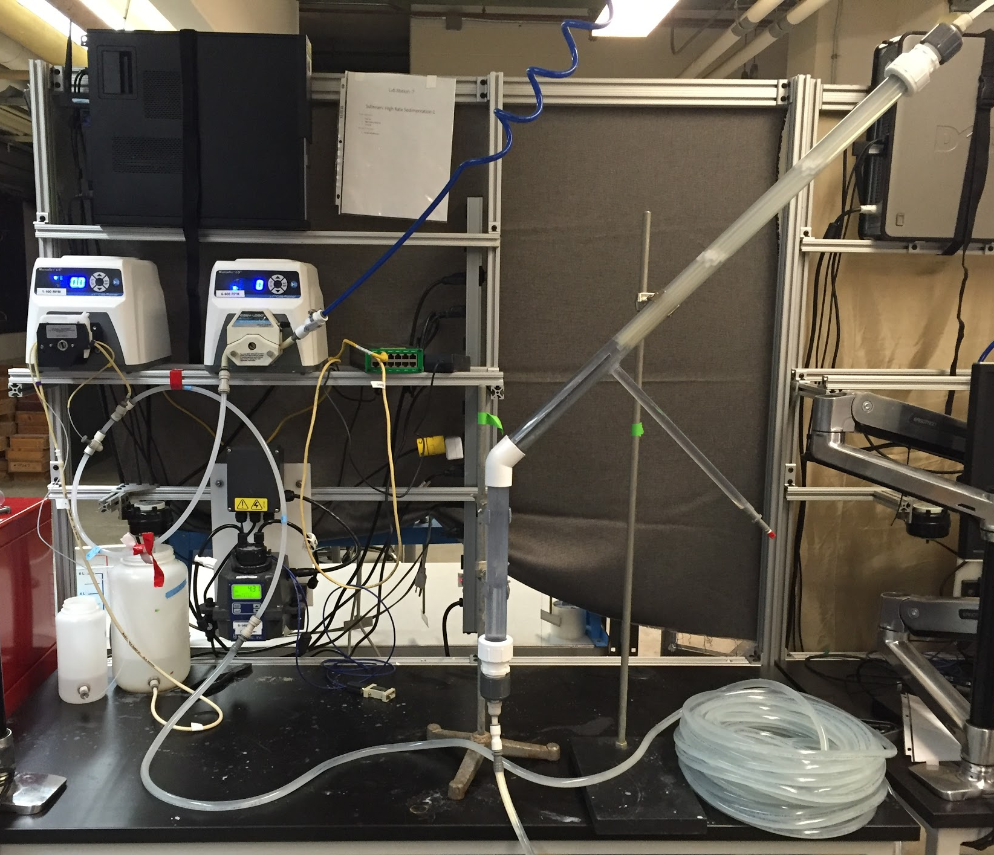
Tank in a Tube Experiment
Investigate a new sedimentation tank geometry
Determine the feasibility of two sets of plate settlers in the sedimentation tank
Waste floc and sludge disposal - Maintain “self-cleaning”
The bench scale setup for the Tank in a Tube Experiment.

Slide 7
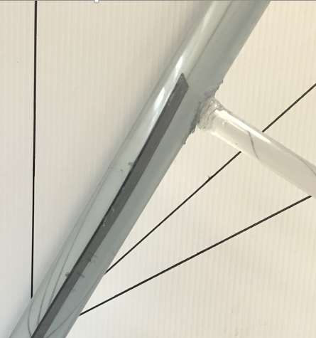
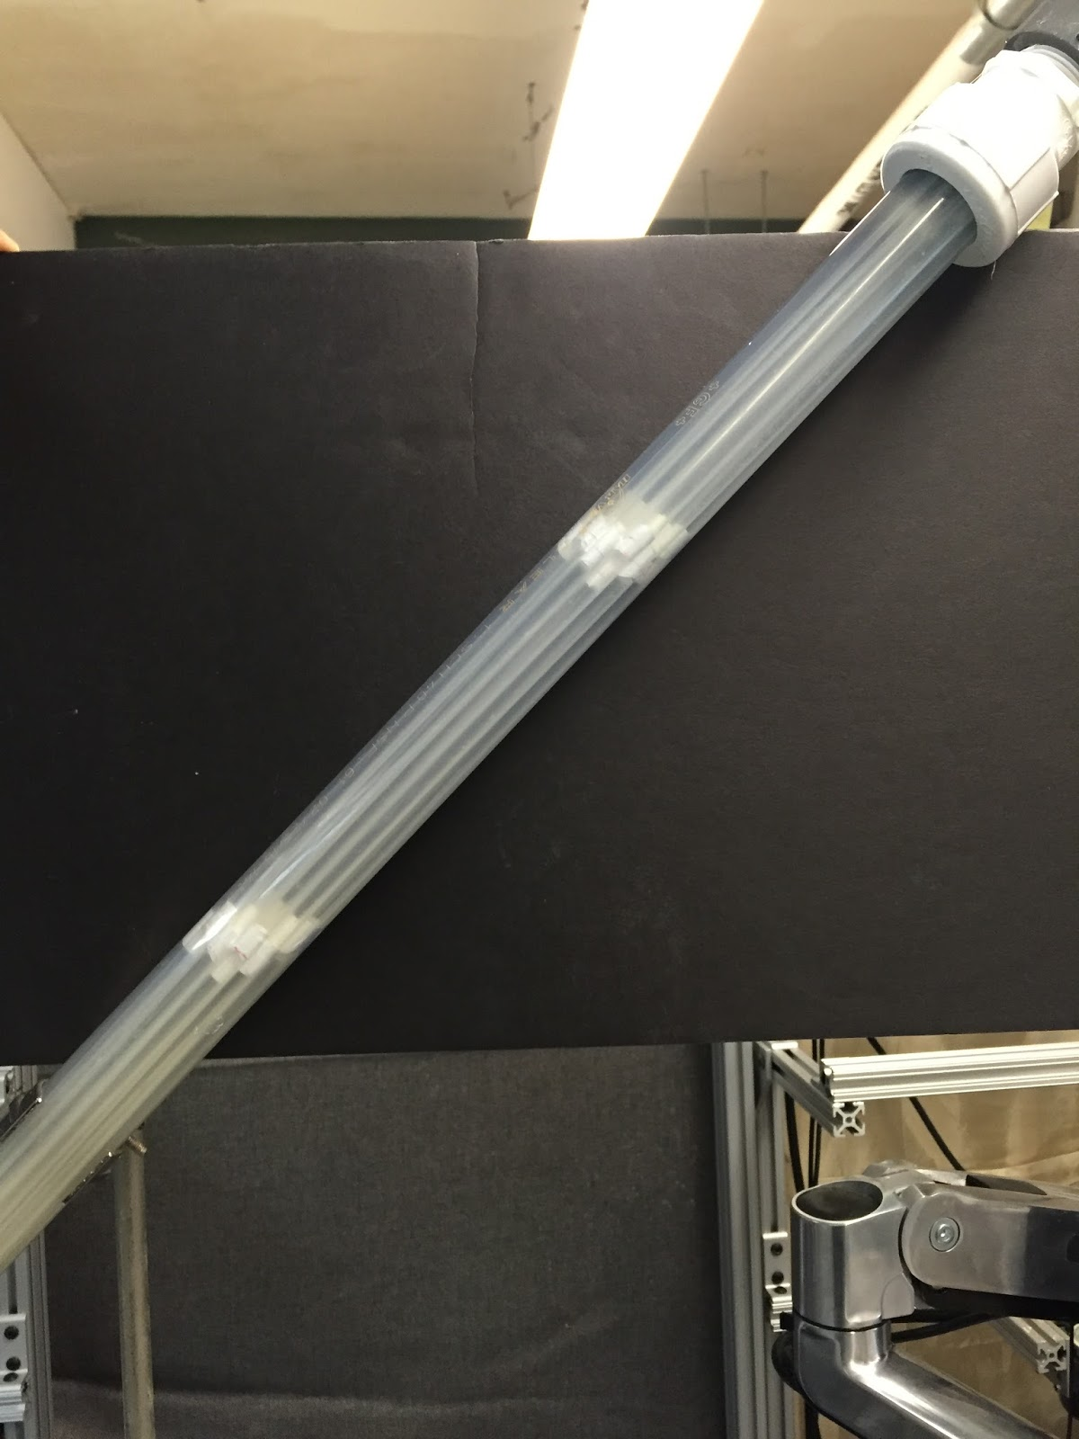
New Setup
Plate settler at the bottom of the tube column and the floc hopper tube
Plate settlers in the top of the pipe column.

Slide 8
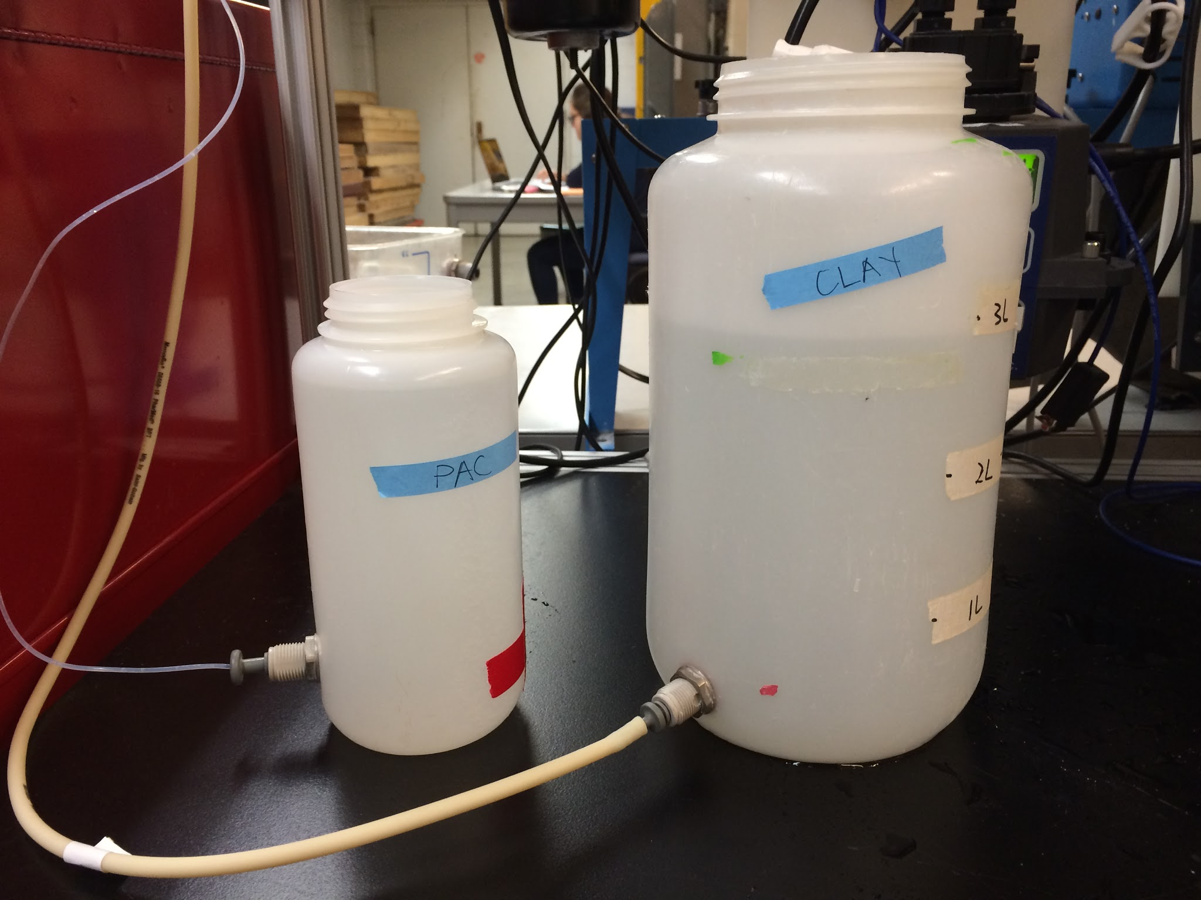
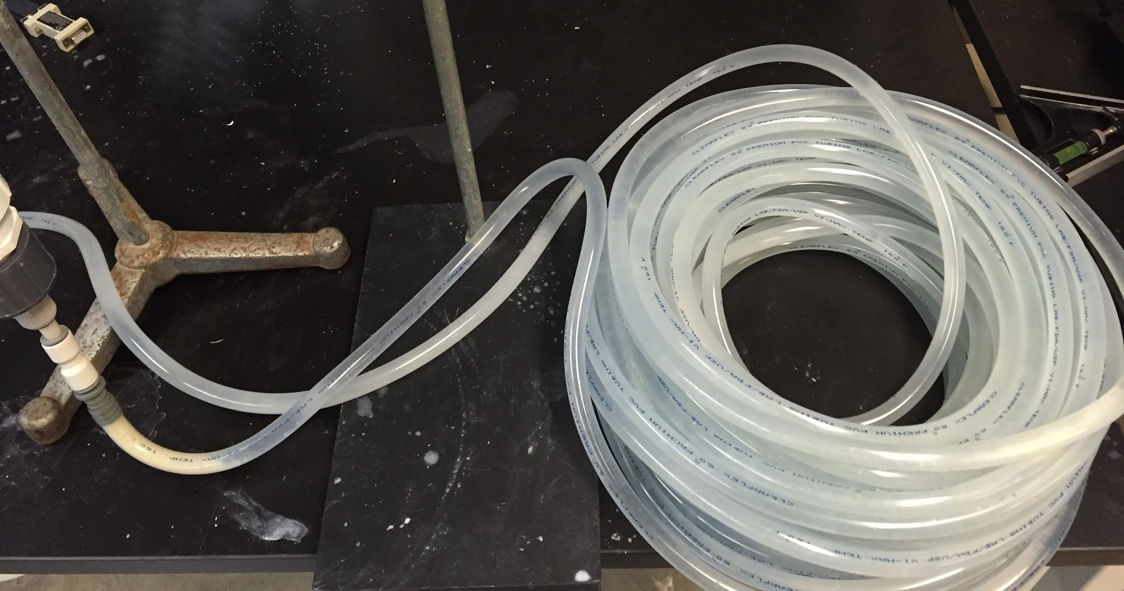
New Setup
The Flocculator

Slide 9
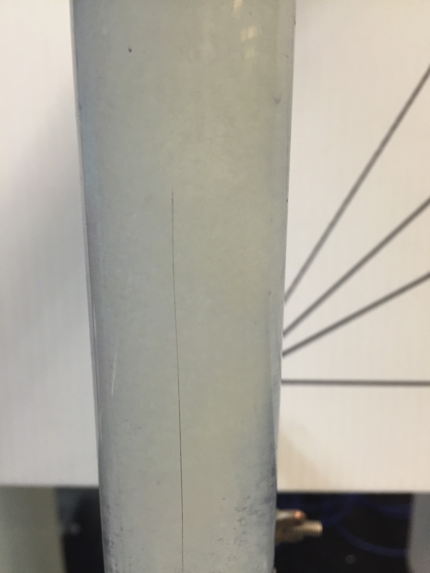
Low Flow Rate,
High Coagulant Dose
A dense region of large flocs was observed in the vertical region
A fairly low concentration of flocs in the angled region and these small flocs settled on the large plate settler or bottom of the angled pipe.
Floc blanket forming in vertical region of setup

Slide 10
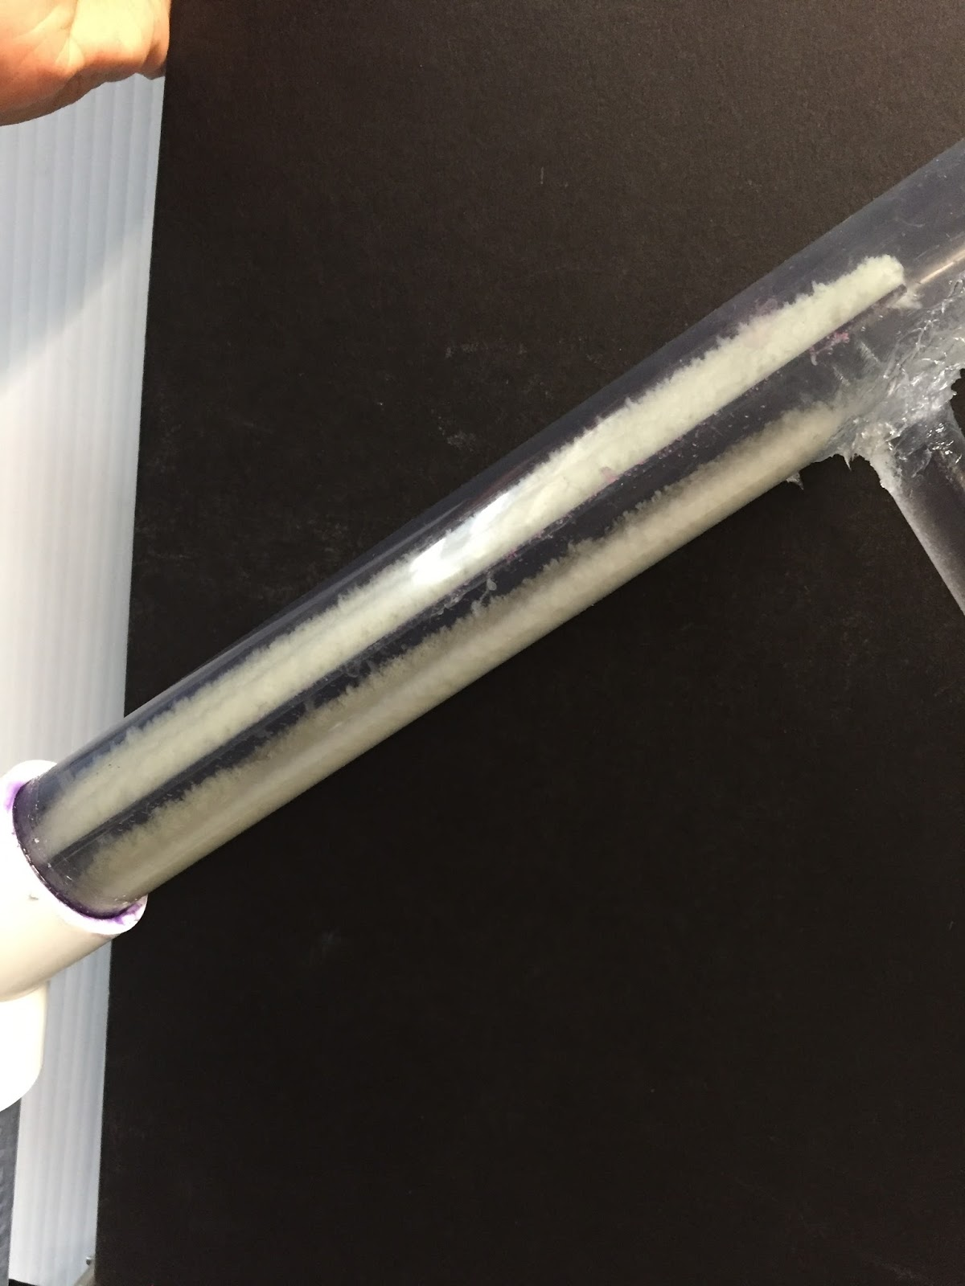
High Flow Rate,
High Coagulant Dose
There were a greater number of flocs in the angled region
No fluidization,instead the larger flocs had settled onto the plate settler and bottom of the tube. They seemed to be static
Video of Floc Activity in Experiment 2
Static flocs, flocs seemed to be stuck to plate settler and pipe

Slide 11
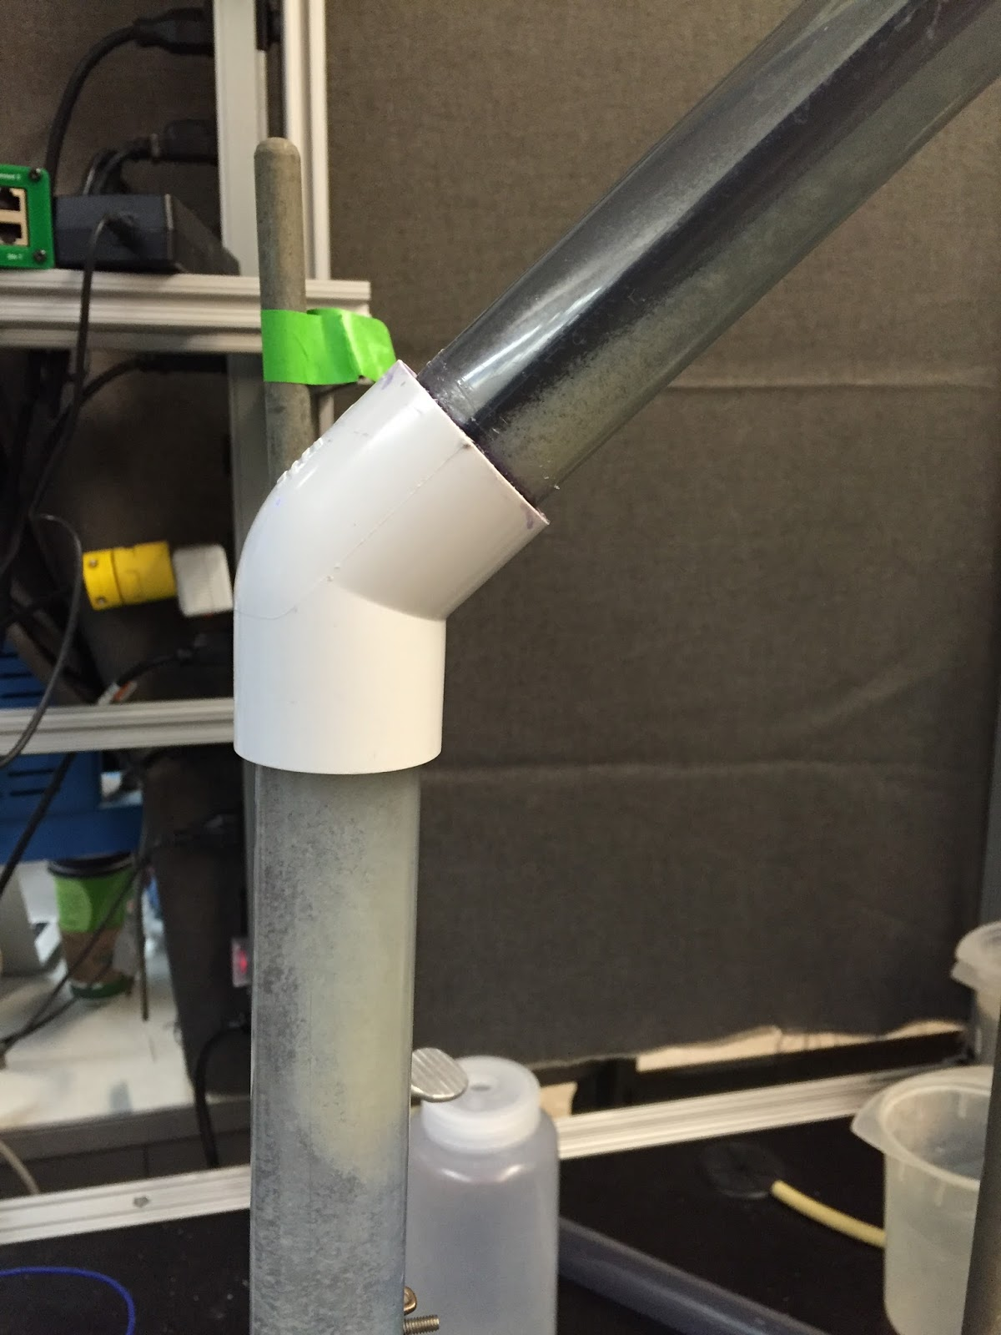
High Flow Rate,
Low Coagulant Dose
A dense area of flocs formed around the bend, and in the large plate settler
Flocs were continually sliding down the plate settlers and reintegrating into the floc blanket
Video of Floc Activity in Experiment 3
Video of Flocs Rolling Down Plate Settler in Experiment 3

Slide 12
Future Work
Build larger apparatus to avoid issues with plate settler spacing and floc rollup
Use a 60 degree angle instead of a 45 degree one
Place floc drain in correct location to determine self sustaining floc blanket is possible given proper draining
Run both influent and effluent through turbidimeter to determine particle remove effectiveness

Slide 13
High Rate Sedimentation
Questions?

