Slide 1

CSFBR
A novel method of removing arsenic, fluoride and dye from
contaminated water with the use of floc blankets.
For more information, visit https://www.overleaf.com/read/ztnzhxkyxgsy
Research | Final Presentation Spring 2016
Notes:
Countercurrent Stacked Floc Blanket Reactor (CSFBR)
Floc blankets, which are suspended layers of highly concentrated flocs, have the potential of being a more efficient option for removing arsenic, fluoride, and certain dyes in terms of energy and water consumption than currently employed techniques. For floc formation, a coagulant needs to be added to the water, allowing particles to adsorb to each other when they collide. Previous research has shown that the coagulant, polyaluminum chloride (PACl), has properties that allow arsenic, fluoride, and certain dyes to adsorb to its surface. The first iteration of this research used three floc blankets in series with a counter-current flow of contaminated water and flocs. By feeding flocs from the last reactor into the second, and from the second into the first, the PACl's surface area can be saturated. To test this theory and apparatus, a dye, Remazol Brilliant Blue R (RBBR), was chosen to be the contaminant due to its less toxic nature and visual component. With this apparatus and contaminant, this semester's goals were to test dye removal efficiency from water with varying concentrations of clay, PACl, and dye. With a 1:1 ratio of PACl to dye, a dye removal efficiency of roughly 80\% was achieved. However, the transportation of flocs from the third reactor to the second and first was not sustainably achieved.
https://www.overleaf.com/4368567wwrsjb#/13013031/

Slide 2
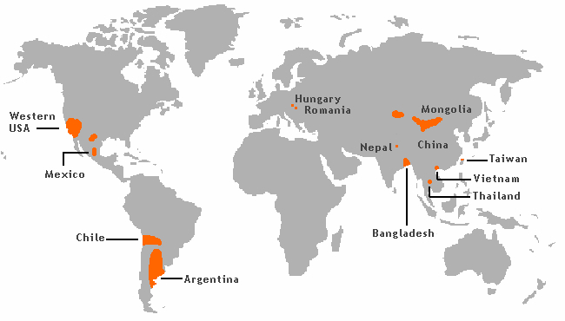
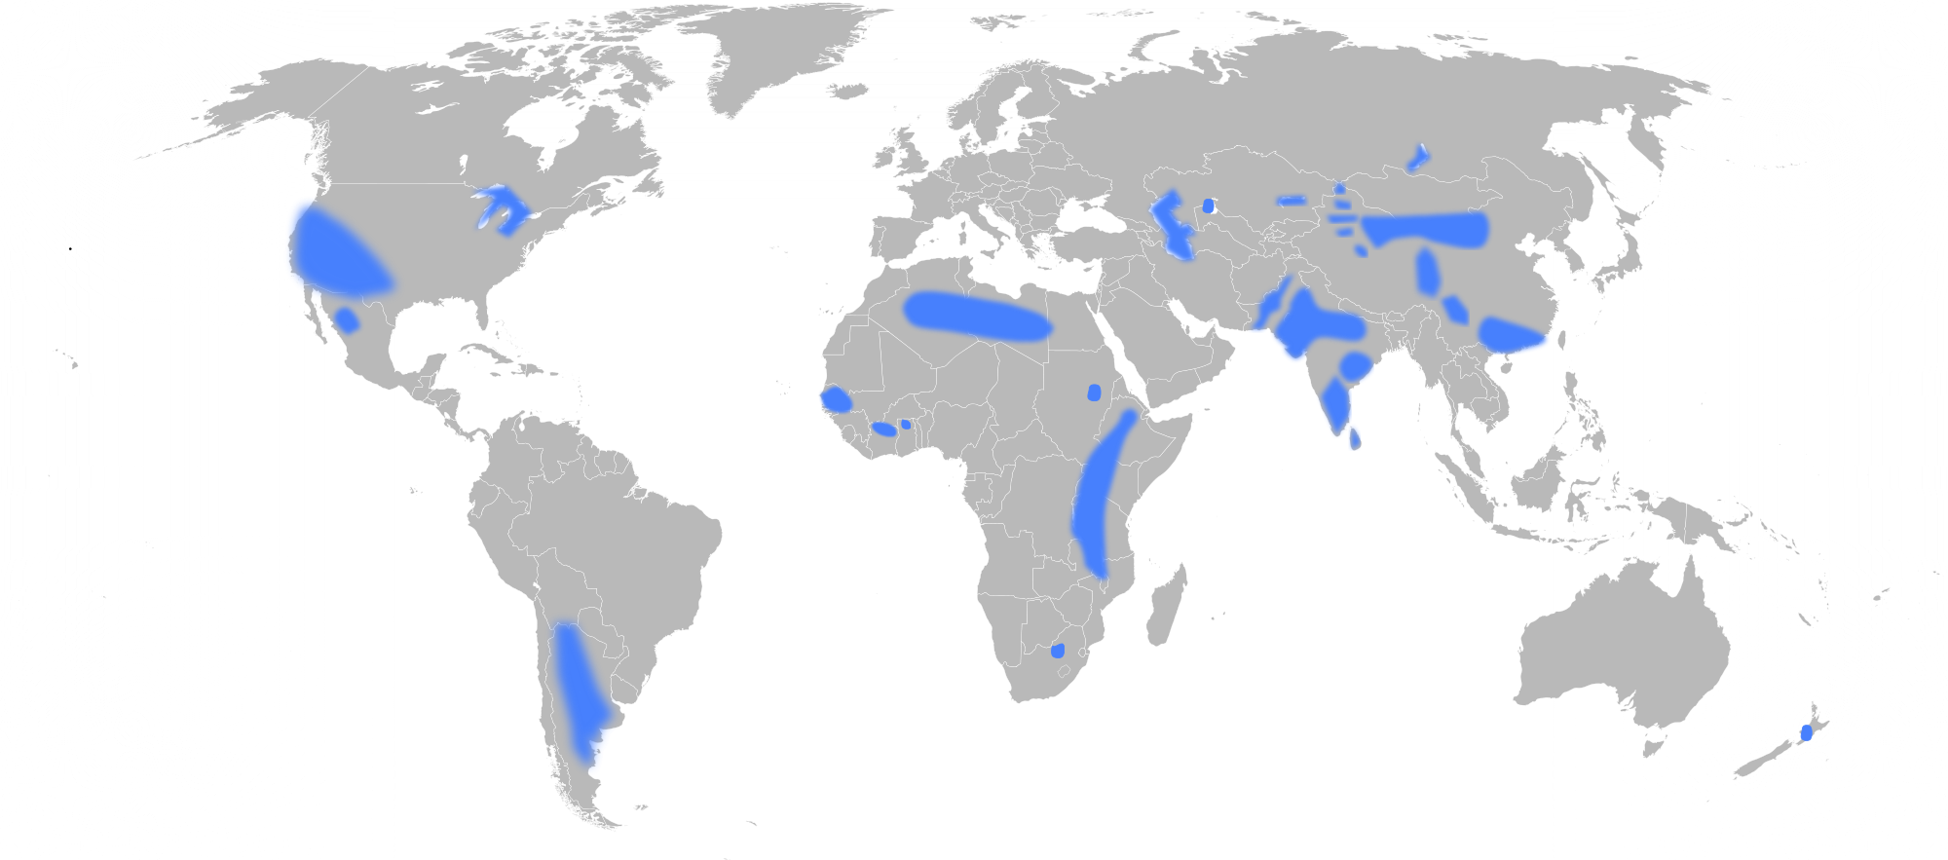
Groundwater can be
contaminated with fluoride and arsenic
Exposure contaminated groundwater can lead to
Increased mortality rates
Calcification of ligaments
Internal hemorrhaging
Fluoride and arsenic contaminated groundwater is detrimental to health!
CSFBR | Research | Final Presentation Spring 2016
Notes:
Caption and relevance:
Photo 1 taken from http://soma.alaya.net/?p=10533
Photo 2 taken from http://www.nhmrc.gov.au/_files_nhmrc/file/publications/synopses/Eh41_Flouridation_PART_A.pdf
Summary:
Arsenic and fluoride are naturally occurring elements found in rock and soil that are toxic in their inorganic form. In many parts of the world, people are exposed to elevated levels of these contaminants through groundwater. Long-term exposure to arsenic and fluoride can lead to organ failure with internal hemorrhaging, and calcification of ligaments, respectively. Presence of these inorganic contaminants in water, therefore, is a major health concern for communities around the world. These carcinogenic elements are known to contaminate groundwater sources in countries such as India, Bangladesh, Vietnam, and Argentina, and exposure to those compounds ultimately decrease living standards and increase mortality rates.

Slide 3
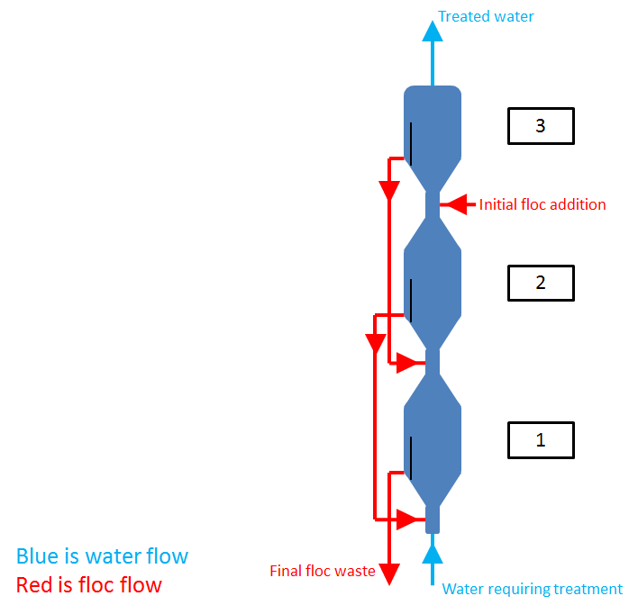
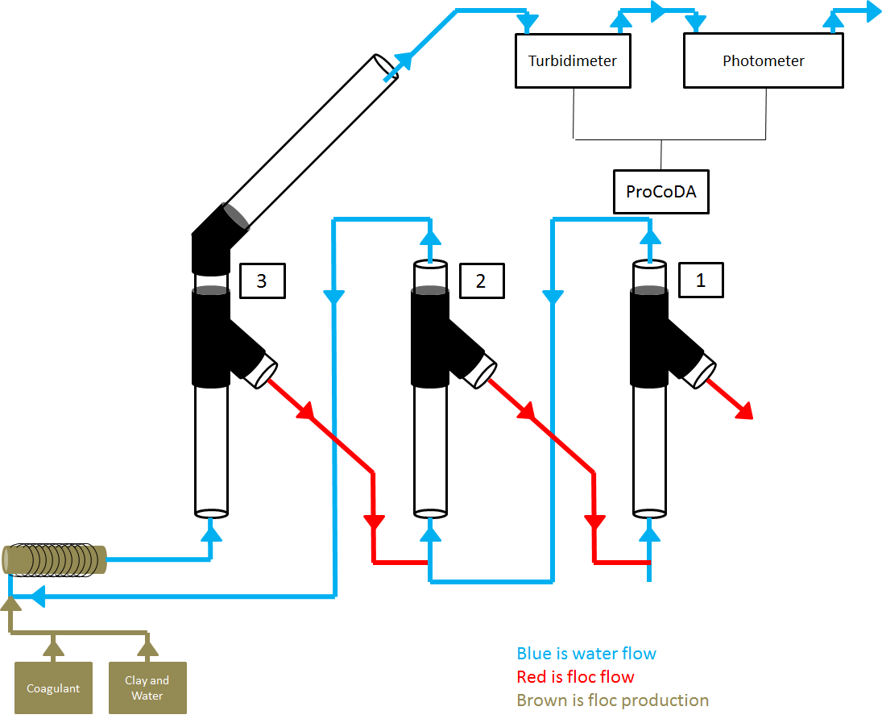
Theory and apparatus for design
Theoretical design and lab apparatus
CSFBR | Research | Final Presentation Spring 2016
Notes:
Summary:
In theory, the goal of the reactors is for flocs and water to flow separately and in opposite directions. PACl enters reactor 3. The coagulant binds with chemical particles such as arsenic and fluoride (or dye, as done in the experiment) and flocs are formed. The small, flaky flocs begin to aggregate and increase in density, thus settling out to the bottom of reactor 3 and forming a floc blanket. When the floc blanket gets high enough, the flocs spill over the weir. Ultimately, flocs and PACl coagulant are sent (pumped) into the feed stream of the second reactor. The process repeats where the PACl coagulates with chemicals in the water and the floc blanket builds. Finally, PACl and flocs from the second reactor get pumped into the first reactor. Again, the process repeats once more. The flocs should accumulate in reactor 1, where they will be drained into a waste stream. In this design, the dirtiest water enters through reactor 1 and through the coagulation and flocculation process, chemical contaminants are removed, and the cleanest water exits the top of reactor 3. The outlet stream is analyzed with a photometer and turbidimeter. Through literature research, we found a blue dye that efficiently adsorbs to PACl, which we chose to use for experimentation because it would act like arsenic and fluoride because we know that PACl likes arsenic and fluoride, but won’t be nearly as toxic.

Slide 4
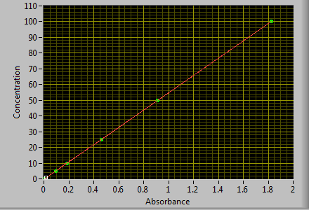
Calibration of ProCoDA
ProCoDA was calibrated with known concentrations of dye, and jar tests were performed with various concentrations of PACl to see removal efficiency.
CSFBR | Research | Final Presentation Spring 2016
Notes:
Since blue and red are on the opposite ends of the spectrum, we have used a red LED in the photometer. The red light emitted by the LED is absorbed by the blue dye and absorbance is recorded. This is performed for 5 known concentrations of dye and the concentration of the dye used is plotted against absorbance.
Summary:
For the spring semester of 2016, ProCoDA was used for data collection and analysis. The photometer can only take voltage readings based on the amount of light that passes through the sample of effluent and ProCoDA takes these voltage readings, and calculates an absorbance based on the absorbance relationship. In the relationship, V_sample is the voltage reading from the sample of effluent, V_blank is the voltage reading when there are no contaminants in the water and V_dark is the voltage reading when the voltage sensor is completely covered. Once the absorbance is determined, ProCoDA converts absorbance to dye concentration, based on a calibration curve. The calibration curve was created by placing dye stock concentrations of 0 mg/L, 2 mg/L, 5 mg/L, 10 mg/L, 20 mg/L, and 50 mg/L, and 100 mg/L in the photometer, recording the respective voltage readings, and calculating the respective absorbance readings. Those absorbance readings were then plotted with their respective dye stock concentration. The calibration curve can be seen above. Details outlined in the appendix.
This semester began with experimenting with dye addition to jar tests. These tests were done in order to observe the adsorption relationship between the concentration of RBBR dye and the concentration of PACl, and the percent removal of dye from water. Various concentrations based on the experimental data in the figure were tested. The goal of these experiments were to see if the literature results were reproducible. The first concentrations tested were 100 mg/L of dye and 75 mg/L of PACl. The solution was mixed for 15 minutes and was allowed to settle for 15 minutes. After the allocated settling time, a sample of the supernatant was extracted to determine the dye removal efficiency.
The photometer calculated the concentration of dye in the supernatant to be 5.56 mg/L. With the concentration of 100 mg/L dye and 75 mg/L PACl, there was a 94.44% removal of dye. This value was slightly lower than expected, as the relationship in the figure showed 75 mg/L PACl corresponding to around 97%. In the next jar test, a lower ratio of PACl to dye was tested. The concentration of PACl was modified to 50 mg/L while keeping the dye concentration at 100 mg/L. From the figure, a 88% removal of dye efficiency was expected. The same procedures were repeated, and the removal efficiency was found to be 44.5%. This result was a much larger deviation from the expected value. It concluded that for future testing, ratios of concentrations of PACl to dye should be approximately 3:4, or higher, for best removal efficiency.
Figures taken from the report

Slide 5
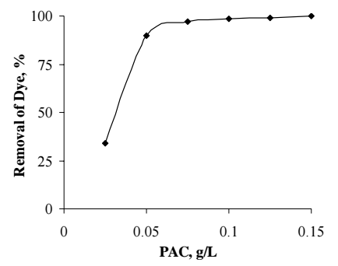
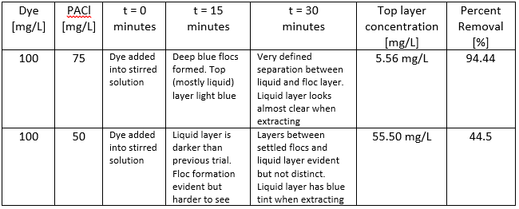
Jar Tests were performed
Graph of dye removal with jar tests from literature
Jar Test and Results
CSFBR | Research | Final Presentation Spring 2016
Notes:
This is a graph we pulled from the literature review. Trying to replicate what we found in the literature review… We performed two jar tests: one with 75 mg/L PACl and the other with 50 mg/L. We got expected percentage removal from a concentration of 75 mg/L but we got a very low removal percentage for 50 mg/L. With 75 mg/L, we expected a removal percentage of 97% for a concentration of 75 mg/L and we received a removal percentage of 94.44%. With 50 mg/L, we received a percentage removal of 44.5 whereas we were expecting a percentage removal of 88%
Summary:
For the spring semester of 2016, ProCoDA was used for data collection and analysis. The photometer can only take voltage readings based on the amount of light that passes through the sample of effluent and ProCoDA takes these voltage readings, and calculates an absorbance based on the absorbance relationship. In the relationship, V_sample is the voltage reading from the sample of effluent, V_blank is the voltage reading when there are no contaminants in the water and V_dark is the voltage reading when the voltage sensor is completely covered. Once the absorbance is determined, ProCoDA converts absorbance to dye concentration, based on a calibration curve. The calibration curve was created by placing dye stock concentrations of 0 mg/L, 2 mg/L, 5 mg/L, 10 mg/L, 20 mg/L, and 50 mg/L, and 100 mg/L in the photometer, recording the respective voltage readings, and calculating the respective absorbance readings. Those absorbance readings were then plotted with their respective dye stock concentration. The calibration curve can be seen above.
This semester began with experimenting with dye addition to jar tests. These tests were done in order to observe the adsorption relationship between the concentration of RBBR dye and the concentration of PACl, and the percent removal of dye from water. Various concentrations based on the experimental data in the figure were tested. The goal of these experiments were to see if the literature results were reproducible. The first concentrations tested were 100 mg/L of dye and 75 mg/L of PACl. The solution was mixed for 15 minutes and was allowed to settle for 15 minutes. After the allocated settling time, a sample of the supernatant was extracted to determine the dye removal efficiency.
The photometer calculated the concentration of dye in the supernatant to be 5.56 mg/L. With the concentration of 100 mg/L dye and 75 mg/L PACl, there was a 94.44% removal of dye. This value was slightly lower than expected, as the relationship in the figure showed 75 mg/L PACl corresponding to around 97%. In the next jar test, a lower ratio of PACl to dye was tested. The concentration of PACl was modified to 50 mg/L while keeping the dye concentration at 100 mg/L. From the figure, a 88% removal of dye efficiency was expected. The same procedures were repeated, and the removal efficiency was found to be 44.5%. This result was a much larger deviation from the expected value. It concluded that for future testing, ratios of concentrations of PACl to dye should be approximately 3:4, or higher, for best removal efficiency.
Figures taken from the report

Slide 6
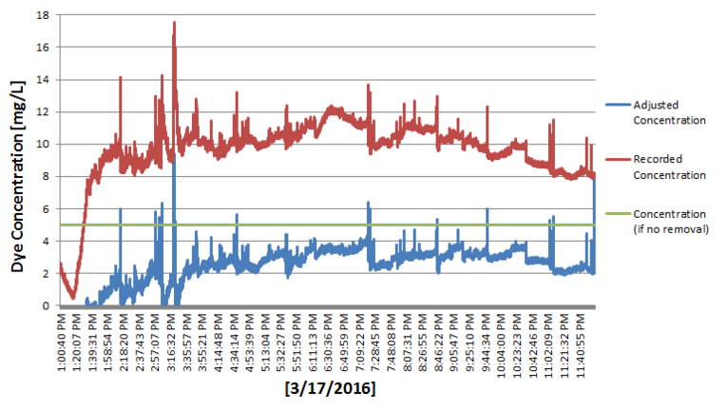
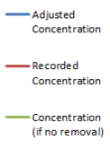
Experimental Results
Data collection results after adjusting absorbance measurement
CSFBR | Research | Final Presentation Spring 2016
Notes:
Caption and relevance:
This graph shows the correction factor used in analyzing the data. The correction factor makes an adjustment to the solids particulates that interfere with the photometer.
The correction factor experiment is detailed in the Appx. S1
Summary:
3/17:
Influent concentration of 5 mg/L for both PACl and dye.
Clay concentration was decreased : 2400 mg/L stock
Error with this experiment: Flow directions got flipped so the transport of flocs was never achieved
Any amount of turbidity could interfere with the photometer and cause error in the voltage reading. However, the dye within the water did not affect turbidity readings. To adjust for this error in the photometer's voltage readings, a correction factor was incorporated to achieve more accurate data for dye concentrations.
The graphical representation of the results from the correction factor throughout an experiment. In the figure, the green line is the concentration of dye that was fed in. The red curve represents the raw data from the photometer, which has clay and PACl interference. After applying the absorbance correction to the raw data, the blue curve was developed. This final blue line demonstrates dye removal from the influent feed.
We saw that the effluent turbidity was relatively high, which caused us to continue and decrease clay concentration. It eventually lead to the complete removal of clay in the experiment (Shown on next slide).

Slide 7
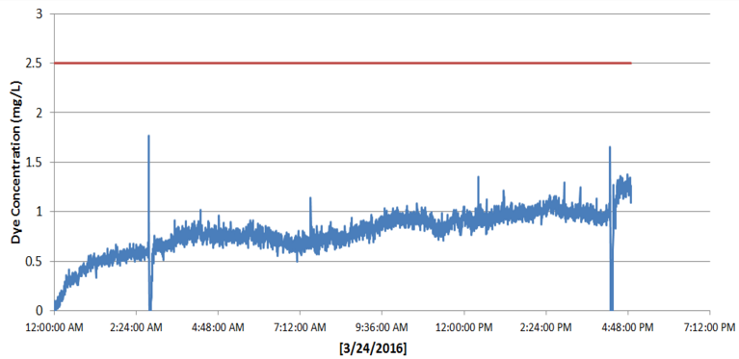

Experimental Results
Experimental results with PACl, clay, and dye.
Average removal was 65.78 %
CSFBR | Research | Final Presentation Spring 2016
Notes:
Caption and relevance:
Experimental results with PACl, clay, and dye. The figure was taken from the final CSFBR report
Summary:
3/24:
Influent concentration of 2.5 mg/L for both PACl and dye.
Clay concentration was decreased : 1800 mg/L stock
Pump Speeds
The clay, PACl, and dye were pumped at 3.04 mL/min
Tap water was pumped at 21.282 mL/min
The weirs were pumped at 4.872 mL/min.
Average removal was 65.78 %.
High and low peaks: were taking data points in tiny intervals: a point every second

Slide 8
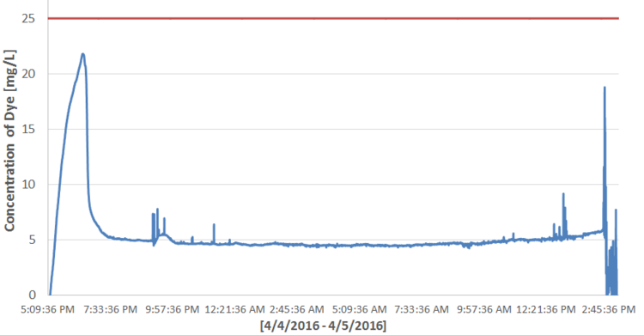
Experimental results
Experimental results with PACl, clay, and dye.
Average removal was 81.10 %
CSFBR | Research | Final Presentation Spring 2016
Notes:
Caption and relevance:
Experimental results with PAC and dye. No clay was used in this experiment. The figure was taken from the final CSFBR report
Summary
4/4 - 4/5:
PACl and dye stock concentration both increased to 250 mg/L
Influent concentration for both is 25 mg/L
NO clay used
Same pump speeds
Average dye concentration in effluent is 4.72 mg/L
Average dye removal is 81.1 %
Conclusion:
Based on these results, it has been hypothesized that clay was acting as a competitor for dye. Both the clay and dye were attempting to adsorb to the PACl. The clay and the dye that was not able to adsorb to the PACl appeared in the effluent of the system. This explains why the average turbidity reading decreased when the clay stock concentration was decreased, and also explains why dye removal increased from 65.78\% to 81.11% when the clay was removed.
Furthermore, data collection was taken once every 15 seconds. A smoother trend is observed.

Slide 9
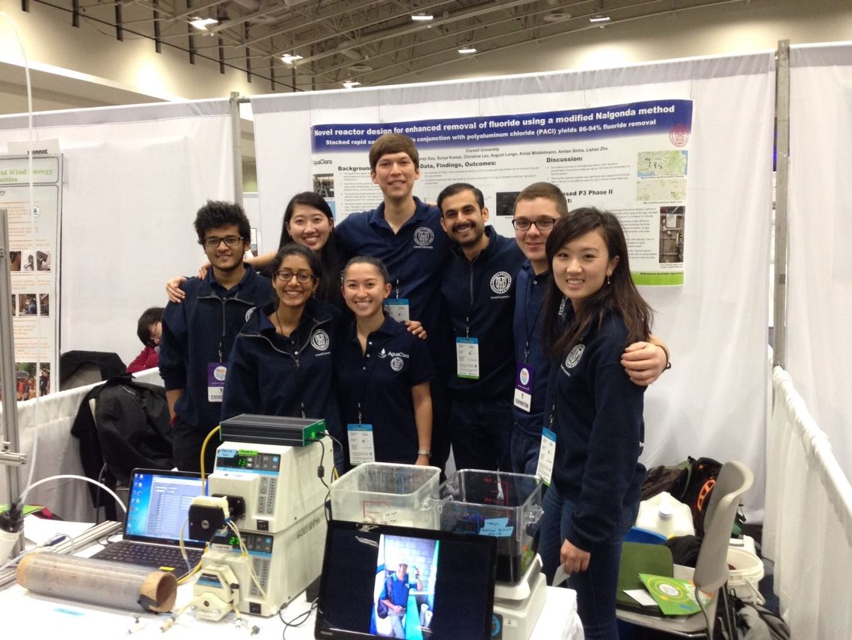
Competing for EPA grant
The Fluoride Filter and CSFBR team in Washington D.C. competing for an EPA P3 Phase II grant.
CSFBR | Research | Final Presentation Spring 2016
Notes:
Summary:
The Fluoride Filter and CSFBR team in Washington D.C. competing for an EPA P3 Phase II grant. The Fluoride Filter team won Phase I of the grant in 2014, were invited to compete for Phase II. More information about the EPA P3 grant can be found here: https://www.epa.gov/P3. After it was proven that fluoride could be removed with less coagulant if a sand filter is dosed with Polyaluminum Chloride (PACl),it was realized that the method was inefficient in potable water consumption. It was the hope of this new research that arsenic, fluoride, and dye could be removed with very little water consumption.

Slide 10
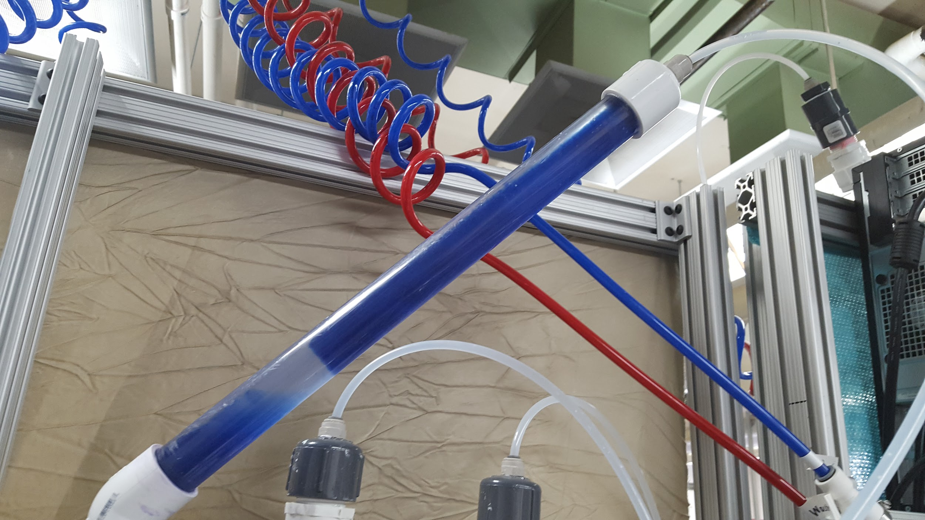
Certain issues were encountered
Settling of flocs in tubing and reactors was a major issue.
CSFBR | Research | Final Presentation Spring 2016
Notes:
Caption and relevance:
Description - dense clumping of flocs observed in the reactor
This is an example of settling observed within the tubing and reactors. Initially, the team was using ⅜ inch tubing to drain the flocs and pump them into the next reactors. Within these tubes, flocs were observed to settle at the bottom as the effluent water passed through. This phenomenon was observed in reactor 3, as pictured.
Summary of slide:
In the early testing phase, the reactors did not form floc blankets. The team hypothesized that the clay concentration was not high enough compared to the PACl concentration. Thus, in the next set of experiments, the team increased their clay concentration to approximately 2400 mg/L. With this concentration, the floc blankets were able to develop.
There was also settling observed within the tubing and reactors. Initially, the team was using ⅜ inch tubing to drain the flocs and pump them into the next reactors. Within these tubes, flocs were observed to settle at the bottom as the effluent water passed through. This phenomenon was observed in reactor 3 (Figure 20). This hindered the transportation of flocs. To address the problem, the team changed the tubes pumping flocs with ¼ in. tubing. The team also observed the clay and floc mixture settling within the flocculator. Because the flocculator was created with ⅜ in. tubing, the team is looking into replacing those tubes with ¼ in. as well.

Slide 11
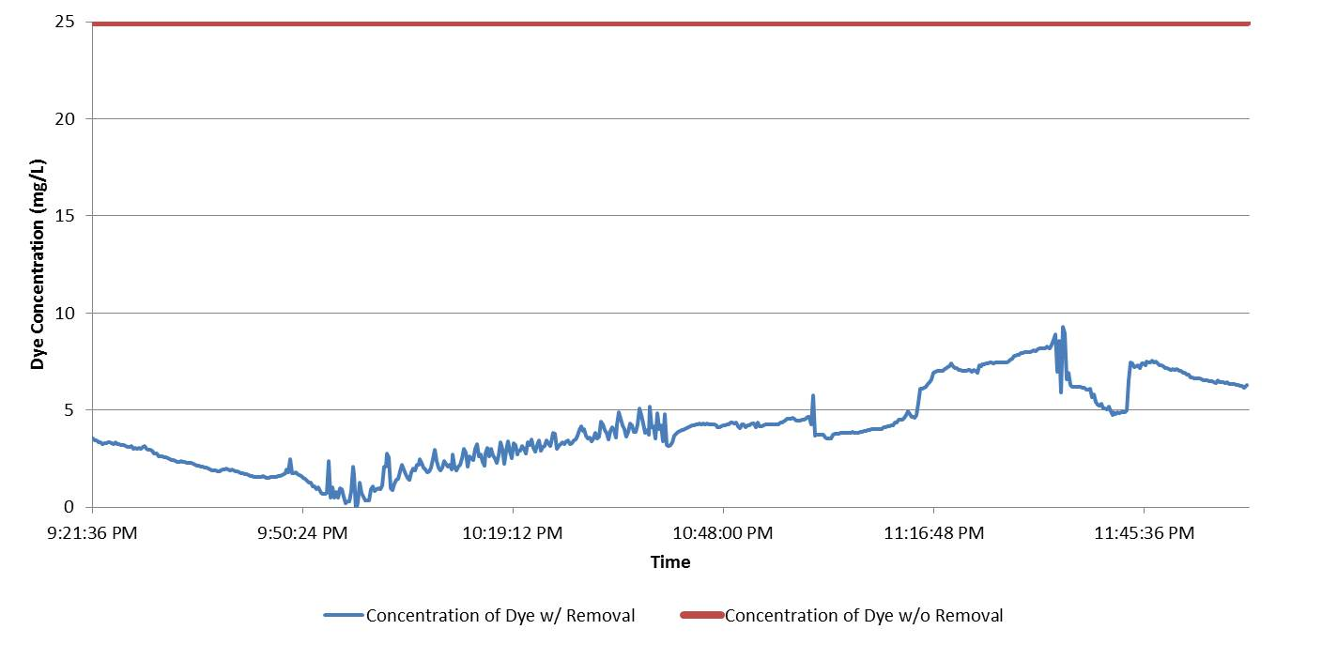
Certain issues were encountered
Settling of flocs in tubing and reactors was a major issue.
CSFBR | Research | Final Presentation Spring 2016
Notes:
Caption and relevance:
Description - In the run that was pictured in the previous slide, the photometer data clearly showed a sharp rise in effluent concentration despite an initial decrease in concentration.
This is graphical data portraying the fact that settling was clearly an obstacle in experiments.
Summary of slide:
The consequences of the phenomenon observed in reactor 3 was clearly recorded by the photometer. While the first 30 minutes of the experiment showed a reasonable amount of decrease in concentration, concentration increased drastically after the system was overwhelmed by settling.
In later experiments, when experiments were ran using concentrations of 100mg/L PACl and 500 mg/L dye, it was observed that there was no floc blanket formation in the reactors. Instead, flocs clumped together and sludge formed at the bottom of the reactor. This effect is illustrated in this figure. Analysis of parameters led the team deduce that the formation of sludge could be from one or more of the following factors:
The concentration of PACl was high relative to the concentration of dye
The concentration of dye was low relative to the concentration of PACl
The presence of flat surfaces in the re-circulation unit (or jet reversal unit) might have caused the flocs to settle and therefore led to the formation of sludge. Since the team used a step drill when making the expansion pipe, flat surfaces may have been present in the threads.A higher upflow velocity and therefore, a higher flow rate may be required to prevent the flocs from settling
The piece of tubing going into Reactor 3 was not straight and thus caused the jet of water to enter at an angle, resulting in a lower effective velocity.
The team decided to re-fabricate reactor 3 and smoothed the slope in the expansion pipe to make sure there are no flat surfaces in the thread. In order to ensure that the flow-rates are accurate and a desired upflow velocity of 1.1 mL/s was obtained, pumps were recalibrated and flow rates were increased to 31.923 mL/min. It was also ensured that tubing connecting the expansion pipe was straight. Unfortunately, sludge formation still persisted after the aforementioned modifications.

Slide 12
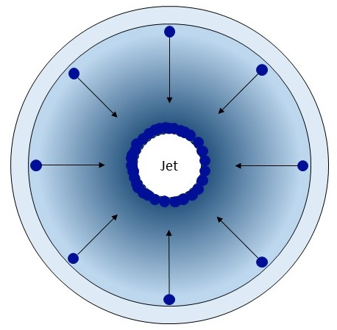
There are two main future goals
CSFBR has two major goals for the future, both related to ensuring floc flow between reactors.
CSFBR | Research | Final Presentation Spring 2016
Notes:
Caption and relevance:
Potential reason for sludge formation in the floc re-circulation unit is that the flocs could settle together and form a ring around the jet and remain stable. This ring would also provide a surface for further sludge formation
Summary:
The team has two major goals for the future. One goal is to determine a more effective geometry for the re-circulation unit to prevent sludge formation in the bottom of the reactors. After multiple experiments and iterations, it was determined that there must be some problematic aspect with the geometry.
It has been hypothesized that because the cross-section of a pipe reactor is circular to the flux of flocs, larger flocs might settle as a ring around the jet, which allows for sludge formation and failed floc re-circulation. This proposed theory can be seen in this figure.
In a traditional AguaClara sedimentation tank, however, flocs only enter the re-circulation unit from one direction of the reactor because the jet of water enters from the other. The next team must find a way to employ the same principles from a traditional AguaClara sedimentation tank to the pipe reactors used for CSFBR.
Due to the difficulties experienced with creating a fluidized floc blanket while removing dye, it was never determined if multiple floc blanket reactors in series would be more advantageous than one. If the issue of sludge formation can be solved, then the second goal would be to compare a single reactor system to a multiple reactor system through experimentation that places both systems under the same conditions.

Slide 13
Questions
and
Recommendations
Mickey Kumar
M.Eng. Environmental Processes
sk837@cornell.edu
Christine Leu
B.S. Chemical Engineering
cl864@cornell.edu
Amlan Sinha
B.S. Mechanical Engineering
as2558@cornell.edu
Cindy Dou
B.S. Chemical Engineering
cd484@cornell.edu
CSFBR| Research | Final Presentation Spring 2016

Slide 14
Appendix
Slides
CSFBR | Research | Final Presentation Spring 2016

Slide 15


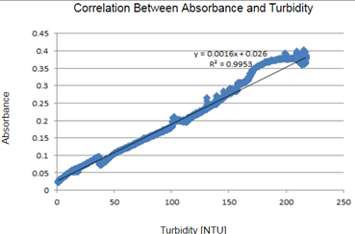
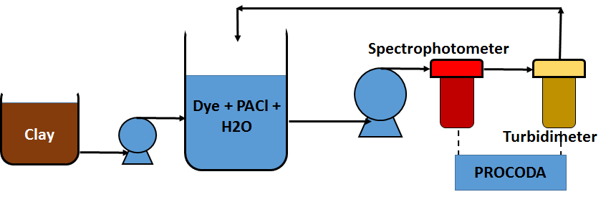
Appendix S1
Absorbency values graphed against the turbidity values
Find the linearity between the two sets of values
R-squared value of 0.9953 was found
CSFBR | Research | Final Presentation Spring 2016
Notes:
To do this correction factor, a system was set up to test the absorbency and turbidity of a mixture that received a constant addition of clay over time.
In this experiment, various absorbency values were determined along with their corresponding turbidity values. The absorbency values were graphed against the turbidity values to find the linearity between the two sets of values. An R-squared value of 0.9953 was found, and, therefore, the equation for the linear trendline was calculated.
With this linear relationship, the amount of absorbance interference caused by clay and PACl was able to determined for any given turbidity. This determined absorbance error can be deducted from the total absorbance to arrive at the absorbance caused by only the dye.

