Slide 1

Countercurrent Stacked
Floc Blanket Reactor Team
Surya Kumar, Christine Leu
Amlan Sinha, Cindy Dou

Slide 2
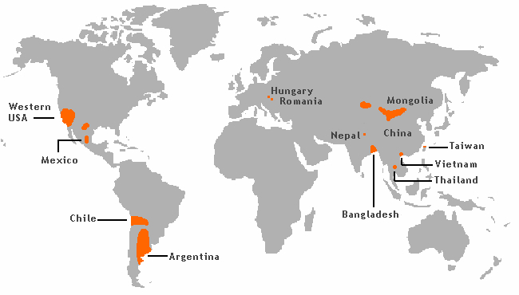
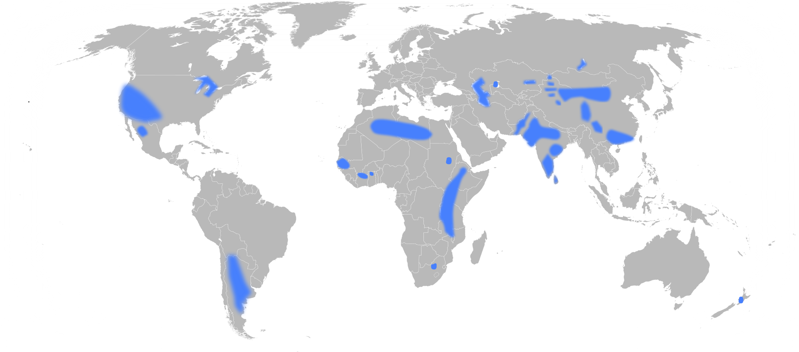

Background
Problem:
Arsenic and fluoride in water
Arsenic Contamination
Carcinogen
Inhibit brain development
Increased mortality rates
Fluoride Contamination
Notes:
AMLAN:
Arsenic and Fluoride are two of the most common contaminants of ground-water in certain parts of the world. Sustained, long-term exposure to such contaminants can result in mental and physical disabilities. For example, long-term exposure to arsenic leads to arsenicosis, which may lead to pigmentation, hyperkeratosis (or skin thickening) and even cancer in skin, lungs, bladder and kidney. On the other hand, long-term exposure to fluoride may lead to tooth decay and extensive skeleto-muscular damage ultimately leading to crippling. These carcinogens can be removed by filtration. However, filtration is inefficient since at regular intervals of time, the process needs to be stopped, the filters need to be washed and repacked, etc. This ultimately wastes water and resources. An example of such a filtrant would be a sand filter. In addition to this, by the time the system needs to be backwashed, the top layer is the dirtiest. However, the bottom layer is relatively cleaner, and is still capable of filtering solutions. We want to get around this waste and develop a more efficient process. This has been the inspiration behind CSFBR.

Slide 3
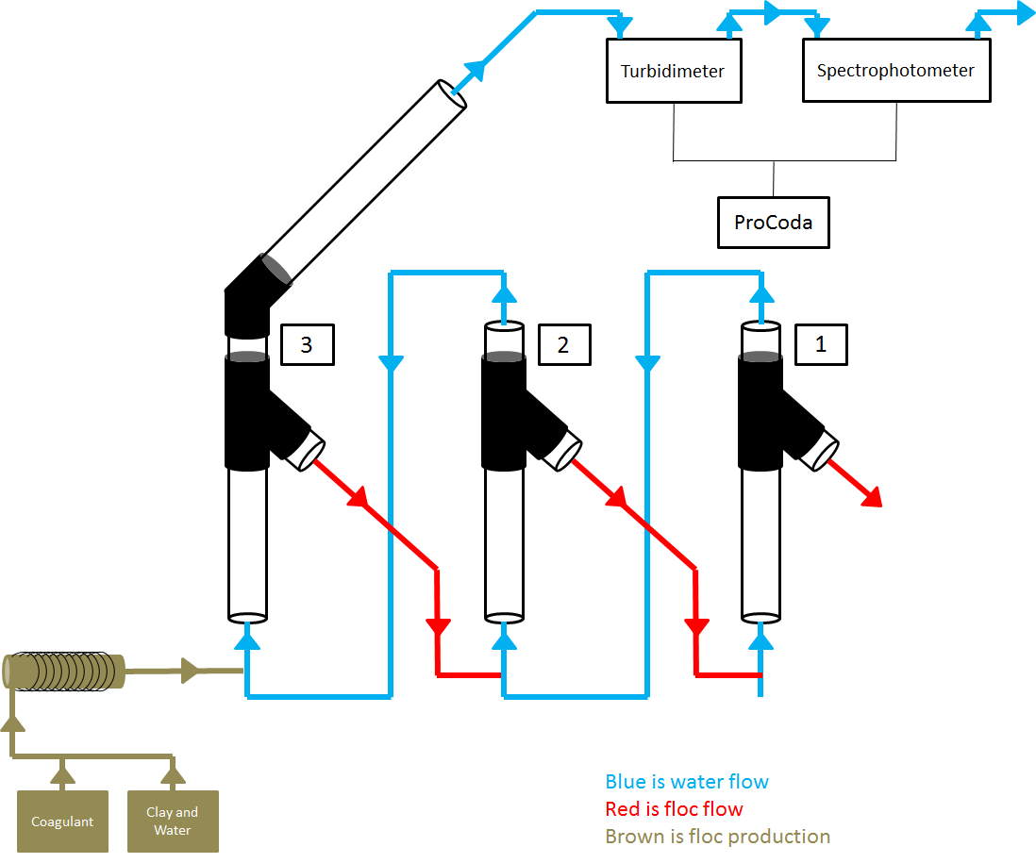
Background
Purpose of CSFBR:
To design a reactor that can efficiently remove arsenic and fluoride from water
Reactors are in series and gracity powered
Potential implementation in India and Honduras
Other application? Textiles?
Notes:
Last semester: We wanted to build a reactor series that could remove chemicals in water. We tested with a clay and coagulant mixture.
There is a schematic of our process.
This semester

Slide 4
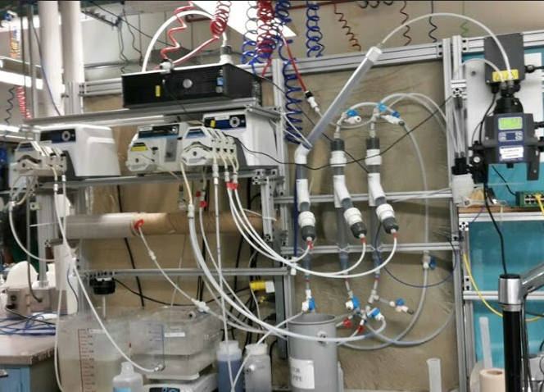
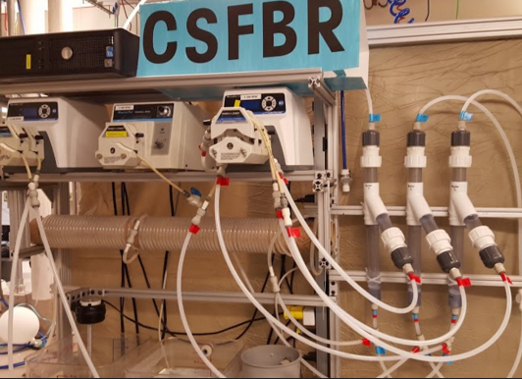
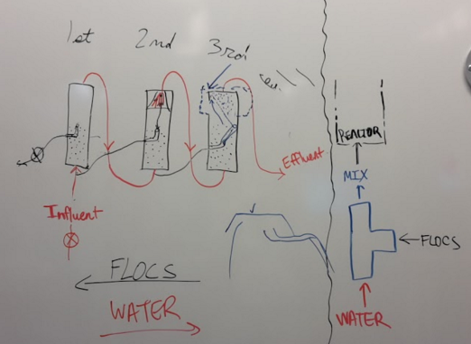
Background
Last Semester
Building and setting up reactor
Calibrating pumps
Calibrating spectrophotometer
Creating floc blankets
Testing with dye
Notes:
Evolution of our design

Slide 5
How It Works
Blue is water flow
Red is floc flow
In GENERAL:
Clay + PACl = Flocs
Floc blankets will form and be sent to
lower reactors
Flocs drained at the end
Test turbidity and absorbance

Slide 6
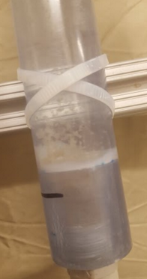
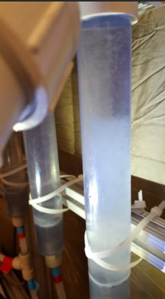
How It Works
Pictures of Flocs
Why THREE Reactors?
Multiple reactors encourage more collisions of PACl with particulants in water to make more flocs
Notes:
AMLAN:
According to the principle of continuity, the mechanical energy of a system is conserved. This led to the formulation of Bernoulli’s Principles which dictates that the sum of pressure and the mechanical energy of a system remains the same. Therefore, if a fluid flows through a pipe and the diameter of the pipe decreases, then the velocity of the fluid will increase resulting in a decrease in pressure to balance out the increase in its kinetic energy.

Slide 7

Challenges and Goals
Prove the theory
Can our system remove particulates in water?
Can PACl remove dye in water?
Can we minimize the amount of clay and PACl?
Research and Testing
Calculations
Experimentation
EPA P3 - People, Prosperity, and Planet

Slide 8
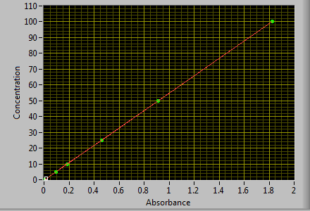
Troubleshooting
Setup
Cleaning and “pigging”
Recalibrating absorbance
Switching over to ProCODA

Slide 9
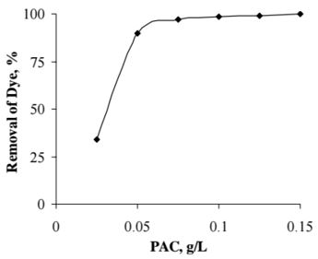
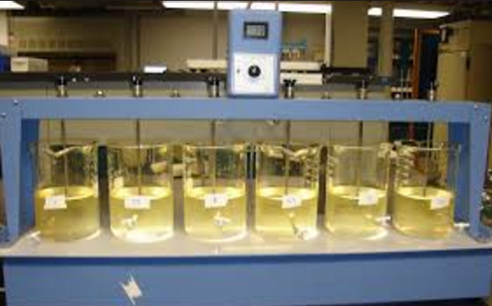
Jar Tests
Purpose:
Determine concentrations with the convenienve of a jar
Mix dye and PACl to see how well the percent removal is

Slide 10
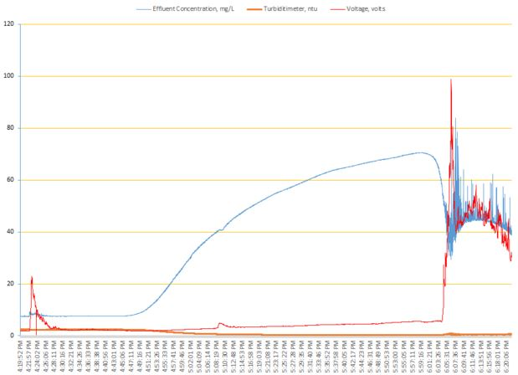
Experimentation
ProCODA:
Calibration
Obtain voltage
Read concentration
Testing phase
  Create floc blanket
  Introduce dye
Notes:
Reduce losses and ease the flow rate in. This is done to prevent breaking flocs. Also encourage floc resuspension.

Slide 11
New Ideas?
More effective ways to accurately incorporate dye
Modifying concentrations to maintain certain reactor concentration
Collaboration with Fluoride filter
Dye Tank
Dye Tank
Notes:
New pic - with a blank background

Slide 12
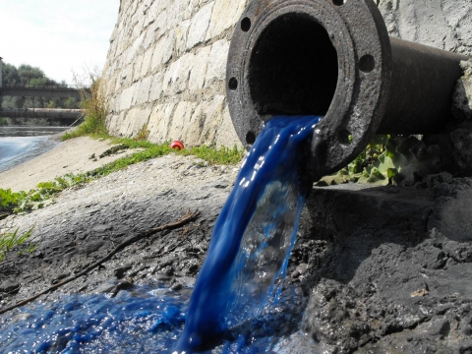
Problems
Trouble with floc concentrations and blanket formation
Determine correction factor in spectrophotometer to only read dye absorbance
Super low concentration calibration <1 mg / L

Slide 13

Future Goals
Procoda
Reliable floc blanket concentration
Testing
EPA P3
Notes:
Procoda: Allows us to turn on feed tanks simultaneously
Programming for convenience

Slide 14

Questions?

