Slide 1

Countercurrent Stacked
Floc Blanket Reactor Team
Mickey Kumar, Christine Leu
Amlan Sinha, Cindy Dou

Slide 2
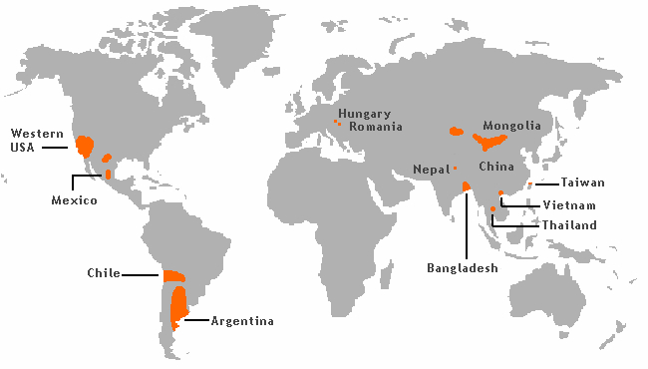
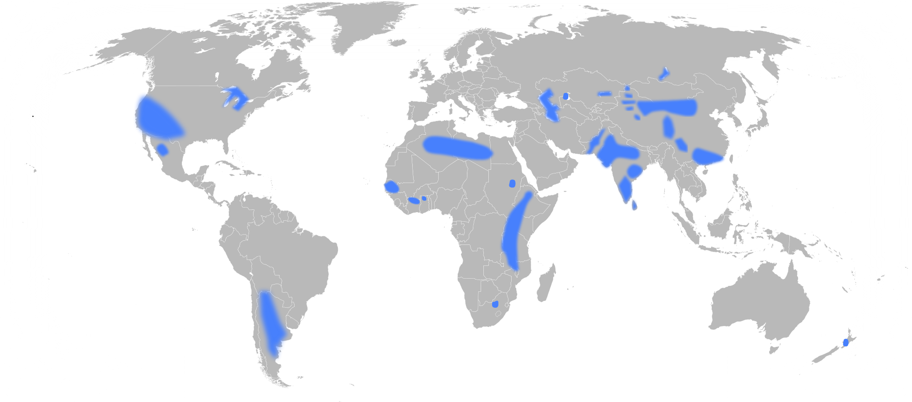

Background
Problem:
Arsenic and fluoride in water
Arsenic Contamination
Carcinogen
Inhibit brain development
Increased mortality rates
Fluoride Contamination
Notes:
AMLAN:
Arsenic and Fluoride are two of the most common contaminants of ground-water in certain parts of the world. Sustained, long-term exposure to such contaminants can result in mental and physical disabilities. For example, long-term exposure to arsenic leads to arsenicosis, which may lead to pigmentation, hyperkeratosis (or skin thickening) and even cancer in skin, lungs, bladder and kidney. On the other hand, long-term exposure to fluoride may lead to tooth decay and extensive skeleto-muscular damage ultimately leading to crippling. These carcinogens can be removed by filtration. However, filtration is inefficient since at regular intervals of time, the process needs to be stopped, the filters need to be washed and repacked, etc. This ultimately wastes water and resources. An example of such a filtrant would be a sand filter. In addition to this, by the time the system needs to be backwashed, the top layer is the dirtiest. However, the bottom layer is relatively cleaner, and is still capable of filtering solutions. We want to get around this waste and develop a more efficient process. This has been the inspiration behind CSFBR.

Slide 3
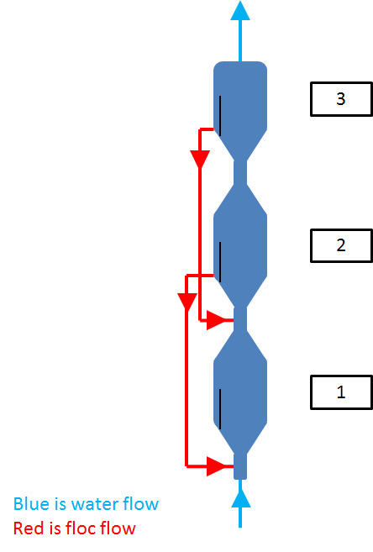
Background
Purpose of CSFBR:
To design a reactor that can efficiently remove arsenic and fluoride from water
Gravity powered
Reactors in series
Water Flow
Floc Flow
Notes:
AMLAN:
The design involves creating a series of three reactors, and the final iteration of the plant would be completely powered by gravity to accommodate the scanty resources of rural communities in different parts of the world such as South Asia, some parts of Central America and Africa. The design implements stacked floc blankets instead of conventional filtration systems and thereby negating waste of resources.
Add in PACl entering in last one, flocs leaving whole system from first one
Include why we want fresh, clean PACl in last one

Slide 4
How It Works
Dirty water in fed at the bottom
Clean PACl fed at the top
Floc blankets will form and be sent to lower reactors
Flocs drained from bottom
Water Flow
Floc Flow

Slide 5
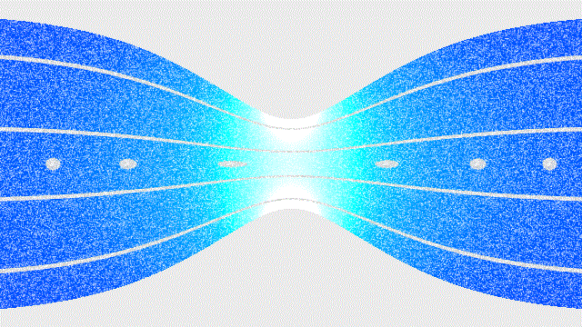

How It Works
Venturi effect
  Reduction in fluid pressure, p
  Increase in velocity, v
Notes:
AMLAN:
According to the principle of continuity, the mechanical energy of a system is conserved. This led to the formulation of Bernoulli’s Principles which dictates that the sum of pressure and the mechanical energy of a system remains the same. Therefore, if a fluid flows through a pipe and the diameter of the pipe decreases, then the velocity of the fluid will increase resulting in a decrease in pressure to balance out the increase in its kinetic energy.

Slide 6

Challenges and Goals
“Iteration Zero”
Determine the viability and effectiveness
Horizontal series of reactors
Clay and coagulant concentration
Floc blanket formation
Flow rates
Research and Testing
Calculations
Accuracy
EPA P3 - People, Prosperity, and Planet

Slide 7
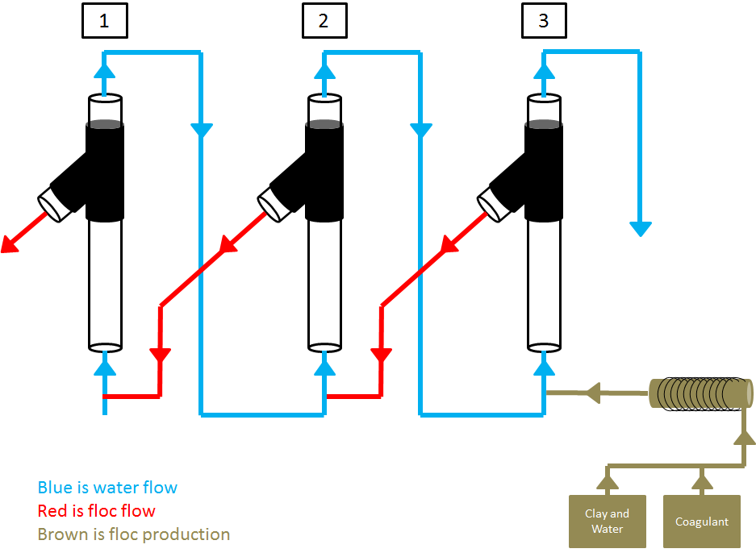
Reactor Design
Iteration Zero
Upflow velocity: 1 mm/s
Height: 40 cm
Inner Diameter: 1 inch
Pumps: 2

Slide 8
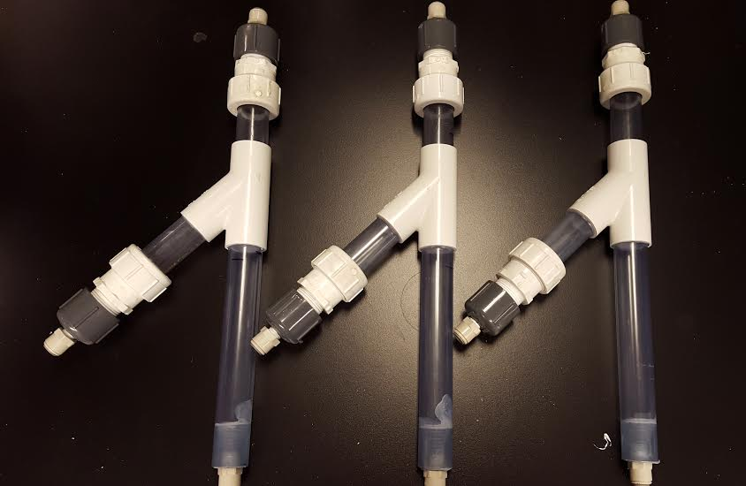
Assembly
Reactor Body
Wye tube acts as floc weir
Pressure caps secure ends
Expansion piping

Slide 9
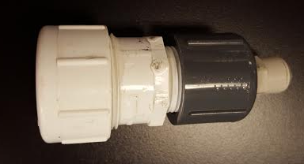
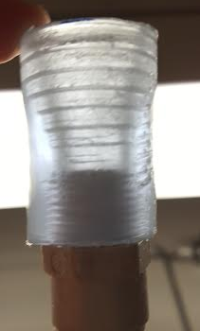
Assembly
Pressure caps
Expansion pipe
Notes:
Reduce losses and ease the flow rate in. This is done to prevent breaking flocs. Also encourage floc resuspension.

Slide 10
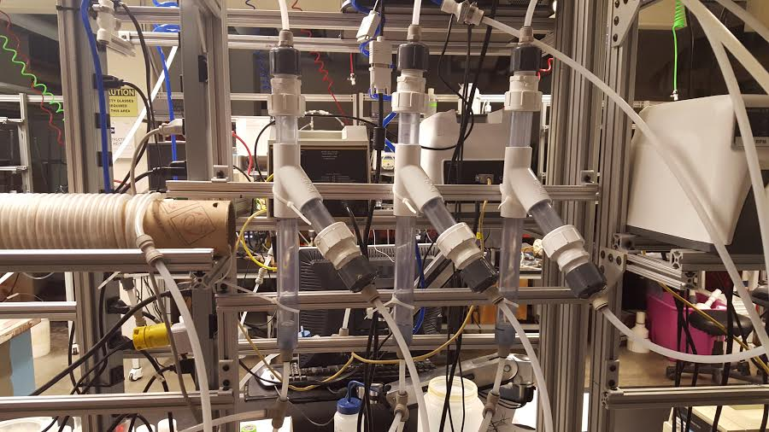
Assembly
Pump heads
Flocculator
Residence time
Notes:
New pic - with a blank background

Slide 11
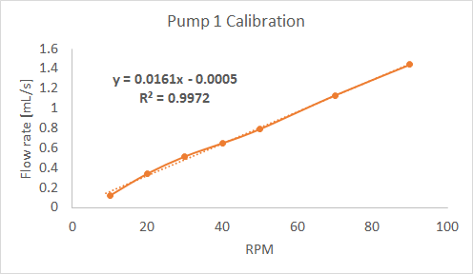
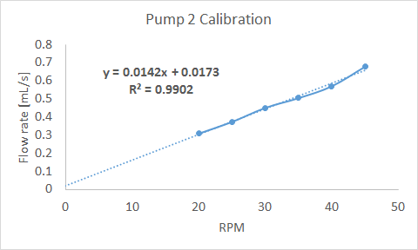
Calibration
Pumps 1 feeds water Pump 2 feeds clay and PACl
Provide accurate concentration of water / PACl + clay mixture into reactors
Notes:
Pumps were calibrated
They are relatively linear and have a y intercept close to 0
We will use these calibration curves to accurately provide the reactor with a PACl/water mixture. Our aim is to come up with a ratio of PACl and water that will provide a total flowrate of 1 mL/s and successfully create flocs

Slide 12
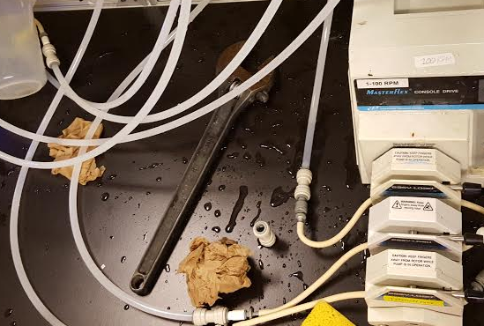
Problems
Draining mechanism
Pressure build up
Air bubbles
Leaks

Slide 13

Future Goals
Procoda
Calculations/Calibration
Testing
Vertical reactor draft
EPA P3
Notes:
Procoda: Allows us to turn on feed tanks simultaneously
Programming for convenience

Slide 14

Questions?

