Slide 1

Countercurrent Stacked
Floc Blanket Reactor Team
Mickey Kumar, Christine Leu
Amlan Sinha, Cindy Dou

Slide 2
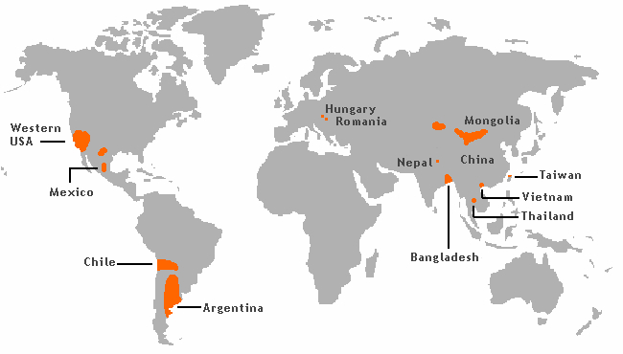
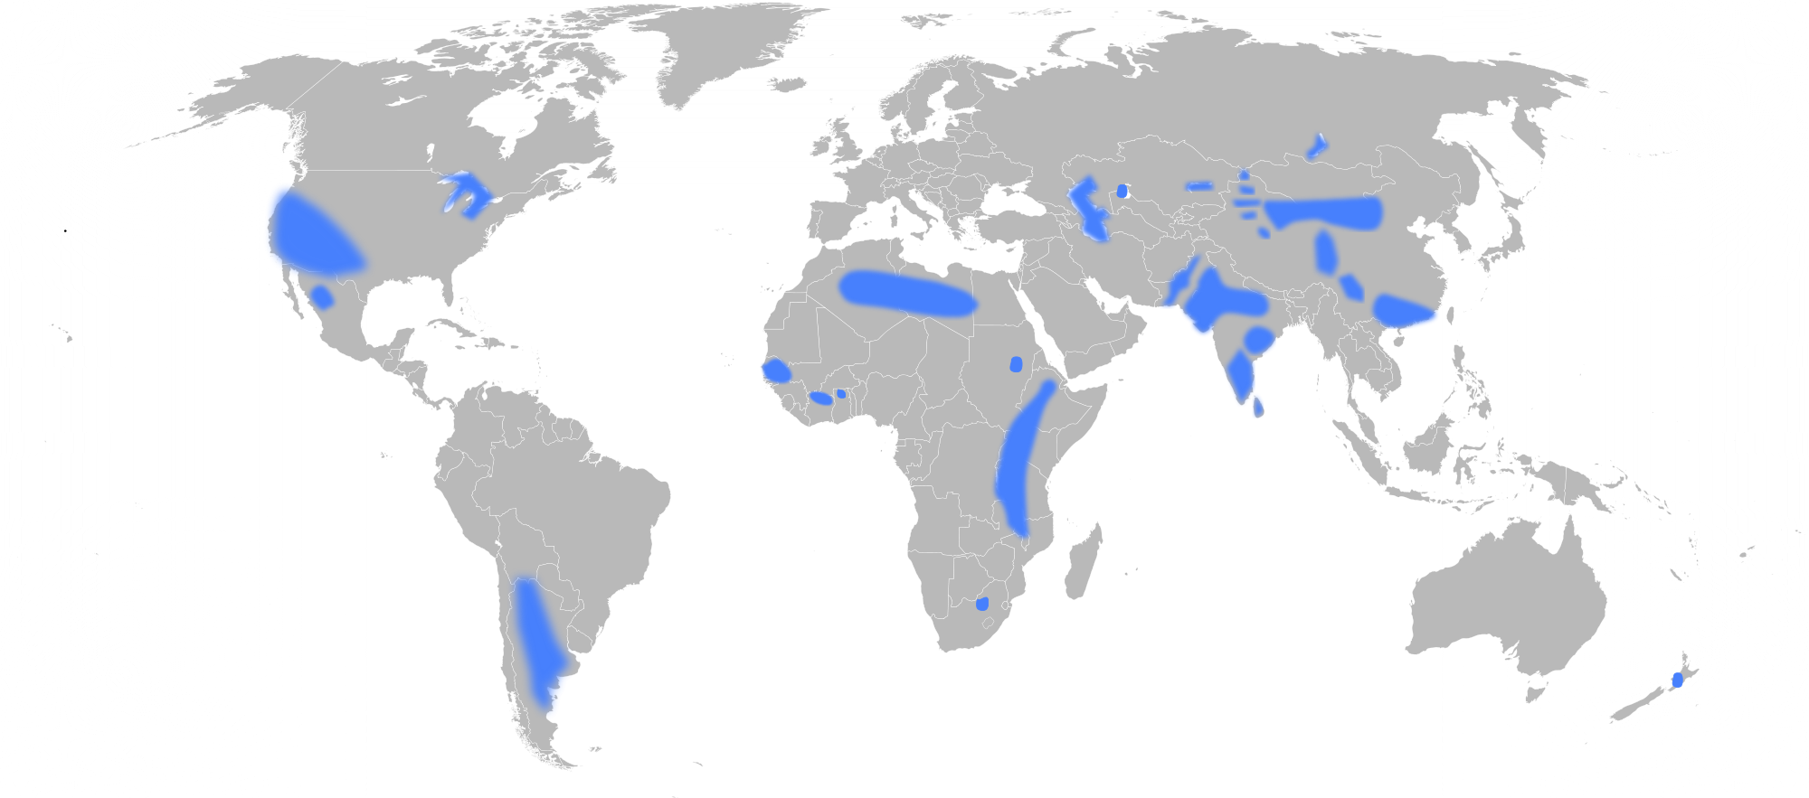

Background
Problem:
Arsenic and fluoride in water
Arsenic Contamination
Carcinogen
Inhibit brain development
Increased mortality rates
Fluoride Contamination
Notes:
AMLAN:
Arsenic and Fluoride are two of the most common contaminants of ground-water in certain parts of the world. Sustained, long-term exposure to such contaminants can result in mental and physical disabilities. For example, long-term exposure to arsenic leads to arsenicosis, which may lead to pigmentation, hyperkeratosis (or skin thickening) and even cancer in skin, lungs, bladder and kidney. On the other hand, long-term exposure to fluoride may lead to tooth decay and extensive skeleto-muscular damage ultimately leading to crippling. These carcinogens can be removed by filtration. However, filtration is inefficient since at regular intervals of time, the process needs to be stopped, the filters need to be washed and repacked, etc. This ultimately wastes water and resources. An example of such a filtrant would be a sand filter. In addition to this, by the time the system needs to be backwashed, the top layer is the dirtiest. However, the bottom layer is relatively cleaner, and is still capable of filtering solutions. We want to get around this waste and develop a more efficient process. This has been the inspiration behind CSFBR.

Slide 3
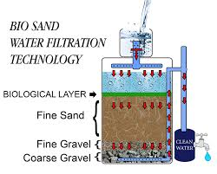
Background
Current Solution:
  Sand Filtration
Disadvantages:
  Clogged sand beds
  Slower filtration
  Consume clean water
  Large areas of land
Fluoride Contamination
Notes:
AMLAN:
Arsenic and Fluoride are two of the most common contaminants of ground-water in certain parts of the world. Sustained, long-term exposure to such contaminants can result in mental and physical disabilities. For example, long-term exposure to arsenic leads to arsenicosis, which may lead to pigmentation, hyperkeratosis (or skin thickening) and even cancer in skin, lungs, bladder and kidney. On the other hand, long-term exposure to fluoride may lead to tooth decay and extensive skeleto-muscular damage ultimately leading to crippling. These carcinogens can be removed by filtration. However, filtration is inefficient since at regular intervals of time, the process needs to be stopped, the filters need to be washed and repacked, etc. This ultimately wastes water and resources. An example of such a filtrant would be a sand filter. In addition to this, by the time the system needs to be backwashed, the top layer is the dirtiest. However, the bottom layer is relatively cleaner, and is still capable of filtering solutions. We want to get around this waste and develop a more efficient process. This has been the inspiration behind CSFBR.

Slide 4
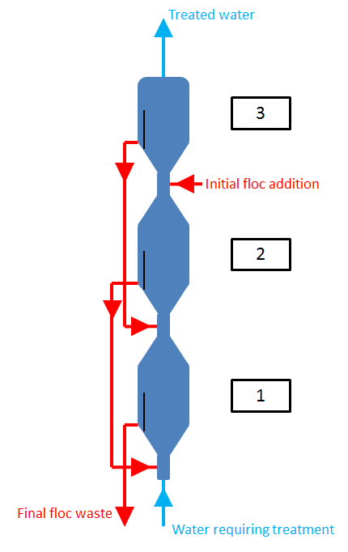
Background
Blue is water flow
Red is floc flow
Purpose of CSFBR:
To design a reactor that can efficiently remove arsenic and fluoride from water
Gravity powered
Reactors in series
Notes:
AMLAN:
The design involves creating a series of three reactors, and the final iteration of the plant would be completely powered by gravity to accommodate the scanty resources of rural communities in different parts of the world such as South Asia, some parts of Central America and Africa. The design implements stacked floc blankets instead of conventional filtration systems and thereby negating waste of resources.
Add in PACl entering in last one, flocs leaving whole system from first one
Include why we want fresh, clean PACl in last one
“A conventional method of removing pollutants such as arsenic and fluoride from water is by using sand filters.Despite its effectiveness, the treatment process leaves the sand filters clogged, and thus these filters need to be flushed out frequently. The backwashing ultimately wastes a significant amount of water, and disrupts the treatment process. In order to reduce water consumption during the cleaning process, a new design was proposed. A set of floc blanket reactors in series could be used to coagulate and filter out organic contaminants; this proposal would ultimately replace the sand filter process and maintain a continuous reactor flow. “

Slide 5

Challenges and Goals
“Iteration Zero”
Reactor setup
Clay and coagulant concentration
Floc blanket formation
Incorporating tracer dye
Notes:
Christine

Slide 6
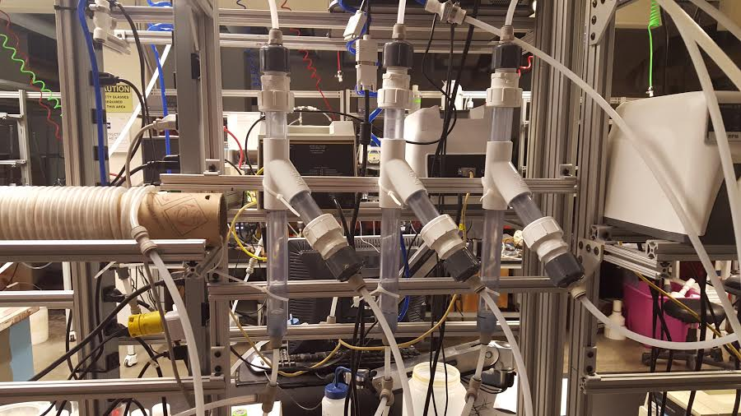

The First Half of the Semester
Still Trying to
Figure out flow mechanism
Create floc blankets
Calculate concentrations
Notes:
Christine
This is where we left off from last time

Slide 7
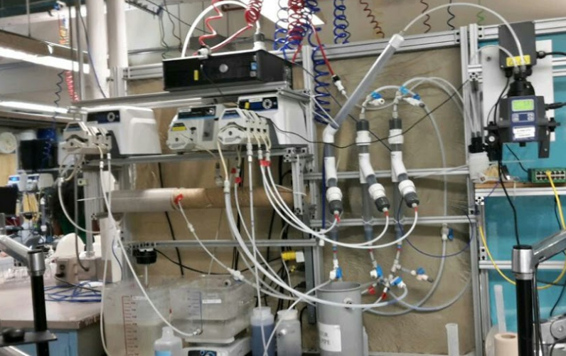
Second Half of the Semester
Notes:
Christine

Slide 8
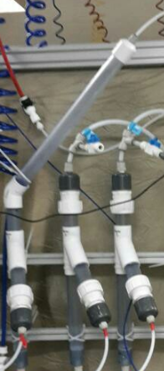
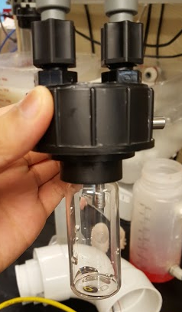
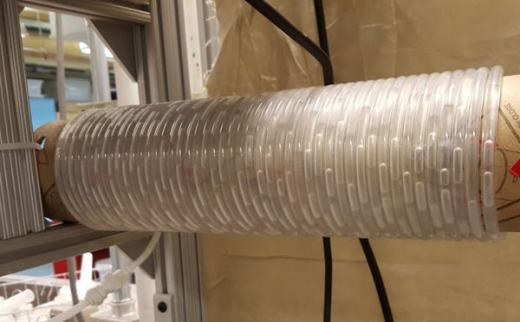
New Additions
New Additions
Flocculator with smaller tubing
Tube Settler
Turbidimeter
Spectrophotometer
Notes:
Christine

Slide 9
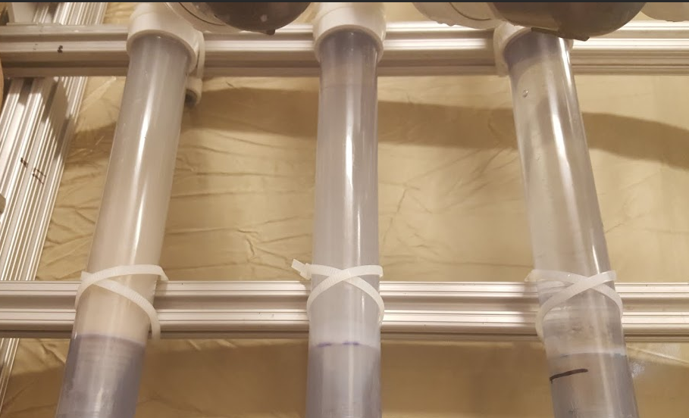
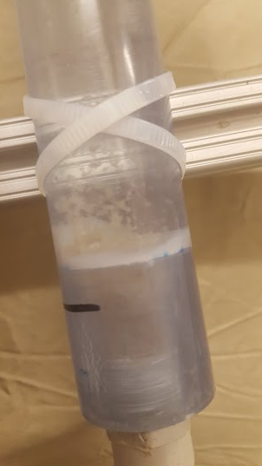
Early Testing
Formation of Floc Blankets
Heavy sedimentation
Switched tubing to ¼ inch
Altered concentration and flow rates
Notes:
Mickey

Slide 10
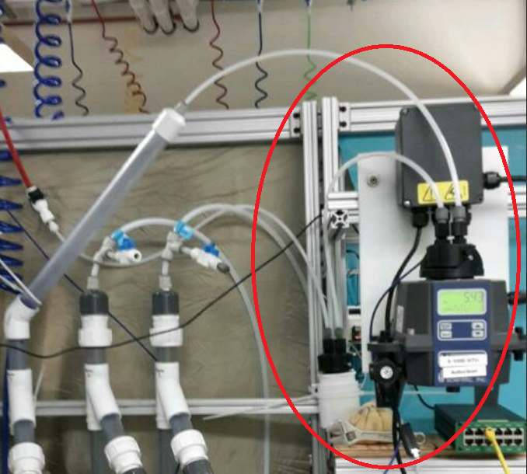
Spectrophotometer
Determine PACl concentration of effluent
ProCoda data collection
SHOUT OUT: Spectrophotometer team!!
Notes:
Mickey

Slide 11
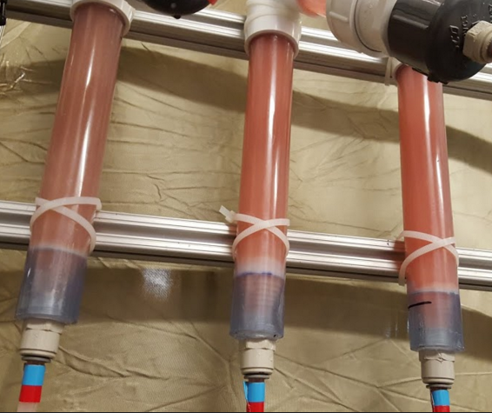
Introducing a Tracer Dye
Red Dye
PACl did not adsorb dye effectively
Other alternatives?
Remazol Brilliant Blue R
Notes:
Mickey

Slide 12
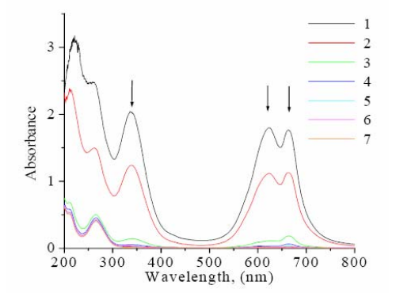
Introducing a Tracer Dye
RBBR
Wavelength of absorbance 620-660 nm
Red LED light replacement
Literature value:
  80-90 % of removal dye
Notes:
Cindy

Slide 13
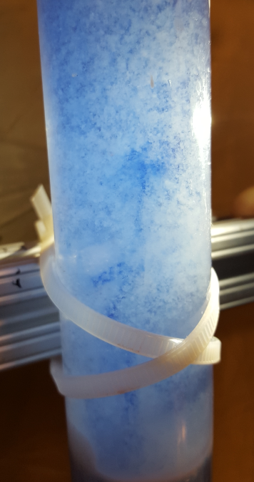
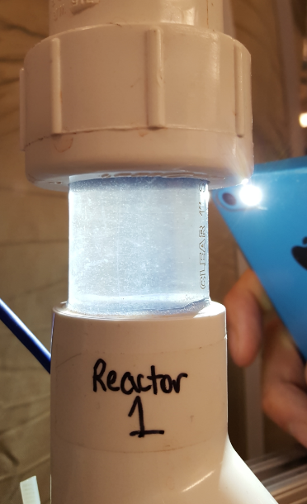
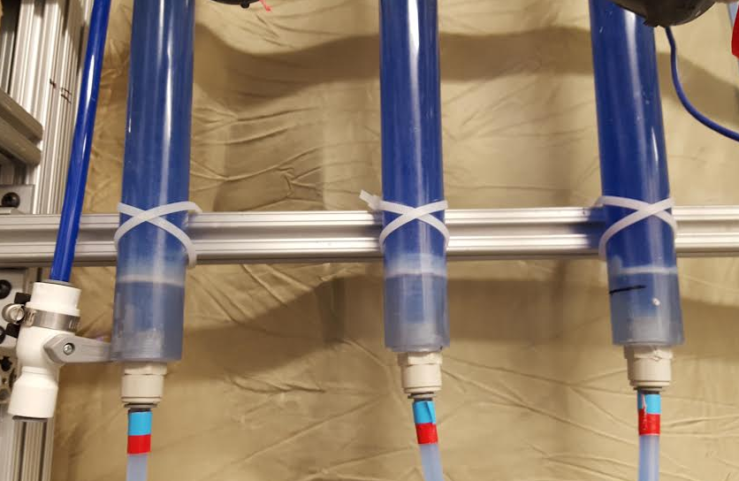
Data Results
Notes:
Cindy

Slide 14
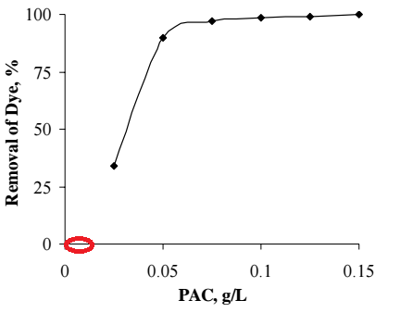
Data Results
Concentration of PACl too low
Direct feed into reactor
Increasing acidity of water?
Notes:
Cindy

Slide 15

Future Goals
Recalibration Spectrophotometer
Verify Experiments
Vertical reactor draft
EPA P3
Notes:
Cindy

Slide 16

Questions

