Slide 1
Granular Sequencing Batch Reactor
Nisarg Gohil
Amiel Middelmann
Andrea Whalen

Slide 2
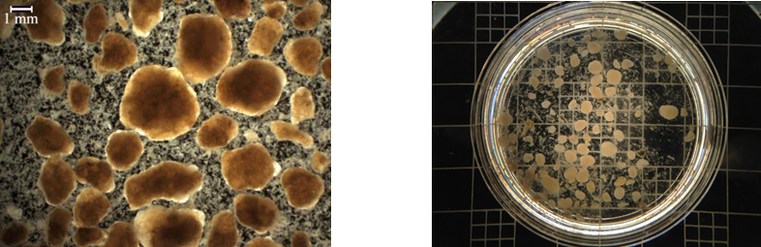
Motivation for GSBR
Reduced footprint
Less energy usage
Combined nutrient and COD removal

Slide 3
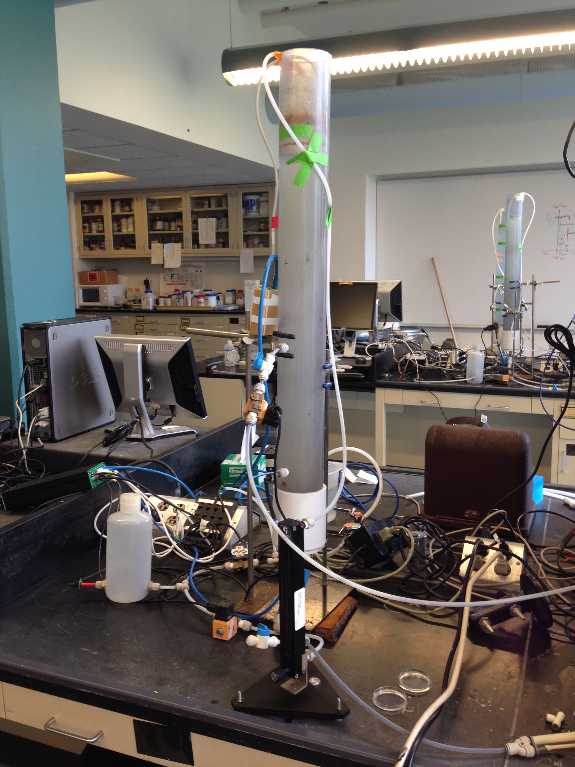
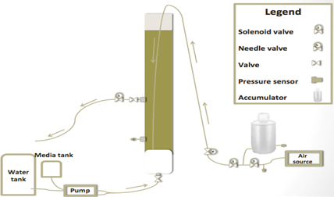
Experimental Setup

Slide 4
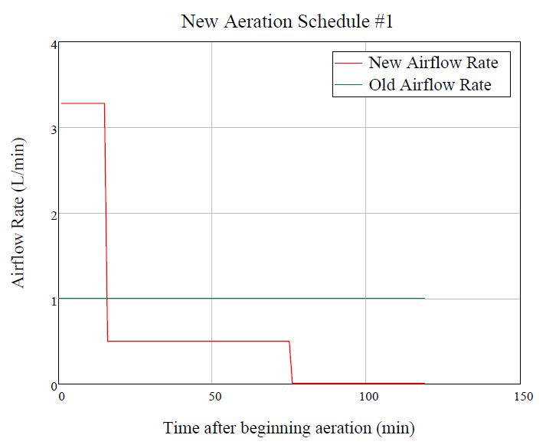
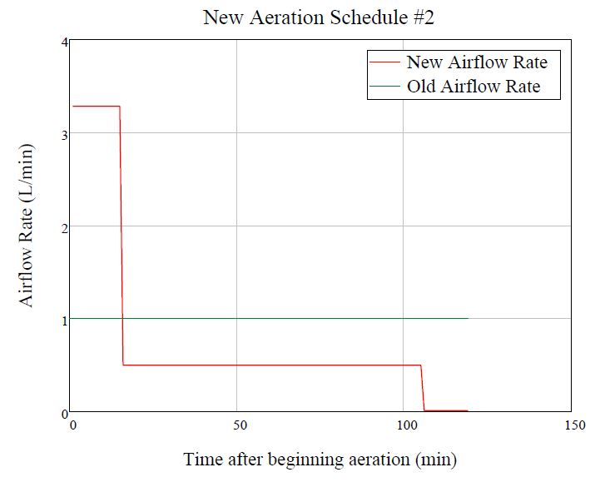
Experiment Plan
Began 10/12/15
Began 11/24/15
Notes:
Change #1:
15 minutes of “high shear” air flow rate
60 minutes of moderate aeration
30 minutes of very low air flow rate
Change #2:
Increase moderate aeration time to 90 minutes
Decrease anoxic airflow time to 15 minutes

Slide 5
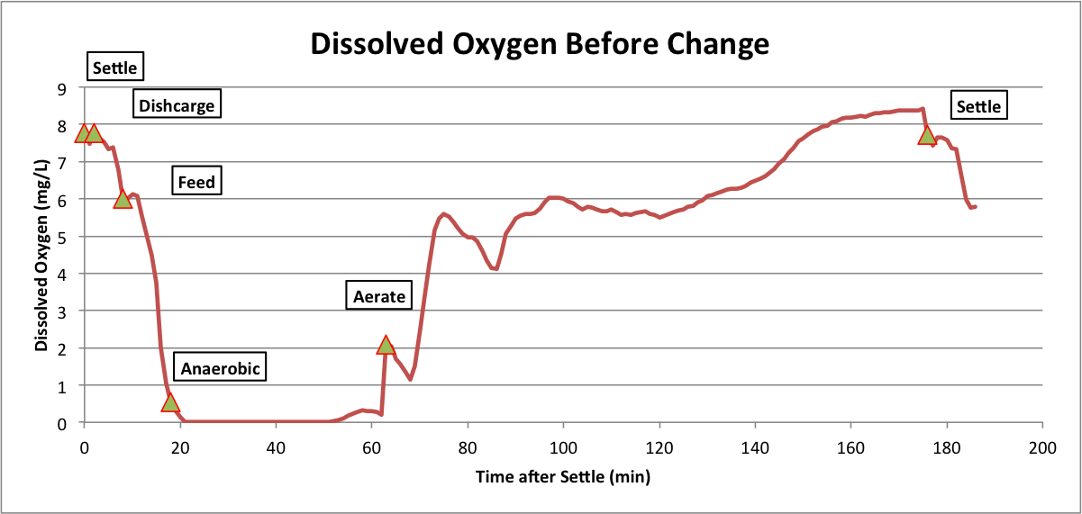
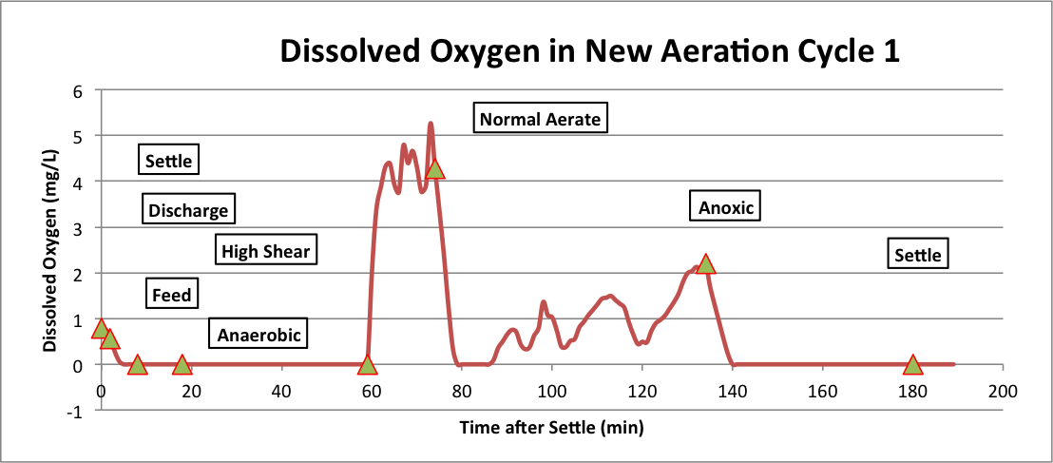
DO Results

Slide 6
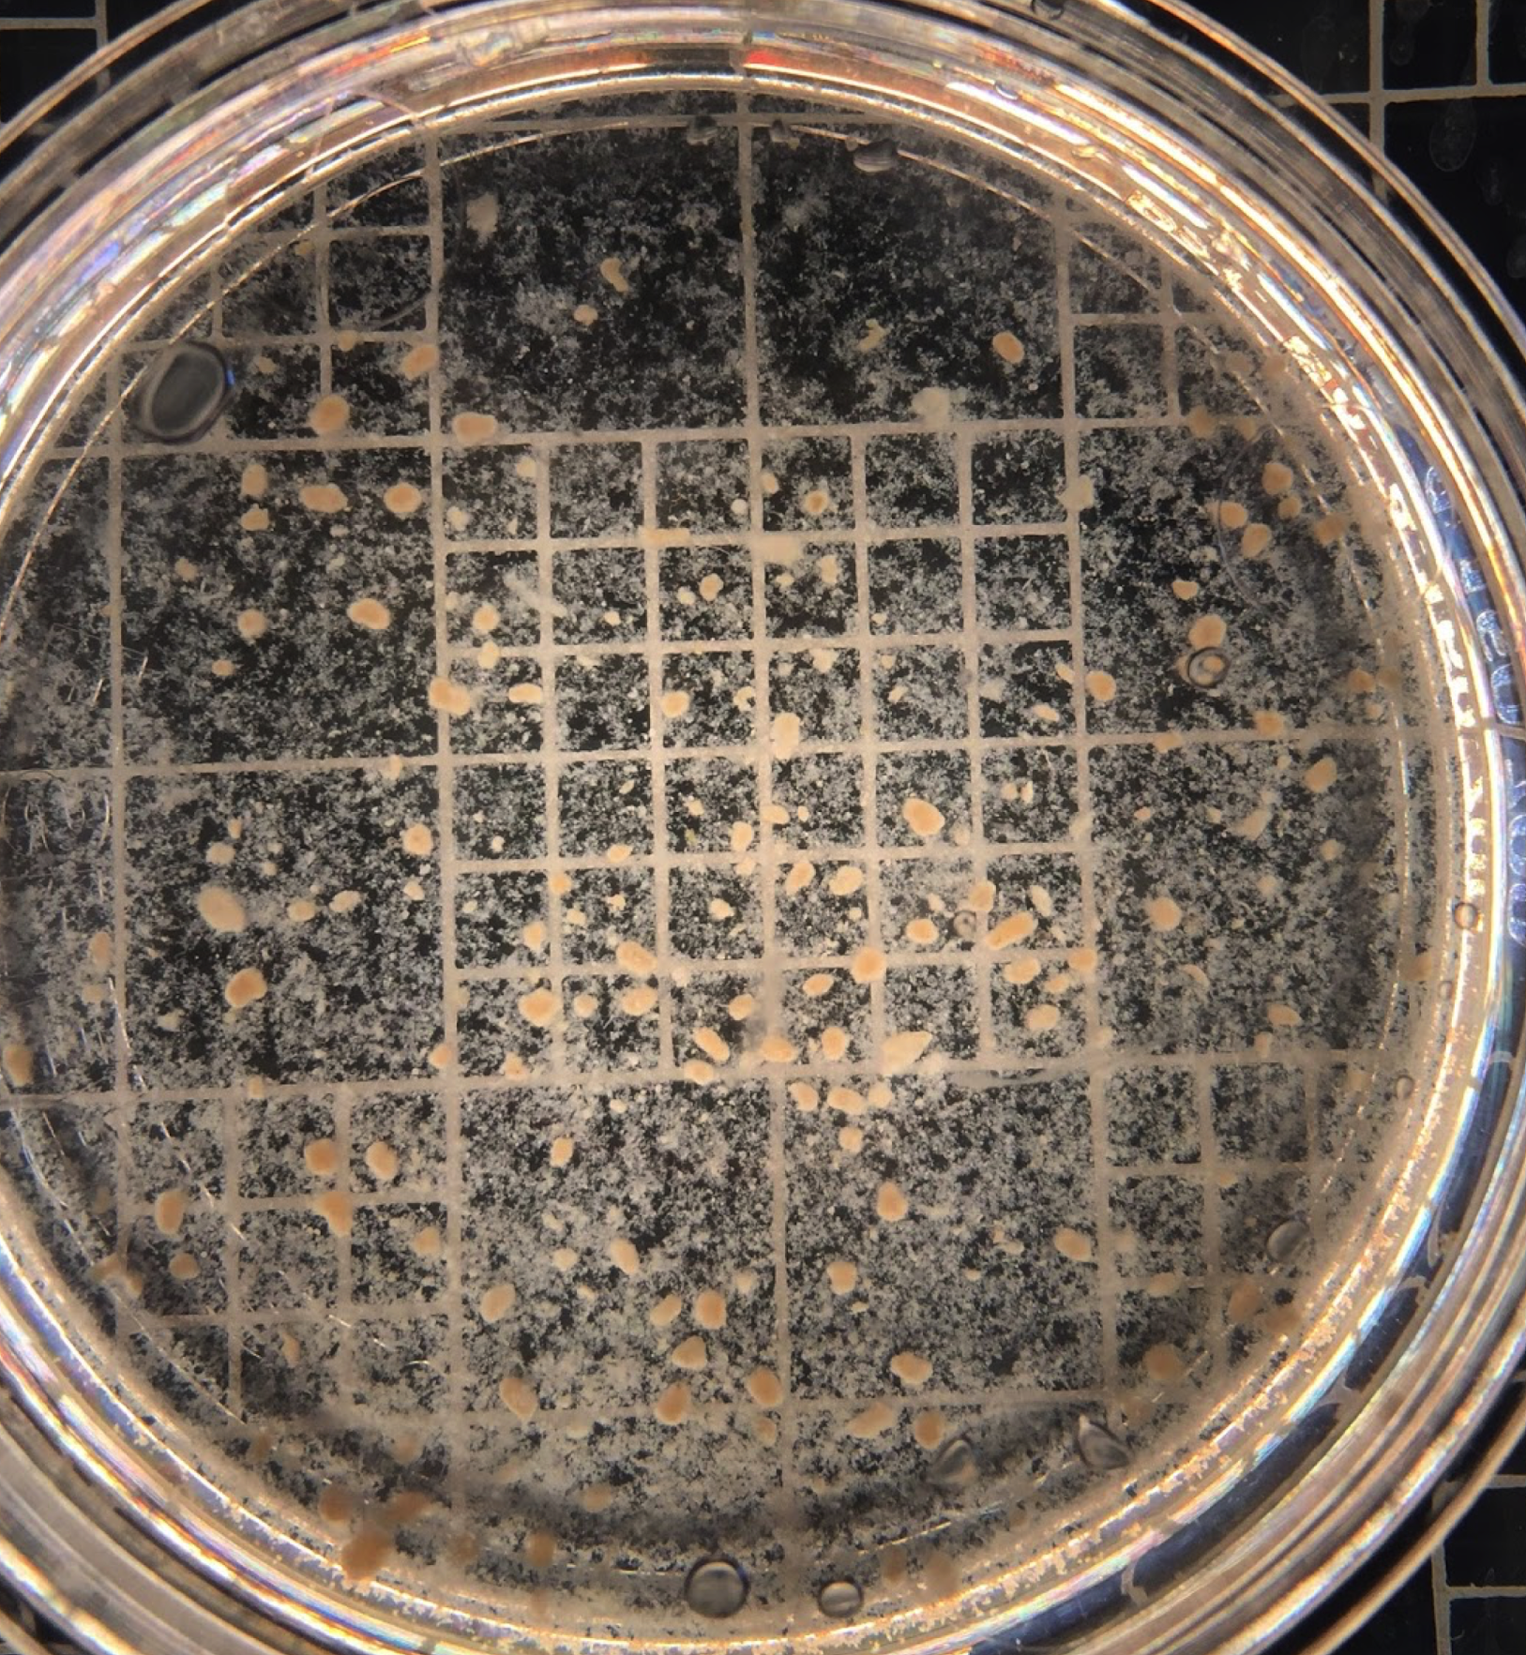
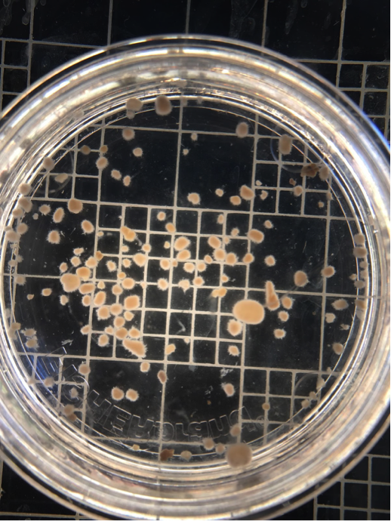
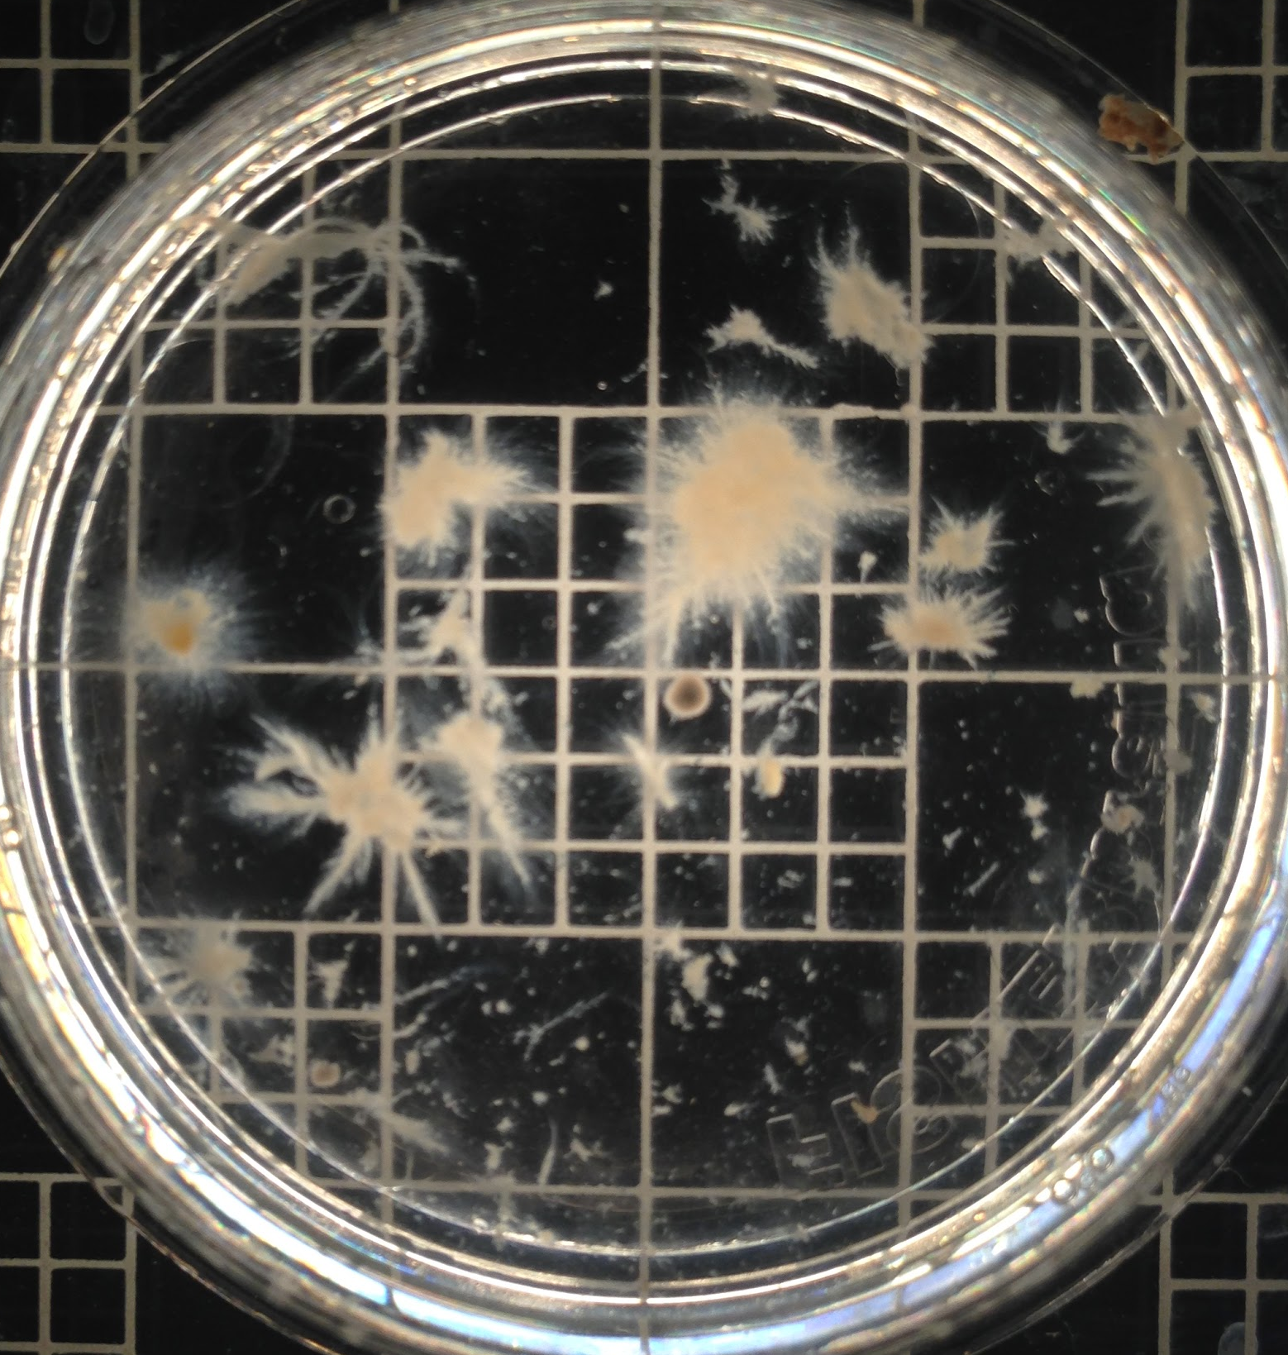
Granule Images
10/16/15
10/27/15
12/04/15

Slide 7
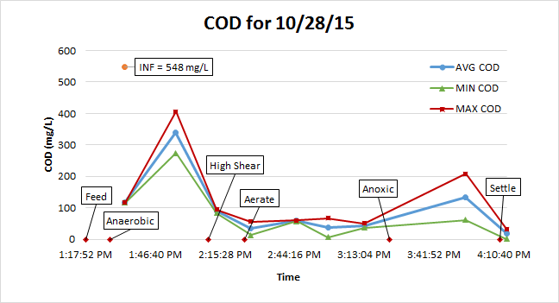
Typical Cycle COD

Slide 8
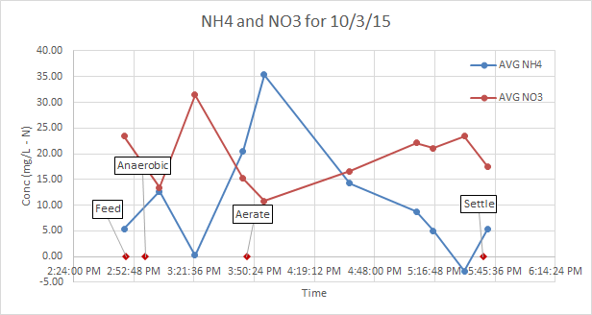
Nitrogen Before Changes

Slide 9
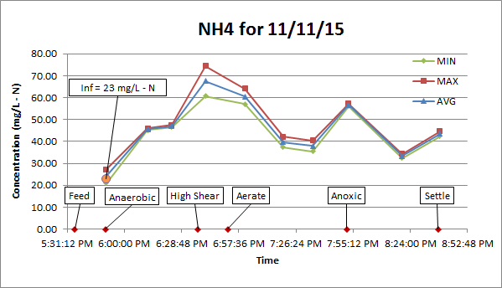
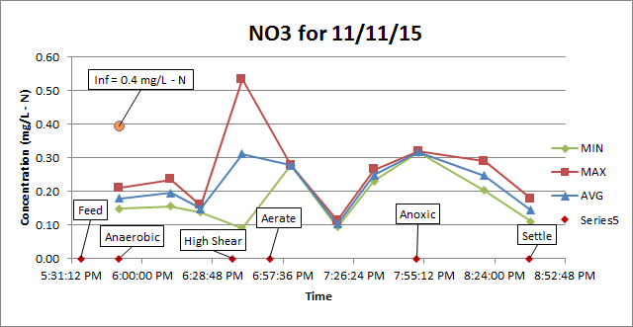
Nitrogen After First Change

Slide 10
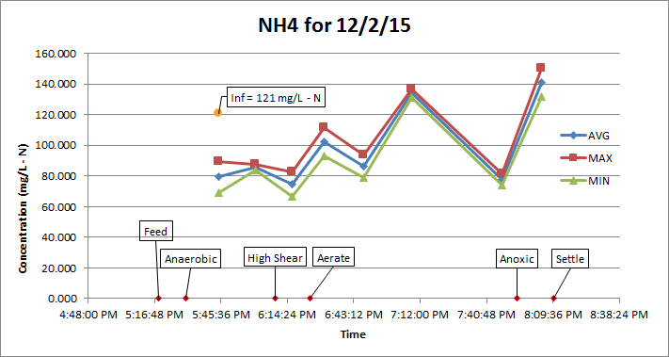
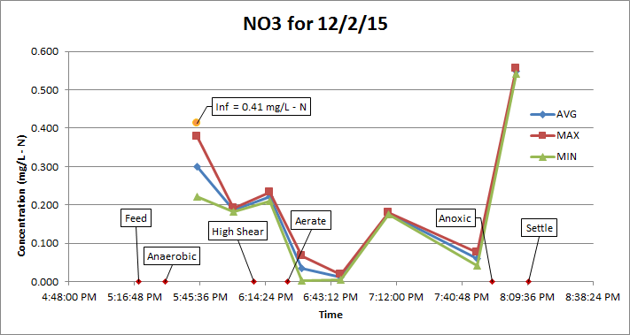
Nitrogen After Last Change

Slide 11
Analysis and Conclusions
Results from New Aeration Schedules:
COD removal at high efficiency with less airflow
Granule structure not maintained
Increased Denitrification not obtained
  Nitrifiers were decreased
Short term increase in aeration did not improve nitrification

Slide 12
Future Work
More work needed to find aeration sweet-spot
Can we improve sampling and measurements?
Microbiology of the granules
Understanding granulation
Pairing GSBR + UASB

Slide 13
Questions?

