Slide 1
Granular Sequencing Batch Reactor
Nisarg Gohil
Andrea Whalen
Amiel Middelmann

Slide 2
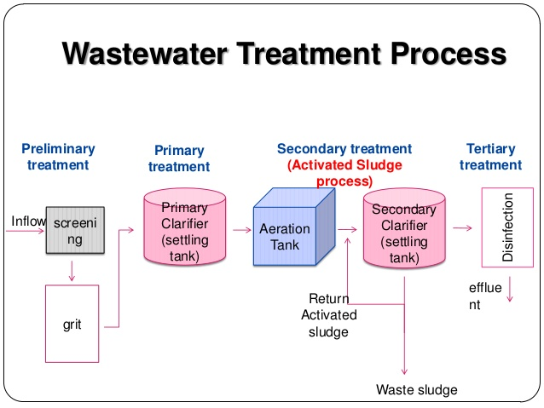
Conventional Wastewater
Goals
Remove organic matter and nutrients
prevent environmental degradation
improve public health
Limitations
High energy
Complexity

Slide 3
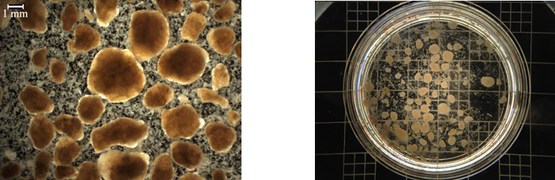
Motivation for GSBR
Consolidates activated sludge and sedimentation processes
Reduced footprint
Less energy usage
Combined nutrient and COD removal

Slide 4
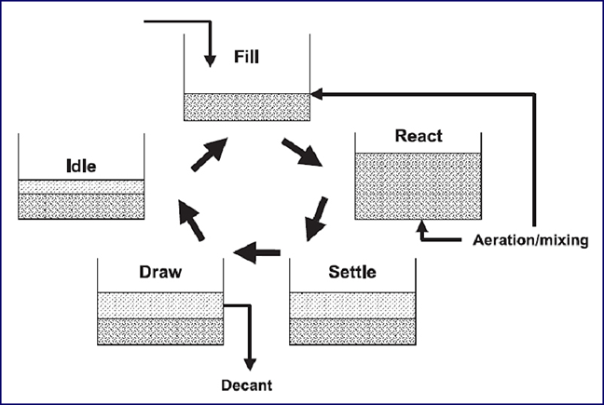
How it works

Slide 5
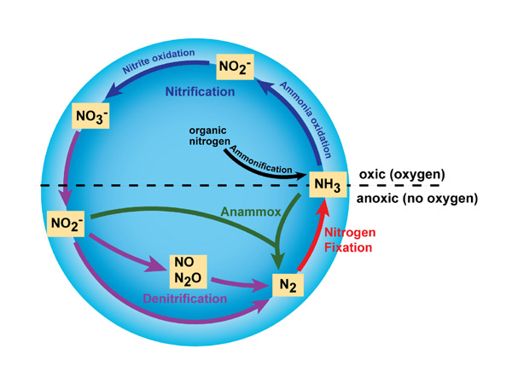
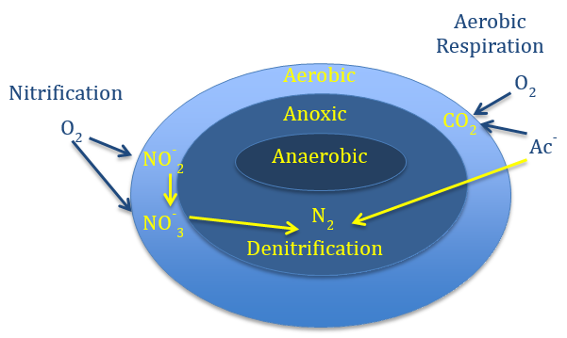
Nitrogen Removal
Nitrogen Cycle In Granules

Slide 6
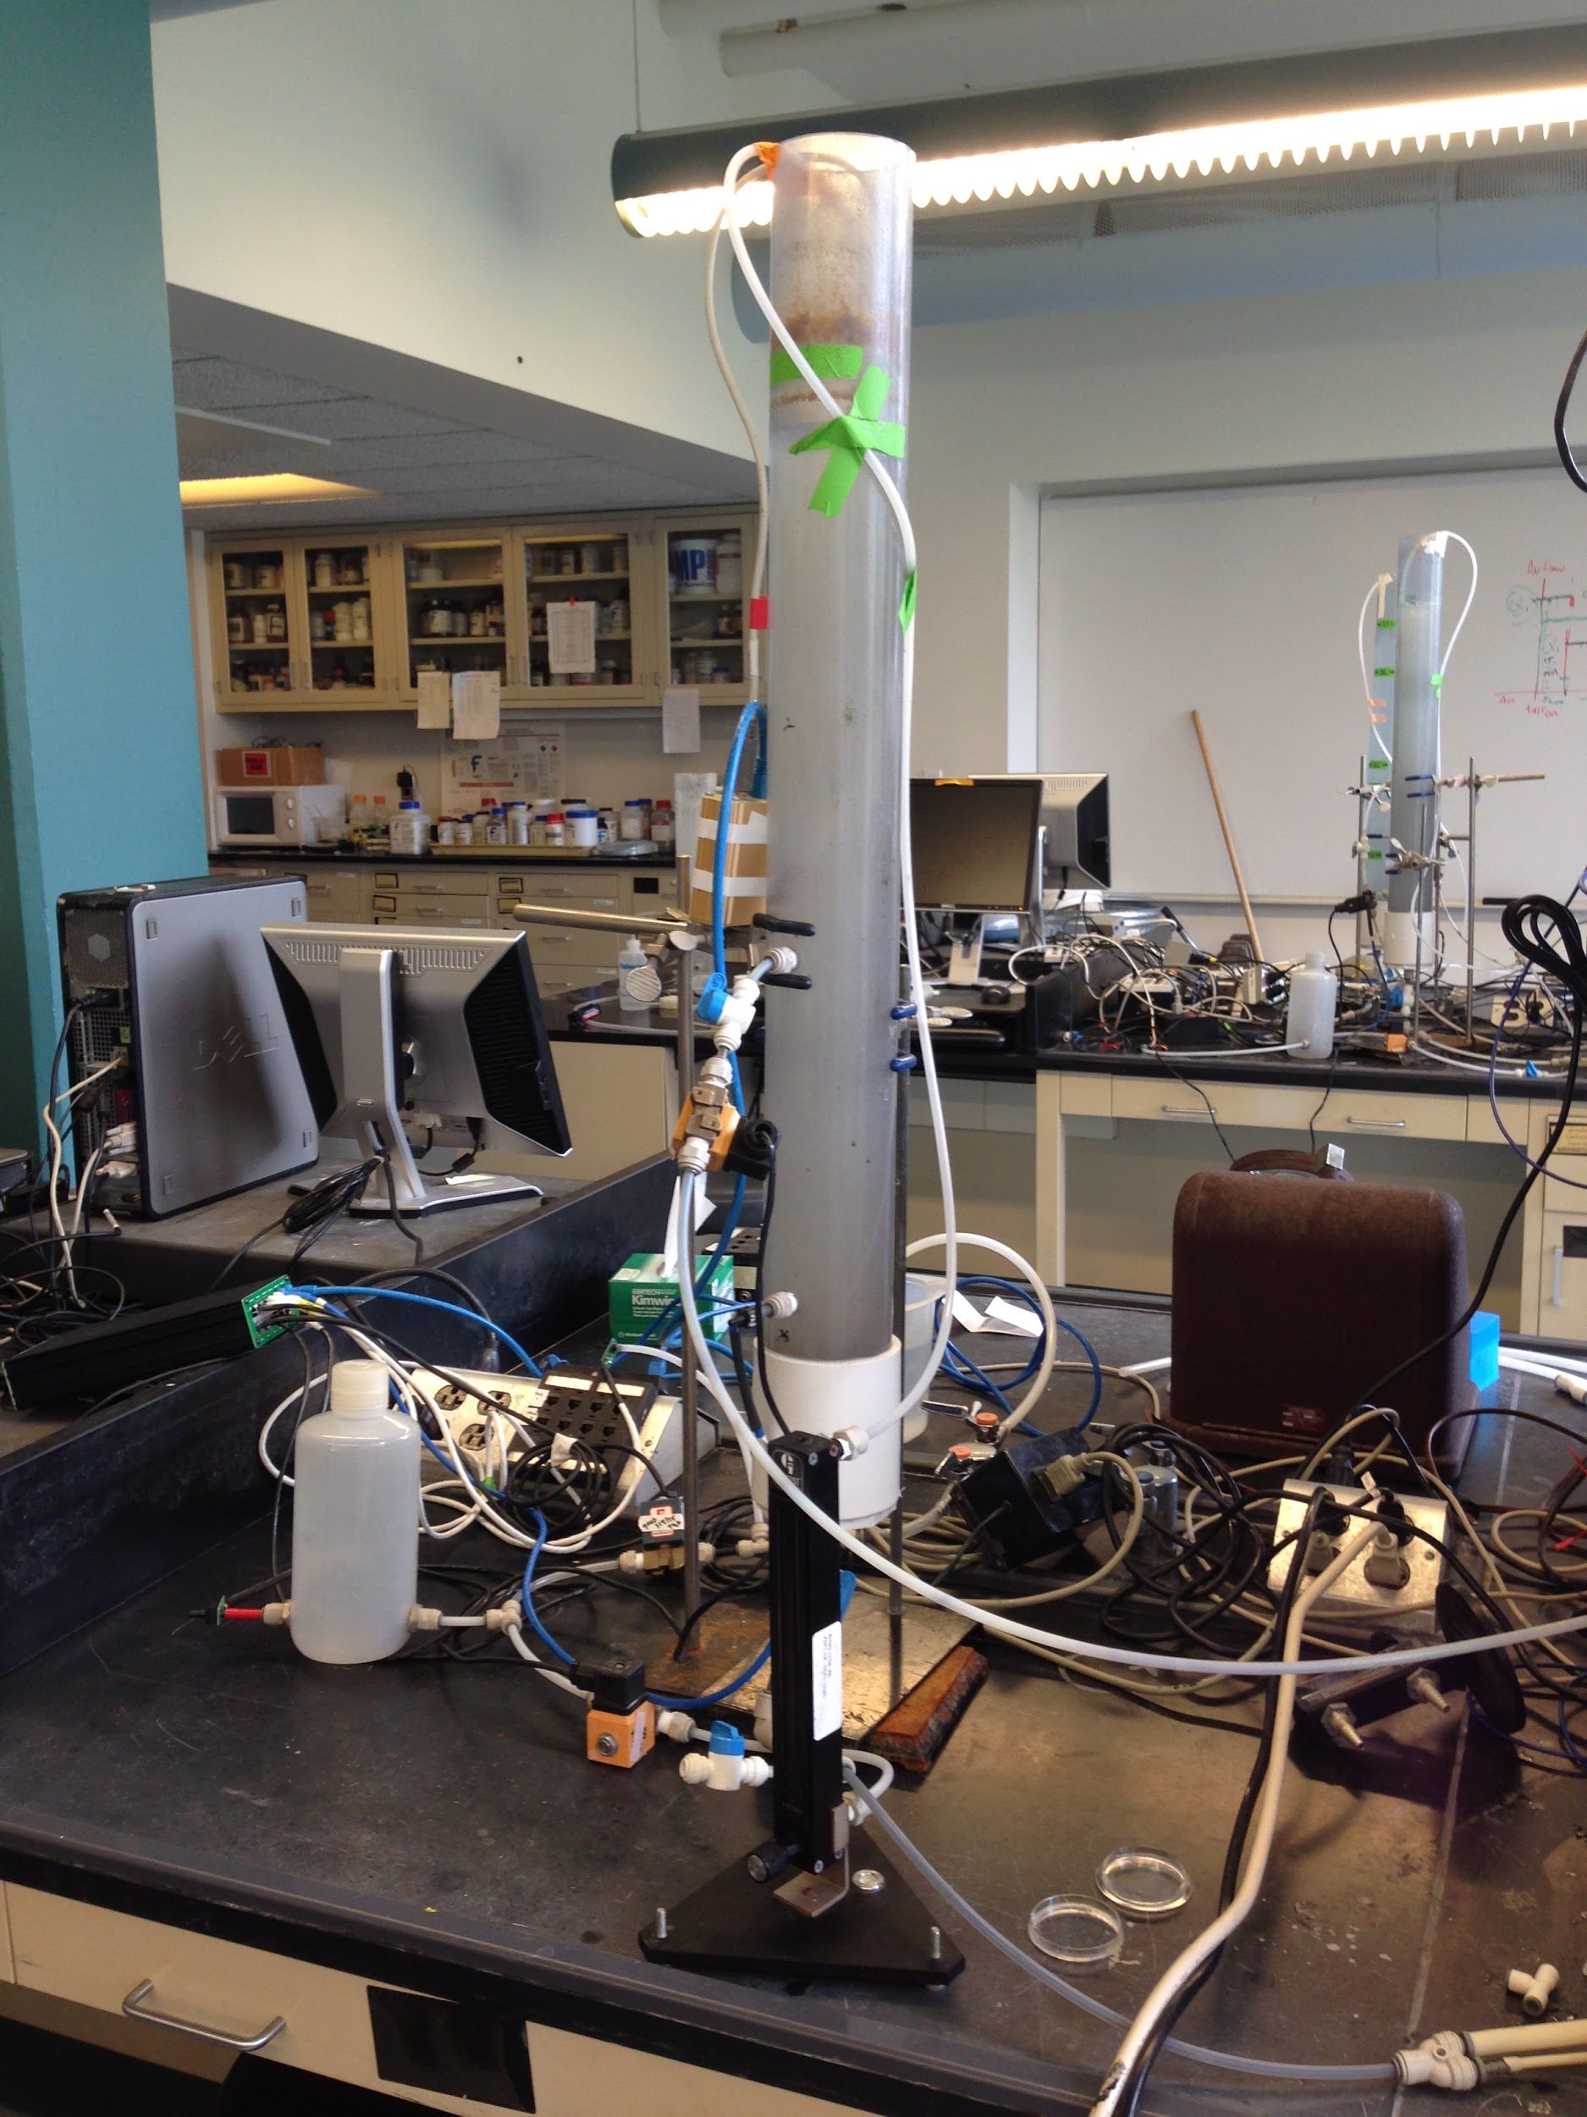
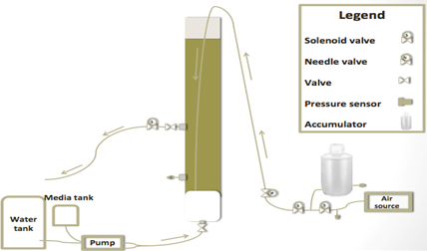
Experimental Setup

Slide 7
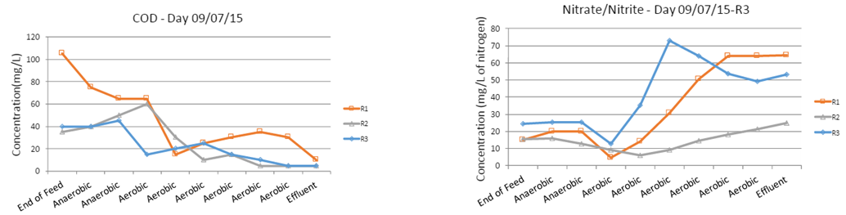
Previous Work

Slide 8
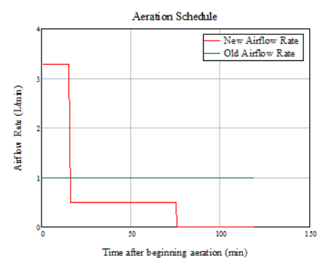
Experiment Plan
15 minutes of “high shear” air flow rate
60 minutes of moderate aeration
30 minutes of very low air flow rate.

Slide 9
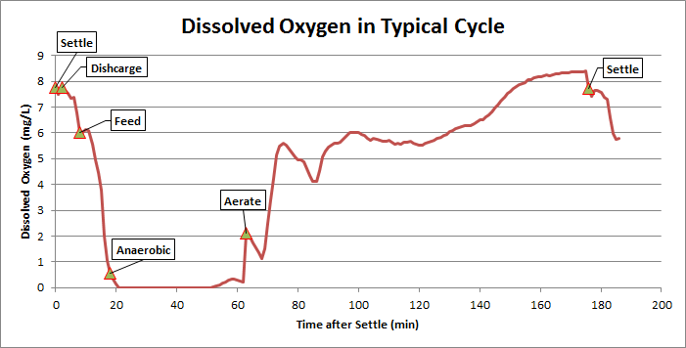
Recent Results

Slide 10
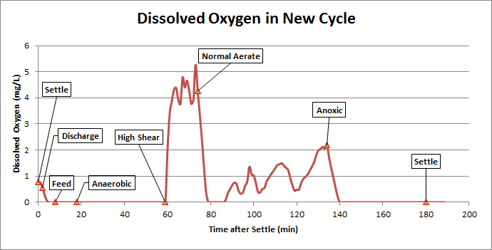
Recent Results

Slide 11
Future Work
Current Experiment
Monitor progress of denitrification and reactor performance
COD, Ammonium, Nitrate/Nitrite analyses
Change parameters as needed for further experiments
Future Experiments
High strength wastewater
Test parameters to improve granulation
Pair GSBR with UASB

