Slide 1
Upflow Anaerobic Sludge Blanket Reactors
Zoe Maisel, Evan Greenberg, Yi Guo, Mason Minot

Slide 2
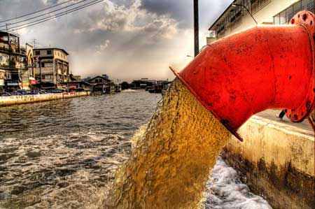
Wastewater Around the World
“Up to 90% of wastewater in developing countries does not undergo treatment” [1]
Environmental and health hazard
https://www.laprogressive.com/dumping-wastewater-into-aquifers/

Slide 3
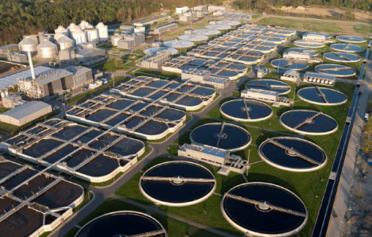
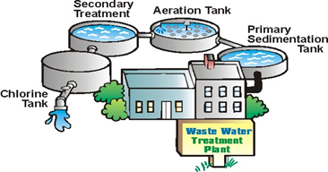
Current State of Treatment
Large capital and operational costs
Large energy demand
Difficult to handle lower flows

Slide 4
Alternative Treatment Goals
Low cost
Energy neutral/positive
Small scale treatment
(households to small communities)
Reduce biological sludge production

Slide 5
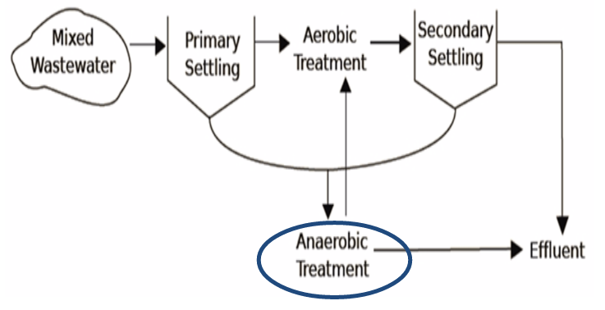
Proposed Treatment
Process Flow
Combining anaerobic and aerobic treatment can reduce the need for downstream processing

Slide 6
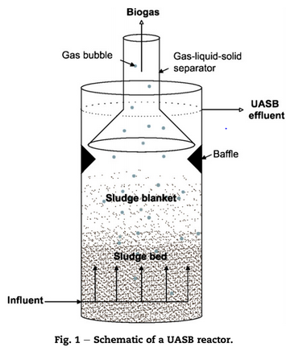
Upflow Anaerobic Sludge Blanket (UASB)
influent wastewater contains chemical oxygen demand (COD)
granular biomass of a mixture of bacterial species form a sludge bed and fluidized sludge blanket

Slide 7
Upflow Anaerobic Sludge Blanket (UASB)
granules process the COD to produce biogas (Methane and Carbon Dioxide)
biogas is captured by Gas-Liquid-Solid (GLS) separator

Slide 8
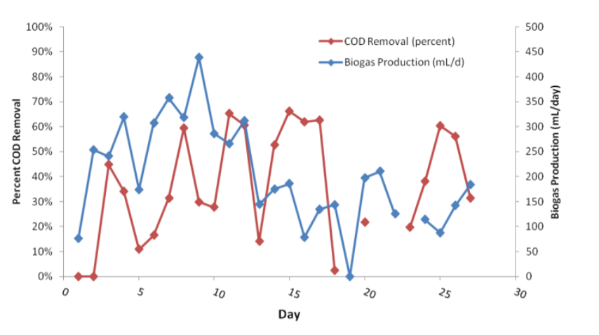
Previous Work and Challenges
Summer 2013 Goals and Challenges
  Remove COD, turbidity, and pathogens
  Energy neutral reactor through collection of biogas
  Challenges: Poor treatment efficacy
    Biomass washout, granular disintegration, scaling
Summer 2013 testing
Notes:
2 UASBs constructed: chosen because fits constraints of
Low flows; influent COD: 500 mg/L
Small footprint
Low Energy

Slide 9
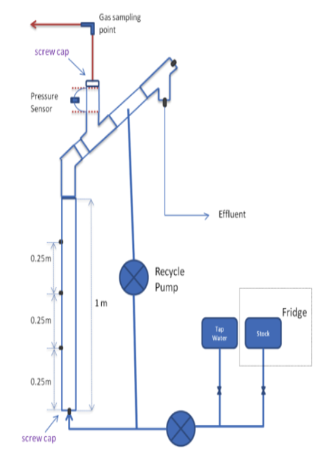
Previous Work and Challenges
Fall 2013 Goals and Challenges
  New gas chamber sealing method
  Models for particle fluidization and settling
  Dissolved methane tests
  Characterization of granules
    Confocal microscopy and chemical staining
  Challenges: inability to collect significant data for gas production
    Leaks, lengthy startup time
Fall 2013 Gas sampling method
Notes:
new gas chamber sealing method based on the coupling of a pressure sensor with process controller that would potentially only release accumulated biogas once a certain gas pressure has been reached.
fluidization velocity and settling velocity increase as granule diameter and density increase
dissolved methane escaping in effluent
confocal microscopy and chemical staining in an attempt to characterize the granules within the reactor. The group was able to identify regions within the granule involved in active DNA and RNA synthesis as well as groups of aggregated methanogens.

Slide 10
Previous Work and Challenges
Spring 2014 Goals and Challenges
  Gas chromatography to monitor methane production: Bag test
  Fixing leaks: Teflon tape, parafilm and epoxy
  Operational changes:
    Heating
    Double strength of wastewater
    Double hydraulic retention time (HRT)
    Reduce pump flow rate to half
  Challenges: inconsistencies between theoretical and experimental gas production, inconsistent COD feed concentration delivery, and vessel leakage

Slide 11
Semester Goals
Can GSBRs be used effectively to further treat wastewater after a UASB process? (links with Aerobic GSBR team)
How effective are designs at capturing methane generated in UASB (minimizing losses in effluent and through leaks)?
How well do the UASBs treat Nitrogen, phosphorus and, possibly, fecal indicator bacteria (harmless E.coli)?
How sensitive are cultures to Oxygen stress?

Slide 12
Semester Goals
Can GSBRs be used effectively to further treat wastewater after a UASB process? (links with Aerobic GSBR team)
How effective are designs at capturing methane generated in UASB (minimizing losses in effluent and through leaks)?
How well do the UASBs treat Nitrogen, phosphorus and, possibly, fecal indicator bacteria (harmless E.coli)?
How sensitive are cultures to Oxygen stress?

Slide 13
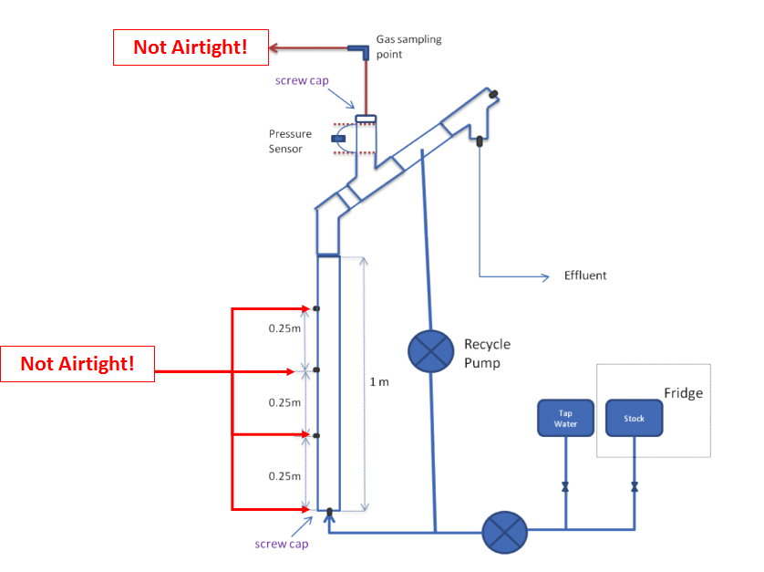
Previous Experimental Setup
Leaks in head unit interfere with accurate data collection

Slide 14
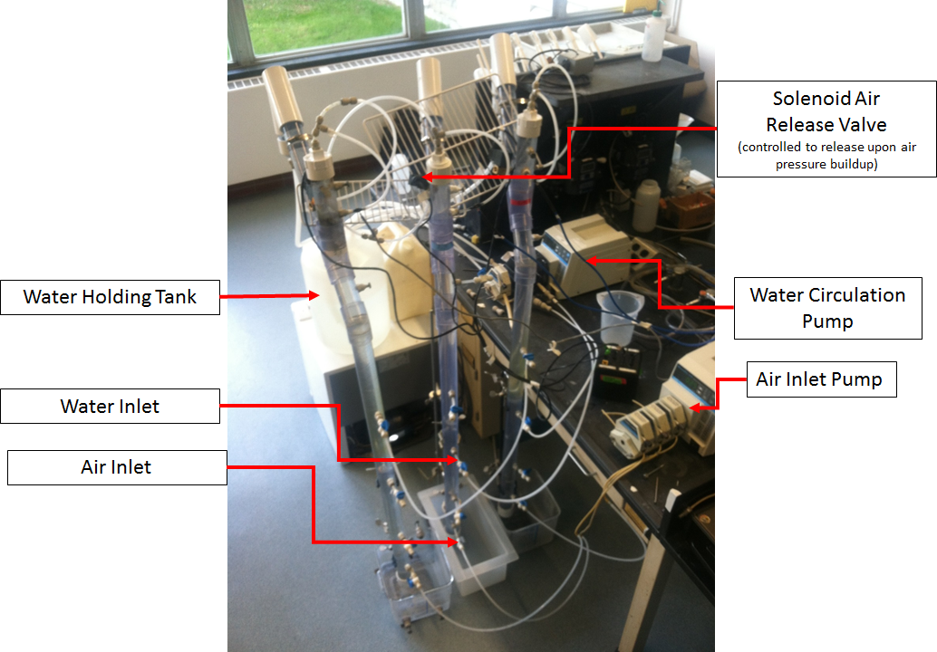
Experimental Setup
3 reactors in parallel
water and air only
(no biomass)
to identify and quantify leaks

Slide 15
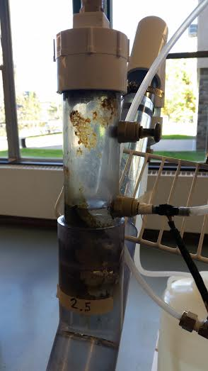
Methods
Cleaning the existing reactors
-Agitation
-Soap
-Bleach

Slide 16
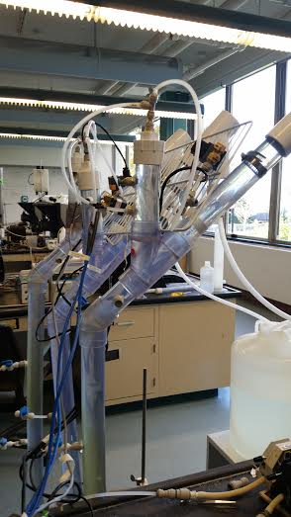
Methods
Testing Air Loss
-Soap Test: High pressure over short duration
-Pressure test: operational pressure over long duration

Slide 17
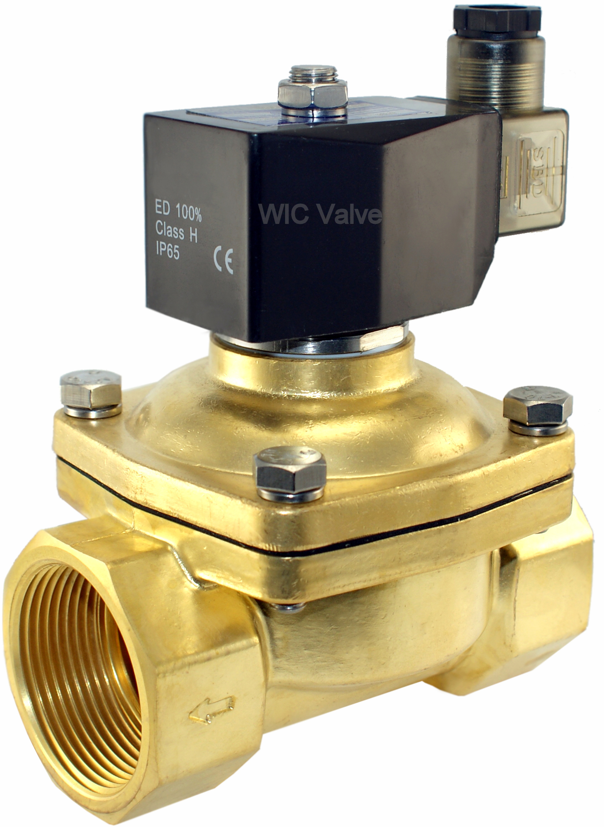
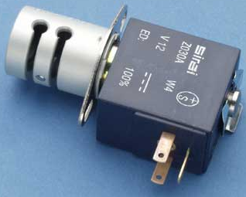
Methods
Testing Functionality of Equipment
-Valves
-Pumps

Slide 18
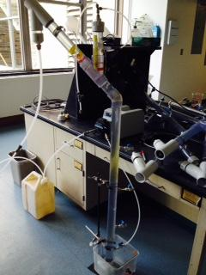
Current Conclusions
Cleaning the UASB reactor
After bleach disinfection, most of the sludge was removed.
Well-Cleaned!
Fig.1 The Picture of Well-cleaned UASB Operator 2.4

Slide 19
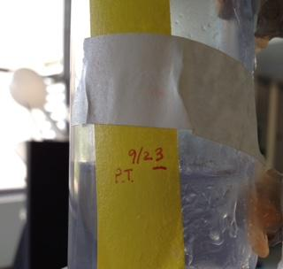
Current Conclusions
Testing Air Loss
Soap-solution Test
Not airtight
Higher pressure
Don’t know the extent of leaking
2) Pressure Test
Air Leaking Rate
Fig.2 The Change of Water Level of Operator 2.4

Slide 20
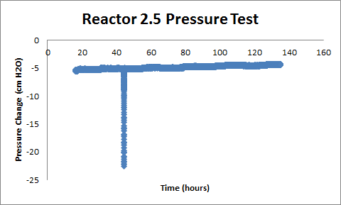
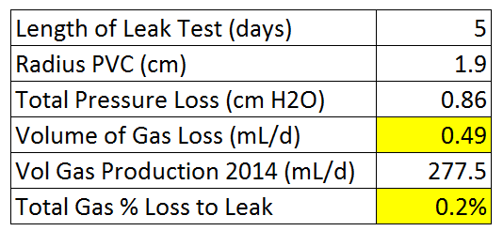
Current Conclusions
Testing Air Loss
Pressure Test
Sharp drop due to pressure sensor reorientation
Slope: Pressure Change Rate
Ignore when calculating
Tab.1 Calculation of Air Loss
Fig.3 Pressure Testing Outcomes
Air Leaking Rate*
*For now, this leak will be considered negligible.

Slide 21
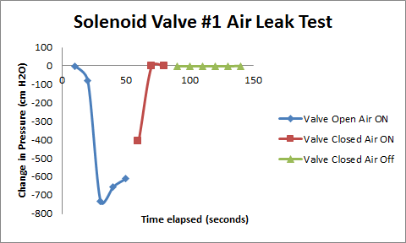
Current Conclusions
Testing Pinch and Solenoid Valves
Three New Solenoid Valves
Valves closed again, pressure returned to the initial zero.
Similar Data
Work the same
Successful test
Three Old Pinch Valves
Fig.4 The Result of Solenoid Valve Test
Ineffective
Leak Problem

Slide 22
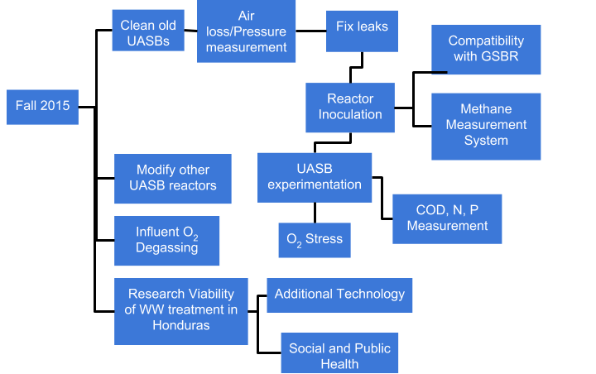
Challenges/Future Work

Slide 23
Challenges/Future Work
Notes:
have granules, wastewater stock, tubing necessary - tested delivery of pumps to get desired concentration.
ready to inoculate as soon as leaks are better understood/addressed

Slide 24
Questions/Comments?
Thank you!

Slide 25
References
http://epi.yale.edu/the-metric/help-us-improve-our-global-wastewater-indicator
http://www.filtsep.com/view/40993/wastewater-treatment-technology-for-developing-countries
Chong, S., Sen, T., Kayaalp, A., & Ang, H. (2012). The performance enhancements of upflow anaerobic sludge blanket (UASB) reactors for domestic sludge treatment – A State-of-the-art review. Water Research, 3434-3470.
Aiyuk, S., Amoako, J., Raskin, L., Haandel, A., & Verstraete, W. (2004). Removal of carbon and nutrients from domestic wastewater using a low investment, integrated treatment concept. Water Research, 3031-3042.
Yu, H., Tay, J., Fang, H., (2001). The Roles of Calcium in Sludge Granulation During UASB Reactor Start-Up. Wat. Res., 4, 1052-1060.
Mes, T., Stams, A., Reith, J., Zeeman, G., (2003). Methane production by anaerobic digestion of wastewater and solid wastes. From Bio-Methane & Bio-Hydrogen: Status and Perspectives of Biological Methane and Hydrogen Production (Chapter 4).
Aiyuk, S., Forrez, I., Lieven, D., K., A, Haandel, A., Verstraete, W., (2006). Anaerobic and complementary treatment of domestic sewage in regions with hot climates - A review. Bioresource Technology, 97, 2225-2241.
Experimental Thermal and Fluid Science. (2006). Science Direct, 30(4), 329-336. Retrieved September 30, 2014, from http://www.sciencedirect.com/science/article/pii/S0894177705000993
Weber-Shirk, M. (2014, September 14). Flow Control and Measurement. Retrieved September 30, 2014, from https://confluence.cornell.edu/display/cee4540/Syllabus

