Slide 1
Upflow Anaerobic Sludge Blanket Reactors
The fabrication of small-scale packed bed UASB reactors.
More information can be found on the AguaClara wiki page - (UASB)

Slide 2
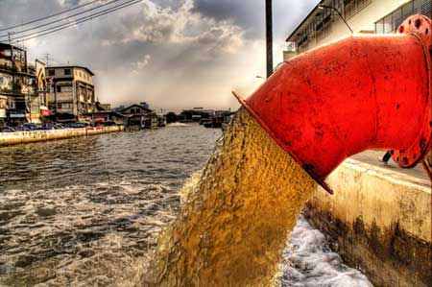
Wastewater Around the World
“Up to 90% of wastewater in developing countries does not undergo treatment” [1]
Environmental and health hazard
UASB | Research | Final Presentation Spring 2016

Slide 3
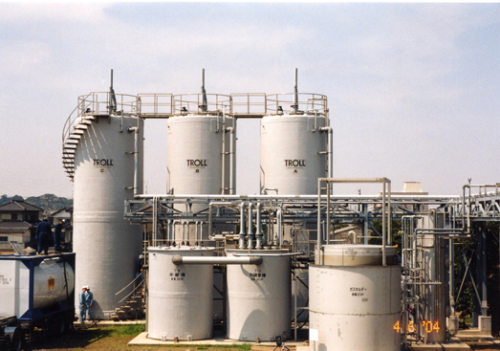
Current State of Treatment
High capital/operating costs and large energy demand
UASB | Research | Final Presentation Spring 2016
Notes:
not feasible in rural and impoversihed regions due to high cost and inability to treat low flows

Slide 4

Our Goal
Develop low cost, low energy, small scale wastewater treatment
UASB | Research | Final Presentation Spring 2016

Slide 5
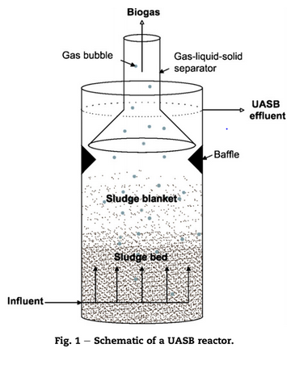
Overview of UASB Technology
(Chong et al. 2012)
The Upflow Anaerobic Sludge Blanket Reactor
UASB | Research | Final Presentation Spring 2016
Notes:
influent wastewater contains chemical oxygen demand (COD)
granular biomass of a mixture of bacterial species form a sludge bed and fluidized sludge blanket
granules process the COD to produce biogas (Methane and Carbon Dioxide)
biogas is captured by Gas-Liquid-Solid (GLS) separator

Slide 6
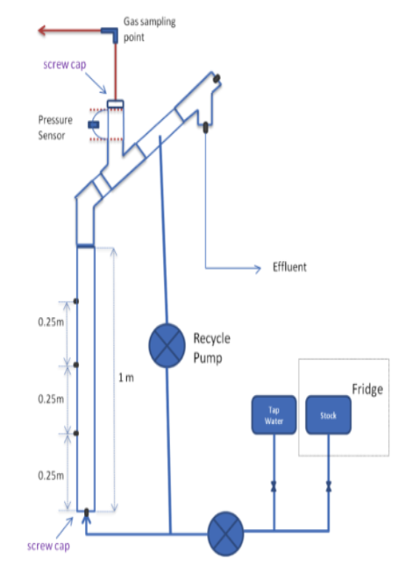
Lessons learned from previous teams
Gas collection is challenging!
UASB | Research | Final Presentation Spring 2016
Notes:
Summer 2013: Challenges: Poor treatment efficacy
Biomass washout, granular disintegration, scaling
Fall 2013: Challenges: inability to collect significant data for gas production
Leaks, lengthy startup time
Spring 2014: Challenges: inconsistencies between theoretical and experimental gas production, inconsistent COD feed concentration delivery, and vessel leakage
Fall 2015: Challenges: inability to collect significant data for gas production
Leaks, lengthy startup time
Caption your figure and explain its relevance to your presentation/thesis here. You can take the caption from your Final Report and modify it.
Write a summary of this slide here. A future team member or client should be able to read this note and understand this slide without having your team explain it to them.
If there are any appendix slides that are relevant to this slide, mention it in your notes.

Slide 7

Focus of This Semester
Building a set of small-scale reactors
UASB | Research | Final Presentation Spring 2016
Notes:
Moving from spacious teaching lab to the more snug AguaClara lab imposed some size limitations.
Previous large reactors were unstable and broken after falling over.
New reactors were designed to better suit the lab space.
This gave us the opportunity to redesign the reactors to eliminate inefficiencies and issues caused by the old design.

Slide 8
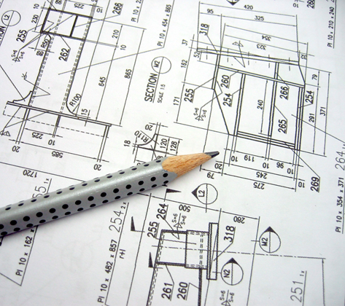
MathCad Reactor Design
4 hr HRT. Upflow velocity 0.05 mm/s
UASB | Research | Final Presentation Spring 2016
Notes:
Constraint: HRT fixed at 4 hrs and upflow velocity at 0.05 mm/s
Performed all calculations for Sch40 PVC from 0.5” id to 3.5” to determine the optimum inner diameter
Reactor height required calculated based on constraints HRT*Vup - 2.36 ft
Calculated reactor volumes
Calculated flow rates required for water and influent wastewater to deliver necessary 3gm/L/day COD loading
Determined that for our system, with the bench space and pumps available that 1” is optimum diameter

Slide 9
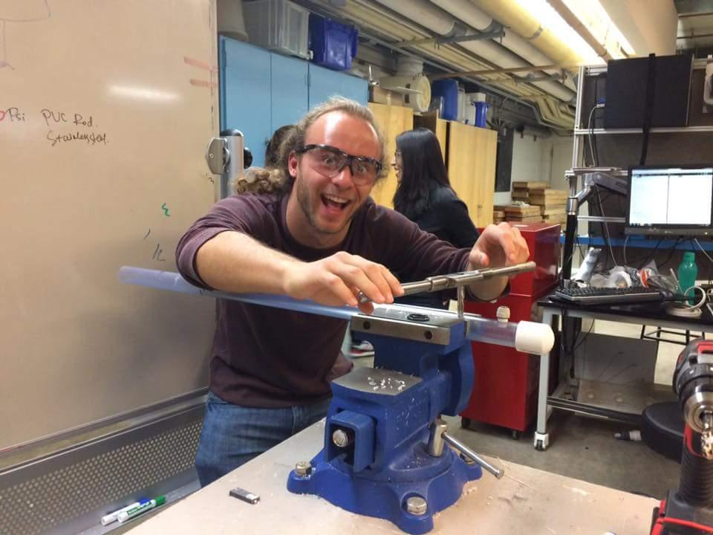
Design Process
UASB | Research | Final Presentation Spring 2016
Notes:
The team had very little fabrication experience, so training was needed. Threading, sanding, cutting, glueing
4 identical reactors
Minimize number of ports into and out of reactor to maintain air-tightness
Head unit
Option for methane sensors for gas production quantification
Narrow head unit for more frequent offgasses with old methane sensing method

Slide 10
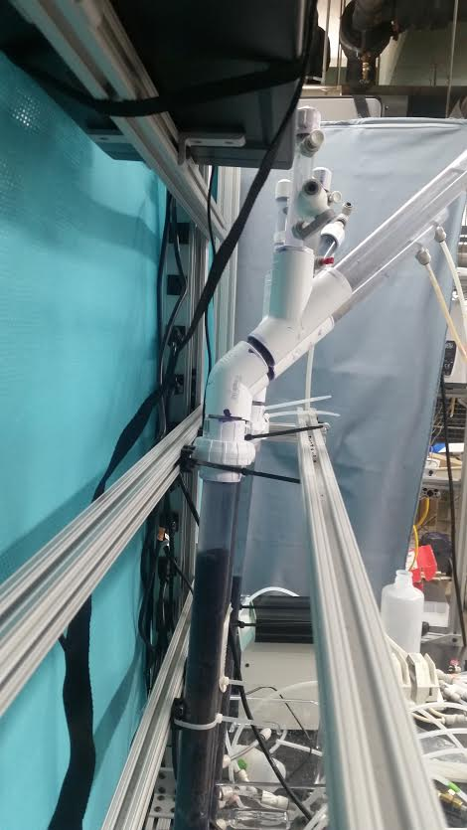
Benefits of New Design
UASB | Research | Final Presentation Spring 2016
Notes:
Properly sized for the new lab space
Easily secured to lab bench
Simplified inoculation and maintenance with new design
Skills gained from fabrication

Slide 11
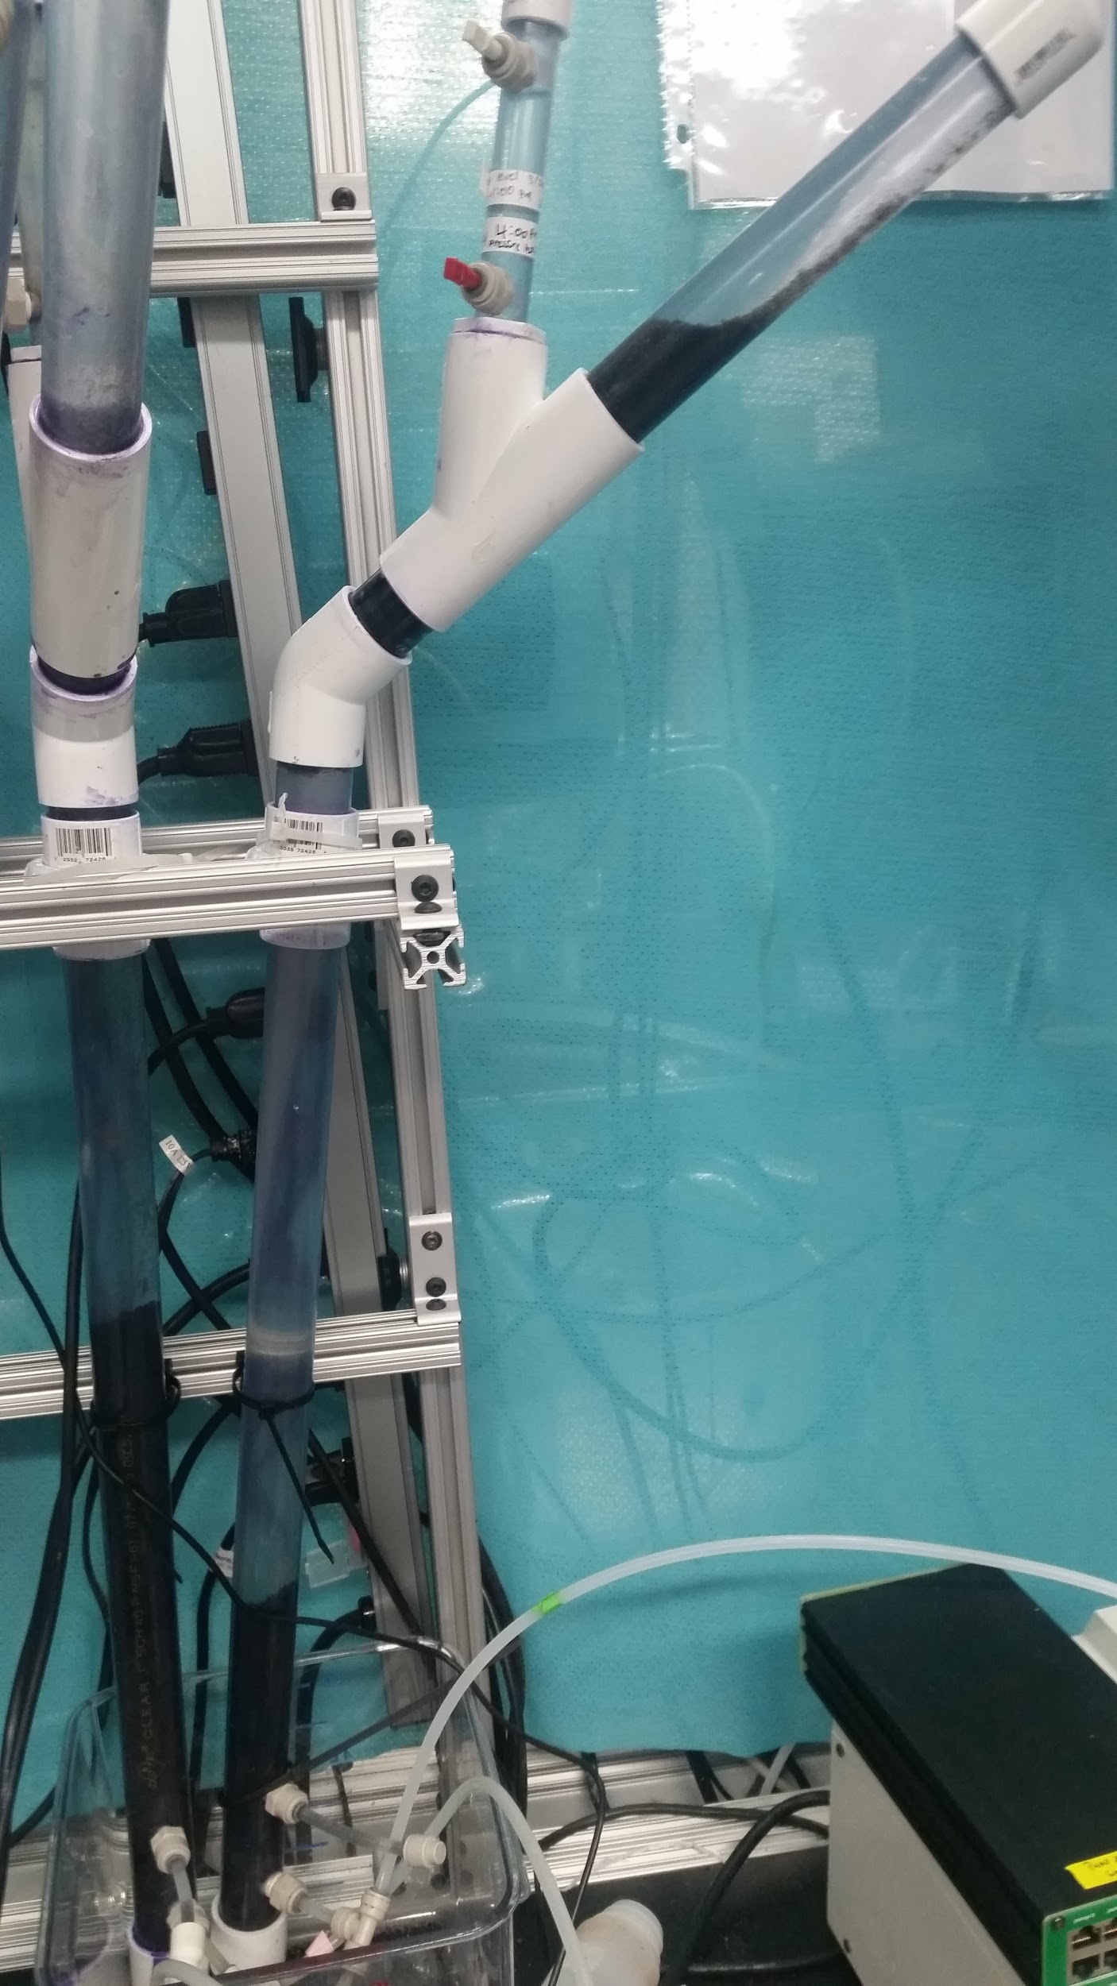
Drawbacks of New Design
UASB | Research | Final Presentation Spring 2016
Notes:
Rising plugs of granules- Air cannot navigate through the densely packed granules and causes plugs of them to rise up the body of the reactor. The narrow body of the reactor provides too much drag and overpowers the force of gravity

Slide 12
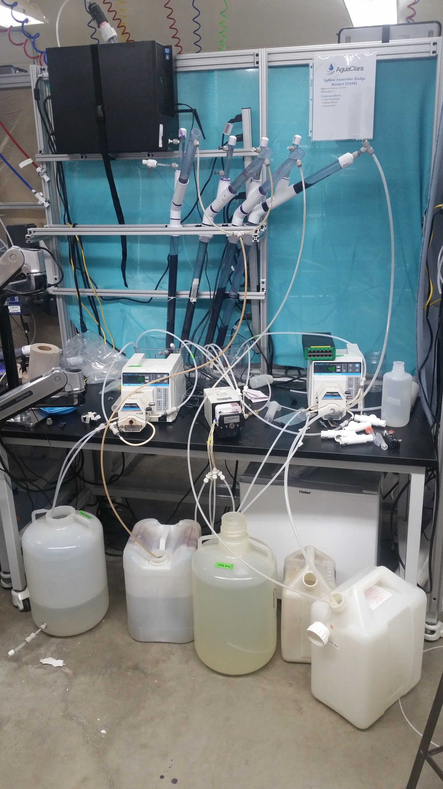
Drawbacks of New Design
UASB | Research | Final Presentation Spring 2016
Notes:
Daily maintenance- need to change influent and effluent tanks every 18 hours
Cluttered lab space

Slide 13
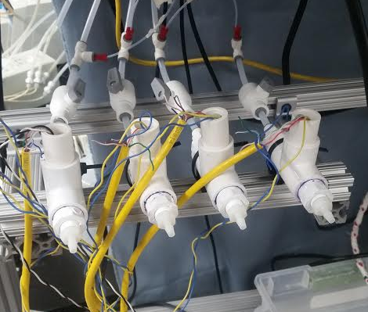
Future Improvements
Gas Collection!
UASB | Research | Final Presentation Spring 2016
Notes:
Efficient use of pumps
Reduced daily maintenance
Obstructions to breakup plugs

Slide 14
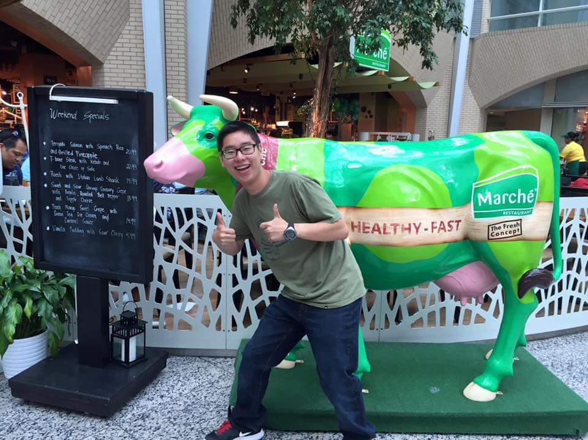
Future Work
Gas Collection and Experimentation!
UASB | Research | Final Presentation Spring 2016
Notes:
Reactors will used for research over the summer
Analyze effect of oxygen stress on culture resiliency, methane production, and COD treatment efficiency
Analyze the biomass response to a variable influent COD concentration and highly concentrated blackwater

Slide 15
Questions and
Recommendations
Mason Minot
M.S. CBE
mm2674@cornell.edu
Evan Greenberg
B.S. BEE
ecg77@cornell.edu

Slide 16

Thank You

Slide 17
Appendix
Slides

Slide 18
References
Svenkst Gasteknist Center AB (2012). Basic Data on Biogas. http://eks.standout.se/userfiles/file/BiogasSydost/BioMethaneRegions/BasicDataonBiogas2012-komprimerad.pdf
Aiyuk, S., Amoako, J., Raskin, L., Haandel, A., & Verstraete, W. (2004). Removal of carbon and nutrients from domestic wastewater using a low investment, integrated treatment concept. Water Research, 3031-3042.
Chong, S., Sen, T., Kayaalp, A., & Ang, H. (2012). The performance enhancements of upflow anaerobic sludge blanket (UASB) reactors for domestic sludge treatment – A State-of-the-art review. Water Research, 3434-3470.
Yu, H., Tay, J., Fang, H., (2001). The Roles of Calcium in Sludge Granulation During UASB Reactor Start-Up. Wat. Res., 4, 1052-1060.
Mes, T., Stams, A., Reith, J., Zeeman, G., (2003). Methane production by anaerobic digestion of wastewater and solid wastes. From Bio-Methane & Bio-Hydrogen: Status and Perspectives of Biological Methane and Hydrogen Production (Chapter 4).
Aiyuk, S., Forrez, I., Lieven, D., K., A, Haandel, A., Verstraete, W., (2006). Anaerobic and complementary treatment of domestic sewage in regions with hot climates - A review. Bioresource Technology, 97, 2225-2241.
Experimental Thermal and Fluid Science. (2006). Science Direct, 30(4), 329-336. Retrieved September 30, 2014, from http://www.sciencedirect.com/science/article/pii/S0894177705000993
Weber-Shirk, M. (2014, September 14). Flow Control and Measurement. Retrieved September 30, 2014, from https://confluence.cornell.edu/display/cee4540/Syllabus
Botheju, D., Samarakoon G., Chen, C., Bakke, R. (2010) An Experimental Study on the Effects of Oxygen in Bio-gasification – Part 2. European Association for the Development of Renewable Energies, Environment and Power Quality. http://www.icrepq.com/icrepq'10/732-Botheju.pdf
UASB | Research | Final Presentation Spring 2016
Notes:
Cite your sources here.
Caption your figure and explain its relevance to your presentation/thesis here. You can take the caption from your Final Report and modify it.
Write a summary of this slide here. A future team member or client should be able to read this note and understand this slide without having your team explain it to them.
If there are any appendix slides that are relevant to this slide, mention it in your notes.

Slide 19
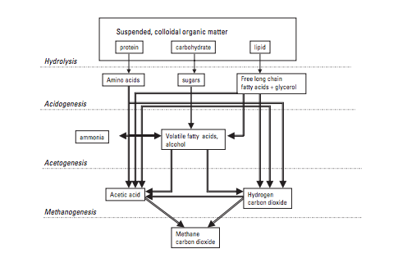
COD Processing Within Granules
(Mes et. al 2003)
UASB | Research | Final Presentation Spring 2016
Notes:
Cite your sources here.
Caption your figure and explain its relevance to your presentation/thesis here. You can take the caption from your Final Report and modify it.
Write a summary of this slide here. A future team member or client should be able to read this note and understand this slide without having your team explain it to them.
If there are any appendix slides that are relevant to this slide, mention it in your notes.

Slide 20
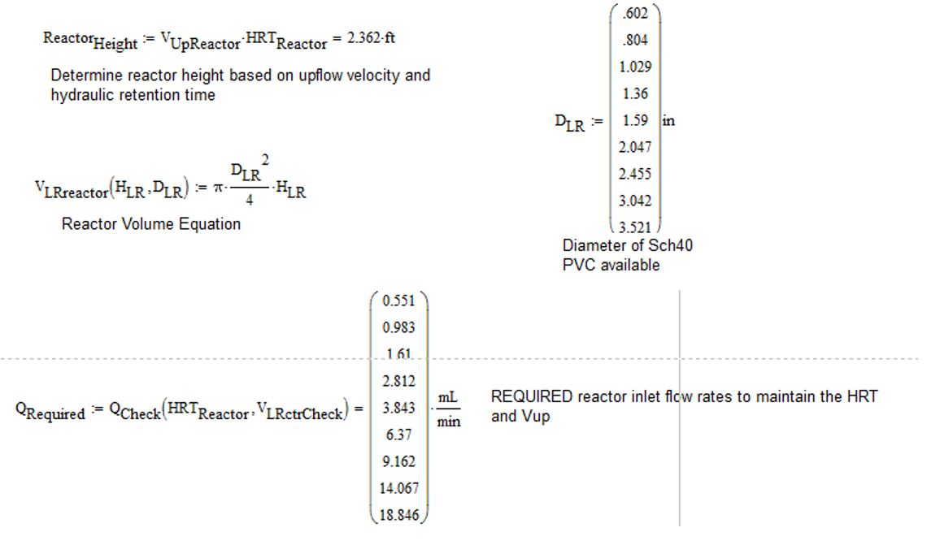
Mathcad Design
UASB | Research | Final Presentation Spring 2016
Notes:
Cite your sources here.
Caption your figure and explain its relevance to your presentation/thesis here. You can take the caption from your Final Report and modify it.
Write a summary of this slide here. A future team member or client should be able to read this note and understand this slide without having your team explain it to them.
If there are any appendix slides that are relevant to this slide, mention it in your notes.

Slide 21
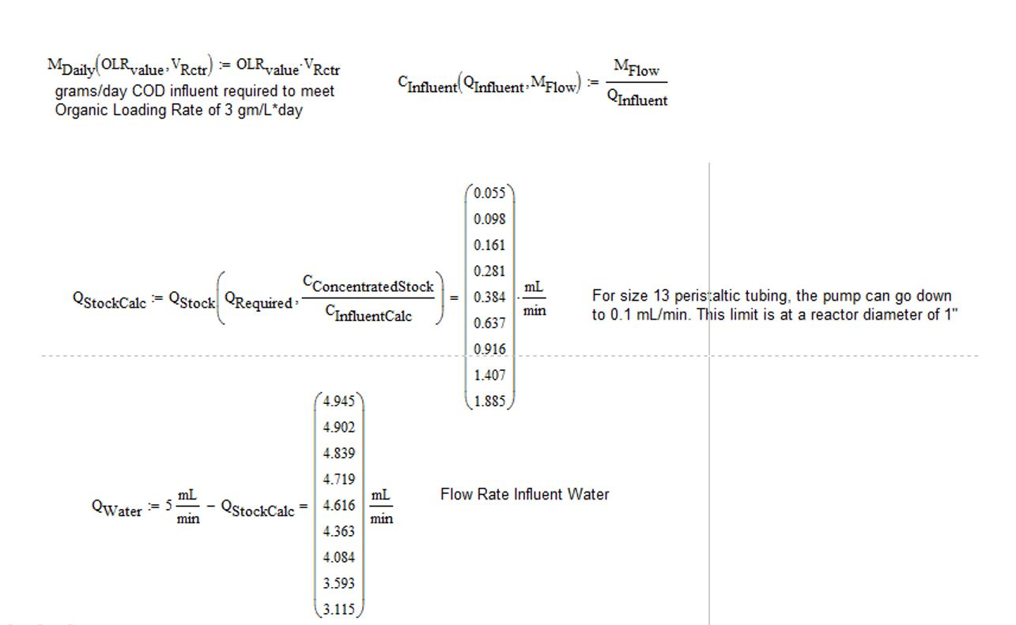
Mathcad Design
UASB | Research | Final Presentation Spring 2016
Notes:
Cite your sources here.
Caption your figure and explain its relevance to your presentation/thesis here. You can take the caption from your Final Report and modify it.
Write a summary of this slide here. A future team member or client should be able to read this note and understand this slide without having your team explain it to them.
If there are any appendix slides that are relevant to this slide, mention it in your notes.

