Slide 1
Upflow Anaerobic Sludge Blanket Reactors
Zoe Maisel, Evan Greenberg, Yi Guo, Mason Minot

Slide 2
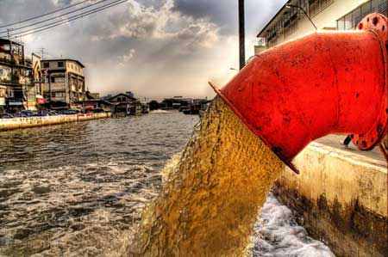
Wastewater Around the World
“Up to 90% of wastewater in developing countries does not undergo treatment” [1]
Environmental and health hazard
https://www.laprogressive.com/dumping-wastewater-into-aquifers/

Slide 3
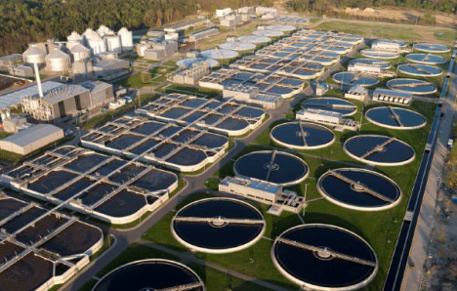
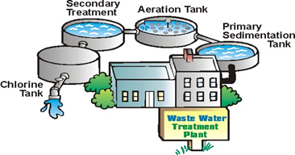
Current State of Treatment
Large capital and operational costs
Large energy demand
Difficult to handle lower flows

Slide 4
Alternative Treatment Goals
Low cost
Energy neutral/positive
Small scale treatment
(households to small communities)
Reduce biological sludge production

Slide 5
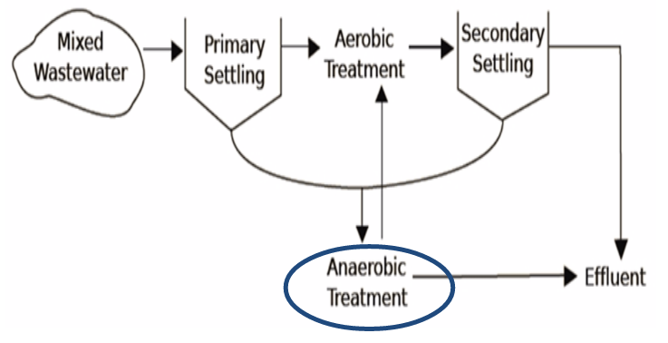
Proposed Treatment
Process Flow
Combining anaerobic and aerobic treatment can reduce the need for downstream processing

Slide 6
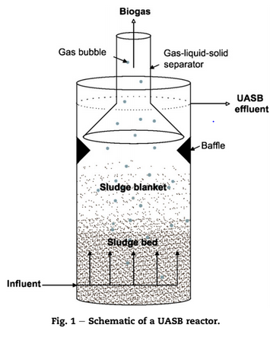
Upflow Anaerobic Sludge Blanket (UASB)
influent wastewater contains chemical oxygen demand (COD)
granular biomass of a mixture of bacterial species form a sludge bed and fluidized sludge blanket

Slide 7
Upflow Anaerobic Sludge Blanket (UASB)
granules process the COD to produce biogas (Methane and Carbon Dioxide)
biogas is captured by Gas-Liquid-Solid (GLS) separator

Slide 8
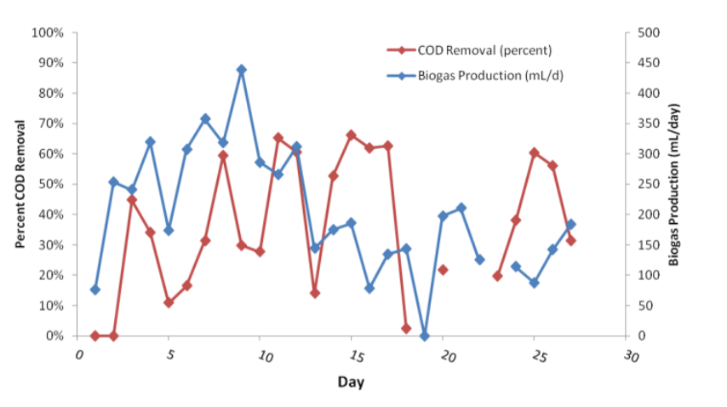
Previous Work and Challenges
Summer 2013 Goals and Challenges
  Remove COD, turbidity, and pathogens
  Energy neutral reactor through collection of biogas
  Challenges: Poor treatment efficacy
    Biomass washout, granular disintegration, scaling
Summer 2013 testing
Notes:
2 UASBs constructed: chosen because fits constraints of
Low flows; influent COD: 500 mg/L
Small footprint
Low Energy

Slide 9
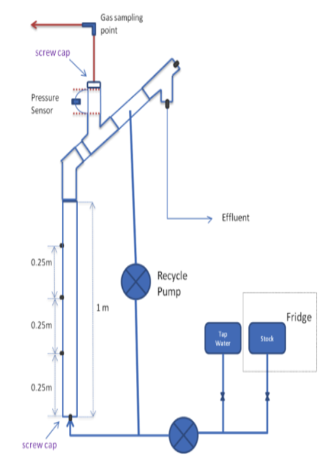
Previous Work and Challenges
Fall 2013 Goals and Challenges
  New gas chamber sealing method
  Models for particle fluidization and settling
  Dissolved methane tests
  Characterization of granules
    Confocal microscopy and chemical staining
  Challenges: inability to collect significant data for gas production
    Leaks, lengthy startup time
Fall 2013 Gas sampling method
Notes:
new gas chamber sealing method based on the coupling of a pressure sensor with process controller that would potentially only release accumulated biogas once a certain gas pressure has been reached.
fluidization velocity and settling velocity increase as granule diameter and density increase
dissolved methane escaping in effluent
confocal microscopy and chemical staining in an attempt to characterize the granules within the reactor. The group was able to identify regions within the granule involved in active DNA and RNA synthesis as well as groups of aggregated methanogens.

Slide 10
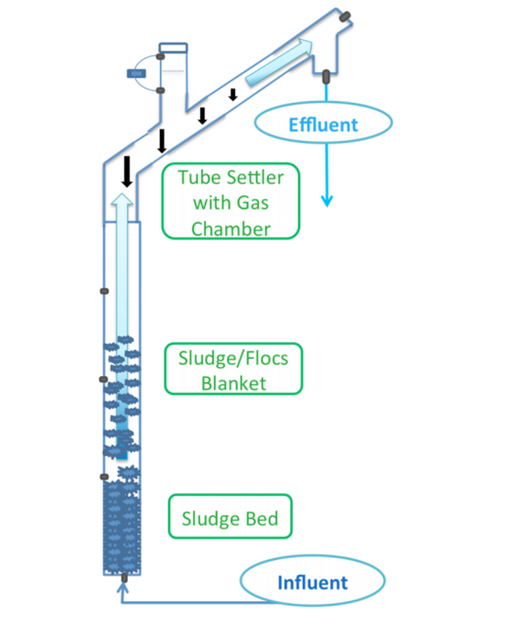
Previous Work and Challenges
Spring 2014 Goals and Challenges
  Gas chromatography to monitor methane production: Bag test
  Fixing leaks: Teflon tape, parafilm and epoxy
  Operational changes:
    Heating
    Double strength of wastewater
    Double hydraulic retention time (HRT)
    Reduce pump flow rate to half
  Challenges: inconsistencies between theoretical and experimental gas production, inconsistent COD feed concentration delivery, and vessel leakage

Slide 11
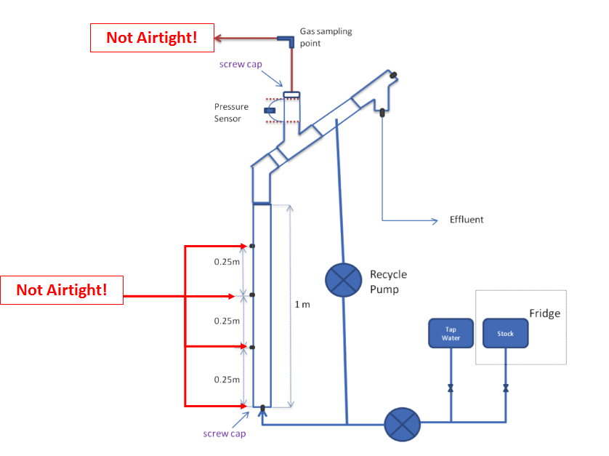
Semester Goals
Determine effectiveness of current design with respect to:
  treating influent COD
  producing biogas
  minimizing biogas losses due to leaks and dissolved methane.

Slide 12
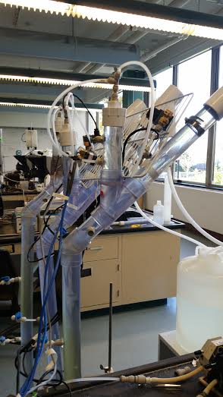
Methods
Testing Air Loss
-Soap Test: High pressure over short duration
-Pressure test: operational pressure over long duration
2. Valve Tests

Slide 13
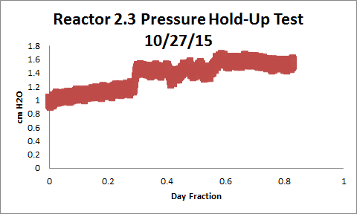
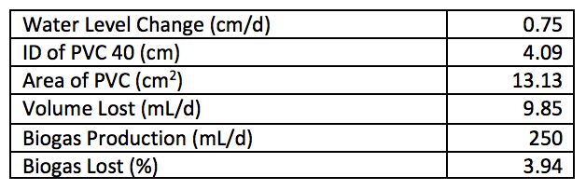
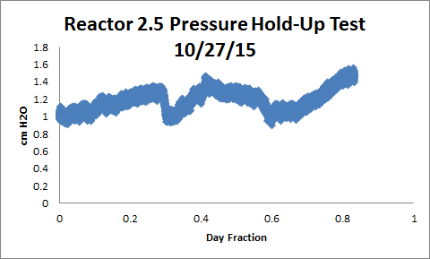
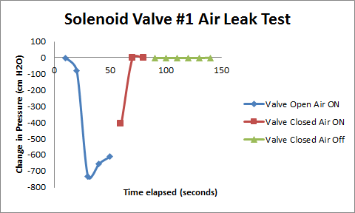
Air Loss and Valve Test Results

Slide 14
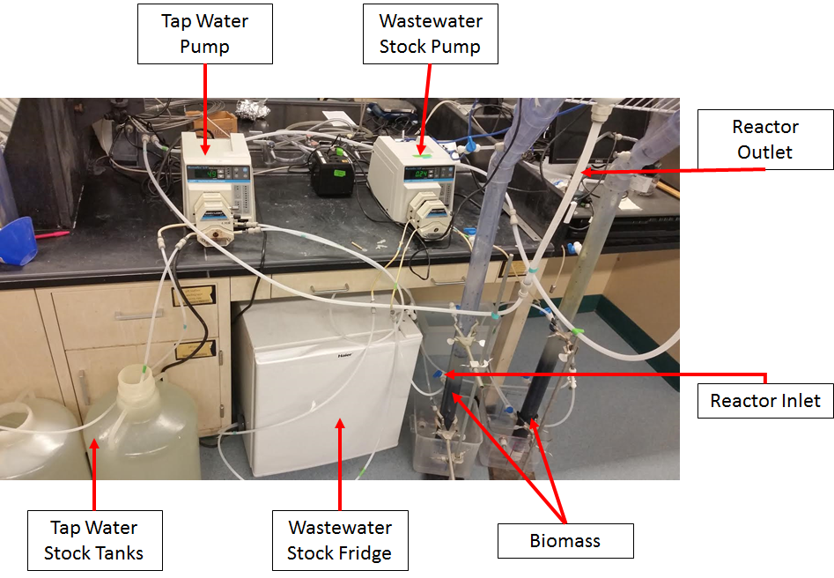
Methods
3. Preparation for inoculation
a. Tubing, Pumps,
Stock, Tanks, Fridge
b. Inoculation
4. Biogas Production Measurement

Slide 15
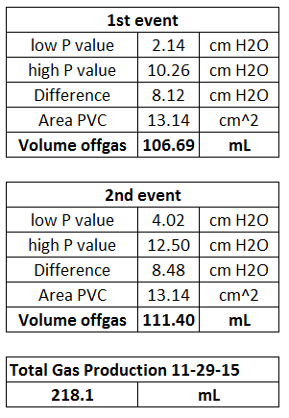
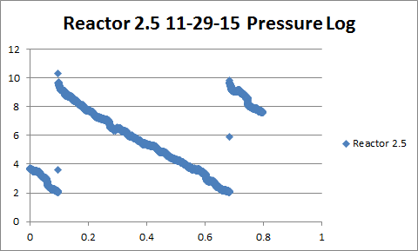
Biogas Production Results
Biogas Production Measurement

Slide 16
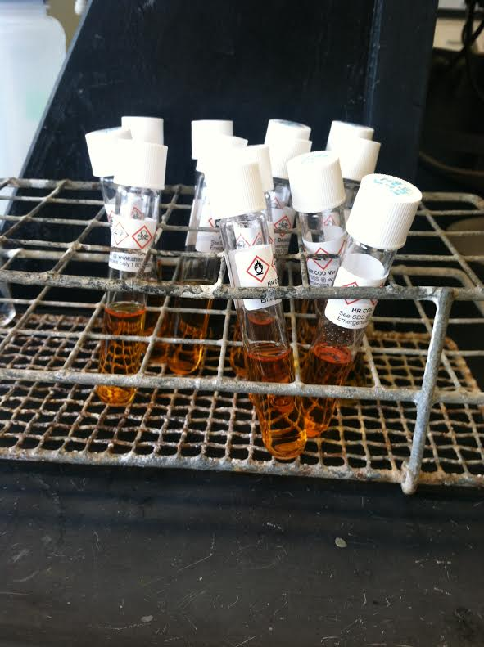
Methods
5. COD analysis
6. Gas Chromatography

Slide 17
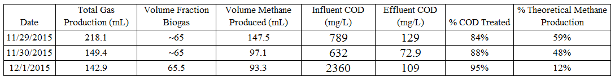
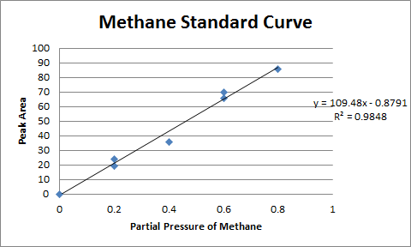
COD and GC Results

Slide 18
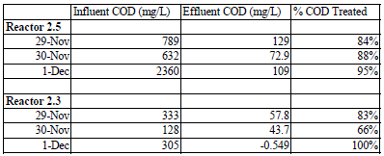
COD and GC Results
Reactor 2.5

Slide 19
Conclusions
Leaks quantified at ~4% theoretical biogas/day production
Instrumentation setup and reactors inoculated
Biogas production monitored via pressure sensor offgassing
COD removal quantified ~85%
Methane production ranged from 12-59% theoretical value

Slide 20
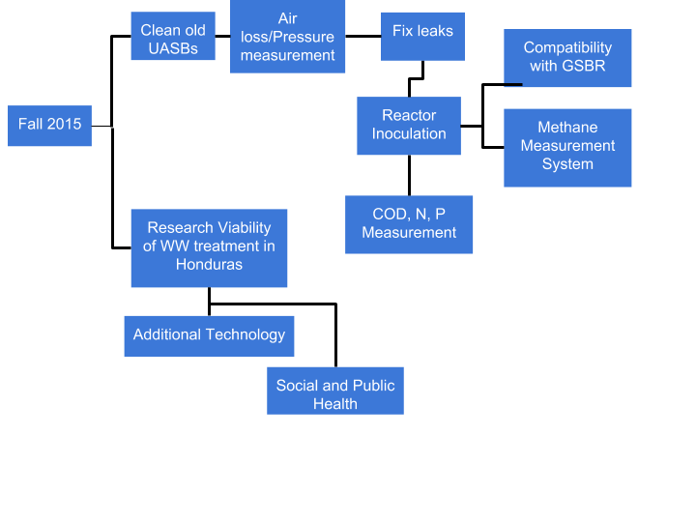
Challenges/Future Work

Slide 21
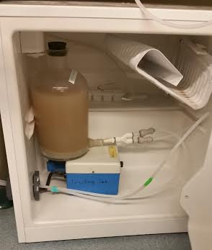
Future Work
Modify reactor design
  Air tightness
Wastewater stock delivery
Process Controller modifications

Slide 22
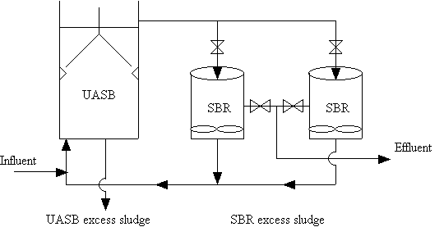
Future Work
UASB-GSBR coupling
UASB treatment of Nitrogen, phosphorus and, possibly, fecal indicator bacteria (harmless E.coli)
Oxygen stress tests

Slide 23
Questions/Comments?
Thank you!

Slide 24
References
http://epi.yale.edu/the-metric/help-us-improve-our-global-wastewater-indicator
http://www.filtsep.com/view/40993/wastewater-treatment-technology-for-developing-countries
Chong, S., Sen, T., Kayaalp, A., & Ang, H. (2012). The performance enhancements of upflow anaerobic sludge blanket (UASB) reactors for domestic sludge treatment – A State-of-the-art review. Water Research, 3434-3470.
Aiyuk, S., Amoako, J., Raskin, L., Haandel, A., & Verstraete, W. (2004). Removal of carbon and nutrients from domestic wastewater using a low investment, integrated treatment concept. Water Research, 3031-3042.
Yu, H., Tay, J., Fang, H., (2001). The Roles of Calcium in Sludge Granulation During UASB Reactor Start-Up. Wat. Res., 4, 1052-1060.
Mes, T., Stams, A., Reith, J., Zeeman, G., (2003). Methane production by anaerobic digestion of wastewater and solid wastes. From Bio-Methane & Bio-Hydrogen: Status and Perspectives of Biological Methane and Hydrogen Production (Chapter 4).
Aiyuk, S., Forrez, I., Lieven, D., K., A, Haandel, A., Verstraete, W., (2006). Anaerobic and complementary treatment of domestic sewage in regions with hot climates - A review. Bioresource Technology, 97, 2225-2241.
Experimental Thermal and Fluid Science. (2006). Science Direct, 30(4), 329-336. Retrieved September 30, 2014, from http://www.sciencedirect.com/science/article/pii/S0894177705000993
Weber-Shirk, M. (2014, September 14). Flow Control and Measurement. Retrieved September 30, 2014, from https://confluence.cornell.edu/display/cee4540/Syllabus

