Slide 1
Chemical Safety
Anna Doyle, Deniz Yilmazer

Slide 2
Introduction
New team
Goals:
  Aims to ensure safety of the workers in AguaClara plants
  Explain the use of proper PPE
  Demonstrate safety hazards and first aid measures
Why our research is important:
  Safer for employees
  Eliminate possible incidents
  Provide necessary steps in case of an accident
It will ensure that while providing safe drinking water, the safety of the workers is not compromised.
Notes:
-Why is our research important?
-What are our goals for the semester?
The chemical safety team is a new team that aims to ensure the safety of the people that are working in AguaClara water treatment plants, especially those who work with hazardous chemicals. The main focus of the team is to create training materials for the workers in the plants that explain the use of proper personal protection equipment. The team also aims to demonstrate the possible safety hazards that may arise if the workers do not use the safety equipment correctly. The first aid information regarding possible accidents will also be given importance in case of an emergency.
Completion of the challenge will make working in one of the AguaClara plants safer for the employees. It would eliminate possible incidents that may be damaging for people or the environment. It would also be effective in case of an accident by providing the necessary steps to deal with the problem with least damage. It will ensure that while providing safe drinking water, the safety of the workers are not compromised.

Slide 3
Existing Materials
Notes:
-What do the existing safety training materials look like?
-Operators’ Manual includes presentation on hygiene and occupational safety
-presentation includes safety controls, occupational safety laws, exercises to help emphasize safety in/around the plants
-Features we will be keeping/getting rid of
-Will be keeping fire diamonds/charts, getting rid of photos of employees /safety hazards
-Emphasize that we are not replacing this manual, simply adding onto it

Slide 4
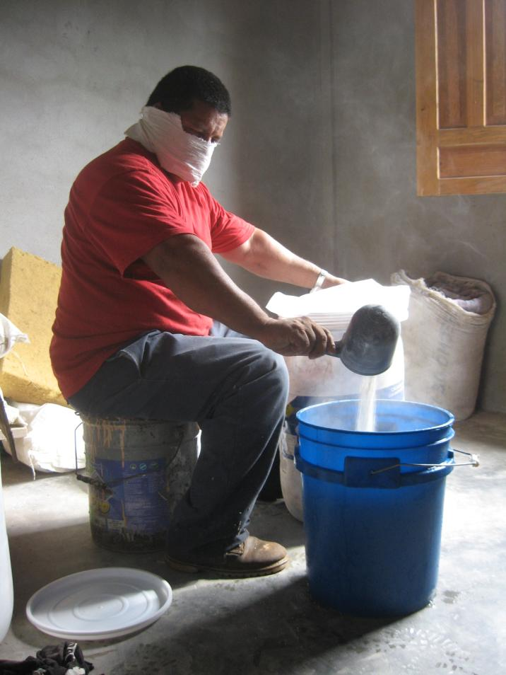
¿Cuáles riesgos ves en la mezcla de cloro en Támara?
Notes:
We will be removing photos such as this one from our training materials. It is possible that if a trainee were to see this, he or she would think that because this worker is not wearing the required PPE, it is acceptable for him/herself to do the same.

Slide 5

El “Diamante de Fuego”
Fuego
Explosiones
Nos dice los riesgos de un material por color
Salud
Especial
Notes:
Some slides from the original training manual that we will be re-using in our training materials: This one, which describes the concept of a “fire diamond”

Slide 6
Número | Fuego | Salud | Explosión
0 | No quema | Sin riesgo | Estable, no causa explosiones
1 | Se tiene que calentar para encenderse | Exposición sólo causa daños menores | Normalmente estable
2 | Calentar o ser expuesto a temperaturas altas para encenderse | Exposición continua causaría discapacidad temporal | Explota a temperaturas altas y reacciona con agua
3 | Se enciende fácilmente a temperaturas ambientales | Exposición menor causa problemas graves | Se puede detonar con un choque fuerte
4 | Se inflama fácilmente | Exposición rápida causa muerte o problemas graves | Se puede detonar a temperaturas normales
MÁS PELIGROSO
Notes:
This one describes the range of possible values for each section of the fire diamond, and what each value means in terms of safety hazards.

Slide 7
Our Additions
Notes:
-How is our training manual different than what AguaClara/APP plant operators have been using?
-information regarding the hazards and the proper use of ppe
-Where did we get our information from?
-MSDS for PAC

Slide 8
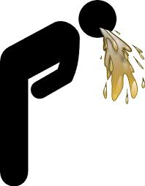
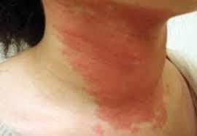
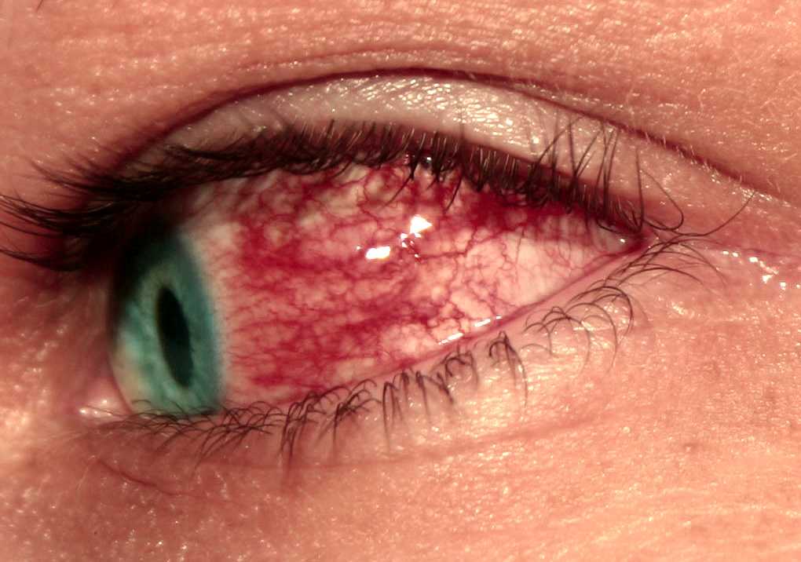


Peligros Para la Salud
Inhalación: Irritación respiratorio
Ojos: Irritación
Piel: Irritación
Ingestión: Náusea, vómito, diarrea, problemas gastrointestinales

Slide 9
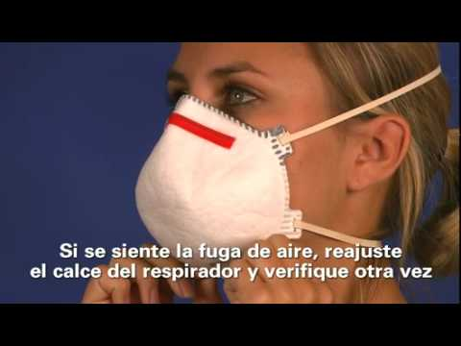
Seguridad de las Máscaras de Respiración

Slide 10
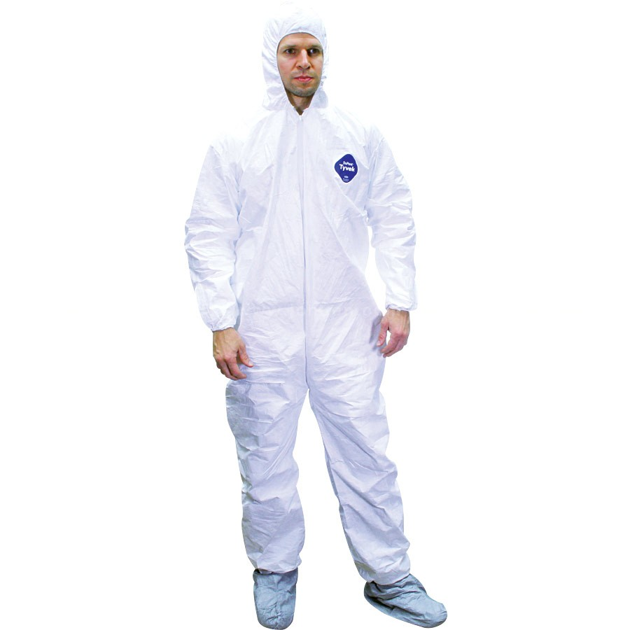
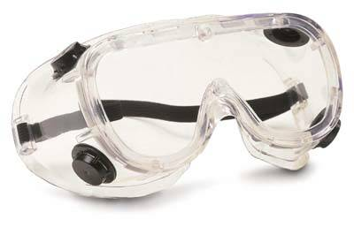
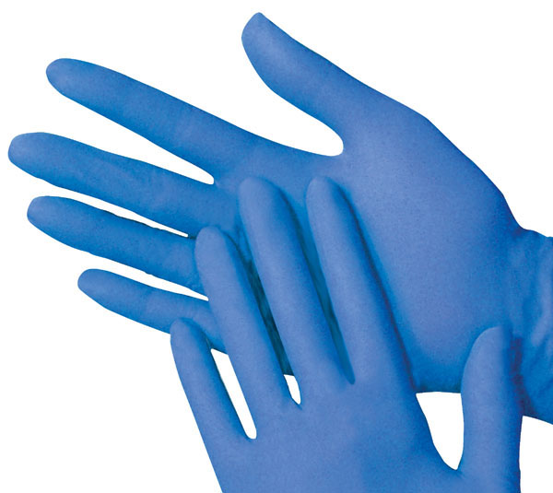
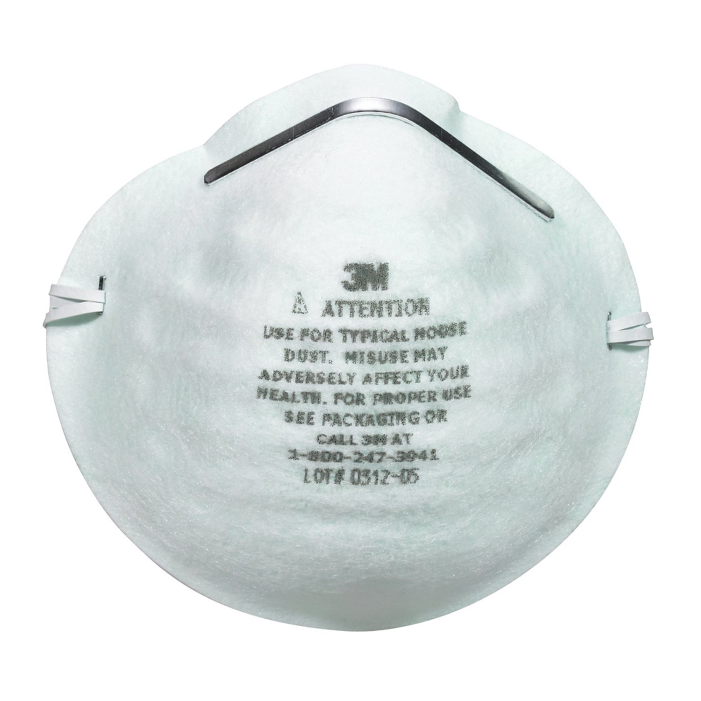
Protección Personal Requerido
Ojos: Gafas de seguridad
Manos: Guantes hechos de Neopreno, goma, o butyl
Cuerpo: Ropa que no deja la piel exposido, trajes desechables hechos de fibra

Slide 11
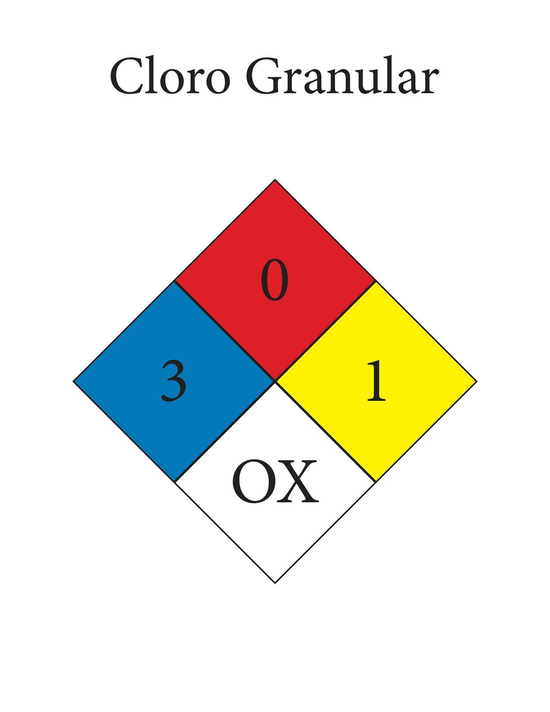
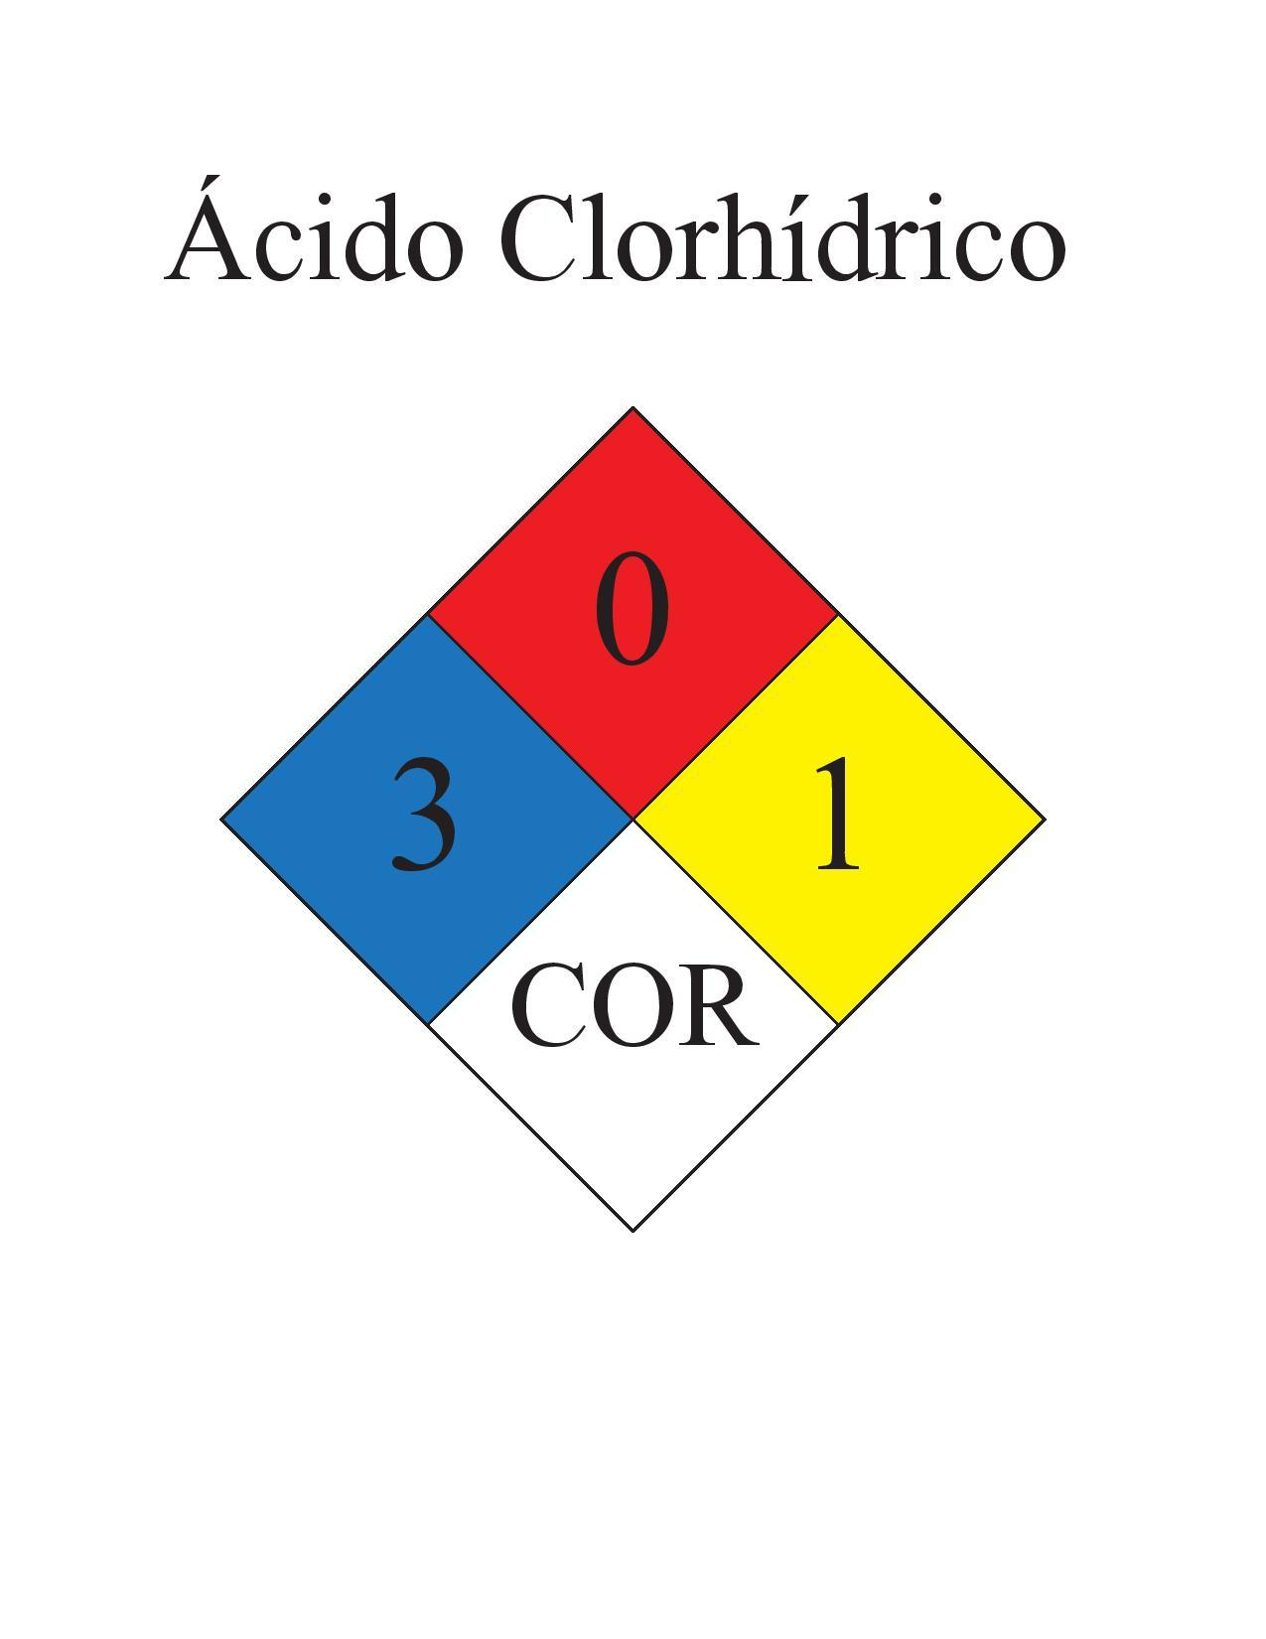
Cloro Granular
Ácido Clorhídrico

Slide 12
Artículo 380
Los trabajadores que utilicen estos productos estarán capacitados según su actividad sobre las siguientes áreas: toxicidad de los compuestos utilizados, vías de absorción, manipulación de productos concentrados y formulados, métodos de aplicación, limpieza y mantenimiento de equipo, precauciones para evitar la contaminación de otras sustancias, alimentos, ropa y abastecimientos de agua, signos y precoces de intoxicación, medidas de primeros auxilios, medidas de protección individual y colectiva, deposición y eliminación de residuos y protección al medio ambiente.

Slide 13
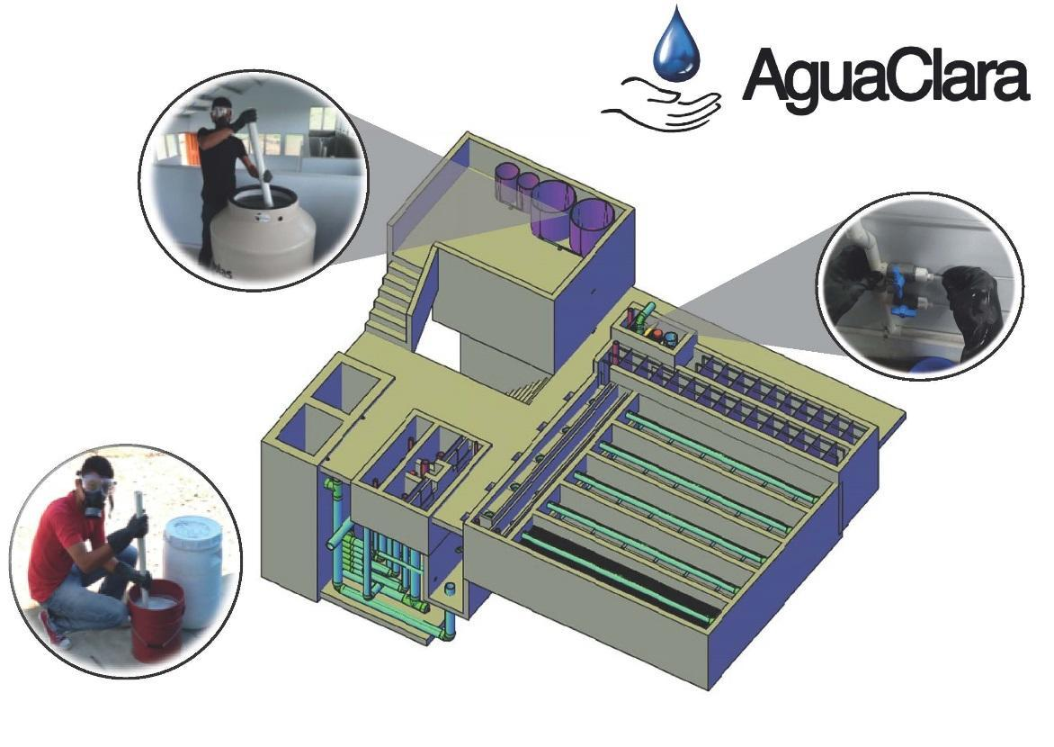
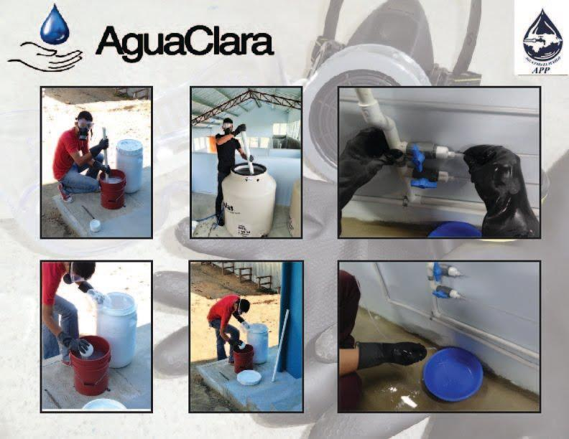
Posters

Slide 14
The Shoe Controversy
Shoes cover the feet so that in case of a spill corrosion is minimized
However, it also makes it harder for the affected area to be rinsed immediately
Therefore there is a trade-off between the coverage and the rapid first aid
Our analysis of the concentrations used in AguaClara plants showed that it is not strictly necessary to wear closed-toed shoes
The chlorine used is even less concentrated than household bleach!

Slide 15
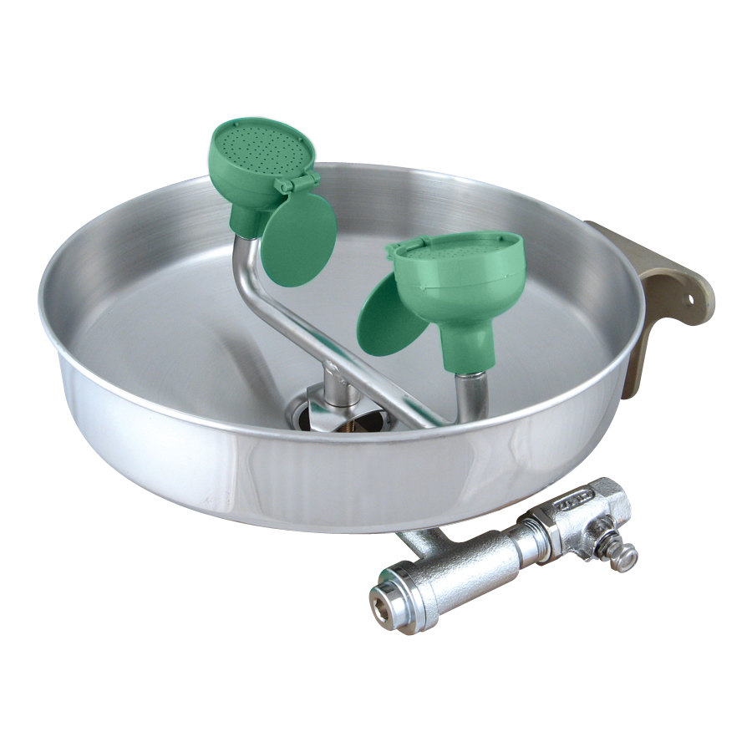
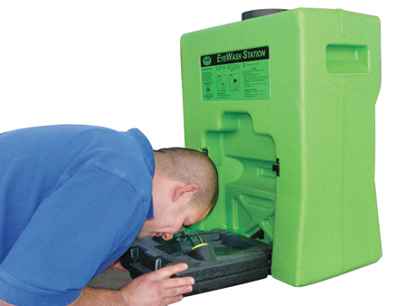
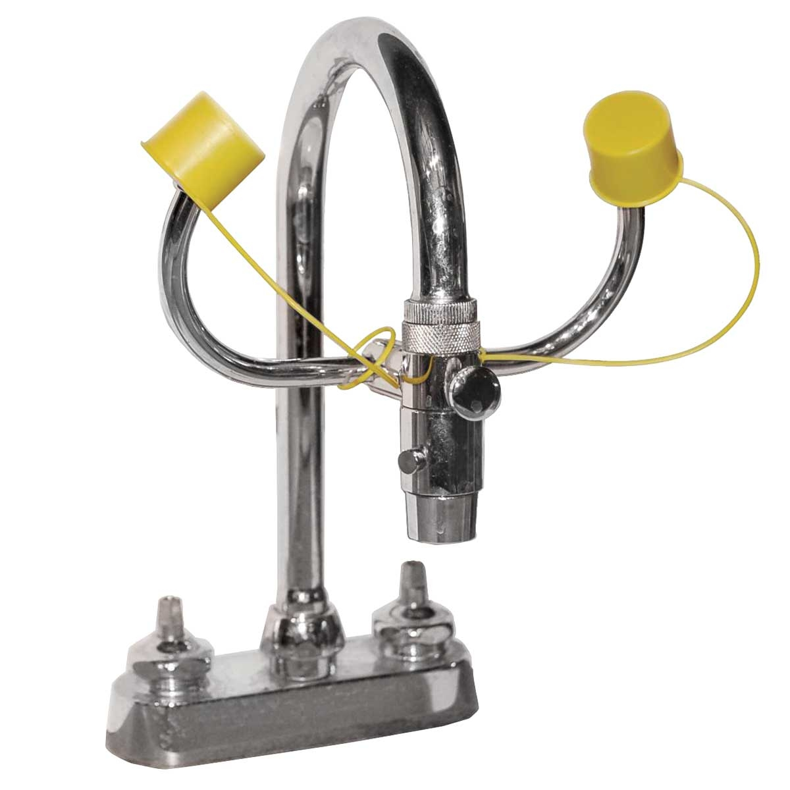
Eye Washes
There are no eye washes in AguaClara plants at the moment.
Three options:
Wall Mounted Eyewash
Self Contained Eyewash
Sink Attachment

