Slide 1
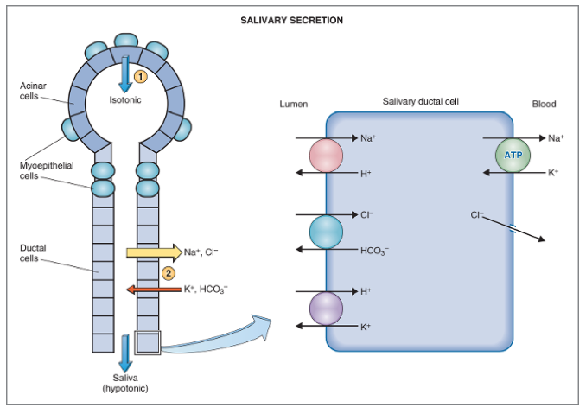
Notes:
Typical salivary gland with its acini and salivary duct.
The acini will secrete a primary secretion that contains ptyalin (for digestion of PT) and/or mucin in a fluid with a similar composition as that of ECF.
Then the saliva will flow through the salivary duct and there will be an active reabsorption of sodium and active secretion of potassium, passive absorption of chloride and secretion of HCO3.
The final composition of saliva will be hypotonic containing high concentration of potassium and bicarb, and low concentration of NaCl.
Salivary secretion is under the control of a nervous stimulation, primarily parasympathetic, Blood supply also affects salivation, with increase in BF to the salivary glands (which is important to bring the nutrients necessary for the composition of saliva) also increasing salivation

Slide 2
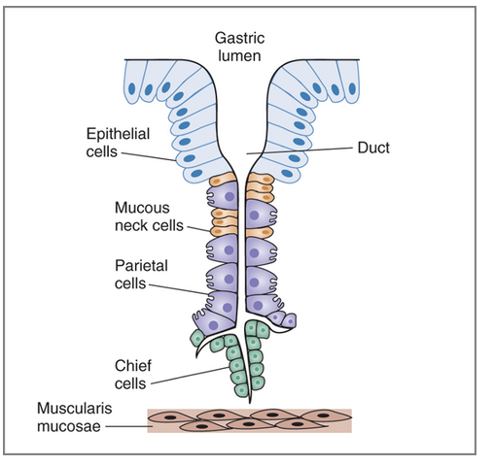
Notes:
This is the schematic of a typical gastric gland composed of 4 types of cells important in gastric secretion: mucous cells, parietal cells and chief cells.

Slide 3
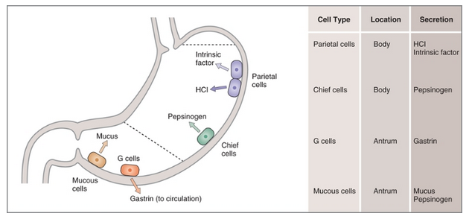
Notes:
The proportion of each type of cells is dependent on the location in the gastric wall.
At the level of the antral portion of the stomach, we find pyloric glands and those are mainly composed of mucus cells, a lower number of parietal and chief cells, and also contain G cell.

Slide 4
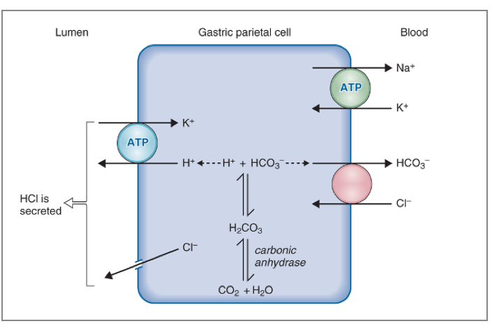
Notes:
The mechanism of HCl secretion is shown in this picture.
The first step will be the formation of H+ and bicarb from water and CO2. H+ is then actively secreted into the lumen through the H+/K+ ATPase pump.
HCO3 will be reabsorbed into the blood in exchange of chloride.
Chloride will be secreted into the lumen through chloride channels
Presence of hydrogen and chloride in the lumen will lead to the formation of HCL!

Slide 5
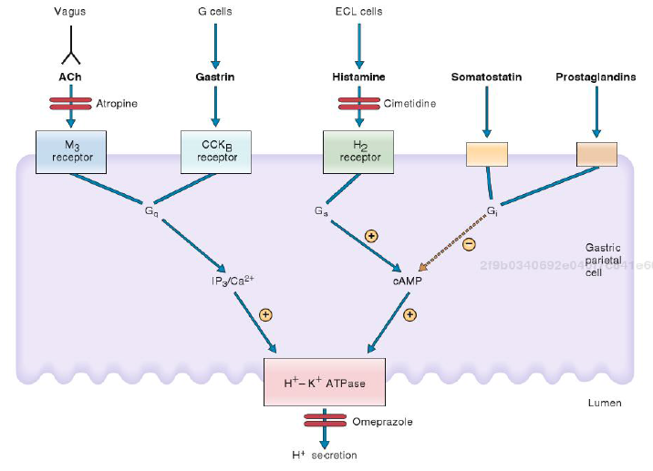

Slide 6
