Slide 1
Primary Hemostasis

Slide 2
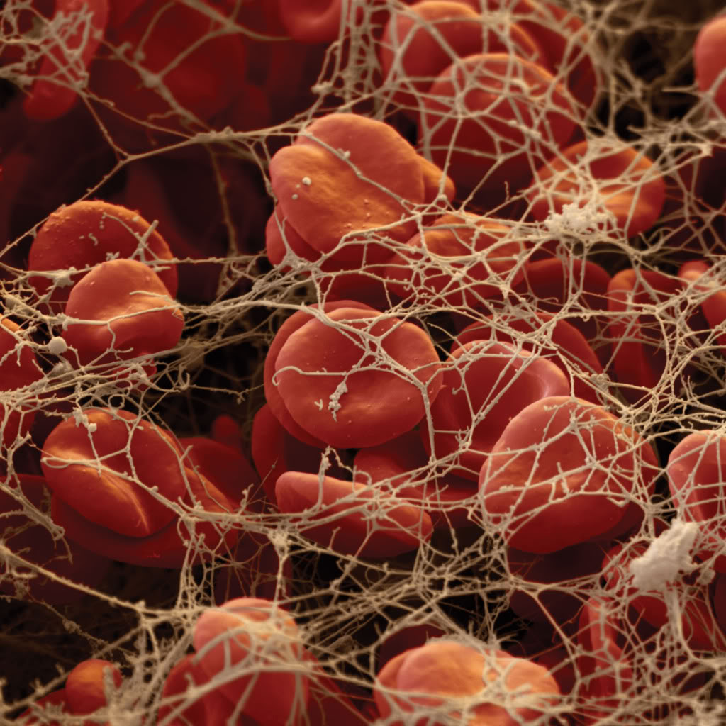
Hemostasis
Primary hemostasis
  Formation of the platelet plug
Secondary hemostasis
  Reinforcement of the platelet plug via a cross-linked fibrin meshwork
Fibrinolysis
  Clot breakdown

Slide 3
Vascular System
Smooth and continuous endothelial lining is designed to facilitate blood flow
Intact endothelial cells inhibit platelet adherence and blood coagulation
  Physical barrier between platelets and subendothelial collagen
  Constitutive expression of nitric oxide synthase and arachidonic acid
  Production of NO and prostacyclin
    Vasodilatory and antiplatelet activity

Slide 4
Vascular System
Injury to endothelial cells promotes localized clot formation
  Vasoconstriction
    Narrows the lumen of the vessel to minimize the loss of blood
    Brings the hemostatic components of the blood (platelets and plasma proteins) into closer proximity to the vessel wall
  Decreased production on platelet antagonists

Slide 5
Primary Hemostasis
Formation of a platelet plug
  Interaction of platelets, damaged endothelium and subendothelial collagen
‘Plug off’ small injuries
  Microvessels (< 100 μm)
  Mucosal tissues
    Respiratory, gastrointestinal, genitourinary tracts
Establish local factors necessary for secondary hemostasis

Slide 6
Platelets
Average lifespan of 6 days (canine)
Production stimulated by thrombopoietin
  Synthesized in bone marrow and smooth muscle cells
  Elimination from the circulation occurs via adsorption onto platelets
  Negative feedback mechanism
Nonviable or aged platelets removed by spleen & liver
2/3 of platelets circulate in the peripheral blood
1/3 are sequestered in the spleen
Spontaneous hemorrhage <10,000-30,000plt/μL

Slide 7
Platelet Anatomy
Alpha granules
  Platelet derived growth factor, fibronectin, transforming growth factor b, b-thromboglobulin, platelet factor 4, fibrinogen, factors V and VIII, and von Willebrand factor
Delta (dense) granules
  ADP, ATP, histamine, epinephrine, serotonin, and calcium ions
Actin, myosin, thrombosthenin (contractile protein), mitochondria, enzyme systems (that form ADP, ATP, and prostaglandins), fibrin stabilizing factor (factor XIII), growth factors, endoplasmic reticulum, and golgi

Slide 8
Primary Hemostasis
Platelet adhesion to subendothelial collagen
  Indirectly via vWf (high shear stress)
  Directly (low shear stress)
Platelet activation
  Structural changes to platelets
  Recruitment of additional platelets to the injured site
Platelet aggregation
  Fibrinogen bridges between activated platelets

Slide 9
Platelet Adhesion
Endothelial injury
Exposure of subendothelial collagen
High shear stress conditions
  vWF attachment to subendothelial collagen
  Platelet binding to vWF: collagen complex
Low shear stress conditions
  Direct binding to subendothelial collagen
  Platelet binding independent of vWF

Slide 10
von Willebrand Factor
Synthesized by megakaryocytes and endothelial cells
  Small vWF multimers are constitutively synthesized, and released into circulation
  Large vWF multimers stored within secretory vessels
    Megakaryocytes, platelets: alpha granules
    Endothelial cells: Weibel-Palade bodies
Release stimulated by multiple factors
  Thrombin, fibrin, vasopressin, collagen, PAF, epinephrine, histamine

Slide 11
von Willebrand Factor
‘Bridging molecule’ at sites of vascular injury
  Platelets:subendothelial structure complexes
  Platelet:platelet complexes
Promotes platelet aggregation
Carrier for factor VIII in the circulation
  Increasing the half-life of factor VIII 5x

Slide 12
von Willebrand Factor
Binds to subendothelial collagen
Each vWF monomer contains binding sites for collagen, GPIb, factor VIII, and other vWF monomers
Large vWF multimers have multiple binding sites
  Allows for multiple interactions with both platelet receptors and subendothelial structures
  May be prothrombotic

Slide 13
von Willebrand Factor
The normal half-life of circulating vWF is approximately 8 to 12 hours
vWF circulates as flexible 2nm thick strands in a tangled coil configuration
Under conditions of high shear stress, its structure becomes more linear
  Functional form for binding to the GPIb receptor
    GPIb receptor mediates platelet adhesion and aggregation
  This conformation allows for recruitment of platelets from circulation

Slide 14
von Willebrand Factor
Plasma vWF concentrations vary widely among normal individuals
In humans, the [plasma] of vWF is affected by the blood group of the individual
  Type O blood adults have ~25-30 percent lower levels of vWF than those with types A, B, or AB
  Identical portion of the carbohydrate present on vWF and blood groups, which influences vWF clearance?

Slide 15
Platelet Adhesion: High Shear Stress
Upon endothelial injury, vWF binds to exposed subendothelial collagen
  Release of factor VIII
Platelet binding (via receptor GPIb) to the vWF:collagen complex
Induces a conformational change and initiation of platelet activation

Slide 16
Platelet Adhesion: Low Shear Stress
Platelet adhesion to subendothelium via collagen, fibronectin, and laminin
Less stable bond (vs vWF)
Also results in platelet conformational change and activation

Slide 17
Platelet Activation
Shape change
Degranulation
Phospholipid membrane metabolism
Membrane flipping
Microvesiculation
Recruitment of additional platelets
Fibrinogen receptor activation

Slide 18
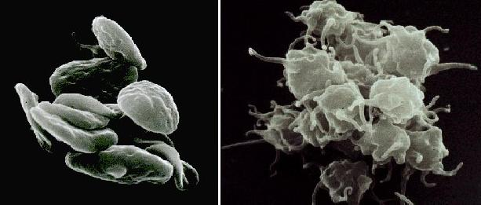
Platelet Activation
Shape change
  Elongated cells with cytoplasmic extensions
  Increased surface area

Slide 19
Platelet Activation
Degranulation of cytoplasmic granules
  α- granules
    vWF, fibrinogen: primary hemostasis
    Factor V, Factor XII: secondary hemostasis
    Adhesion molecules (P-selectin, platelet derived growth factor, fibronectin)
  Dense granules
    ADP, serotonin, calcium, ATP, histamine, epinephrine, serotonin

Slide 20
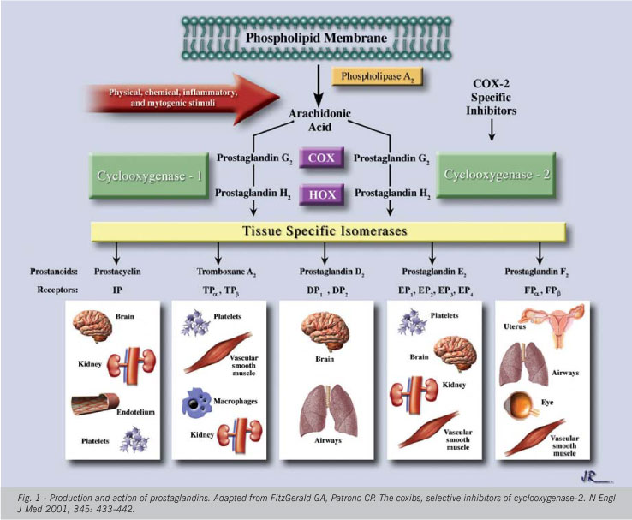
Platelet Activation
Phospholipid metabolism
  Activation of phospholipase_{A2} hydrolyzes membrane phospholipids (phosphatidylcholine) to arachadonic acid
  Activation of COX-1 pathway
    Thromboxane_{A2}
      Platelet agonist
      Vasoconstrictor

Slide 21
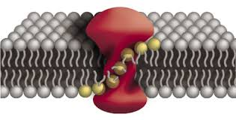
Platelet Activation
Membrane flipping
  Phosphatidylserine
    Normally maintained on the inner cell wall membrane
    Site for coagulation factor binding
    Amplifies coagulation factor activity
    Promotes fibrin formation
  ‘Flips’ to the outer cell wall membrane with platelet activation

Slide 22
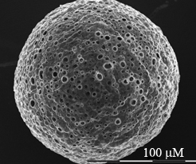
Platelet Activation
Microvesiculation
  Shedding of tiny microparticles enriched in phosphatidylserine from platelet membrane surfaces
  Increases the overall surface area of the platelets, thus providing a larger surface for fibrin formation

Slide 23
Platelet Activation
Recruitment of additional platelets via platelet agonists
  ADP, thromboxane_{A2}: Released by activated platelets
  Thrombin: Formed from activated coagulation factors
  Bind to surface receptors on platelets and trigger ‘outside-in’ signaling
    Activates the recruited platelets
Important platelet agonist receptors are:
  P2Y₁₂: ADP receptor
  Protease-activated receptors (PAR): Bind several agonists, but primarily thrombin

Slide 24
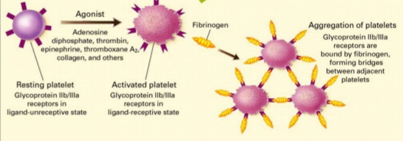
Platelet Activation
Activation of the fibrinogen receptor (GPIIb/IIIa)
  Unable to bind fibrinogen in an inactivated state
  With activation, GPIIb/IIIa changes conformation
  Fibrinogen is able to bind adjacent activated platelets

Slide 25
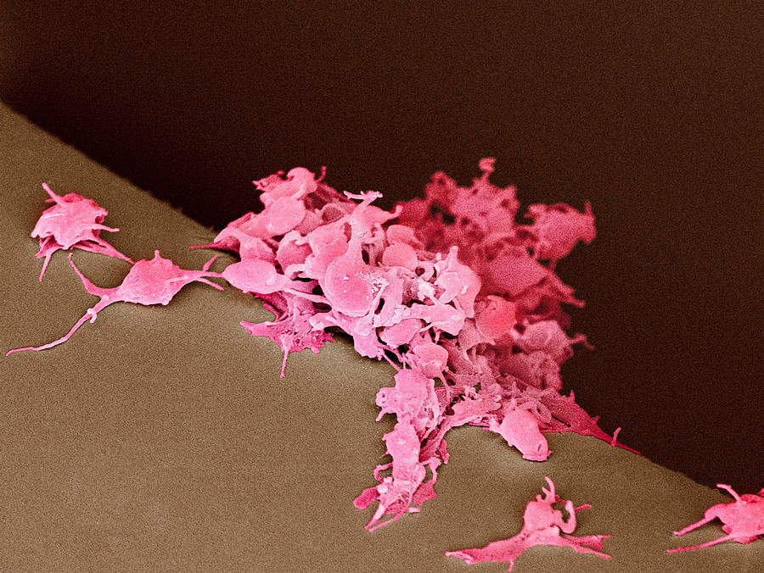
Platelet Aggregation
Mediated primarily by fibrinogen
Binds to GPIIb/IIIa receptor
Links platelets together, forming the primary plug

Slide 26
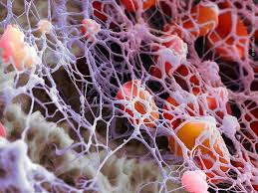
Secondary Hemostasis
Stabilization of the platelet plug
Fibrin crosslinking

Slide 27
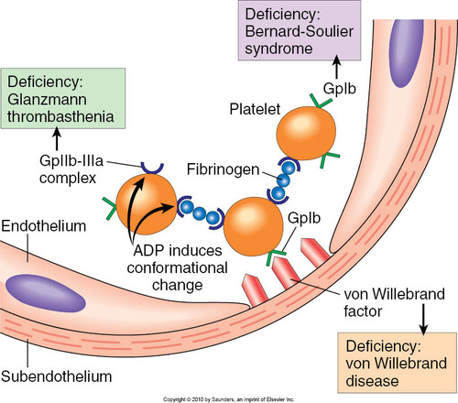
Overview

Slide 28
Syndromes Affecting Primary Hemostasis
Thrombocytopenia
Thrombocytopathia
Vasculitis/ endothelial disruption

Slide 29
Thrombocytopenia
Decreased platelet production
  Most common cause of thrombocytopenia in dogs, rare in cats
  Drug-induced, bacterial or viral infections, myelodysplasia, idiopathic
Sequestration
  Occurs with splenic diseases or splenomegaly
  Rarely hepatomegaly

Slide 30
Thrombocytopenia
Increased destruction
  Immune-mediated diseases, bacterial or viral infections, neoplasia, drug-induced
Consumption
  Disseminated intravascular coagulation
  Endotoxemia
    LPS sensitizes platelets to agonist stimulation
    Induces the accumulation of platelets in the blood vessels of certain organs such as the lung and liver
    Induces consumptive thrombocytopenia

Slide 31
Thrombocytopathia
Functional platelet defect
Acquired
  Ehrlichiosis, FeLV, envenomation, liver disease, neoplasia, uremia, drugs
  Bone marrow infection, hypoplasia or destruction
Inherited
    Von Willebrand disease (vWD)
    Most common inherited primary hemostatic defect (in dogs)

Slide 32
Thrombocytopathia
von Willebrand Disease
  Type 1 vWD: decreased concentrations of vWF (all multimers)
    Airedale Terrier, Akita, Corgi, Dachshund, Doberman Pinscher, GSD, Golden Retriever, Greyhound, Irish Wolfhound, Manchester Terrier, Poodle, Schnauzer, Shetland Sheepdog
  Type 2 vWD: normal concentration of abnormally functioning vWF
    German Shorthaired Pointer, German Wirehaired Pointer
  Type 3 vWD: absent circulating vWF
    Chesapeake Bay Retriever, Scottish Terrier, Shetland Sheepdog, Border Collie, Bull Terrier, Cocker Spaniel, Labrador Retriever, Pomeranian

Slide 33
Thrombocytopathia
von Willebrand Disease
  Spontaneous bleeding, petechiae and ecchymoses are rarely seen
  Rather patients bleed excessively during or after surgery, with teething or during estrus
  Perinatal death or abortions/ stillbirths are common in litters with vWD

Slide 34
Endothelial Damage or Vasculitis
Infection
  Endotoxin, Rickettsia rickettii, Leishmania, FIP, heartworm disease
Heatstroke, drug toxicity, immune-mediated disease or neoplasia
Can lead to dysfunction or decreased numbers of endothelial adhesion receptors

Slide 35
Tests of Primary Hemostasis
Blood smear
Bone marrow biopsy
Tick-borne disease evaluation
Buccal Mucosa Bleeding Time
vWF:Ag Assay
PF-100
Thromboelastography
Flow cytometry

Slide 36
Blood Smear
Estimate of platelet number
  1 platelet/hpf = 12,000 to 15,000 plt/μL
  Breed specifics
    Greyhounds: 80,000 and 120,000/μL
    CKCS with macrothrombocytopenia: <50,000/μL
Platelet counts
  Less than 25,000/μL: common in dogs with immune-mediated thrombocytopenia (IMT)
  50,000 to 75,000/μL: more common in dogs with ehrlichiosis, lymphoma affecting the spleen, or rodenticide toxicity

Slide 37
Blood Smear
Relative platelet size
  Large platelets may indicate increased production or accelerated platelet turnover
  Cats have increased average platelet size
    May result in abnormal counts on automated counter
Evidence of DIC, concurrent IHA

Slide 38
Thrombocytopenia
Bone marrow biopsy
  Evaluate for megakaryocytes
PCR for tick borne disease
  Canine ehrlichiosis, Rocky Mountain spotted fever, cyclic thrombocytopenia, babesiosis, bartonellosis, FeLV, FIV

Slide 39
Buccal Mucosa Bleeding Time
Measurement of time until platelet plug formation is achieved
Often prolonged with platelet counts < 70,000/μl
If petechiae are present, a BMBT will not provide additional information
Highly user dependent and prone to error
  May miss up to 30% vWD
  Interoperator and intraoperator variability: up to 80%

Slide 40
vWF:Ag Assay
A measurement of the amount or concentration of vWF in a blood sample
Dogs having low plasma vWF:Ag (below 50%) are at risk for transmitting or expressing the vWD trait
Plasma vWF levels fluctuate from day to day in normal, healthy dogs
  Exaggerated during pregnancy or heat in bitches
  Any dog having a systemic illness
    Liver disease or inflammatory disorders
Puppies can be sampled as young as 6 to 8 weeks of age

Slide 41
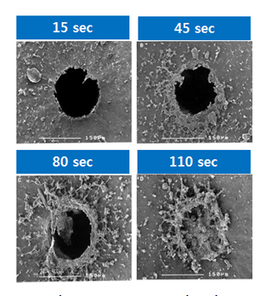
PF-100
Measure of platelet plug formation
Anticoagulated whole blood is passed through an opening in a biologically active membrane at a high shear rate
Platelet plug formation is induced
The time, in seconds, for blood to completely occlude the aperture is referred to as the Closure Time (CT)

Slide 42
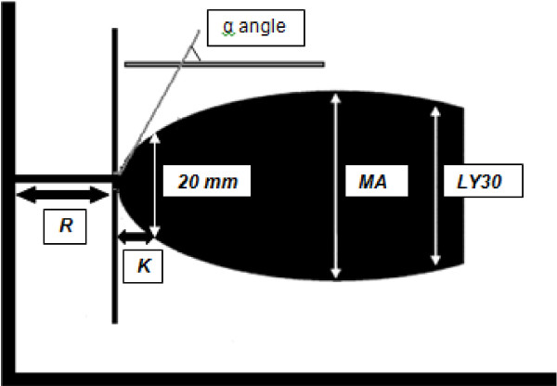
Thromboelastography
Provides a dynamic view of whole blood coagulation
Assessment of platelet function, clot strength, and fibrinolysis

Slide 43
Flow Cytometry
Platelet activation
  Determined by measuring components of either the alpha or dense granules
Rapid and sensitive test
Small sample volumes
  Neonate

Slide 44
Management
Minimal handling
25G needle for venipuncture, pressure bandage application for a minimum of 5 minutes
Acceptable ‘procedures’
  Peripheral IVC
  Bone marrow biopsy
  Splenectomy

Slide 45
Management of Thrombocytopenia
Platelet-rich plasma (PRP) or platelet transfusions
  The platelet count of the recipient is rarely raised enough to halt bleeding
  PRP and platelet transfusions are of no benefit in patients with peripheral platelet destruction because the platelets are removed from the circulation immediately after the transfusion
Vincristine
  Stimulates megakaryocyte endomitosis
  Results in early platelet release from the bone marrow
  Platelets are released prematurely and are not fully functional

Slide 46
Management of IMT
Immunosuppressive steroids
  Prednisone, dexamethasone
  Responses are usually seen within 24 to 96 hours
  Anecdotally, dexamethasone may have a higher incidence of upper GI ulceration
Cyclophosphamide
  Single dose, aid in inducing remission
Azathioprine
  Effective in maintaining remission, but not a good agent for inducing remission

Slide 47
Management of IMT
Intravenous immunoglobulin
  The mechanism by which hIVIG modulates the immune system is unknown
  The primary mechanism of hIVIG is hypothesized to be blockade of Fc receptors on mononuclear phagocytes, thereby inhibiting phagocytosis
Splenectomy
  If extravascular hemolysis is present

Slide 48
Management of IMT
Cats
  Chronic thrombocytopenia that does not lead to spontaneous bleeding is common
    Platelet count of 10,000 to 30,000/μL is relatively common
    Platelet counts do not increase markedly with treatment
  Concurrent regenerative or non- regenerative anemia, neutropenia, lymphocytosis, or combinations thereof
  Combination of dexamethasone and chlorambucil
  hIVIG

Slide 49
Management of vWD
All types
  Cryoprecipitate (CRYO)
    A small volume of fluid
    Increased factor VIII, fibrinogen, and vWF
Type 1
  Desmopressin (DDAVP)
    Causes a large release of vWF from endothelial cells
    Improves BMBT and PFA-100 times within 30 minutes of SC administration

Slide 50
Thromboembolic Therapies
Dissolving existing thrombi (thrombolytic drugs)
  Systemic thrombolytic drugs, local thrombolytic drugs, and mechanical or surgical extraction
Preventing new thrombus formation (antiplatelet drugs)
  Aspirin, clopidogrel, ticlopidine

Slide 51
Thrombolytic Therapies
Thrombolytic therapies
  Plasminogen activation, leading to the formation of plasmin
  Fibrin degradation
  Risk for bleeding, embolus
  Streptokinase, urokinase, TPA

Slide 52
Antiplatelet Therapies
Aspirin
  Inhibition of COX-1, resulting in decreased Thromboxane_{A2}
  production
  Thromboxane_{A2} is a potent platelet activation agonist and also causes vasoconstriction
  Effects seen at low dose ranges
  Side effects include GI upset, GI ulceration

Slide 53
Antiplatelet Therapies
ADP receptor antagonists (clopidogrel, ticlopidine)
  ADP is released from dense granules during platelet activation, and is itself a potent platelet activation agonist
    ADP is also found in RBC and endothelial cells
Non-competitive, irreversible
60-70% reduction in ADP binding
Maximal effect in 4-7 days
Side effects: diarrhea, rash

Slide 54
Questions?

