Slide 1
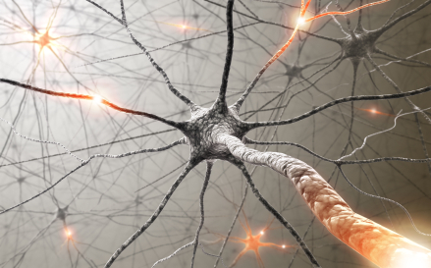


Physiology of Pain
Mariana A. Pardo
Emergency and Critical Care Resident
2016

Slide 2
Definition of Pain
Types of Pain
Causes of Pain
Nociceptive Pathway
  Types of Pain Transmission
4 Phases of Nociceptive Pain
  Pain Stimuli
  Afferent Fibers
  Ascending Pathways
  Gate Control Theory
  Descending Pathways
Summary
Pain Terminology

Slide 3
“an unpleasant sensory and emotional experience associated with actual or potential tissue damage or described in terms of such damage”
Definition of Pain

Slide 4
Types of Pain
Acute
Chronic
Occurs immediately after a stimulus is received
Severity can vary
Responds well to treatment
Subsides once stimulus is removed
Persists past initial stimulus (3-6 months)
Severity can vary
May or may not respond well to treatment; may require a “multi-modal” approach
Can result in allodynia, hyperalgesia, and opioid tolerance
Notes:
Allodynia: pain caused by a non painful stimulus
Hyperalgesia: exaggerated response to a painful stimulus

Slide 5

Causes of Pain
Inflammation of nerves (i.e.: trigeminal neuritis)
Injury of nerves with scar formation (i.e.: surgical damage)
Nerve invasion by cancer
Injury to thalamus or cortical areas that process pain information (i.e.: spinal trauma)
Abnormal activity in the nerve circuits that is perceived as pain (i.e.: phantom pain)
http://www.natural-dog-health-remedies.com/dog-back-problems.html
Notes:
Inflammation
Nerve damage and scarring
Nerve invasion by cancer
Damage to pain processing areas
Abnormal activity in nerve pathways

Slide 6
Nociceptive Pathway
Nociception: stimulation of sensory nerve cells called nociceptors, which produce a signal that travels along a chain of nerve fibers via the spinal cord to the brain
3 Neuron Pathway:
  1st neuron — the primary afferent neuron — transduction of noxious stimuli and conduction of signals from the peripheral tissues to neurons in the dorsal horn of the spinal cord.
  2nd neuron — the projection neuron — receives input from the primary afferent neurons and projects to neurons in the medulla, pons, midbrain, thalamus, and hypothalamus.
  3rd neuron — supraspinal neurons — integrate signals from the spinal neurons and project to the subcortical and cortical areas where pain is finally perceived
Notes:
Nociception does not necessarily mean Pain
Stimulation does not = Pain

Slide 7
Types of Pain Transmission

Slide 8
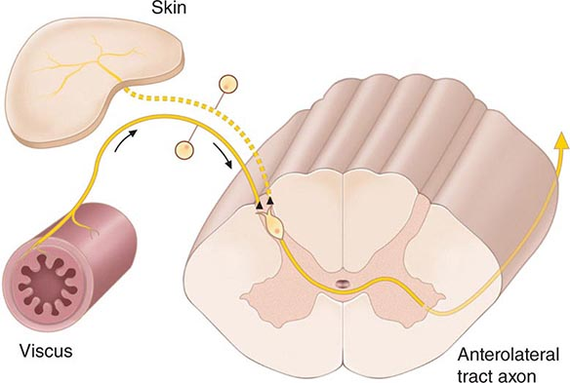
Visceral Nociceptor
Physiologic Structures: Organs and linings of body cavities
Mechanism: Activation of nociceptors
Characteristics: Poorly localized, diffuse, deep, cramping or splitting
Sources of Acute Pain: Chest tubes, abdominal drains, bladder and intestinal distention
Sources of Chronic Pain: Pancreatitis, liver metastases, colitis
http://clinicalgate.com/back-and-neck-pain/

Slide 9
Somatic Nociceptor
Physiologic Structures:
  Cutaneous: Skin and SQ tissues
  Deep Somatic: blood vessels, muscle, connective tissue
Mechanism: Activation of nociceptors
Characteristics: Well-localized, constant, achy
Sources of Acute Pain: Incisions, insertion site of tubes and drains, wound complications, orthopedic procedures, skeletal muscle spasms
Sources of Chronic Pain: Bony metastases, arthritis, low-back pain
http://clinicalgate.com/back-and-neck-pain/

Slide 10
Non-Nociceptor or Neuropathic
Physiologic Structures: Nerve fibers, spinal cord, CNS
Mechanism: Non-nociceptive injury to nervous system structures
Characteristics: Generalized along distribution of damaged nervous structures
Sources of Acute Pain: Poorly localized, shooting, burning, fiery, shock-like, sharp, painful numbness
Sources of Chronic Pain: Nervous tissue injury due to diabetes, chemotherapy, neuropathies, post-therapeutic neuralgia, trauma, surgery
http://clinicalgate.com/back-and-neck-pain/

Slide 11
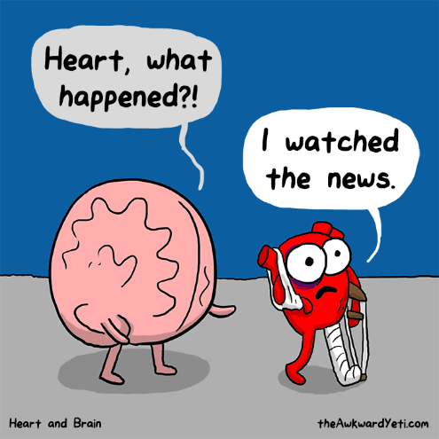
Psychogenic
Physiologic Structures: No organic structures
Mechanism: Emotional
Characteristics: Variable, often numerous
Sources of Acute Pain: Nonorganic
Sources of Chronic Pain: Nonorganic psychological factors
Notes:
Pain may be triggered by anticipation
“broken heart”

Slide 12
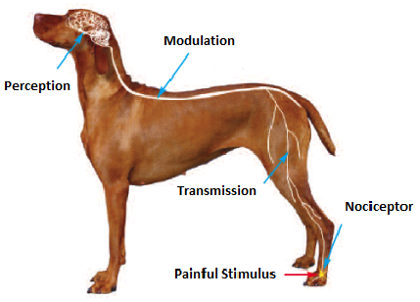
4 Phases of Nociceptive Pain
Transduction
Transmission
Perception
Modulation

Slide 13
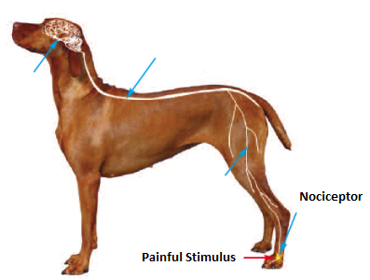
4 Phases of Nociceptive Pain
Transduction: substances are released by damaged tissues and lead to the generation of an action potential
  Chemical stimuli
  Thermal stimuli
  Mechanical stimuli
Notes:
Noxious stimuli triggers trasnduction

Slide 14
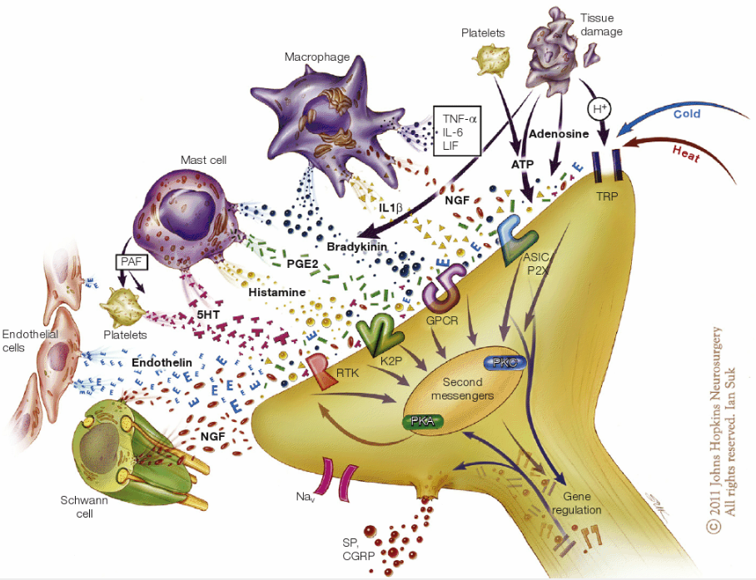
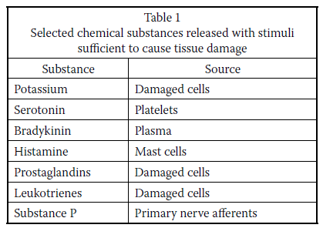
Chemical Stimuli
Patel, 2010
Ringkamp et al, 2013
Notes:
Also called inflammatory soup
Tissue injury and infection cause inflammation via plasma extravasation and infiltration of immune cells such as macrophages, T cells and neutrophils into the damaged tissue. The infiltrated immune cells and resident cells, including mast cells, macrophages and keratinocytes, release several inflammatory mediators, such as bradykinin, prostaglandins, H⁺, ATP, nerve growth factors (NGFs), pro-inflammatory cytokines (tumour necrosis factor (TNF; formerly known as TNFα), interleukin-1β (IL-1β) and IL-6) and pro-inflammatory chemokines (CC-chemokine ligand 2 (CCL2), CXC-chemokine ligand 1 (CXCL1) and CXCL5). Nociceptor neurons express the receptors for all of these inflammatory mediators, which act on their respective receptors on peripheral nociceptor nerve fibres. These receptors include G protein-coupled receptors (GPCRs), ionotropic receptors, and tyrosine kinase receptors, and their activation results in the generation of second messengers such as Ca²⁺ and cyclic AMP, which in turn activate several kinases, such as protein kinase A (PKA), PKC, calcium/calmodulin-dependent protein kinase (CaMK), phosphoinositide 3-kinase (PI3K) and the mitogen-activated protein kinases (MAPKs) extracellular signal-regulated kinase (ERK), p38 MAPK and JUN N-terminal kinase (JNK). Activation of these kinases causes hypersensitivity and hyperexcitability of nociceptor neurons (known as peripheral sensitization) through the modulation of key transduction molecules such as transient receptor potential cation channel subfamily A member 1 (TRPA1), TRPV1 and Piezo (a stretch-activated ion channel), as well as key conduction molecules such as the voltage-gated sodium channels Nav1.7, Nav1.8 and Nav1.9. Nociceptor neurons also express Toll-like receptors (TLRs; specifically, TLR3, TLR4 and TLR7), which can be activated by exogenous ligands (known as pathogen-activated molecular patterns, which include viral and bacterial components) and endogenous ligands (known as danger-activated molecular patterns, such as RNAs). Certain microRNAs (for example, let-7b) serve as novel pain mediators to activate nociceptors via TLR7, which is coupled to TRPA1 (the coupling is further enhanced when TLR7 is activated by let-7b). Bacterial infection with Staphylococcus aureus also directly activates nociceptors and induces neuronal hyperexcitability by releasing bacterial N-formylated peptides (FPs) and the formation of the pore-forming toxin α-haemolysin (α-HL). Activation of nociceptors also releases substance P and calcitonin gene-related peptide (CGRP), which are involved in the generation of neurogenic inflammation. CGRP also negatively regulates lymphadenopathy after inflammation. 4-HNE, 4-hydroxynonenal; 5,6-EET, 5,6-epoxyeicosatrienoic acid; ASIC, acid-sensing ion channel; FPR1, formyl peptide receptor 1; HETE, 5-hydroxyeicosatetraenoic acid; HMGB1, high mobility group protein B1; P2X3, P2X purinergic receptor 3; PGE₂, prostaglandin E₂; RTK, receptor tyrosine kinase.

Slide 15
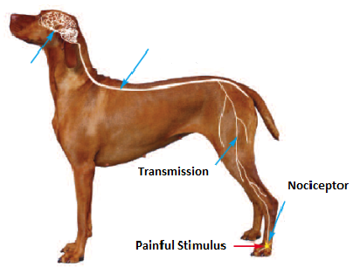
4 Phases of Nociceptive Pain
Transmission: action potential continues from the site of damage to the spinal cord, then ascends up the spinal cord to higher centers in the brain
  Peripheral afferent nociceptors
    A – β fibers
    A – δ fibers
    C – fibers
  Ascending Pathways – Spinal Cord
    Spinothalamic Tract – Pain and temperature
    Dorsal Column System – Touch and proprioception

Slide 16
Types of Primary Afferent Nerves

Slide 17
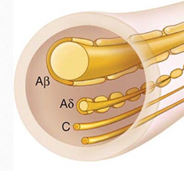
Primary Afferent Nerves:
A-β Nociceptor:
Activated by light touch and/or moving stimuli
Largest of the myelinated nerves 6-22 μm diameter
Fast with a conduction velocity of 33-75 m/s
Primarily in skin, normally don’t produce pain

Slide 18
Primary Afferent Nerves:
A-δ Nociceptor:
Activated by mechanical and thermal stimuli
Smallest of the myelinated nerves 2-5 um diameter
Fast with a conduction velocity of 6-30 m/s
Short-lasting, pricking-type pain

Slide 19
Primary Afferent Nerves:
C Nociceptor:
Activated by mechanical, chemical and thermal stimuli
Unmyelinated nerves 2 um diameter
Slow conduction velocity of 0.5-2 um/s
Dull, poorly localized, burning type pain

Slide 20
Primary Afferent Nerves:
C Nociceptor:
Divided into 2 classes:
Peptidergic: expression of neuropeptides
  Substance P
  Calcitonin gene related peptide (CGRP)
  Neurokinin A
  Expresses receptors
Nonpeptidergic:
  Expresses several receptors for neurotrophic factors and ion channels

Slide 21
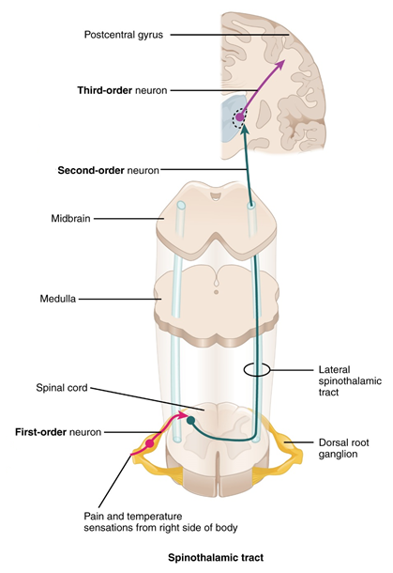
Ascending Pathways
Nociceptive fibers synapse with 2nd order neuron in the dorsal horn of the spinal cord.
http://philschatz.com/anatomy-book/resources/1417_Ascending_Pathways_of_Spinal_Cord.jpg

Slide 22
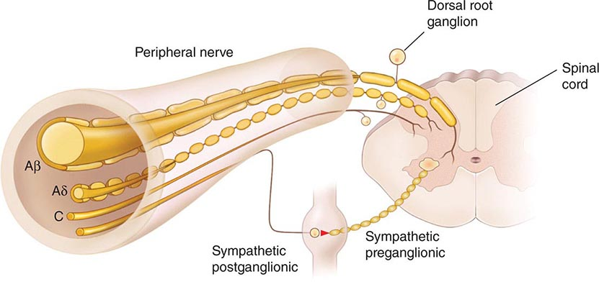
Dorsal Horn
1st order neuron from the nociceptors goes to the dorsal horn and the rexed laminae
Information travels to the contralateral ventral horn (Decussation)and then up the spinothalamic tract
http://clinicalgate.com/back-and-neck-pain/
Notes:
Decussation

Slide 23
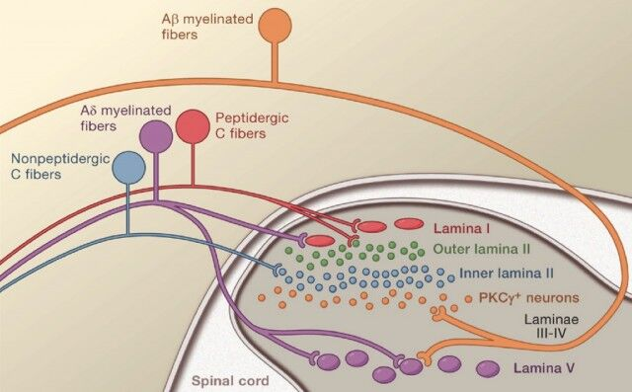
Rexed Laminae
Lamina I - marginal layer
Lamina II - substantia gelatinosa
Lamina III
Lamina IV
Lamina V – wide range dynamic neurons
nucleus proprius
Notes:
Wide range dynamic neurons: receive input from both A-δ and A-β afferents
Peptidergic: expression of neuropeptides
Substance P
Calcitonin gene related peptide (CGRP)
Neurokinin A
Expresses receptors

Slide 24
Ascending Pathways
Pain information is then sent through the spinothalamic tract to the thalamus and through the spinomesencephalic tract to the periaqueductal grey (PAG)
2nd order neuron synapses with the 3rd order neuron and information is sent to the Somatosensory Cortex
http://philschatz.com/anatomy-book/resources/1417_Ascending_Pathways_of_Spinal_Cord.jpg

Slide 25
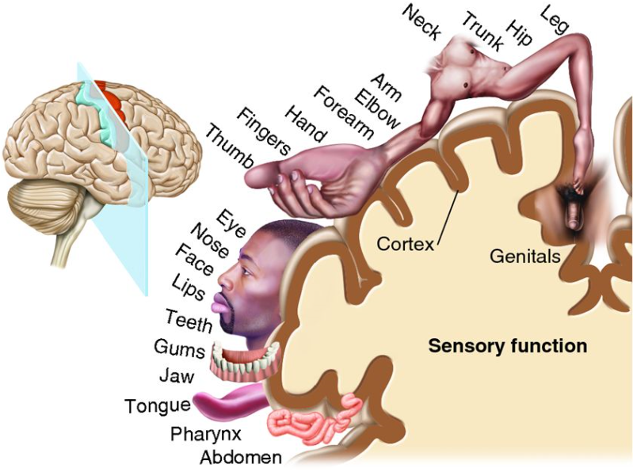
Somatosensory Cortex
3rd order neuron then sends information to the appropriate area of the Homunculus of the Primary Somatosensory Cortex
http://biology-forums.com/index.php?topic=93010.0

Slide 26
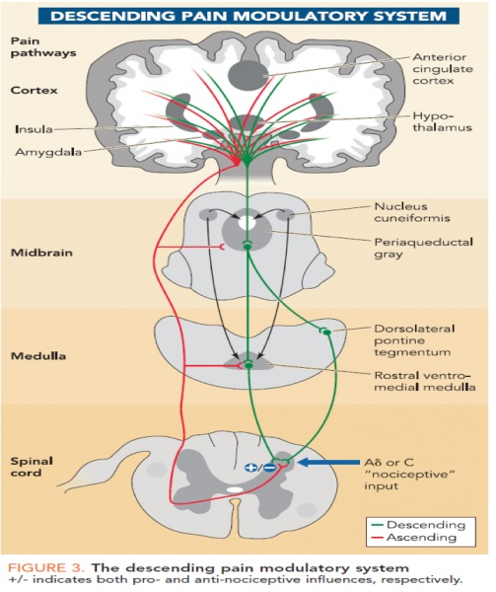
Ascending Pathways
2nd order neuron from laminae II, IV and V synapse with Reticular Activating System (RAS) in the brainstem relaying information:
  Touch, vibration and limb proprioception
RAS has projections to medial thalamus and limbic system:
  Mediates motor, autonomic, endocrine and emotional response to pain
2nd order neuron from laminae I and V synapse with pons, medulla, midbrain, Periaqueductal grey (PAG) and thalamus
Notes:
Caudal medulla = brainstem

Slide 27
4 Phases of Nociceptive Pain
Perception: conscious awareness of pain

Slide 28
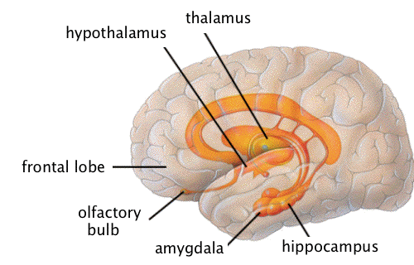
Limbic System
Cingulate gyrus: behavior and emotion
Amygdala: conditioned fear, anxiety
Hippocampus: memory
Hypothalamus: sympathetic autonomic activity
Locus ceruleus: arousal, vigilance, behavior
http://webspace.ship.edu/cgboer/limbicsystem.html

Slide 29
4 Phases of Nociceptive Pain
Modulation: neurons descending from the brain release substances that inhibit the transmission of painful impulses and produce motor responses to avoid pain

Slide 30

Endogenous Mechanism of Pain Modulation
3 Main Mechanisms:
  Descending Inhibitory Nerve System
  Endogenous Opioid System
  Segmental Inhibition or “Gate Control Theory”
Excitatory Nerve System
https://www.painmanagementlosangeles.com/pain-management-clinics-in-los-angeles.html
Notes:
Excitatory nerve system – will lead to motor activity

Slide 31
Descending Inhibitory Nerve System
Control the ascent of nociceptive information to the brain:
Periaqueductal gray matter (PAG)
Rostral ventromedial medulla (RVM)
Main transmitters:
Serotonin
Norepinephrine
http://www.physio-pedia.com/File:Descending-inhibitory-pathway.jpg

Slide 32
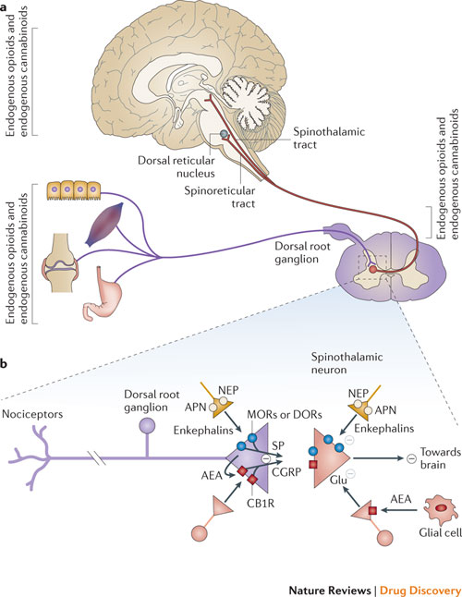
Endogenous Opioid System
3 Groups of Endogenous Compounds:
Enkephalins
Endorphins
Dynorphins

Slide 33
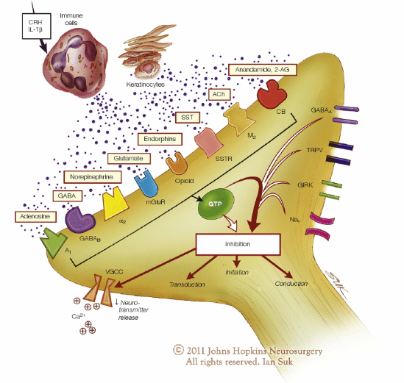
Peripheral Modulators of Nociception
On terminals of nociceptors
Modulate voltage gated Ca²⁺ and decrease Ca²⁺ entry
Inhibition of neurotransmitter release and pain pathways

Slide 34
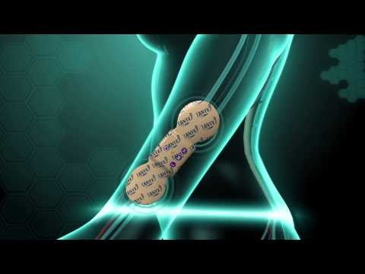
Gate Theory of Pain

Slide 35
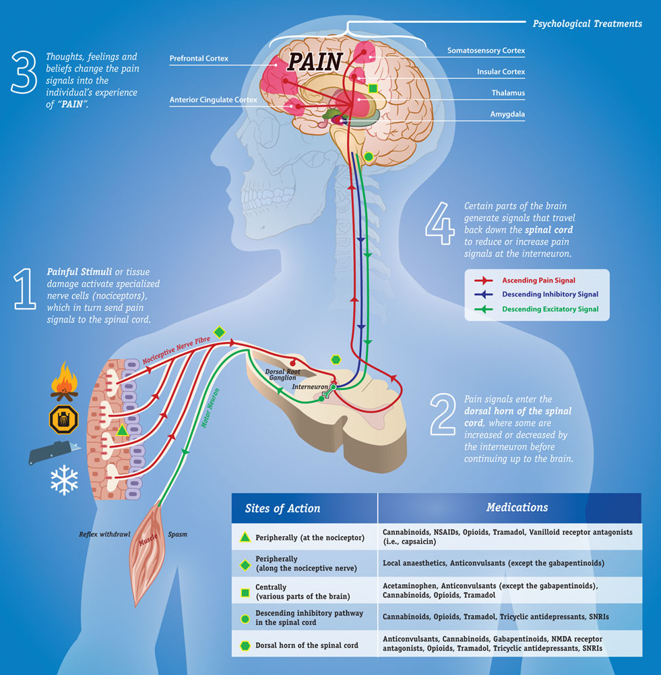

Slide 36
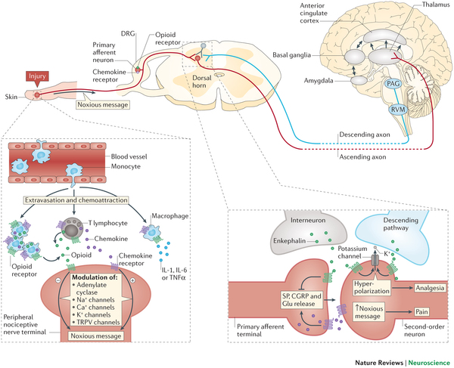
http://www.nature.com/nrn/journal/v16/n2/full/nrn3858.html

Slide 37
Summary
Ascending Pathways
Descending Pathways
Nociceptor
Dorsal Horn
Spinothalamic Tract
  Somatosensory Cortex
Spinomesencephalic Tract
  PAG
  Rostral ventral medulla
PAG
Rostral ventral medulla
Dorsal Horn
  Inhibitory pathway
  Excitatory pathway

Slide 38
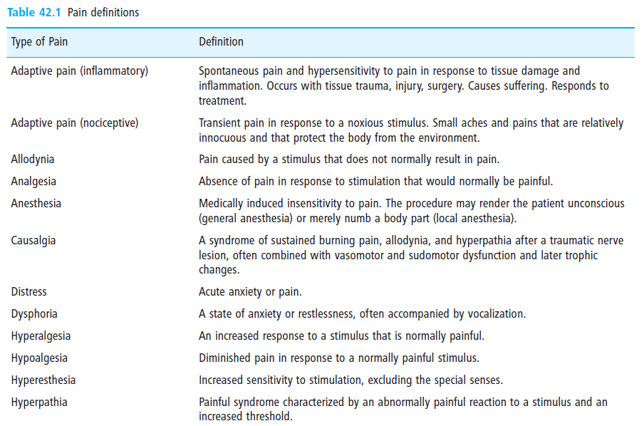

Slide 39
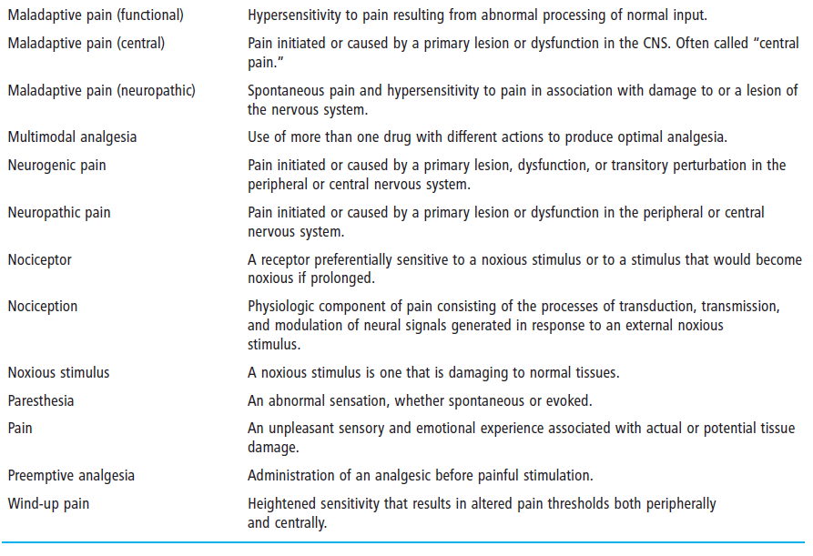

Slide 40
References
Hellyer, Peter, et al. "AAHA/AAFP pain management guidelines for dogs and cats." Journal of Feline Medicine & Surgery 9.6 (2007): 466-480.
Kopf, Andreas, and N. B. Patel. "Guide it Pain Management in Low Resource Settings." (2009).
Lemke, Kip A. "Understanding the pathophysiology of perioperative pain." The Canadian Veterinary Journal 45.5 (2004): 405.
McMahon, Stephen, et al. Wall & Melzack's Textbook of Pain. Elsevier Health Sciences, 2013.
Muir III, William W., and Clifford J. Woolf. "Mechanisms of pain and their therapeutic implications." Journal of the American Veterinary Medical Association 219.10 (2001): 1346-1356.
Valtolina, Chiara, and Robert Goggs. "Pain Recognition and Management." Advanced Monitoring and Procedures for Small Animal Emergency and Critical Care (2012): 523-539.
Wiese, A. Pain Pathways. IVECCS MDR Indianapolis, IN, 2014.

