Slide 1
Pulmonary Thromboembolism:
Pathophysiology and Diagnosis
Erik Zager
Cornell University
Department of Emergency and Critical Care

Slide 2
Outline
Pathophysiology
Predisposing Factors
  Associated Disease Processes
Presentation
  Clinical Signs
  Physical Examination
Diagnostics
  Minimum Database
  Diagnostic Imaging
  Ancillary Tests
Human Scoring Systems
Summary

Slide 3
Outline
Pathophysiology
Predisposing Factors
  Associated Disease Processes
Presentation
  Clinical Signs
  Physical Examination
Diagnostics
  Minimum Database
  Diagnostic Imaging
  Ancillary Tests
Human Scoring Systems
Summary

Slide 4
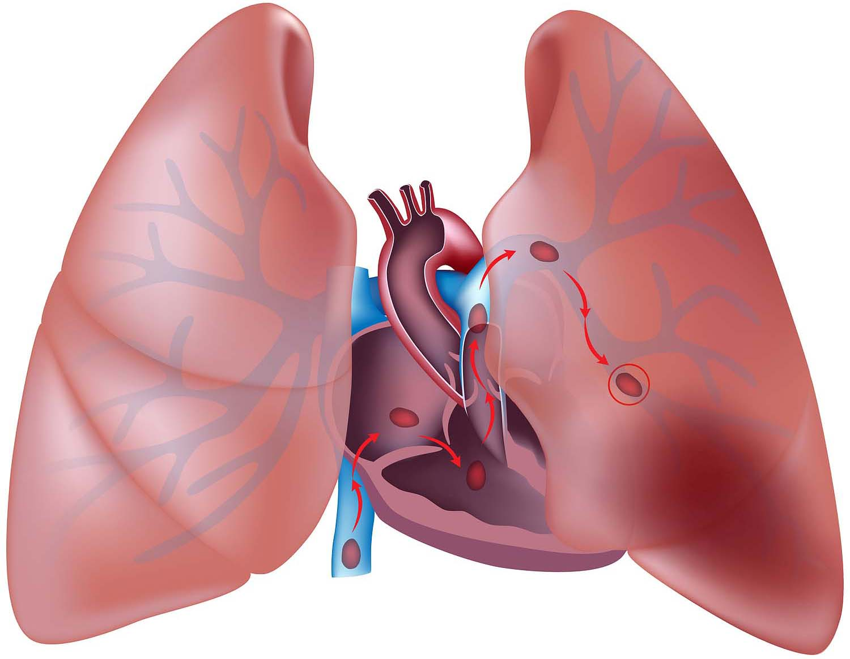
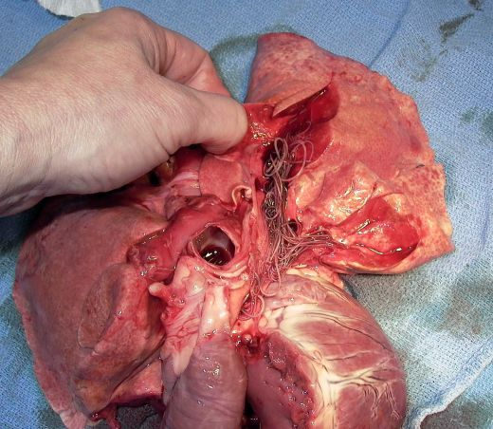
Pathophysiology of Pulmonary Thromboembolism
Pulmonary thromboembolism (PTE) or pulmonary embolism (PE) is an obstruction of pulmonary arteries due to:
  Thrombus
    Pulmonary embolism
    Can be due to any material
    Most often thought of as blood clot
  Local formation of clot in pulmonary vasculature
    Primary pulmonary thrombosis

Slide 5
Pathophysiology of Pulmonary Thromboembolism
Multiple factors involved in pathophysiology of PTE
  Two Major body systems involved are the pulmonary system and cardiovascular system
Degree of Severity highly depends on cardiac and pulmonary reserve
  Smaller obstructions can cause big problems in patients with previously compromised heart or lungs

Slide 6
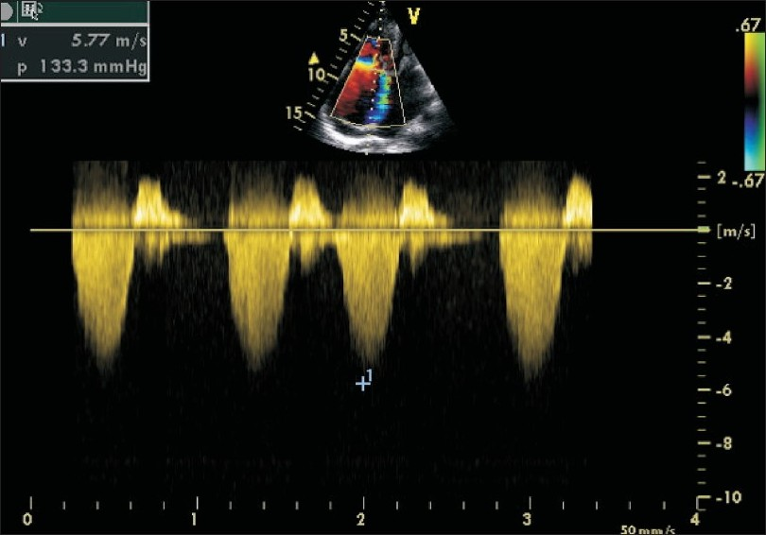
Pathophysiology of Pulmonary Thromboembolism
Cardiac effects of PTE
  Increase in pulmonary vascular resistance and pulmonary hypertension leads to increased right ventricular afterload
  RV becomes dilated/enlarged
    Can occur acutely
  Can overwhelm compensatory mechanisms leading to PEA and sudden death

Slide 7
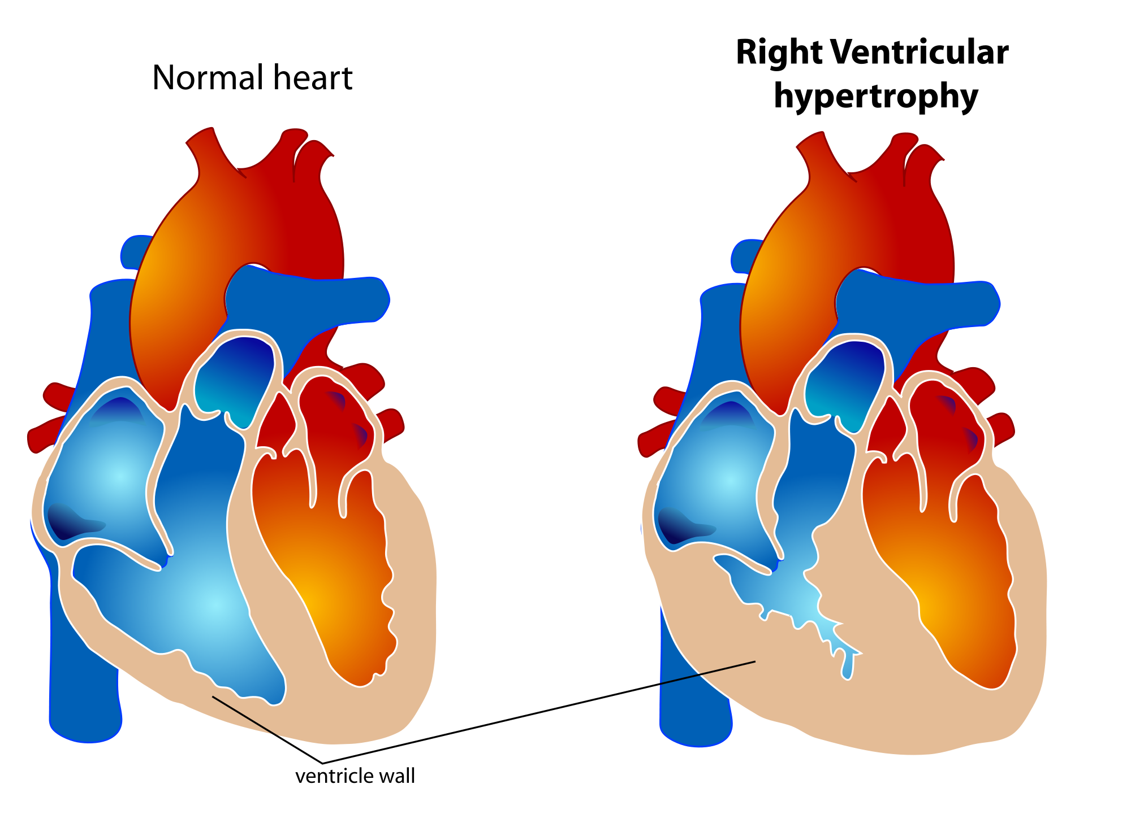
Pathophysiology of Pulmonary Thromboembolism
Cardiac effects of PTE
  Decrease in right sided output leads to decreased left sided filling and decreased cardiac output
  Acute right sided heart changes also impedes left ventricular function
    ventricular interdependence
  Left sided functional deficits result in
    Syncope
    Systemic hypotension
    Cardiogenic shock

Slide 8
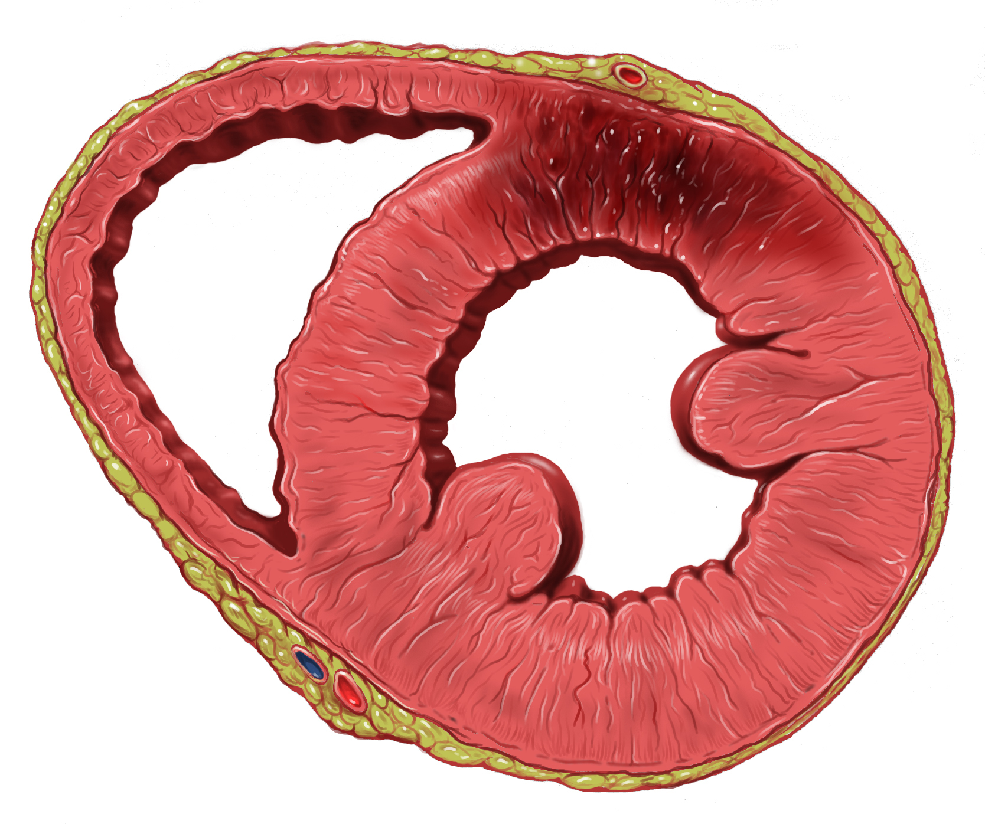
Pathophysiology of Pulmonary Thromboembolism
Cardiac effects of PTE
  Right ventricular overload can decrease right coronary perfusion pressures
    Right coronary artery is less resistant to right ventricular changes than left CA
  Leads to subendocardial ischemia or infarction and further right sided dysfunction

Slide 9
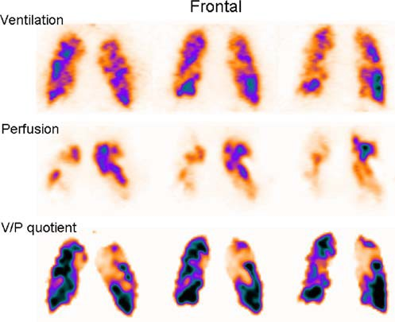
Pathophysiology of Pulmonary Thromboembolism
Pulmonary effects of PTE
  Occlusion of pulmonary arterial vasculature will result in decreased perfusion of lung tissue
  If ventilation remains constant, then V/Q mismatch (high V low Q mismatch) occurs with subsequent hypoxemia
  Reflex and humoral vasoconstriction may occur
    Some human papers suggest this is only an experimental phenomena

Slide 10
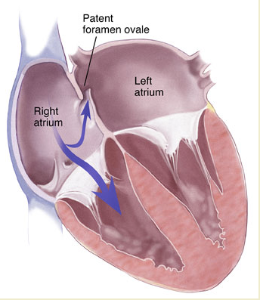
Pathophysiology of Pulmonary Thromboembolism
Pulmonary effects of PTE
  Increases in right ventricular and right atrial pressures can open foramen ovale and cause increased right to left shunting and even paradoxical thromboemboli into the arterial circuit
  Hypercapnia is rare except in the most severe cases
    Compensatory mechanisms allow for sufficient ventilation

Slide 11
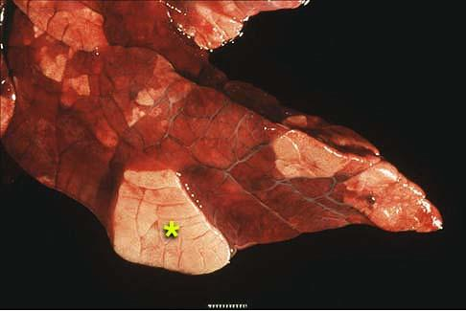
Pathophysiology of Pulmonary Thromboembolism
Pulmonary effects of PTE
  Congestive atelectasis
    Pulmonary edema due to decreased type II pneumocyte surfactant production
    Possibly only an experimental phenomena

Slide 12
Outline
Pathophysiology
Predisposing Factors
  Associated Disease Processes
Presentation
  Clinical Signs
  Physical Examination
Diagnostics
  Minimum Database
  Diagnostic Imaging
  Ancillary Tests
Human Scoring Systems
Summary

Slide 13
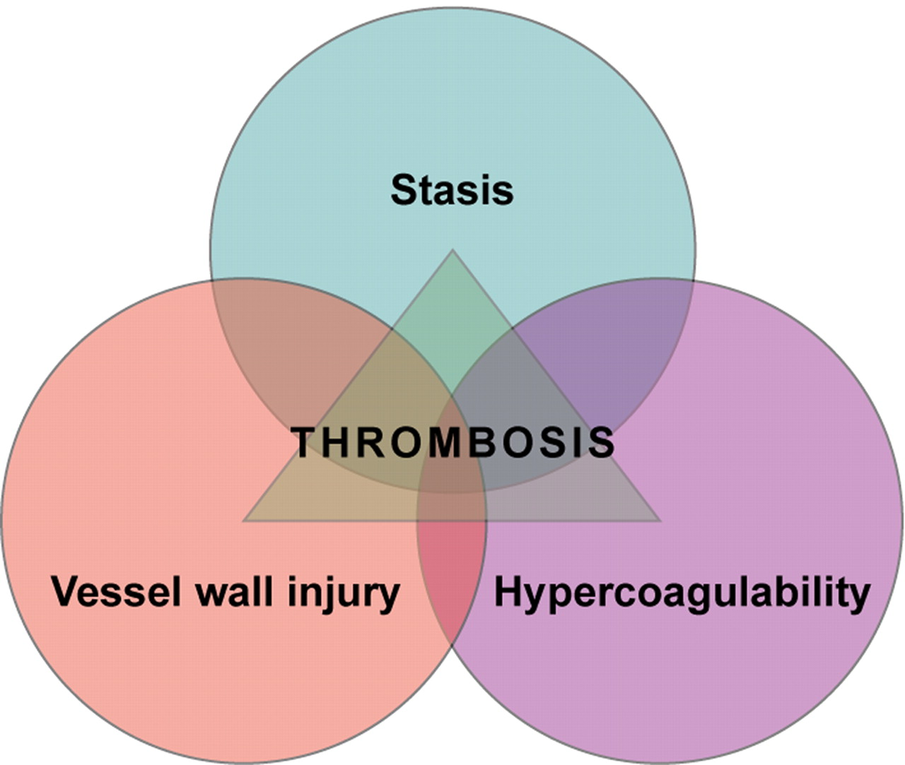
Predisposing Factors
Any abnormalities in Virchow’s triad can lead to thrombosis and PTE
  Stasis and deep vein thrombosis is #1 predisposing factor in humans
Multiple diseases in veterinary patients cause hypercoagulability

Slide 14
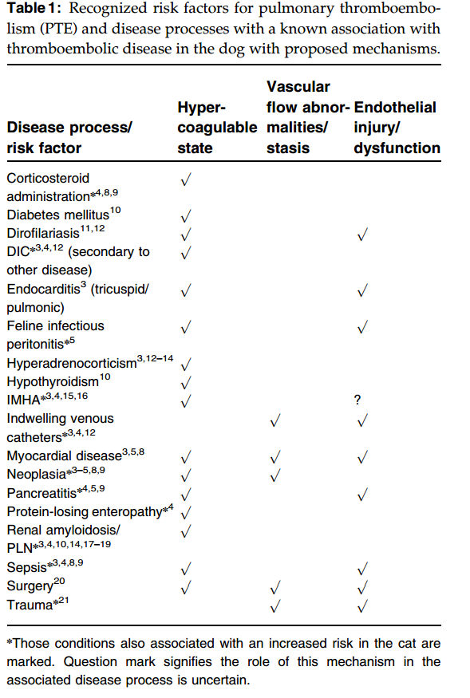
Predisposing Factors
Any abnormalities in Virchow’s triad can lead to thrombosis and PTE
  Stasis and deep vein thrombosis is #1 predisposing factor in humans
Multiple diseases in veterinary patients cause hypercoagulability
Goggs et al, JVECC, 2009

Slide 15
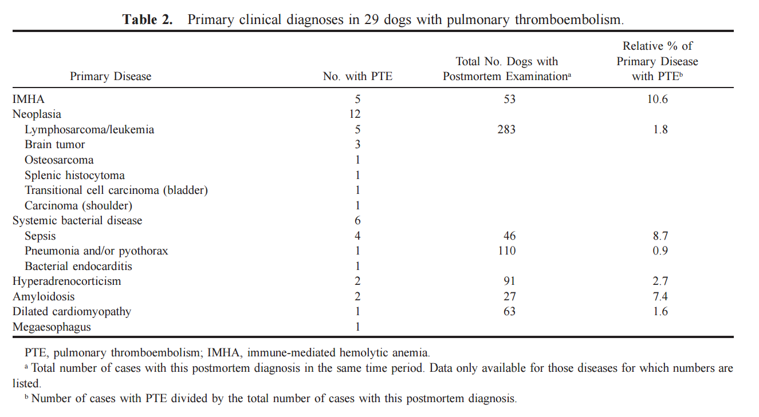
Predisposing Factors
Johnson et al JVIM 1999

Slide 16
Outline
Pathophysiology
Predisposing Factors
  Associated Disease Processes
Presentation
  Clinical Signs
  Physical Examination
Diagnostics
  Minimum Database
  Diagnostic Imaging
  Ancillary Tests
Human Scoring Systems
Summary

Slide 17
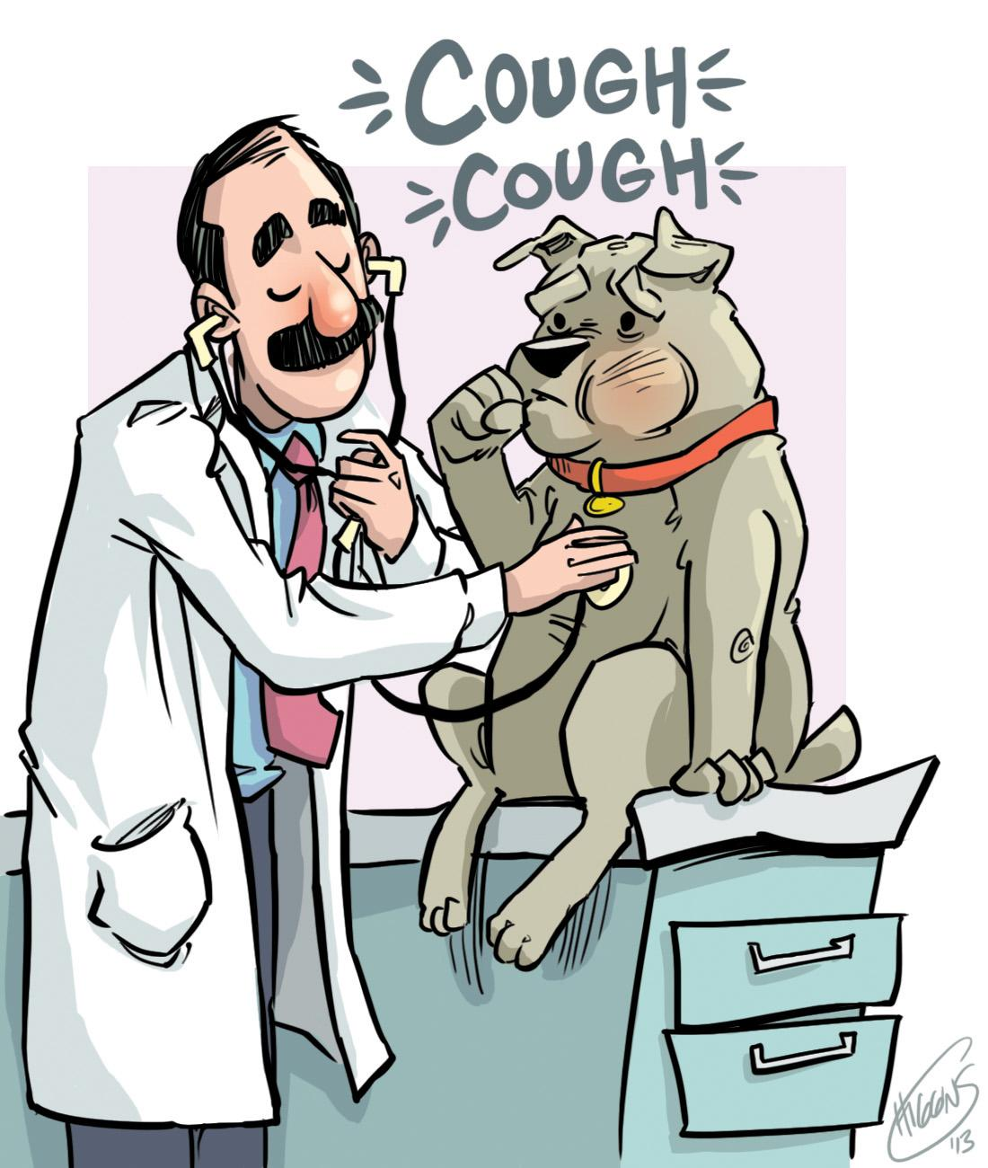
Clinical Signs
In humans, most common signs are
  Coughing
  Hemoptysis
  Chest Pain
  Dyspnea
Veterinary patients less frequently have the first three. Instead, our patients have
  Dyspnea
  Tachypnea
  Lethargy
Less commonly
  Cough, hemoptysis, cyanosis, syncope

Slide 18

Clinical Signs
Auscultation findings include
  Pulmonary crackles
  Harsh lung sounds
  Or dull lung sounds
    Pleural effusion possible
  Or even normal lung sounds…

Slide 19
Outline
Pathophysiology
Predisposing Factors
  Associated Disease Processes
Presentation
  Clinical Signs
  Physical Examination
Diagnostics
  Minimum Database
  Diagnostic Imaging
  Ancillary Tests
Human Scoring Systems
Summary

Slide 20
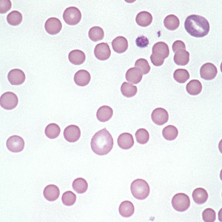
Minimum Database
Complete Blood Count
  No specific findings in CBC will help in directly diagnosing PTE
  Helpful for looking for predisposing factors
    IMHA
  Primary (essential) thrombocytosis may predispose to thromboembolic disease
    Secondary thrombocytosis does not
  Markers of DIC should increased index of suspicion for PTE
    Thrombocytopenia
    Schistocytosis
Serum Biochemistry
  Same as CBC - no specific changes for PTE, but helps look for underlying causes

Slide 21
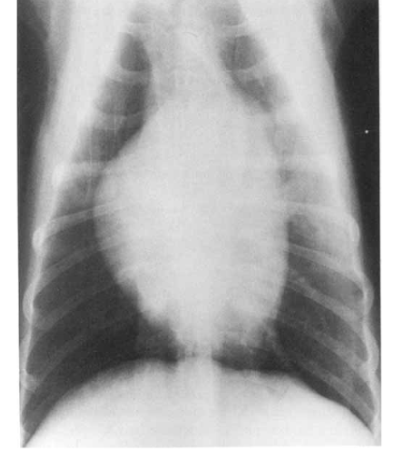
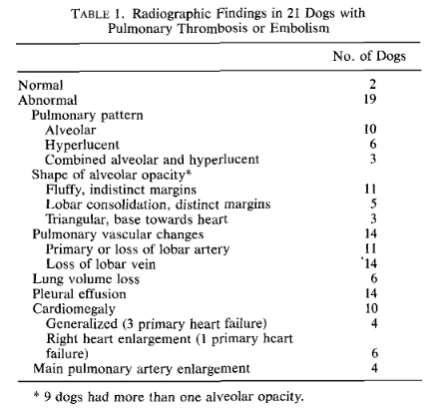
Diagnostic Imaging
Chest Radiographs
  Most common two patterns are
    Alveolar pattern
    Regional hypovascular lung pattern
Flückiger and Gomez, Vet Radiology, 1984
Notes:
PTEs confirmed by necropsy - retrospectively analyzed radiographs at similar times

Slide 22
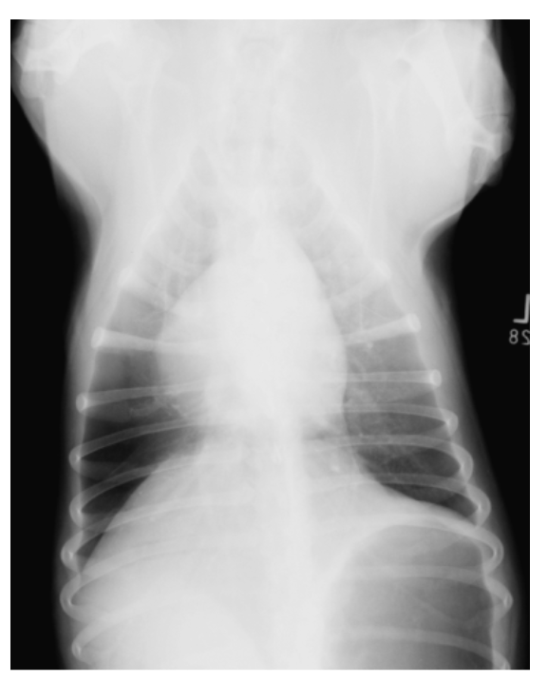
Diagnostic Imaging
Chest Radiographs
  Most common two patterns are
    Alveolar pattern
    Regional hypovascular lung pattern
Goggs et al, JVECC, 2009
Notes:
PTEs confirmed by necropsy - retrospectively analyzed radiographs at similar times

Slide 23
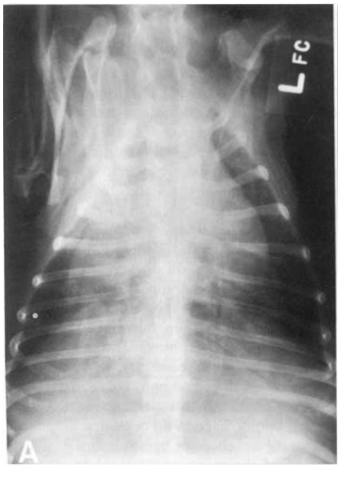
Diagnostic Imaging
Chest Radiographs
  Up to 27% can have normal radiographs
Flückiger and Gomez, Vet Radiology, 1984
Notes:
PTEs confirmed by necropsy - retrospectively analyzed radiographs at similar times

Slide 24
Diagnostic Imaging
  Non-selective
    Jugular catheter
    Much more difficult to interpret due to large amount of vascular highlighting from contrast
Pulmonary Angiography
  Selective
    Requires pulmonary artery catheter
    Bolus of contrast into PA
    Highlights pulmonary arterial tree
    Diagnostic
      Intraluminal filling defects
      Abrupt pulmonary arterial termination
      absence of arterial branches
    Suggestive
      Loss of vascularity
      asymmetry
      Tortuous PA
      Premature vessel tapering
    Requires anesthesia for PA catheter

Slide 25
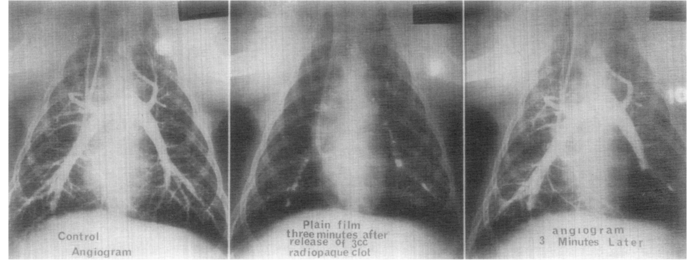
Diagnostic Imaging
Pulmonary Angiography
  Selective
    Requires pulmonary artery catheter
    Bolus of contrast into PA
    Highlights pulmonary arterial tree
    Diagnostic
      Intraluminal filling defects
      Abrupt
Dalen et al, American Heart Journal , 1966

Slide 26
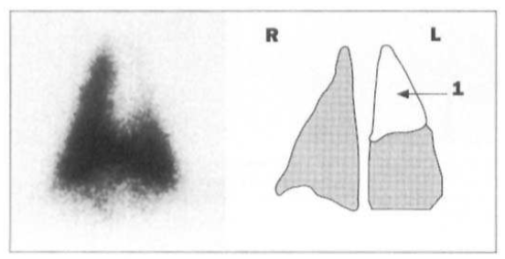
Diagnostic Imaging
Scintigraphy scan in cat with PTE
Pouchelon et al, JSAP, 1997
Scintigraphy
  Ventilation/perfusion (V/Q) scan
  May require anesthesia depending on patient
  Requires radioactive medium and specialized equipment
  Two separate studies
    Ventilation study using radionuclide labeled gas for inspiration
    Perfusion study requiring technetium-labeled IV infusion
  Well ventilated, but poorly perfused areas of lungs suggestive of PTE
  Can do with just perfusion scan compared to thoracic radiographs

Slide 27
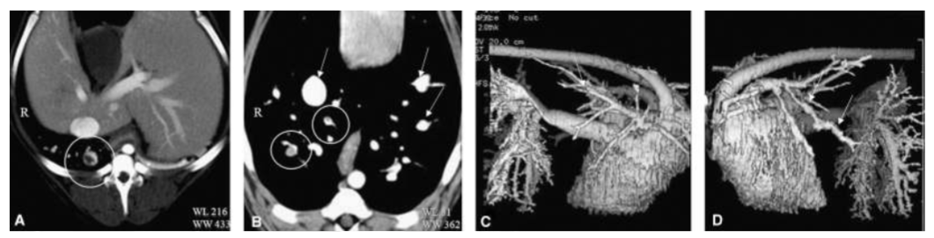
Diagnostic Imaging
Computed Tomography with Pulmonary Angiography (CTPA)
  Newest additional to the diagnostic imaging of PTE
  Similar to radiographic pulmonary angiography, but with CT
  Heavy sedation or anesthesia may be required for contrast comparison
  Studies in dogs have been done with experimentally induced PTE, so unknown sensitivity or specificity

Slide 28
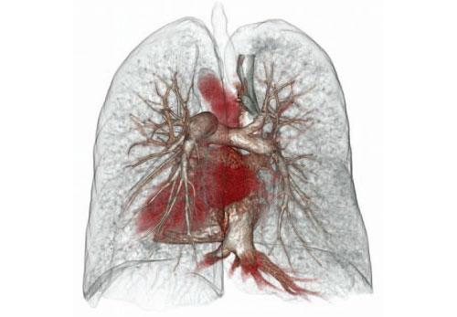
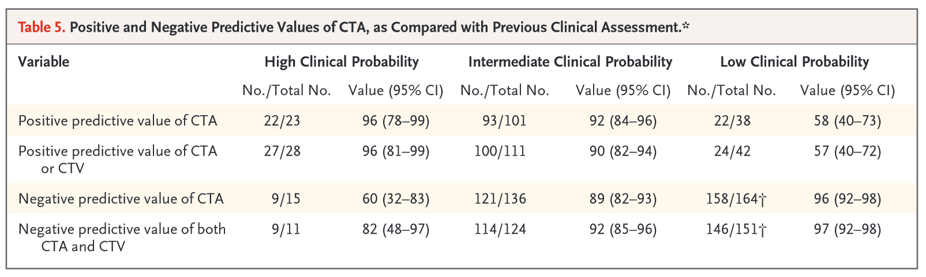
Diagnostic Imaging
Computed tomography with pulmonary angiography
(CTPA) combined with venous phase imaging
(CTA-CTV) in humans
  Positive predictive values and negative predictive
  values are very highly dependant on the clinical
  probability of PTE based on scoring system
  developed for humans
Stein et al, NEJM, 2006

Slide 29
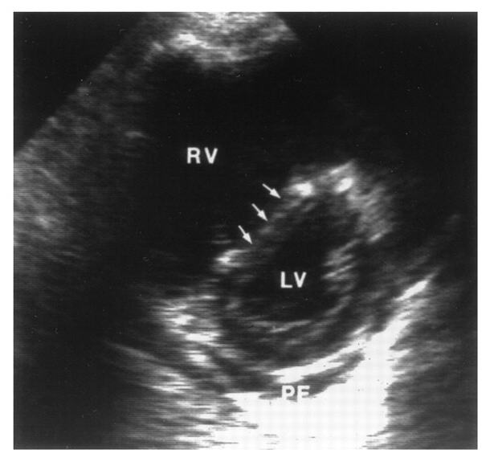
Diagnostic Imaging
Echocardiography
  Since cardiovascular effects of PTE are often more significant than pulmonary effects, echocardiogram is very important diagnostic
  Right heart enlargement
    even in acute PTE
  Pulmonary hypertension
  Flattening of interventricular septum
  Sometimes able to visualize PTE in proximal pulmonary artery/trunk

Slide 30
Diagnostic Imaging
Echocardiography
  Conflicting evidence of usefulness in human medicine
  Given severe cardiovascular abnormalities seen with PTE, can be helpful for ruling out other cardiac disease

Slide 31
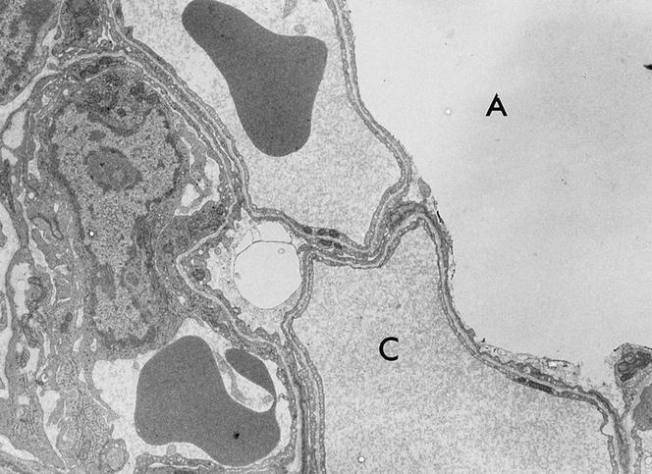
Ancillary Tests
Arterial blood gas analysis
  Allows for determination of oxygenation ability, as well as for A-a gradient
  Study of 29 dogs with PTE, 15 had arterial blood gas
    100% had increased A-a gradient
    80% had hypoxemia
    47% had hypocapnia

Slide 32
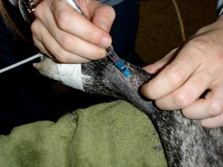
Ancillary Tests
Arterial blood gas analysis
  Calculation of A-a gradient
  P_{A}O2 = F_{i}O2(P_{atm}-P_{H2O}) - (P_{a}CO2/0.8)
  P_{A}O2 = 150 - (PCO2/0.8) (at sea level)
  P_{A}O2 - P_{a}O2 should be ≦ 10

Slide 33
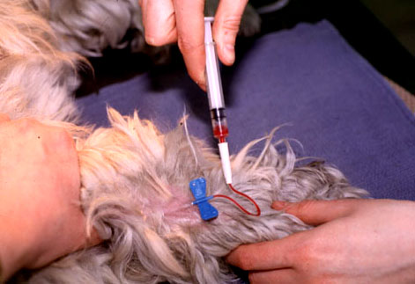
Ancillary Tests
Coagulation Testing
  PT and aPTT are often normal
    depending on underlying disease
  Antithrombin levels
    May be reduced in a number of diseases and states that predispose to PTE
    May be helpful in determining the risk of thrombosis

Slide 34
Ancillary Tests
Coagulation Testing
  PT and aPTT are often normal
    depending on underlying disease
  Antithrombin levels
    May be reduced in a number of diseases and states that predispose to PTE
    May be helpful in determining the risk of thrombosis

Slide 35
Ancillary Tests
Coagulation Testing
  PT and aPTT are often normal
    depending on underlying disease
  Antithrombin levels
    May be reduced in a number of diseases and states that predispose to PTE
    May be helpful in determining the risk of thrombosis
AT
Xa
AT
IIa

Slide 36
Ancillary Tests
Coagulation Testing
  PT and aPTT are often normal
    depending on underlying disease
  Antithrombin levels
    May be reduced in a number of diseases and states that predispose to PTE
    May be helpful in determining the risk of thrombosis
AT
Xa
AT
IIa

Slide 37
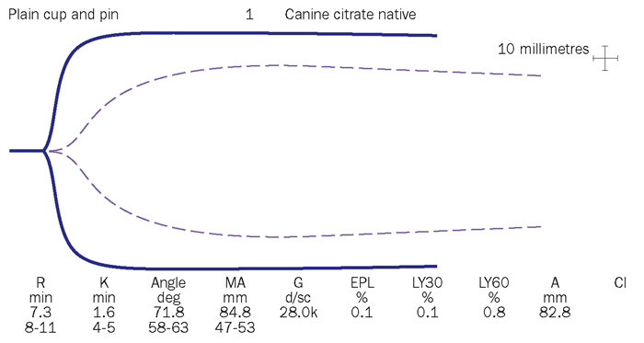
Ancillary Tests
Thromboelastography
  Risks based on TEG have been establish in human studies
    Increased overall thromboembolic disease risk in post-surgical people with increased MA
    Thromboembolic disease includes PTE, myocardial infarction or stroke

Slide 38
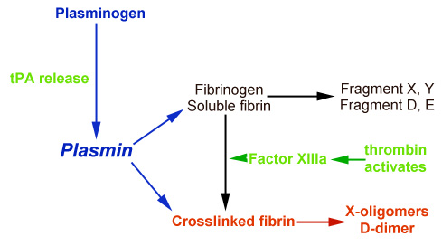
Ancillary Tests
D-Dimers and FDPs
  Difference between FDPs and D-dimers is crosslinking of fibrin by factor XIIIa
  FDPs more specific to actual clot formation

Slide 39
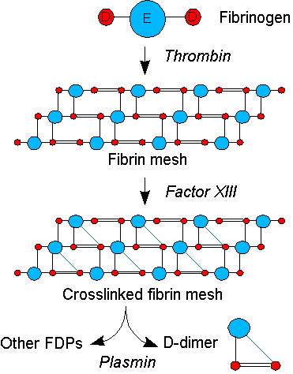
Ancillary Tests
D-Dimers and FDPs
  Major screening test (high sensitivity) in human medicine for PTE or other thrombotic disease
    In patients that do not have high probability calculations
  Usually not run in patients in high probability groups due to low specificity

Slide 40
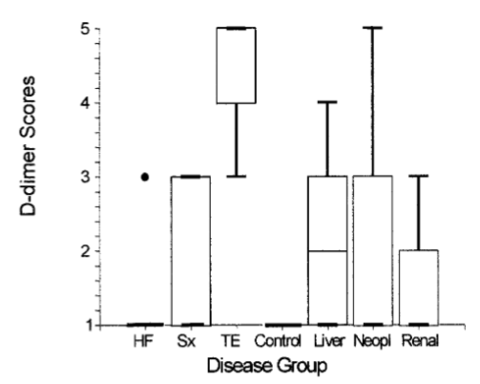
Ancillary Tests
D-Dimers and FDPs
  Sensitivity and specificity in dogs is dependant on cutoff values
    Using 500 ng/mL is very sensitive (100%, but there is overlap with other disease processes (Sp 70%)
    Using 2000 ng/mL is very specific (98.5%) for TE disease but lacks sensitivity (36%)
Nelson and Andreasen, JVIM, 2003

Slide 41
Ancillary Tests
D-Dimers and FDPs
  TE group was 20 dogs with TE (almost all confirmed with necropsy or direct visualization with echo/ultrasound)
  19/20 TE was PTE
    One multi-organ thrombosis
  Most common cause of PTE in this study was PLN (5)
    Followed by IMHA (3)
Nelson and Andreasen, JVIM, 2003

Slide 42
Outline
Pathophysiology
Predisposing Factors
  Associated Disease Processes
Presentation
  Clinical Signs
  Physical Examination
Diagnostics
  Minimum Database
  Diagnostic Imaging
  Ancillary Tests
Human Scoring Systems
Summary

Slide 43
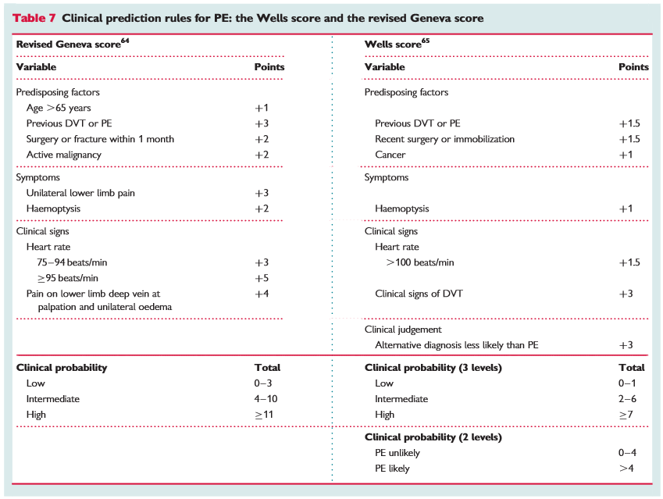
Human Scoring Systems
Scoring systems in human medicine the cornerstone of diagnostic work-up of PTE
  First line defence
  Algorithms based on clinical probability dictate further testing
    D-Dimers for low probability groups
    Imaging for high probability groups

Slide 44
Human Scoring Systems
Chest pain or dyspnea
Low probability Score
High probability score
Low D-dimer
High D-dimer
CT-angio
PTE confirmed
NO TREATMENT
PTE not confirmed
TREATMENT

Slide 45
Outline
Pathophysiology
Predisposing Factors
  Associated Disease Processes
Presentation
  Clinical Signs
  Physical Examination
Diagnostics
  Minimum Database
  Diagnostic Imaging
  Ancillary Tests
Human Scoring Systems
Summary

Slide 46
Conclusions
PTE is a very difficult diagnosis with many possible clinical presentations and predisposing disease processes
Clinical suspicion should be heavily weighted
Do not forget to think about possibility of PTE
D-dimers is the most helpful test for ruling out PTE
CT-Angio may be helpful in more stable animals
Less stable animals may benefit most from echocardiogram, DIC panel, and chest x-rays

