Slide 1
M & M Rounds
Pepper Phillips #244736

Slide 2
Signalment and History
9 YO FS Poodle
2 day history of vomiting & lethargy
RDVM referred for suspect ruptured gallbladder mucocele

Slide 3
RDVM
Presentation TPR
  T = 103.0
  HR = 144 bpm
PE
  Lethargic
  NOT painful on abdominal palpation at that time

Slide 4
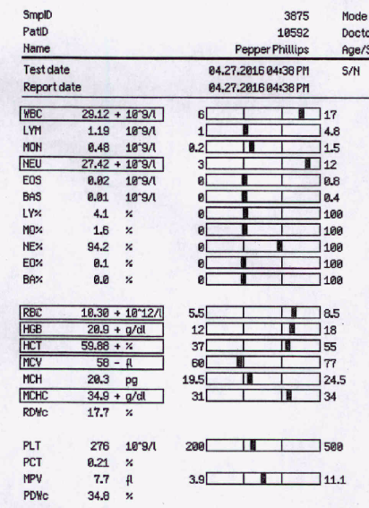
RDVM Bloodwork – CBC

Slide 5
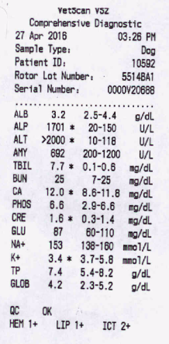
RDVM Bloodwork – CHEM

Slide 6
RDVM – other diagnostics
Pancreatic lipase test normal

Slide 7
RDVM - Treatments
Hospitalized
IV Fluids @ 50 cc/hour
Ampicillin 30 mg/kg IV q8hrs
Cerenia 10 mg q24 hrs SQ
Clotting times (4/28):
  PT 24.4
  PTT 129
  Vitamin K was added

Slide 8
RDVM – 4/29 (2nd day hospitalization)
Anorectic but no vomiting overnight
HR = 188 bpm
Abdomen tense and painful on palpation
AFAST: no free abdominal fluid
Hospitalized on:
  Ampicillin 30 mg/kg IV q8hrs
  Enrofloxacin 3.24 mg/kg IV q12hrs
  Cerenia
  Vitamin K
  KCl added to Norm R
  Fentanyl
  Metronidazole

Slide 9
RDVM 4/29
Abdomen painful
Abdominal ultrasound suspicious for ruptured gallbladder mucocele
  “inflamed gallbladder mucocele, incipient rupture suspected if not already present, reactive hepatopathy, mild pancreatitis affecting right limb, adrenal enlargement suspected. Consider ruling out underlying Cushings.”
Referred to Cornell for further imaging and surgery.

Slide 10
CUHA Presentation
T = 103.0 F HR = 148 bpm RR = 54 brpm WT = 11.13 kg
CRT 1-2 seconds, MM pink, PQ poor
PE: QAR, painful on abdominal palpation, severe dental disease, SQ mass left axilla, possible enlargement of submandibular LN
PCV/TS = 45/8.6 AZO 15-26 PT/PTT = 17/124
Blood gas: see handout
BP: 137/85 (114)
AFAST: suspicious for ruptured GB
USG 1.020
Smear: 6-8 platelets/hpf, subjective neutrophilia
Abdominal ultrasound
  Ruptured GB mucocele, enlarged left adrenal
  Cytology of abdominal fluid aspirate obtained in US: no bacteria seen

Slide 11
Samples Saved
CBC
CHEM
Coags
No urine
No blood cultures

Slide 12
Initial Therapy
Methadone 0.2 mg/kg IV
Plasmalyte 20 mL/kg bolus IV over 20 minutes then 60 mL/kg/day IV + 40 mEq/L KCl
Dexmedetomidine 5 mcg/kg IV and Methadone 0.2 mg/kg IV for abdominal ultrasound
Notes:
maintenance versus twice maintenance fluids
"Thus, if postoperative hypotension was present the risk of death was increased 20 times. The risk of death is also increased 0.3 times for each increment in lactate concentration in the
postoperative period."Clinical Findings and Prognostic Factors for Dogs Undergoing Cholecystectomy for Gall Bladder Mucocele - Sarah Malek et al.

Slide 13
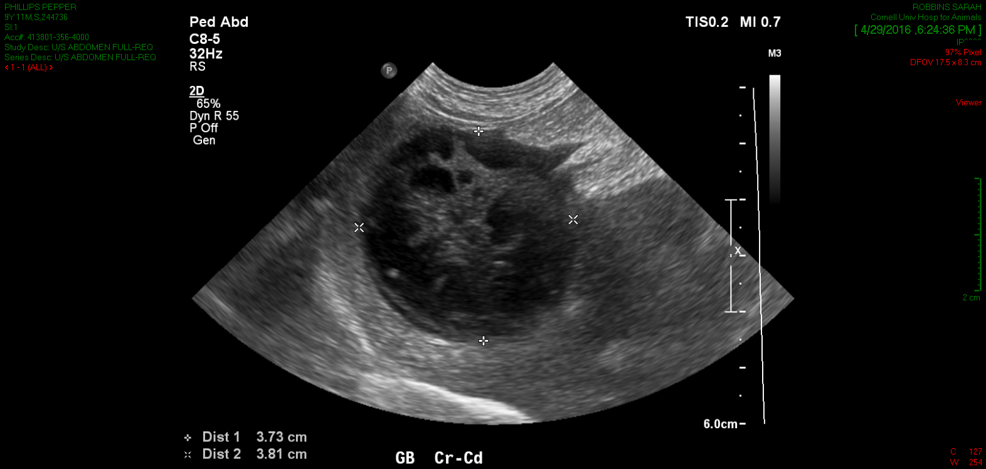
Abdominal US
Gallbladder mucocele
Cranial abdominal peritonitis
Jejunal lymphadenopathy
Few nonspecific splenic nodules (hypoechoic)
Transferred to surgery with the following on board:
  Unasyn 22 mg/kg IV
  Metronidazole 10 mg/kg IV
  Enrofloxacin 10 mg/kg IV
  Cerenia 1 mg/kg IV
  Pantoprazole 1 mg/kg IV
Notes:
Damage control – AFAST + RDVM U/S: repeat or explore?

Slide 14
Surgery (Cholocystectomy) & Anesthesia
Rent in cystic duct, body of GB intact. Large amount of semi solid mucoid bile suctioned. Liver parenchyma adjacent to duct was severely edematous, thick and firm. Gel foam applied to dissected liver fossa, GB stump sewn with 4-0 PDS. No bile leakage visualized. Concern for dehiscence risk given how friable the duct tissue was and how deep the location of the rupture. Pancreas edematous and bordered thick inflamed mesentery but otherwise unremarkable.
Placed NG tube (palpated in stomach during surgery) and triple lumen jugular catheter – no placement radiographs taken.
Samples free fluid, biopsy of R medial liver, GB for histopathology and culture
Reaction to ioban
Plasma Transfusion in surgery (110 cc)
Hypotense during surgery (MAP ranging from 50-70)
Notes:
Thus, if postoperative hypotension was present the risk of death was increased 20 times. The risk of death is also increased 0.3 times for each increment in lactate concentration in the postoperative period. Clinical Findings and Prognostic Factors for Dogs Undergoing Cholecystectomy for Gall Bladder Mucocele - Sarah Malek et al

Slide 15
Post-Op transfer to CC
PE and Diagnostics
Treatment Plan
T = 98.7 F HR = 160 bpm RR = 20 brpm
MM pink and dry
Mild increase in inspiratory effort
Painful, tense abdomen
Erythematous skin reaction from ioban
SpO2 95%
BP 113/68 (85)
Lactate 1.9
PT/PTT = 16/134
PCV/TP = 31/5.3
See blood gas
Plasmalyte + 40 mEq/L KCl @ 60 ml/hr
Metoclopramide 2 mg/kg/day
Fentanyl 2 mcg/kg/hr
Lidocaine 30 mcg/kg/min (for pain)
Ketamine 2 mcg/kg/min
Enrofloxacin 10 mg/kg q24hrs , Unasyn 22 mg/kg IV q8hrs
Metronidazole 10 mg/kg IV q12hrs (not given pre-op?)
Cerenia 1 mg/kg IV q24 hrs
Pantoprazole 0.7 mg/kg IV
Flush unused ports q6hrs, Aspirate NG tube q4hrs, Rotate recumbancy q6hrs if needed
Start clinicare 1/3 RER at 4 AM
Notes:
Starting with Lidocaine/Ketamine/Fentanyl vs using 1-2 and increasing doses?

Slide 16
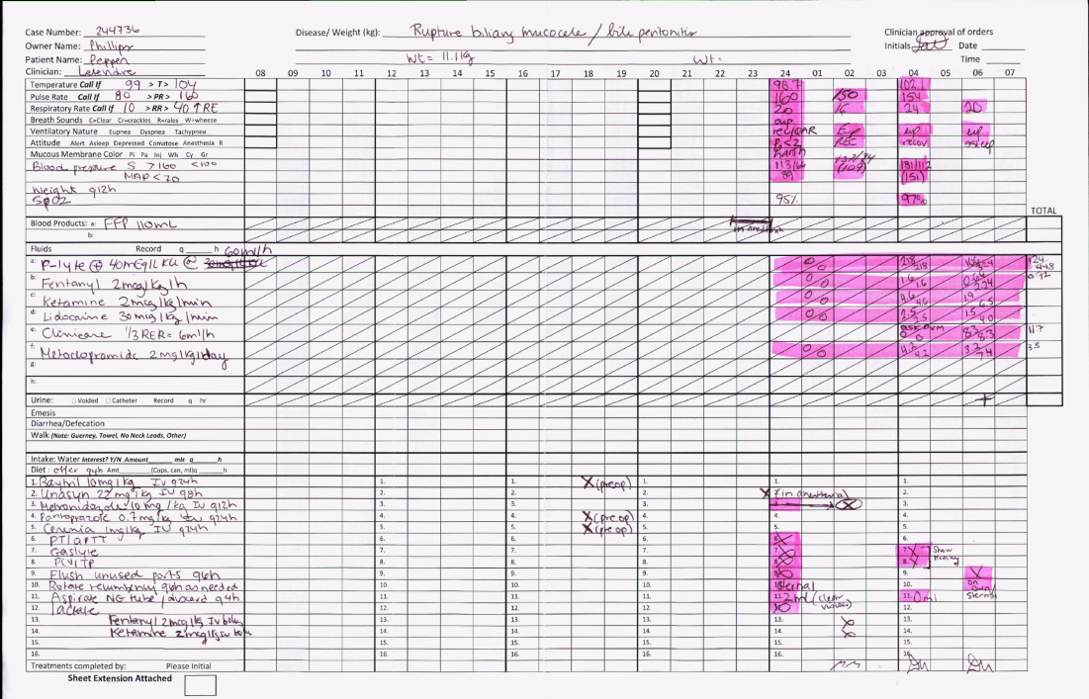

Slide 17
4/30: 1 day post op
PE
Plan
Erythematous skin ventral abdomen
NG tube in place with moderate amount of brown foamy discharge at nostril (29 cc aspirated)
BP = 155/69 (120), 133/88 (100)
SpO2 95%
Tachypneic and frequently panting
Tense and distended abdomen
Tires quickly during neuro exam/walk
Bloodgas/ Qats: See Handout
Plasmalyte + 40 mEq/L KCl @ 30 cc/hr
Fentanyl CRI (3 mcg/kg/hr)
Lidocaine (25 mcg/kg/min)
Metoclopramide CRI (2 mg/kg/day)
Dexmedetomidine CRI (1 mcg/kg/hr)
D/C Ketamine CRI
Clinicare via NG @ 6 cc/hour
Enrofloxacin, Unasyn, Metronidazole
Cerenia, Pantoprazole
Trazadone 25 mg via NG tube PRN
Lube eyes q6hrs

Slide 18
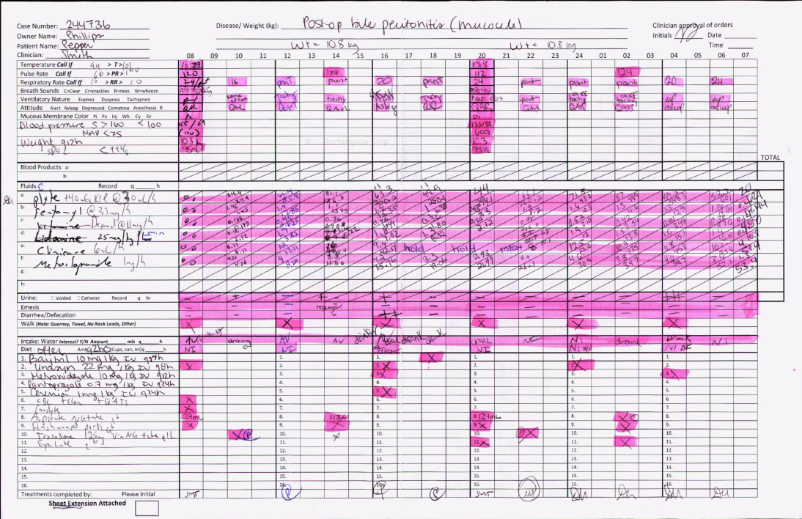

Slide 19
CBC/CHEM
CHEM
CBC

Slide 20
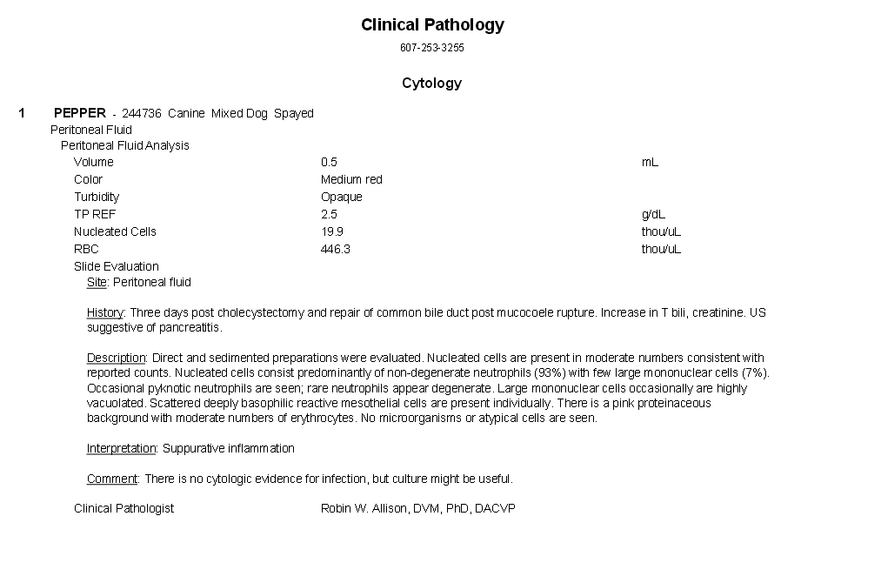
Clin Path Cytology of peritoneal fluid

Slide 21
5/1: 2 days post op
PE
Plan
Unchanged
More quiet, less anxious
HR 140-152 bpm throughout the day
No regurge since 4 PM the day before
BP = 131/75 (90) SpO2 = 94%
AFAST: mild volume free fluid, moderate ileus with hypoechoic fluid in stomach and moderate gastric distension, mesenteric edema/peritonitis present
TFAST: No free fluid, glide present, normal lungs except small area (right middle lung lobe area) caudal to heart, suspect atelectasis
FS =44% (33-66%), LA:Ao = 1.15: 1
Eagerly ate 1 tbsp. of warm chicken baby food at 4 AM (5/2)
Plasmalyte + 20 mEq/L KCl @ 30 cc/hr
Decrease Fentanyl CRI (2 mcg/kg/hr)
Lidocaine CRI (25 mcg/kg/min)
Metoclopramide CRI (1 mg/kg/day)
Decrease dexmedetomidine CRI (0.5 mcg/kg/hr)
Continue with Clinicare, Enro, Metro, Unasyn, Cerenia, Trazadone
D/C Pantoprazole

Slide 22
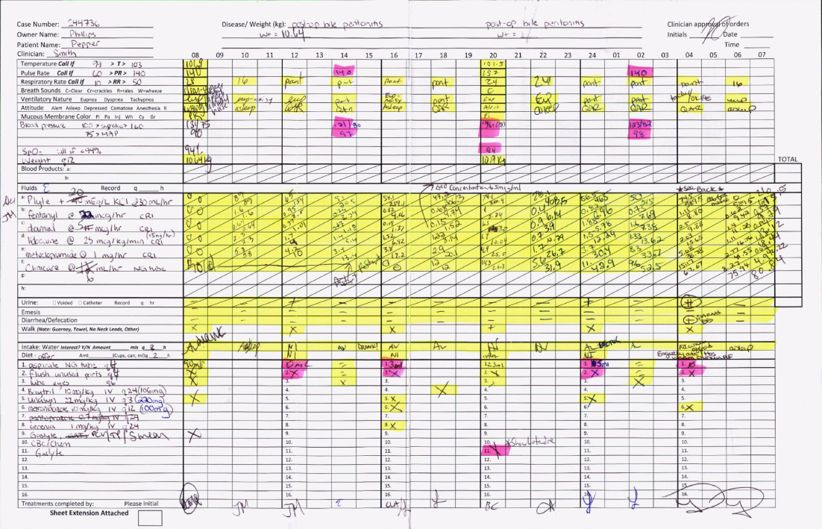

Slide 23
5/2: 3 days post op
Plan:
Had eaten baby food night before
No regurge through night but in AM walk regurge ~ 3 mLs
NG tube in place with small amount of dark yellow discharge
BP = 142/75 (99) SpO2 =94 %
Still tachypneic and panting
Abdomen moderately tense but not painful
Plasmalyte + 20 mEq/L KCl @ 30 cc/jr
Fentanyl, Lidocaine
Metoclopramide CRI 1 mg/hr
Dexmedetomidine CRI 5 mcg/hr
Clnicare 6 cc/hr
Enro, Unasyn, Metro, Cerenia, Trazadone continued.

Slide 24
5/2 Flow Sheet MIA ☹

Slide 26
Abdominal ultrasound on 5/2
New, moderate volume, echoic peritoneal fluid and diffuse hyperechoic mesentery
Post surgical cholecystectomy and bile duct closure without deterioration of the bile duct region
New moderately enlarged hypoechoic pancreas with focal hyperechoic mesentery
New mild lymphadenopathy, pancreaticoduodenal (reactive)
Degenerative change, bilateral kidneys and similar mild pyelectasia
Resolved splenic nodules.
Conclusions: consisting with pancreatitis. Definitive cause for AKI not determined. In view of mild pyelectasia, if the patient has UTI, pyelonephritis is possible.

Slide 27
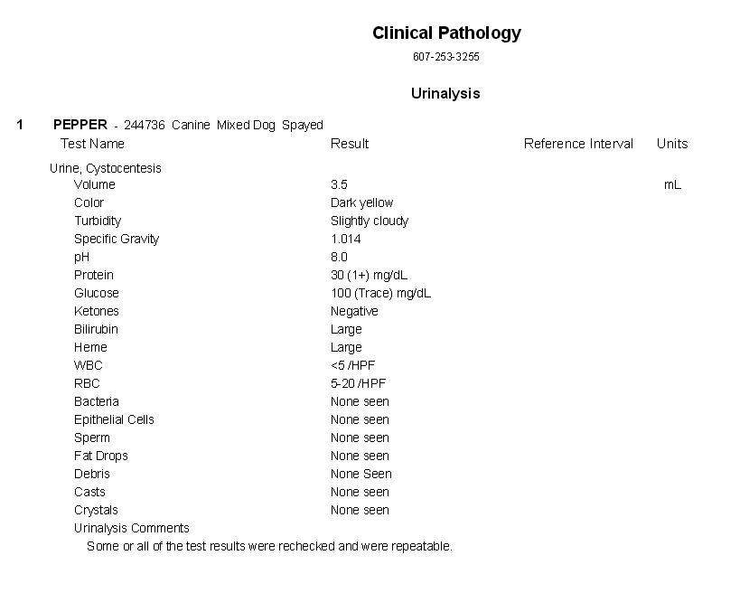
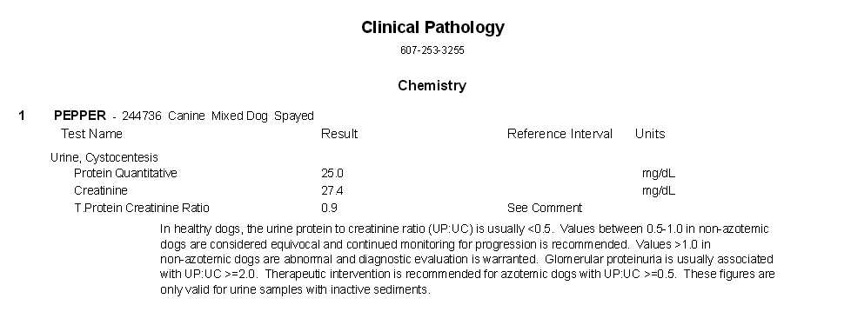
Notes:
Therapeutic intervention: already on fluids, increase to more than maintenance? De-escalate abx selection vs continue to wait on cultures?

Slide 28
5/3: 4 days post op
Regurge 10:30 AM, Melena 4 AM (5/4)
Orange colored urine 6 PM
Clinicare reduced to 3 cc/hr, aspirated 300 cc fluid from NG tube
Not interested in warmed baby food
NG tube had substantial amount of dark yellow discharge at both nostrils
Systolic BP = 144 MAP 116 SpO2 94%
Abdomen moderately tense on palpation
See blood gas
Added B vitamin to P lyte (@ 90 mL/kg/day) + 40 mEq/L KCl
Dexmedetomidine (1 mcg/kg/hour)
Clinicare 3 cc/hr
NAC 140 then 70 mg/kg q8hrs
Vitamin K 0.5 mg/kg SQ q12hrs
Cisapride 0.5 cc PO via NG tube
Methadone 0.2 mg/kg IV q4hrs and fentanyl D/C
Ketamine 3 mcg/kg/min
Nebulization q6hrs
Continuous ECG
Pantoprazole 1 mg/kg
Metoclopramide, Unasyn, Metro, Cerenia, Enro continued
Notes:
Did we wait too long to start on liver protectants?

Slide 30
10:20 AM Regurged through right nostril, residual upper airway noise, tried to suction oropharynx but not productive > clinicare decreased to 3 cc/hr
1:45 pm radiographs of chest taken: negative for thoracic cause for inflammatory leukogram (mild-mod reduced thoracic volume, mild pleural fluid)
2:15 pm 175 cc pRBC given over 4 hours (DEA1+)
5:40 pm BP noted to be trending up, Hr ~ 150 bpm T = 104.4 F no changes at that time.
10 pm BG = 76 > 0.5 mL/kg bolus of 50% dextrose diluted 1:2 in NaCl over 20 minutes and Dextrose in fluids increased to 5%.
11:10 pm Pepper noted to be very uncomfortable HR > 175 consistently > 1 mcg/kg bolus dexmedetomidine administered and HR down to 144 bpm.
12 am: Pepper uncomfortable, HR > 185 bpm > another 1 mcg/kg dexmed bolus administered
3:15 am: HR 170-178, abdomen more distended and temperature 105
3:30 am: abdomen distended and painful, removed 240 cc fluid > improved comfort. TFAST LVEED 2.4 (can tolerate fluids), CdVC collapsing with respiration > 200 cc Plasmalyte bolus administered over 10 minutes.

Slide 31
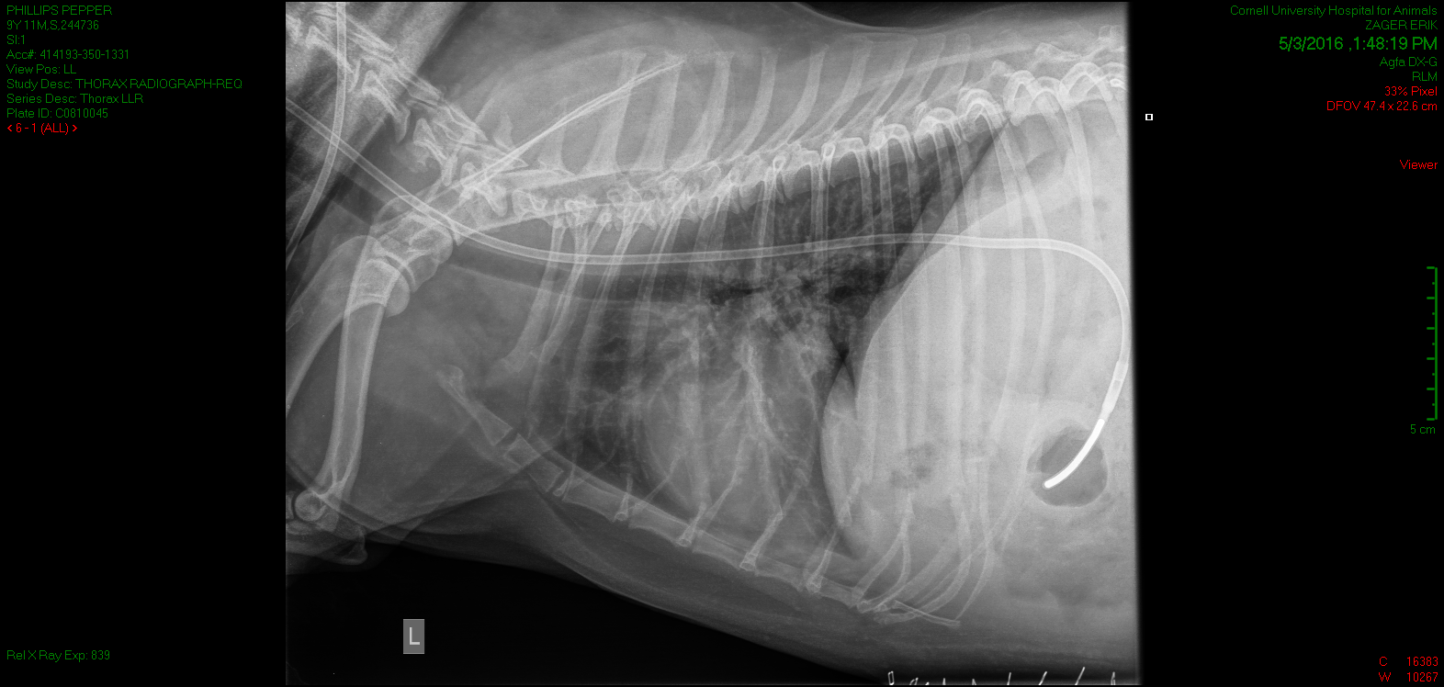
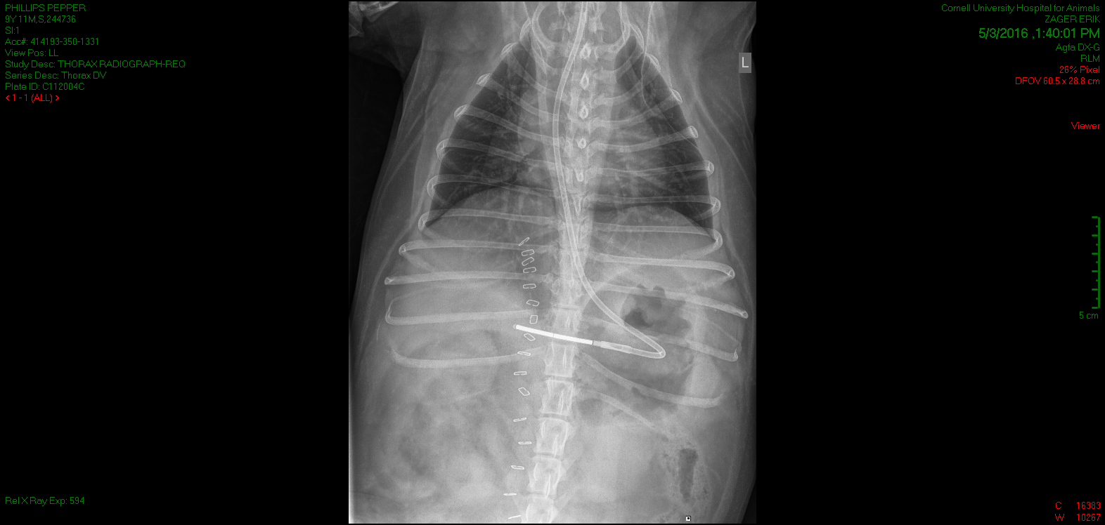

Slide 32
Chest rads
Negative for thoracic cause of inflammatory leukogram
  Mild to moderately reduced thoracic volume
  Mild pleural fluid
  Placement of NG tube
  Moderate volume peritoneal effusion
  Post op cholecystectomy and bile duct repair
  Incidental transition vertebrae T13

Slide 33
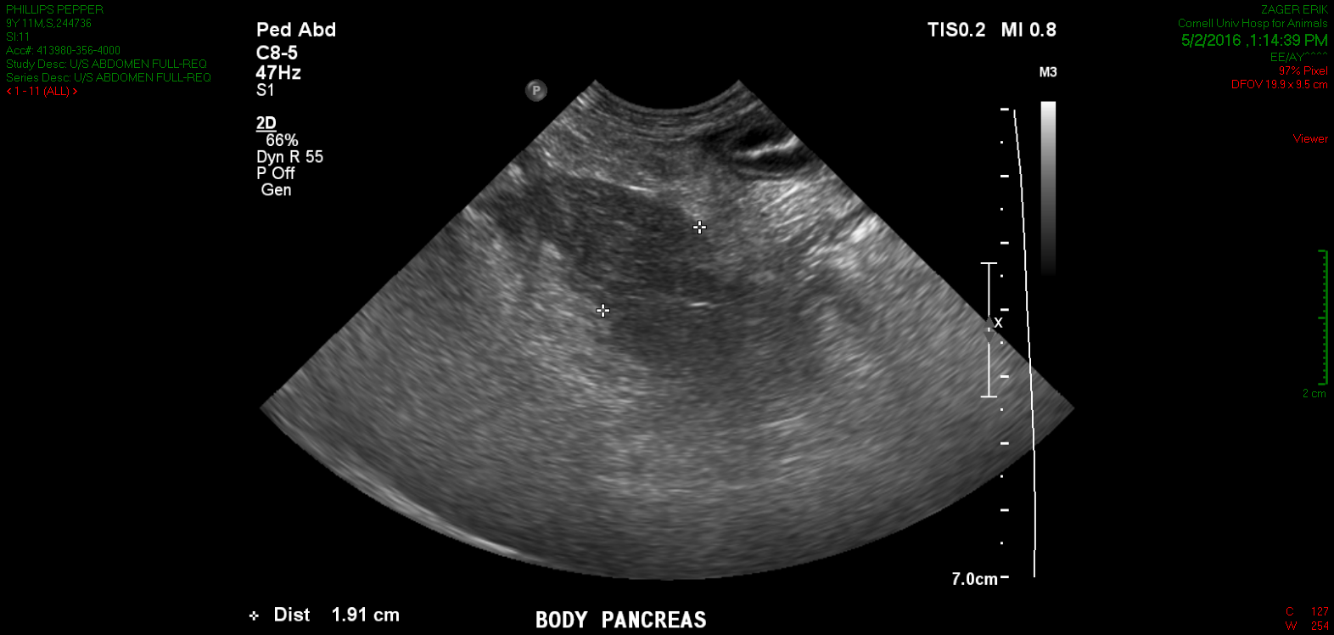
Repeat Abdominal US
New moderate volume echoic fluid and diffuse hyperechoic mesentery
Post surgical cholecystectomy and bile duct closure without deterioration of the bile duct region
New moderately enlarged, hypoechoic pancreas with focal hyperechoic mesentery
New mild lymphadenopathy, pancreaticoduodenal (reactive)
Degenerative change, bilateral kidneys and similar mild pyelectasia
Resolved splenic nodules

Slide 34
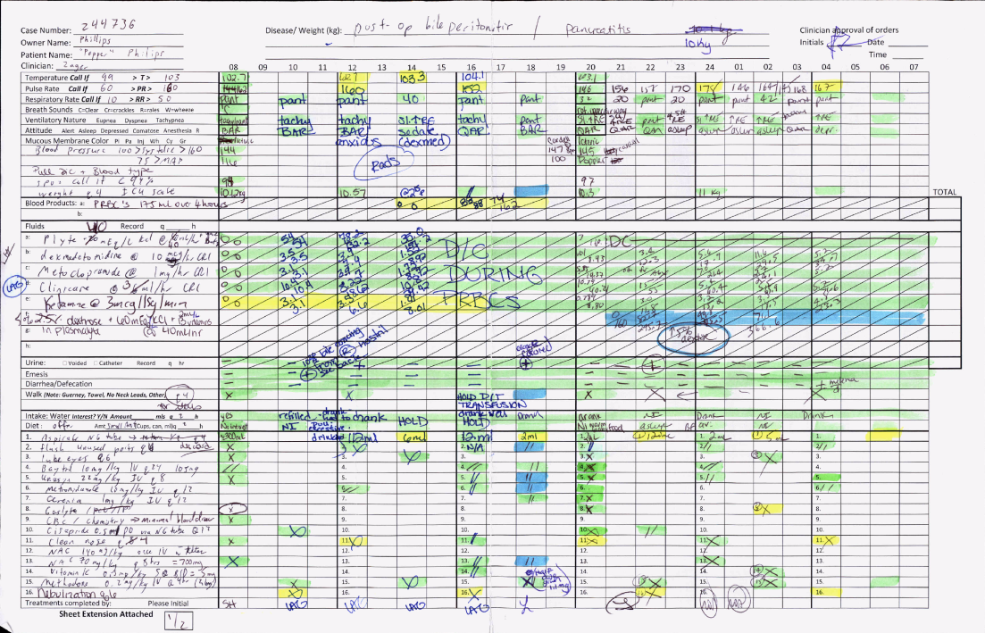

Slide 35
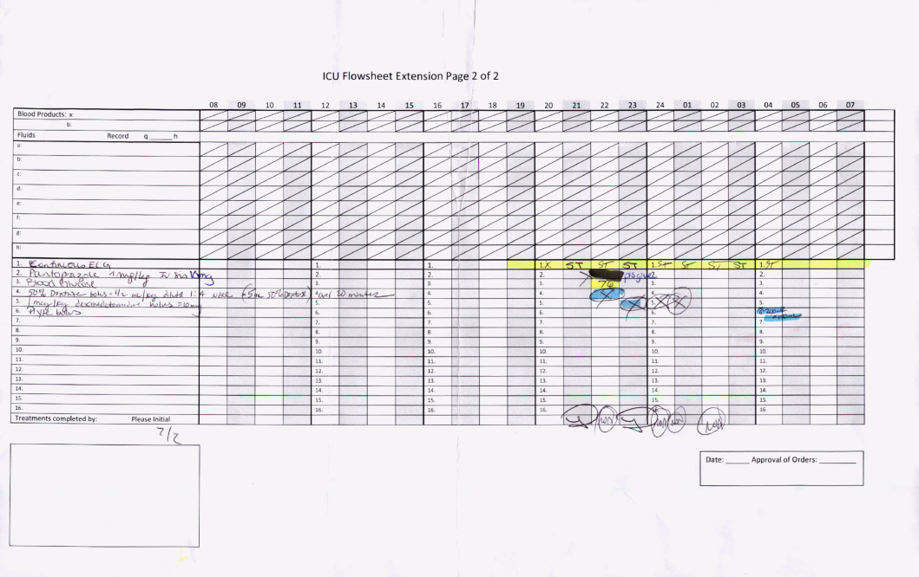

Slide 36
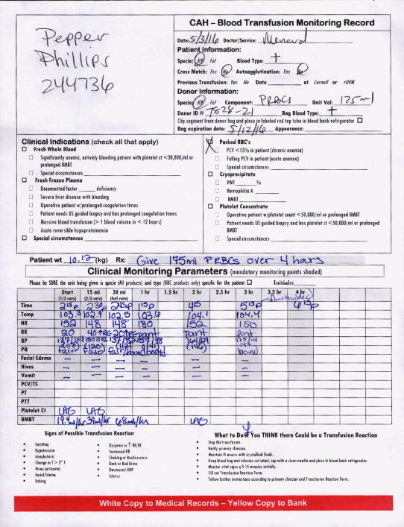
Transfusion pRBC

Slide 37
5/4: 4 days post op
~ 4:30 AM Pepper neurologically abnormal , heart rate dropped and agonal breathing. Owner elected euthanasia. Dyspneic and orthopneic HR ~ 160 prior to CA. spontaneous return of heart beat after 30 seconds but bradycardic with severe arrhythmias. Pulses very weak.

Slide 38
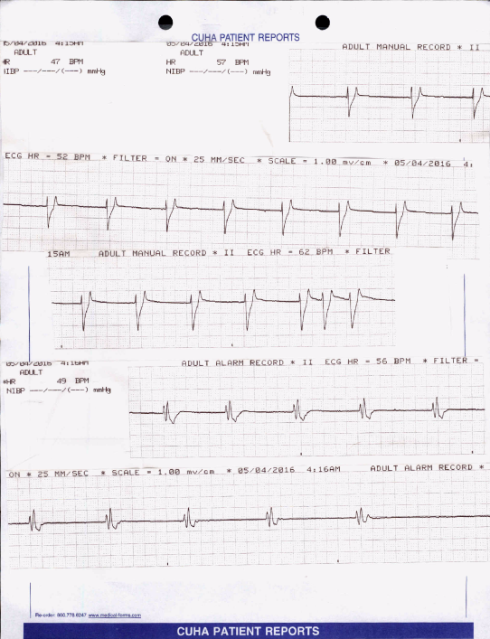
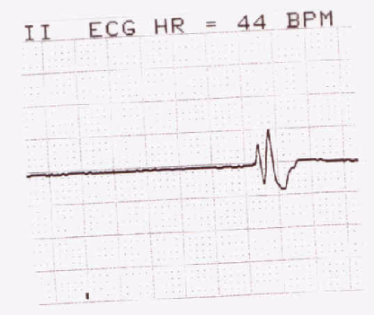

Slide 39
Anatomic Pathology
Liver Histopathology
  Moderate generalized subacute suppurative lymphohistiocytic cholangiohepatitis with biliary hyperplasia, ductular reaction, focal parenchymal extinction and widespread regeneration (bacterial infection suggested)
  Moderate generalized microvesicular lipidosis (hepatocelular injury)
  Mild generalized dissecting fibrosis
  Moderate lto (perisinusoidal)cell hyperplasia
Gallbladder
  Mucocele with bilirubinates, mild papillary hyperplasia, compressive necrosis, granulation tissue and fibrin thrombi

Slide 40
Bacteriology – Culture Results
Bile: no growth on aerobic or anaerobic culture

Slide 41
Anatomic Pathology – Necropsy
Euthanasia
Bile Peritonitis (abdominal viscera, diaphragm, common & cystic bile duct, liver)
Kidney: Moderate, multifocal chronic lymphoplasmacytic interstitial nephritis with tubular protein bile and hemoglobin casts, tubular degeneration necrosis and regeneration and chronic infarct
Spleen: moderate extramedullary hematopoiesis with erythrophagocytosis
Left adrenal glands: cortical adenoma
Lip: collagenous hamartoma
Heart: Mild valvular endocardiosis

Slide 42
Gross Pathology
Peritoneum, omental, mesenteric and perirenal adipose tissue: severe, acute multifocal to coalescing necrotizing steatitis with bile staining and serosanguineous peritoneal effusion (bile peritonitis)
Peri-pancreatic adipose tissue: Moderate subacute necrotizing steattis
Extrahepatic bile duct: moderate, chronic diffuse choledochitis with periductular fibrosis
Liver: severe diffuse hepatopahty, body: diffuse icterus
Skin: mild acute generalized petechiae
Kidneys: moderate chronic multifocal infarcts
Heart: Left AV valve with moderate chronic multifocal to coalescing endocardiosis
Surgical site of the gallbladder cystotomy was secure and intact in situ and the common bile duct did not have a grossly evident defect.

