Slide 1
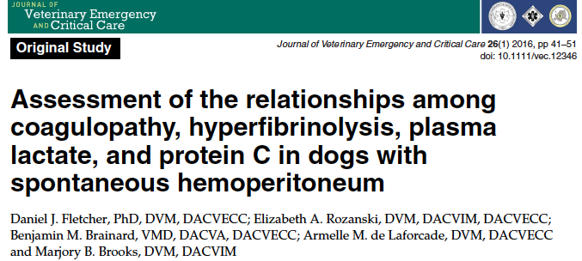
Journal Club 2/25/2016
Francesca Di Mauro

Slide 2
Research Question
Does shock severity (assessed by lactate at admission) affect coagulation and fibrinolysis in dogs with SHP vs age and breed related controls
Does this have an effect on transfusion requirements
Notes:
Is there evidence of coagulation or fibrinolysis derrangements in dogs with SHP? NO

Slide 3
Study Design
Prospective
Observational
Case-control study
Multicenter – 3 veterinary teaching hospitals
28 client owners dogs with SHP
28 breed and age matched controls

Slide 4
Selection Criteria: SHP group
Diagnosis of SHP
Confirmed with abdominocentesis
Exclusion: traumatic, hemoperitoneum, severe thrombocytopenia, NSAID/steroid/aspirin administration or disease known to affect coagulation or fibrinolysis

Slide 5
Selection Criteria: Control group
Age and breed associated
‘Healthy’

Slide 6
Predictor Variables
Lactate on admission
  Measured with benchtop and POC analyzer
  Nova (0.4-20mmol/L) vs Lactate Pro (0.8-23.3mmol/L)
  Good agreement (Thronloe CVP 2007)
Notes:
Predictor variables: what might cause or predict changes in outcome variable

Slide 7
Outcome Variables
Do dogs with SHP demonstrate hypocoagulability and hyperfibrinolysis compared to controls
  Platelet count, PT, aPTT, Fibrinogen, Antithrombin, Protein C, TEG
  Fibrinolysis testing (D-dimer, TEG lysis parameters with and without addition of tPA - 50U/mL vs 100U/mL)
Notes:
Outcome variables – what are investigators trying to predict?

Slide 8
Outcome Variable
Is the severity of disturbances associated with:
1. Severity of shock?
  Measured using admission lactate
2. Activity and depletion of protein C
3. Increasing transfusion requirements

Slide 9
Results: Animals
22 went to surgery
18 survived
3 euthanized at surgery or post-op
1 died post-op
Diagnoses: HSA 71%, Hepatocellular carcinoma (11%), 1 benign hematoma, 1 adrenal carccinoma, 1 prostatic carcinoma, 1 histiocytic sarcoma, 1 splenic soft tissue sarcoma

Slide 10
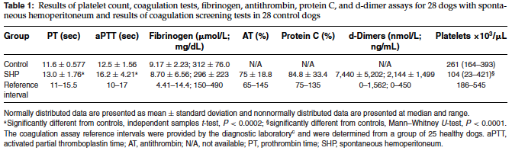
Results: Coagulation
1
2
3

Slide 11
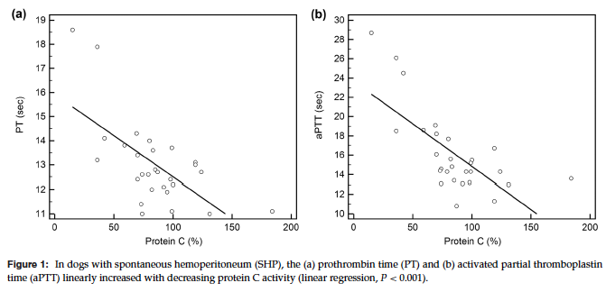
Results: Coagulation
*Only protein C activity was independently associated with aPTT and PTT
*Decreasing protein C activity associated with increases in clotting times

Slide 12
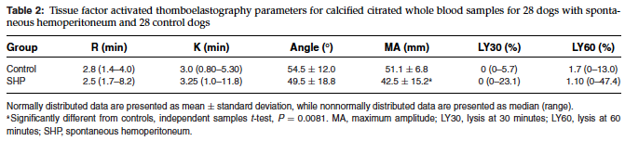
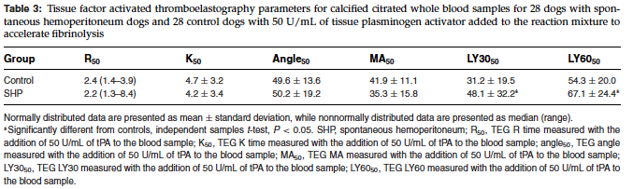
Results: Fibrinolysis
1
2
3
1

Slide 13
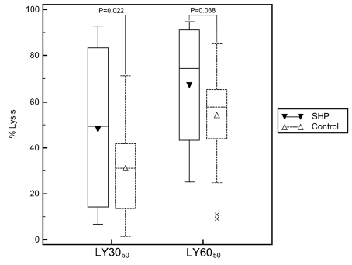

Slide 14
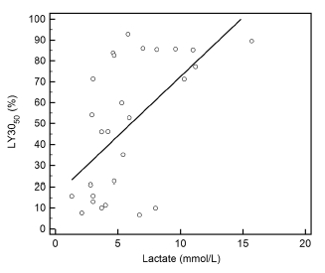

Results: Fibrinolysis

Slide 15
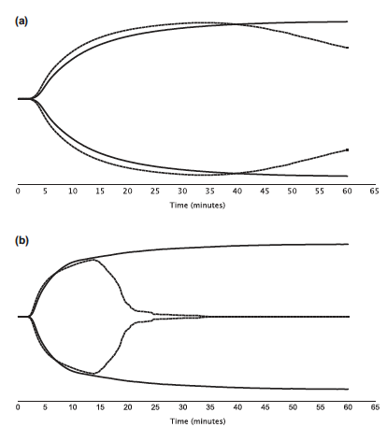
TEG

Slide 16
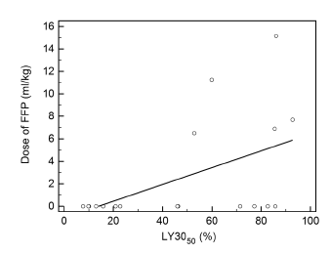
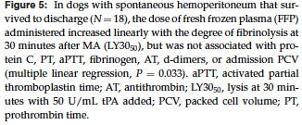

Slide 17
Main Points
Dogs with SHP show features of hypocoagulability and hyperfibrinolysis
  Associated with severity of shock as reflected in blood [lactate]
Suggests that treatment with antifibrinolytic drugs may reduce blood loss in these patients
  inexpensive alternative to blood products

Slide 18
Conclusions
Potentially represent novel therapeutic target
Prospective trials evaluating the efficacy and safety of antifibrinolytic drugs in dogs with SHP needed
  Does this improve outcome in SHP?
  SHP due to neoplasia vs trauma?
  Larger population needed

Slide 19
Conclusions
Use of antifibrinoytic drugs for patients at risk of enhanced fibrinolysis is currently recommended in human medicine based on results of large scale clinical trials
  Regardless of lab documentation of hyperfibrinolysis
  Similar approach necessary in vet med

Slide 20
Conclusions
The severity of coagulation abnormalities are associated with protein C deficiency in this population

Slide 21
Conclusions
Severity of hyperfibrinolysis (as measured by LY30) at admission was associated with total dose of plasma administered during hospitalization

Slide 22
Research question answered?
Is there evidence of coagulation or fibrinolysis derrangements in dogs with SHP

Slide 23
Research Question Answered?
Does shock severity (assessed by lactate at admission) affect coagulation and fibrinolysis in dogs with SHP vs age and breed related controls
Does this have an effect on transfusion requirements
Is there evidence of coagulation or fibrinolysis derangements in dogs with SHP?

Slide 24
Conclusions
Further studies of blood product usage in larger cohort with better defined transfusion criteria
  To investigate relationship between hyperfibrinolysis at admission and rbc and plasma requirements
  To determine if finding of an association between admission LY30 and plasma transfusions is truly indicative of an association between admission LY30 and bleeding tendencies
  Or statistical anomaly due to the small sample size

Slide 25
Study Limitations: Measure of Fibrinolysis
27/28 dogs had increased d-dimers
  This may reflect normal lysis secondary to increased fibrin formation rather than primary pathologic up regulation of fibrinolytic system

Slide 26
Study Limitations: Measure of Fibrinolysis
LY30 and LY60 TEG parameters assess fibrinolytic potential by quantifying the degree of clot lysis over time in whole blood
  Assay limited by absence of local contributors to fibrinolysis such as endothelial cells and blood cell and platelet responses to endothelial damage
  May not reflect in vivo fibrinlytic potential in areas of endothelial damage

Slide 27
Study Limitations
Cannot rule out possibility that differences in fibrinolysis between control group and SHP dogs were due to underlying malignant disease rather than to effects of tissue injury and shock

Slide 28
Study Limitations
96% of dogs had SHP secondary to malignant neoplasia
  Possible that hemostatic abnormalities in study may not generalize to animals with other causes of hemoperitoneum (i.e. trauma)
  Vascular neoplasms like HAS can have independent effects on fibrin generation

Slide 29
Study Limitations
Coag and fibrinolysis testing only done at single time point (@ hospitalization)
  How would these parameters change after administration of EACA or TXA
Criteria for administration of blood products were not standardized
  Given at discretion of the attending clinician

Slide 30
Study Limitations
Conclusions regarding hemostatic derangements and severity of shock must be interpreted cautiously
  Absence of robust measure of shock severity
  Lactic acidosis type B?
Notes:
Reduced clearance secondary to neoplasia/malignant disease, not reflective of shock severity

