Slide 1
WHAT I’VE LEARNED AT IVECCS 2015
Jo-Annie Letendre, DVM

Slide 2
BETA-BLOCKERS IN SEPSIS
To achieve HR control and improve morbidity & mortality
Initially: increase in HR to improve CO
Over time: elevated HR = detrimental
  Increased risk of major cardiac adverse events
  Increased duration of ICU hospitalization
  Inreased myocardial oxygen
  Decreased diastolic filling and coronary perfusion
  Poor outcome
Notes:
Increased HR to compensate for hypovolemia, low SVR, and changes in BP, increase HR to increase CO.
n critically ill human patients, myocardial dysfunction and damage secondary to sepsis contributes to clinical outcomes, and persistent tachycardia despite treatment of hypovolemia, anemia and pain or agitation has been shown to significantly increase the risk of major cardiac adverse events and duration of ICU hospitalization.
Prolonged elevations in heart rate may result in increased myocardial oxygen demand and decreased diastolic filling and coronary perfusion, increasing the risk of a poor outcome

Slide 3
Literature Review
Wien Klin Wochenschr. 2012 Aug;124(15-16):552-6
  n = 10 septic patients, on NE CRI
  HR decreased from 142 to 112 bpm (significant)
  NSD in CO, CI, DO2, VO2, OER, lactate, PAWP, NE infusion rate
  Conclusion: no adverse impact on global hemodynamic

Slide 4
Literature Review
JAMA. 2013;310(16):1683-1691
  n=77 patients (esmolol); 77 controls
  Reduction in HR
  Improved stroke volume and left ventricular stroke work indices, systemic vascular resistance
  Needed less norepinephrine and IV fluid
  Improved kidney function, lactate and pH
  40% reduction in mortality
Notes:
HR between 80-94 bpm
LVSWI (Left Ventricular Stroke Work Index) measures the amount of work the left ventricle does during each contraction. It is a means of evaluating the pumping function of the left ventricle. It is the best measurement of contractility.
SV x (MAP - PAWP) x 0.0136
Reduced toxic effects of catecholamines and improved stroke volumes with longer diastolic filling times

Slide 5
Literature Review
Zhonghua Wei Zhong Bing Ji Jiu Yi Xue. 2014; 26(10):714-7
  From abstract (text in Chinese)
  n = 21 (study); n = 20 (control)
  Reduced HR and CI
  Improved SVRI and GEDVI
  NSD: MAP, CVP, SVI
  Faster reduction in cardiac troponin
  NSD: ScvO₂
Notes:
HR and CI in the treatment group were gradually declined after treatment, SVRI and GEDVI were gradually increased. There were significant differences in HR, CI, SVRI, and GEDVI between treatment group and control group from 12 hours on [HR (bpm): 93 ± 4 vs. 118 ± 13, CI (L × min⁻¹ × m⁻²): 3.3 ± 0.8 vs. 4.5 ± 0.6, SVRI (kPa×s × L⁻¹ × m⁻²): 159.2 ± 27.4 vs. 130.5 ± 24.2, GEDVI (mL/m²): 668 ± 148 vs. 588 ± 103, P<0.05 or P<0.01]. MAP, CVP and SVI in the treatment group showed no significant changes. (3) Lac after treatment in both groups was decreased slowly, Lac (mmol/L) at 12 hours after treatment was significantly decreased compared with that before treatment (control group: 8.8 ± 3.2 vs. 9.8 ± 3.4, treatment group: 9.5 ± 3.1 vs. 10.5 ± 4.1, both P<0.05). The Lac of control group and treatment group were 2.5 ± 1.2 and 2.7 ± 1.1 at 72 hours after treatment, and there was no significant difference between two groups (all P>0.05). The ScvO₂was not decreased in both groups. (4) Compared with before treatment, cTnI in the control group was gradually increased, peaked at 72 hours, and that in the treatment group was gradually increased, peaked at 24 hours and then gradually declined. Compared with control group, the cTnI (μg/L) in the treatment group was decreased significantly at 24, 48, 72 hours (1.15 ± 0.57 vs. 1.74 ± 0.77, 0.93 ± 0.52 vs. 2.15 ± 1.23, 0.52 ± 0.36 vs. 2.39 ± 1.17, all P<0.01).
CONCLUSIONS:
β-blockers (esmolol) can improve cardiac function and myocardial compliance, reduce the myocardial injury in patients with sepsis shock. Although β-blockers can decrease cardiac output, it has no influence on the circulation function and tissue perfusion

Slide 6
Other Possible Effects Of Beta Blockade
Glucose homeostasis
Modulation of cytokine production
  Anti-inflammatory effects
Improved fibrinolytic activity
Notes:
beneficial effects on metabolism, glucose homeostasis, cytokine expression and myocardial function in SIRS and sepsis.
Beta-blockade has also been shown to modulate cytokine production, exerting primarily anti-inflammatory effects;
counteract metabolic dysfunction; and improve fibrinolytic activity in the procoagulant state that may develop in SIRS
and sepsis

Slide 7
Do You Use Beta-blockers In Your Sepsis Patients?

Slide 8
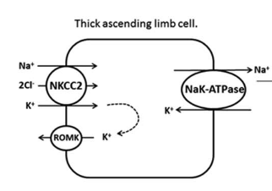
ROMK
Renal Outer Medullary K+ Channel
  ATP-dependent
  Thick ascending limb of Henke
    K+ recycling
Notes:
Connecting tubule and cortical collecting duct
K+ secretion

Slide 9
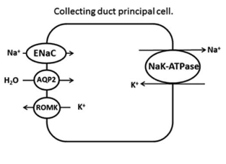
ROMK
Renal Outer Medullary K+ Channel
  Connecting tubule and cortical collecting duct
    Principal cells
    Aldosterone
    Magnesium
      Limits amount of K+ excreted
      Hypomagnesemia
Notes:
ROMK-mediated K⁺ transport is dependent on the driving force for K⁺ secretion, which is primarily determined by electrogenic ENaC-mediated sodium reabsorption (71). Thus, as the activity of ENaC increases in the late DCT, more sodium is reabsorbed, which generates a lumen-negative stimulus for K⁺ efflux through ROMK potassium channels.

Slide 10
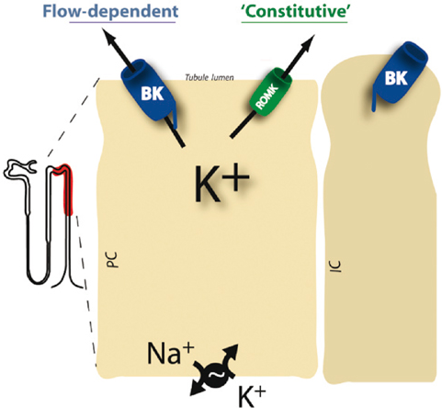


BIG K
Notes:
Flow-dependent, activated with higher flow of urine, so allow excretion of more potassium

Slide 11
Stem Cells In Critical Care
Regenerative medicine
Paracrine effects
  Immunomodulation
  Antibacterial properties
  Interaction with the innate and adaptive immune systems
  Interaction with pathogens
Notes:
As stem cells can incorportate into recipient tissue, differientiate and repair and regenerate tissue
migrate to sites of injury and inflammation in the body, where they generate cytokines, chemokines
and growth factors, in response to the inflammatory state of the tissues, so as to promote tissue repair.6,9 MSCs exert
profound immunomodulatory effects and have antibacterial properties in the context of inflammation and infection,
interacting with both the innate and adaptive immune systems and the pathogens themselves

Slide 12
Stem Cells In Critical Care
ARDS
  Anti-inflammatory
  Permeability
  Alveolar fluid clearance
  Phagocytic activity
  Anti-apoptotic
  Phase I: START trial (STem cells for ARDS Treatment trial)
    Safe
  Phase II: efficacy and safety
Notes:
Potential
mechanisms of the therapeutic success of MSCs in ARDS models include anti-inflammatory effects, reduction in
permeability of the alveolar epithelium and vascular endothelium, improvement in alveolar fluid clearance, enhanced
phagocytic activity of monocytes, macrophages and neutrophils, anti-apoptotic effects, and mitochondrial transfer

Slide 13
Stem Cells In Critical Care
Cats with CKD
  Adverse effects, no relevant improvement
Cats with asthma
  No short-term effect
    BALF IgE, serum or BALF IL-10 or CD4+ T lymphocyte differentiation
  Long-term
    Less global lung attenuation and lower bronchial thickening scores on thoracic CT
    Not sustained at 12 months – need to repeat tx?
Abdominal sepsis

Slide 14

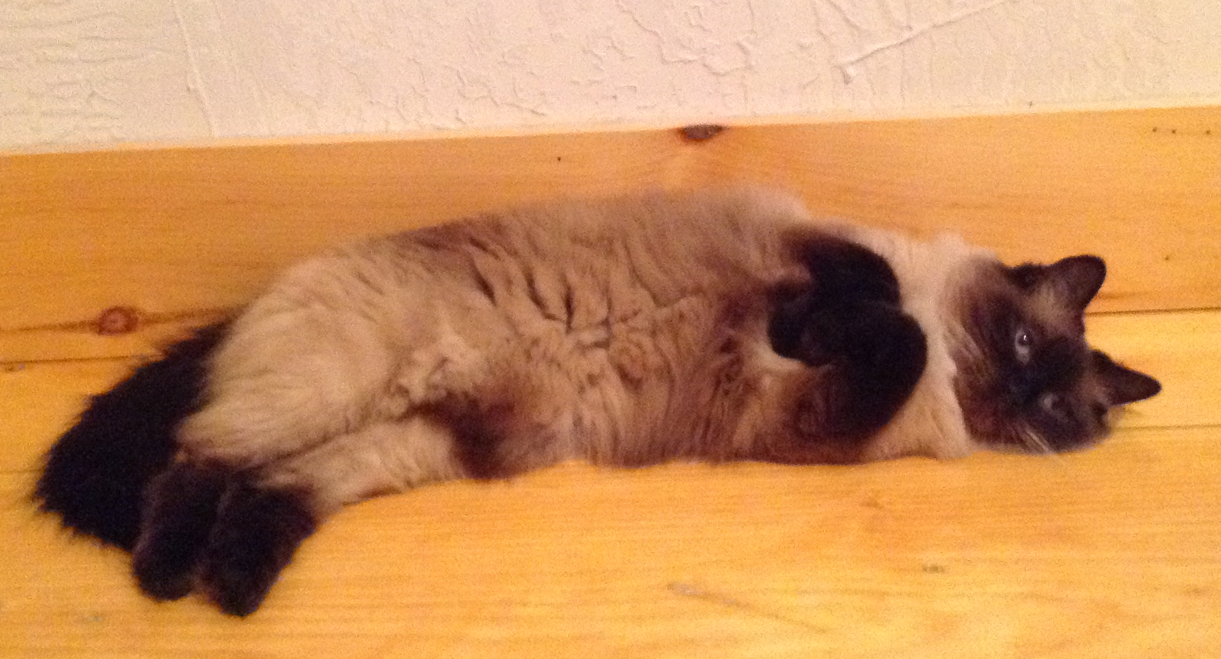
PLATELETS
RESTING PLATELET
ACTIVATED PLATELET

