Slide 1
Endothelium and the Glycocalyx
Josh Smith

Slide 2
Overview
Physiology
  Endothelium
  Glycocalyx
  Starling and fluid exchange
Dysfunction
  Sepsis
  Fluid Therapy
Treatment
Take Homes

Slide 3
Endothelium
Previously thought endothelium was inert
  Layer of nucleated cellophane
  Non-reactive barrier properties
  Non-thrombogenic surface for blood flow and
  Guarding against pro-inflammatory insults

Slide 4
Endothelium
Single layer of endothelial cells lines the entire vascular system
In adults, approximately ten trillion cells
  Form an almost 1 kg of organ
Semipermeable
Regulates the transfer of small and large molecules
Dynamic
Metabolic and synthetic functions

Slide 5
Endothelium
Differ in size, shape, thickness, and nuclear orientation from different sites of the vascular system
Metabolically active barrier
Can simultaneously receive messages from the underlying metabolically active tissue and send messages to the underlying tissue or the flowing blood

Slide 6
Endothelium
Tight Junctions – two properties
First allows selected paracellular passage of ions, water, and other molecules (gate function)
Second allows no passage but maintains cell polarity (fence function)

Slide 7
Endothelium
Caveolae are invaginations in the cell membrane and are important vesicle carriers responsible for transcellular transport (transcytosis) in endothelial cells
Transcytosis via caveolae is the primary means of albumin transport across endothelium
Albumin

Slide 8
Endothelium
The endothelium and smooth muscle cells of arteries and arterioles are coupled both structurally and functionally
Conduction along the arteriole is attributable to gap junctions coupling contiguous cells
Local depolarization and hyperpolarization of the capillary endothelial cell and communication is achieved by an electronic transmission via endothelial-smooth muscle cell-to-cell gap junctions

Slide 9
Endothelium
The endothelium surface is composed of multiple transport systems for glucose and amino acids
Makes possible the intracellular transport of L-arginine, the substrate for nitric oxide synthase
NO is a key mediator involved in the control of vasomotor tone
NO can be released in response to two distinct stimuli:
Mechanical (shear stress)
Humoral (via a receptor- mediated pathway)

Slide 10
Endothelium - mechanical
Shear Force
Ca2+
L-arginine
Endothelium
NOS
NO + citrulline
Smooth
Muscle
NO
GC
cGMP
GTP

Slide 11
Endothelium - humoral
Ach
Bradykinin
Insulin
Substance P
Ca2+
L-arginine
Endothelium
NOS
NO + citrulline
Smooth
Muscle
NO
GC
cGMP
GTP

Slide 12
Endothelium
Also produces vasoconstrictors
Endothelin – 1 is major vasoconstrictor
ET-1 exerts vasoconstrictor actions through stimulation of ETA receptors in vascular smooth muscle and vasodilator actions through stimulation of ETB receptors in endothelial cells

Slide 13
Endothelium
There are seven facilitative glucose transporters of the GLUT supergene family but only GLUT-1 and GLUT-4 are expressed in endothelial cells
Regulation of GLUT-4 expression is an essential process in the modulation of glucose transport and is particularly important in diabetes and hypoxemia
The blood-brain barrier is the major endothelial tissue expressing GLUT transporters
GLUT-1 is the most abundant isoform in endothelial cells.
GLUT 1

Slide 14
Endothelium
Endothelial cells also regulate leukocyte movement into tissues
Regulated process involving adhesion molecules
Endothelial cells express E-selection, P-selectin, intercellular adhesion molecule-1 (ICAM-1) and vascular cell adhesion molecule (VCAM)

Slide 15
Endothelium
Under basal conditions, endothelial cells synthesize and express Tissue Factor Pathway Inhibitor (TFPI)
Heparan sulfates at the endothelial extracellular matrix enhance the inhibitor activity of antithrombin
TF
AT
TFPI
Heparan Sulfate

Slide 16
Endothelium
Thrombin binds to thrombomodulin expressed on the endothelial cell surface
This complex activates Protein C
Protein C and Protein S bind together
Inactivates activated cofactors V and VIII
Protein C
Th
Activated PC
TM

Slide 17
Endothelium
Fibrinolysis is induced by thrombin through endothelial release of tissue plasminogen activator (tPA)
Activity is controlled by plasminogen activator inhibitor (PAI)-1
tPA is constitutively expressed by endothelial cells
  The main source of this enzyme
Endothelial cells produce urokinase plasminogen activator

Slide 18
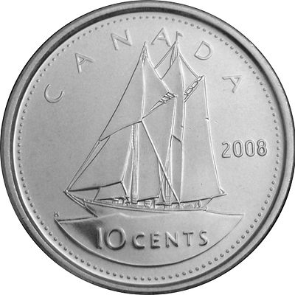
Endothelium
tPA
Plasminogen
Plasmin
D-

Slide 19
Glycocalyx
Complex and multicomponent layer of macromolecules at the luminal surface of vascular endothelium
This concept was proposed more than 70 years ago
First seen by EM in 1966
Only recently has it been studied
Still holds many mysteries

Slide 20
Glycocalyx
Comprised of sulfated proteoglycans, hyaluronan, glycoproteins, and plasma proteins that adhere to this surface matrix
These constituents form a tight and negatively charged meshwork
Proteoglycan
Glycosaminoglycans
Hyaluronan
Plasma proteins

Slide 21
Glycocalyx
The EGL is semi-permeable with respect to anionic macromolecules such as albumin and other plasma proteins
Size and structure appear to determine their ability to penetrate the layer
May see excessive penetration through damaged layer

Slide 22
Glycocalyx - Function
Protection: Cushions the plasma membrane and protects it from chemical injury
Immunity to infection: Enables the immune system to recognize and selectively attack foreign organisms
Defense against cancer: Changes in the glycocalyx of neoplastic cells enable the immune system to recognize and destroy them
Transplant compatibility: Forms the basis for compatibility of blood transfusions, grafts and organ transplants
Cell adhesion: Binds cells together so that tissues do not fall apart
Inflammation regulation: Glycocalyx coating on endothelial walls in blood vessels prevents leukocytes from rolling/binding in healthy states

Slide 23
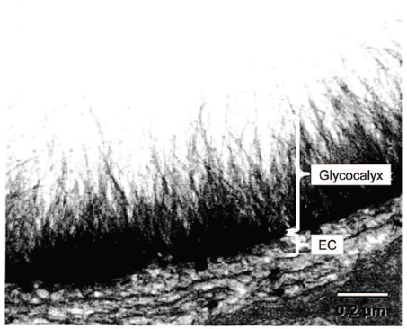
Glycocalyx
Glycocalyx/ESL thickness is substantially greater than endothelial cell (EC) thickness
700 ~ 1000 mL of “non-circulatory” plasma fixed within
  Adult human

Slide 24
Glycocalyx
The interactions between GAGs and proteins is highly dependent on the conditions of their local microenvironment
  Cation content and concentration, and pH
Endothelial cells actively regulate the content and physicochemical properties of GAGs on their surface
High rates of continuous metabolic turnover that allow adaptation to changes in the local environment
Glycocalyx matrix and endothelial permeability also changes based on type of vessel/location

Slide 25
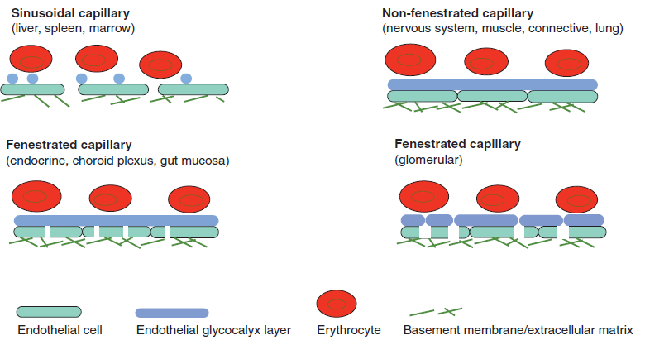

Slide 26
Glycocalyx - GAGs
GAGs are linear polydisperse heteropolysaccharides, characterized by distinct disaccharide unit repeats
Specific combinations of these give rise to different GAG families, such as
  Heparan sulfate (HS)
  Chondroitin sulfate (CS)
  Hyaluronic acid or hyaluronan (HA)
Proteoglycans are proteins that contain specific sites where sulfated GAGs are covalently attached

Slide 27
Glycocalyx - GAGs
Heparan sulfate serves as a dominant structural component in the glycocalyx
Chondroitin sulfate and hyaluronan contribute significantly to vascular permeability
Hyaluronan is the only GAG that is not covalently linked to other proteins and has no negatively charged sulfate groups

Slide 28
Glycocalyx - PGs
Endothelial-bound glycoproteins and proteoglycans including the syndecan and glypican families
Carry negatively charged GAG side chains
The core protein groups span the cell membrane (syndecans) or insert into the membrane with a glycosylphosphatidylinositol anchor (glypicans)
Syndecan
Glypican
Cell membrane
Cell membrane

Slide 29
Glycocalyx - Syndecans
Syndecans-1, -2, and -4 are expressed on ECs and have three GAG attachment sites
Almost exclusively heparin sulfate
Syndecan-1 contains two additional sites that are close to the membrane and reserved for chondroitin sulfate
Transmembrane cytoplasmic tails associate with the cytoskeleton and assist in its organization, through molecules such as tubulin, dynamin, and α-actinin

Slide 30
Glycocalyx - Glypicans
Glypican-1 is the only one expressed on ECs
Close to the membrane, its three to four GAG attachment sites are exclusively substituted with HS
Glypican-1 is bound directly to the plasma membrane through a C-terminal glycosylphosphatidylinositol (GPI) anchor
GPI anchor localizes this proteoglycan to lipid rafts, which are cholesterol- and sphingolipid-rich membranous domains involved in vesicular transport and cell signaling

Slide 31
Glycocalyx - Glypicans
Remember calveolae? 20 slides back?
Caveolae can be considered a subset of lipid rafts, which arise from the incorporation of protein caveolin-1
They are a cholesterol carrier inserted into the membrane, where they may form characteristic cave-like structures
Can be stimulated to transport more albumin into and across ECs
Albumin

Slide 32
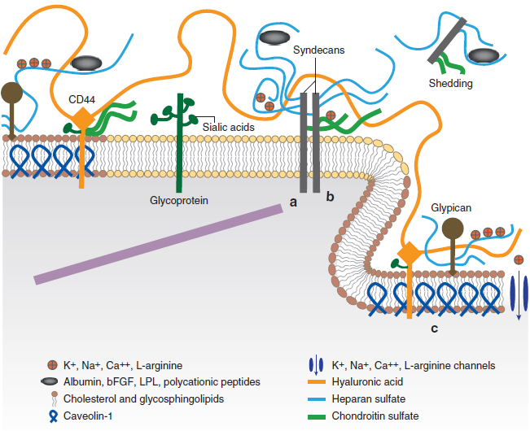

Slide 33
Fluid exchange - Starling
Model of Ernest Starling published as early as in 1896
High proportion of outwardly directed hydrostatic pressure in the arterial capillaries should lead to leakage of intravascular fluid into the interstitial space while
The venous part of the capillary should have an inward directed oncotic pressure inducing a re-absorption of this extravasated fluid
Jv =[Lp A (Pc - Pi)] – [σ (πc – πi)]

Slide 34
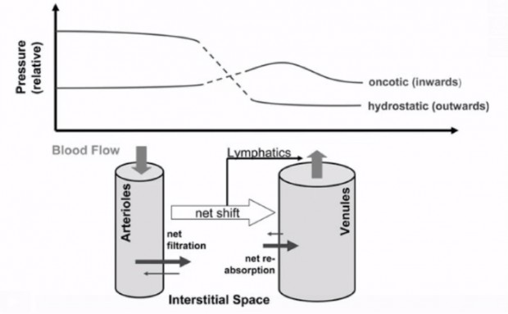
Fluid exchange - Starling

Slide 35
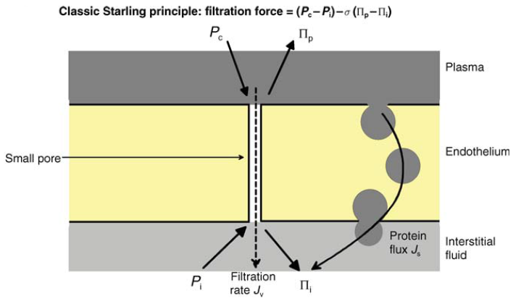
Fluid exchange - Starling

Slide 36
Fluid exchange – Starling problem
1. The protein concentration in the interstitial fluid equals that measured in the intravascularly
About 70% of the intravascular oncotic pressure can be found in the interstitial space
2. The capacity of the lymphatic system to drain extravasated fluid is limited and not as high as would be required to sufficiently retain interstitial edema

Slide 37
Fluid exchange - New Starling Equation
Jv = Lp A {(Pc − Pi) − σ (πp − πg)}
Pc = Pressure in capillary
Pi = Pressure in interstium
πp = colloid osmotic pressures exerted by plasma
πg = colloid osmotic pressures exerted by the ultrafiltrate on the underside of the glycocalyx

Slide 38
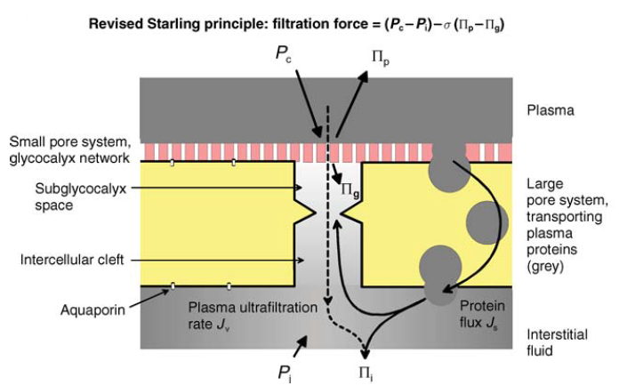
Fluid exchange - New Starling Equation

Slide 39
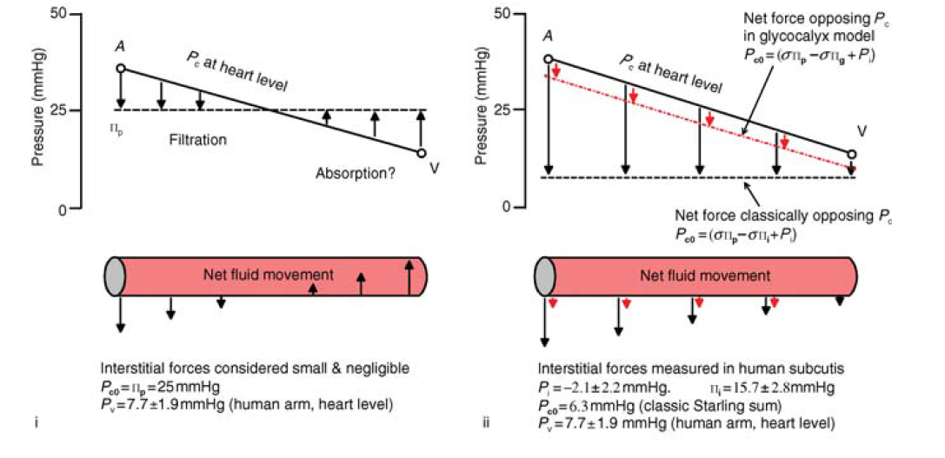

Slide 40
Fluid exchange
Absorption of fluid from interstitium to plasma does not occur, even at reduced capillary pressure
The inter-endothelial cell channels are normally capped by the intraluminal fiber matrix of glycocalyx
Filters fluid that is almost protein-free to the sub-glycocalyx ‘protected region’
At reduced capillary pressure, the velocity of the convection current through the inter-endothelial channels (majority of Jv) approaches zero
Colloid oncotic pressure in the protected region rises as soluble proteins diffuse back from the interstitium
Reduces delta-P between plasma and the protected region that opposes Jv

Slide 41
Fluid exchange
With very acute fall of the trans-endothelial pressure difference (delta-P), there may even be a transient reversal of the convection current
The glycocalyx model thereby preserves a state of minimal filtration even when delta-P is low
Intravenous colloid therapy cannot promote absorption and cannot help to prevent or treat interstitial edema
If endothelial injury is severe enough to destroy the fiber matrix cap of an inter-endothelial channel, the protected region is lost

Slide 42
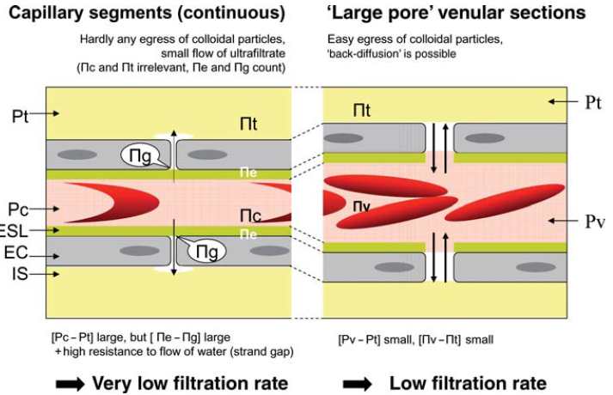
Fluid Exchange
The low filtration–low resorption concept of microvascular fluid homeostasis
An intact endothelial glycocalyx and attached plasma protein molecules, oncotically limits fluid movement across the vascular wall

Slide 43
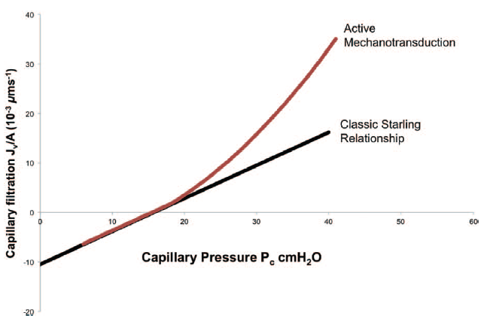
Fluid exchange -Mechanotransduction
During active endothelial mechanotransduction, capillary hydrostatic pressure activates signaling pathways that increase endothelial permeability
Results in nonlinear dynamics and a higher water flux than would be predicted by the summation of net Starling forces

Slide 44
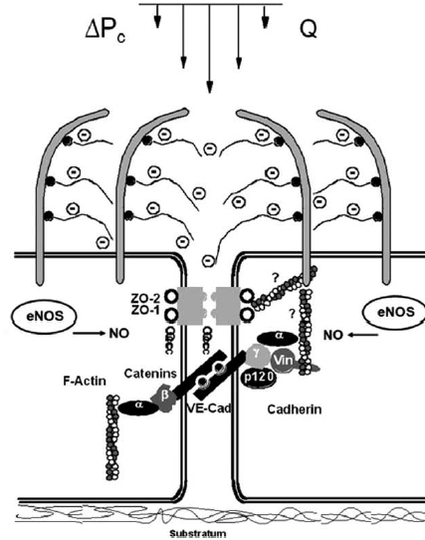
Fluid exchange
During increased vascular pressure, the increased hydraulic flow through the glycocalyx deforms or stresses the glycosaminoglycan fibers
Activates endothelial nitric oxide synthase (eNOS) and leads to barrier dysfunction

Slide 45
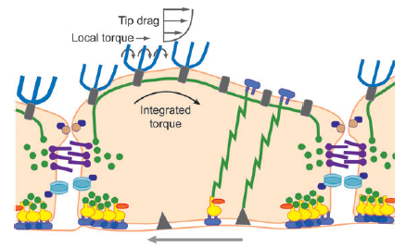
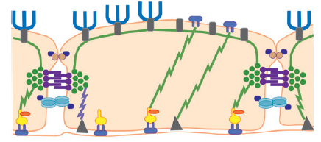
Mechanotransduction

Slide 46
Glycocalyx - Pathology
Partial (shedding)
  Selective cleavage of sulfate side chains (heparinase) or of receptor-bound chains (hialuronidase)
Total destruction of glycocalyx
  Capillary leak syndrome
  Edema formation
  Accelerated inflammation
  Platelet hyperaggregation
  Hypercoagulation
  Loss of vascular tone response

Slide 47
Glycocalyx shedding
TNFα
Redox stress and oxidized lipoproteins
Lipopolysaccharide
Thrombin
Ischemia/reperfusion
Hyperglycemia
Hypervolemia -> ANP
Hypernatremia
Artificial colloids such as hydroxyethyl starch (HES)
  Leads to increased hydraulic conductance and of the ESL and vascular permeability

Slide 48
Glycocalyx shedding – I R
Soluble syndecan-1 is used as a marker of glycocalyx shedding
Soluble syndecan-1 increased transiently up to 42-fold after global ischemia induced by circulatory arrest
Surgically induced ischemia showed an elevation in syndecan-1 by 15-20 times

Slide 49
Glycocalyx - Pathology
Sepsis / Inflammation
  Pathophysiology
  Consequences
Fluid therapy
  Pathophysiology
  Consequences
Treatment and recommendations

Slide 50
Glycocalyx - Sepsis
Localized or systemic inflammation leads to changes in structure and physiology of glycocalyx
Inflammation injury to glycocalyx is linked to increased paracellular permeability and outflow of albumin/fluid in the interstitial space through the endothelial cells
Loss of anionic charges, changes in geometry of the clefts, and direct endothelial injury are responsible for this
  Albumin, antithrombin

Slide 51
Glycocalyx - Sepsis
Other observed changes in glycocalyx function during inflammation
  Loss of vascular tone with local blood pooling
  Degradation of heparan sulfate leading to a shift toward a pro-coagulant state with consequent micro-thrombosis
  Enhanced expression of adhesion molecules with increased leukocyte trafficking
  Loss of antioxidative properties with progressive oxidative injury to the endothelium

Slide 52
Glycocalyx - Sepsis
There is experimental evidence that thickness and stiffness of endothelial glycocalyx are reduced by LPS or TNF-α exposure
Clinically these alterations are linked to loss of vascular tone, loss of albumin, hypovolemia, edema formation, and organ dysfunction
One major cause is the activation of the heparanase enzyme.

Slide 53
Glycocalyx - Sepsis
TNFα
LPS
Heparanase activation

Slide 54
Glycocalyx - Sepsis
Exposure to pro-inflammatory mediators such as IL-1, IL-2, IL-6, TNF-α, and other molecules released during acute inflammation such as bradykinin, thrombin, VEGF, and histamine results in endothelial activation
Results massive increase in glycocalyx expression of endothelial leukocyte adhesion molecule 1, intercellular adhesion molecule 1, and vascular cell adhesion molecule 1
Typically more accessible after glycocalyx shedding

Slide 55
Glycocalyx - Sepsis

Slide 56
Glycocalyx - Sepsis
Oxidative stress plays a central role in inflammatory injury to glycocalyx
In vitro, exposure of GAGs to ROS derived from leukocytes (SO● and ●OH) causes fragmentation of GAGs with loss of some of its components
Degradation of glycocalyx will expose the endothelial cells to oxidative damage
Linked to increased porosity, and interstitial loss of albumin observed in severe sepsis

Slide 57
Glycocalyx - Fluids
The underlying cause for the detrimental action of volume loading is presumably to be found in a volume-sensitive regulatory system
The heart releases atrial natriuretic peptide (ANP) into the circulation in the face of mechanical wall stress and also in hypervolaemia
This hormone is known to induce rapid shifts of intravascular fluid into the interstitial space,80 and it also has a parallel effect on the endothelial glycocalyx

Slide 58
Glycocalyx - Fluids
Large volume fluid resus -> Release of ANP!

Slide 59
Glycocalyx - Fluids
Various types of endothelial receptors for natriuretic peptides are all connected to the intracellular cGMP cascade
Interestingly, the elevation of endothelial cGMP levels generally seems to induce microvascular fluid leakage
This could be based on the shedding of the glycocalyx

Slide 60
Fluids – Shear force and mechanotransduction
Shear Force
Ca2+
L-arginine
Endothelium
NOS
NO + citrulline
Smooth
Muscle
NO
GC
cGMP
GTP

Slide 61
Old vs New
1. Intravascular volume consists of plasma and cellular elements
2. The important Starling forces are the transendothelial pressure difference and the plasma–interstitial COP difference
1. Intravascular volume consists of glycocalyx volume, plasma volume, and red cell distribution volume
2. The important Starling forces are the transendothelial pressure difference and the plasma–subglycocalyx COP difference. ISF COP is not a direct determinant of Jv

Slide 62
Old vs New
3. Fluid is filtered from the arterial end of capillaries and absorbed from the venous end. Small proportion returns to the circulation as lymph
4. Raising plasma COP enhances absorption and shifts fluid from ISF to plasma
3. Jv is much less than predicted by Starling’s principle, and the major route for return to the circulation is as lymph
4. Raising plasma COP reduces Jv but does not cause absorption

Slide 63
Treatments
Glucose control
Hydrocortisone in septic shock
N-acetylcysteine
TNFα inhibition
Antithrombin
Infusion of albumin (interacts with glycocalys and promotes vasodilation and increased nutrient blood flow)
Avoidance of natriuretic peptide release
Sevoflurane
Permissive hypercapnia

Slide 64
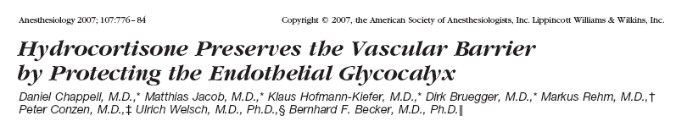
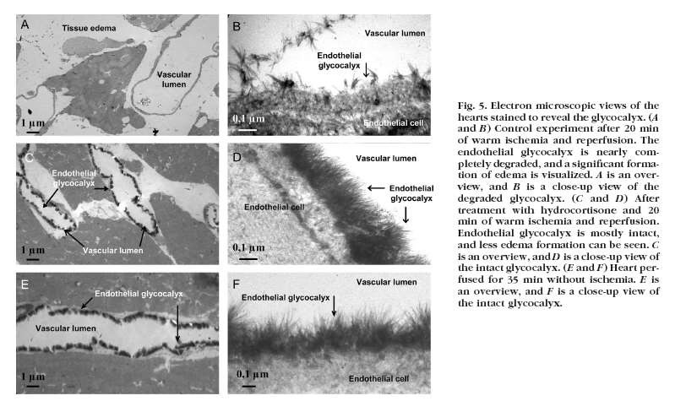
Hydrocortisone

Slide 65
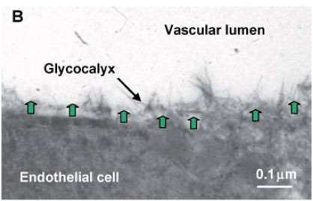
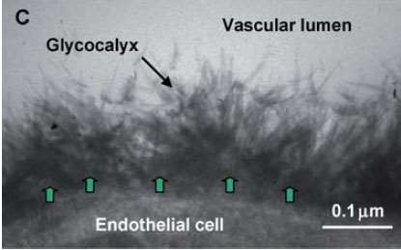
Antithrombin
The glycocalyx is shown for guinea pig hearts after I/R with protection by antithrombin . The green arrows represent the estimated maximal extension (10 nm) of the bonds between membrane molecules for firm endothelial adhesion of leucocytes and platelets. Adhesion molecules in question are the ICAMs, VCAMs, PECAM, integrins, etc.

Slide 66
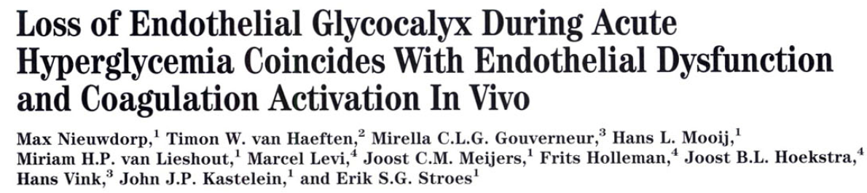
N-acetylcysteine
One study showed the efficacy of an infusion of N-acetylcysteine in preventing hyperglycemia induced shedding of glycocalyx
Supports the role of oxidative stress in the impairment of the glycocalyx and in endothelial dysfunction

Slide 67
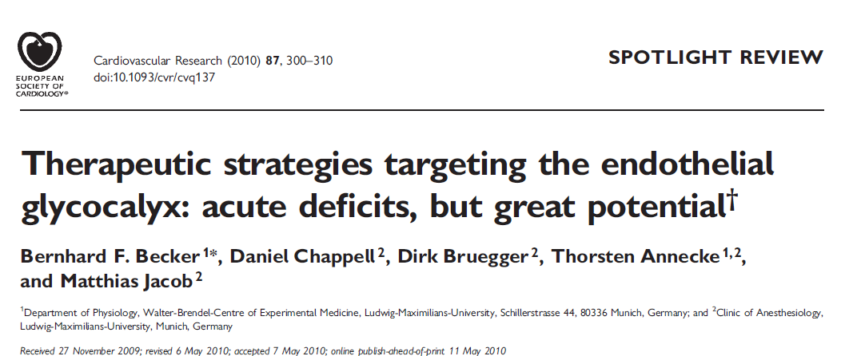
For more treatments

Slide 68
Take Home 1 – Revised Starling
Jv = Lp A {(Pc − Pi) − σ (πp − πg)}
Pc = Pressure in capillary
Pi = Pressure in interstium
πp = colloid osmotic pressures exerted by plasma
πg = colloid osmotic pressures exerted by the ultrafiltrate on the underside of the glycocalyx

Slide 69
Take Home 2 –Colloids and edema
The glycocalyx model preserves a state of minimal filtration even when delta-P is low
Intravenous colloid therapy cannot promote absorption and cannot help to prevent or treat interstitial edema
This is mainly due to the protein free portion of the glycocalyx plasma
During inflammation with glycocalyx damage artificial colloids leak into the interstitium and avoid degradation, potentially prolonging interstitial edema
Also, its theoretical 1 : 5 effectiveness ratio over crystalloid appears to be more like 1 : 1.3 in clinical practice

Slide 70
Take Home 3 – Think about fluids
In septic patients we have multiple mediators that can cause endothelial dysfunction and glycocalyx shedding
Add on aggressive fluids and kiss it good bye
Often see edema forming 1-3 days later
If it is in the skin then imagine what its gut, heart, lungs etc. look like
Increase in free water gain has a significant increase in mortality in AKI, ARDS and Sepsis!!

