Slide 1

Cardiac Output Monitoring
Daniel J. Fletcher, PhD, DVM, DACVECC

Slide 2
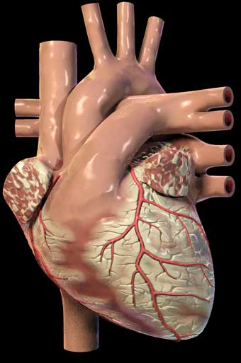
Overview
Determinants of CO
Methods for Measuring CO
  Fick Principle
  Indicator Dilution
  Pulse Contour Analysis
  Thoracic Electrical Bioimpedance (TEB)
  Echocardiography
Current Devices
  Fick: NICO
  Indicator Dilution
    Swan-Ganz (PA) Catheter
    PiCCO (plus Pulse Contour Analysis)
    LiDCO (plus Pulse Contour Analysis)
    COStatus (Ultrasound velocity dilution!)
  Doppler Ultrasound: COStatus
  TEB: Cheetah Starling SV

Slide 3
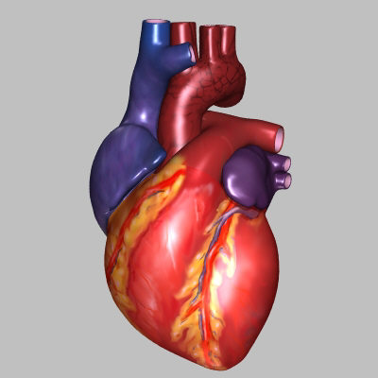
Systolic Function of the Heart
Contractility
Stroke
Volume
Preload
Cardiac
Output
Afterload
Heart
Rate
Arterial
Blood
Pressure
SVR

Slide 4
Methods

Slide 5
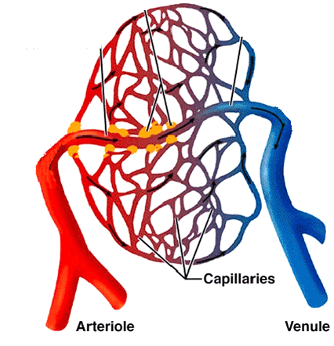
Fick Principle
∙
Oxygen Uptake (V_{O2})
Relationship Between
  O2 uptake by tissue
  Blood flow to tissue
  Change in O2 content of blood
Cv_{O2}
Ca_{O2}
Q
Q
∙
V_{O2}
= Q
{Ca_{O2}
- Cv_{O2}}
∙
VO2
Q =
Ca_{O2} - Cv_{O2}

Slide 6

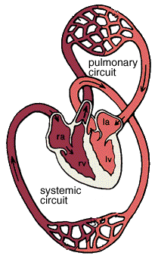
Fick Oxygen Method
GET
WANT
O2
O2
Assumptions in Practice
…You Can’t Always Get What You Want…
  Pulmonary Blood Flow ≈ Systemic Blood Flow
  O2 Uptake from Air ≈ O2 Uptake from Blood
    VO₂ ≈ V_{E} x (F_{i}O₂ – F_{e}O₂)
  C_{a}O2 – C_{mv}O2 ≈ Pulmonary a-v O2
Estimate CO using
the Fick method across the
lungs
WANT
GET
GET
WANT

Slide 7
Fick Oxygen Method
Advantages
Disadvantages
Does not require exogenous substances
Can also use other gases as markers
  CO2 rebreathing
Difficult to implement
  Requires metabolic chamber or intubation
Prone to error
  Small amounts of O2
Invasive
  PA catheter
  Arterial catheter

Slide 8
Indicator-Dilution Technique
x₁ x y₁ = x₂ x y₂
x₂ = (x₁ x y₁)/ y₂
x₁ ml
x₂ ml
y₁ mg/ml
y₂ mg/ml

Slide 9
Indicator-Dilution Technique
Inject indicator as bolus into a flowing stream
Measure concentration downstream over time
Flow = Dose [mg] / AUC [mg/ml * s]

Slide 10
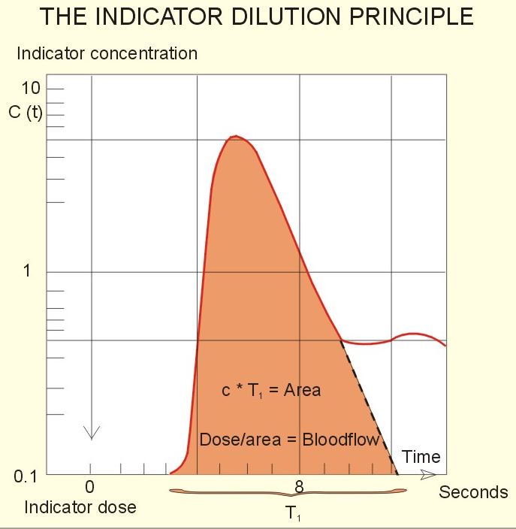
Indicator-Dilution Technique
What is this equation called?
Indicator injected as a bolus into the central circulation
Concentration over time is measured downstream
Most must get downstream before recirculation
CO α Dose / ∫C(t) dt
Notes:
Stewart-Hamilton

Slide 11
Indicator-Dilution Technique
Many indicators have been studied
  Saline
  Temperature
  Indocyanine green
  Lithium chloride
Must not be quickly removed from circulation

Slide 12
Indicator-Dilution Technique
Advantages
Disadvantages
Very accurate
  Considered gold standard clinically
Invasive
Must be repeated to look for changes in CO over time
Injectates can be toxic or accumulate

Slide 13
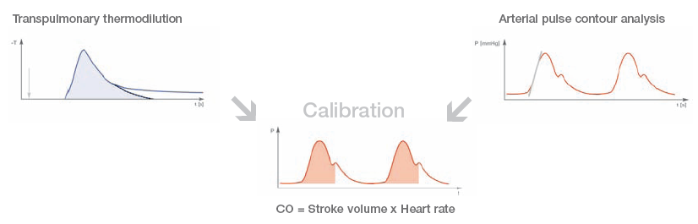
Pulse Contour Analysis
Requires arterial catheter
Use arterial pressure waveforms to estimate SV
  AUC α SV
  Conversion factor depends on arterial compliance
  Changes over time
  Can obtain beat to beat estimates
Must be calibrated with indicator-dilution method

Slide 14
Pulse Contour Analysis
Advantages
Disadvantages
Detect beat to beat changes in CO
Minimally invasive
  Peripheral arterial catheter
Requires calibration with an indicator-dilution method
Changes in arterial compliance require re-calibration

Slide 15
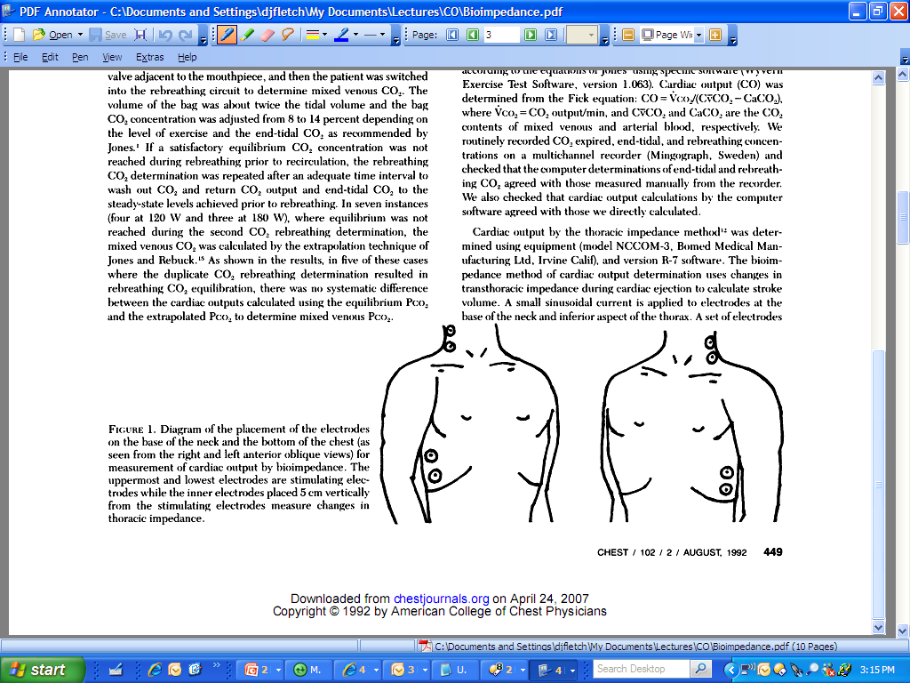
Thoracic Electrical Bioimpedance
Two sets of electrodes
  Stimulating
  Recording
Current applied to stim
Voltage recorded
Impedance = Voltage / Current
Stim
Record
Stim

Slide 16
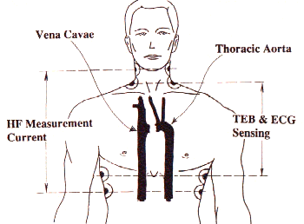
Thoracic Electrical Bioimpedance
TEB α 1 / Thoracic Fluid Content (TFC)
  Impedance of fluid < air
  Also affected by velocity and direction of RBCs
TEB Changes Due To
  Static changes in IFV (e.g. edema)
  Tidal changes in IFV due to respiration
  Volume and velocity changes in blood in the aorta

Slide 17
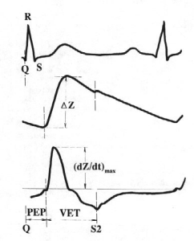
Thoracic Electrical Bioimpedance
Isovolumic Contraction
  Little change in TEB
Ejection Phase
  Starts at opening of aortic valve
  Rapid rise in fluid content (distention of aorta)
  Alignment and acceleration of RBCs
Peak of dTFC/dt = aortic peak blood flow
  α contractility
ECG
TFC
dTFC/dt
Isovolumic
Contraction
Ejection
Phase

Slide 18
Thoracic Electrical Bioimpedance
Stroke volume depends on
  Body size
  Duration of delivery of blood into aorta (VET)
  Peak aortic blood flow (dZ/dt)_{max}
CO = SV * HR
ECG
TFC
dTFC/dt

Slide 19
Thoracic Electrical Biompedance
Advantages
Disadvantages
Non-invasive
Can evaluate beat-to-beat changes in CO
Early reports in dogs question accuracy
  Conversion factors not well studied
Equipment not widely available
Susceptible to motion artifact

Slide 20
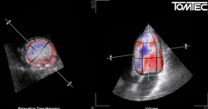
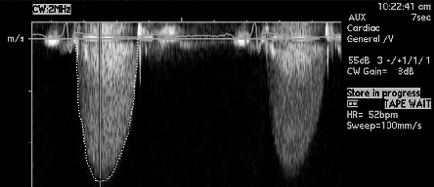
Echocardiography
Volumetric
  Measure LV volume at
  end diastole and end systole
  SV = LVV_{ed} – LVV_{es}
  CO = SV * HR
Doppler
  Measure LVOT velocity
  proximal to aortic valve
  Calculate Time-Velocity Integral (TVI) over ejection
  Measure diameter of LVOT at that level
  CO = π(D/2)² * TVI

Slide 21
Echocardiography
Advantages
Disadvantages
Non-invasive
  No catheterization
  No exogenous indicators
Can also evaluate other aspects of cardiac function
Can evaluate for structural heart disease
Requires estimation of ventricular shape
  3d extrapolation from 2d images
  Small error in volume estimate can result in clinically significant error in CO estimate
Transesophageal echo often required for accurate calculations
Requires skilled operator and sophisticated software

Slide 22
Commerical Devices
Modified Fick Method

Slide 23
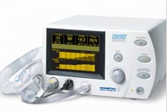
NICO
Fick Principle
  Uses CO2 clearance in the lungs rather than O2 uptake
  Uses partial CO2 rebreathing
Components
  Arterial catheter
  Patients must be intubated
∙
VCO2
Q =
Cv_{CO2} - Ca_{CO2}

Slide 24
NICO - Principle
V_{CO2} = Difference between inspired and expired CO2
Ca_{CO2} estimated by ETCO2 after calibration with ABG
Cv_{CO2} more difficult
  Would require PA cath
  Can be eliminated using CO2 rebreathing
∙
V_{CO2}
Q =
Cv_{CO2} - Ca_{CO2}

Slide 25
NICO Principle
Assume CO does not change with rebreathing
Law of ratios
Assume Cv_{CO2} is equal in both conditions due to large CO2 body stores and slow time constant of stores relative to rebreathing time.
S = slope of CO2 dissociation curve
∙
∙
V_{CO2N}
V_{CO2R}
Q =
=
Cv_{CO2N} - Ca_{CO2N}
Cv_{CO2R} - Ca_{CO2R}
∙
∙
∙
V_{CO2N –} V_{CO2R}
∆V_{CO2}
=
=
(Cv_{CO2N} - Ca_{CO2N}) - (Cv_{CO2R} - Ca_{CO2R})
S∆ETCO2

Slide 26
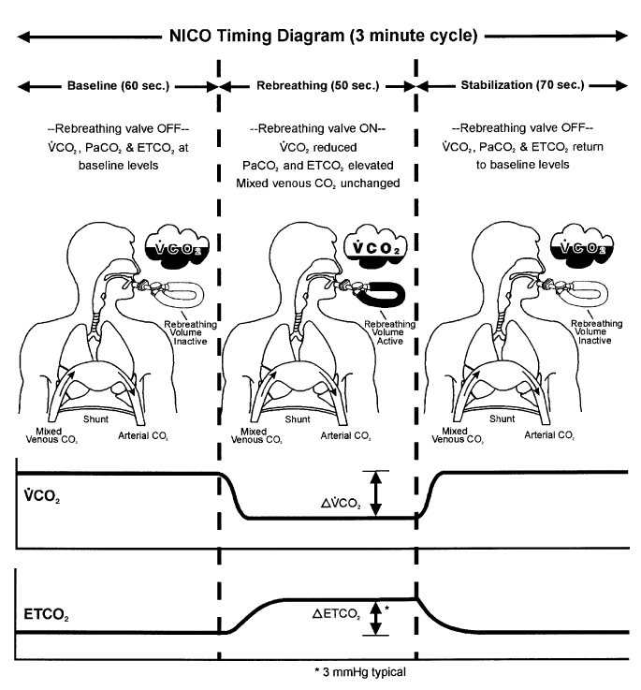
NICO

Slide 27
NICO
Advantages
Disadvantages
Less invasive
Based on Gold Standard (Fick) method
Takes approximately 3 minutes
Requires intubation
Requires assumptions
  C_{VCO2} unchanged by rebreathing
  Dead space unchanged by rebreathing
  Shunt fraction must be estimated by Pa_{O2} measures
Must be in controlled (not assisted) ventilation mode
PaCO2 must be at least 30mmHg

Slide 28
Commerical Devices
Indicator Dilution

Slide 29
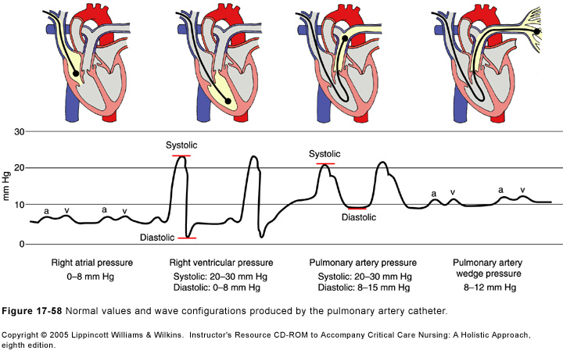
Pulmonary Artery Catheterization
“Gold Standard” clinical method
Swan-GanzTM catheter placed via jugular vein into PA

Slide 30
Pulmonary Artery Catheterization
Cold saline injected into RV
Thermistor on tip of catheter measures temp
CO estimated using indicator-dilution method
  Temperature = indicator
  CO α ∆T * V_{injectate} / AUC
Three measurements should be averaged

Slide 31
Pulmonary Artery Catheterization
Measured Parameters
Calculated Parameters
Central Venous Pressure (CVP)
PA Pressure (PAP)
Pulmonary Artery Occlusion Pressure (PAOP)
  Aka Pulmonary Capillary Wedge Pressure (PCWP)
  Surrogate of LA Pressure
CO
Systemic Vascular Resistance (SVR)
Pulmonary Vascular Resistance (PVR)
Left and Right Ventricular Stroke Work
Oxygen Extraction Ratio

Slide 32
Pulmonary Artery Catheterization
Advantages
Disadvantages
Accurate??
It’s what they’re looking for if you write a paper…
Invasive
Snapshot (not continuous)
Catheter-related complications
  Infection
  Thromboembolism
  Arrhythmias
Susceptible to artifacts
  Must inject cold saline fast
  Tricuspid regurgitation
  VPCs
  Less accurate when CO is low

Slide 33
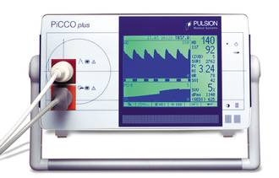
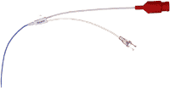
PiCCO
Hybrid device
  Transpulmonary thermodilution
  Pulse contour analysis
Components
  Central venous catheter
  Arterial catheter (large artery)
    3Fr, 7cm 4Fr, 8cm 4Fr, 16cm
    4Fr, 20cm 4Fr, 50cm 5Fr, 20cm

Slide 34
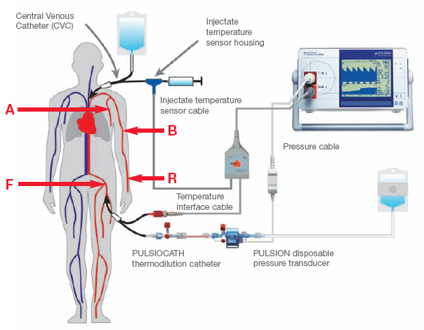
PiCCO - Setup

Slide 35
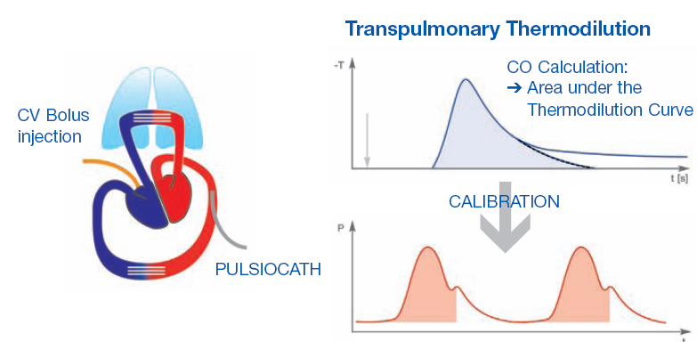
PiCCO - Calibration

Slide 36
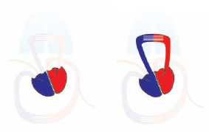
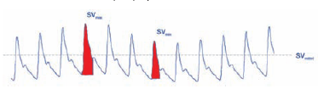
PiCCO
Measured Parameters
Calculated Parameters
CVP
Arterial Blood Pressure
Beat to Beat CO
Preload Measures
  Global End-Diastolic Volume
  Intrathoracic Blood Volume
  Stroke Volume Variation (SVV)
  Pulse Pressure Variation(PPV)
Extravascular Lung Water
Pulmonary Vascular Permeability Index
Systemic Vascular Resistance
Plus many others…
GEDV
ITBV
SVV

Slide 37
PiCCO - Costs
$$$
Monitor = $17,500
Catheter Kit = $260

Slide 38
PiCCO
Advantages
Disadvantages
Less invasive than PAC
Simpler to operate
Real time, beat-beat CO
Good correlation with PAC
Other “stuff”
  SVV and PPV superior to CVP for predicting fluid responsiveness
  Estimates of EVLW
Still invasive
Need special arterial catheter and large artery
Good study comparing PAC thermodilution vs. transpulmonary thermodilution not done
Accuracy issues
  Art line more distal = less accurate
  Must be calibrated 3-4 x/day

Slide 39
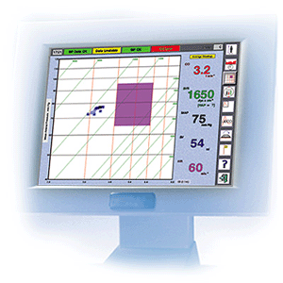
LiDCO
Hybrid Device
  Transpulmonary lithium dilution
  Pulse contour analysis
Components
  Central or peripheral venous catheter
  Peripheral arterial catheter

Slide 40
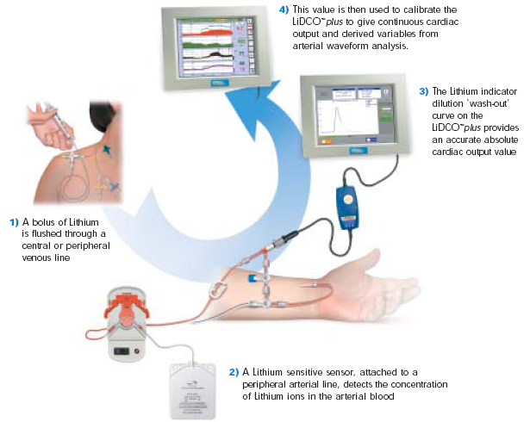
LiDCO- Setup and Calibration

Slide 41
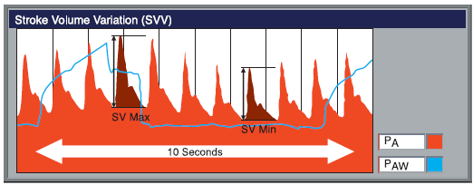
LiDCO
Measured Parameters
Calculated Parameters
ABP
CVP if central line used
Beat to Beat CO
SVR
Preload Measures
  SVV
  PPV

Slide 42
LiDCO - Costs
$$$
Monitor = $22,000
Lithium Sensor = $110
Lithium Injection Kit = $120

Slide 43
LiDCO
Advantages
Disadvantages
Beat to Beat CO information
Can use peripheral catheters
Different (better?) pulse contour algorithm than PiCCO
Requires blood draw of approximately 3ml per calibration
Must be calibrated 3-4 times per day
Lacks additional volume information of PiCCO

Slide 44
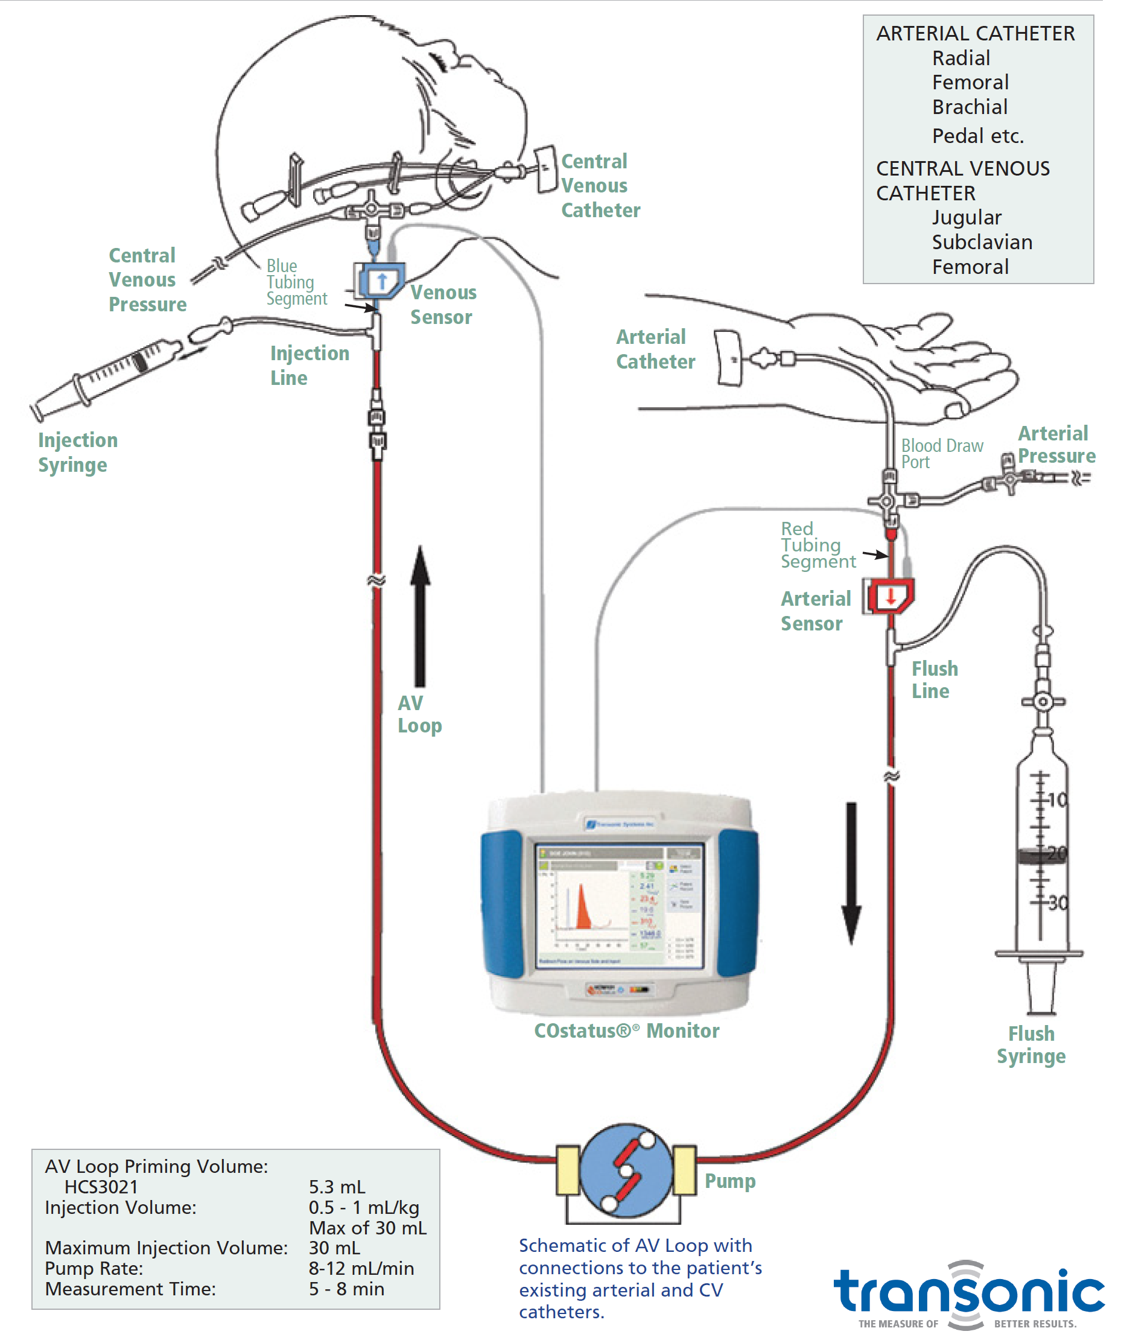
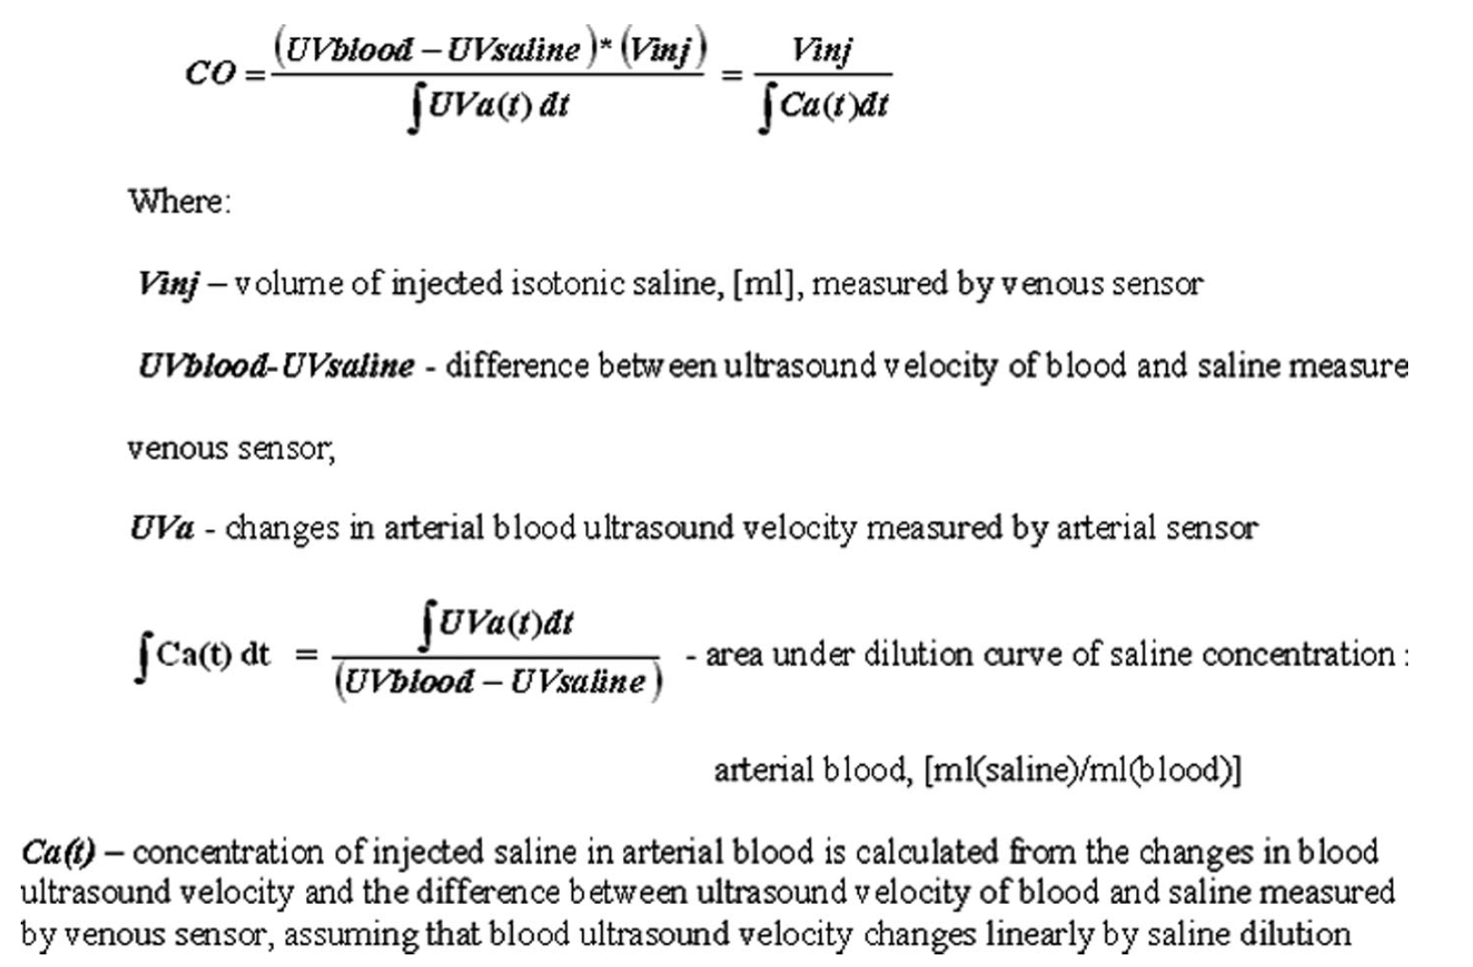
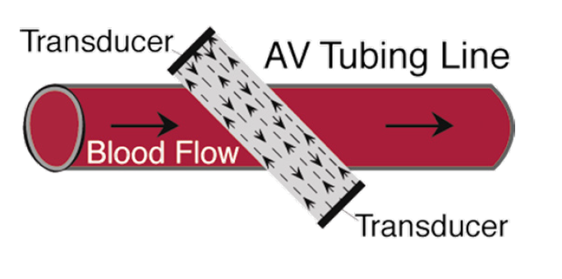
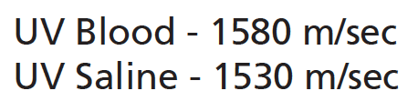
COStatus
Neonatal priming = 2.4ml

Slide 45
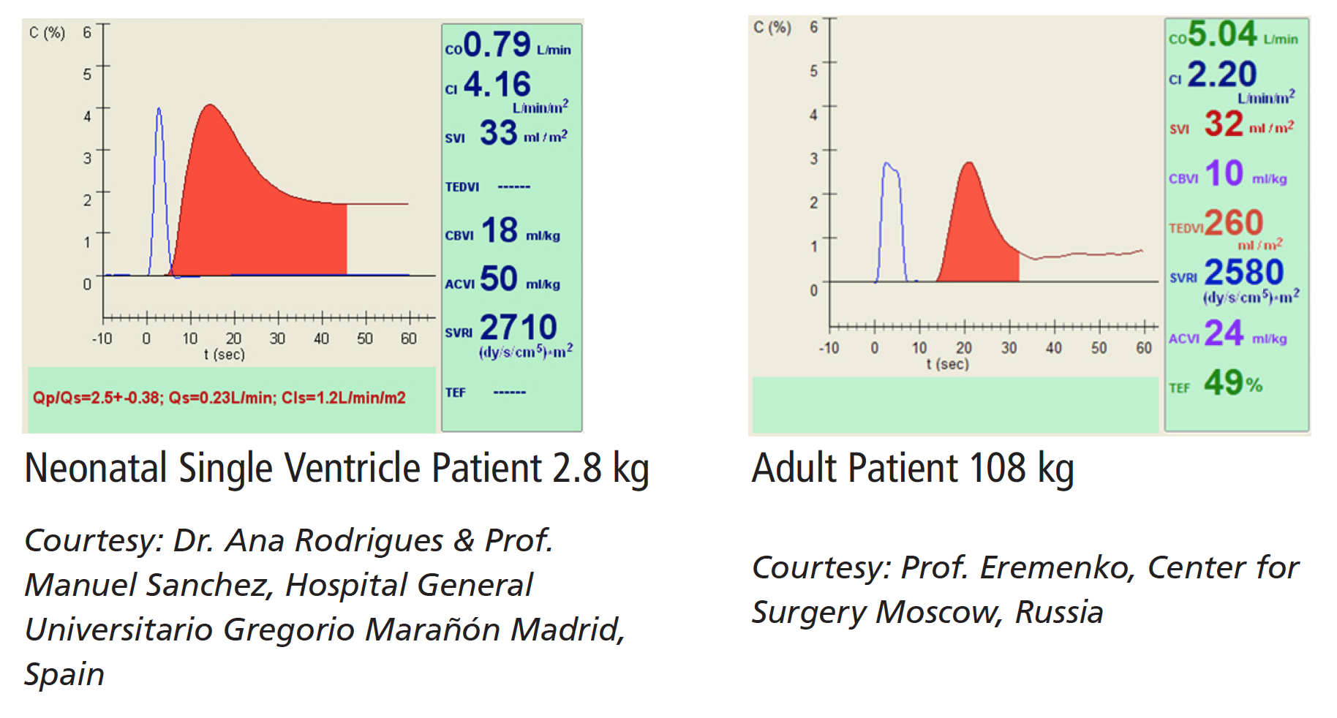
COStatus

Slide 46
Commerical Devices
Doppler Ultrasound

Slide 47
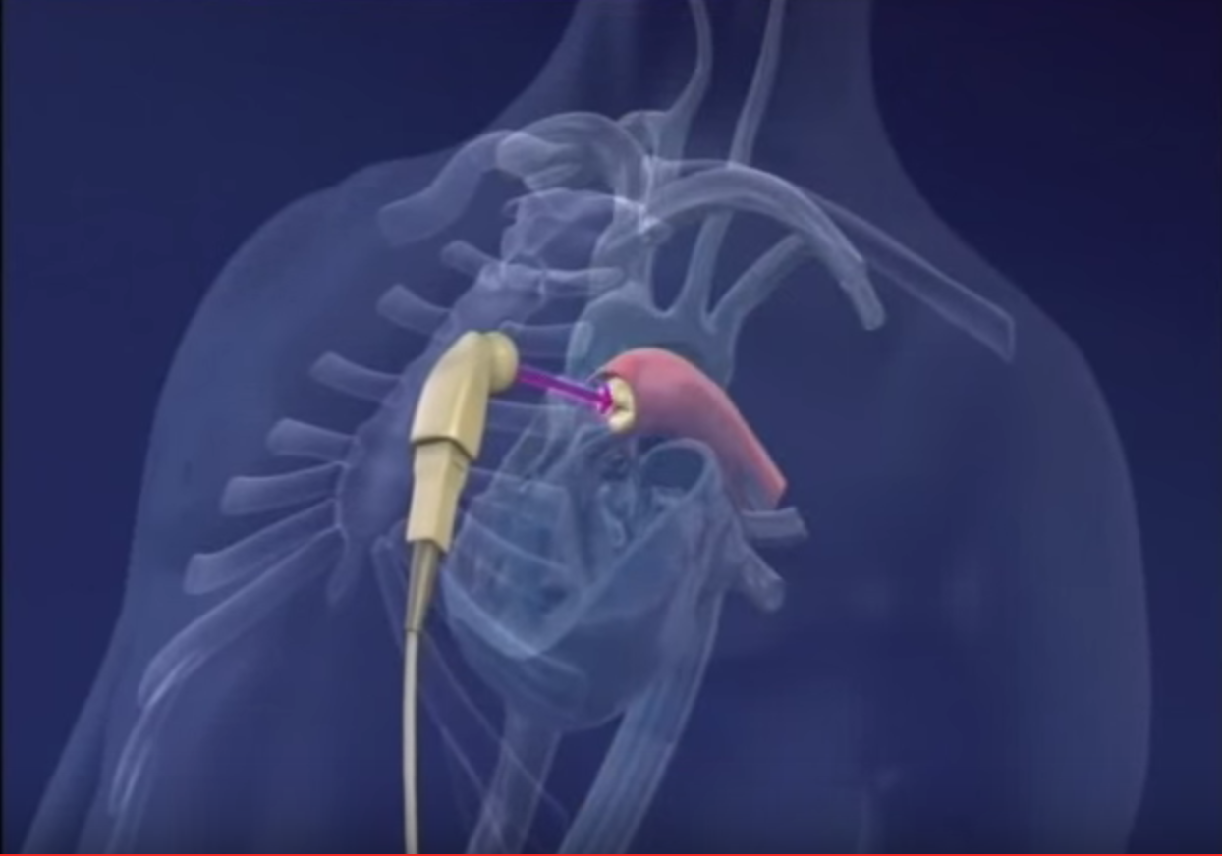
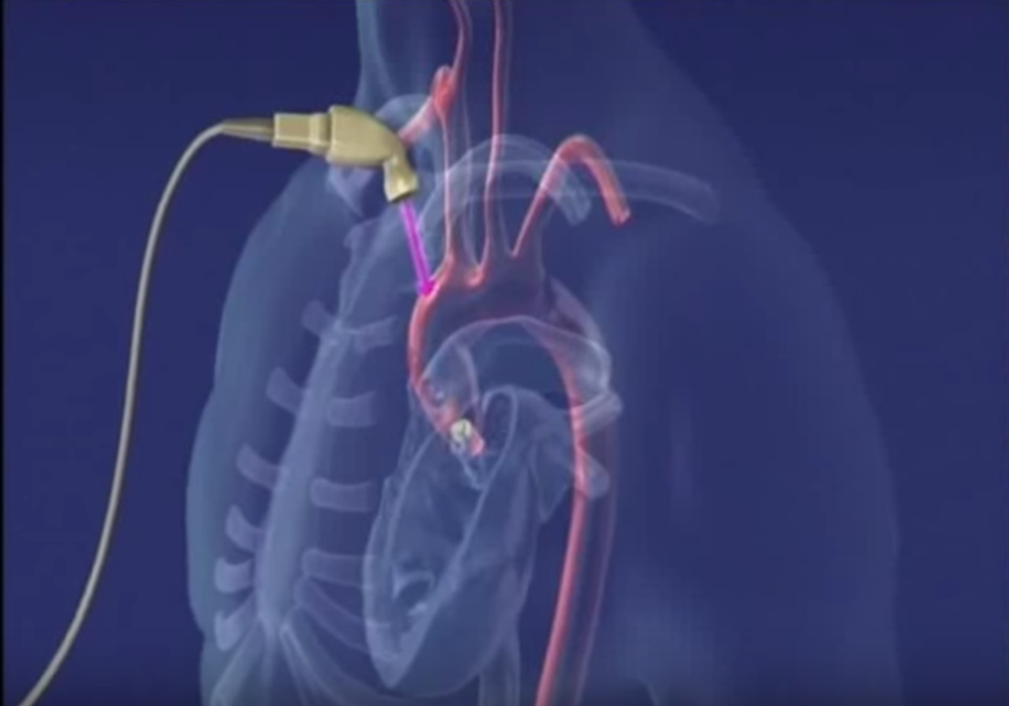
USCOM
https://www.youtube.com/watch?v=ZOUr8WOfxrc

Slide 48
USCOM

Slide 49
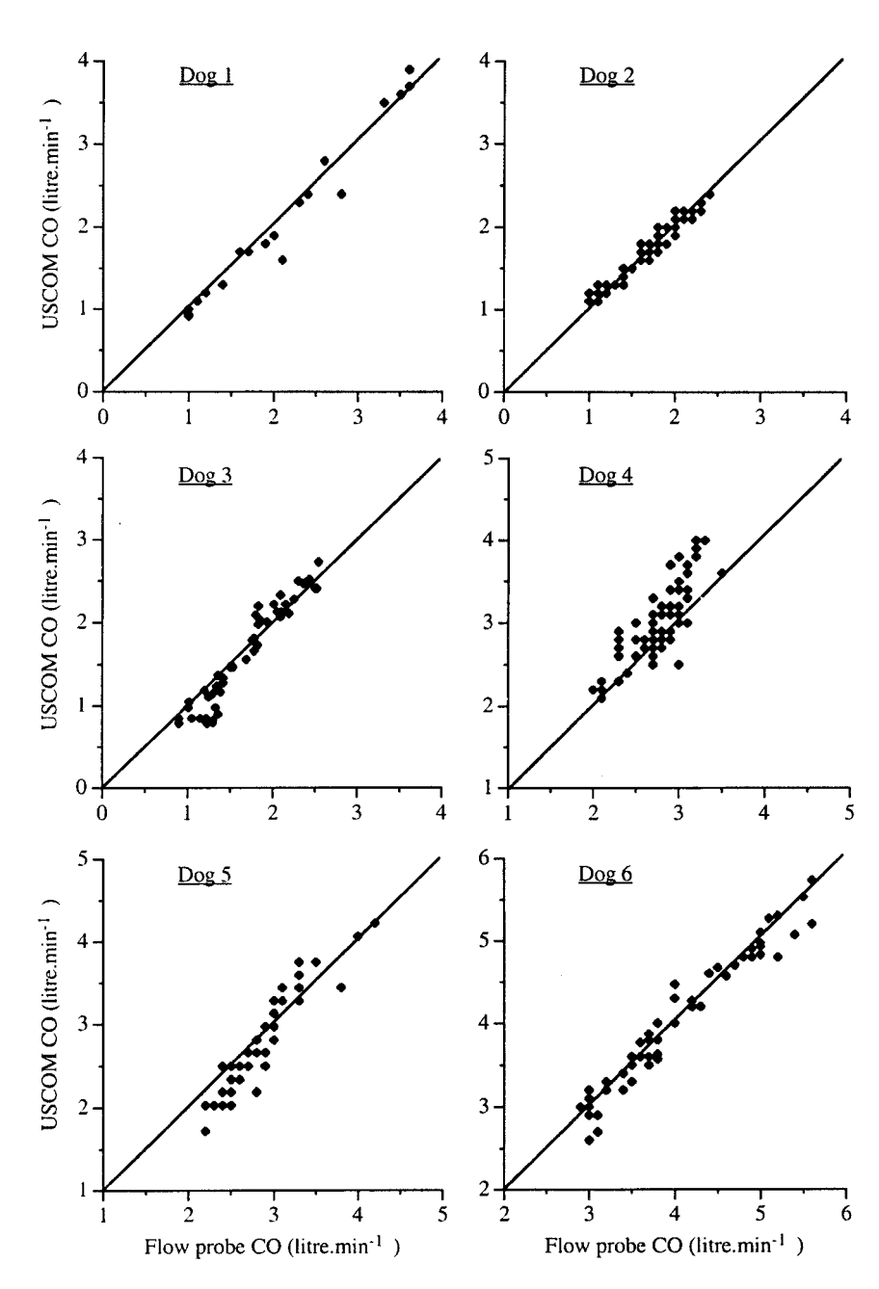
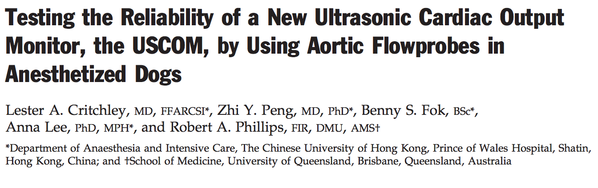
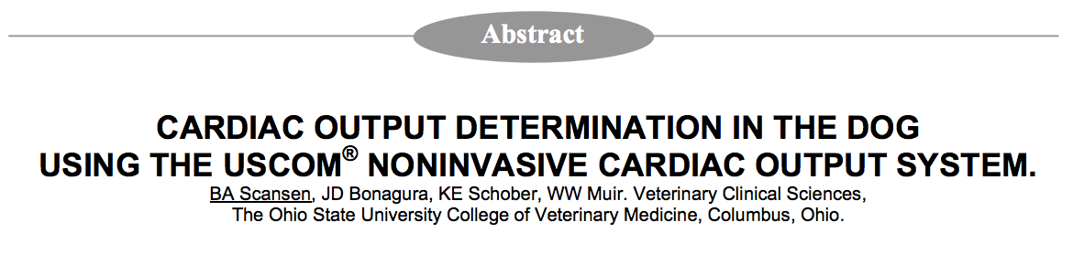
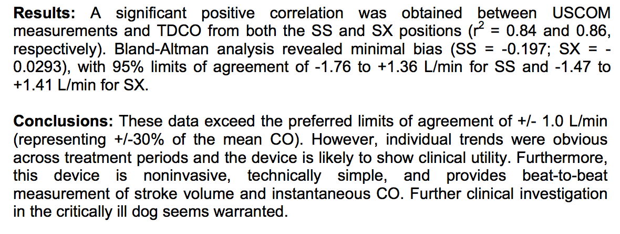

Slide 50
Commerical Devices
Thoracic Biompedance / Bioreactance

Slide 51
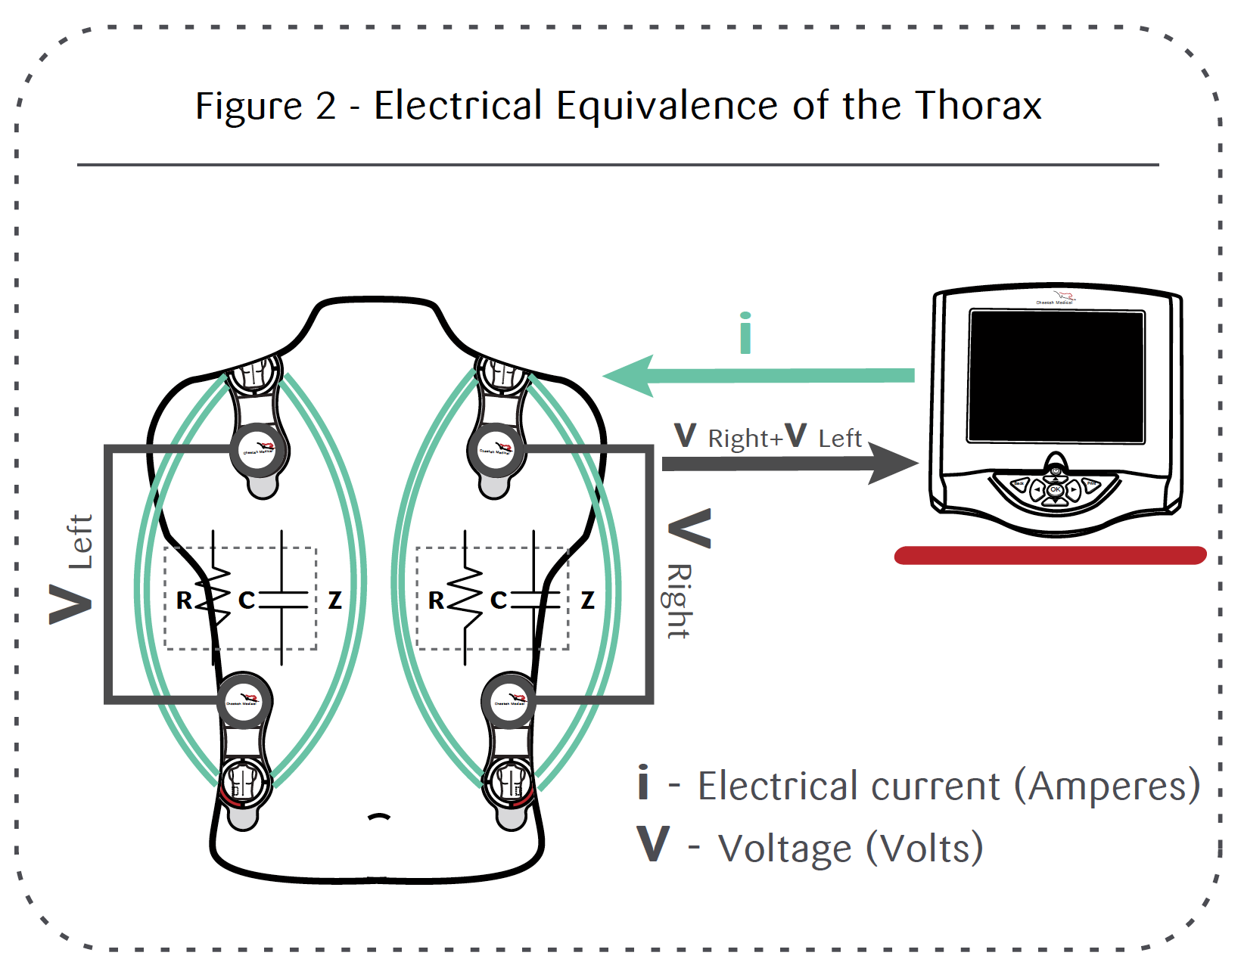
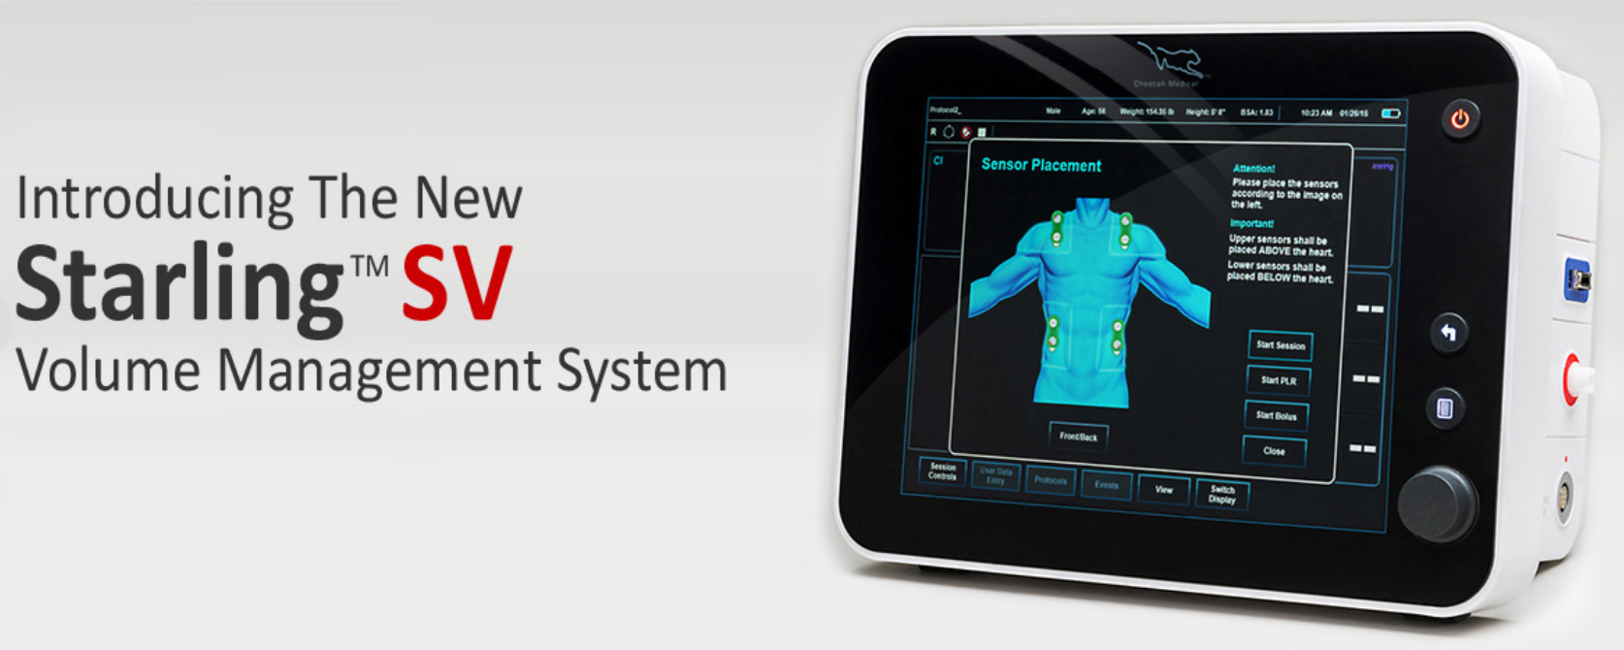
Cheetah Starling SV

Slide 52
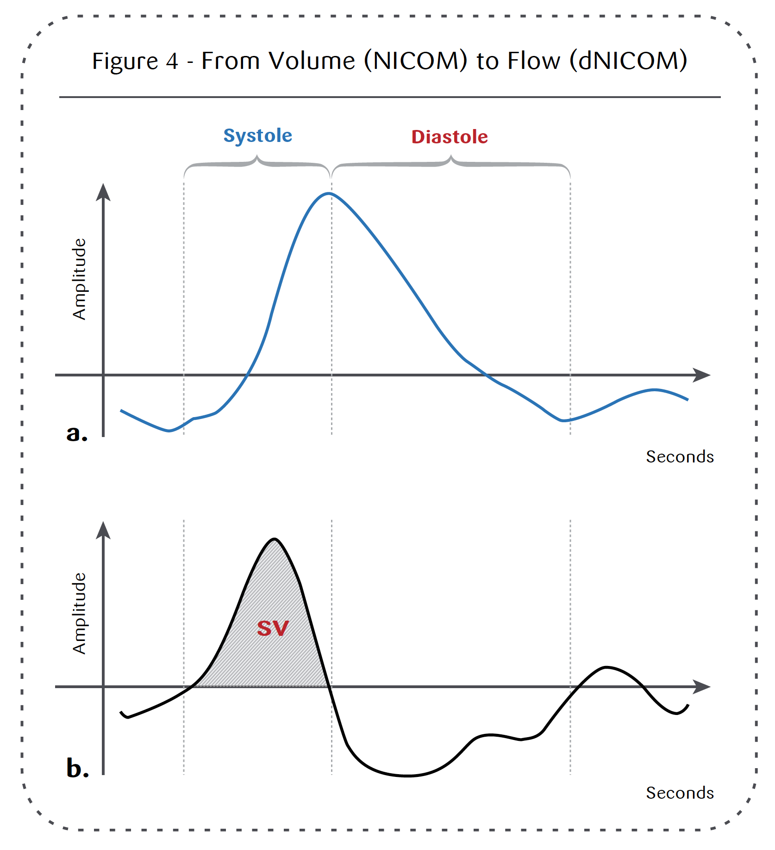
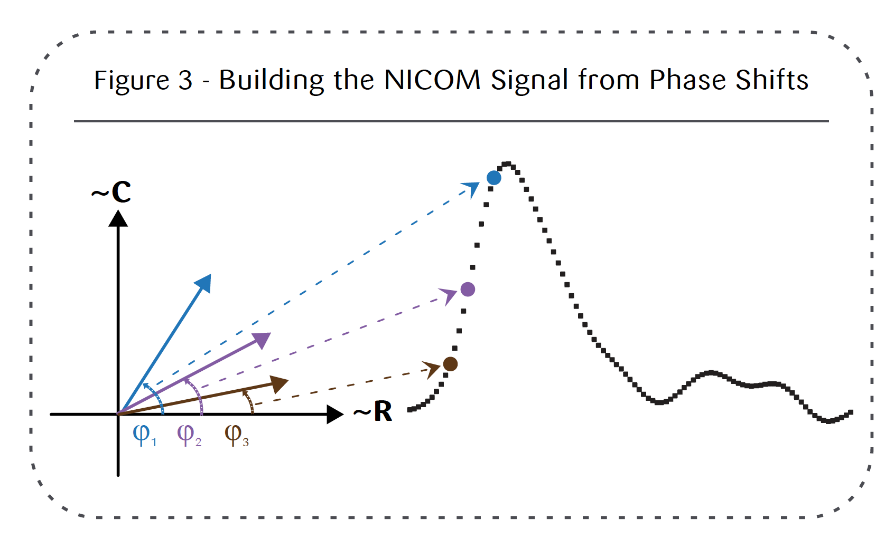
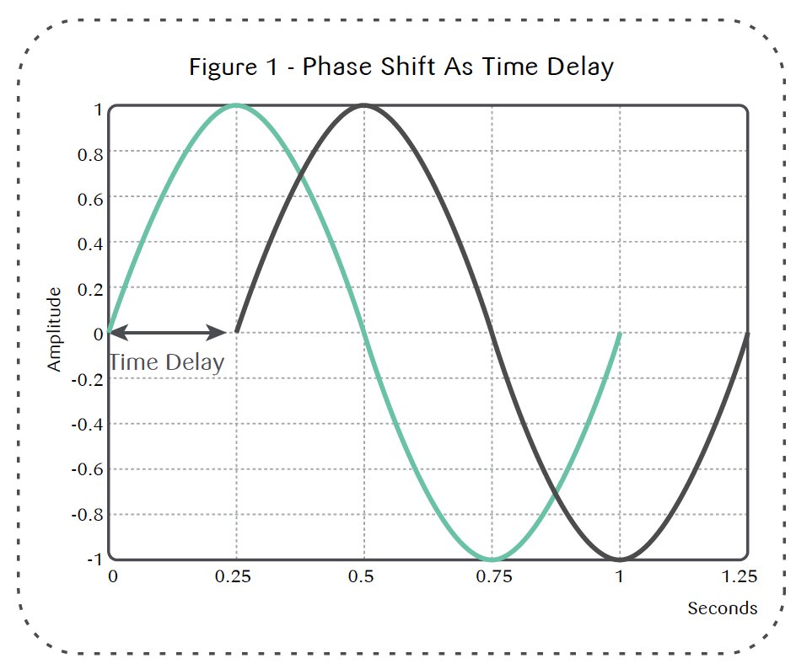
Bioreactance
Phase shift is due to pulsatile blood flow
Closely associated with SV
Notes:
PROPORTIONAL to Stroke Volume. Still need to calibrate for weight, height and age

Slide 53
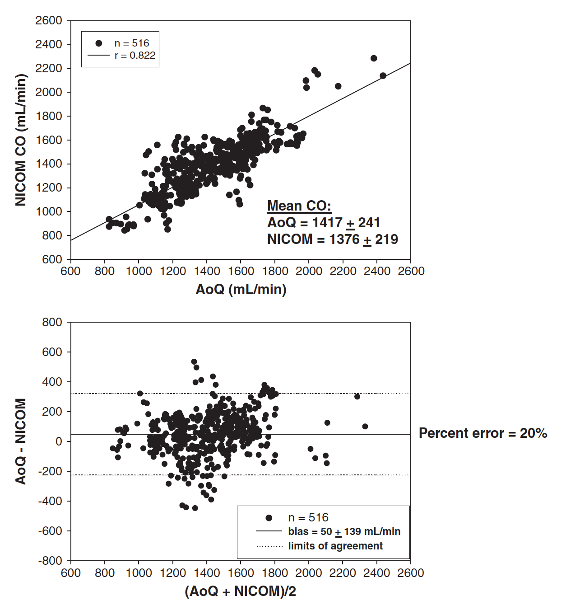
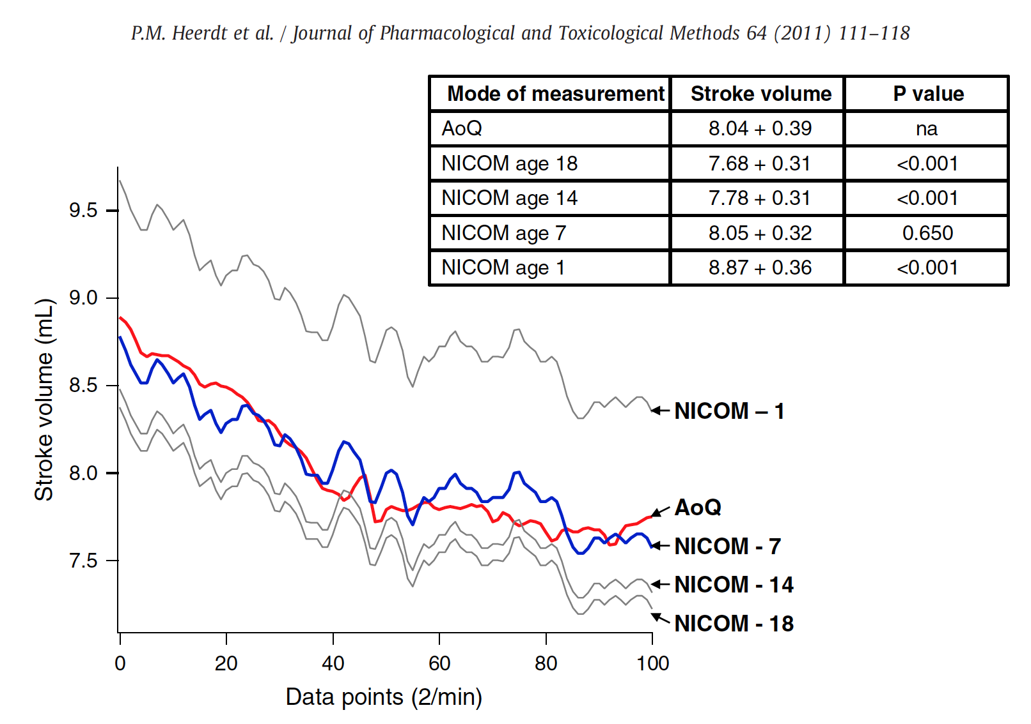
NICOM

Slide 54
Questions?

Slide 55
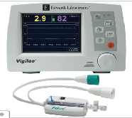
Vigileo
Advanced Pulse Contour Algorithm
  Uses pulse pressure to estimate
  stroke volume
  Adjusts estimate based on demographic information
  Pulse to pulse statistical analysis to look for changes in vascular tone
Components
  Peripheral arterial catheter with high resolution data acquisition

Slide 56
Vigileo
Based upon human demographic data
NOT validated in other species
Unlikely to be of use in our patients currently
Costs
  Monitor = $12,000
  FloTrac Sensors = $225 each
Maybe some day!

