Slide 1
Basic Principles of GI Absorption

Slide 2
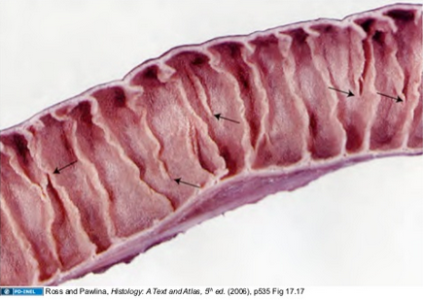
GI Absorption Anatomy
Folds of Kerckring (valvulae conniventes)
  Increase mucosa absorptive surface area: 3x
  Circumferential folds
  Most prominent in the duodenum and jejunum
  Can protrude up to 8mm

Slide 3
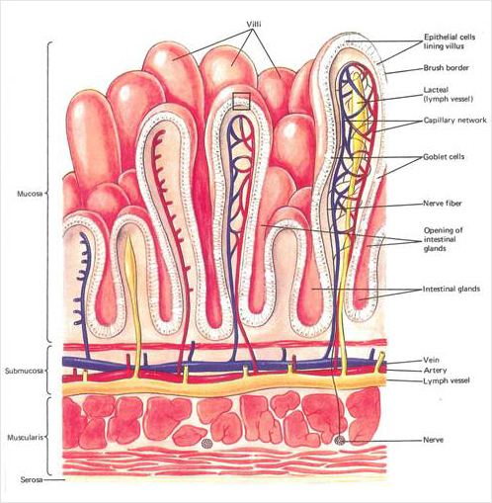
GI Absorption Anatomy
Villi
  Increase total absorptive area by 10x
  Present from the duodenum to the ileocecal valve
    Less profuse in the distal SI
  1mm projections
  Central lacteal
  Vascular system

Slide 4
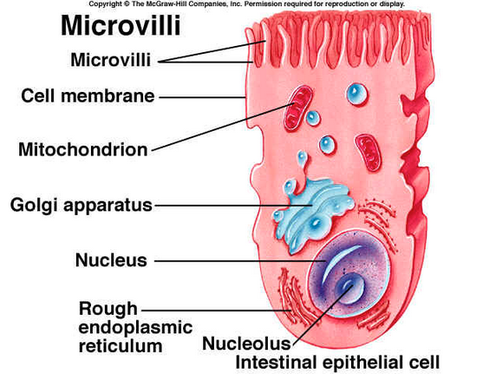
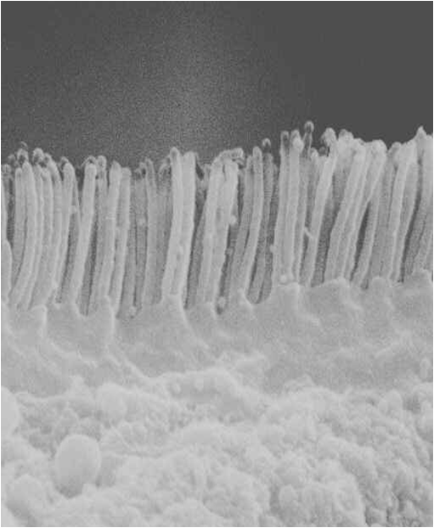
GI Absorption Anatomy
Microvilli
  Present in the Brush Border
  Luminal side of intestinal epithelium
  Up to 1000 microvilli per villi
  1 micrometer in length, 0.1 micrometer in diameter
  Increase total absorptive area by 20x
  Actin filaments extend from the epithelial cell body to the microvilli
    Rhythmic contractions
    Continual movement of microvilli
      Exposure to new intestinal fluid

Slide 5
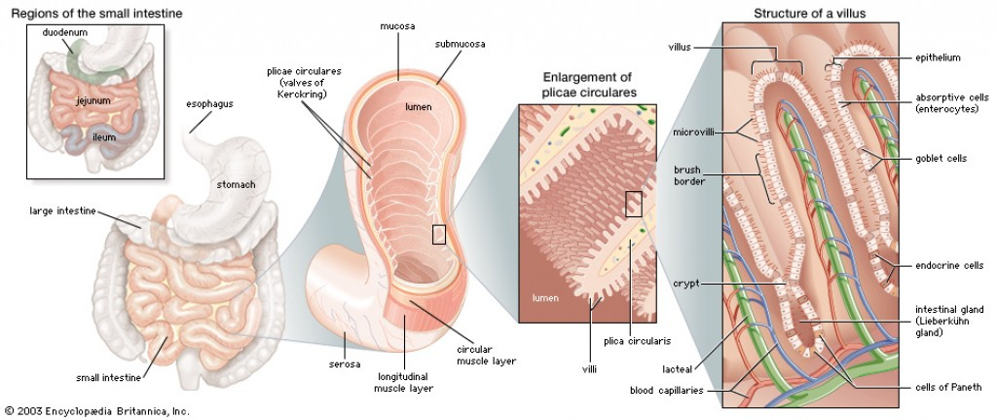
GI Absorption Anatomy
Increase the total surface area by 1000x
  250 meter²

Slide 6
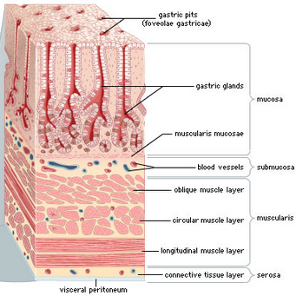
Absorption in Stomach
Poor absorptive area
  Lacks villus-type membrane
  Presence of tight junctions between cells
Absorption of a few highly lipid soluble substances

Slide 7
Absorption in SI
Water
  Isosmotic absorption (diffusion)
  Transcellular and paracellular* pathways
  2º to osmotic gradient

Slide 8
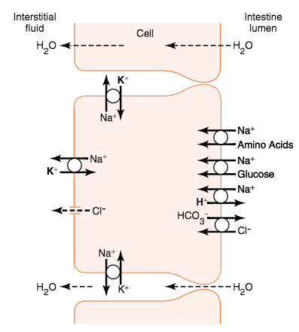
Absorption in SI
Sodium
  Active transport from the basal and lateral epithelial cell walls to paracellular spaces
    Na-K ATPase pump
  Results in a decreased intracellular [Na]
    Passive Na absorption
      Na-glu, Na-amino acid co-transporters
      Na-H exchanger

Slide 9
Absorption in SI
Aldosterone
  Secreted with dehydration
  Increased activation of enzyme and transport mechanism for all aspects of Na absorption
  No loss of NaCl, minimal water loss

Slide 10
Absorption in SI
Chloride
  Upper GI: rapid absorption due to movement along electrochemical gradient
  Ileum/lower GI: Cl⁻/HCO₃⁻ exchanger
  Cl⁻ channels: basolateral membrane

Slide 11
Absorption in SI
Bicarbonate absorption (duodenum/jejunum)
  HCO₃⁻ secreted into duodenum from pancreatic secretions and bile
  H+ secretion into chyme (secondary to Na⁺/H⁺ exchanger)
  Via carbonic acid equation, H₂O remains in chyme and the CO₂ is absorbed into the blood and expired via the lungs
Bicarbonate secretion (ileum/lg intestine)
  HCO₃⁻/Cl⁻ exchanger
  Provides HCO₃⁻ to neutralize acid products (from bacteria) in the large intestine

Slide 12
Absorption in SI
Extreme Na, Cl, H₂0 secretion
  Immature crypt cells secrete NaCl (and subsequently H₂0) into intestinal lumen
    Absorbed by mature villous cells
  Certain toxins can stimulate these cells, resulting in extreme water excretion
  Intracytoplasmic toxin opens brush border Cl channels, secondary activation of Na pump
  “washes” away bacteria, though may result in extreme dehydration and ensuing death

Slide 13
Absorption in SI
Ca
  Active absorption
  Controlled by the need of the body
  PTH/Vitamin D: enhances Ca absorption
Fe
  Active absorption in proportion to body’s need
K/Mg/Phosphorus/others?

Slide 14
Absorption in SI
Carbohydrates
  Monosaccharides (glucose- 80%, galactose, fructose)
    Final digestion product of the most abundant carbohydrate group
  Glucose/galactose
    Active transport (requires Na) into cell
    Then facilitated diffusion to paracellular spaces and blood
  Fructose
    Facilitated diffusion (does not require Na)
Protein
  Same as glucose/galactose

Slide 15
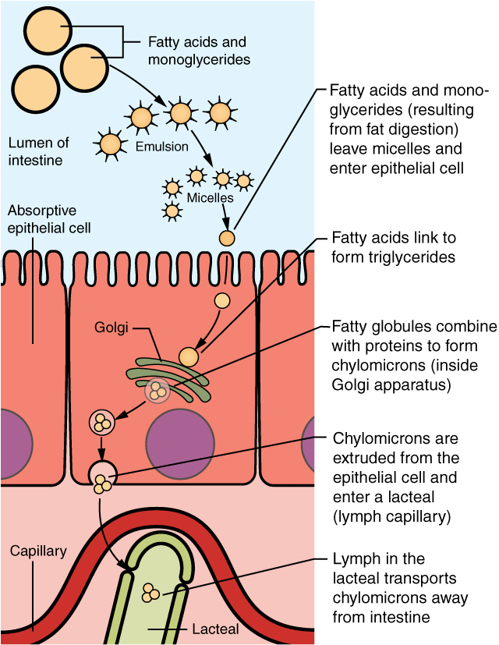
Absorption in SI
Fat
  Fat digestion ➔ monoglycerides and FFAs ➔ dissolve into micelles
  Micelles penetrate the recesses of microvilli and contents diffuse into cytoplasm
  Enter the ER and form triglycerides, released from ER as chylomicrons
  Enter lymph (via central lacteal)
  Short/medium chain FFAs
    Direct absorption

Slide 16
Absorption in LI
1500mLs chyme enters LI, less than 100mLs fluid is excreted in feces
Essentially all ions are absorbed
  Absorbing colon (proximal 50%)
Storage colon (distal 50%)
Increased capacity for NaCl absorption
  Tighter tight junctions
HCO₃⁻ secretion (via Cl⁻ exchanger)

