Slide 1
Fluoride Filter
An overview the work and findings of the Spring 2016 subteam
To find more information about our work visit https://confluence.cornell.edu/display/AGUACLARA/Fluoride
or contact one of us directly.

Slide 2
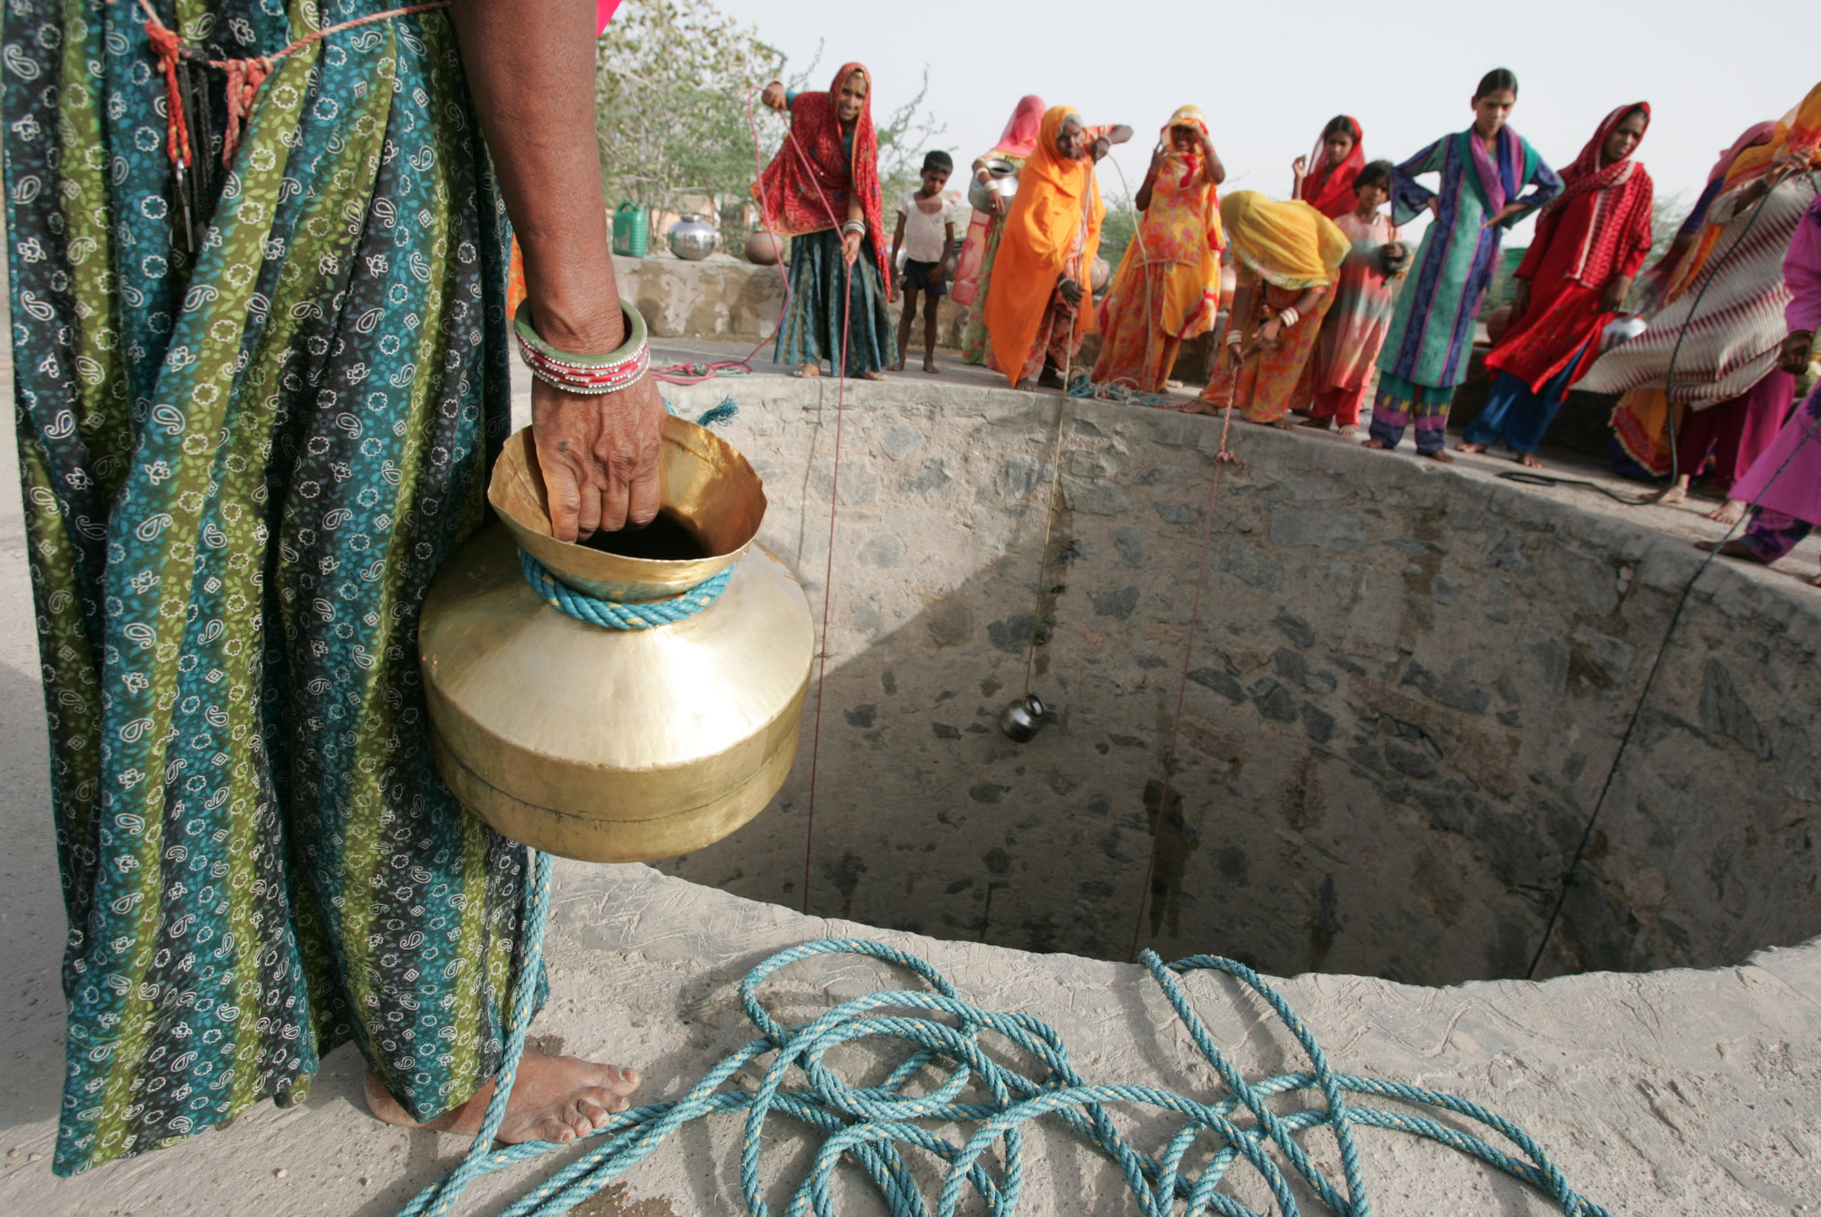
The Problem
Fluoride overconsumption and overexposure
85% of drinking water in India is sourced from groundwater.
Crippling fluorosis, dental fluorosis, osteoarthritis
Two AguaClara plants in India
  Our goal: A simple, efficient and affordable fluoride removal method.
Notes:
Photo Citation: Indian Well, “Here's How To Make A Village Go From Zero Water to Abundant Water In Just 3 Years!” - The Better India. (2015). Retrieved May 20, 2016, from http://www.thebetterindia.com/20286/water-management-manayali-village-maharashtra/
Caption: Many Indians rely on well water to obtain drinking water.
Summary:
Fluoride overconsumption and overexposure is a huge issue in regions dependent on groundwater.
85% of drinking water in India is sourced from groundwater - making this issue particularly relevant to AguaClara’s work with rural villages in India.
Overconsumption can lead to crippling fluorosis, dental fluorosis and osteoarthritis.
With two AguaClara plants located in India, our work has been geared towards finding an efficient, simple, and affordable method of removing fluoride.

Slide 3
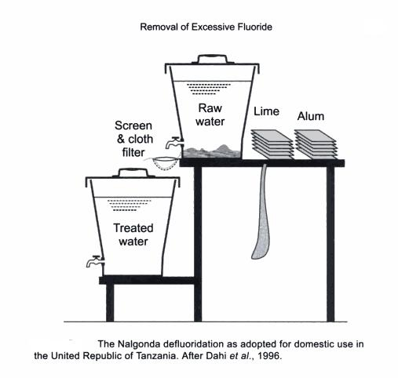
Progress
Advancement at Cornell
  Fall 2015 - Fluoride Sand Filter
    Effective but inefficient
    Frequent backwash
Advancement from literature
  Nalgonda Method
    Batched/Non-continuous
    High coagulant dosage (1.2g/L of Al)
    Still unable to meet WHO guidelines of 1.5 mg/L F-
The work of the Fall 2016 semester builds off of both previous work at Cornell, and established removal techniques in literature.
Notes:
Photo Citation: Nalgonda Defluoridation Graphic, How to Remove Fluoride from Drinking Water. (n.d.). Retrieved May 20, 2016, from http://www.bibliotecapleyades.net/salud/salud_fluor23.htm
Photo caption: Nalgonda defluoridation as adopted for domestic use in the United Republic of Tanzania after Dahi et al. 1996
The team’s work this semester has shown advancements from both fluoride filtration methods in the AguaClara lab last semester, as well as from literature. Last semester, the team used a sand filter to better understand fluoride removal but ultimately found the system inefficient due to necessity to frequently backwash because of head loss buildup within the sand filter. Working off of the achievements of the CSFBR team, we have built a novel reactor system that is capable of removing fluoride. Compared to the literature/currently accepted method of removing Fluoride (the Nalgonda Method) our system is much more efficient - it allows for continuous flow (as opposed to batched treatment), low PACl dosages, and actually bring fluoride levels down to concentrations safe for drinking.

Slide 4
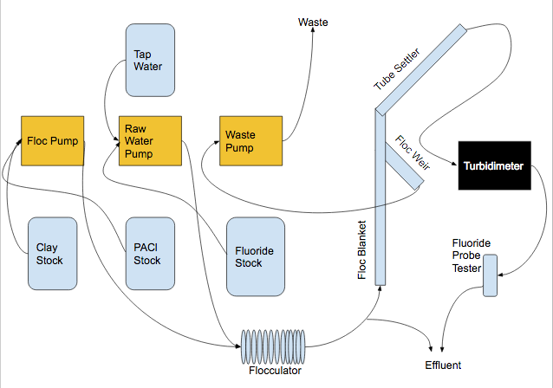
Setup
Notes:
Photo caption: Fluoride reactor setup
This is a schematic of our systems set up. We have three pumps controlling the flocs, raw water and waste, as well as three stock units. The PACl and clay stocks flow into the floc pump and the tap water and fluoride stock both feed into the raw water pump. These two outputs then combine in the flocculator, which then flows up through our reactor. which then flows into the flocculator. Our waste pump takes effluent from our reactor up to waste disposal system. Our reactor consists of a floc blanket, tube settler and floc weir. The effluent is connected to a turbidimeter to measure the quality of the effluent (namely the number of flocs that have travelled up through the tube settler), and a fluoride probe tester that allows us to continuously measure fluoride concentrations. These streams then empty into our waste bucket.
See: Appendix slide 1 and 2

Slide 5
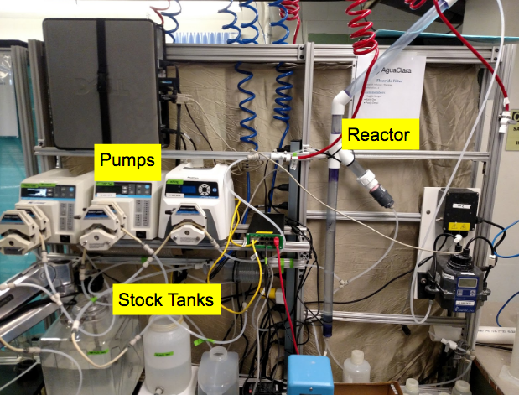
Setup
Notes:
Caption: Fluoride reactor set up at lab bench.
Summary: Here is a picture of our actual set up. The three pumps and stock tanks are visible, as well as the reactor system and turbidimeter. This photo was taken before continuous fluoride measurements were taken. There is a lot going on.
See: Appendix slide 1 and 2

Slide 6
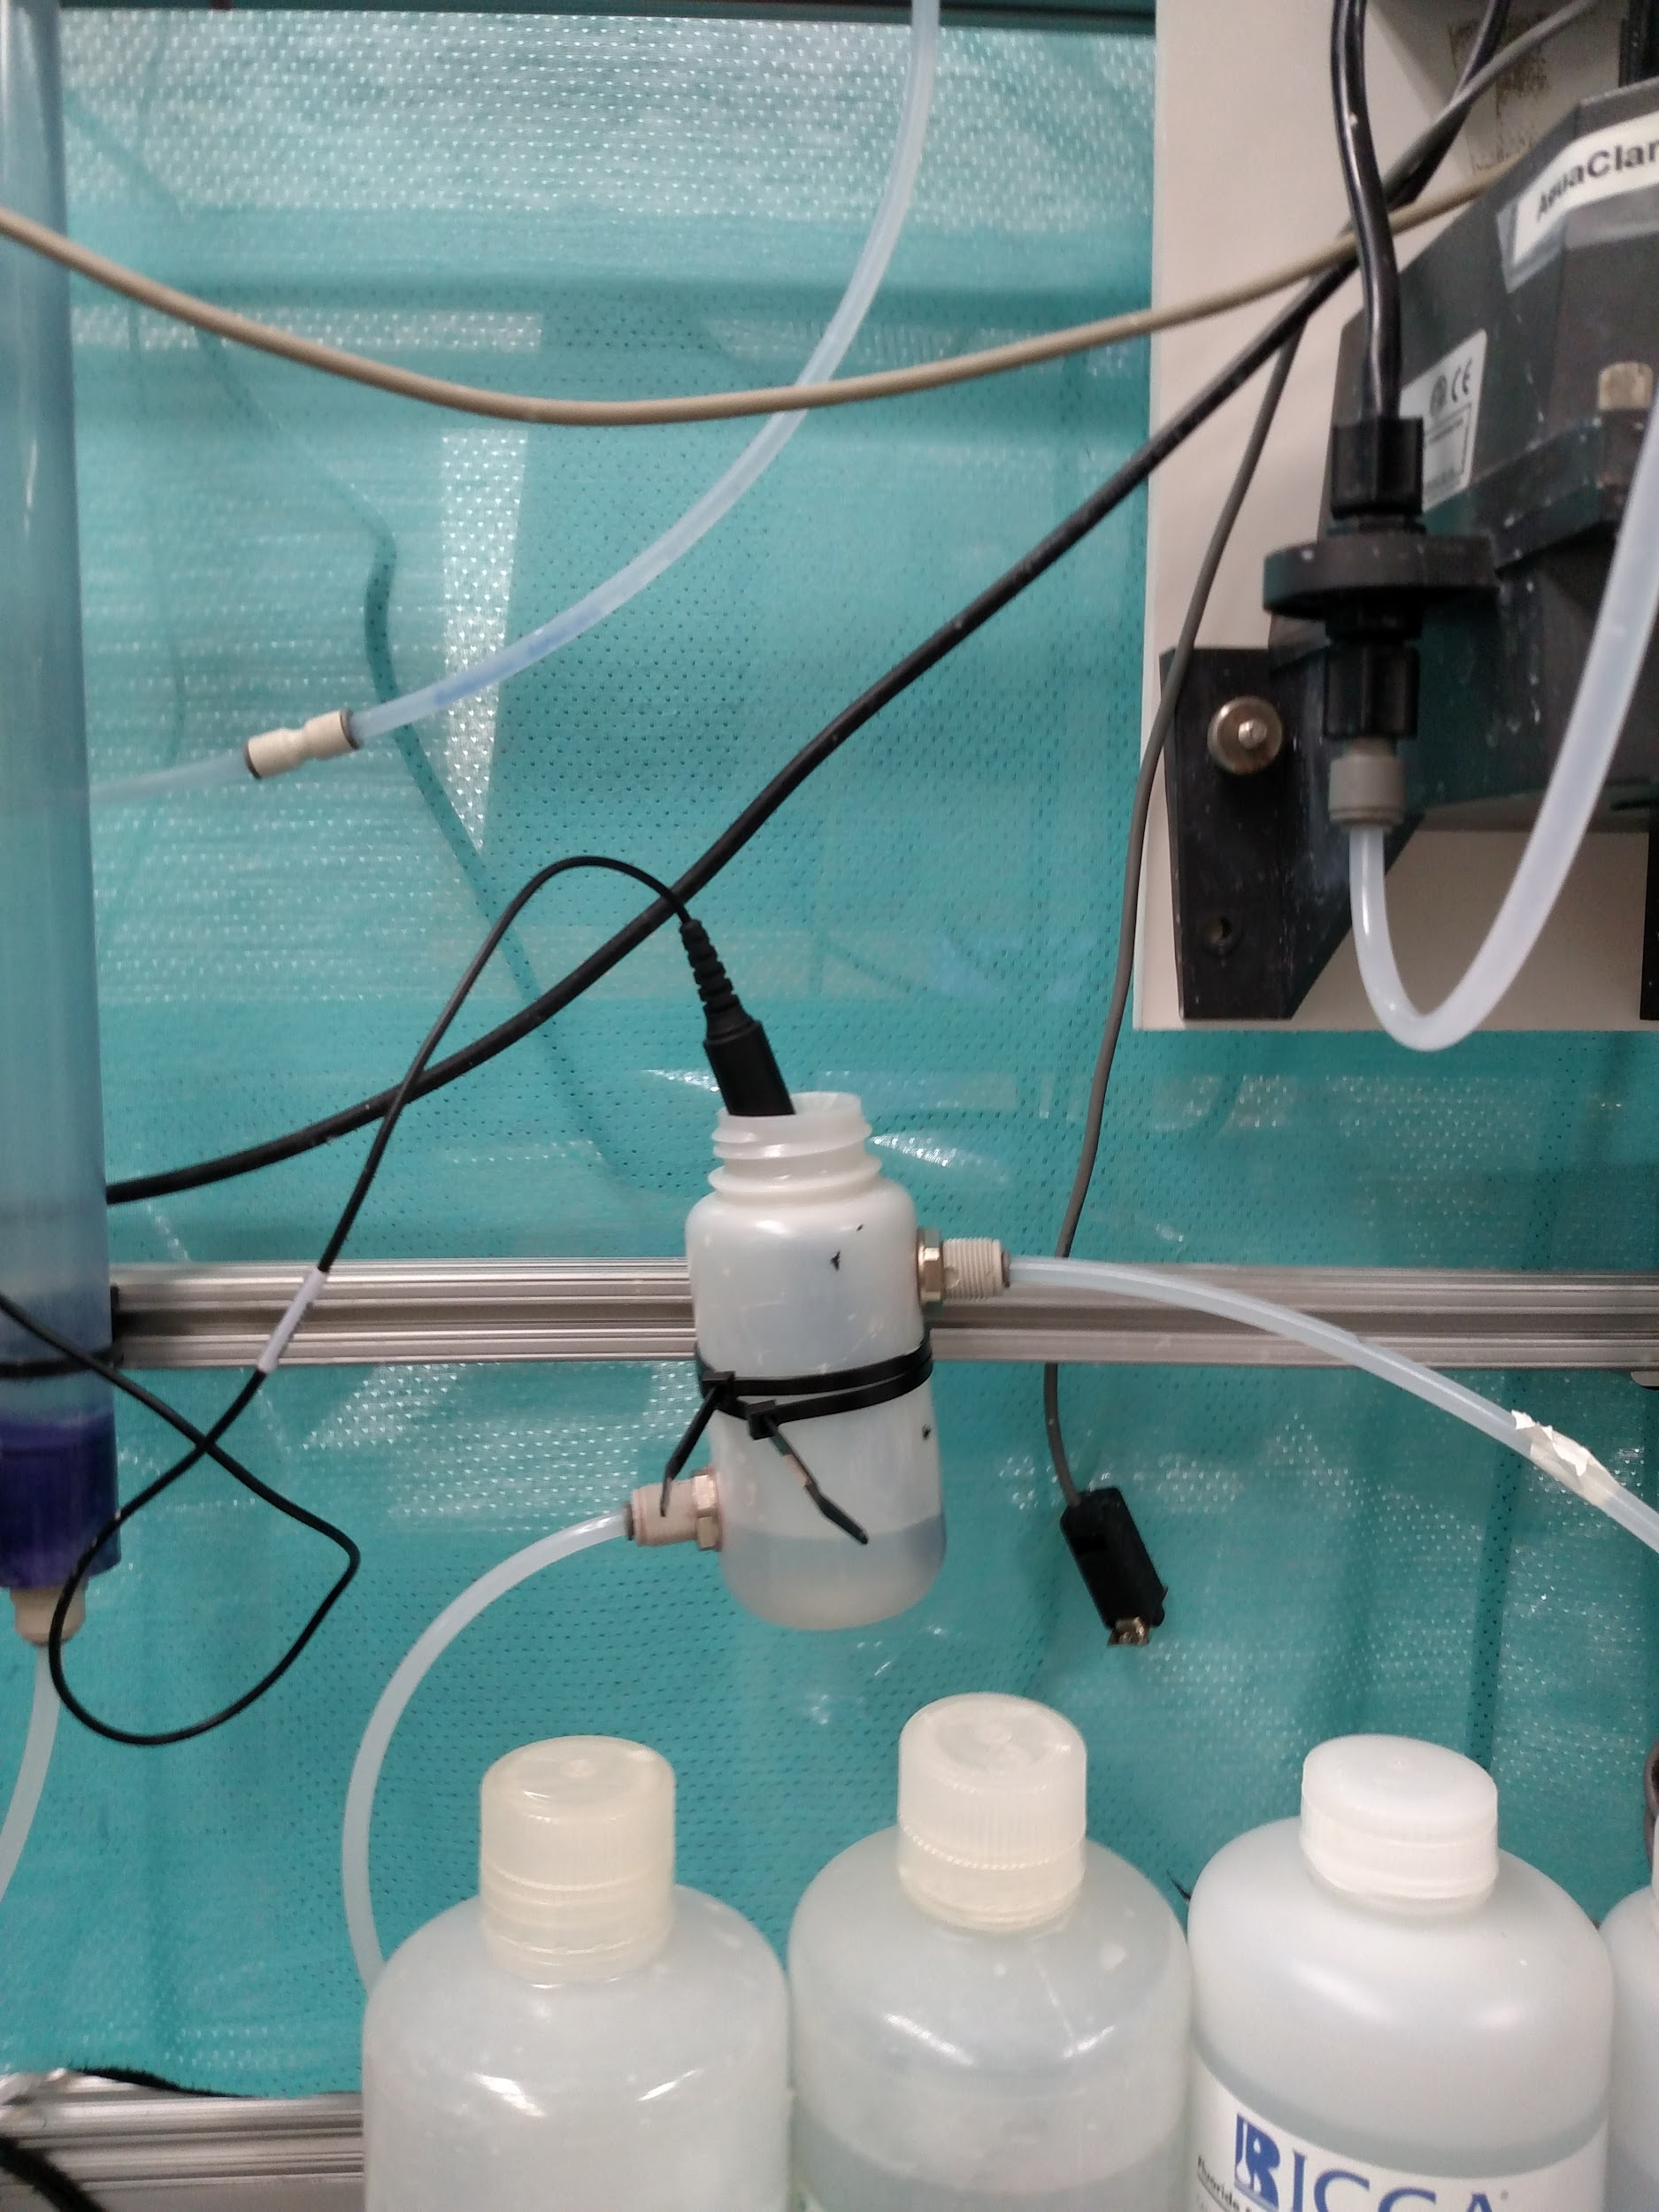
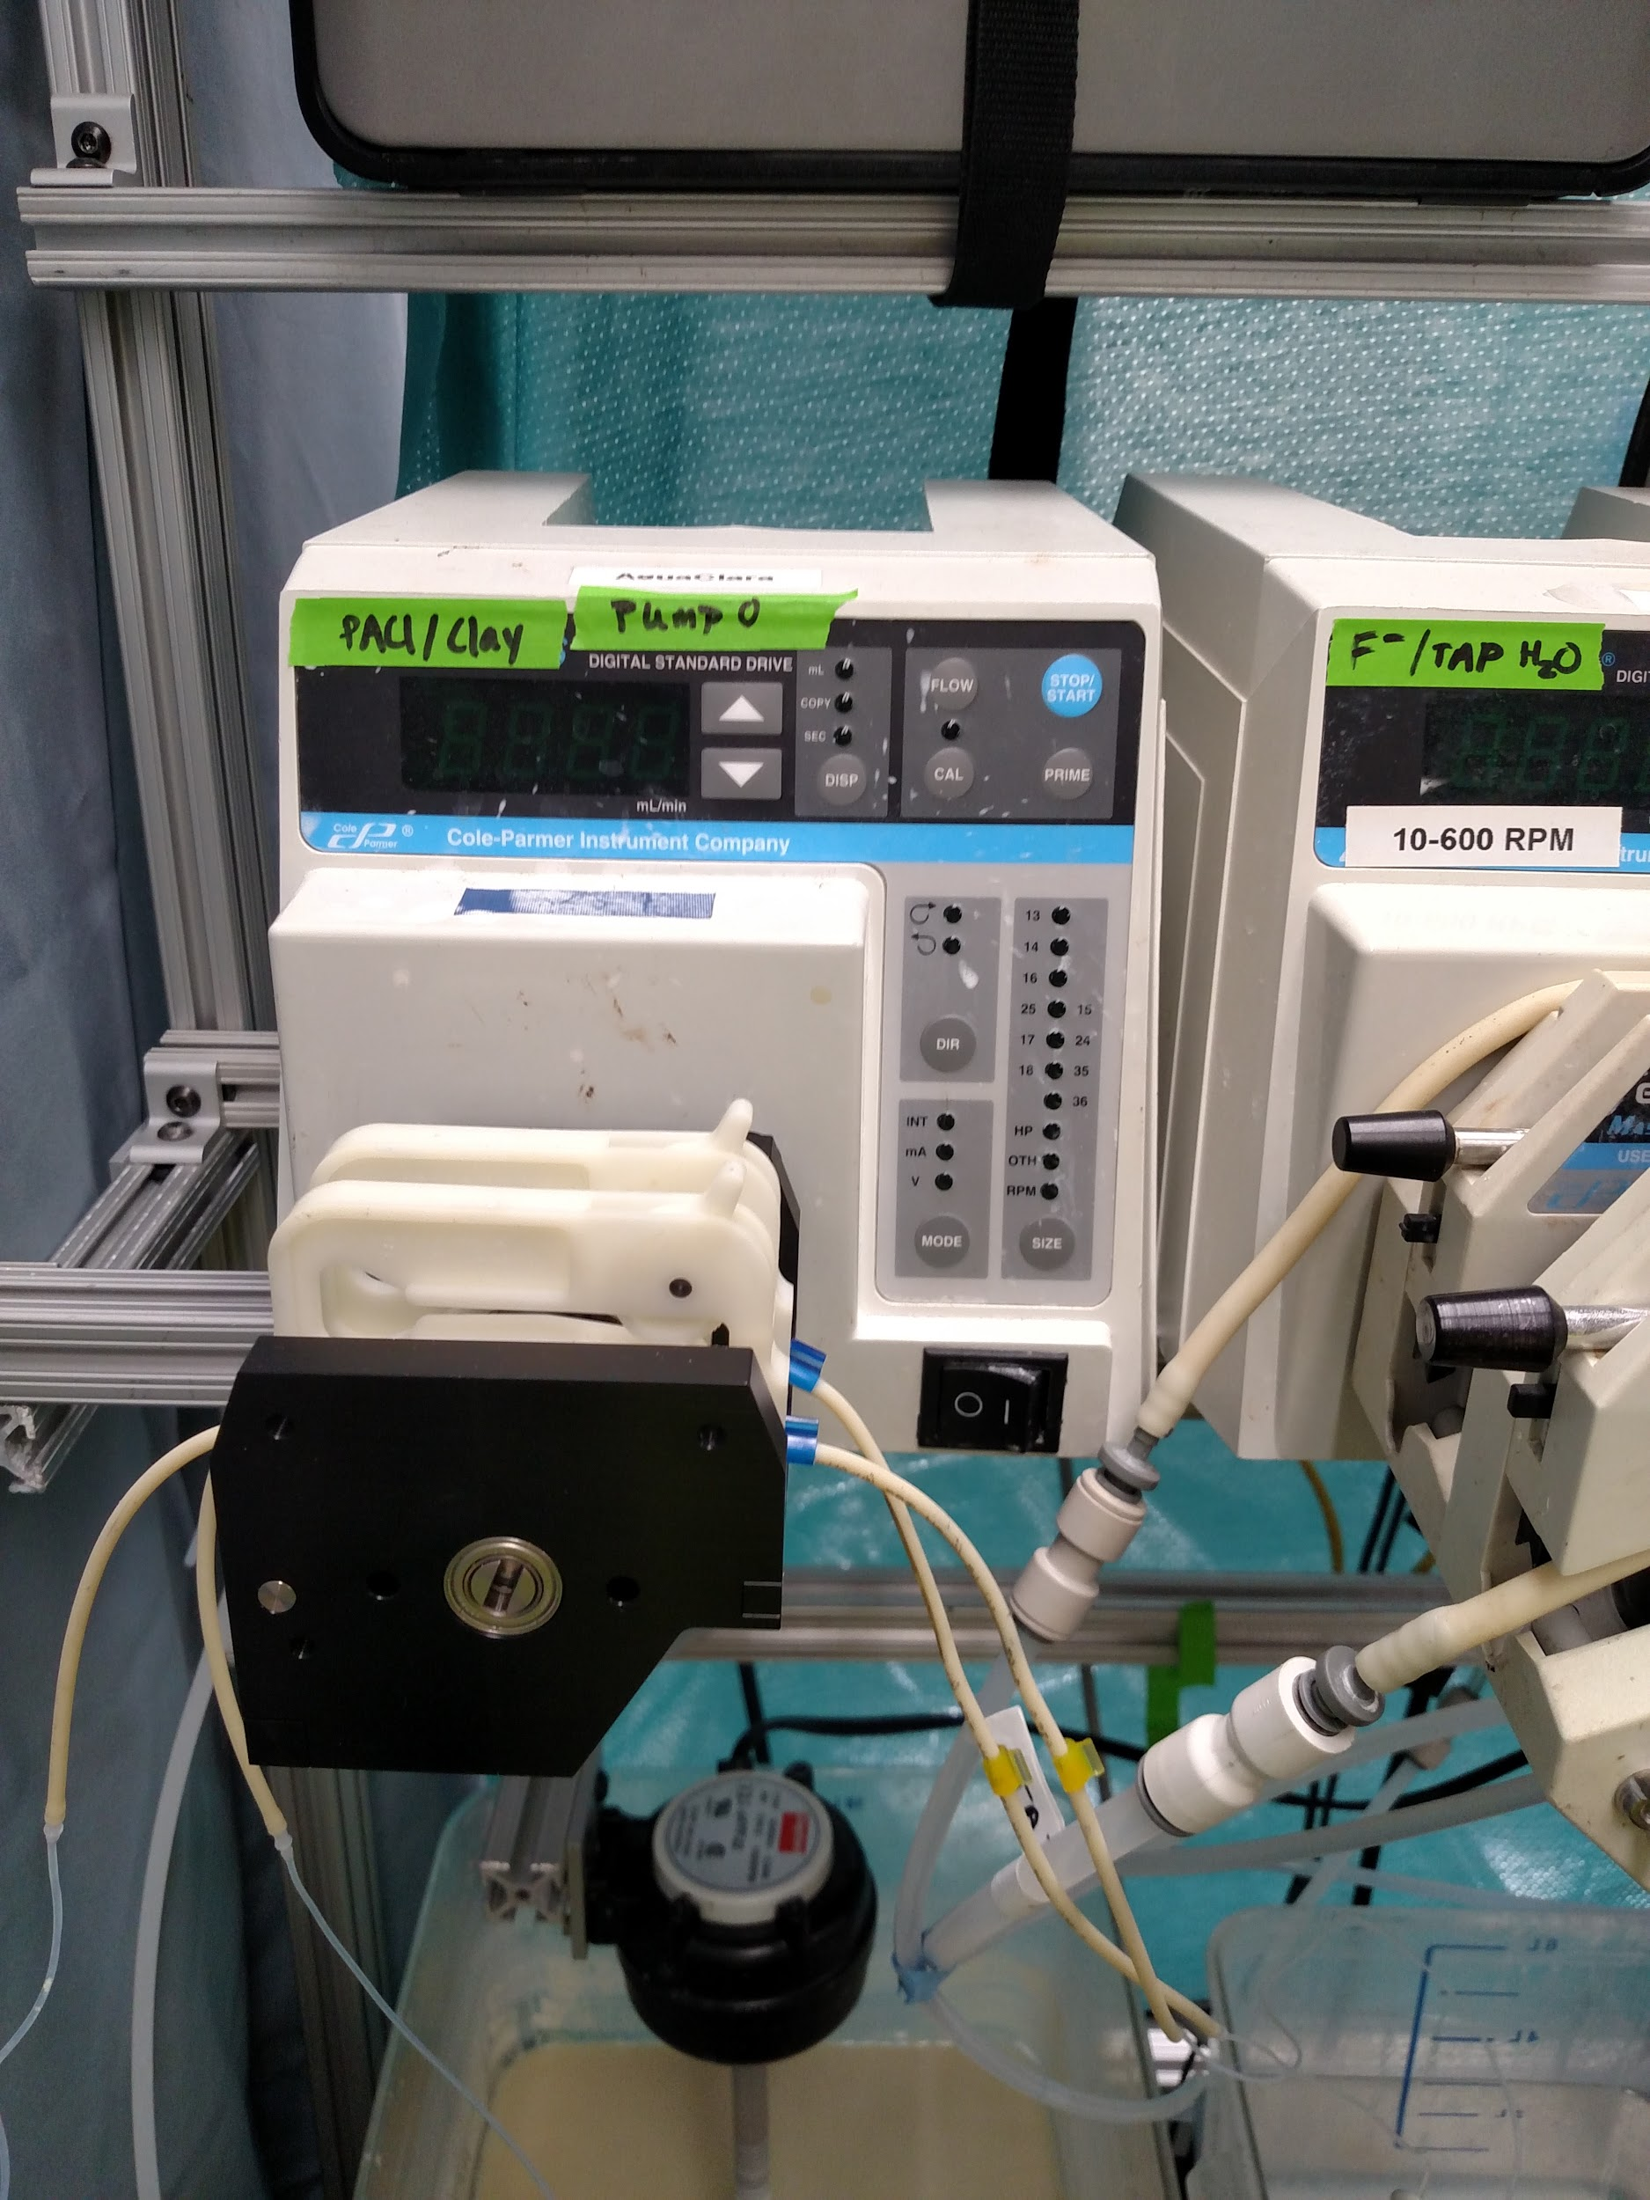
Changes
Micro Tubing
Combining Influents into Flocculator
Constant Fluoride Monitor
Notes:
Photo caption:
1) This device allows the team to obtain continuous fluoride concentration measurements.
2) Close-up of microtubing installed at the PACl/Clay pump.
A few changes were made as we progressed through our work to allow for more optimal testing. We incorporated microtubing into the PACl/Clay pump to increase the velocity of the clay going through the tubing to prevent settling from occuring (flocculator tubing). We found that settling in the tubing caused a decreased concentration of clay going into the reactor which caused the floc blanket to not be as dense as it should have. We added a constant fluoride monitor so our system can consistently access fluoride levels in the water over a period of three or four hours while we were running tests. This greatly helped in tracking data because we had a lot more points on our graphs which showed a more representative progression of our experiment. This was previously done manually every half hour. Finally, we made it so that instead of adding in the fluoridated water right before the reactor, it was added in before the flocculator so it had more time to adsorb to the clay and PACl before going into the reactor floc blanket.

Slide 7
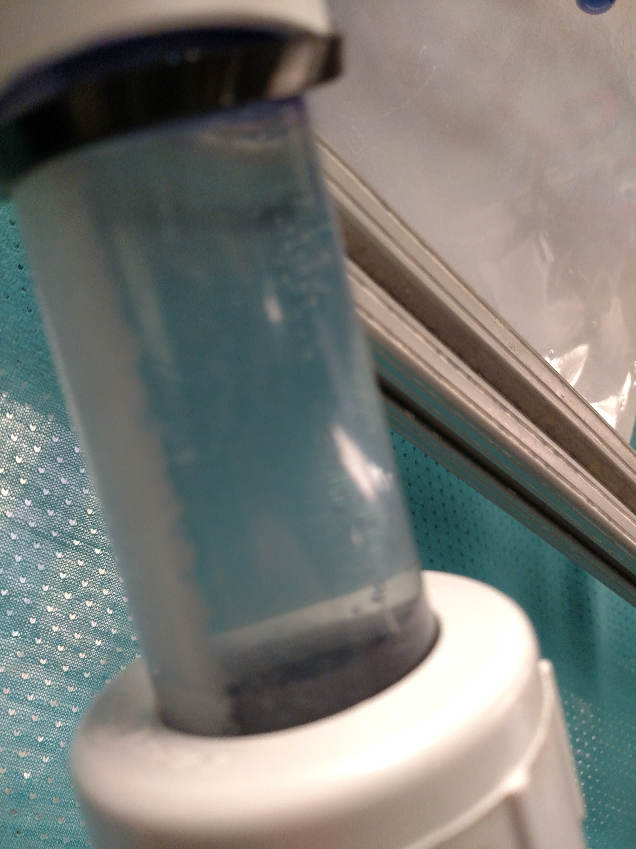
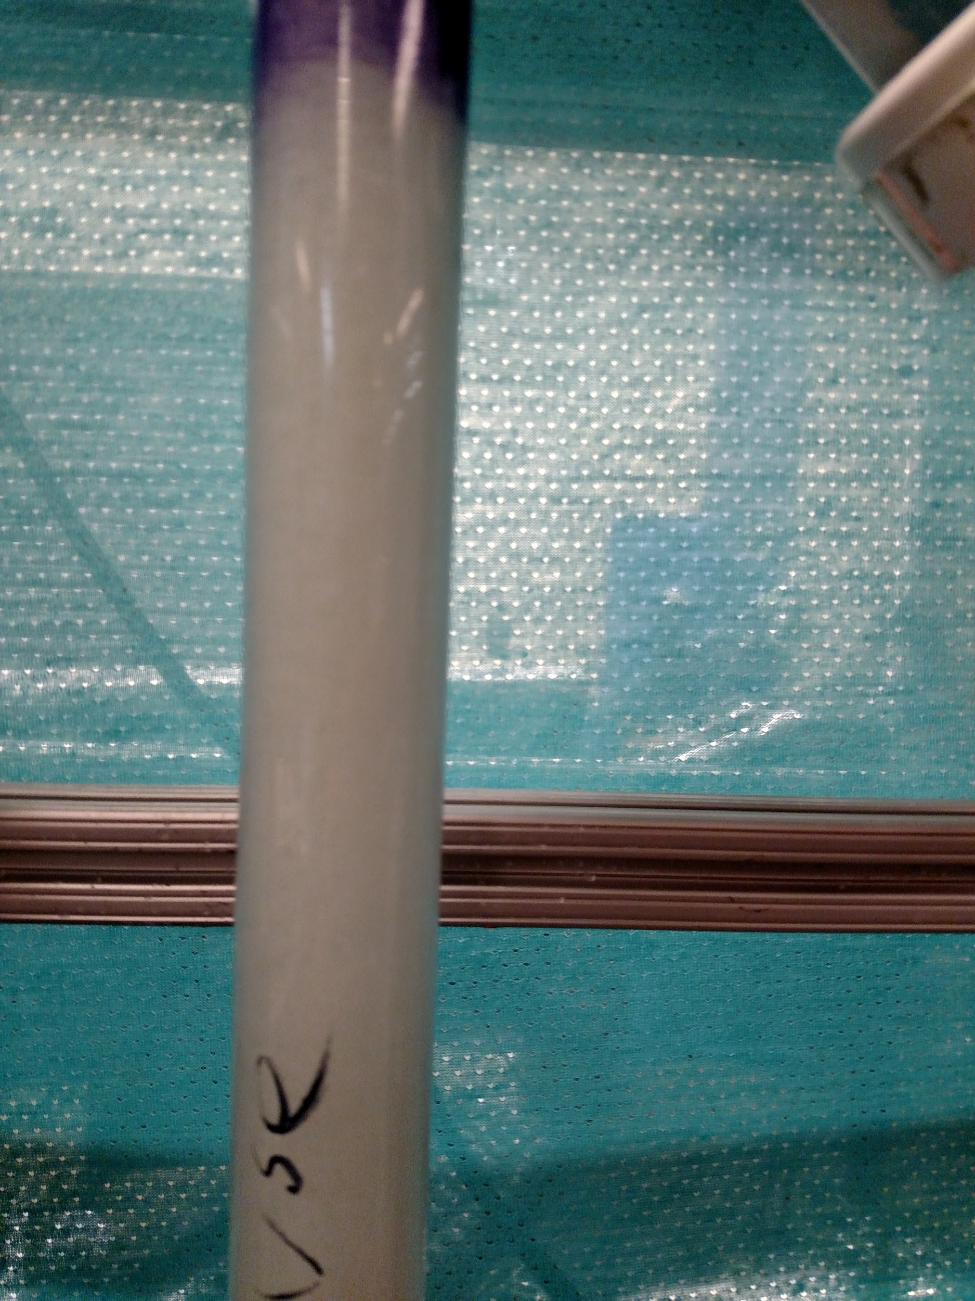
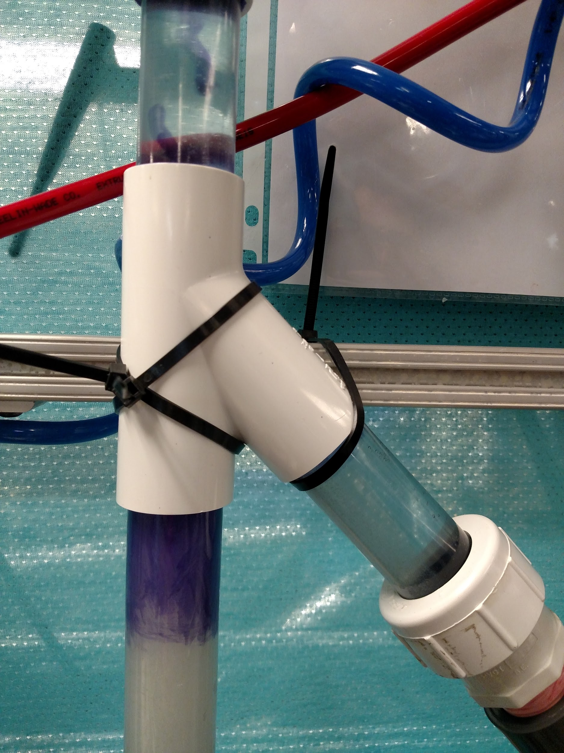
Floc Blanket Creation
Notes:
Caption: L to R: Desired density of our floc blanket, separation of floc blanket and clean water but the floc weir, effluent (floc separation) at the floc weir.
Summary: This slide shows the floc blanket density we achieved at the peak of our experimentation. We were able to successfully separate clean water from the floc blanket using the tube settler and floc weir. As you can see, our floc blanket remained at a consistent height and did not flow up to the tube settler and out into the effluent. The tube settler was able to catch all the excess small flocs that got through the floc blanket. It was found that it took around an hour or two for the floc blanket to reach steady state. Before that there was all problems with flocs getting through and turbidity spiking but after it led to an almost perfect separation and it also removed fluoride! Later in the semester we developed a completely transparent reactor. (See Appendix Slide 2)

Slide 8
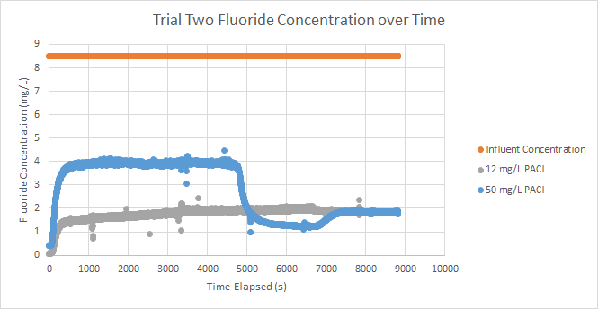
Fluoride Testing
Notes:
Photo caption: Fluoride Removal Testing: Trials 1 (Blue) and 2 (Grey).
Summary:
Our system was automated by ProCoDA, which allowed for regulated flow, dosaging, and constant data acquisition over the course of our experiments. In the blue trial, we started it at 25 mg/L and then around 5000 seconds or an hour and a half, we switched it to 50 mg/L without flushing out the system which the big drop can be seen. The orange line is what the water started at. It is interesting to see that a smaller dosage of PACl led to better removal of fluoride. However, the difference was that in the 12 mg/L run, fluoride was added after the floc blanket was created while in the 25 and 50 mg/L run, it was added in creating the floc blanket.
Data from our fluoride removal trials:
Trial 1:
10 mg/L of PACl was used with 200 mg/L of clay.
2 Hours: 6 mg/L → 1.76 mg/L Fluoride
70.7% removal
Trial 2:
12 mg/L of PACl was used with 200 mg/L of clay.
2 Hours: 8.8 mg/L → 1.61 mg/L Fluoride
81.7% removal
Trial 3:
50 mg/L of PACl was used with 1200 mg/L of clay
2 Hours: 8.5 mg/L → 1.24 mg/L Fluoride
85.4% removal
Ultimately, our system achieved a fluoride concentration that is below the WHO guideline for clean and safe drinking water.
50 mg/L provided the optimal dosage of PACl to bring the fluoride levels below the guideline, however there was a random spike about half an hour later that the team was not sure how to explain.

Slide 9
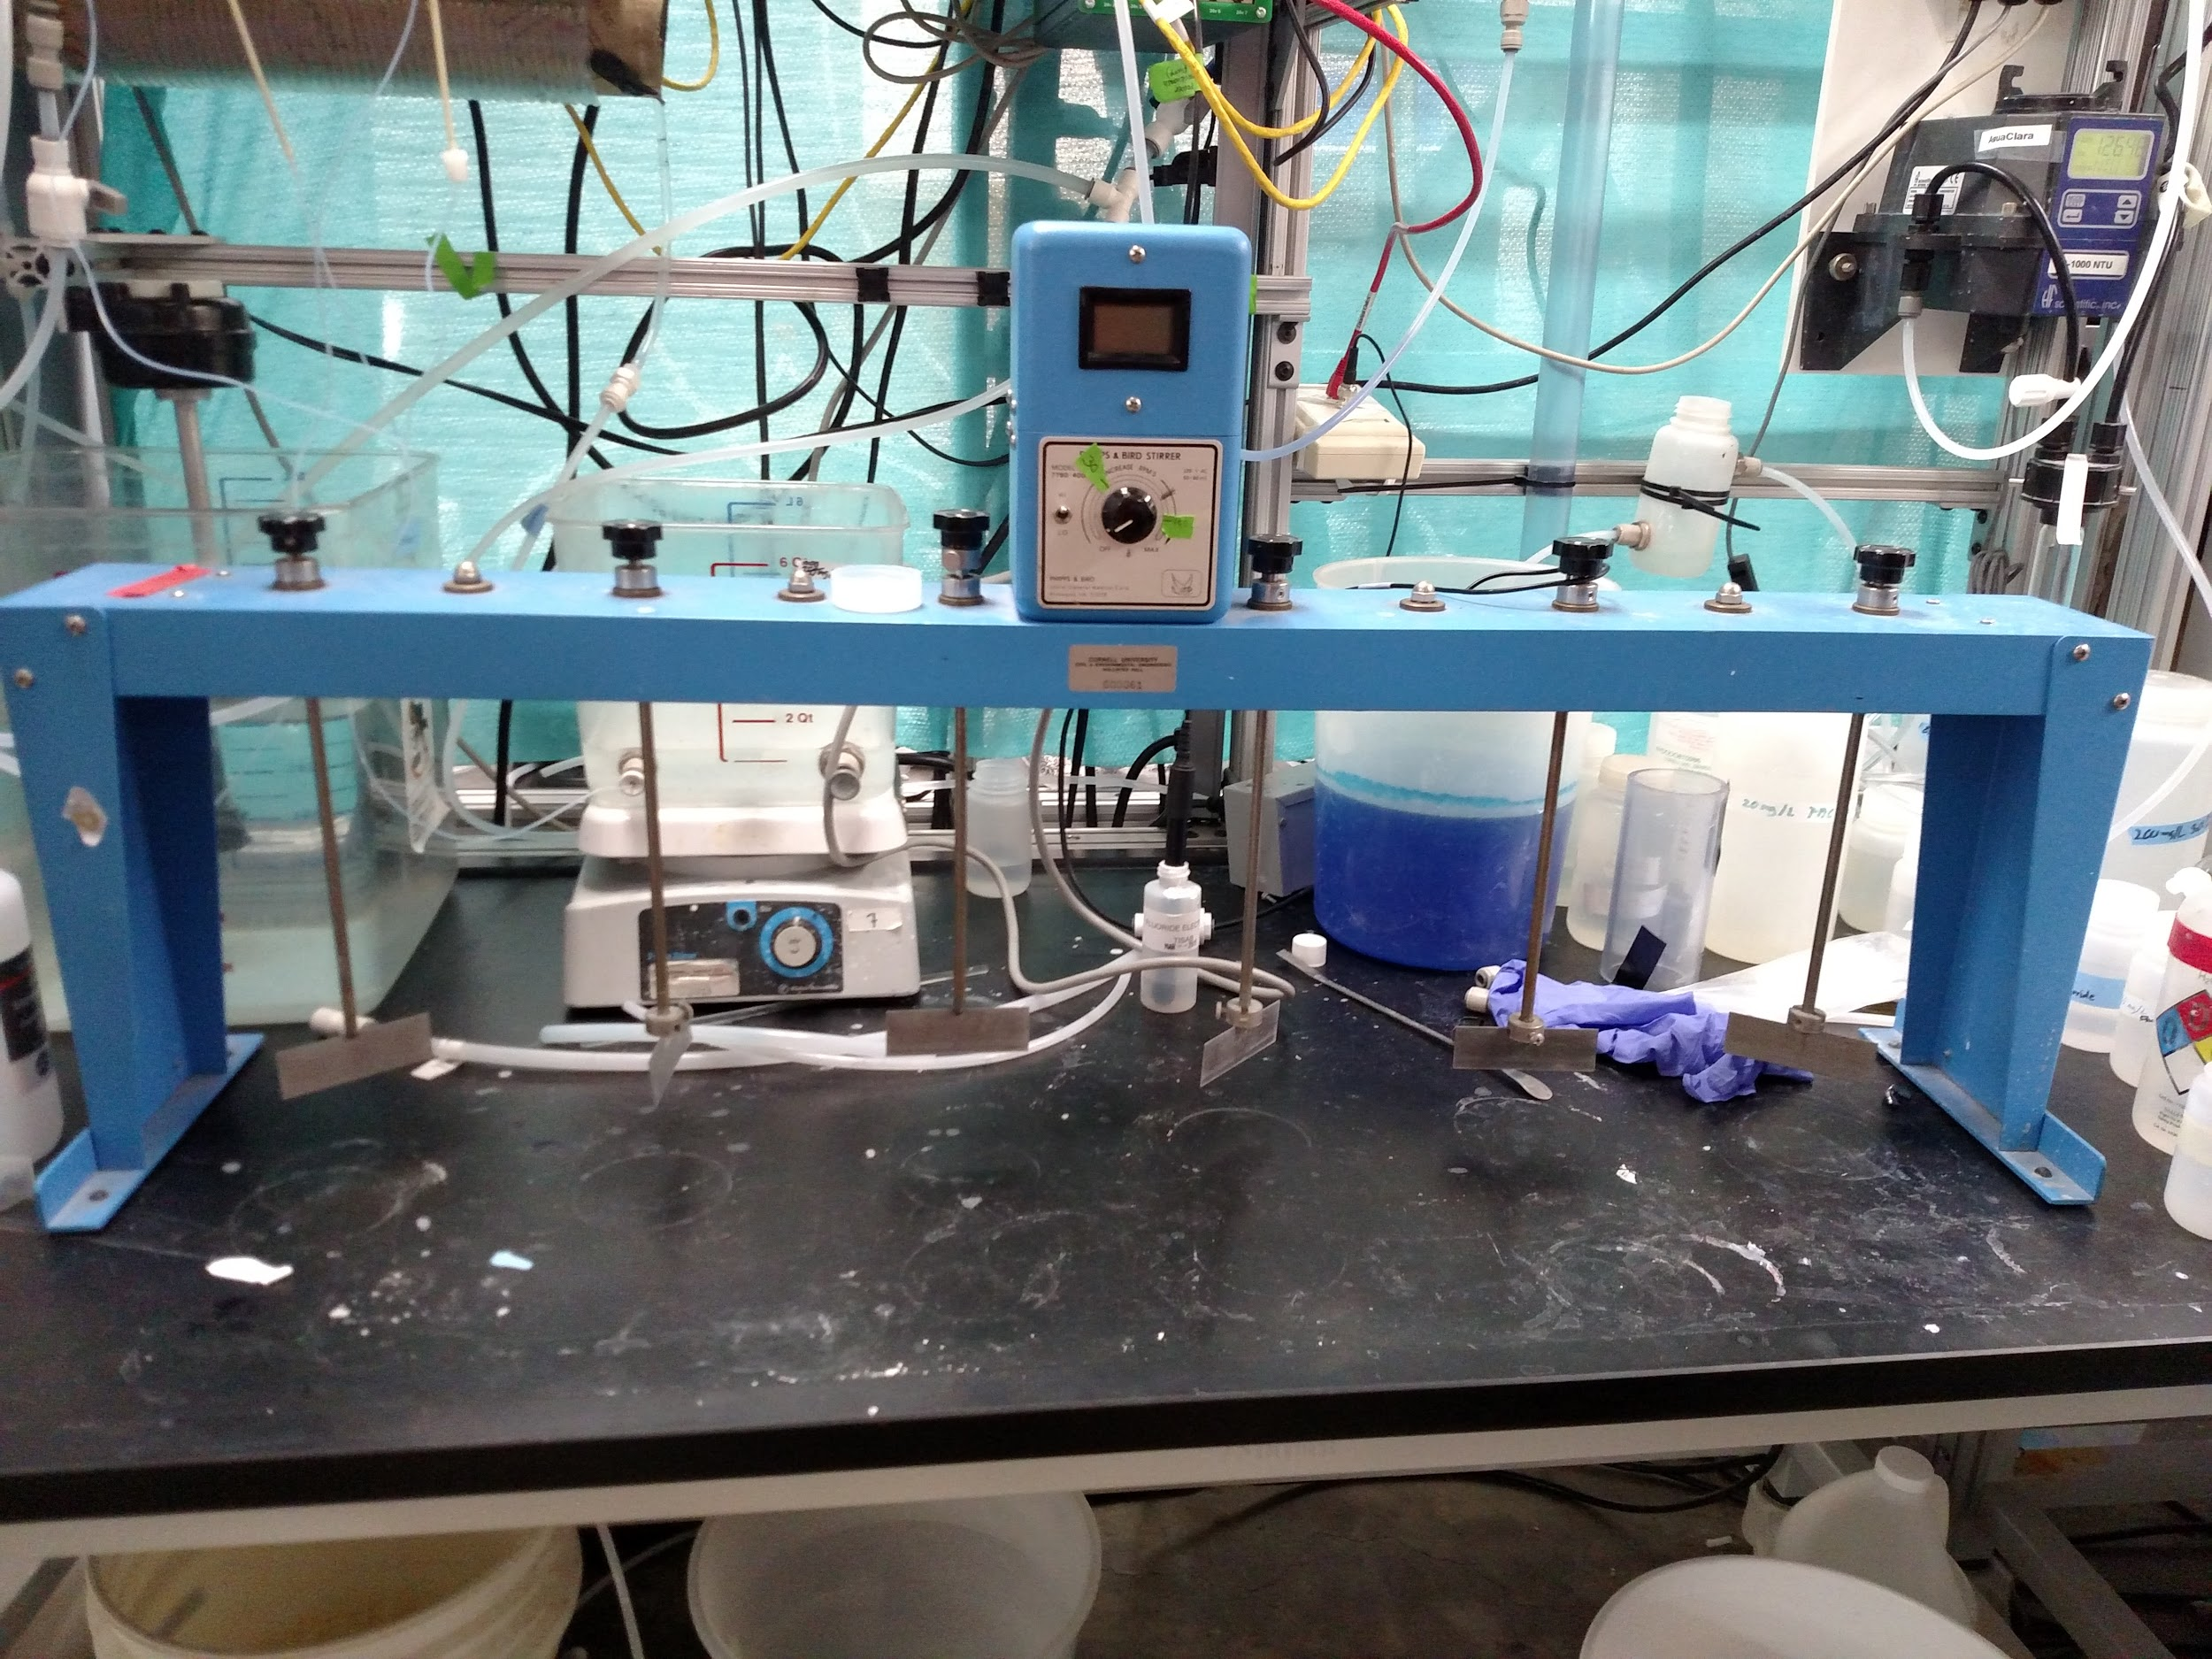
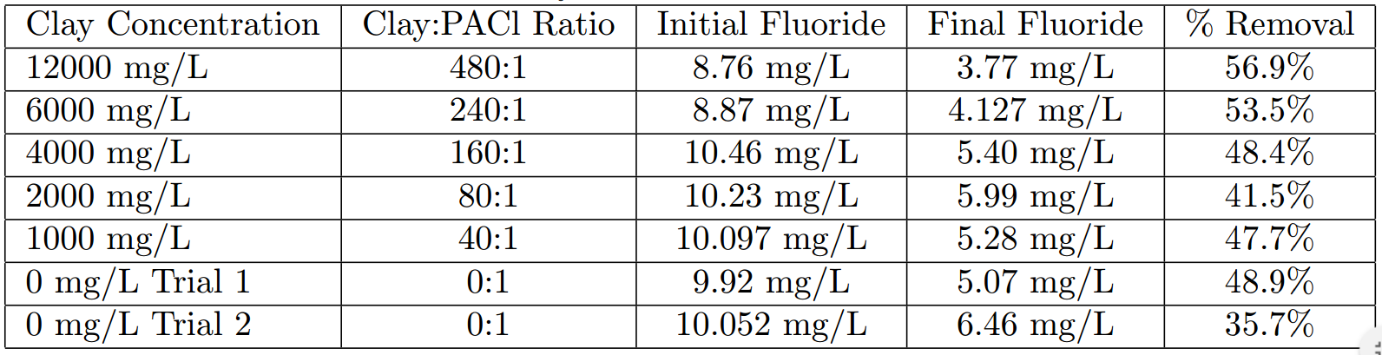
Clay Testing
Is clay necessary for adequate fluoride removal?
Notes:
Photo Caption:
(1) Jar Test Apparatus
(2) Table of results from jar testing
Summary: The next step of the team was to decide if clay was actually necessary in the removal of fluoride, and if and PACl can be used to make flocs that can settle out. In order to test this, a batch jar test was used with different concentrations of clay to PACl. In order, to imitate the concentrations found in the reactor, 25 mg/L of PACl was used, and the ratios in the table were used to create the flocs since they provided enough clay for the PACl and fluoride to adsorb to. As seen in the table, more clay does mean more removal, but even without clay, for two trials there still seemed to be some removal, although not much, with only PACl. Therefore clay may not necessarily need to be used in the removal of fluoride but this should be tested in the apparatus first.

Slide 10
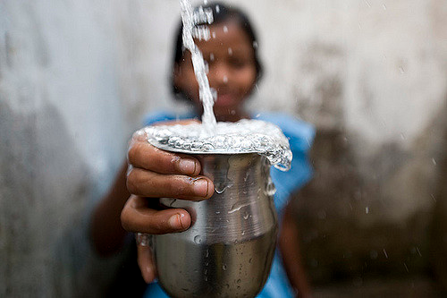
Conclusions
Highly effective in removing fluoride.
  Safe and beneficial drinking water
More efficient than the the currently accepted Nalgonda Method
Parallels between fluoride removal and dye removal
A promising solution to eliminating concerns regarding excessive fluoride in well water in an affordable, efficient, easily operable manner.
Notes:
Photo Caption: Glass of water held by Indian child, Charity: Water / clean water india. (n.d.). Retrieved May 20, 2016, from https://www.flickr.com/photos/twestival/3233453892
Summary: Given our research, the floc blanket reactor system is highly effective in removing fluoride from tap water. Our work has brought fluoride concentrations from extreme (10 mg/L) to minimal (below 1.5 mg/L). Achieved levels of fluoride are below WHO guidelines, signifying that our water is not only clean and safe but also beneficial to the bones. At these smaller concentrations the fluoride is working to strengthen the bones rather than weaken them. Our reactor system utilizes continuous flow and minimal PACl making it more efficient than the currently accepted method of fluoride removal - the Nalgonda method.
We have also learned about the parallels between fluoride and dye removal, and have created an engaging visual to teach others about our work. See Appendix Slide 3
Lastly, our work has proven that fluoride can be removed in a safe, efficient and affordable manner. We look forward to discovering how it can be implemented in the field, and believe our low cost reactor system will be beneficial to the financial constraints of developing regions.

Slide 11
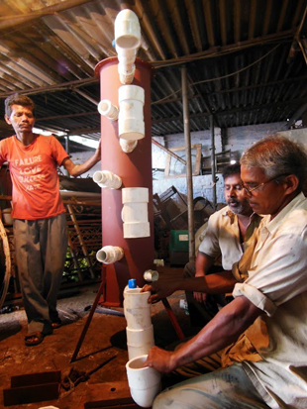
Future Work
Implementation in the field
  Scaling the reactor to meet AguaClara facility needs
  Elimination of electricity
Clay Jar Tests
  Experimentation without clay
Experimenting with simulated ground water
Notes:
Photo caption: A low flow stacked rapid sand filter being fabricated for one of the AguaClara water treatment plants in Jharkhand, India.
Summary: In the future, teams should work with Monroe to understand how this reactor system can be implemented in the field. Currently, the system utilizes electricity and is scaled for experimental purposes. Important questions teams should be asking include: how can we eliminate pumps? How large should the reactor be to supply AguaClara plants in India? Will the reactor still work on a larger scale? The team should reach out to the AguaClara team in India to better understand these challenges.
Furthermore, the team should test fluoride removal without dye - as our latest jar test experiments show that clay may not be necessary for floc blanket formation. Lastly, the team should run these experiments with actual ground water (rather than tap) to emulate the influent water in AguaClara plants.

Slide 12
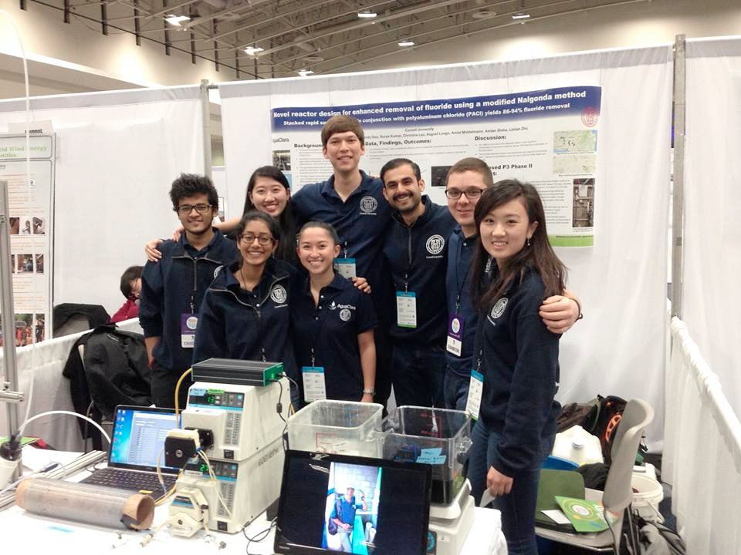
EPA P3 Competition
Notes:
Caption: CSFBR and Fluoride teams at the EPA P3 competion in April 2016.
Here we were able to share our work with professionals, families and children. The team used dye to help explain fluoride removal, and provide an engaging visual for onlookers.

Slide 13
Questions and
Recommendations
August Longo
Chemical Engineering
akl62@cornell.edu
Katherine Dao
Chemical Engineering
ktd23@cornell.edu
Pooja Desai
Human Biology, Health and Society
pmd85@cornell.edu

Slide 14
Appendix
Slides

Slide 15
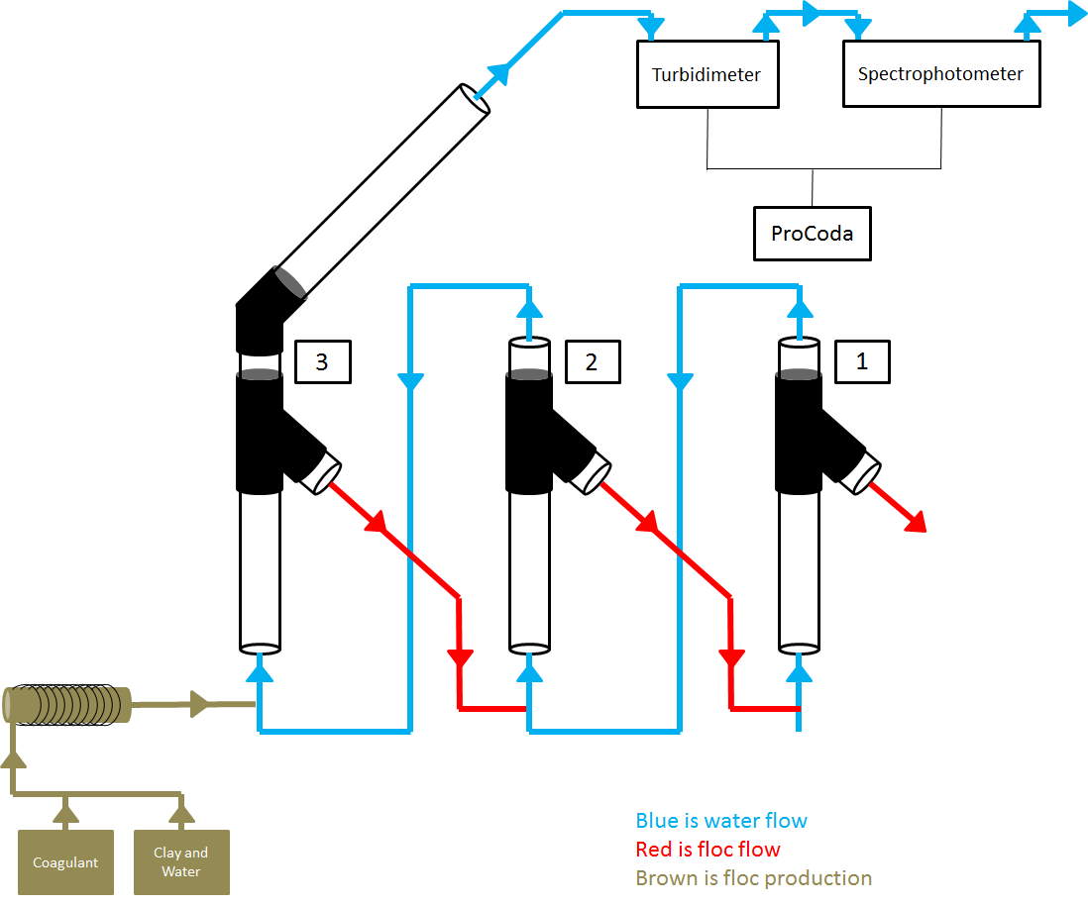
Apparatus Design
Collaboration with the CSFBR team
Successful removal of dye using a series of there floc blanket reactors
Used one floc blanket reactor three times the length of each CSFBR reactor
  Consistent floc blanket length
Both dye and fluoride exhibit an electronic charge.
  PACl has a positive charge, attracts dye, and clumps with dye to remove.
  Similarly, fluoride has a negative charge.
Notes:
Source: CSFBR Fall 2015 Final Presentation
Photo caption: CSBRF Tri-Reactor set-up schematic
Summary: Our apparatus design was based on the successes of the CSFBR team in removing dye with a series of three reactors. To test the efficiency of the reactor system, we modified their set up to consist of a single reactor three times the length of each individual reactor -- allowing for consistent floc blanket length between the two teams. After conducting background research, the team found that fluoride and dye act in a similar manner due to their negative charge, and thus their ability to adhere to PACl which has an overall positive charge. Due to these similarities, fluoride removal was hypothesized to be as efficient or nearly as efficient as dye removal.

Slide 16
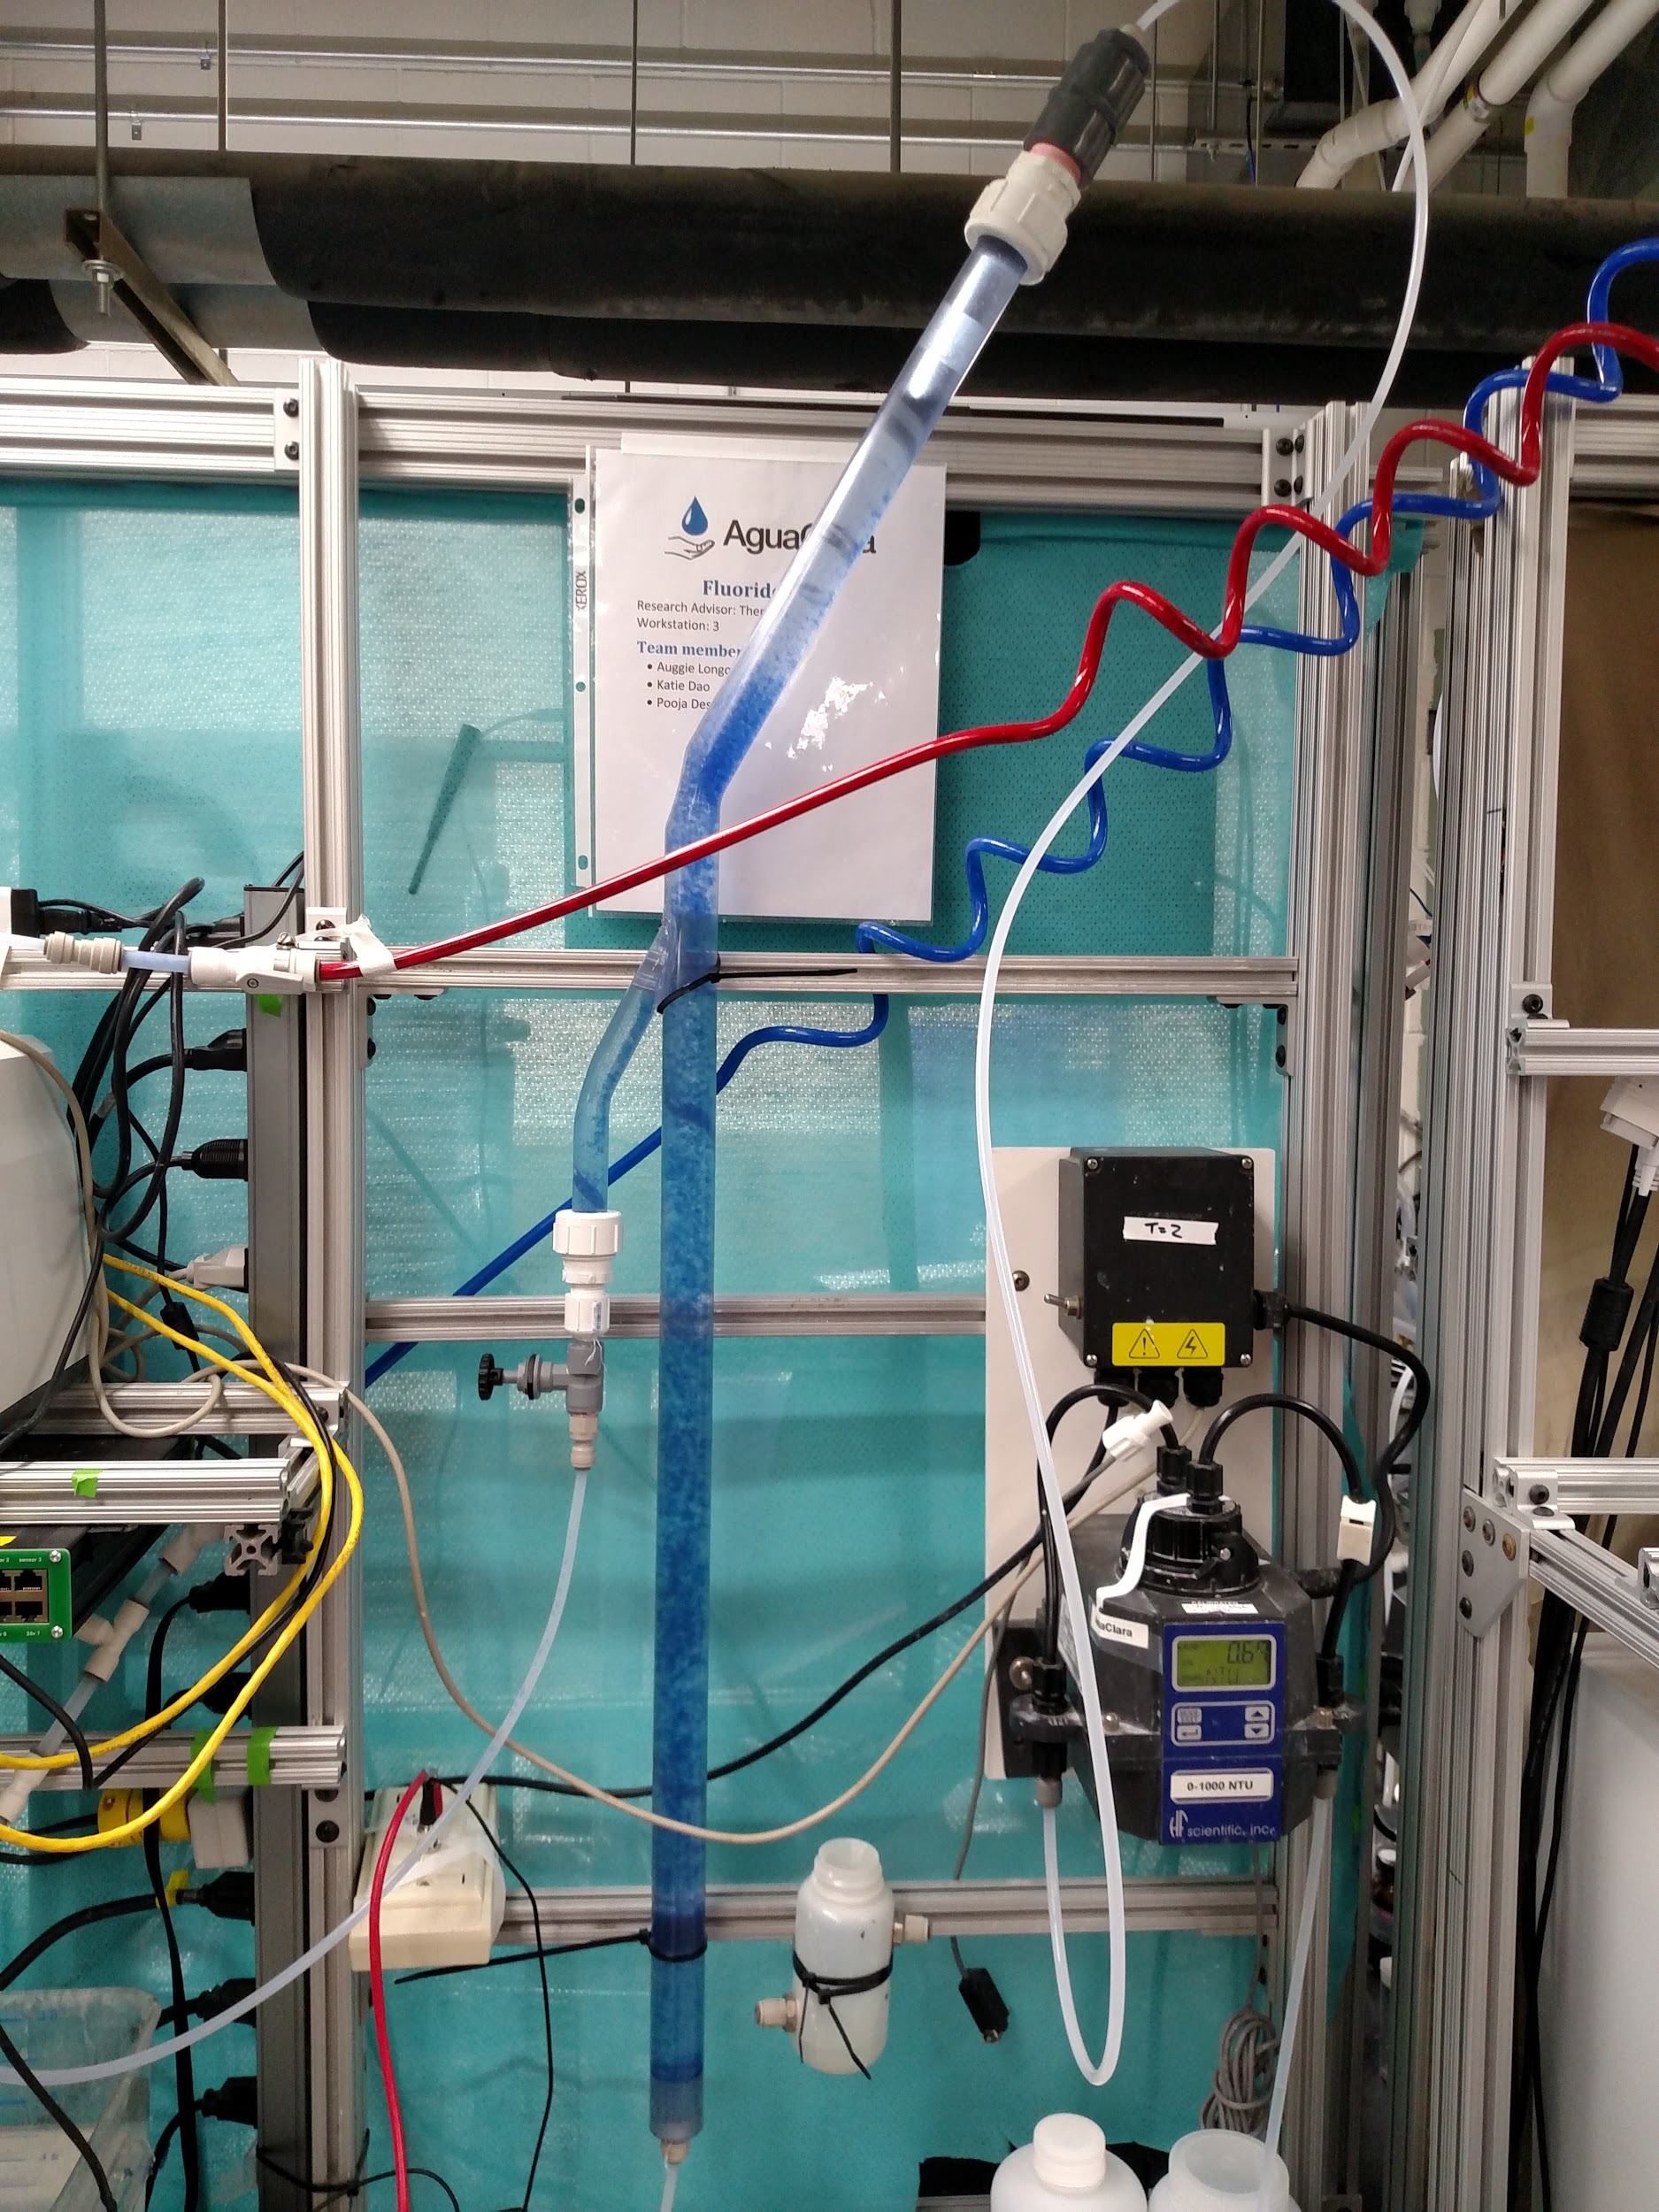
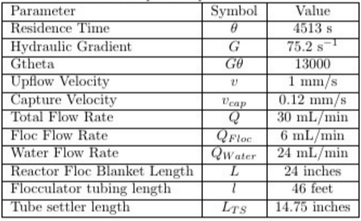
Notes:
Picture of the transparent reactor and list of parameters in the creation of the reactor.

Slide 17
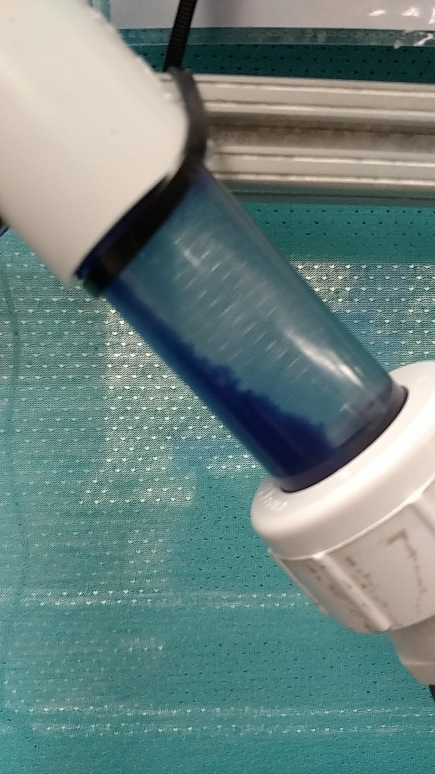
Dye Testing
Given our design parameters - could dye be as successfully removed as fluoride?
Engaging visual to present our work
82% Removal with 25 mg/L PACl Dose
Notes:
Caption: L to R: Floc blanket using blue dye, effluent of PACl and blue dye in the floc weir.
After achieving promising results with fluoride, the team experimented with blue dye to test if the dye can be successfully removed in the same manner. The purpose of this work was to create an engaging visual so clients can understand how the reactor works, and how fluoride flows through each part of the system. The team achieved 82% removal of blue dye with a PACl dosage of 25 mg/L. These experiments was based on the work of the CSFBR team, who found that clay was not necessary for dye removal.

