Slide 1
Fluoride Subteam
Spring 2015

Slide 2
Why Fluoride?
Many developing countries use groundwater as their primary source of drinking water.
    India – 85% sourced by groundwater
Overexposure to fluoride can cause
    Chronic effects on bone formation
    Crippling Fluorosis
    Arthritis
    Dental Fluorosis

Slide 3
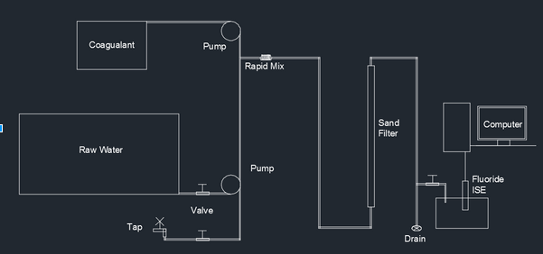
The Set Up

Slide 4
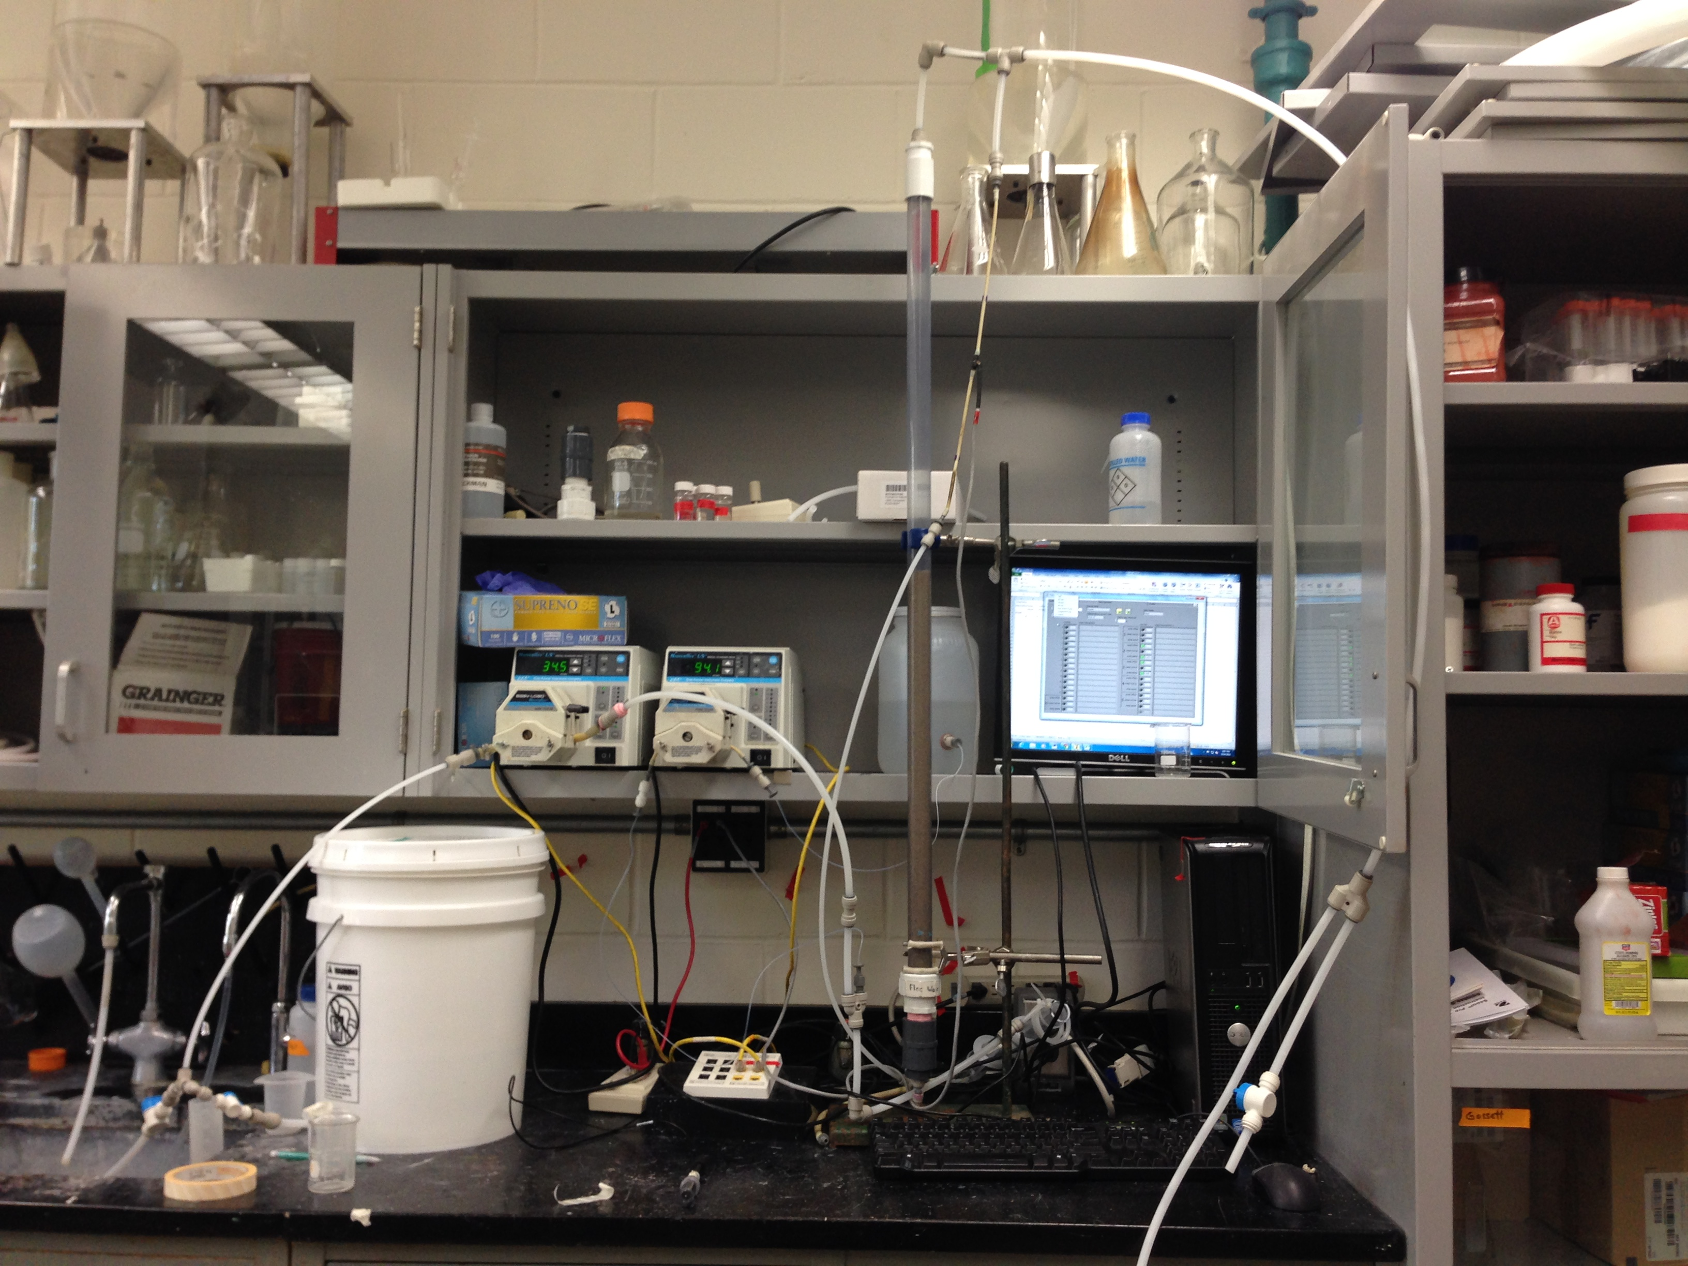
The Set Up

Slide 5
Our ProCoDa Struggle
ProCoDa Box Failures
    Our system was originally set up for ProCoDa, but faulty resistors yielded incorrect rpm values.
    STAMP Box Failures
      We moved to Process Controller, but went through two STAMP Boxes that weren’t responsive to computer input.
      Peristaltic Pump Failure
          Our pumps were faulty and also failed to yield the calculated rpm for our desired flow rate
      Finally after Casey replaced almost every part of our system, we got it to work!

Slide 6
Other Issues We Faced
We had many air bubbles appearing in our system
    Located areas and adjusted fittings
    Finally eliminated bubbles when test water changed to room temperature
Faulty push connects lead to leaks
Compression fitting failure
    Resulted in reworking of sand filter

Slide 7
Process Controller
Raw Water Pump 34.5 rpm
    Raw Water Pump Flow Rate (131 mL/min)
Coagulant Pump 89.8 → 94.1 rpm
    Plant Flow (131 mL/min)
    Stock Concentration (69.4 mg/L)
    Desired Dose (10 mg/L)
    Target Velocity 1.009 mm/sec

Slide 8
Calibration Curve

Slide 9
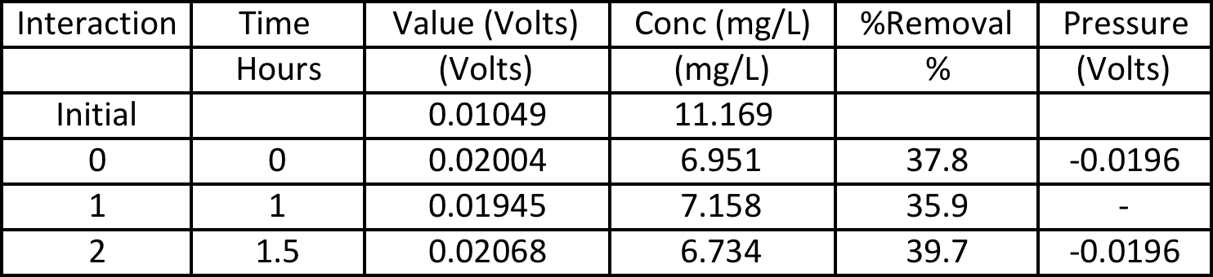
First Removal Run
Though we were only able to run the system once, we had a 40% fluoride removal rate.

Slide 10
Faults
More standard concentrations need to be taken to develop a more accurate calibration curve and equation
Our flow rate my be too high
    When starting our experiment we learned we were just barely fluidizing our sandbed
    Our groundwater and coagulant were rapidly depleted

Slide 11
Future Work
More trials
Varying doses of coagulant and fluoride
More standard points for our calibration curve
  Plotting points that more accurately represent a log scale.
  Develop relationship/guide between varying fluoride concentrations and PAC dosages.
Investigate the primary flow rate
Determine backwash flow rate
Test varying sand types and sand filters
Reproduce more realistic groundwater

Slide 12
Thanks to everyone who helped this budding team this semester!
Especially Paul, Casey and Monroe

Slide 13
Questions?

