Slide 1
Fluoride Filter
Katie Dao, Pooja Desai and Auggie Longo

Slide 2
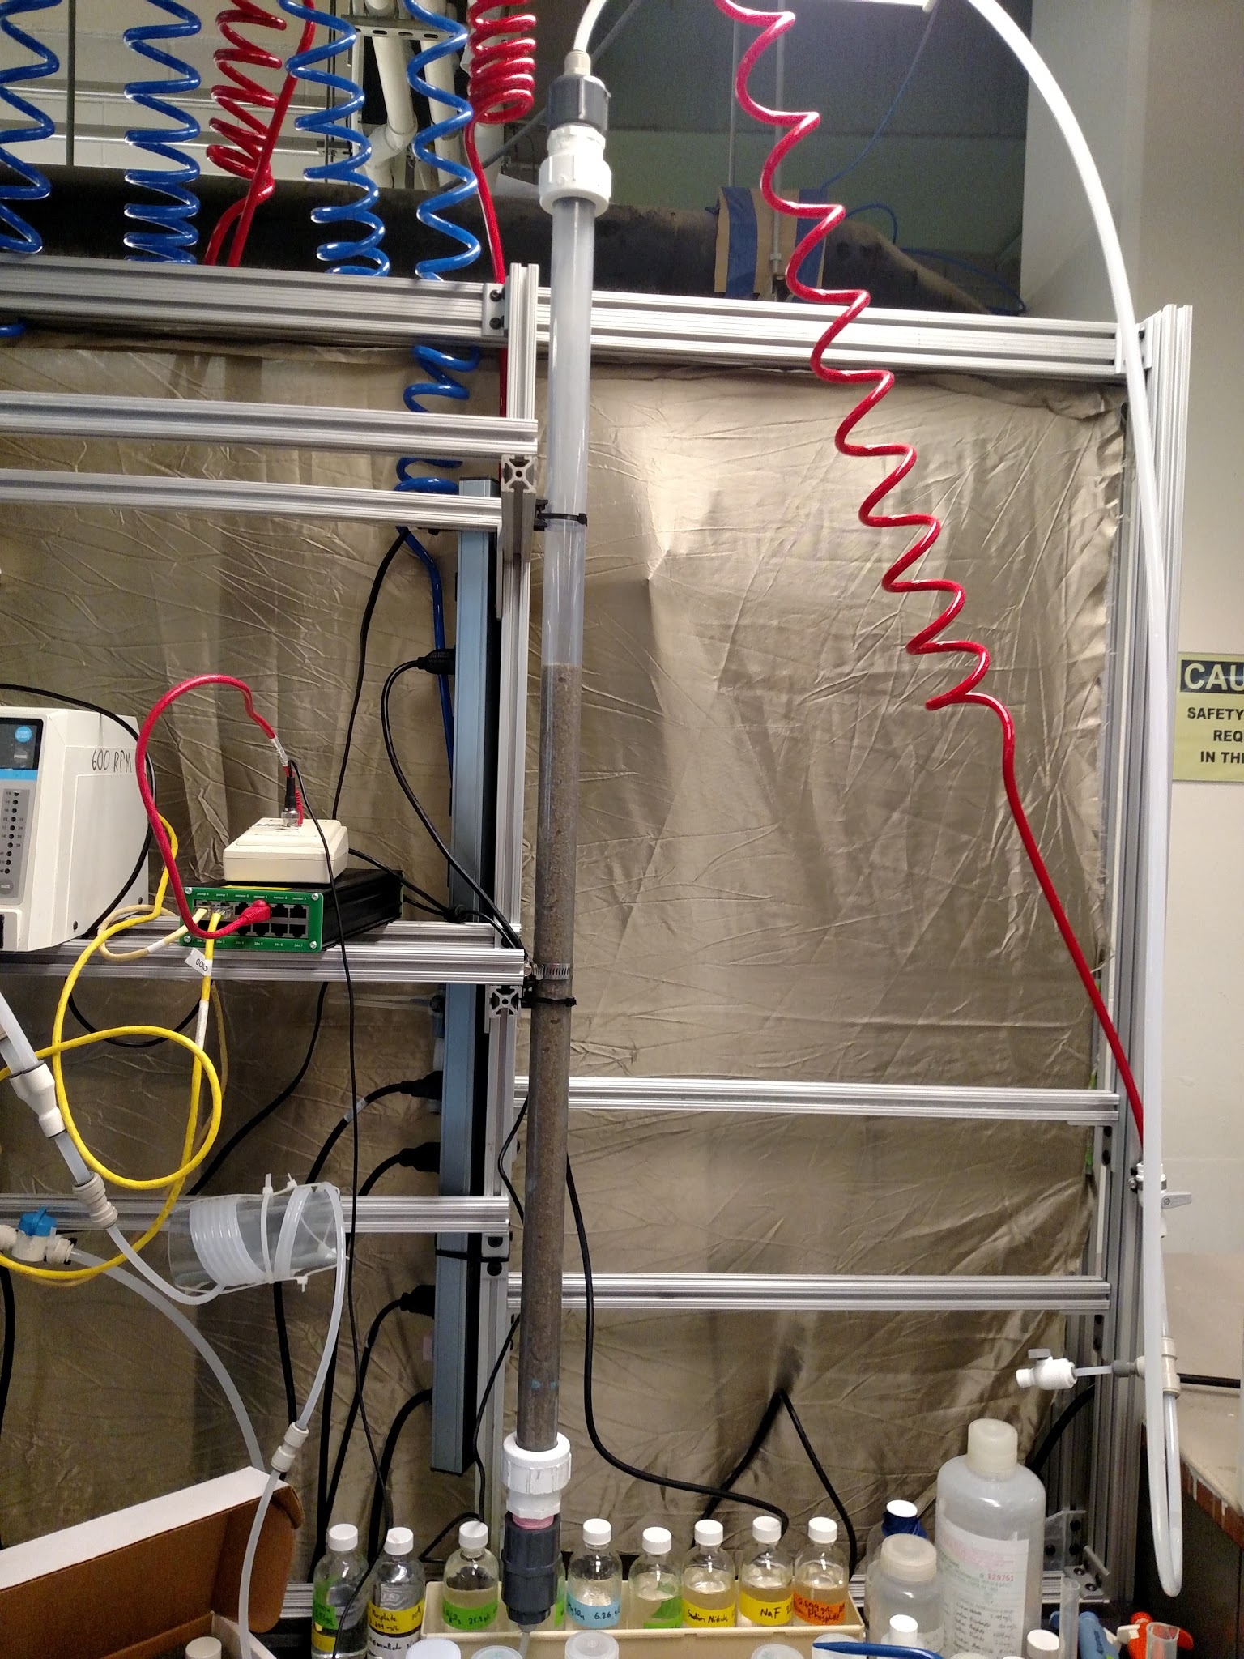
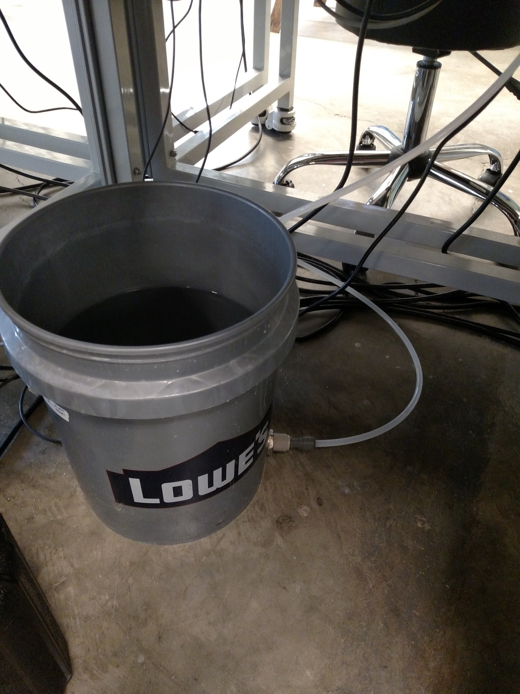
Set-Up
Sand Filter
Raw Water
Notes:
sand filter - PVC column filled with sand
raw water - Water mixed with Sodium Fluoride

Slide 3
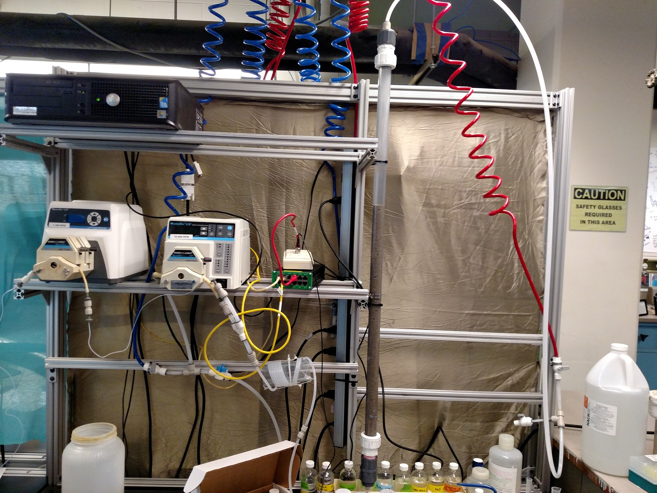
Set-Up
Notes:
Coagulant and raw water are pumped through tubes using ProCoDA to regulate them. The two tubes then combine and and rapidly mix through flexible tube wrapped around a wider tube. Then it goes through the sand filter and out the output stream where it can be measured for pH

Slide 4
What We Accomplished
Research past experiments exploring PACl and Alum vs Fluoride
Designed and built a sand filter apparatus
Set up ProCoDa
Recalculated flow rates (Based on Hui’s system - adjusted for ours)
Established a calibration curve with a high R² value
Tested varying concentration of PACl on 10 mg/L Fluoride
  20 mg/L, 40 mg/L, 50 mg/L
  At least two experiments per each dosage
Determined the optimal coagulant dose
  Needs fine tuning!

Slide 5
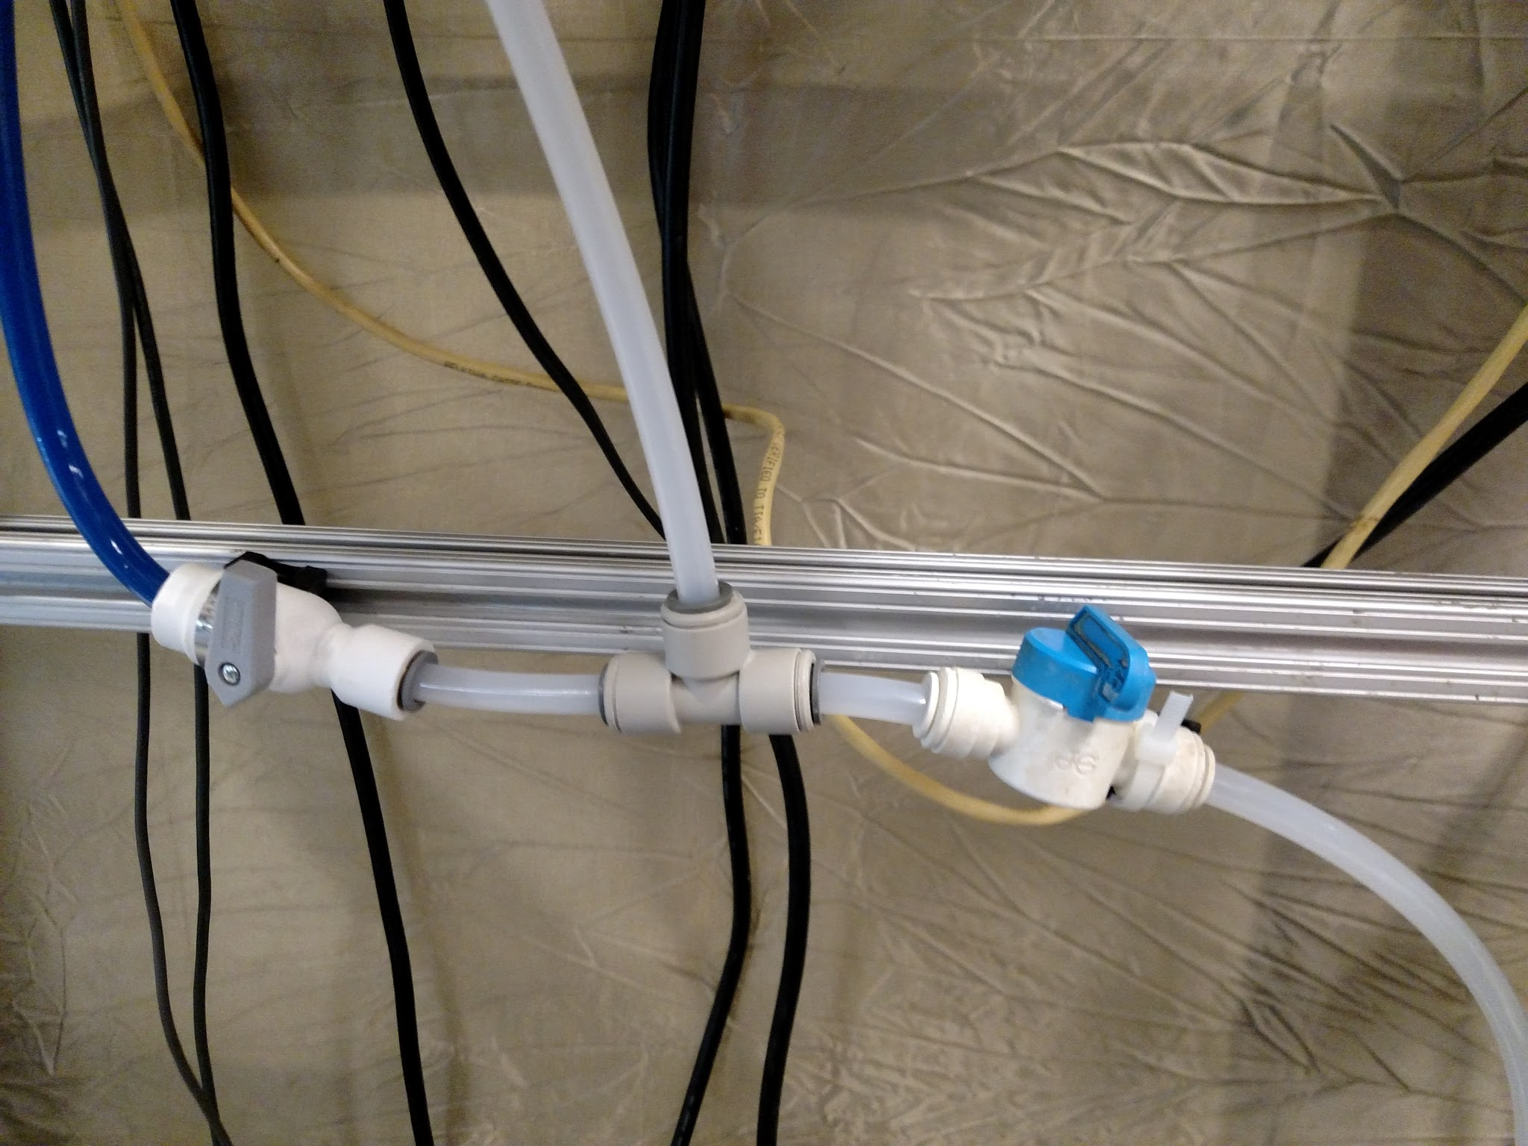
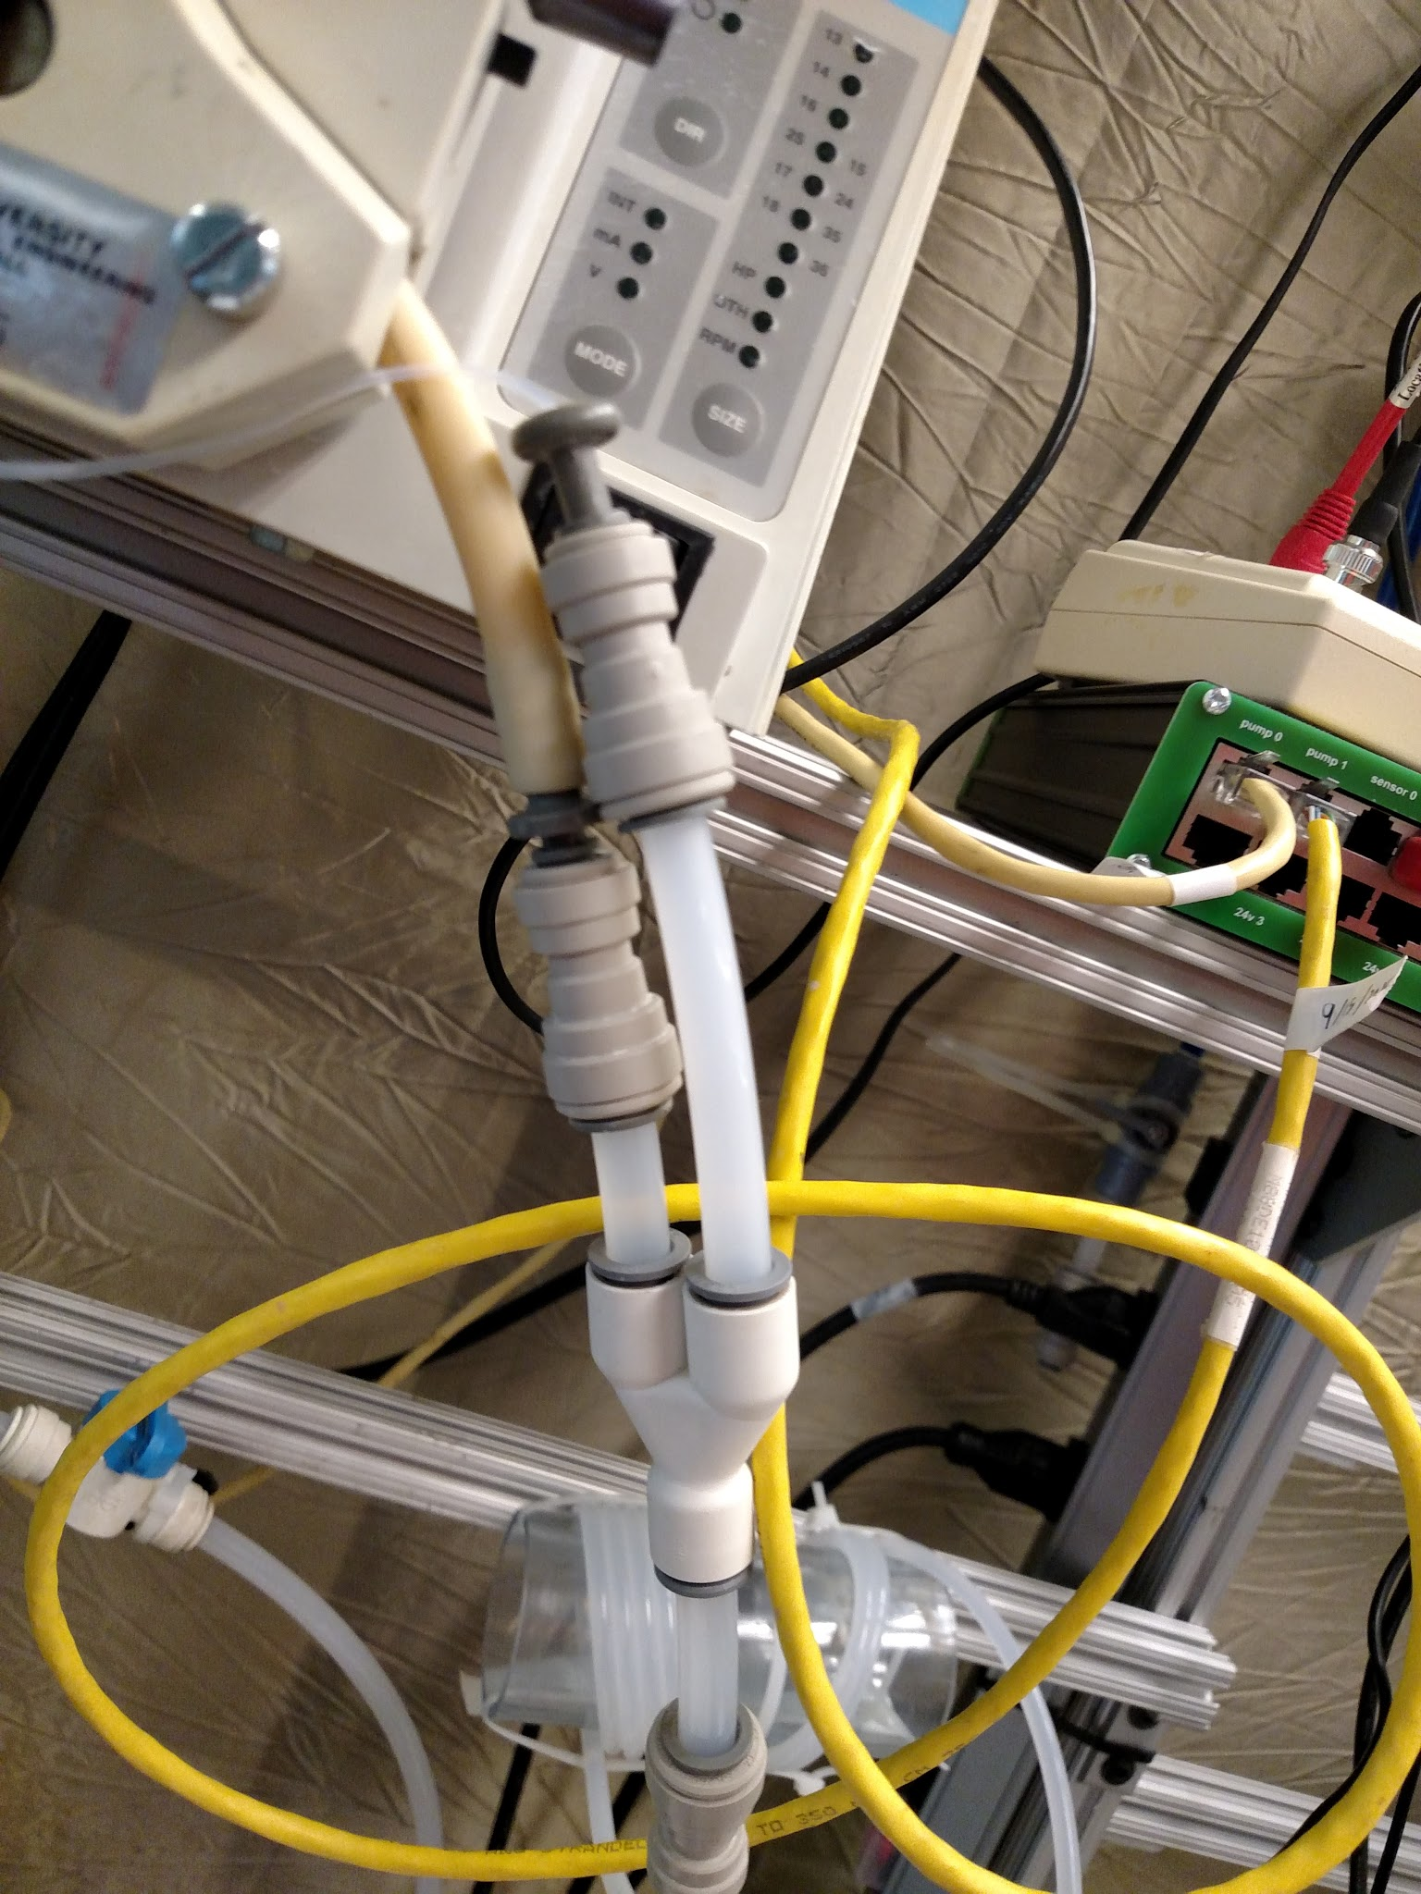
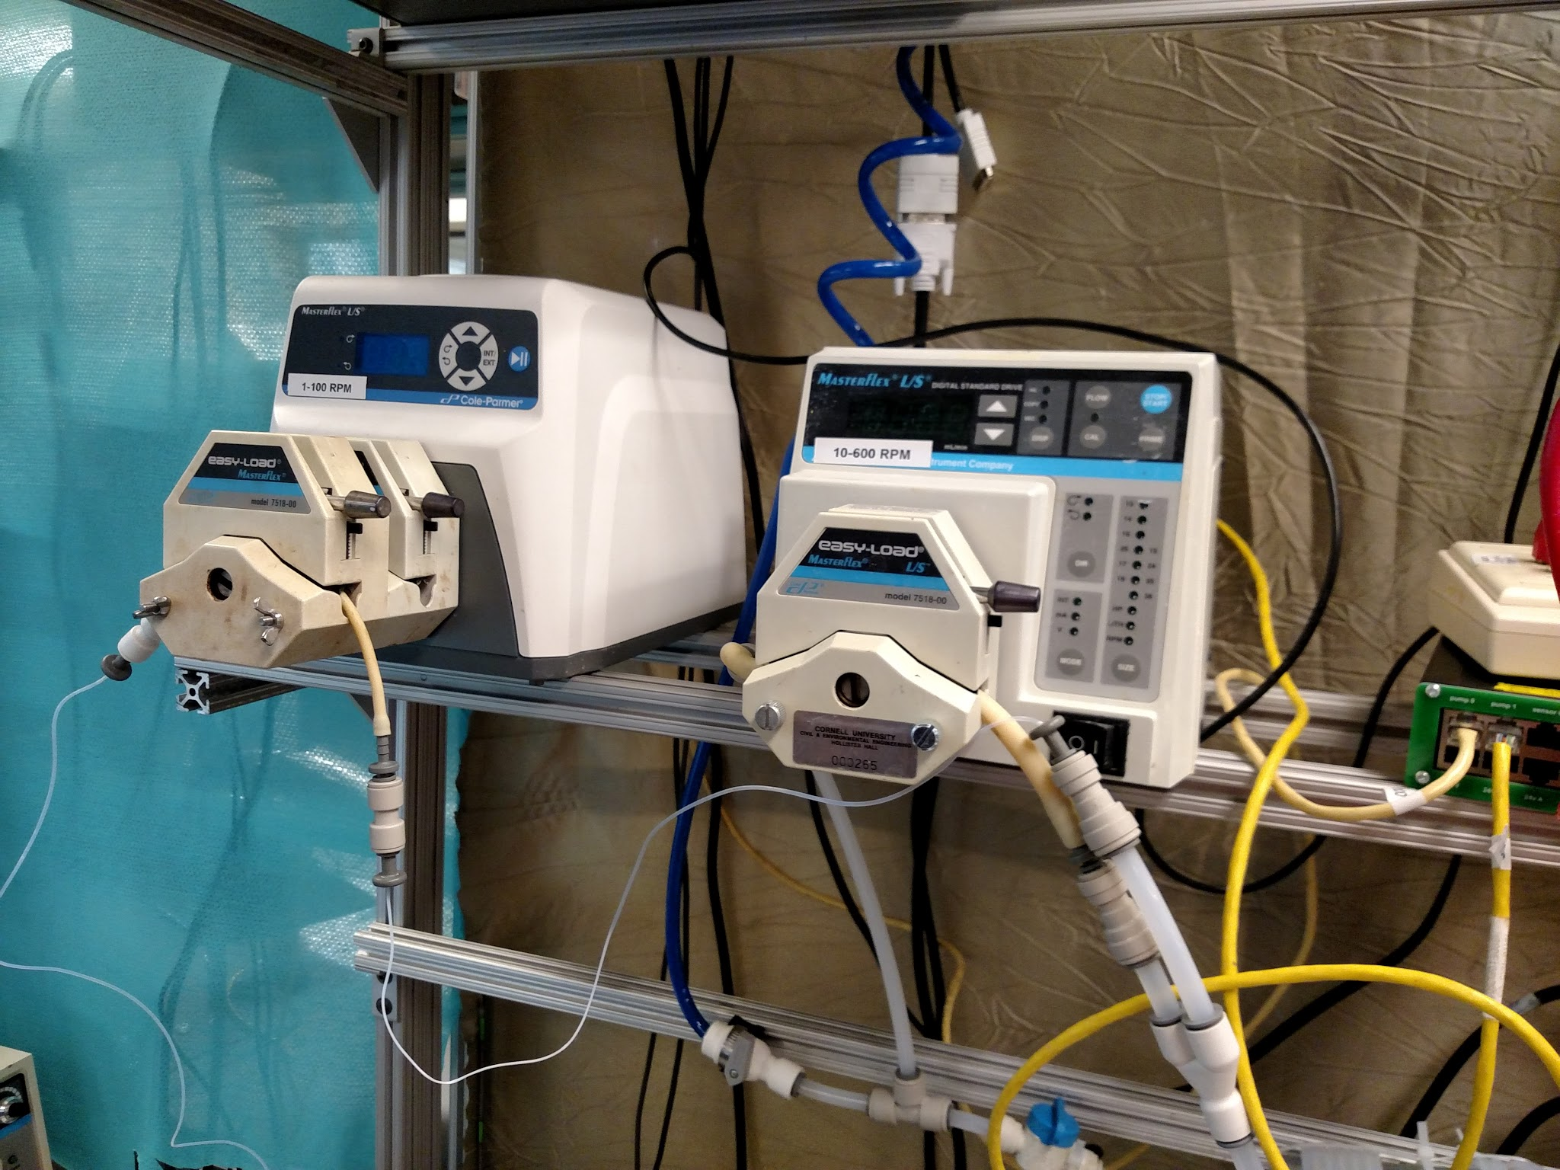
Running the System
Water and Fluoride Water
Problems
  Leaks
  Water not being pumped
  Sand column explosion
Notes:
We ran the system with water to check if there were any problems.
There were a bunch of leaks caused by the push-to-connects not being pushed in all the way - but was easy to fix
we ran the system with the fluoride and was having trouble initially pumping water to the sand filter - solved by finding an air leakage in the system
major system is we blew up the sand filter. We were pumping water in but there was no exit because the valves were closed so the top blew off and the mesh may have broke- still have to address it

Slide 6
Methods
To test fluoride concentrations we use a fluoride probe
  The probe measures the voltage of the water
  We are working under the assumption that fluoride ions can be measured similarly to hydrogen ions
  pF=-log[F-]
To establish a relationship between fluoride concentration and voltage we created a set a standards of various fluoride concentrations and measured/recorded corresponding voltages for each
A calibration curve was then developed: Voltage vs -Log[Concentration]
  We troubleshooted until this curve was linear (due to log scale)

Slide 7
Standard Making
Standard (mg/L) | Total volume of standard (L) | Volume 50 mg/L NaF needed (mL) | Volume of water needed (mL) | Molar Concentration of Standard (mol/L)
0 | 0.1 | 0 | 100 | 0
0.25 | 0.1 | 0.5 | 99.5 | 0.00001315789474
0.5 | 0.1 | 1 | 99 | 0.00002631578947
1 | 0.1 | 2 | 98 | 0.00005263157895
2 | 0.1 | 4 | 96 | 0.0001052631579
5 | 0.1 | 10 | 90 | 0.0002631578947
10 | 0.1 | 20 | 80 | 0.0005263157895
20 | 0.1 | 40 | 60 | 0.001052631579
50 | 0.1 | 100 | 0 | 0.002631578947
Notes:
We diluted a starting concentration of fluoride ion at 1000 ppm. We then diluted it to 50 mg/L and used CV=CV to calculate all the concentrations we needed for standards. Then we simply put in that amount of fluoride ion and added water to make 100 mL standard bottles for multiple concentrations.
Cons of each type of dilution
one dilution - small amount of stock concentration added to containers
serial - possible errors for each dilution

Slide 8
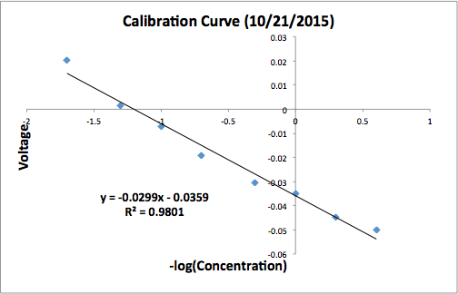
Calibration Curve
Before each experiment, we create a calibration curve with three values (below) to ensure that the probe is working properly, and that all assumptions about fluoride concentrations are valid.
Date: 10/28/2015
Standard (mg/L) | -log(concentrations) | Voltage
1 | 0 | -0.032967934
10 | -1 | -0.004852059
20 | -1.301029996 | 0.007112591
Slope | -0.03013100126
Y-intercept | -0.0333465799

Slide 9
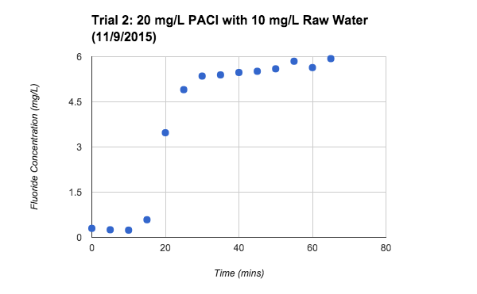
20mg/L PACl
10.3 mg/L Fluoride in the influent raw water
5.7 mg/L in the effluent
56% Fluoride Removal
Other 20 mg/L trial yielded 58% removal

Slide 10
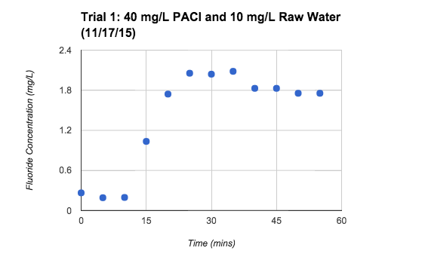
40mg/L PACl
10.8 mg/L Fluoride in the influent raw water
1.75 mg/L in the effluent
84% Fluoride Removal
Other 40 mg/L trial yielded 51% removal

Slide 11
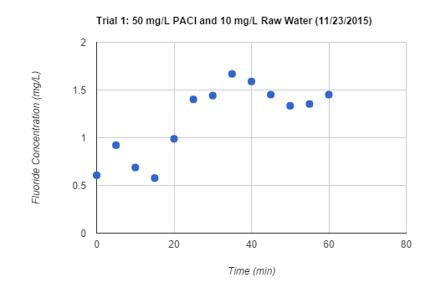
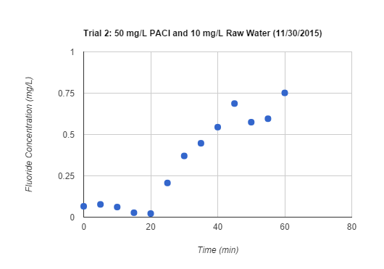
50mg/L PACl
10.3 mg/L Fluoride in the influent raw water
1.4 mg/L and 0.64 mg/L in the effluent
86 and 94% Fluoride Removal
Below WHO standards for optimally safe fluoride drinking concentrations of 1.5 mg/L!

Slide 12
Summary of Results
Trial Number/Coagulant Dosage | Initial fluoride concentration (mg/L) | Final fluoride concentration (mg/L) | Percent Removal
Trial 1, 20 mg/L | 8.9 | 3.7 | 58%
Trial 2, 20 mg/L | 10.3 | 5.7 | 56%
Trial 1, 40 mg/L | 10.8 | 1.75 | 84%
Trial 2, 40 mg/L | 10.7 | 2 | 81%
Trial 1, 50 mg/L | 10.3 | 1.40 | 86%
Trial 2, 50 mg/L | 10.4 | 0.64 | 94%

Slide 13
How We Stack Up
(Against Established Literature)
Article (Year) | Author | Initial F- Concentration | Final F- Concentration | % Removal | Coagulant Used | PACl Dosage
Effectiveness of poly aluminum chloride (PAC) vis‐a‐vis alum in the removal of fluorides and heavy metals (2007) | Sonu Malhbtra, D.N. Kulkarni & Sunil P. Pande | 7.6 mg/L | 3.8 mg/L | 50% | PACl | 500 mg/L
Simultaneous removal of arsenic and fluoride from groundwater by coagulation-adsorption with polyaluminum chloride (2011) | Ana M. Ingallinella, Virginia A. Pacini, Rubén G. Fernández,Romina M. Vidoni & Graciela Sanguinetti | 2.4 mg/L | 1.5 mg/L | 62.5% | PACL | 100 mg/L
Investigations on the column performance of fluoride adsorption by activated alumina in a fixed bed | Subhashini Ghorai & K.K. Pant | 5 mg/L | 0.7 mg/L | 86% | Alum | 200 g in adsorption bed
Removal of excess fluoride from water using residue from alum manufacturing process. Journal of Hazardous Materials | B. S. Chandravanshi & Feleke Zewge | 40.0 mg/L | 7.2 mg/L | 82% | Alum | 16 g/L
Fluoride Removal from Potable Water Supplies | F. W. Sollo, Jr., Thurston E. Larson and Henry F. Mueller | 4.75 mg/L | 1.3 mg/L | 72.6% | Alum | 300 mg/L

Slide 14
Future Plans
Fine tune the concentration of optimal dosage of coagulant
Test varying concentrations of fluoride
Test with more accurate compositions of raw water
Determine the time it takes for PACl to saturate the sand by analyzing data from the pressure sensor
Begin testing with larger particle sizes (Pebbles)
  Fluoride removal, head loss, run time
Prepare for the EPA P3 Competition
  Collaborate with countercurrent stacked floc blanket reactor

Slide 15



Questions?
Suggestions?

