Slide 1
Fluoride
Katie Dao, Pooja Desai and Auggie Longo

Slide 2
Why fluoride?
Set up
Methods
Floc Blanket Creation
Problems We’ve Faced
Future Plans

Slide 3
Why Fluoride?
Why are we trying to reduce fluoride levels?
Why did we switch from the sand filter?

Slide 4
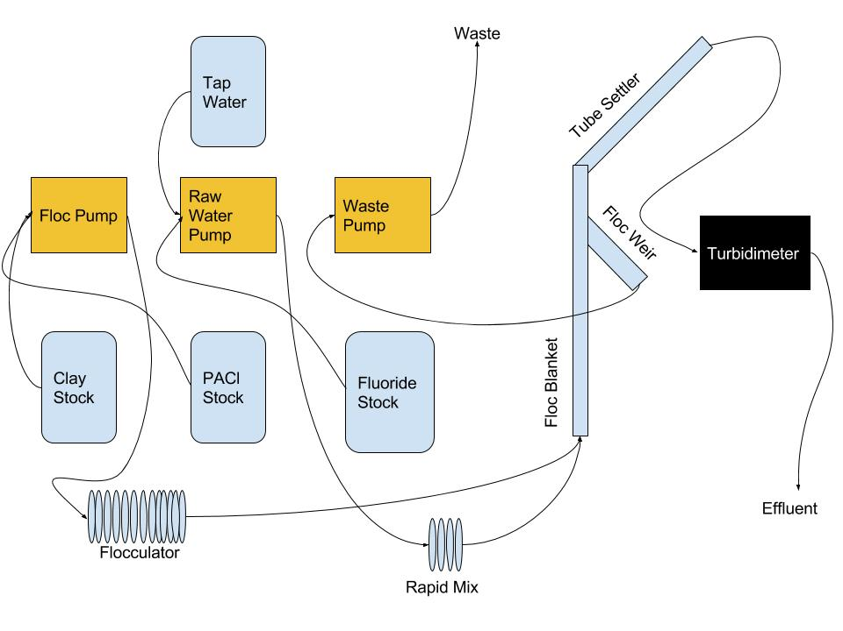
Set-Up

Slide 5
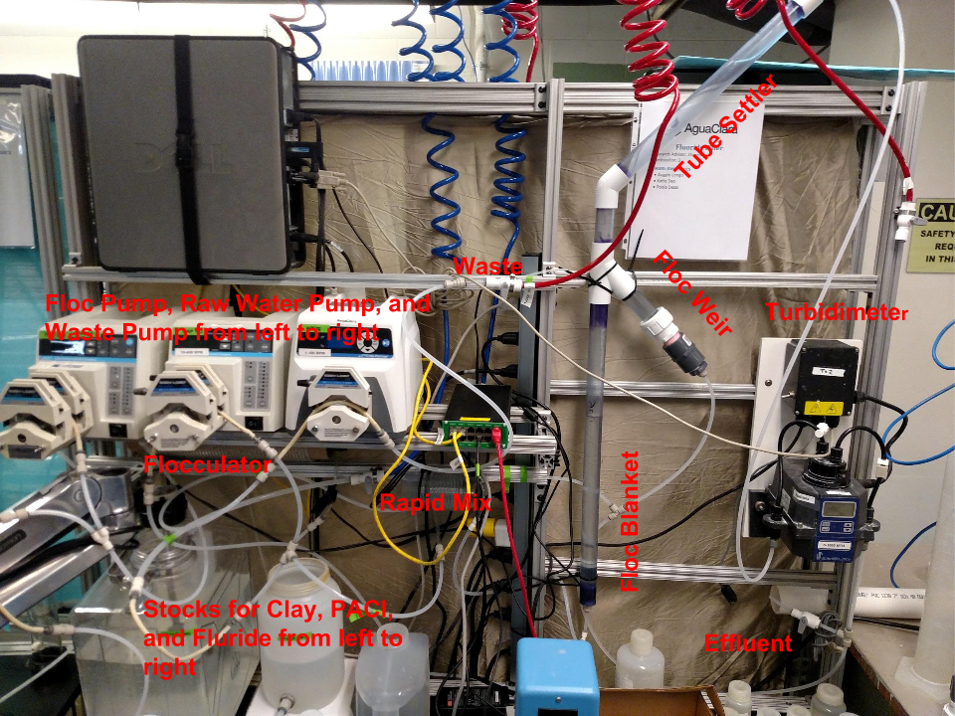
Set-Up

Slide 6
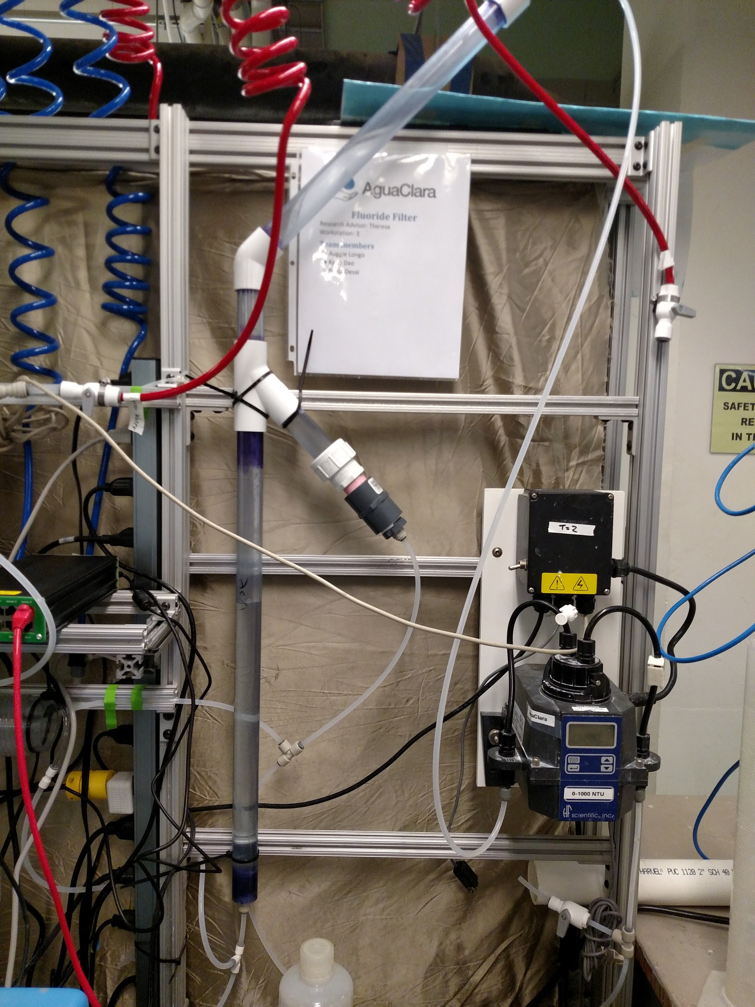
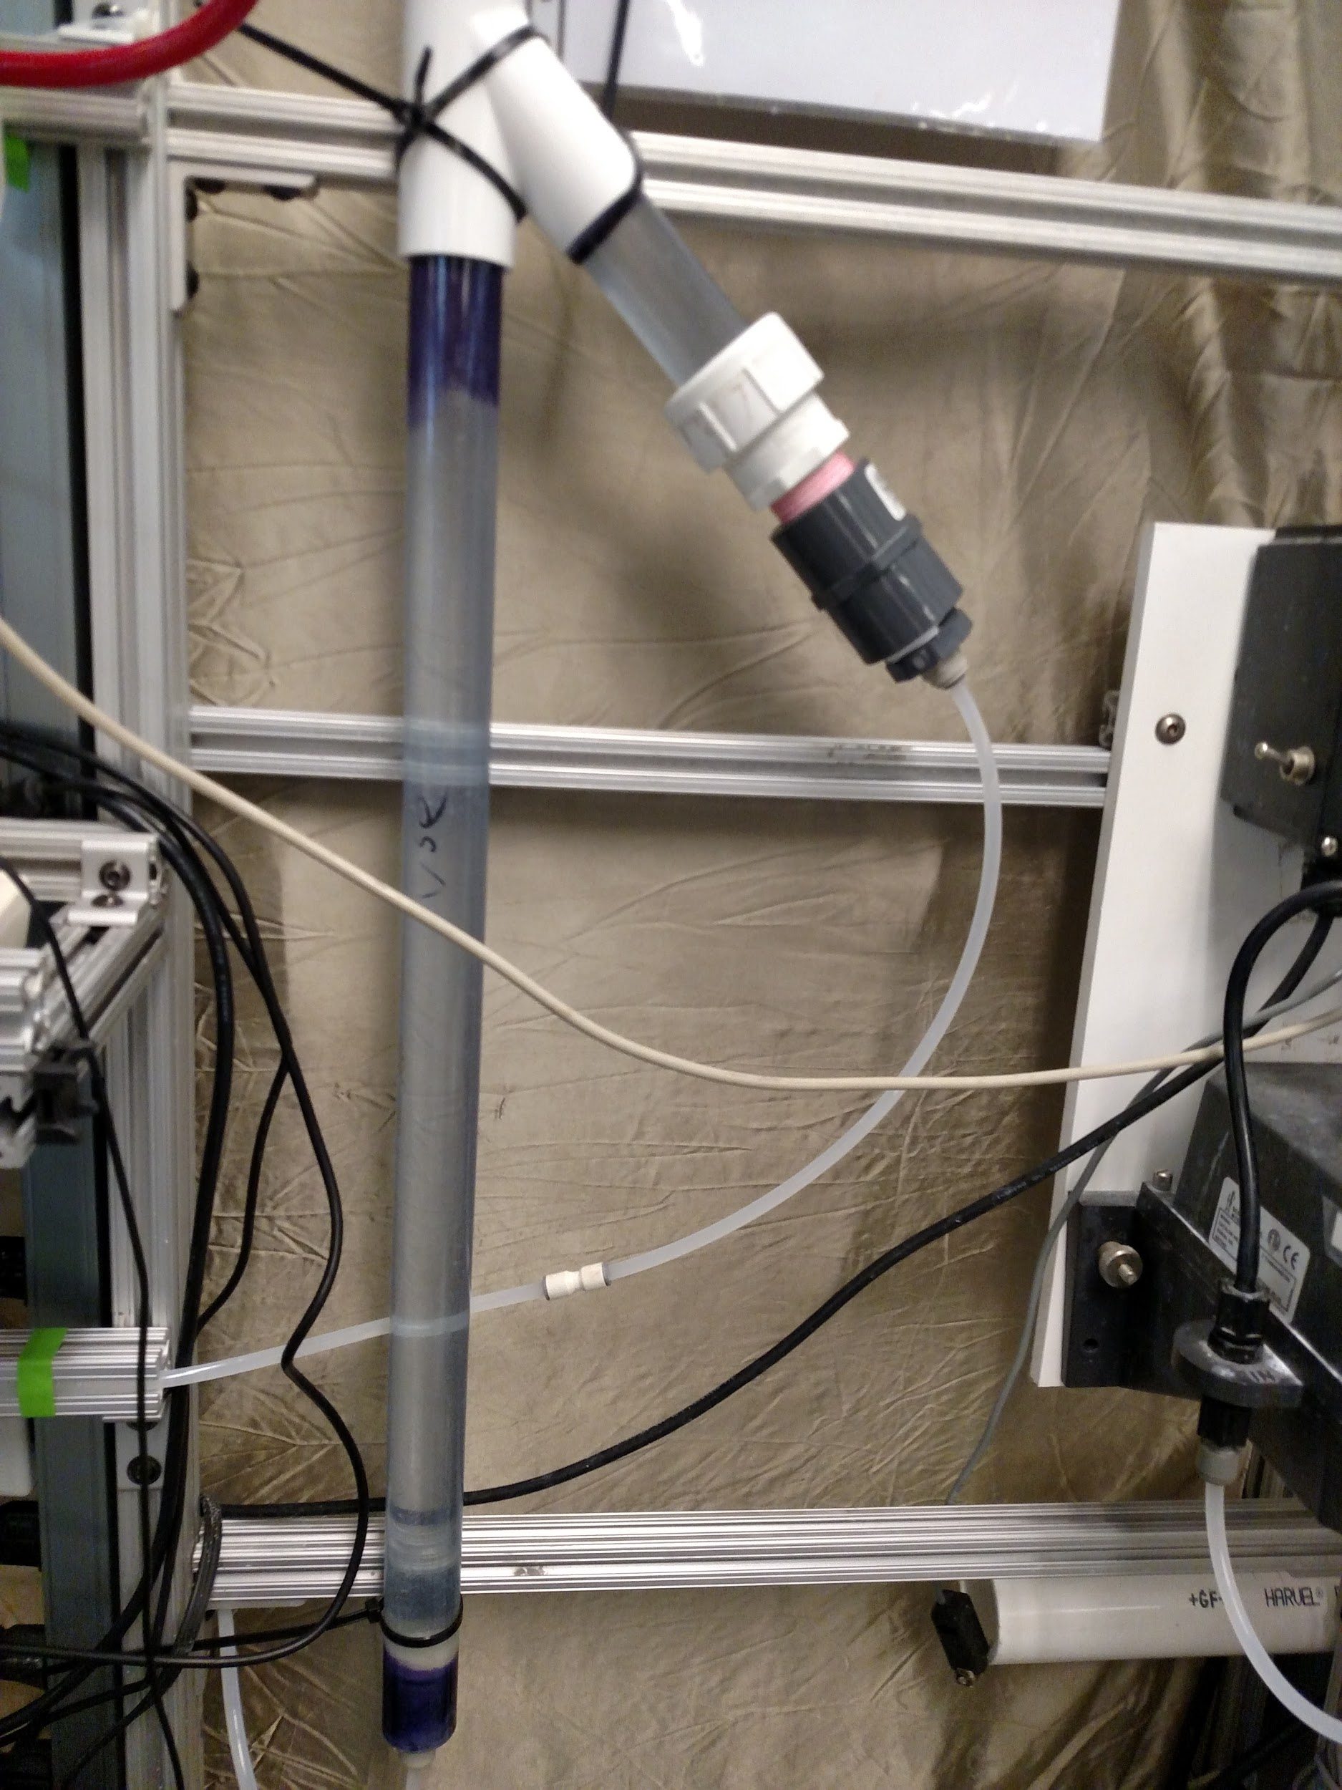
Reactor

Slide 7
Problems We’ve Faced
ProCoDa box power source failures
Pinched water pump tubing
Fluoride probe issues
Clay settling in tube

Slide 8
Experimentation
Modified version of Countercurrent Stacked Floc Blanket Reactor process
Fluoride Probe
Jar Tests
Floc Blankets

Slide 9
Parameters
1 mm/s upflow velocity
Gtheta of 13000
30 mL/min flow rate
8 to 2 raw water to floc ratio
20 mg/L of PACl in column
20 to 1 ratio of clay to PACl

Slide 10
Floc Blanket Creation
First run: 2400 mg/L clay & 200 mg/L PACl
Second run: 2400 mg/L clay & 30 mg/L PACl
Third run: 2400 mg/L clay & 100 mg/L PACl

Slide 11
Future Plans
Continue varying PACl and clay concentrations to create floc blankets
Start adding fluoridated water to test removal
Alter fluoride removal by adjusting Floc to Water ratio
Preparation for EPA competition

Slide 12



Questions?
Suggestions?

