Slide 1
Foam Filtration Pore Size
Caroline Caglioni
Tianchen Yu
Lotta van Leeuwen
Symposium March 2015
Notes:
Lotta

Slide 2
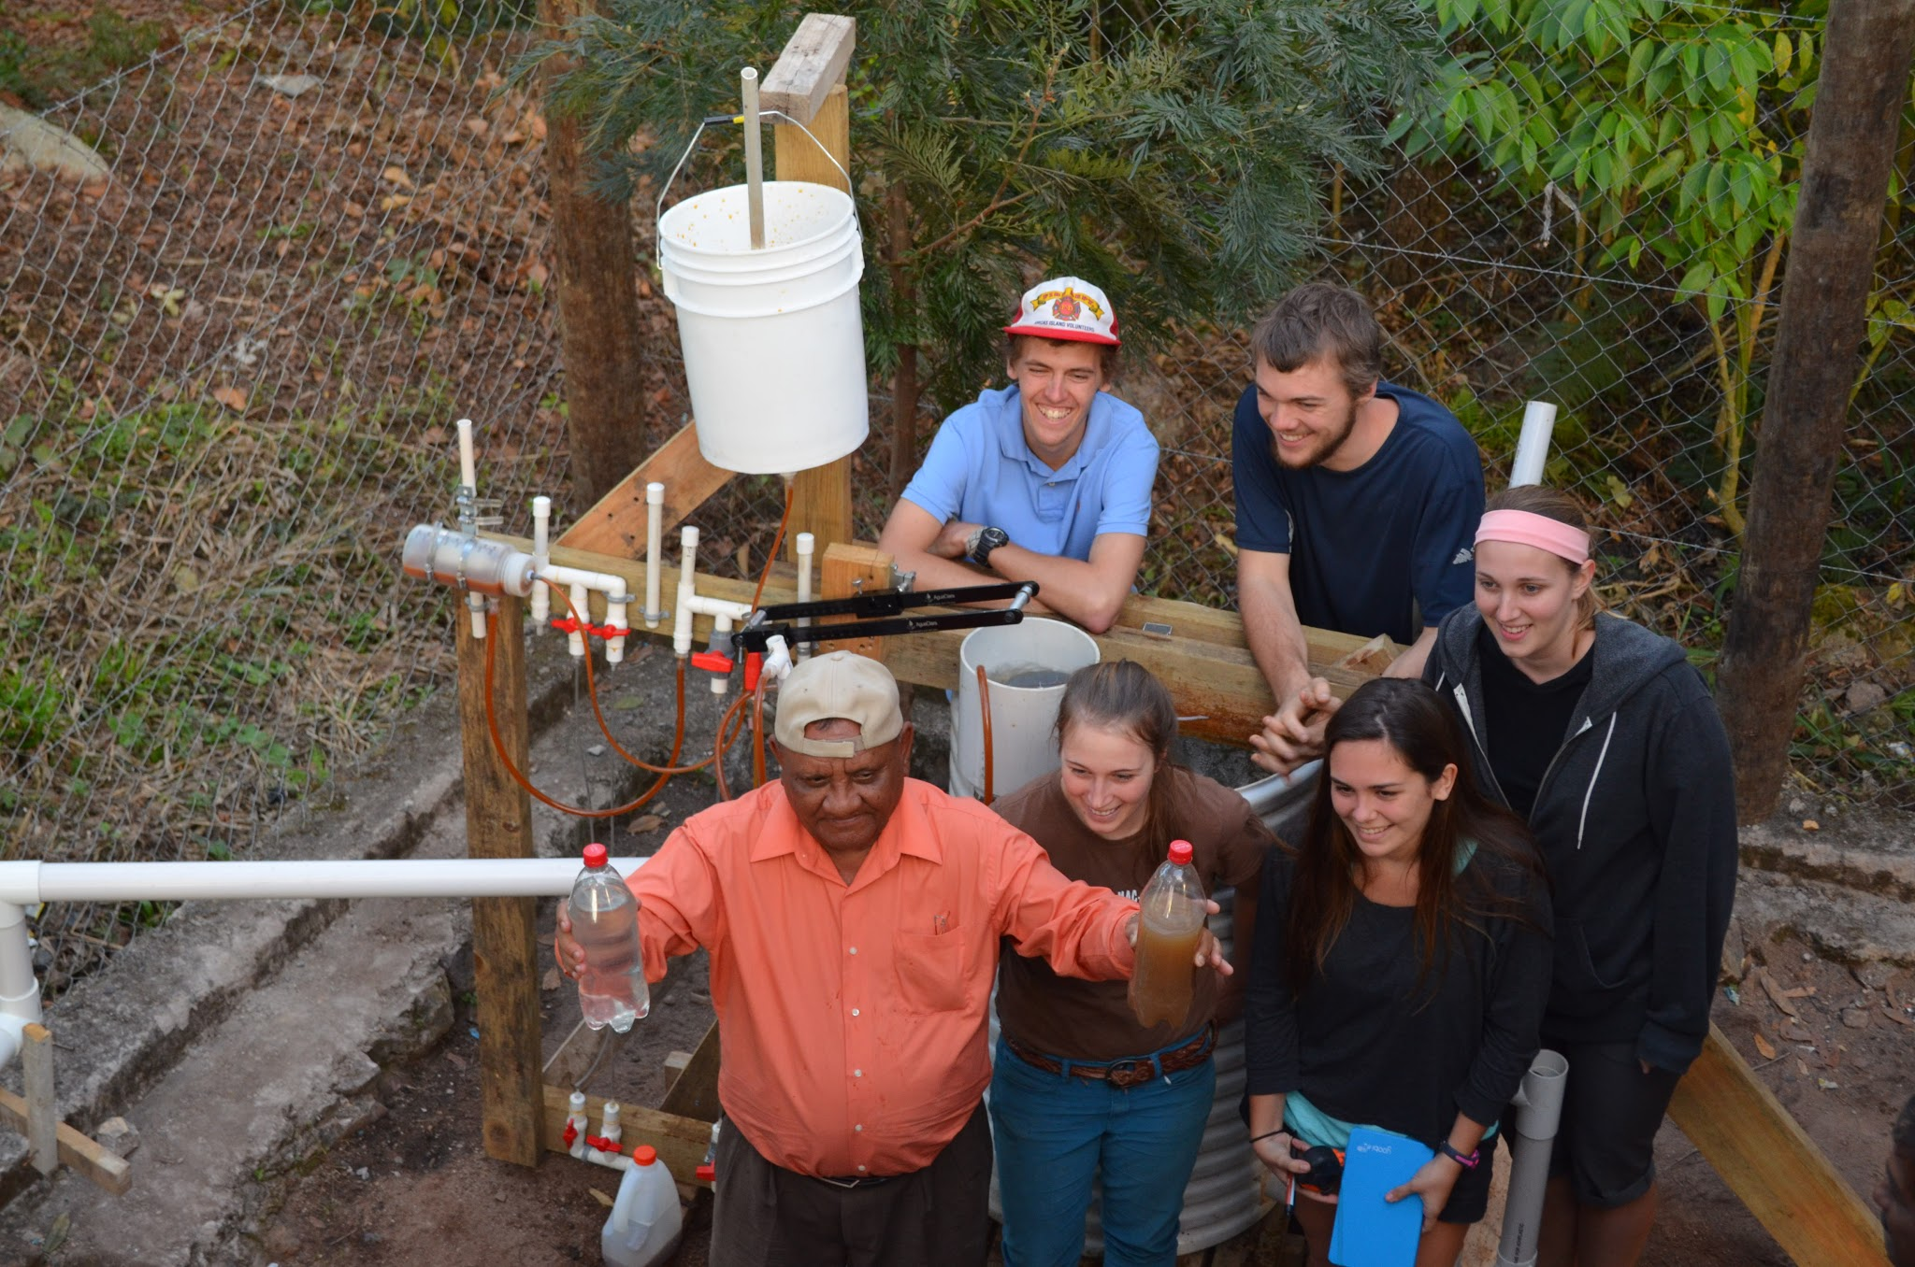
Foam filter
Small treatment facility
Medium sized villages
Notes:
Caroline

Slide 3
Pore Size
Problems to solve
Help Walker in El Carpintero
Find most efficient stratification of foam
Notes:
Tianchen

Slide 4
Goals
Design
Best stratification possible
Understand
Flocculator
Clogging
Humic acid
Pore velocity
Break-through
Notes:
Lotta

Slide 5
3 Challenges
El Carpintero water
Flocculator
New laboratory set-up
Notes:
Caroline

Slide 6
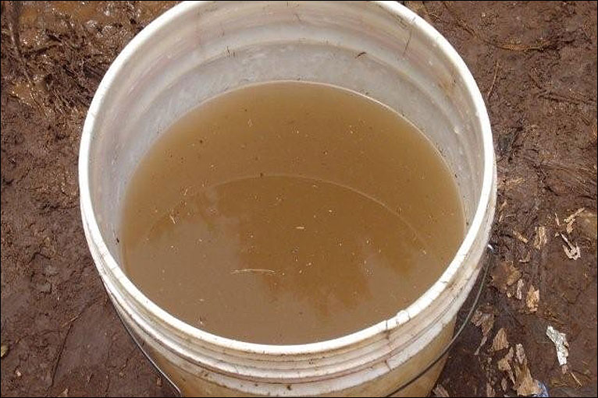
El Carpintero Water
Goal: Create a more representative influent
Include humic acid
Collect data from Walker
Run through 4” design

Slide 7
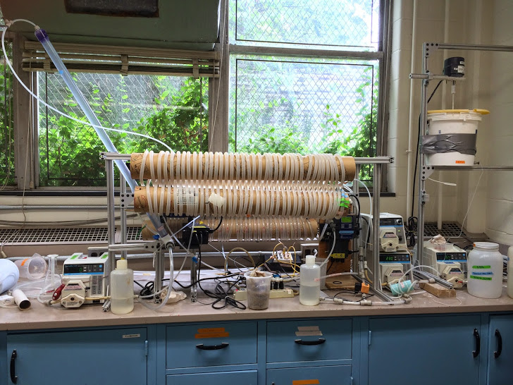
2. Flocculator
Goal: Determine whether a flocculator increases the filtration efficiency
Design in MathCad
Build it

Slide 8
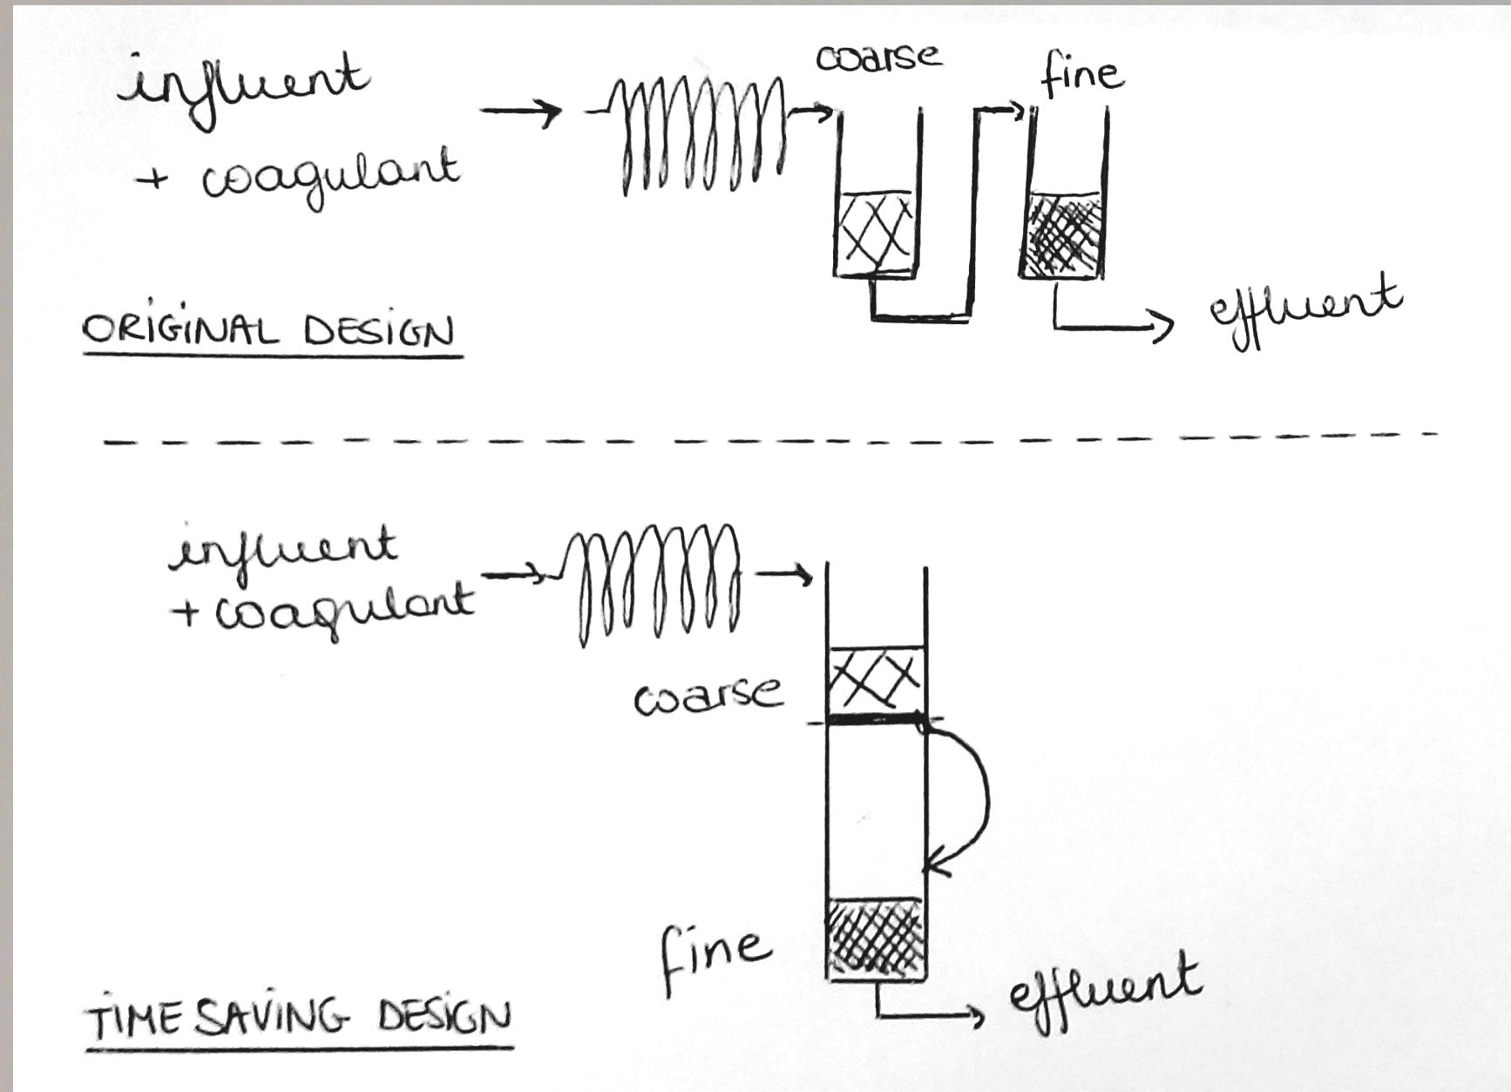
3. New laboratory set-up
Goal: build quickly new filter allowing specific pore size experiments
1” diameter
Coarse and fine
Flocculator
performance
Backwash

Slide 9
What’s Next
Test and construct the concoction
Build the flocculator and test it
Build the new 1” Foam Filter Design and run it
Notes:
Lotta

Slide 10

Questions?
One day
(hopefully by the end of the semester…)
Notes:
Tianchen

