Slide 1

Foam Filter Pore Size
Lotta Van Leeuwen
Tianchen Yu
Caroline Caglioni

Slide 2

Pore Size
LARGE SCALE Problems to solve
  Work of challenges from El Carpintero
  Find most efficient stratification of foam

Slide 3

Three Main Challenges
SMALL SCALE Problems to solve
Build Flocculator
New 1” Foam Filter set-up
Replicate El Carpintero Water

Slide 4
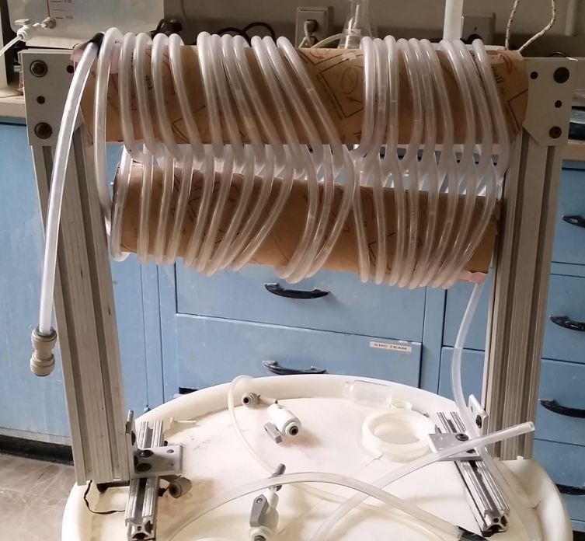
Flocculator
Goal: Determine whether a flocculator increases the filtration efficiency
  Design of new flocculator in MathCad
    Diameter = 3/16th
    Length = 15.64 m
    Residence Time = 90 s
  Build new flocculator

Slide 5
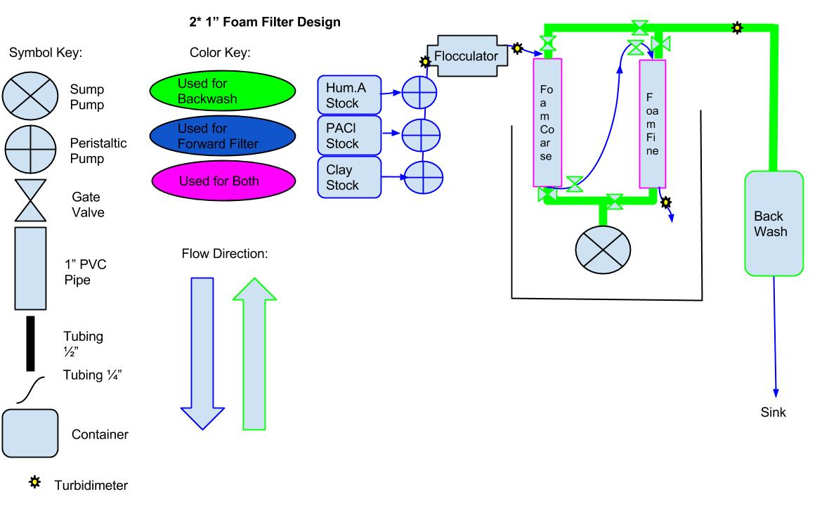
New Filter set-up
Goal: Build quickly new filter allowing specific pore size experiments
1” Diameter
Coarse and
fine foam
Backwash
capability

Slide 6
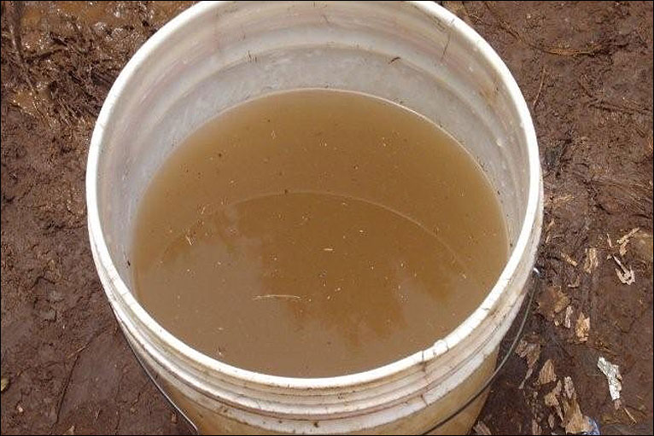
El Carpintero Water
Goal: Create a more representative influent
  Include humic acid → organic matter alternative
  Collect data from Walker
  Run through 1” design
Case | Influent (NTU) | Effluent (NTU) | PACl (mg/L)
1 | 17 | 2-4 | 20-25
2 | 30 | 2-5 | 30

Slide 7
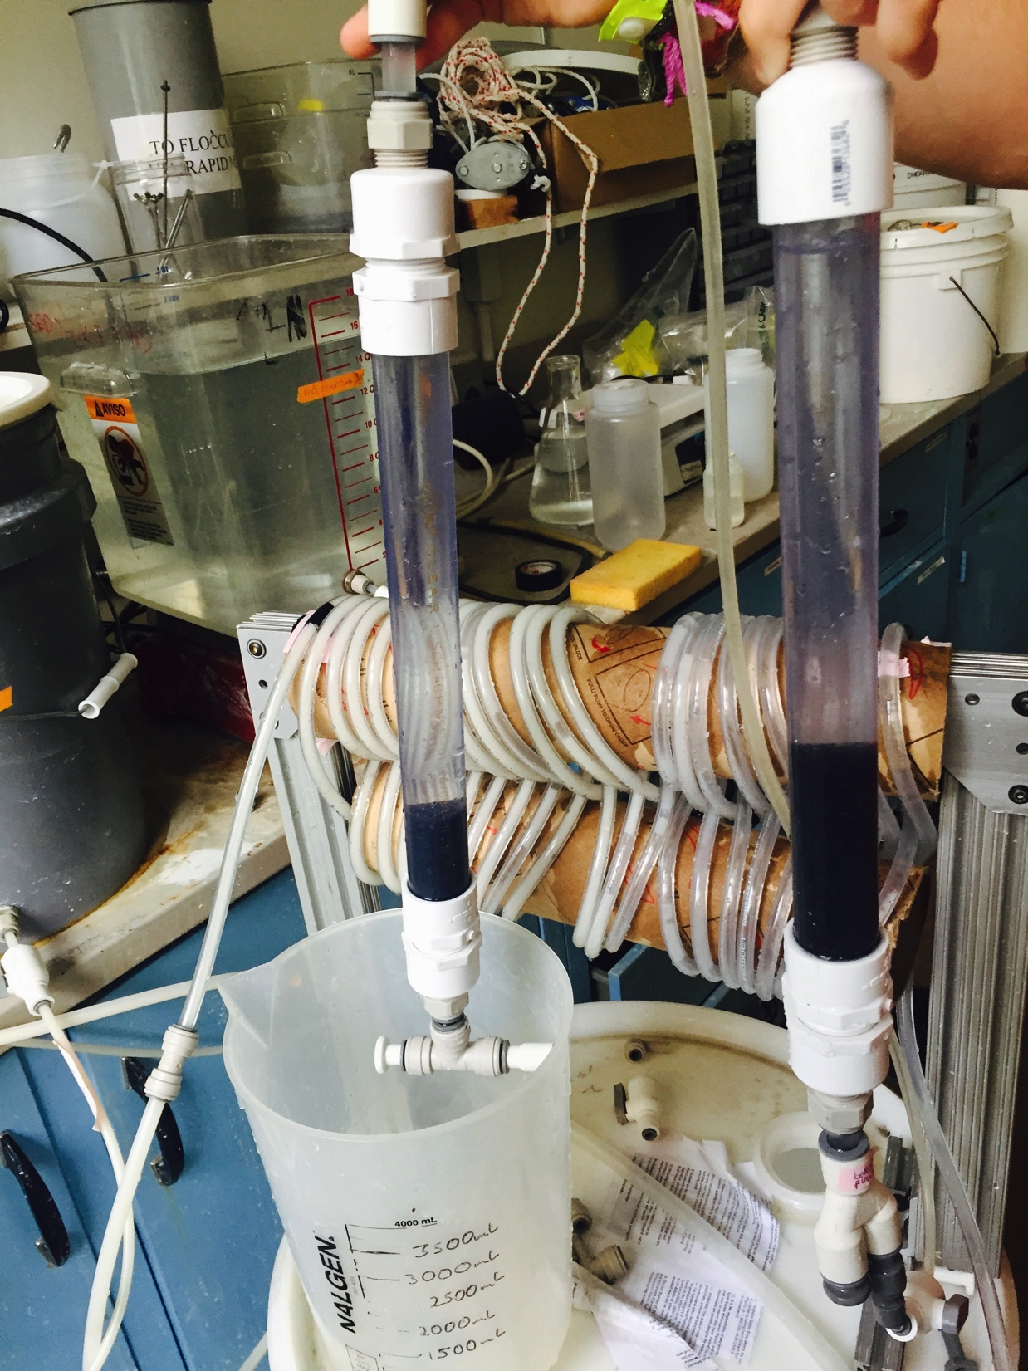

Achievements
Build New 1” Filter
Build New Flocculator
Run test through the
new apparatus

Slide 8
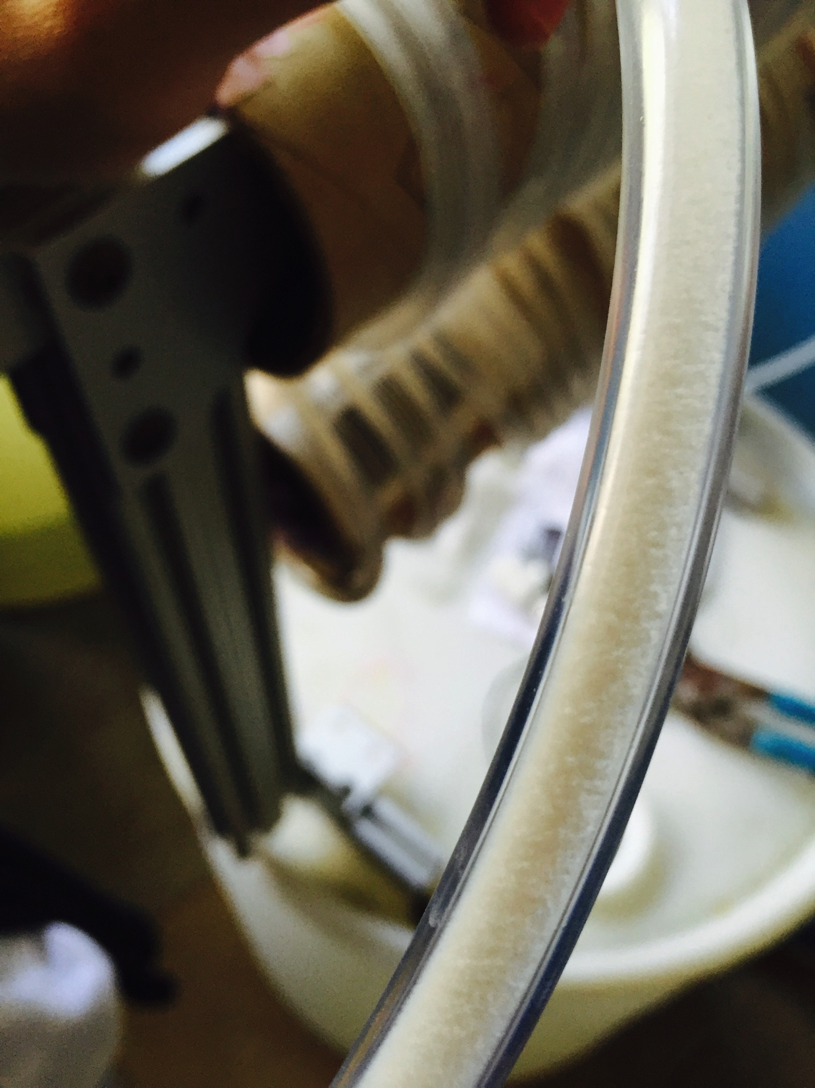
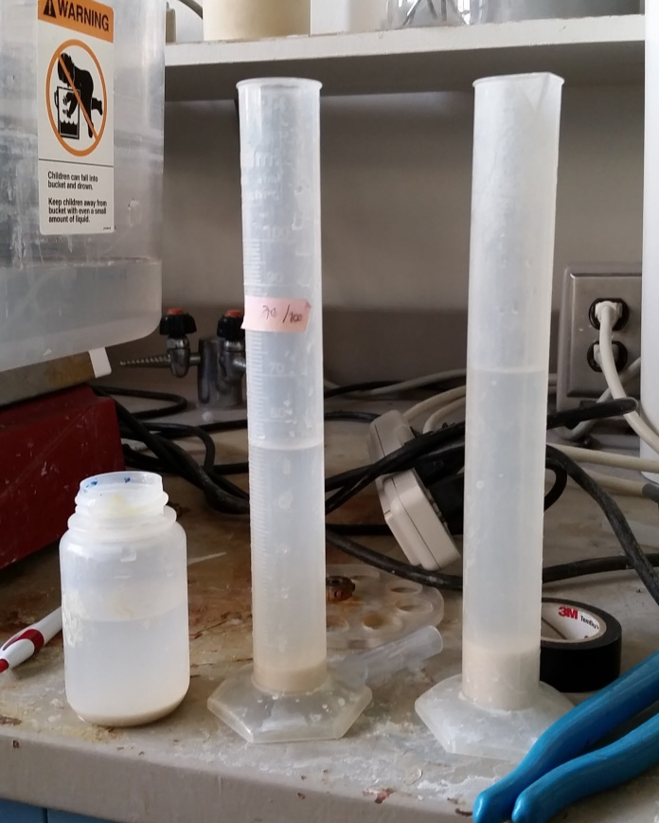
New Flocculator

Slide 9
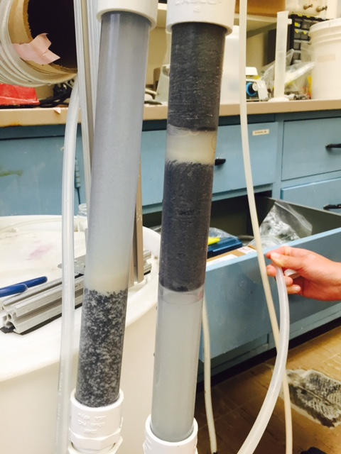
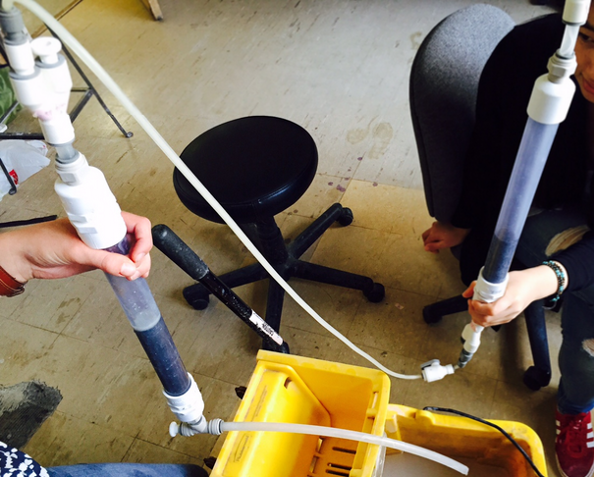
New Foam Filter

Slide 10
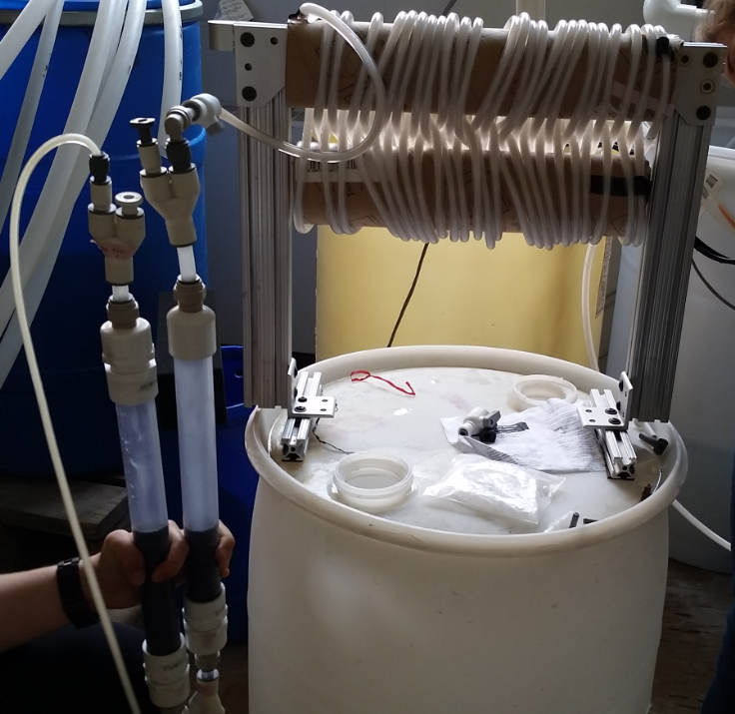
Connect Flocculator with Filter

Slide 11
Experimentation
… and then we ran water through it!
Trial | PACl dose (mg/L) | Influent Clay Turbidity (NTU)* | Influent Clay dosage (RPM) | Effluent notes: settling, etc.
1 | 80 | A | 85 | After 5:30 minutes, the supernatant and precipitate have equal height
2 | 70 | A | 100 | After 5:20 minutes, the supernatant and precipitate reach same height
3 | 80 | A | 80 | After settling for more than 10 minutes the effluent didn’t change much couldn’t see clear layer inside
4 | 80 | A | 70 | The effluent was quickly settled, after 1:30 minutes, the supernatant and precipitate reach same height

Slide 12
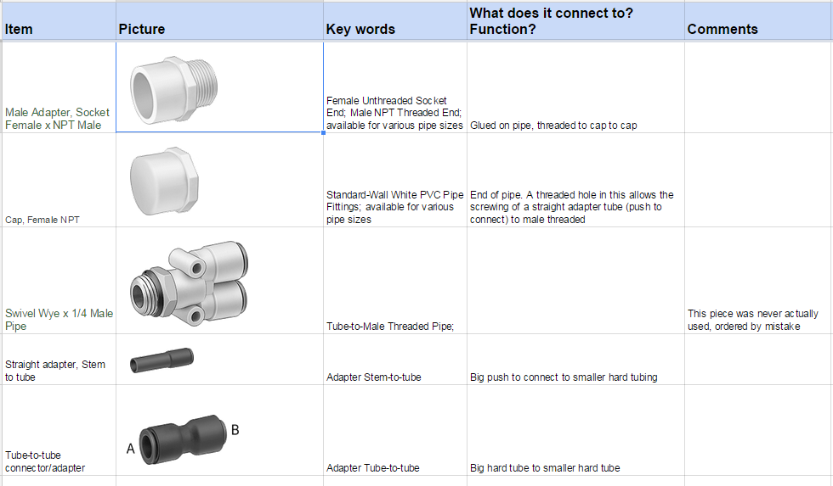
Lab Tool Encyclopedia

Slide 13

Future Expectation
Expectations
Fix the Foam in the Foam Filter
Run more quantitative experiment with the new set up
Keep looking for the most optimum strategy

Slide 14
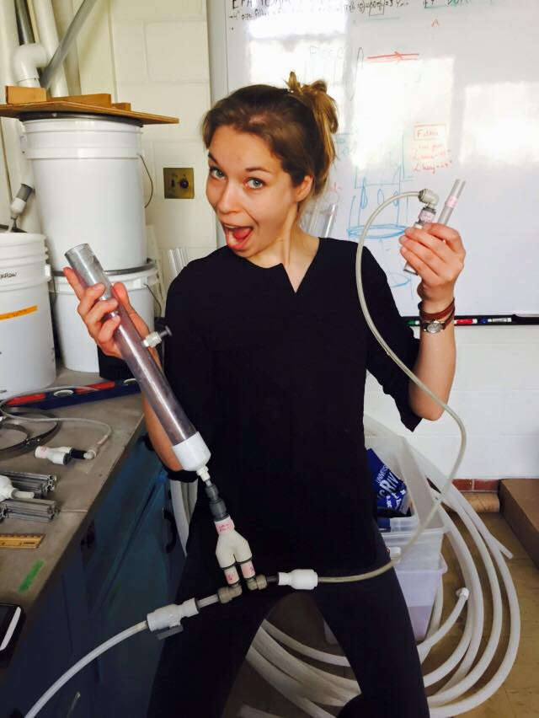
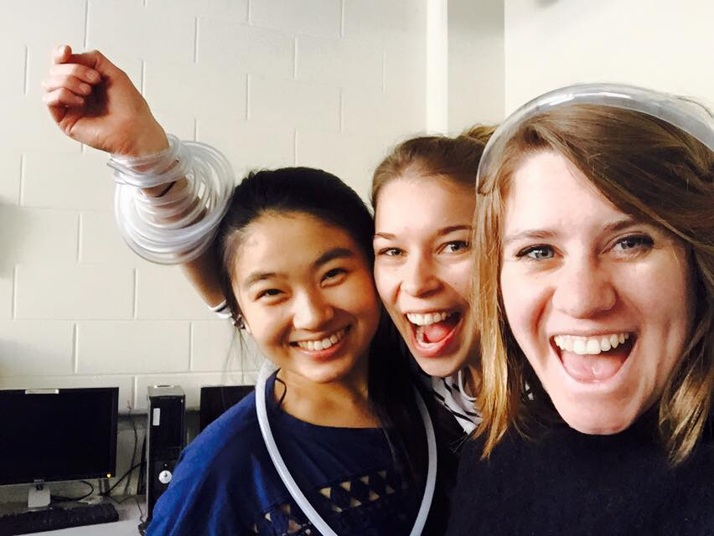
Questions?

Slide 15
Thank you
Muchas Gracias
谢谢
Merci
Dankjewel
Grazie
תודה

