Slide 1
StaRS FInE Team
Michelle Bowen
Mengqi Jiang
Subhani Katugampala

Slide 2
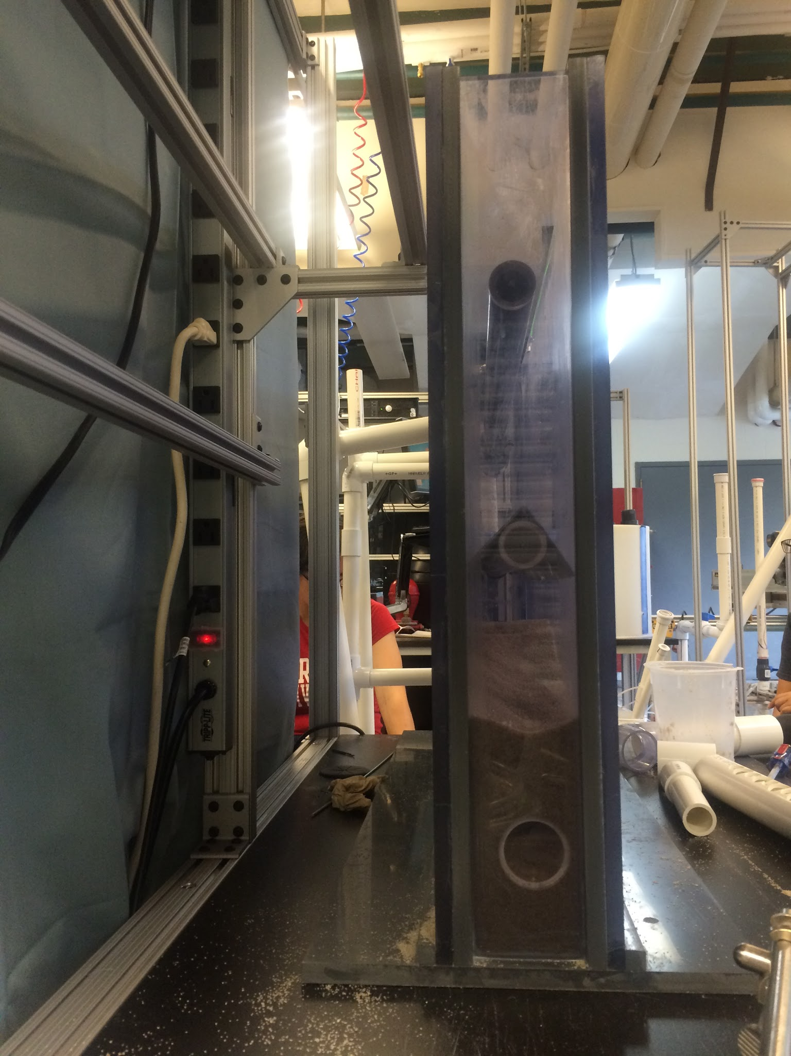
StaRS FInE System
StaRS = Stacked Rapid Sand Filter
FInE = Flow Injection and Extraction
Alternative to Slotted Pipes
Gravity Exclusion Zones
Figure 1: Side View of 10x86cm Filter

Slide 3
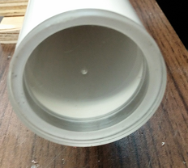
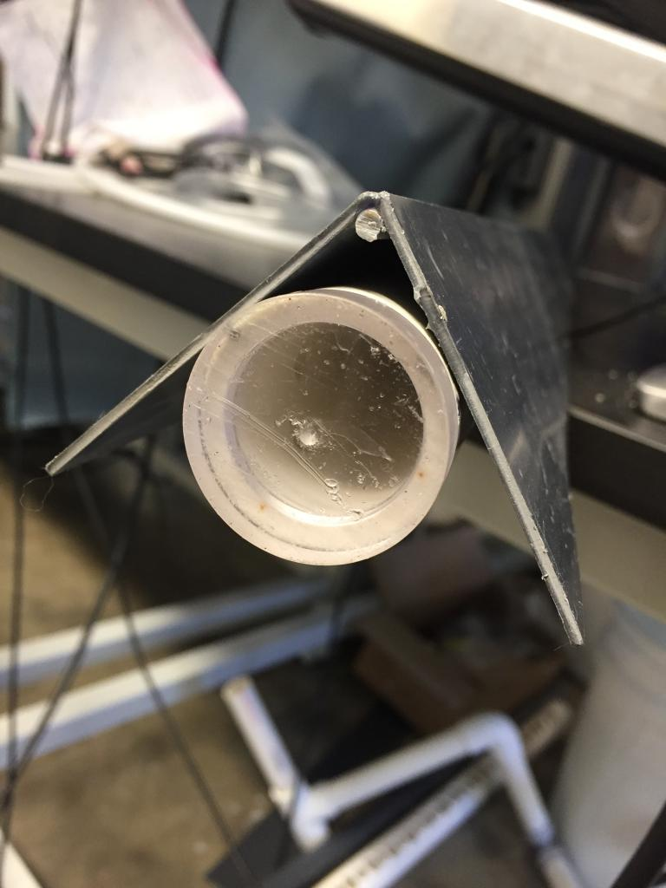
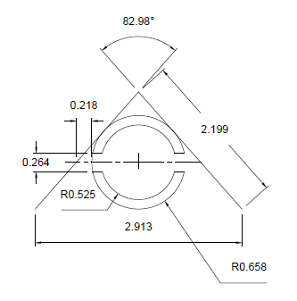
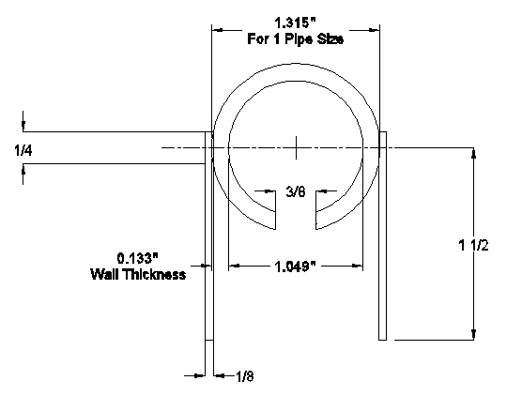
StaRS FInE System: Pipe Designs
Figure 2: AutoCAD and actual images of injection and extraction units

Slide 4
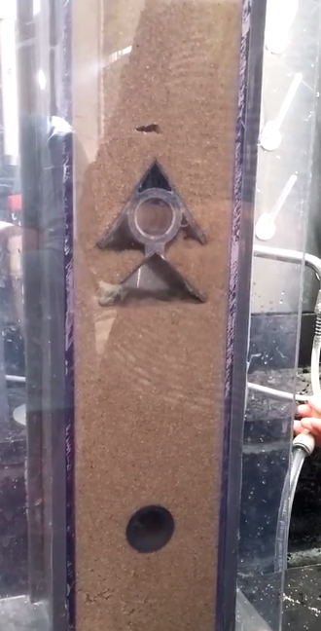
StaRS FInE System: Gravity Exclusion
Figure 3: Gravity Exclusion Zone
(Double winged outlet pipe Spring 2015)
Video 1: Capped Backwash at 11.6 mm/s using old setup (10cmx10cm filter) https://drive.google.com/a/cornell.edu/file/d/0BwW0-ETy63v2TXNrYnNaYmlvRGc/view

Slide 5
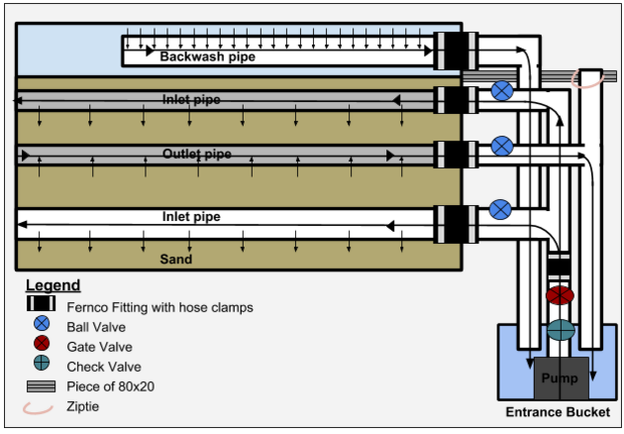
Experimental Setup
Figure 4: Schematic of Lab Setup

Slide 6
Challenges
Use FInE System without sand leaking into extraction piping
Work with a single set of wings
Prevent sand from entering the injection system during the transition from backwash to filtration
Design requirements and fabrication methods for a flow extraction system
Calculate Head loss

Slide 7
Outline of Semester
Test the new outlet system (one-winged)
Make design modifications
Potentially design new outlet system
Notes:
Test the new outlet system (one-winged)
Determine flow rate
Figure out failure modes
Make design modifications
Fix failure modes
Potentially design new outlet system

Slide 8
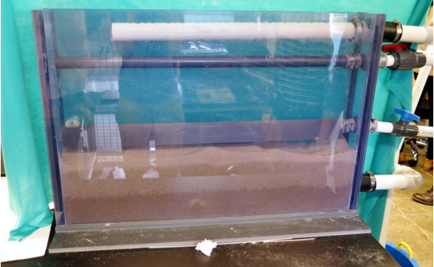
Accomplished Tasks
Added cap to outlet
Added valve to bottom inlet
Added 80x20 support
Adjusted pump height
Added sand to filter
Ran filter with sand and water
Figure 5: 10x86cm Filter in Lab
Notes:
Added cap to outlet
Added valve to bottom inlet (to prevent sand from clogging pump)
Added 80x20 support (to hold up outlet pipe system)
Adjusted pump height
Added sand to filter
Ran filter with sand and water

Slide 9
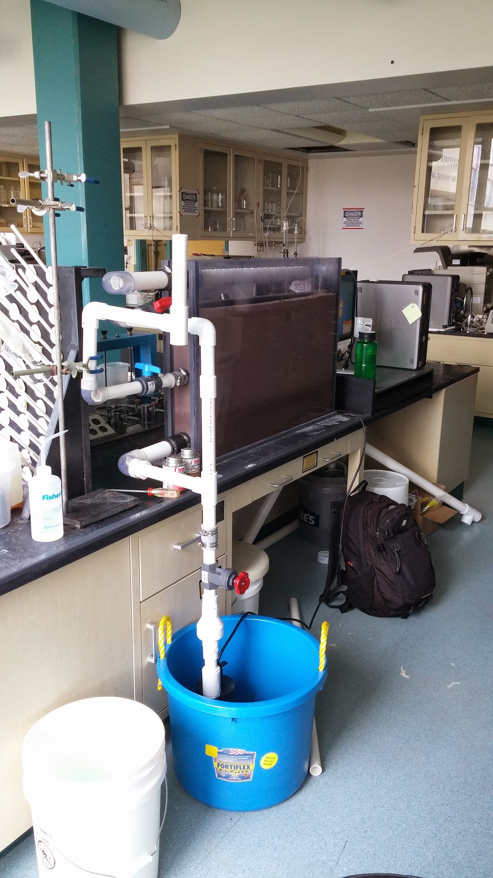
Problems
Sand leaking into outlet pipe
Correct the pump flow rate
Water level for filtration mode
Figure 6: Filter in the Lab

Slide 10
Sand Leaking into Outlet
Gravity exclusion zone may not be forming
  Not visible with current system
Calculated flow rate may be too high
Current design may not be capable of performing as expected
Figure 7: Gravity Exclusion Zone
(Double winged outlet pipe Spring 2015)

Slide 11
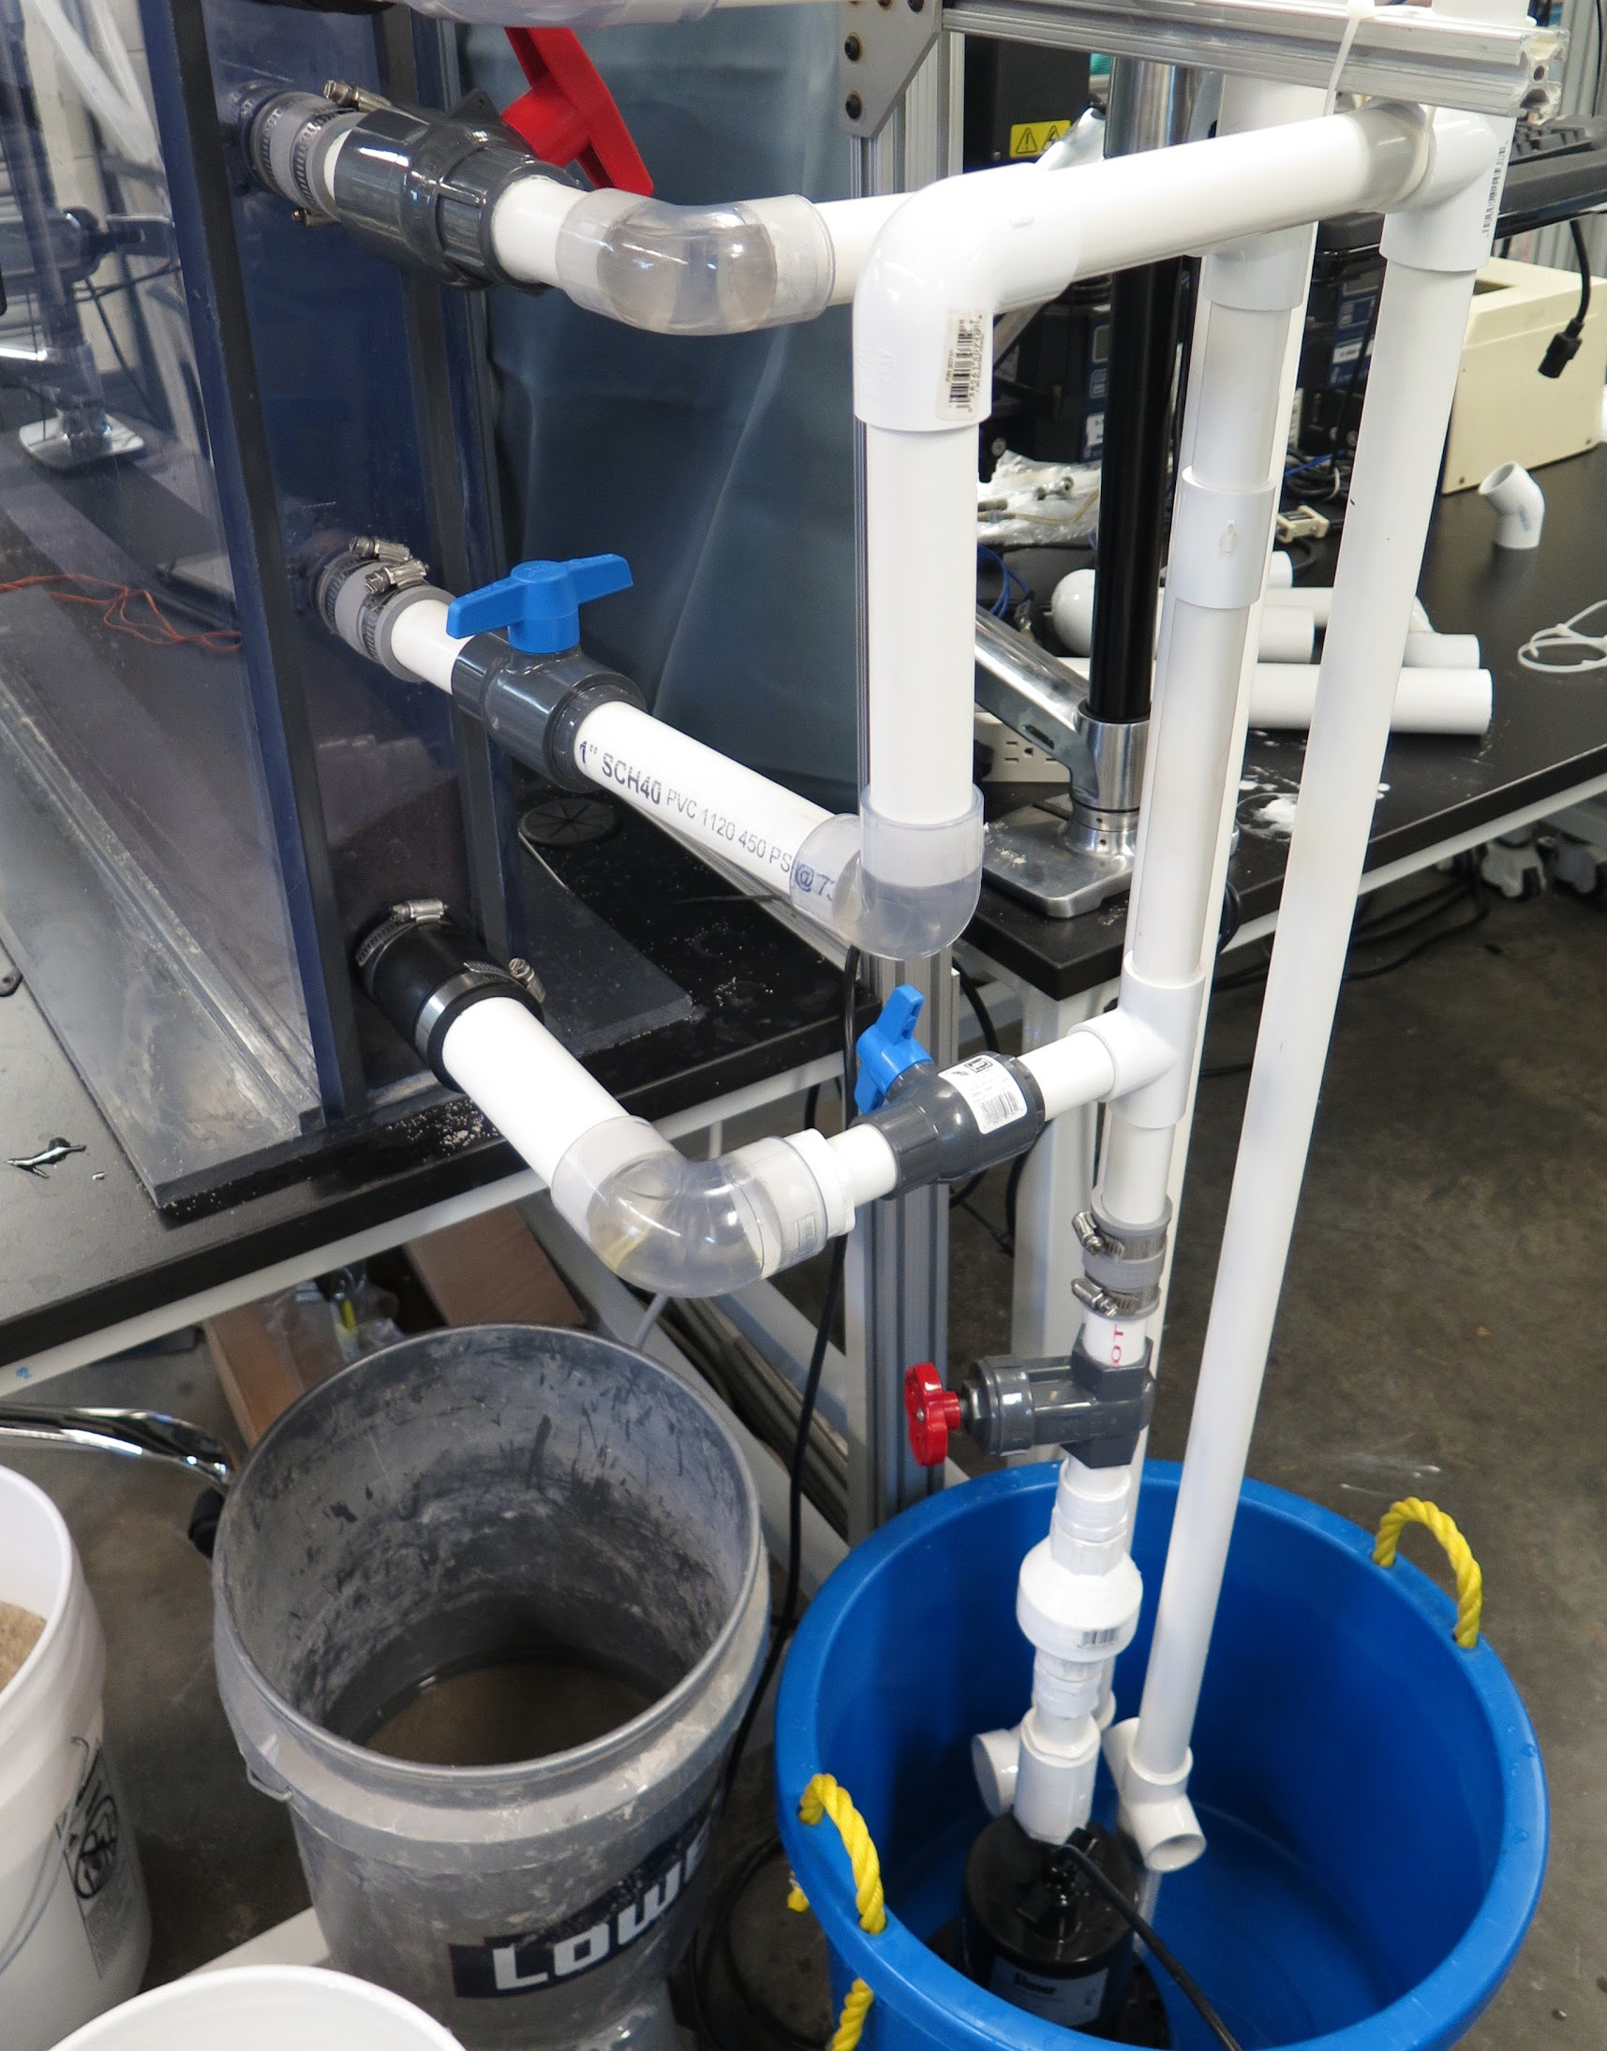
Correct Pump Flow Rate
Gate valve controls pump flow
Previous team marked valve positions
Appropriate flow rates calculated using Mathcad
Measured flow rate through filter and compared values
Figure 8: Pump and pipe system

Slide 12
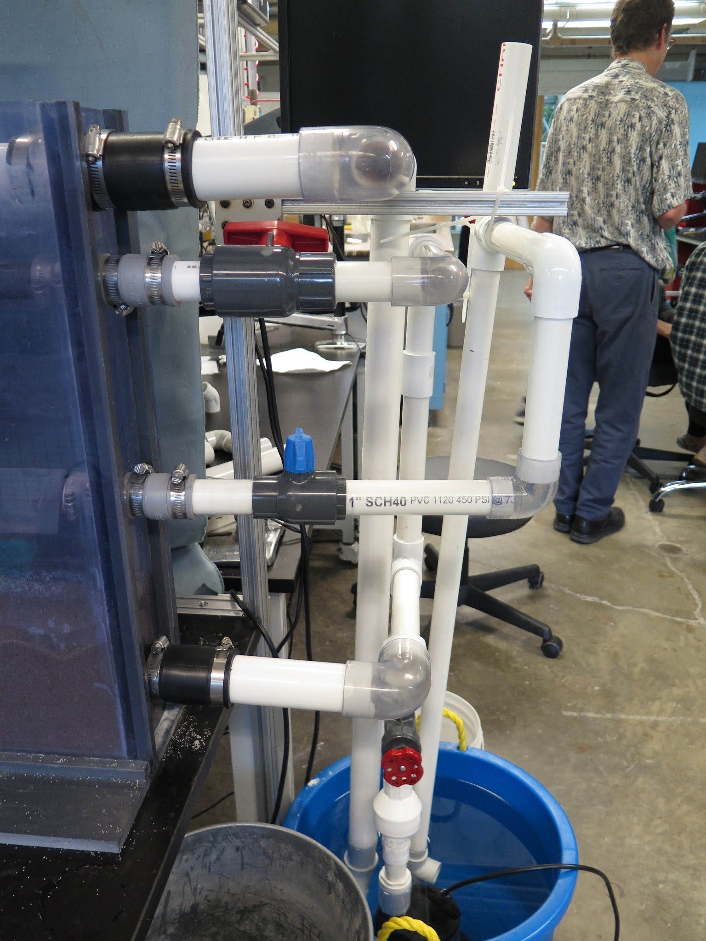
Filtration Water Level
Water level should not reach backwash pipe during filtration
Height of outlet controls water level
Water level varies with flow rate
New design may have increased head loss
Figure 9: Pipe system side view

Slide 13
Future Work
Extend wings over cap of outlet pipe
Better way to clean the sand in pipe and alternatives for ziptie
Run filter in forward and backwash without problems
Create manual for FInE Operation

Slide 14
Questions/Suggestions
Thank You!

