Slide 1
StaRS FInE Team
Michelle Bowen
Mengqi Jiang
Subhani Katugampala
Notes:
SUBHANI

Slide 2
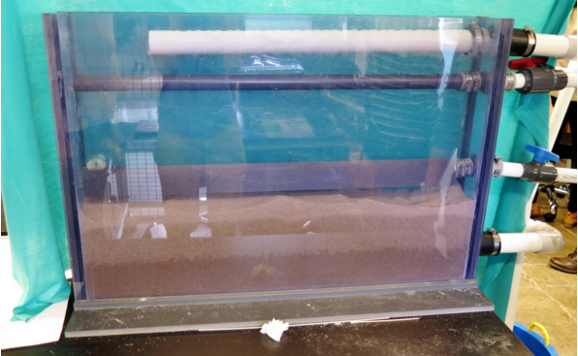
StaRS FInE System
StaRS = Stacked Rapid Sand Filter
FInE = Flow Injection and Extraction
Alternative to Slotted Pipes
Gravity Exclusion
Figure 1: 10cm x 86cm filter in lab.
Notes:
SUBHANI

Slide 3
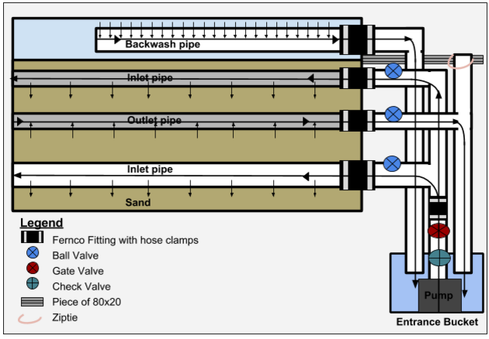
Experimental Setup
Figure 2: Schematic of Lab Setup
Notes:
SUBHANI

Slide 4
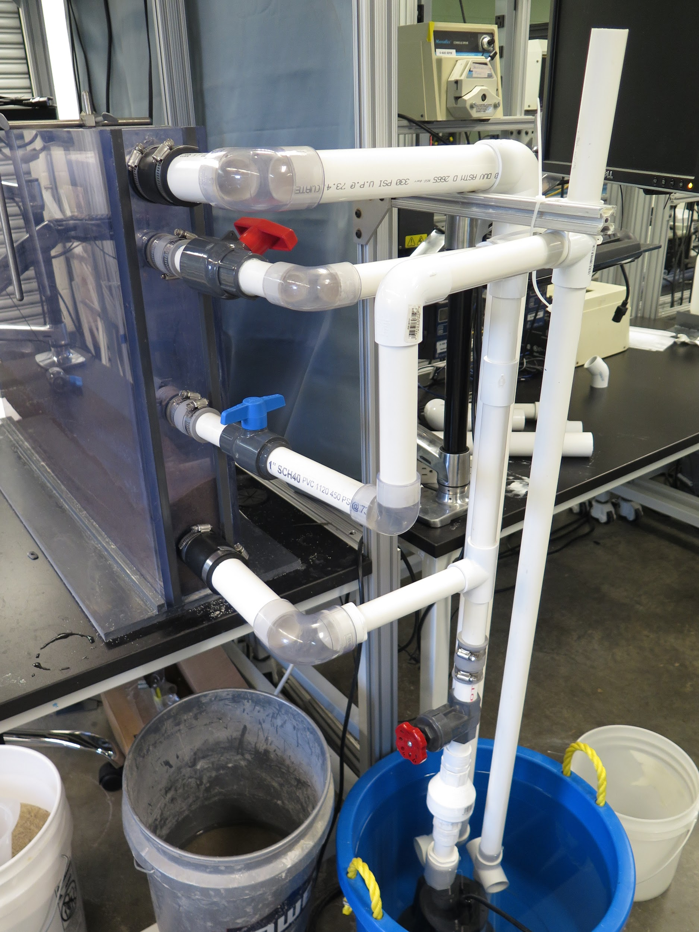
Outline of Semester
Test the new outlet system (one-winged)
Make design modifications
Create user manual
Conduct stress tests on wings
Figure 3: Filter in the Lab
Notes:
SUBHANI
Test the new outlet system (one-winged)
Determine flow rate
Figure out failure modes
Make design modifications
Fix failure modes
Potentially design new outlet system

Slide 5
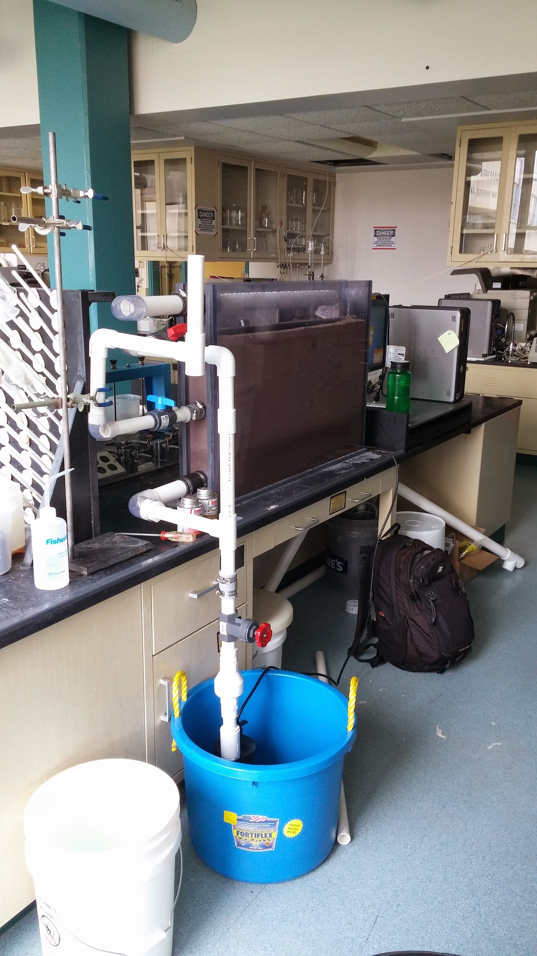
Problems
Sand exclusion not visible
Sand leaking into outlet pipe
Additional head loss accumulated prevented proper flow rates
Transition from backwash to filtration
Figure 4: Filter in the Lab
Notes:
SUBHANI

Slide 6
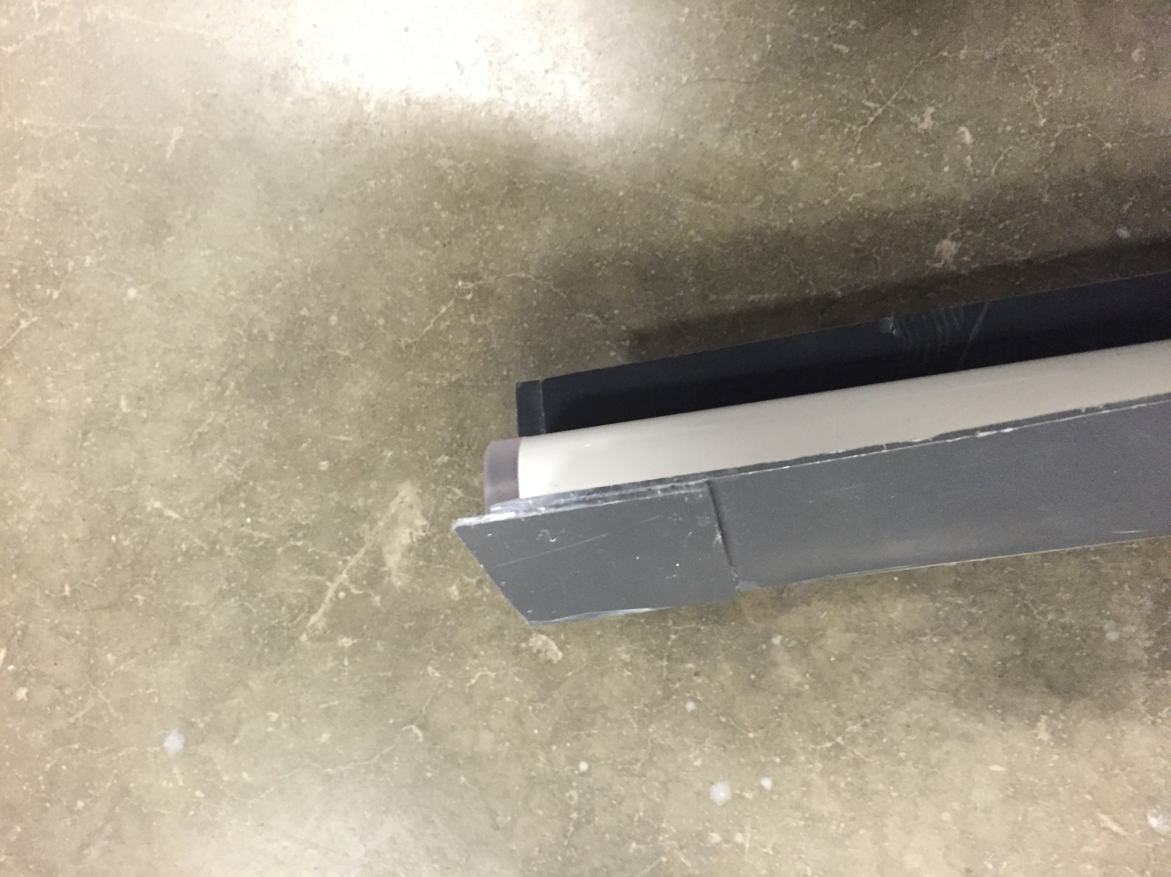
Wing Extension
Extended wings
  To make the exclusion zone visible
Figure 5: Extension of wings on outlet.
Notes:
Michelle

Slide 7
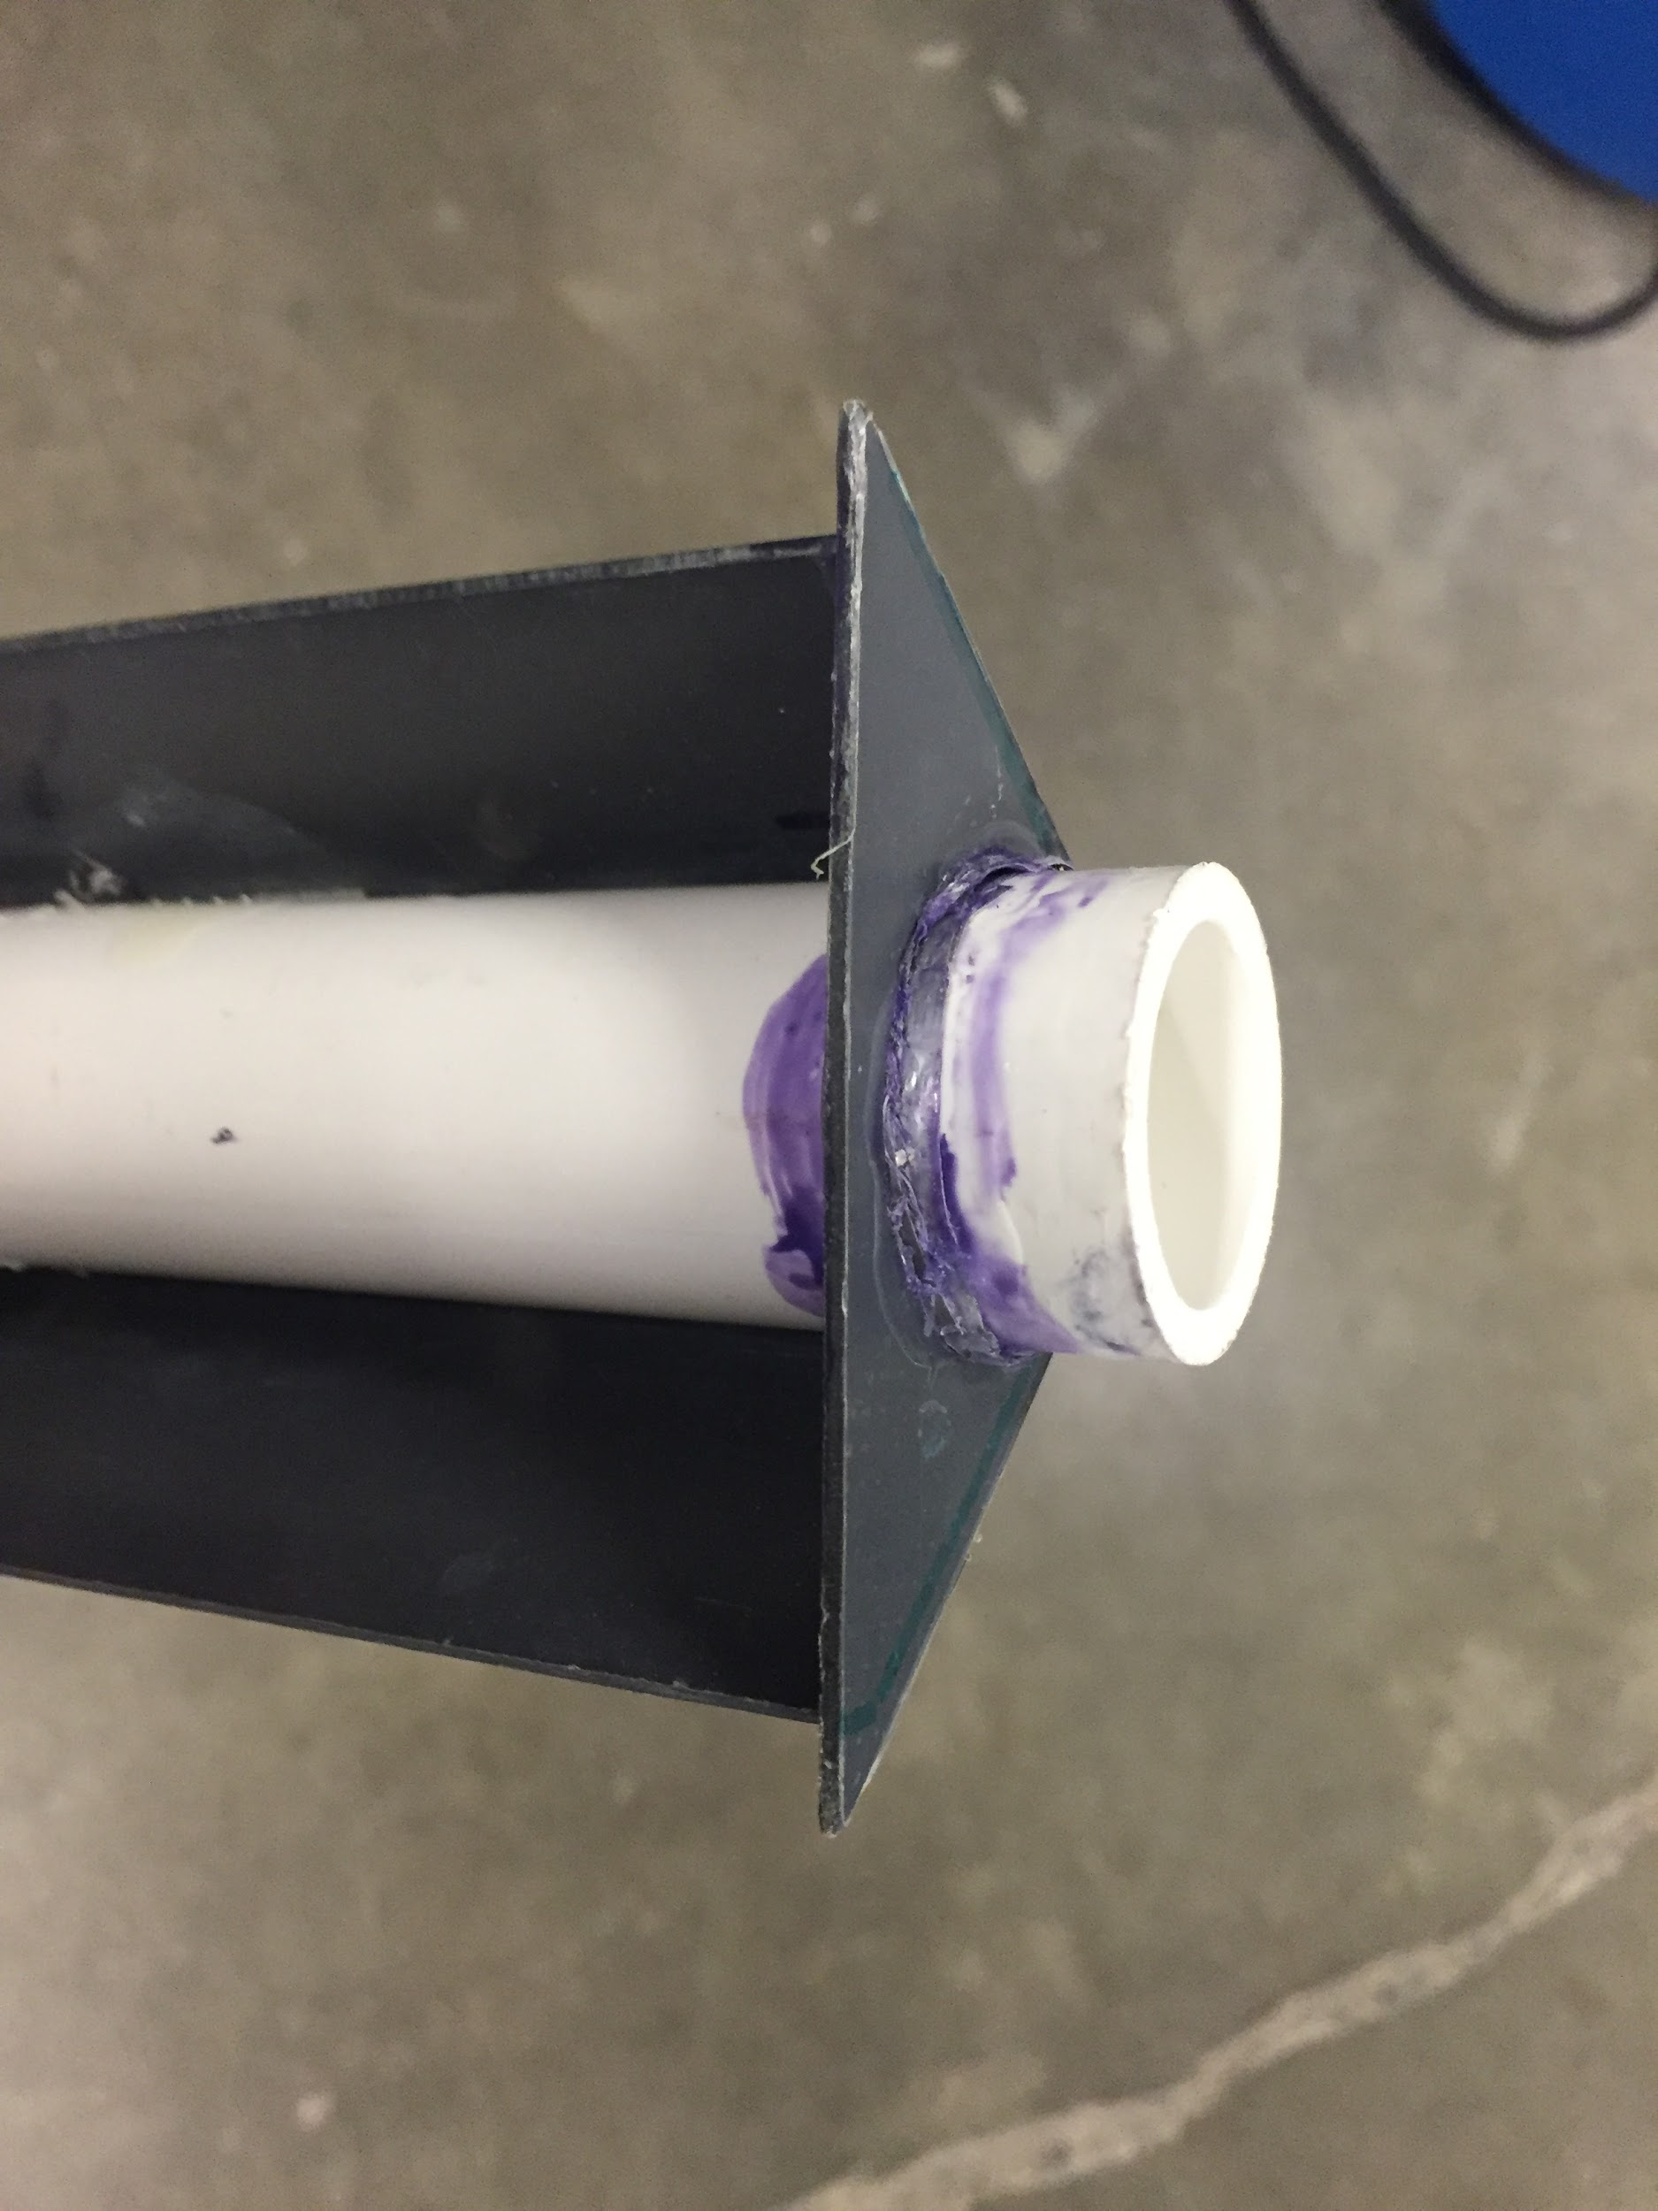
Addition of PVC Cap
Added PVC cap to attempt to maintain sand exclusion zone
Figure 6: Effect of the cap on the outlet.
Figure 7: Outlet pipe with added cap.
Notes:
Michelle
Added cap to outlet
Added valve to bottom inlet (to prevent sand from clogging pump)
Added 80x20 support (to hold up outlet pipe system)
Adjusted pump height
Added sand to filter
Ran filter with sand and water

Slide 8
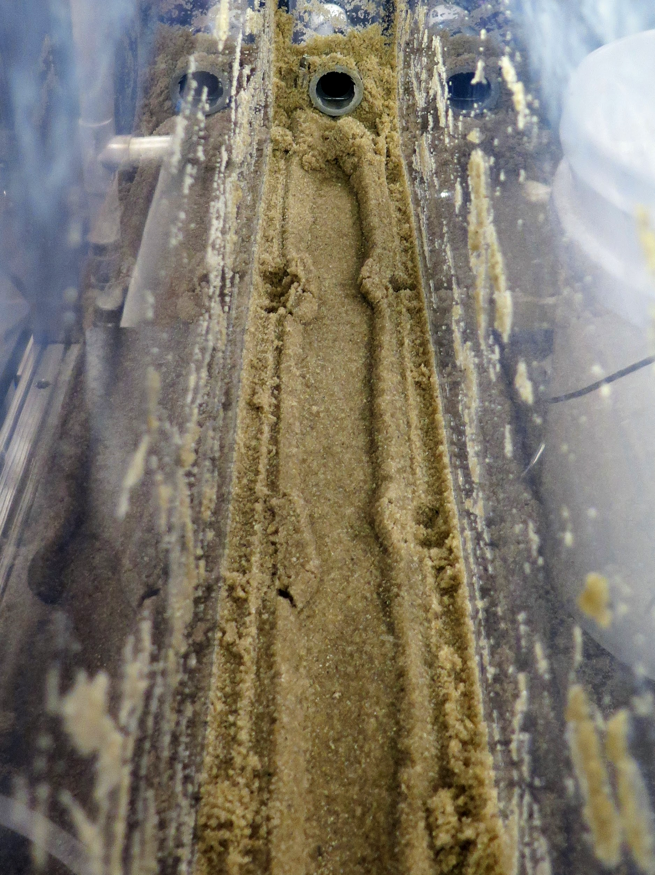
Sand Leaking into Outlet
Sand exclusion zone may not be forming
  Wings not extending entire filter length
Current design is not capable of performing as expected
Figure 8: Sand Exclusion Zone Failure
Notes:
Michelle

Slide 9
Possible Mechanism
Figure 9: Bottom view of the outlet pipe
Notes:
Michelle

Slide 10
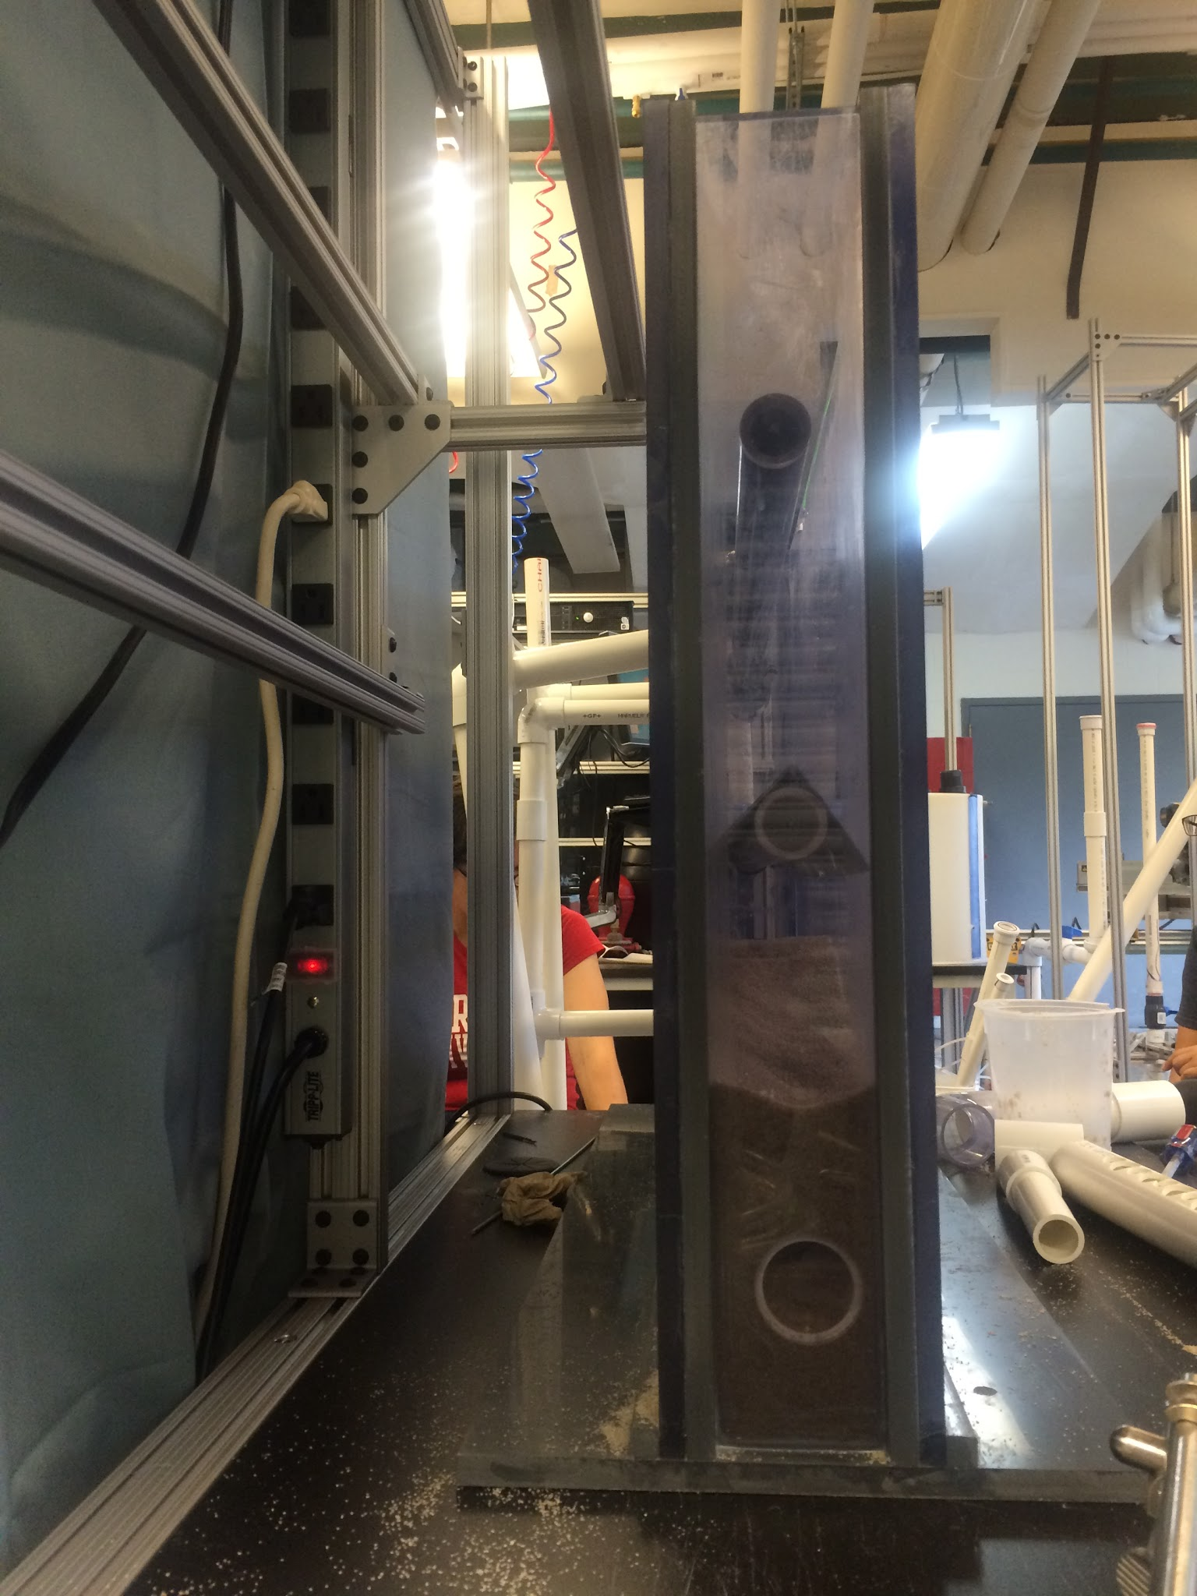
Additional Head Loss
The tank is not high enough to reach proper flow rates
Possible points of origin
  Wings
  Orifices
Increased number of orifices
Figure 10: Side view of filter.
Notes:
MENGQI

Slide 11
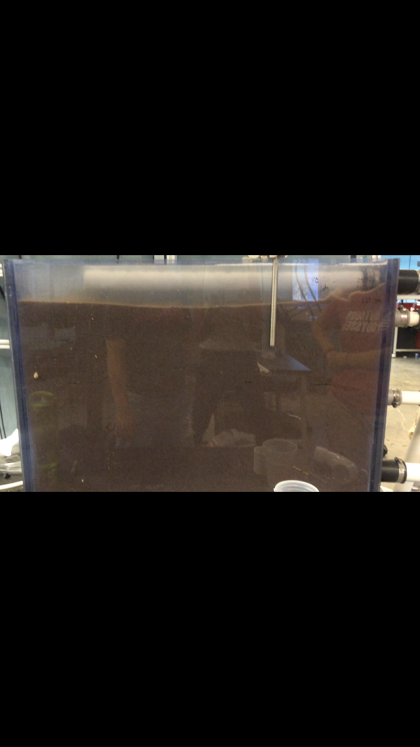
Transition to Filtration
During backwash, water level is high
Sand is forced into outlet when valve opens
Problem solved by draining excess water
Figure 11: Filter during backwash. Water level is at the top of the filter.
Notes:
MENGQI

Slide 12
User Manual
Operation Procedure
  Fill the tank with water in filtration
  Fill the tank with sand in backwash
  Remove water and open valves to switch to filtration
  Close valves to switch to backwash
  Switch to filtration and close valves before shutting down the system
Notes:
MENGQI

Slide 13
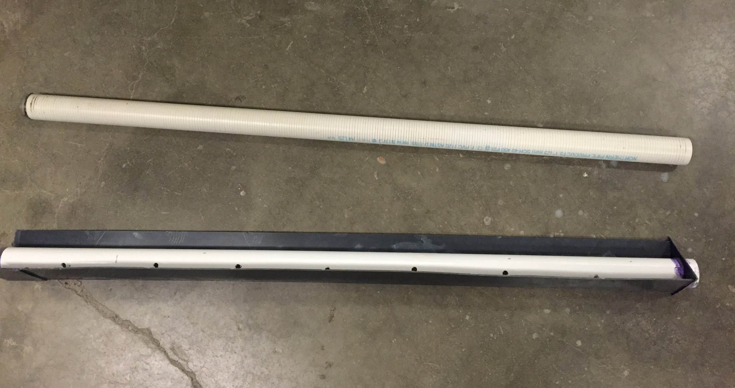
Say Goodbye to StaRS FInE!
Slotted pipe for outlet
Winged pipe for inlet
Figure 12: Slotted pipe (top) and winged pipe (bottom).
“We’ve got 99 problems and sand is all of them.”
Notes:
MENGQI

Slide 14
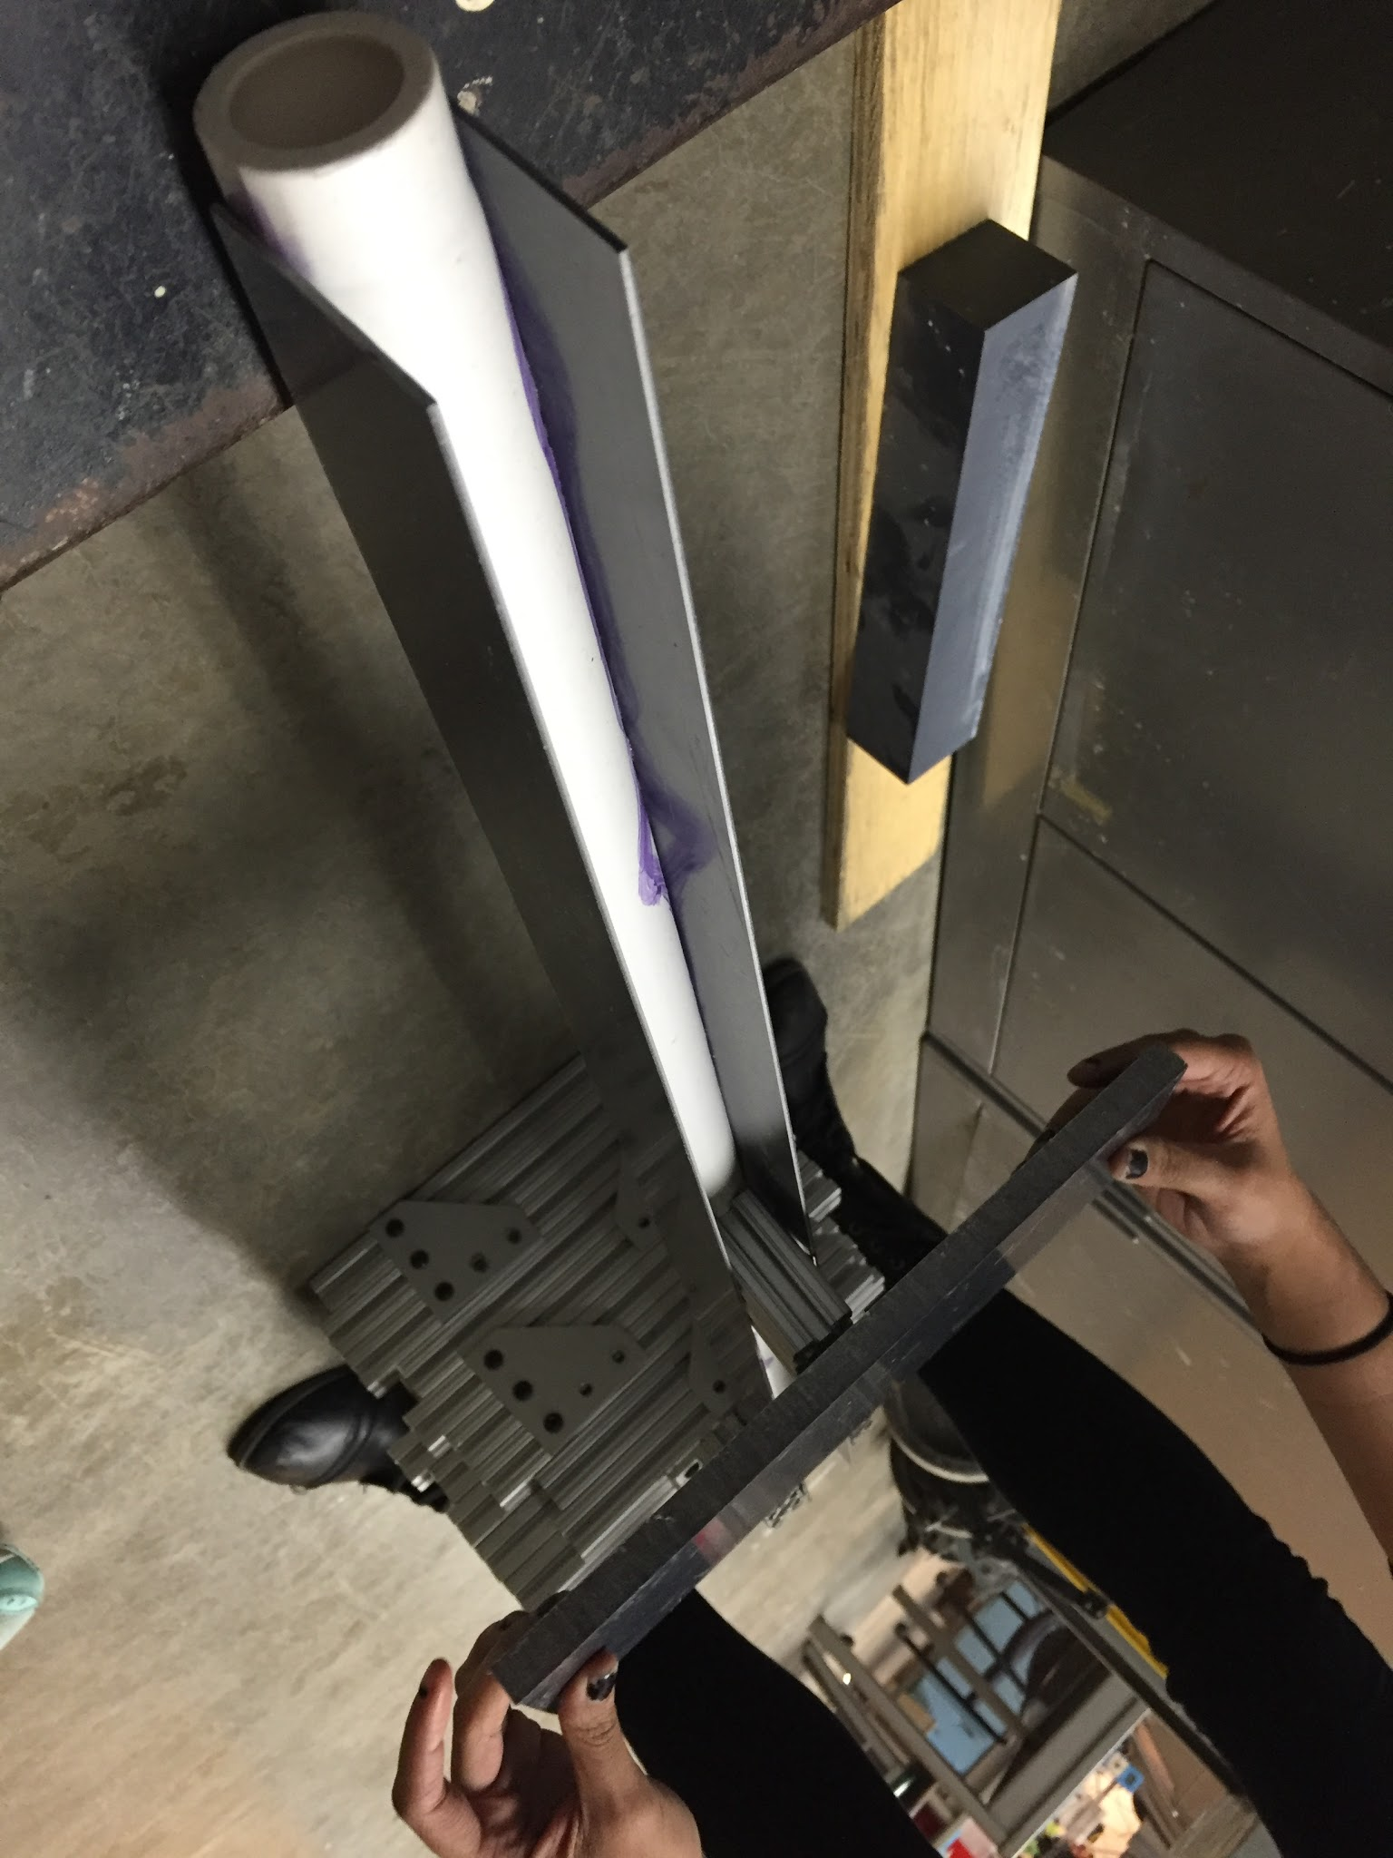
Wing Stress Testing
Tested wings of thickness ⅛” and 1/16”
Length: 1 cm (measured from bottom of the PVC pipe)
  Shortest possible length calculated: 3 micrometers
Figure 12: Applying force to winged inlet.
Notes:
MENGQI

Slide 15
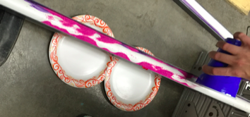
Wing Stress Testing
Maximum force: 80 lbs
Results:
  ⅛” : more than 130 lbs
  1/16”: 100 lbs
Recommendation: wings of 1 cm length and ⅛” thickness
Figure 13: Adding sand to see when failure occurred.
Notes:
MENGQI

Slide 16
Future Work
Further stress testing on wings
Look into alternative outlet designs
Notes:
SUBHANI

Slide 17
Questions/Suggestions
Thank You!
Notes:
SUBHANI

