Slide 1
StaRS FInE Team
Anne Case
Sarah Hunt
Ji Young Kim
Nadia Shebaro

Slide 2
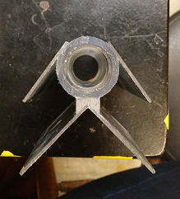
Winged Pipes
Since symposiums…
Tested vertical wings on inlet
Determined wings weren’t necessary on inlet, only orifices
Tested winged outlet pipe with a cap
Notes:
wings were not necessary because sand wasn’t coming into the pipe. Even if sand came in, the amount was negligible and was able to be washed out during filtration/backwash mode

Slide 3
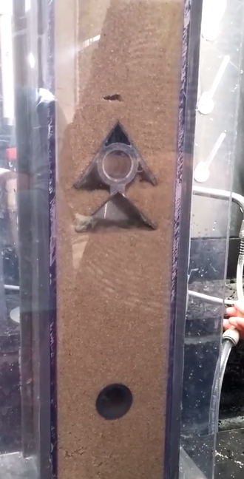
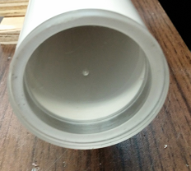
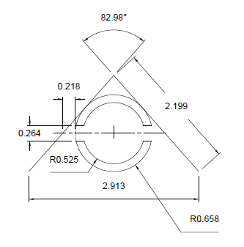
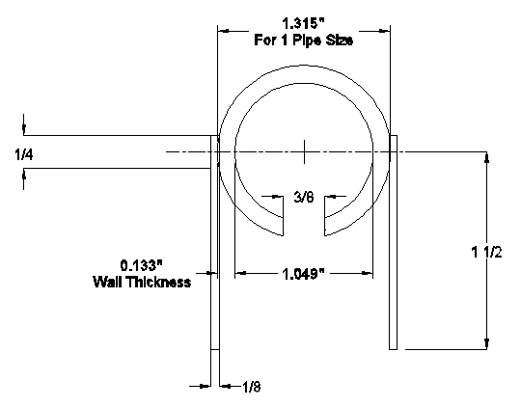
Wings: one vs. two vs none
Notes:
These are the designs we tried this semester or have designed and not yet tested

Slide 4
Final Decision on Inlet Design
No wings necessary
  Sand rarely enters the pipe
  Sand is flushed out during filtration
Holes at the bottom of the Pipe
Hole constraint remaining the same
  Total orifice area = pipe cross-sectional area

Slide 5
Wings on Outlet
Tested capped system in the first filter with holes
Improved backwash fluidization movement
Video: Capped Backwash at 11.6 mm/s
https://drive.google.com/open?id=0BwW0-ETy63v2TXNrYnNaYmlvRGc&authuser=0

Slide 6
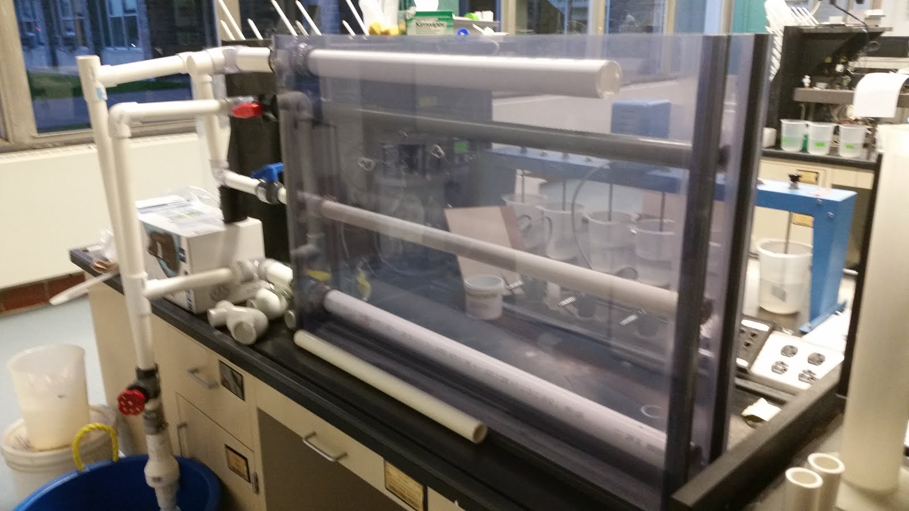
86-cm Filter Box
Interior clearance 10 cm by 86 cm
Height based on human arm length
Bottom Inlet 1.5” pipe
Outlet & Top Inlet 1” pipe
Top Drain 1.5” pipe
¼ hp Pump
Calculations made
  Head loss from the pump to pipes
  Hole sizes for inlets and drain pipe
Moved to teaching lab

Slide 7
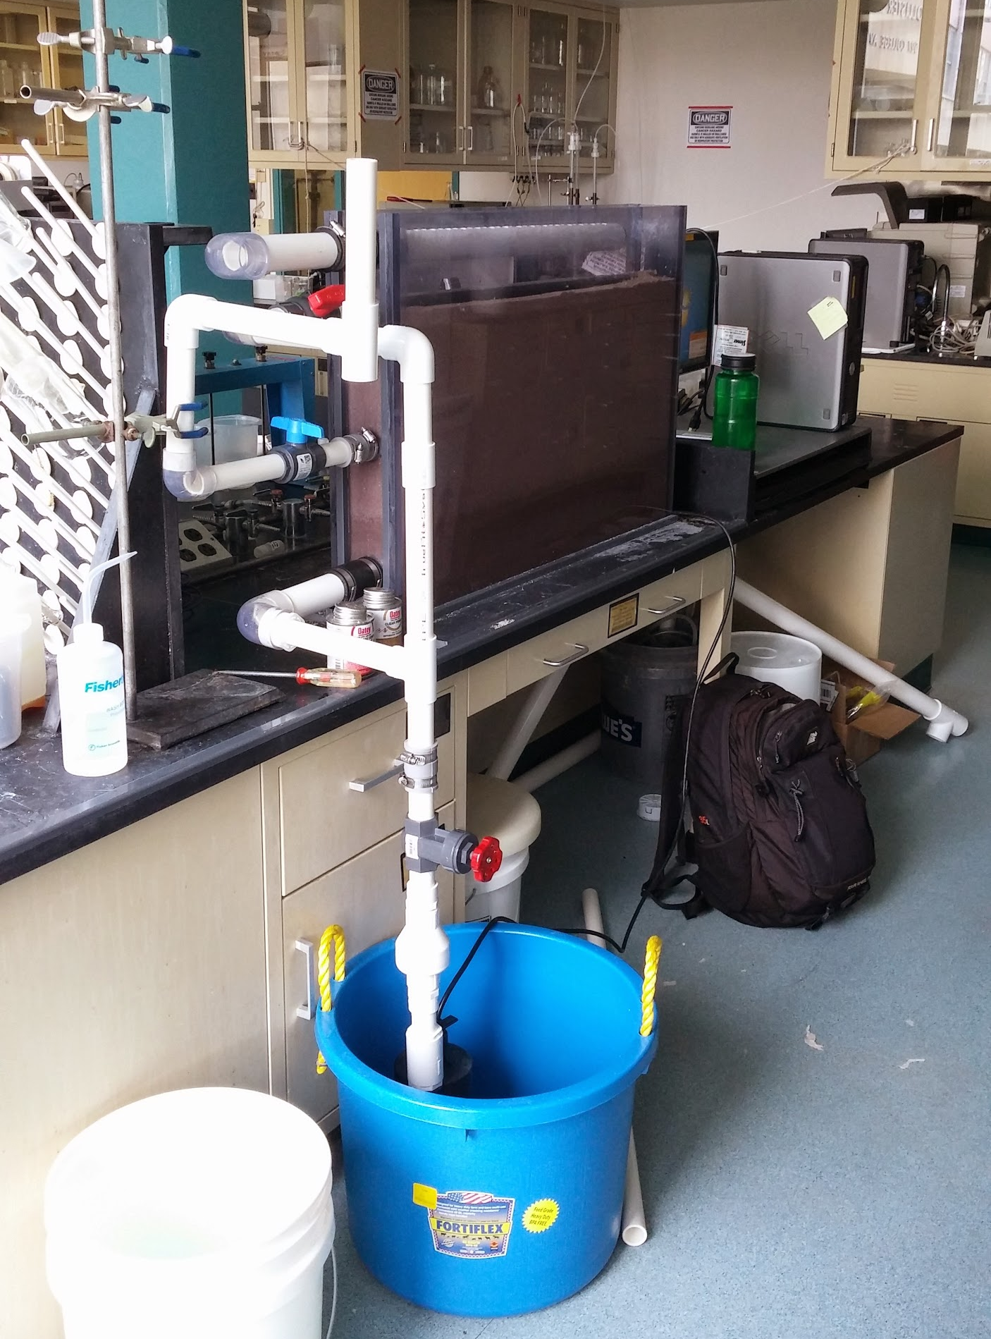
86-cm Filter Box cont.
Fabrication
  Worked with Tim
  Ordered all necessary pieces
  Measured/cut PVC, glued fittings in place
Flow control with pump and gate valve
Recycle system
Backwash outlet is now a pipe with holes on top acting as weir

Slide 8
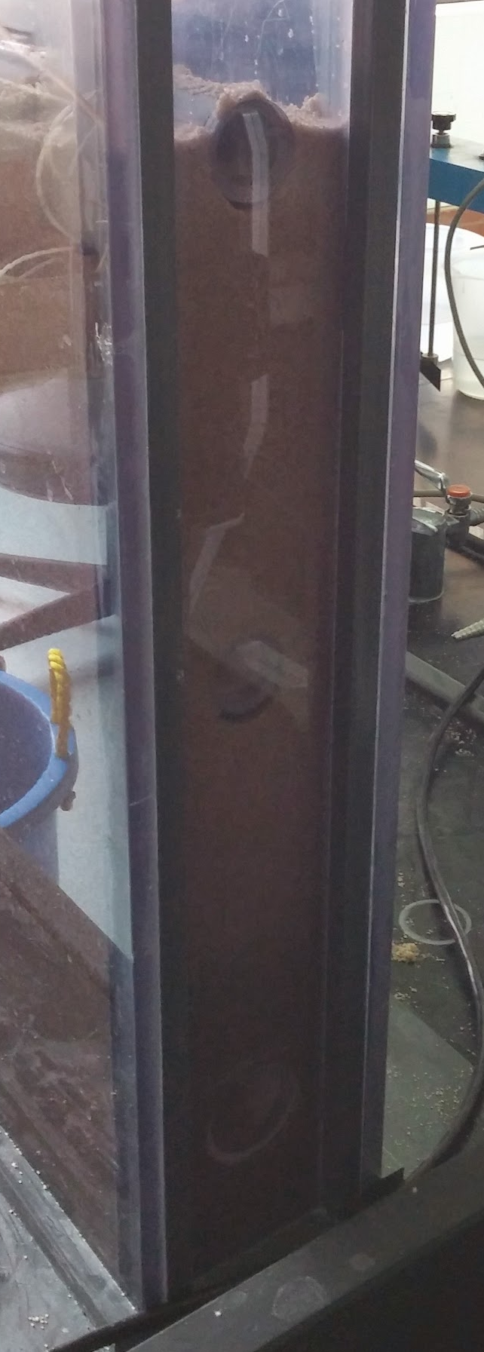
Testing of 86-cm Filter
Installed slotted pipe for the outlet
Initial problems with overflow during backwash
Inlets with orifices only proved to be successful!
  Interesting backwash results
  Sand that gets in pipe is not a problem
Side walls bent when the filter was full of water
  Had to clamp the top of the filter

Slide 9
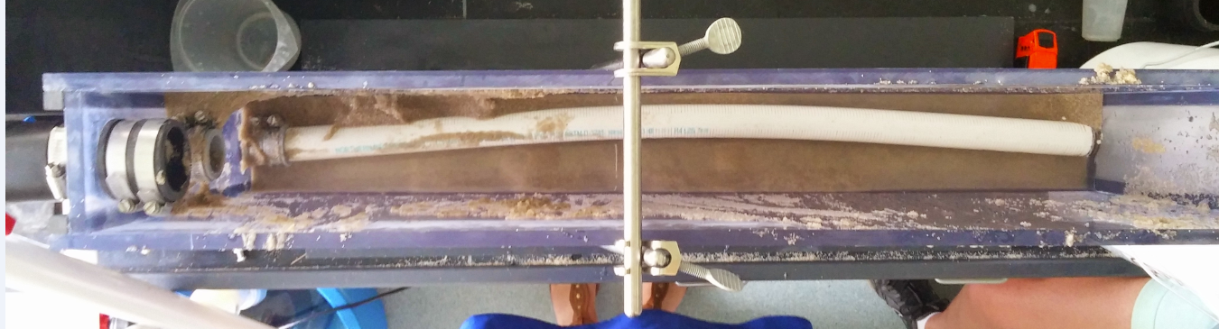
Test with Slotted Pipe
When we had to empty the filter to fabricate our new outlet,
we found our slotted pipe was bent

Slide 10
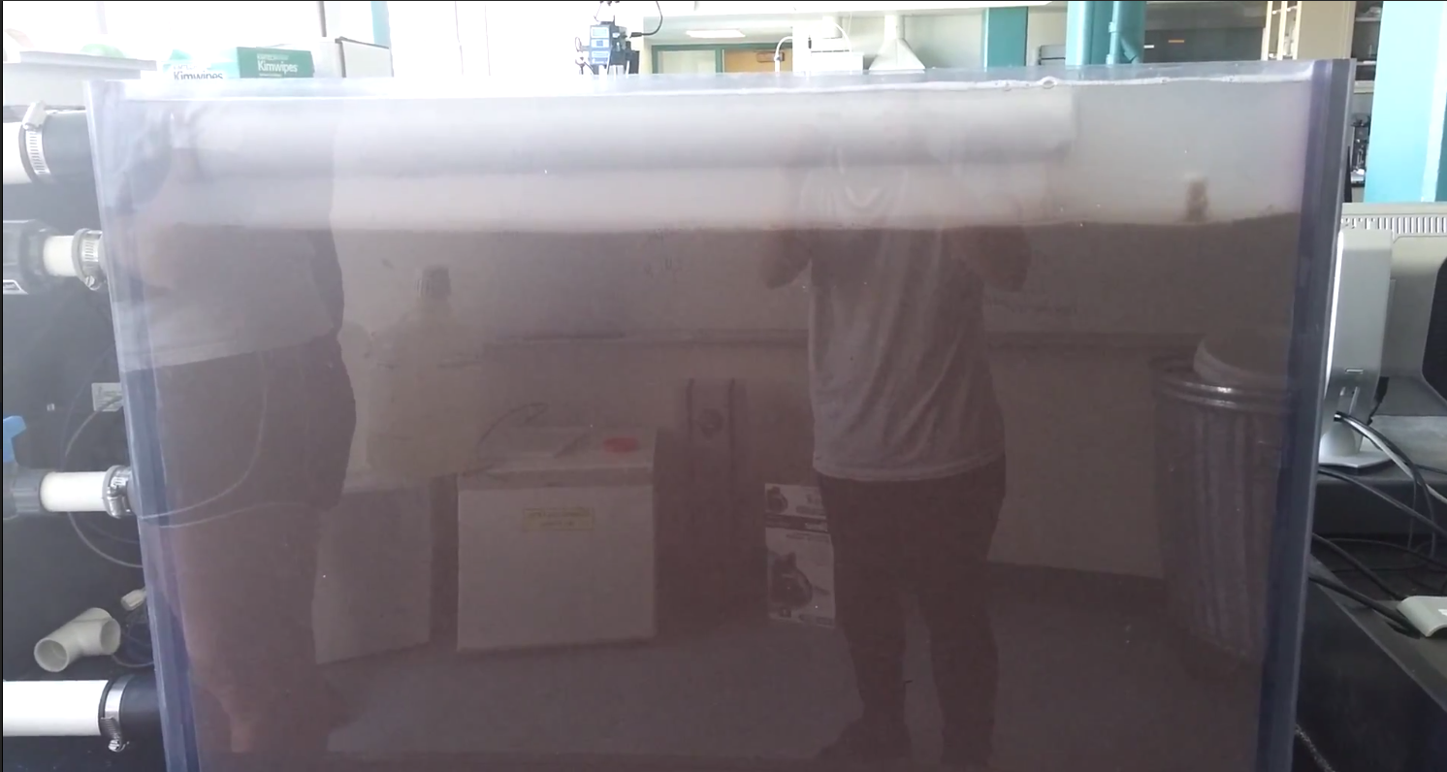
Another Problem
Difficulty on recording videos of experiments
https://drive.google.com/file/d/0BwW0-ETy63v2X0F4cmhGOHZWUlE/view?usp=sharing

Slide 11
Future Work
New winged design for outlet with orifices
  New design could be fabricated on location
  One set of wings instead of two
  Cap on top of pipe
Almost fabricated; one quick test for feasibility before summer
System can be useful for many years to come - good for observation and testing different piping systems

