Slide 1
STaRS FInE
Anne Case, Sarah Hunt, Ji Young Kim, Nadia Shebaro

Slide 2
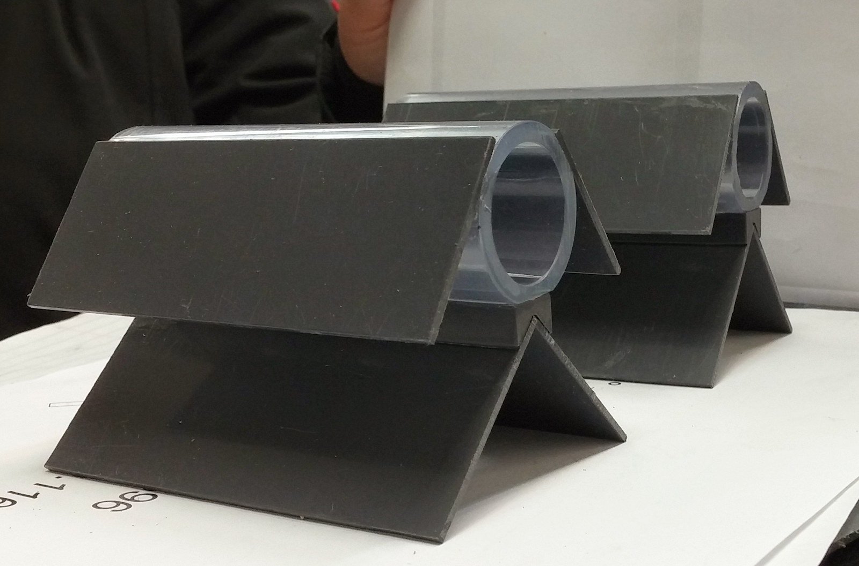
Problem
Clogging of slotted pipes
Need for larger holes
with new method of
sand exclusion
Proposed gravity-exclusion system with winged pipes
  Must prevent fluidization of sand into exclusion zones
  Must be able to fluidize filter bed during backwash
Figure 1: Overview of Winged Pipes

Slide 3
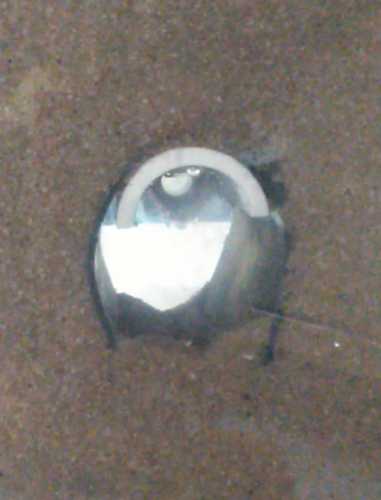
Exclusion Zone Theory
Area directly underneath pipe/wings filled only with water
Gravity prevents sand from entering pipes at filtration flow velocity
During backwash, exclusion zone should be maintained due to lack of flow through pipe
Testing must be done to determine if the sand will move into these zones and into the pipe, especially during backwash when it is fluidized
Figure 2: Inverted U-tube setup

Slide 4
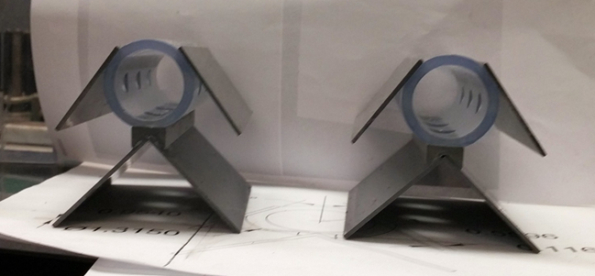
Initial Design
Total bottom hole area = total side hole area
Total orifice area = pipe cross-sectional area
Top wings extend to narrowest point for largest interface area
Bottom wings extend to the same width as top wings
Figure 3: Front view of Winged Pipes

Slide 5
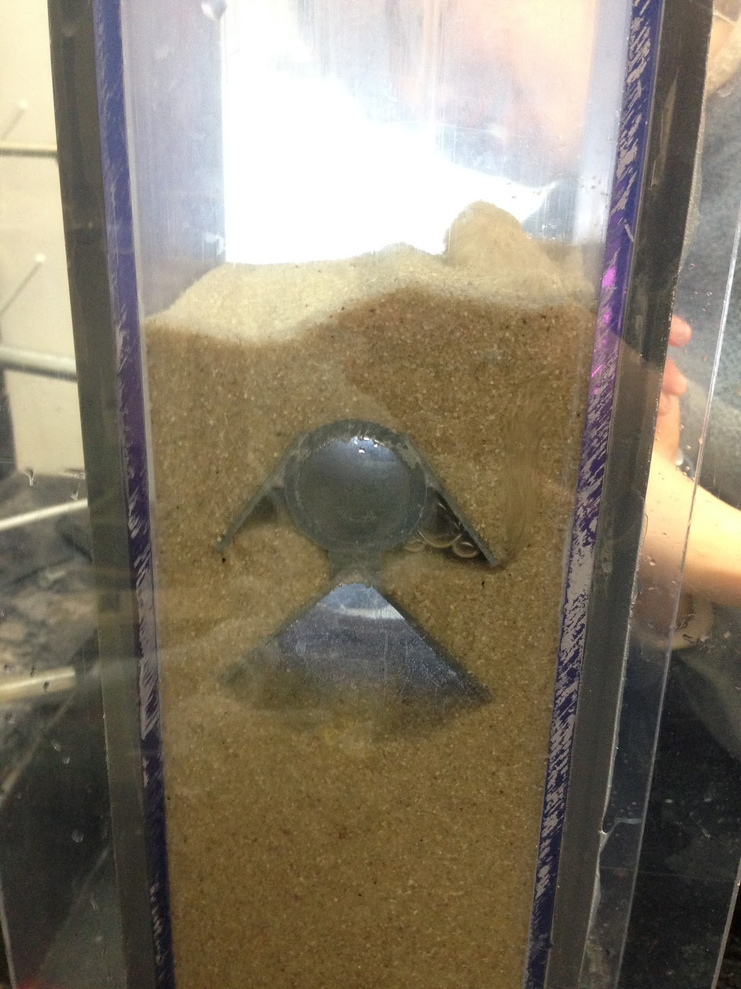
Challenges
Fabrication difficulties
Measuring flow accurately
Dealing with sand in outflow
Air bubbles
Fluidizing the entire sand bed
Exclusion zones not working
and how to get sand out of them to test again
backwash with extreme flow rate
Figure 4: Filtration Experiment Setup
Notes:
exclusion zones not working = mention shortcut of water through pipe during fluidization

Slide 6
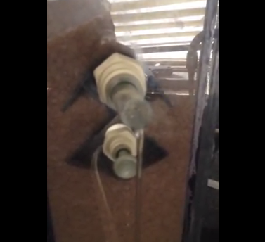
Progress I
Success in Filtration
  highest filtration flow rate was 22 ml/s
low flow filtration 2/23

Slide 7


Progress II
Recalculated hole sizes based on head loss
  Karmen-Kozeny equation, loss through sand bed:
  Equation for head loss through an orifice:
Notes:
hole size necessary for appropriate head loss is larger than the correct area based on initial constraint

Slide 8
Progress III
Backwash with higher flow and smaller holes
backwash success 123.85ml/s_2
Smaller holes allowed higher filtration flow rate
  with bigger holes : 22.5 ml/s
  with smaller holes: 31.10 ml/s

Slide 9
Next Steps
Trial and error process to optimize the winged design
Use pump instead of sink to more accurately measure flow
Change design of inlet pipe potentially
Collaborate with other StaRs teams

