Slide 1
Grit Removal
Innovative Technologies
2015 May 15
Final Presentation
Annie Ding and Mary Millard

Slide 2
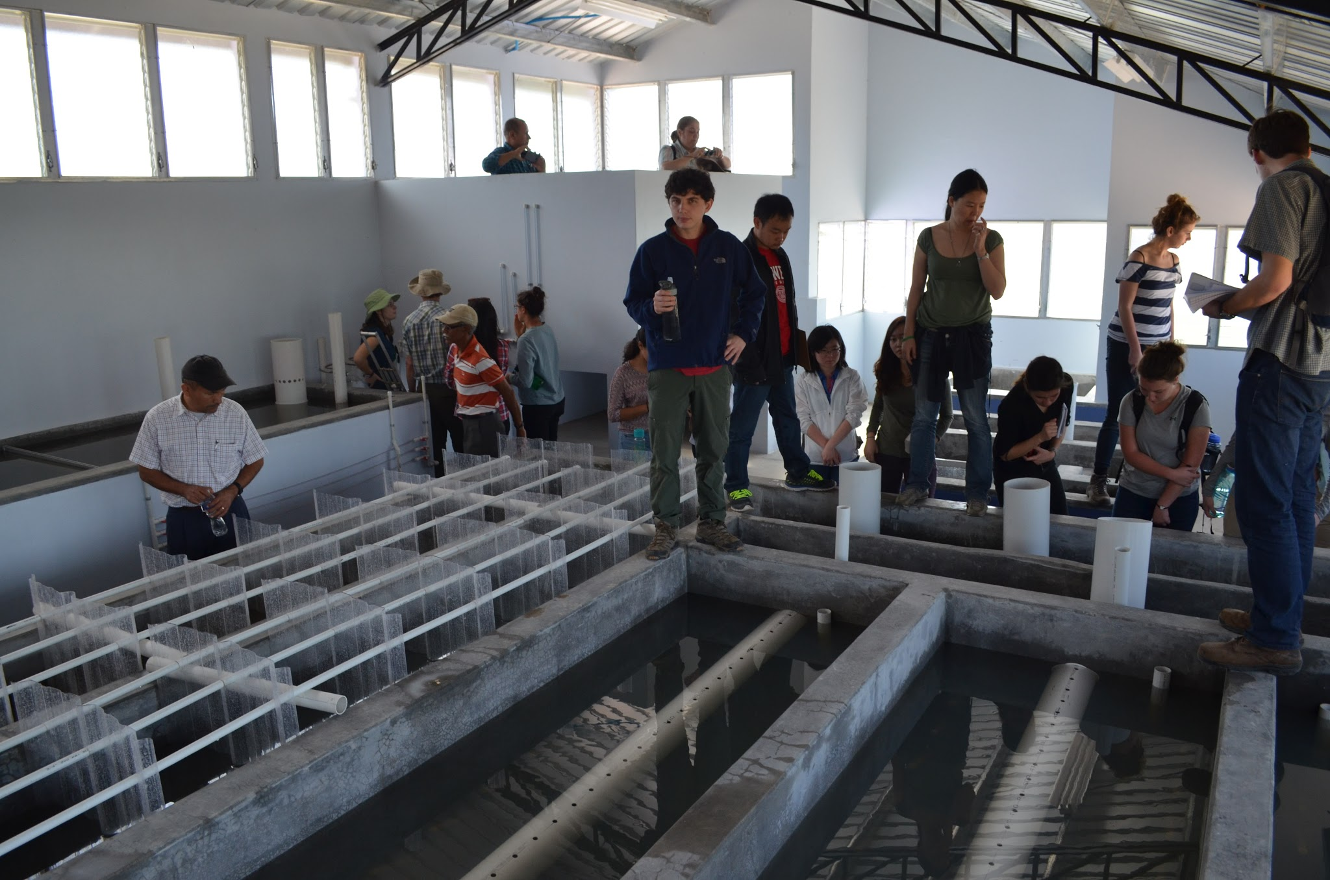
Introduction
The problem: large sand particles clogging the flocculator!
The solution: addition of a grit-removing chamber that will reduce the plant’s plan view area

Slide 3
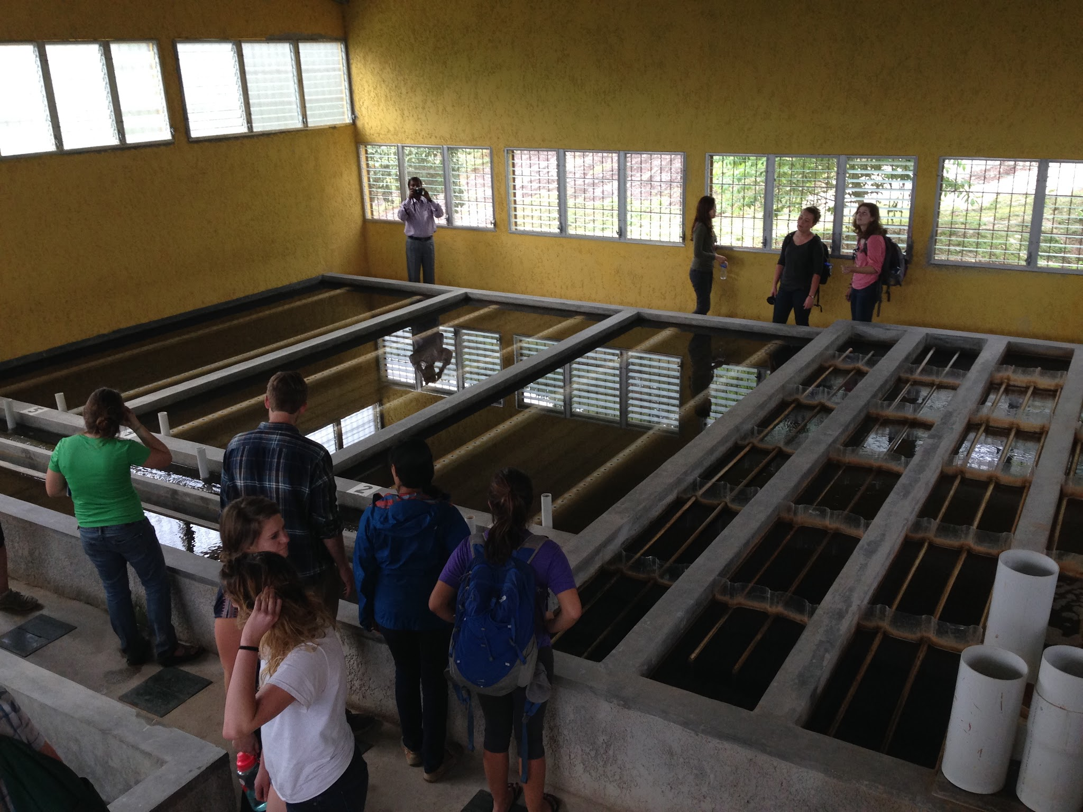
Our Goals
Prevent grit build-up in flocculator
Reduce plant size
Cut cost
Make operation easier

Slide 4
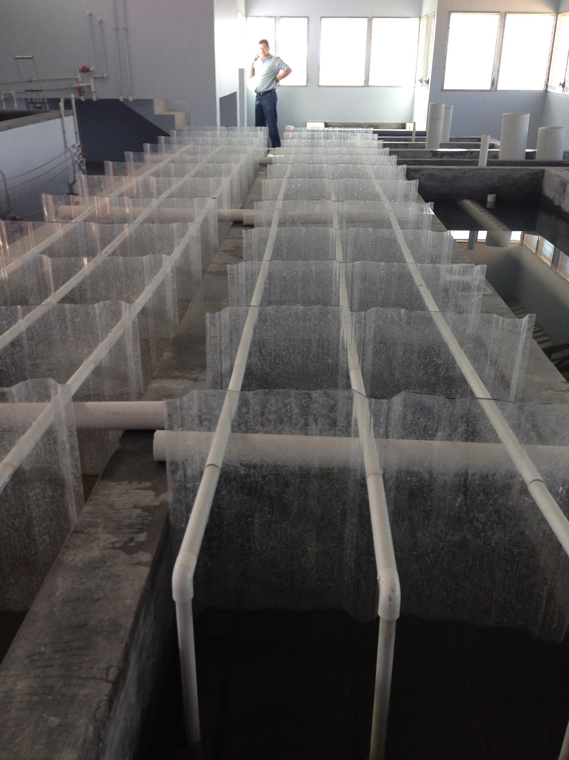
Critical Assumptions!
Relaxed maximum EDR
  V_{cGrit} = 8 mm/s (can be up to 16 mm/s)
Relaxed minimum collision potential
  ψ = 70 m^{⅔}
Minimum width = human width! (~50 cm)

Slide 5
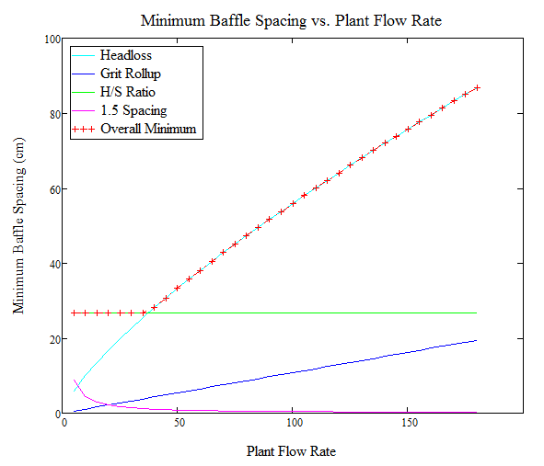
Design #1:
GRF (Grit Removing Flocculator)
Grit removal (sedimentation) added to the first channel of the flocculator
Plate settlers in series
Main constraint:
minimum baffle spacing requirements

Slide 6
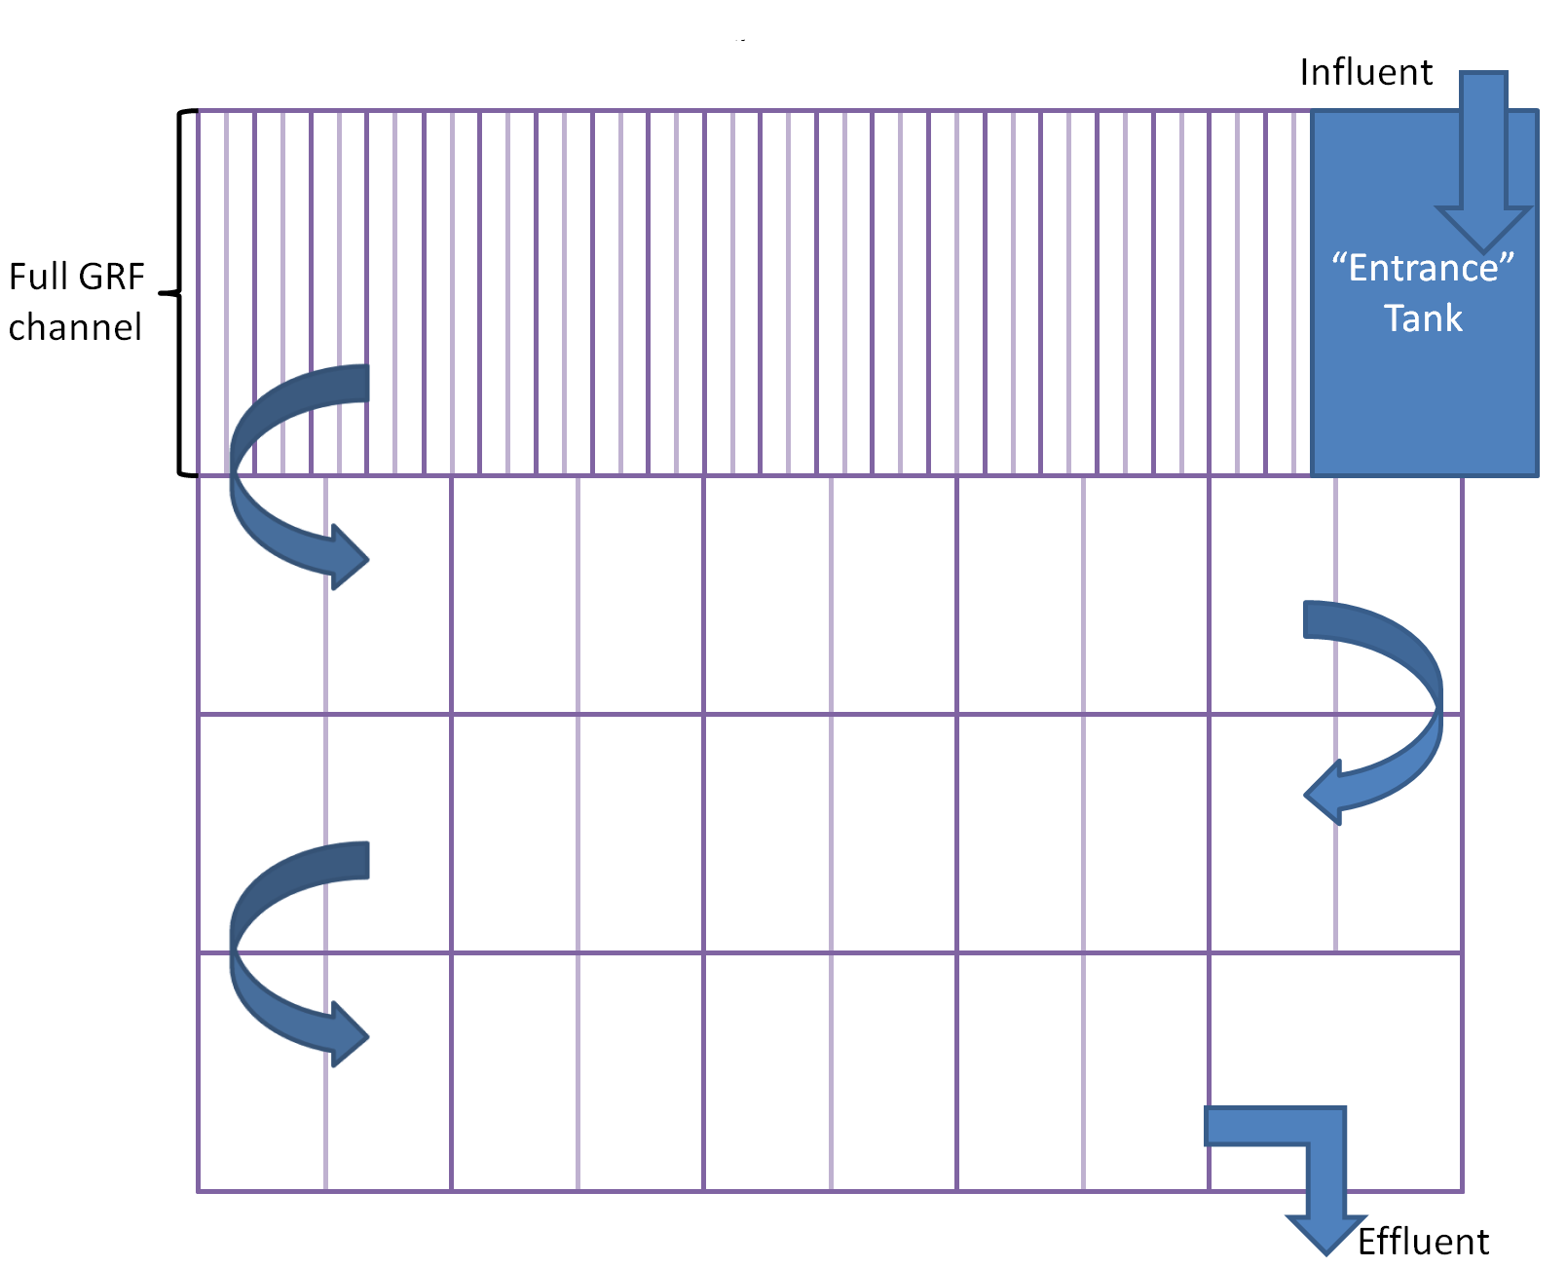
GRF: Top View

Slide 7
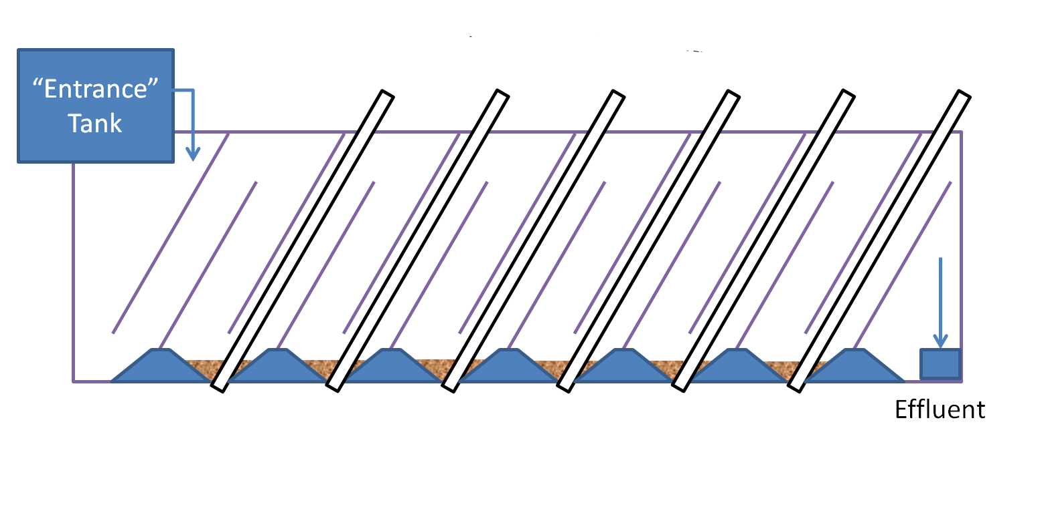
GRF: Side View

Slide 8
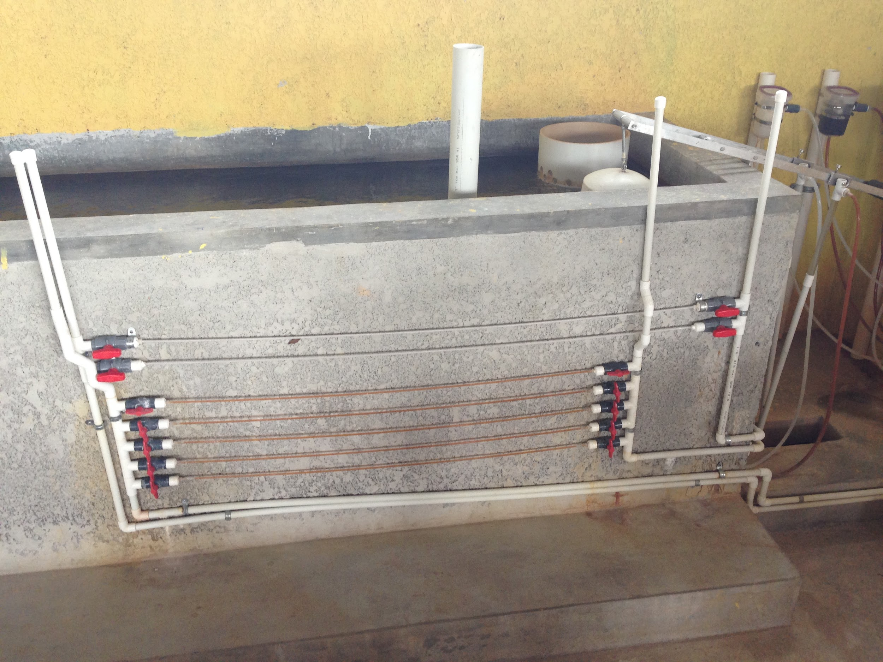
Design #2:
Entrance GRU
An elevated, small sedimentation unit added inside the minimized entrance tank
Main constraints:
  achieving capture velocity
  feasibility of construction
  flow distribution

Slide 9
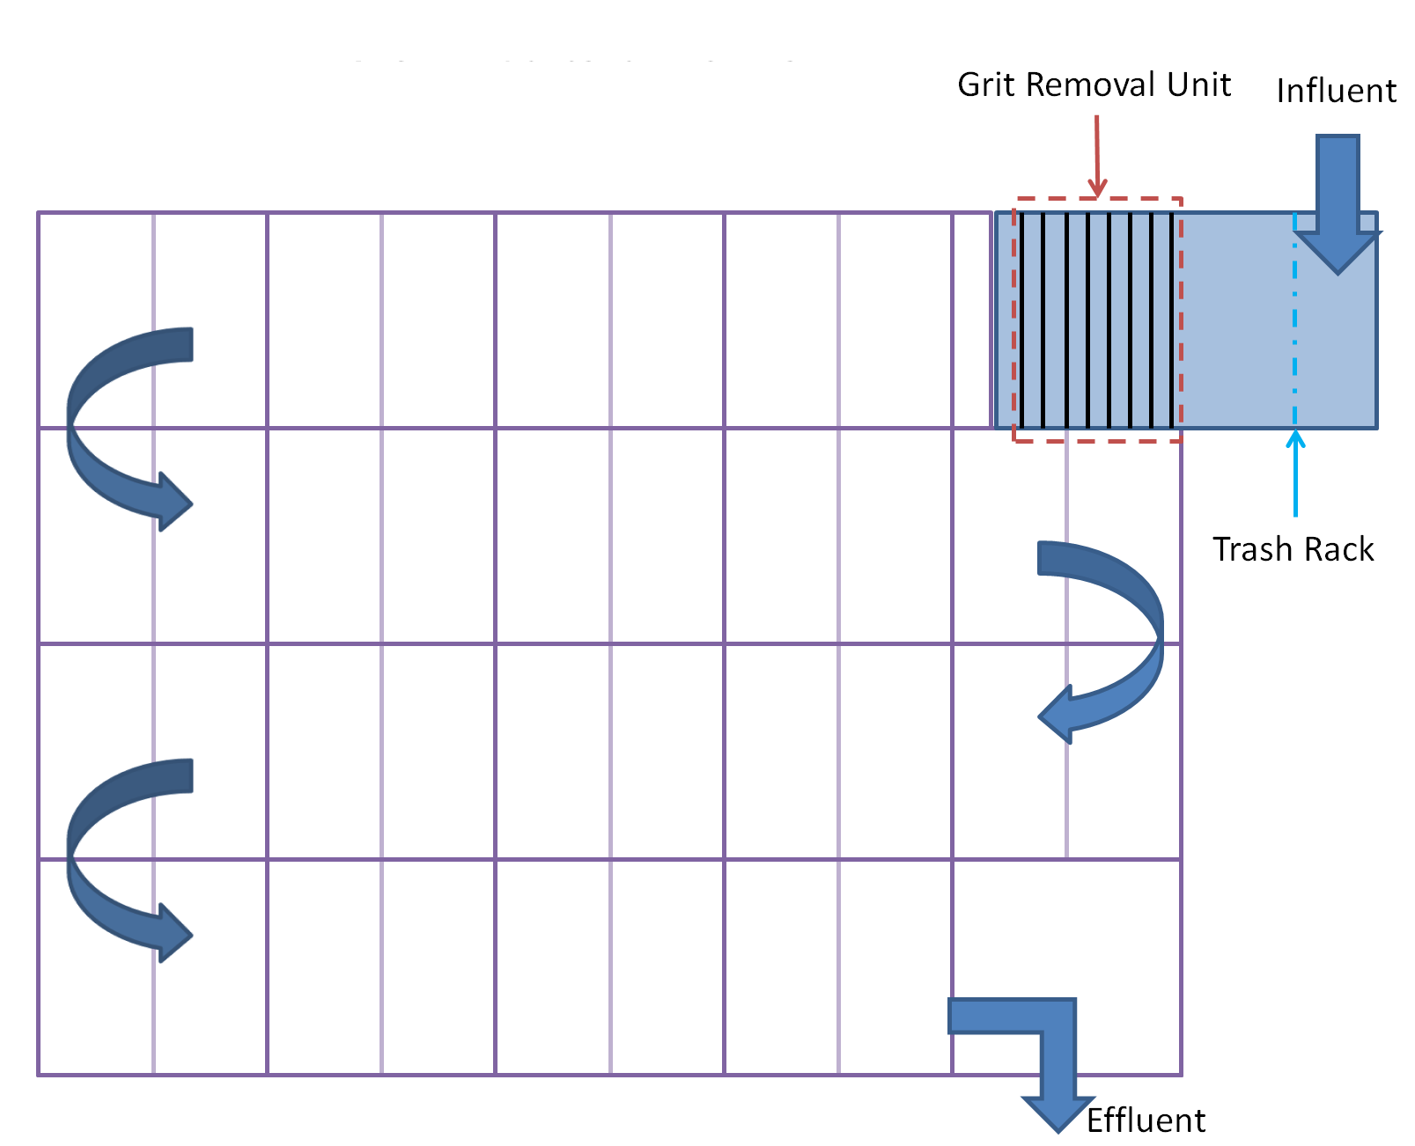
GRU in Entrance Tank:
Top View

Slide 10
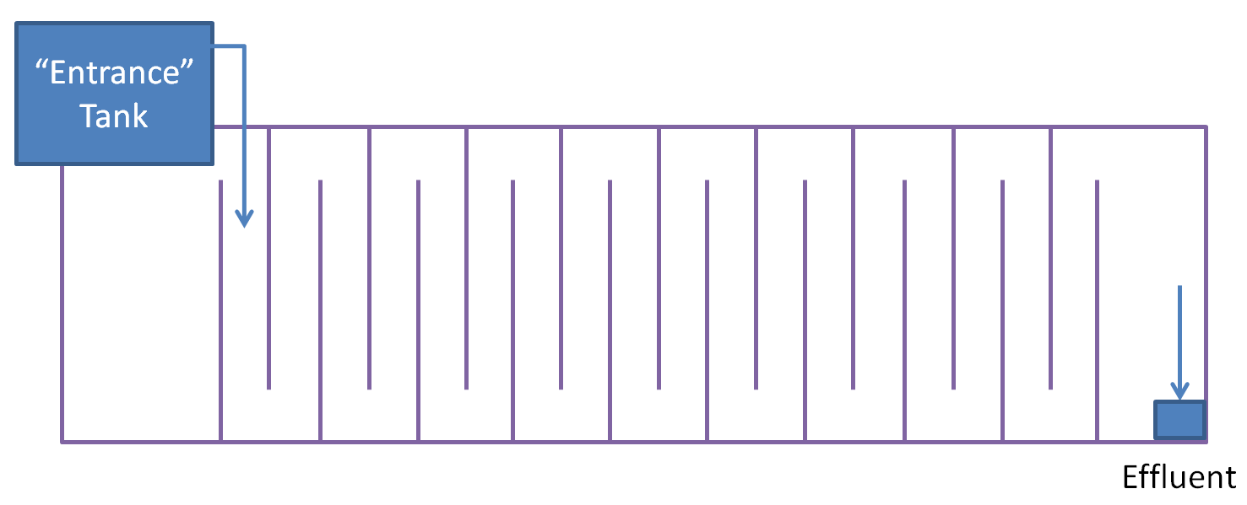
GRU in Entrance Tank:
Side View

Slide 11
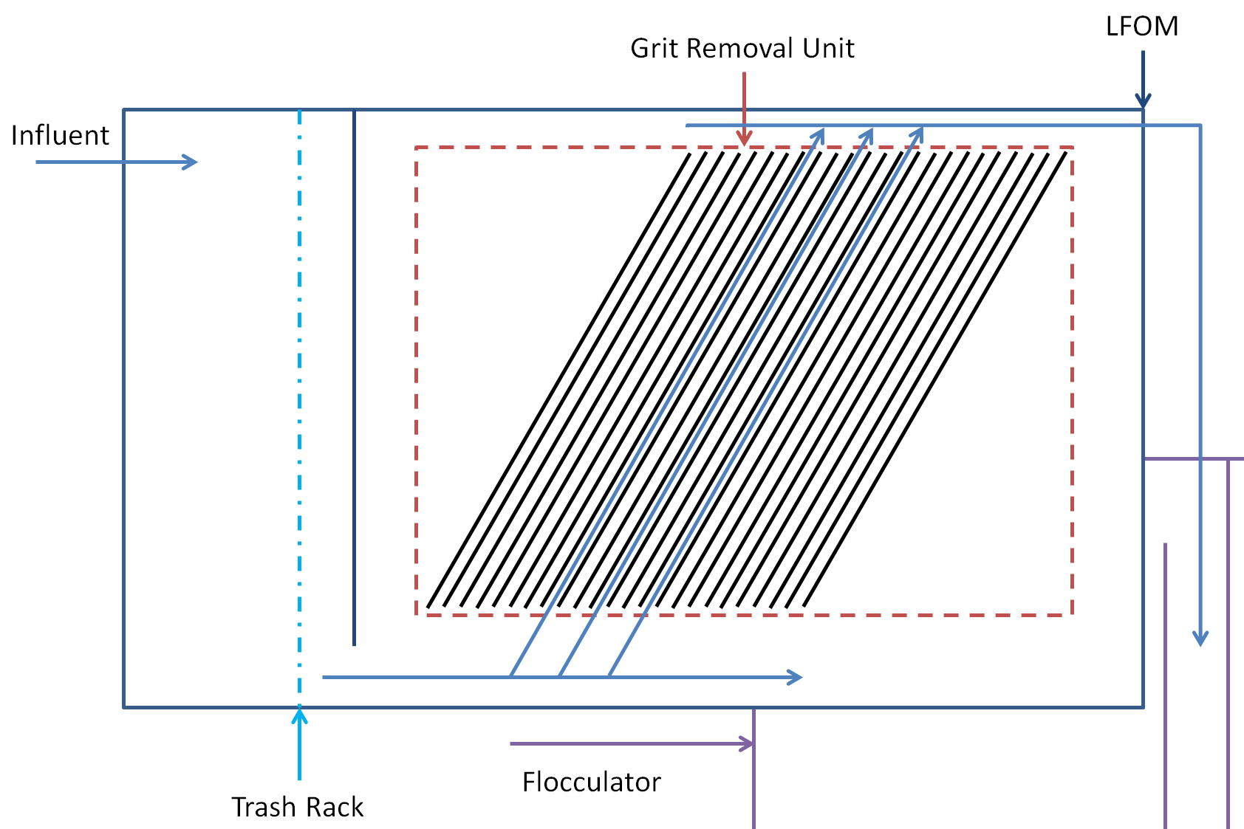
GRU in Entrance Tank:
Side View

Slide 12
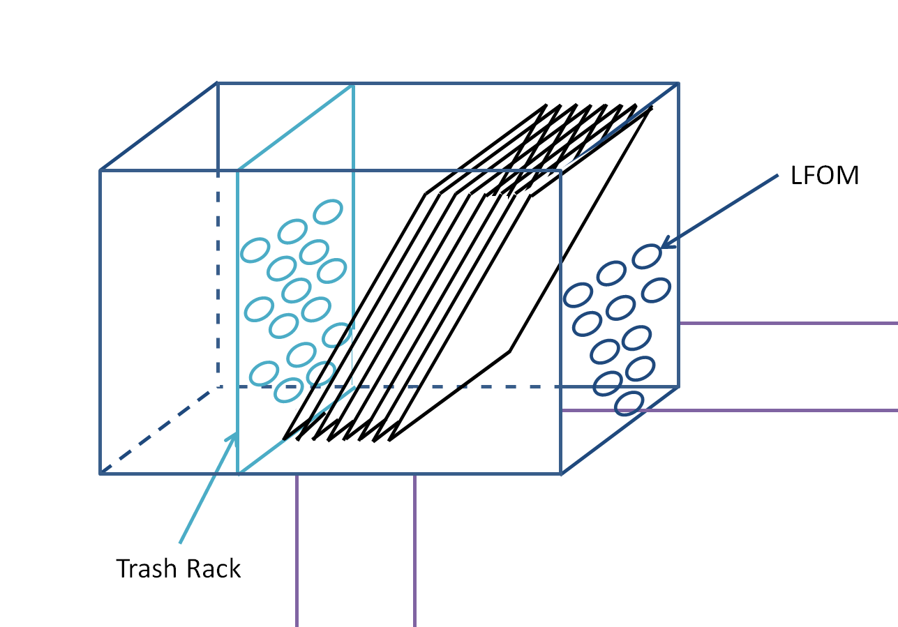
GRU in Entrance Tank:
Another View

Slide 13
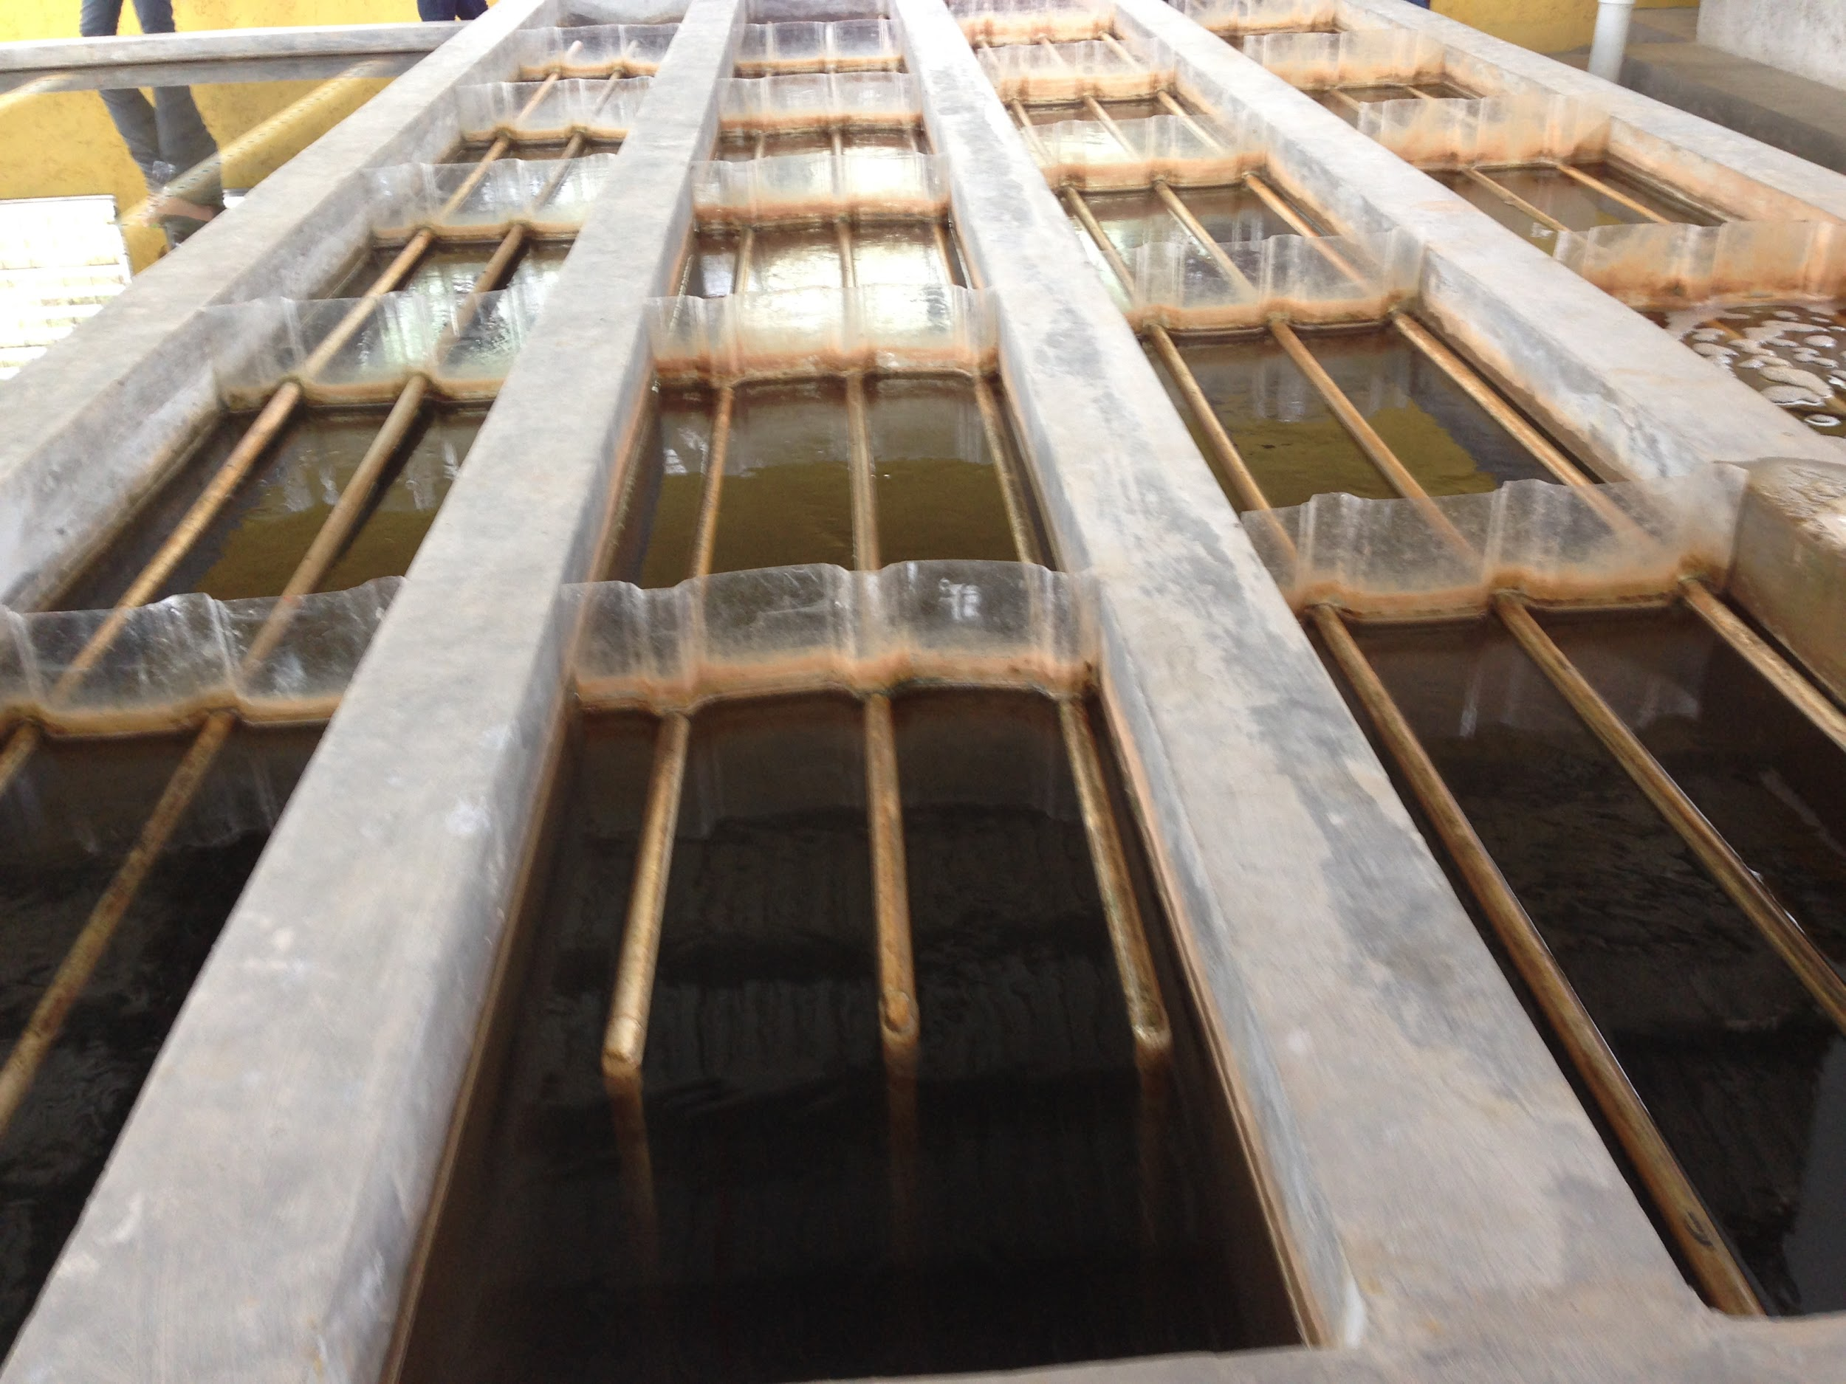
Design #3:
Channel GRU
A small, grit-removing sedimentation unit added into the first flocculation channel
Plate settlers in parallel
Analogous to a tiny rough sedimentation tank
Main constraints:
  achieving desired capture velocity
  feasibility of construction
  overall height and plan view length

Slide 14
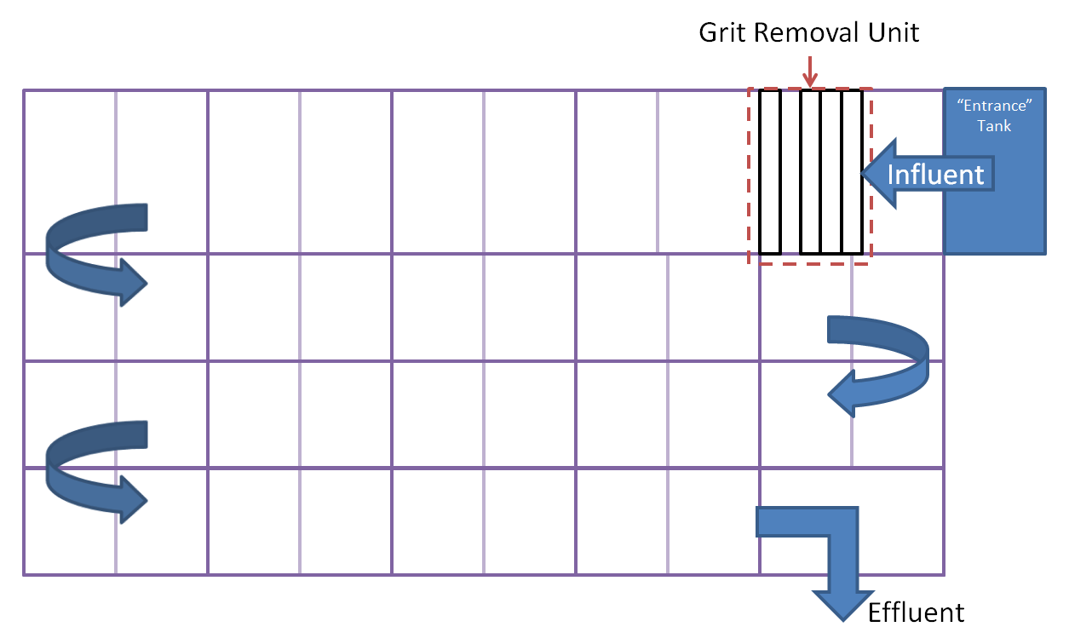
GRU in Flocculator:
Top View

Slide 15
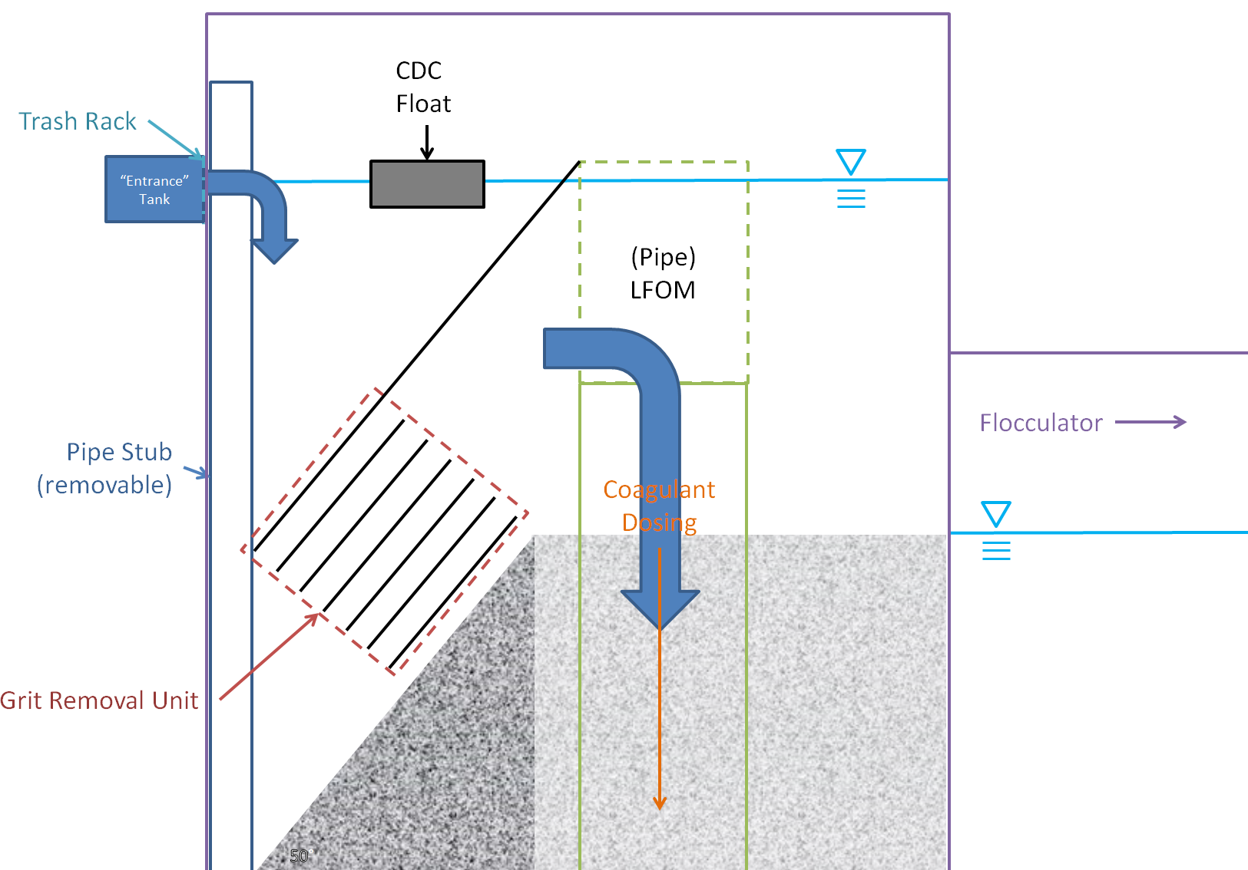
GRU in Flocculator:
Side View

Slide 16
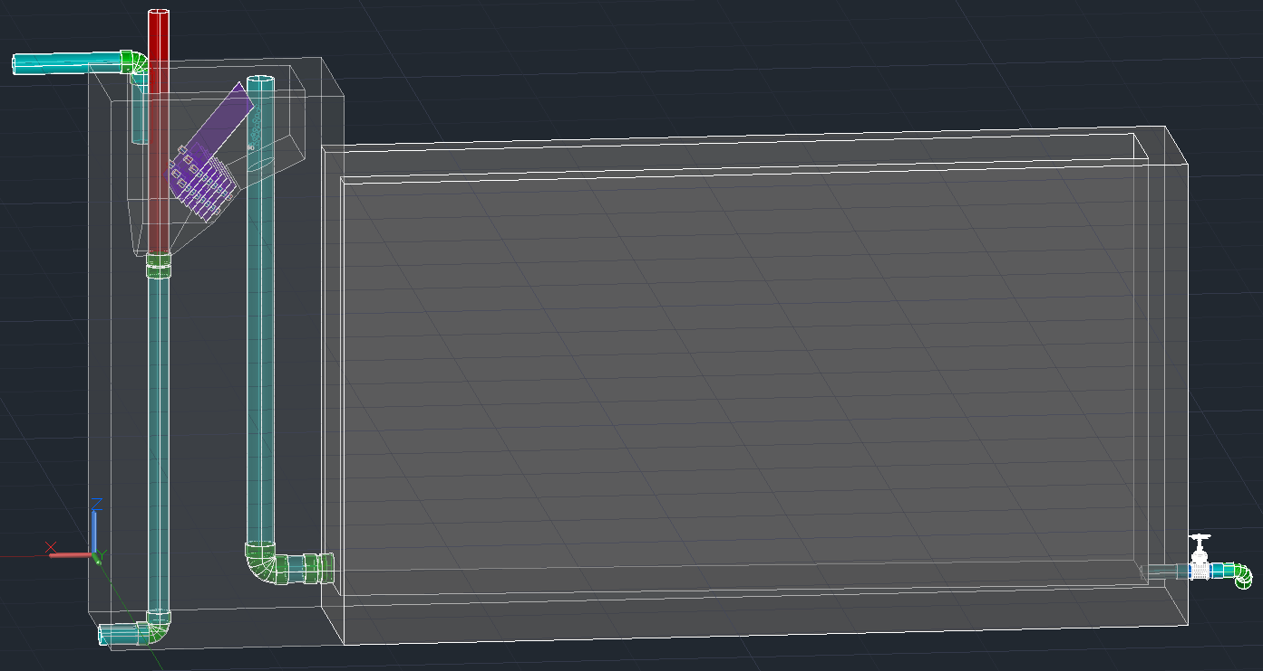
Deliverables
4 L/s plant to be constructed in Honduras!

Slide 17
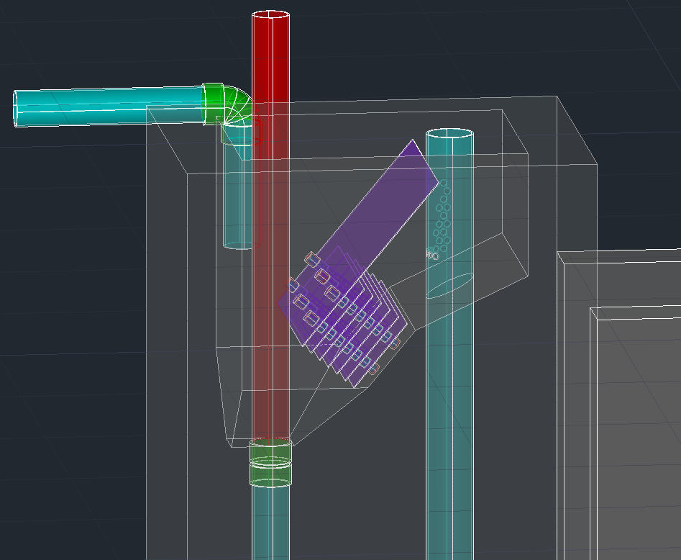
Deliverables

Slide 18
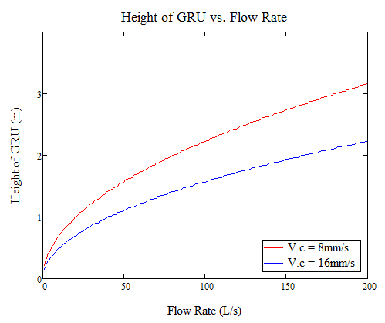
Future Work?
Keep tabs on 4 L/s plant being constructed! Ask for feedback about construction and utilization of the grit removal chamber.
Designing for very large flow rates
Develop cost estimates and comparisons

Slide 19

Questions?
Text
Picture/graph/table

