Slide 1
Grit Removal Design
2015 March 16
Symposium
Annie Ding and Mary Millard

Slide 2
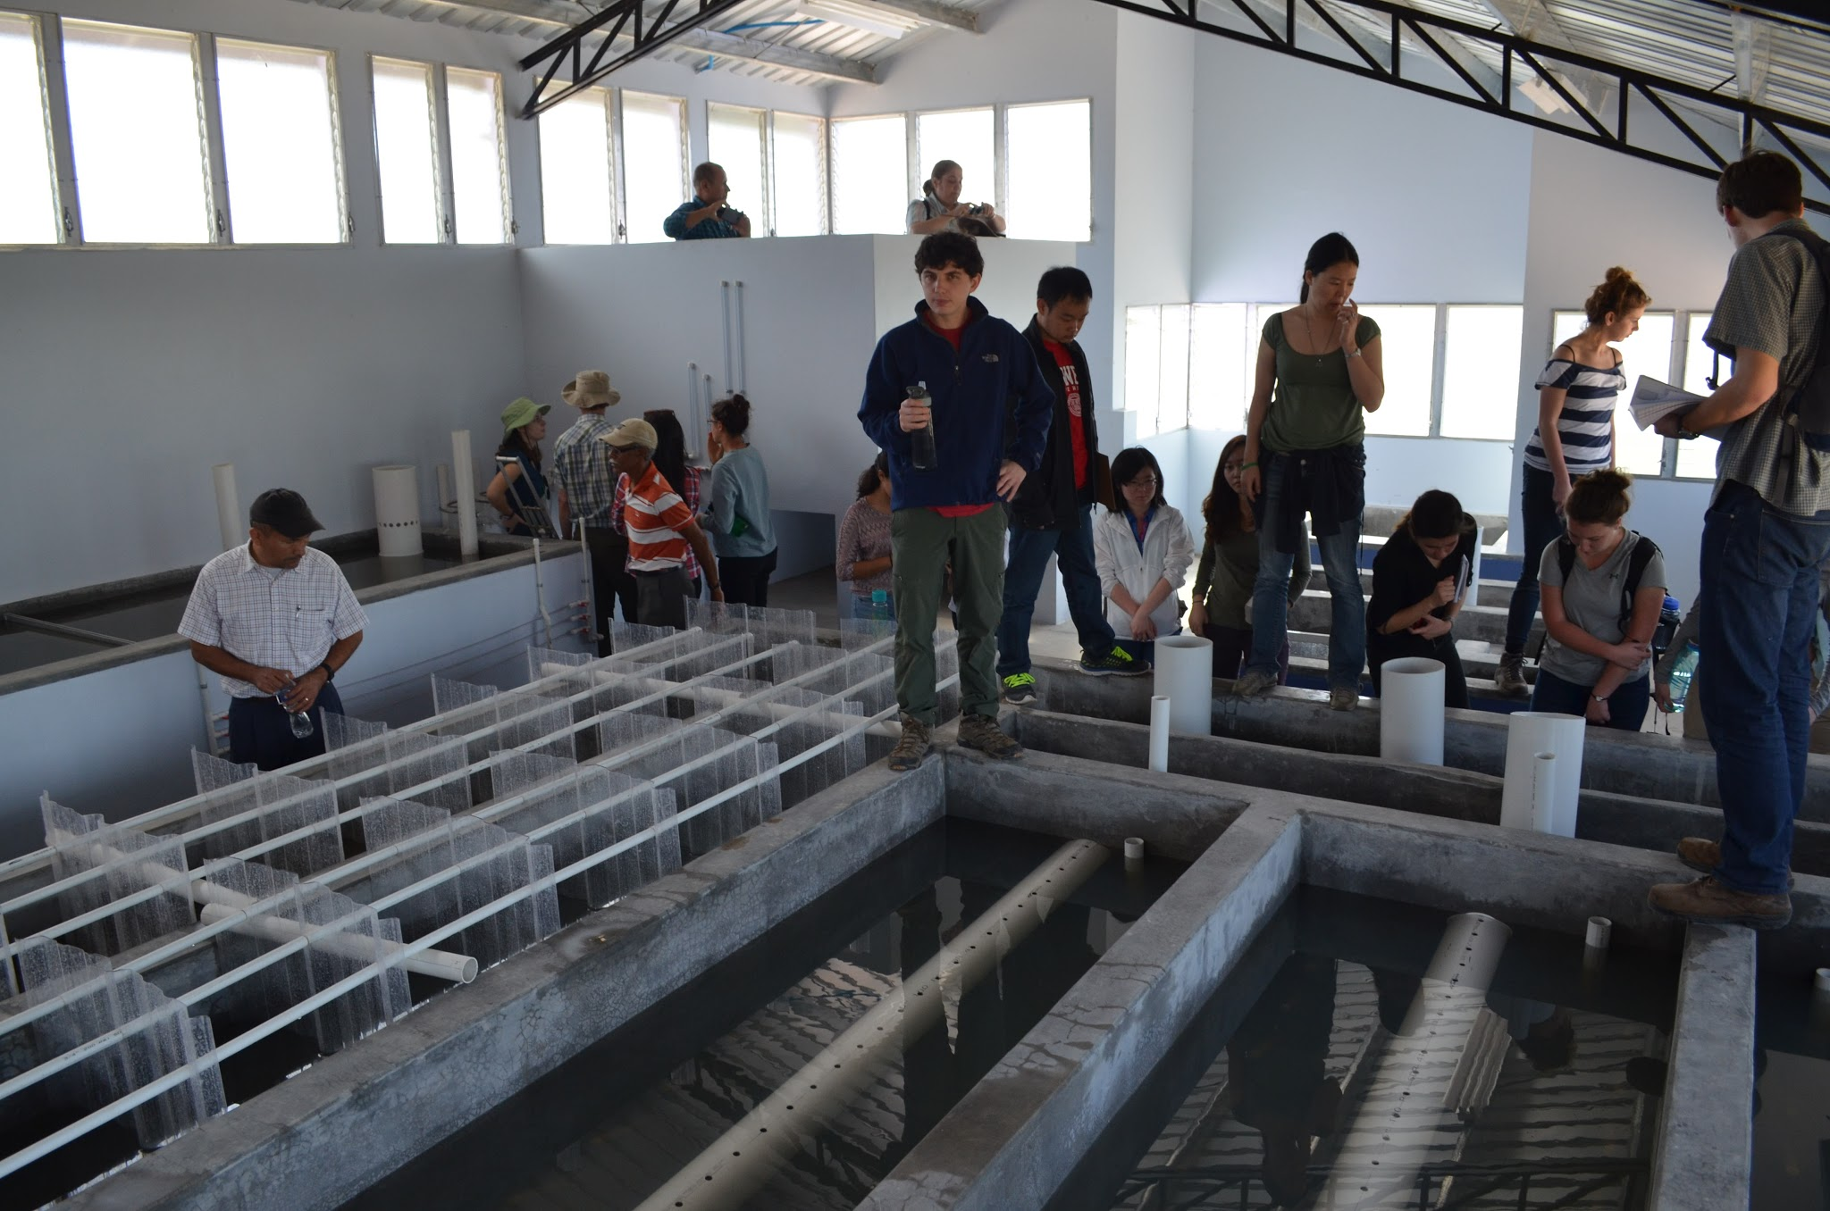
Introduction
The problem: large sand particles clogging the flocculator!
The proposed solution: addition of a grit removing chamber that would actually decrease plant area

Slide 3
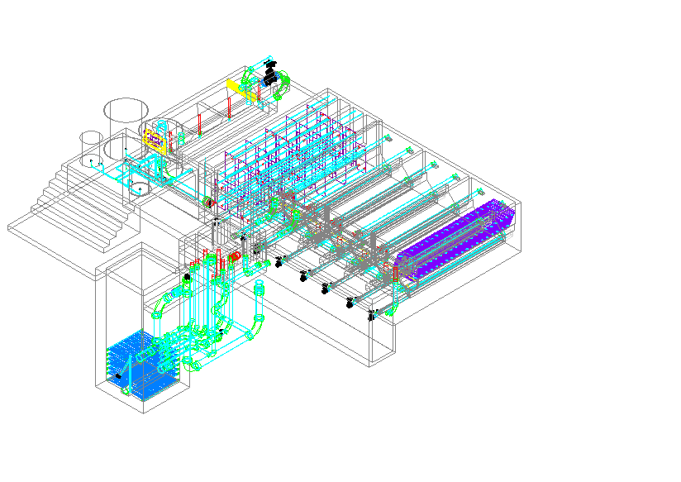
How, you may ask??

Slide 4
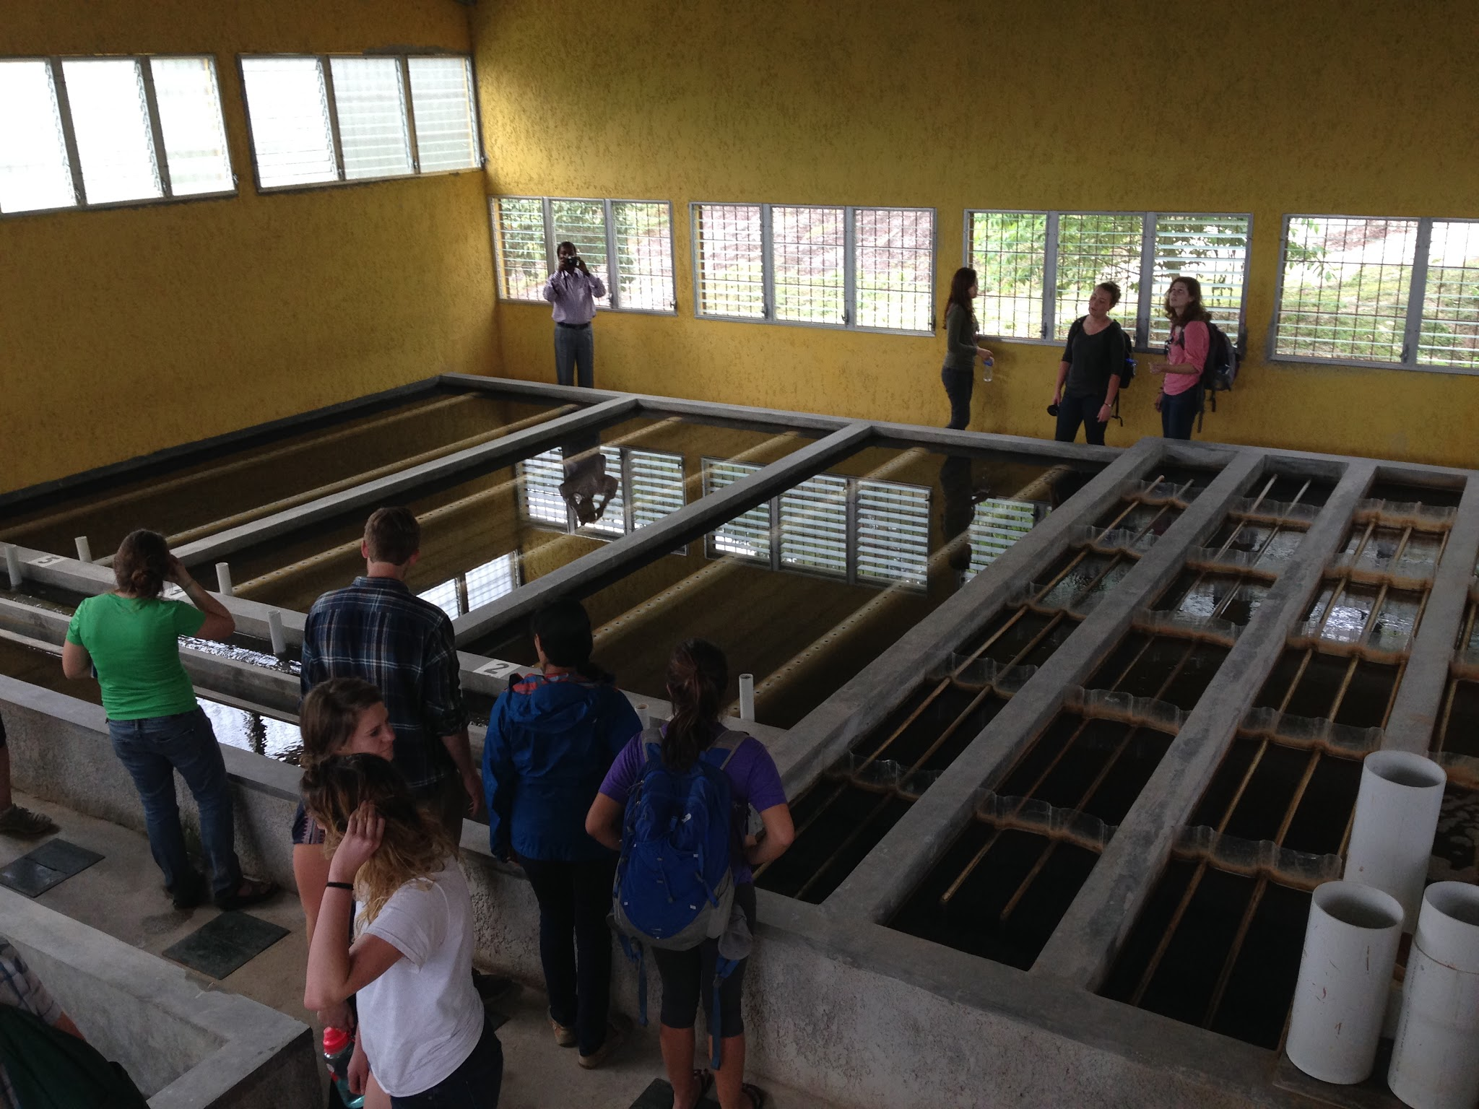
Our Goals
Prevent grit build-up in flocculator
Reduce plant size
Cut cost
Make operation easier

Slide 5
Defining “Grit”
Diameter that will be settled out at 16 mm/s
  d_{GritSettle} = 0.1338 mm
Density
  ρ_{Grit} = 2650 kg/m³ (assuming the same density as silica sand)
Is coagulant consumption a problem?

Slide 6
Critical Assumptions!
Relaxed maximum EDR
  V_{cGrit} = 16 mm/s
Relaxed minimum collision potential
  ψ = 70 m^{⅔}
Minimum width = human width! (~50 cm)

Slide 7

Design #1:
GRF (Grit Removing Flocculator)
Grit removal (sedimentation) capabilities added to the first channel of the flocculator
Plate settlers in series
Main constraints:
  target collision potential of flocculator
  optimal H/S ratio
  achieving Rapid Mix EDR (1 W/kg)?

Slide 8
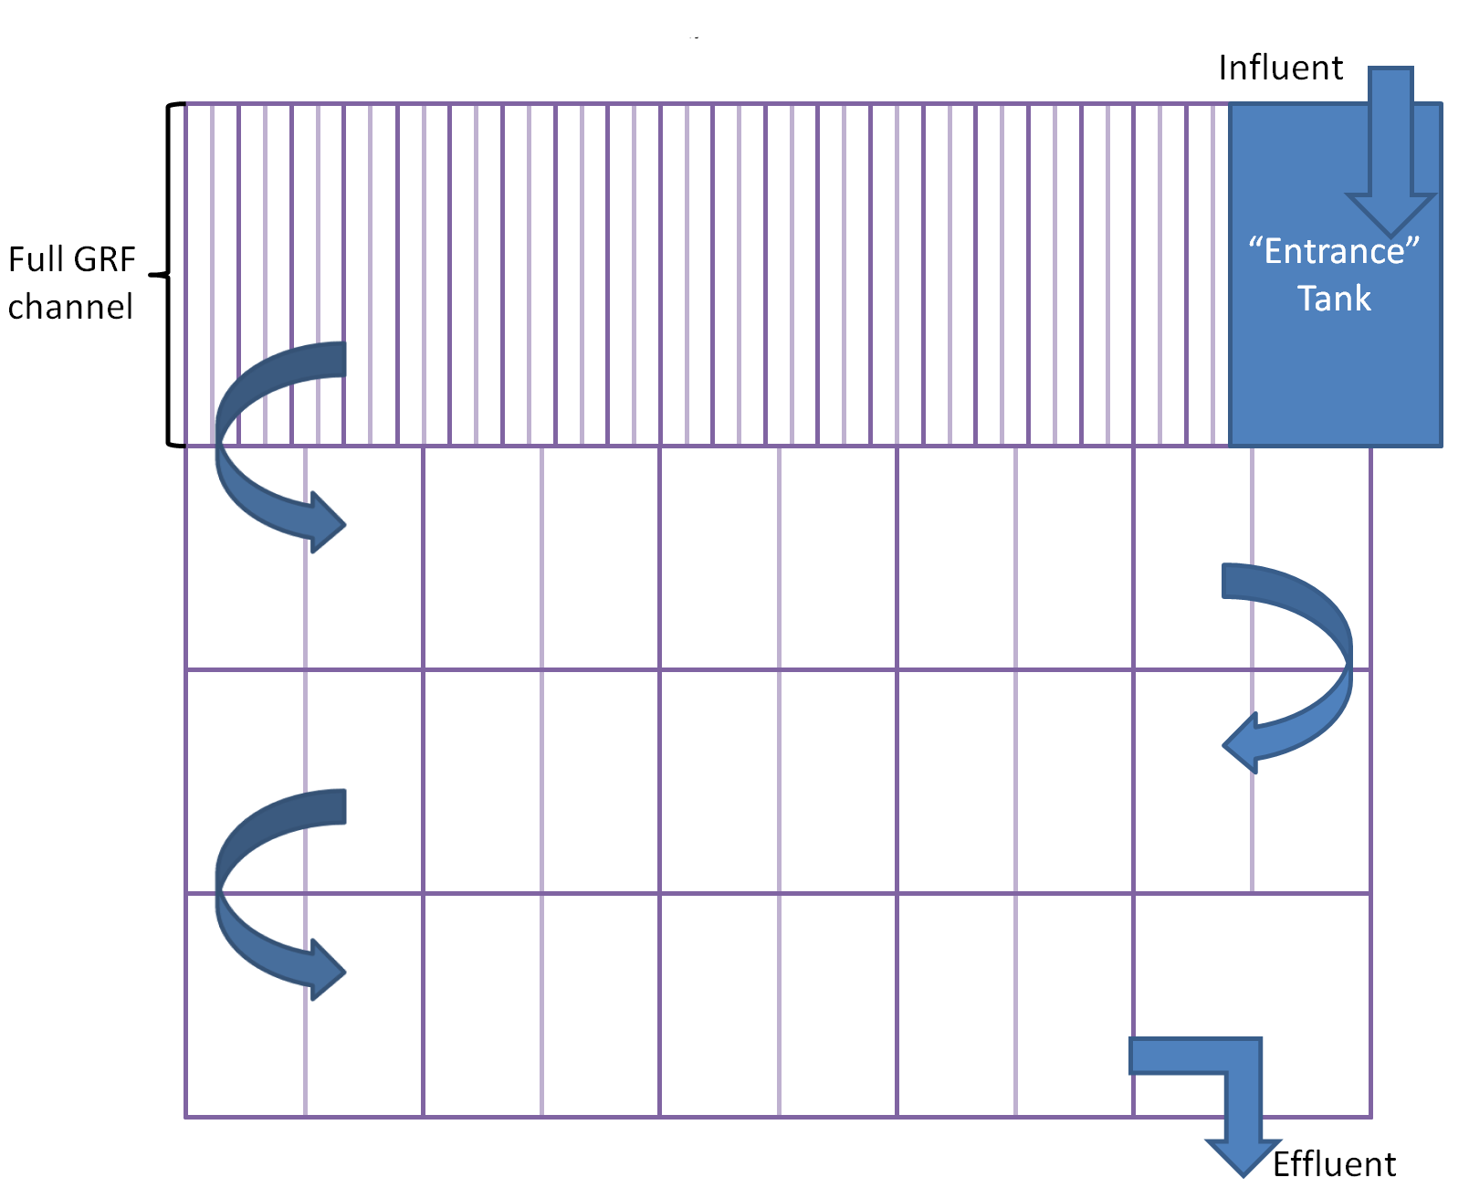
GRF: Top View

Slide 9
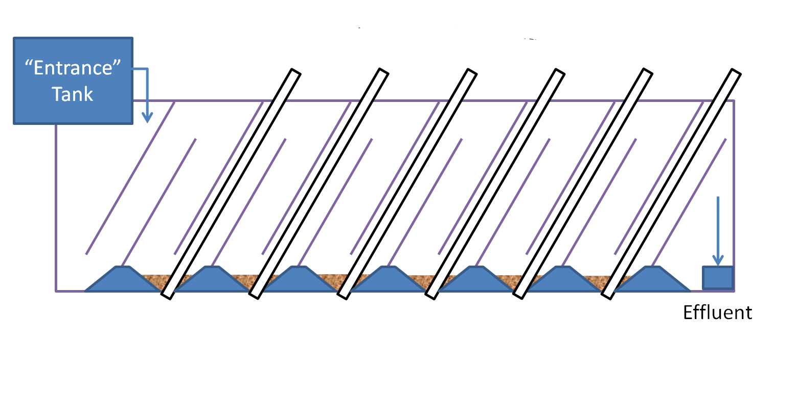
GRF: Side View

Slide 10
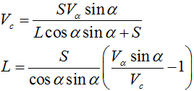
Design #2:
GRU in Flocculator
A small, grit-removing sedimentation unit added into the first flocculation channel
Plate settlers in parallel
Like a tiny rough sedimentation tank
How should we remove the settled grit?
Main constraints:
  avoiding grit “roll-up” effect
  achieving desired capture velocity
  feasibility of construction

Slide 11
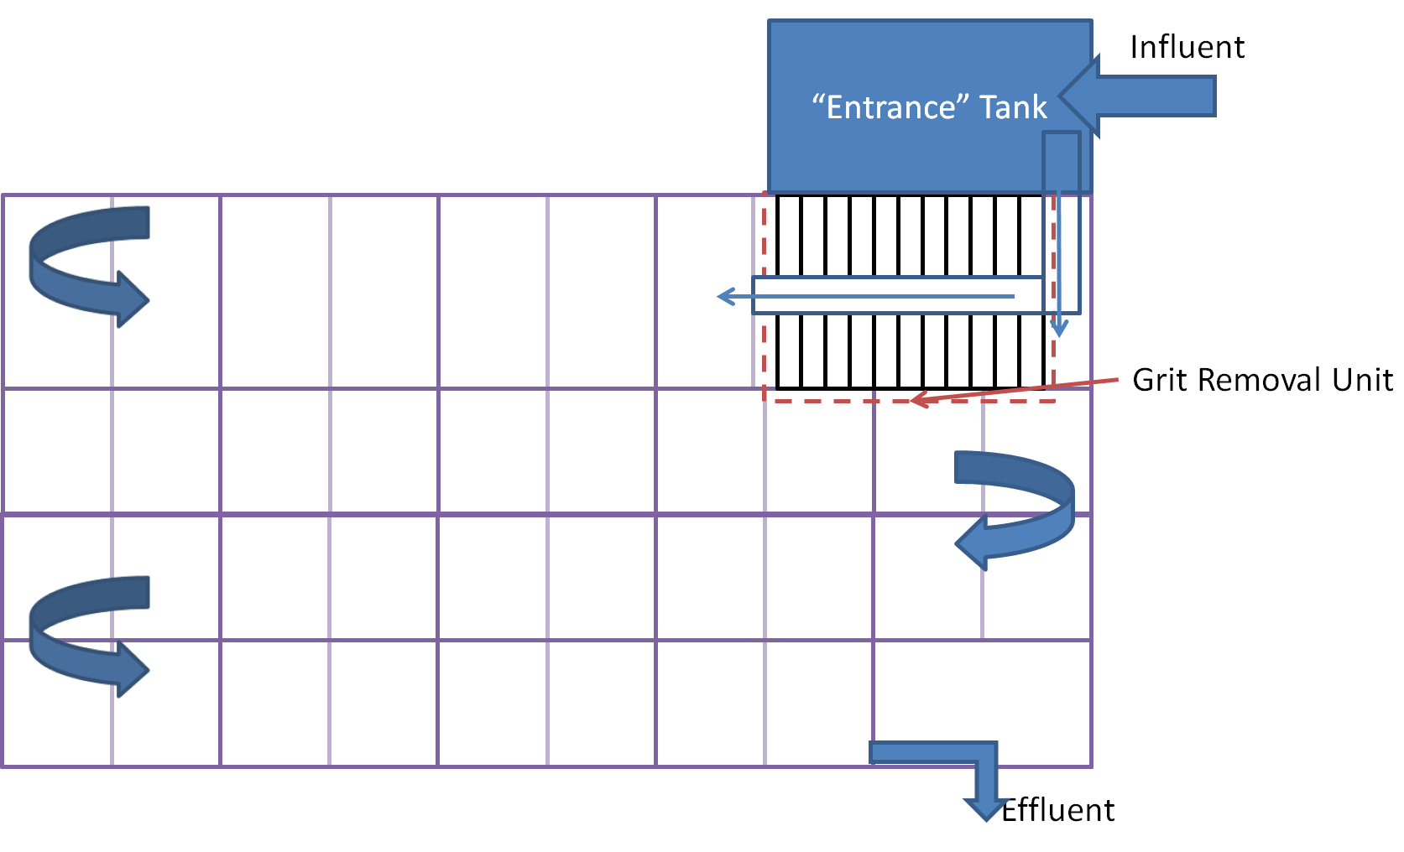
GRU in Flocculator:
Top View

Slide 12
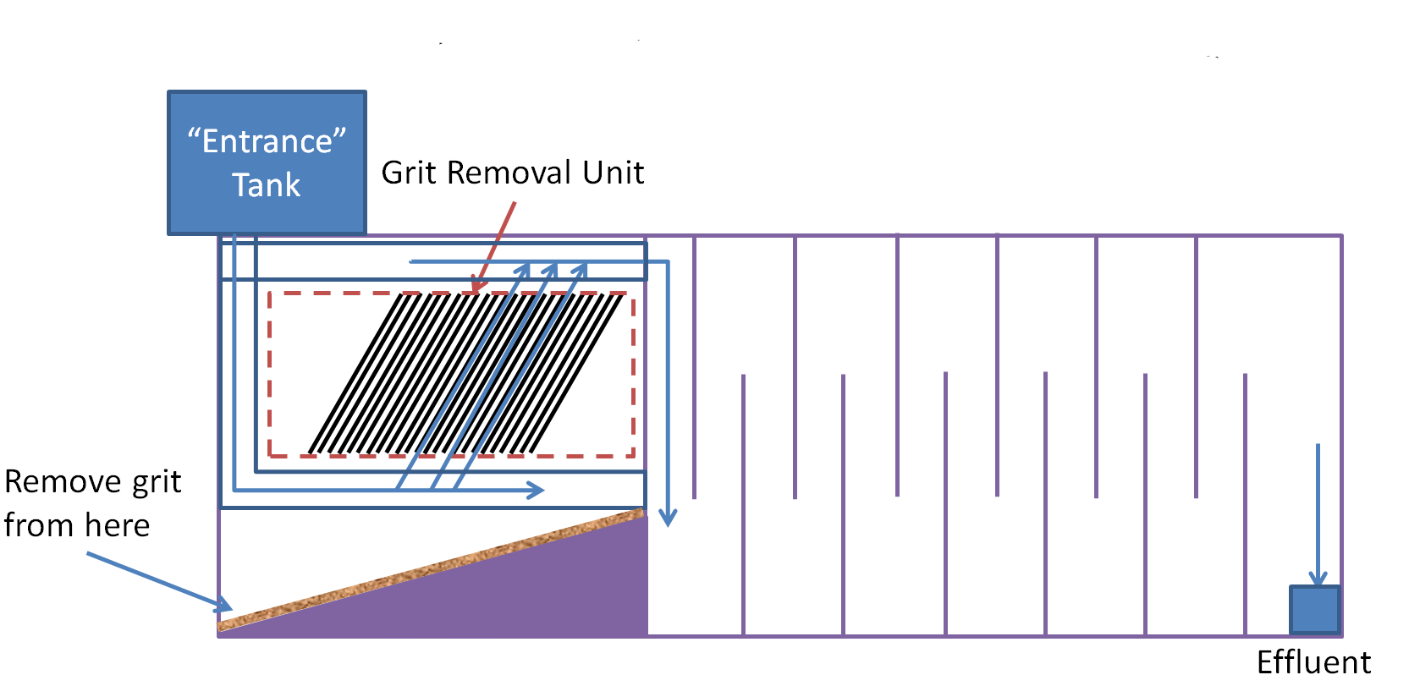
GRU in Flocculator:
Side View

Slide 13
Design #3:
GRU in Entrance Tank
An elevated, small sedimentation unit added inside the minimized entrance tank
(Note that all of our designs eliminate the need for a full-blown entrance tank. Only a small area needed for CDC and LFOM.)
Main constraints:
  achieving capture velocity
  feasibility of construction
  elevation issues with plant flow?

Slide 14
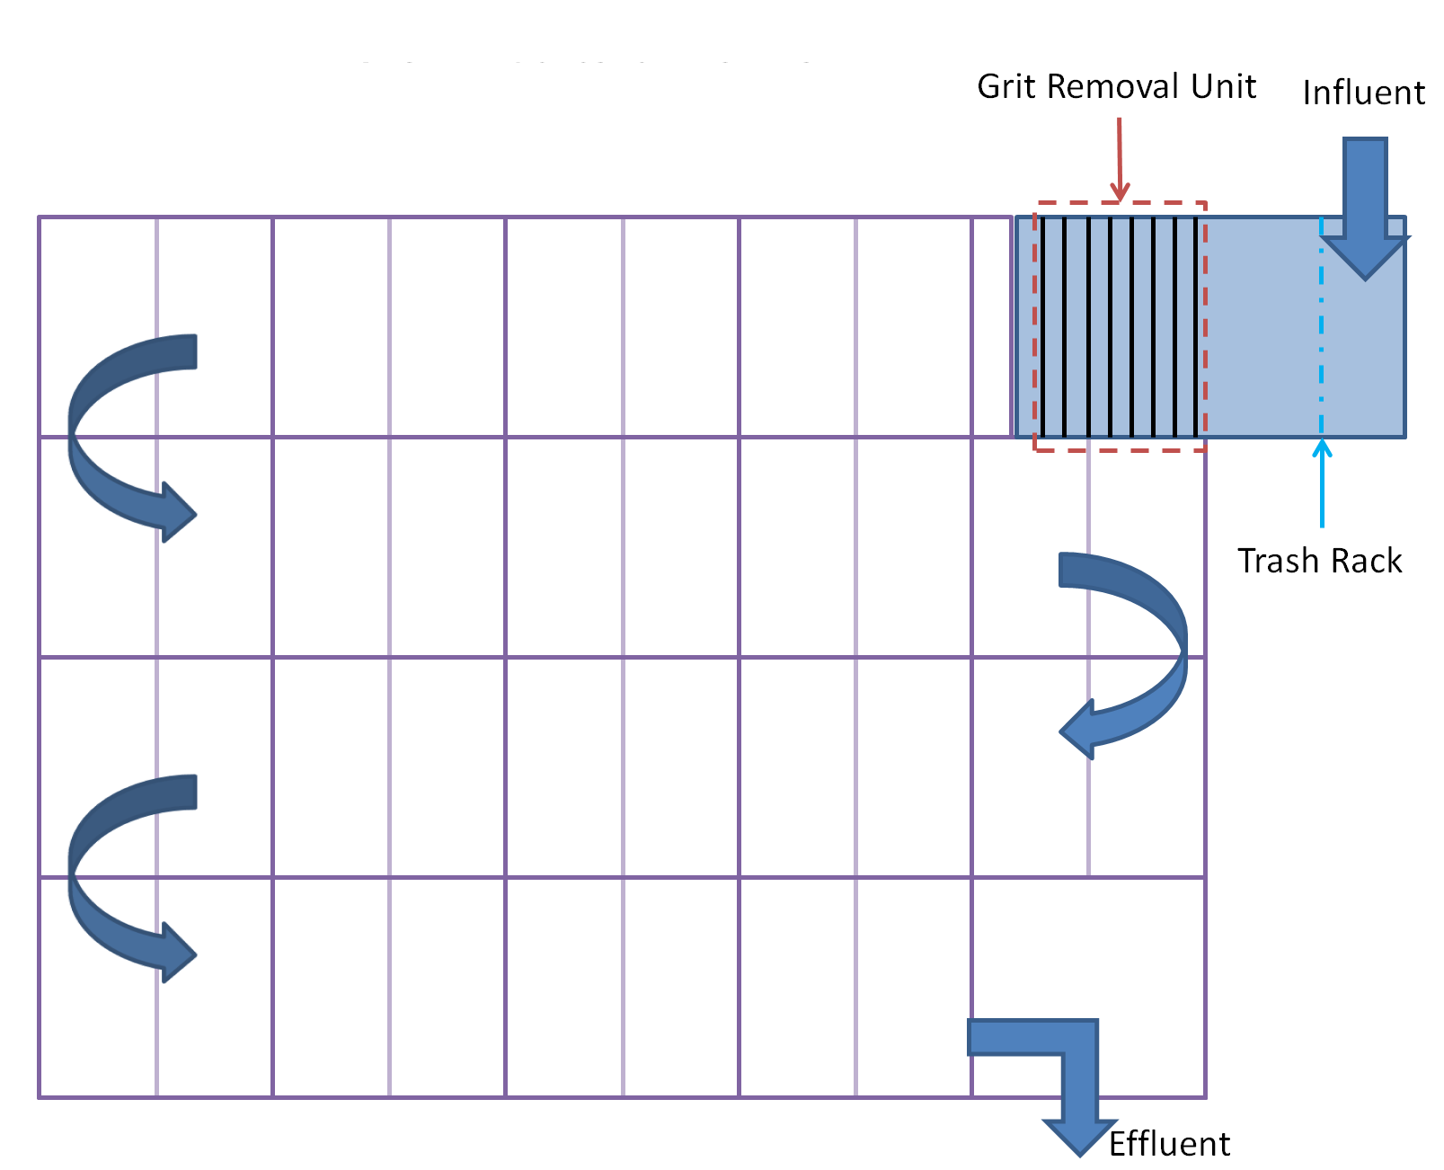
GRU in Entrance Tank:
Top View

Slide 15
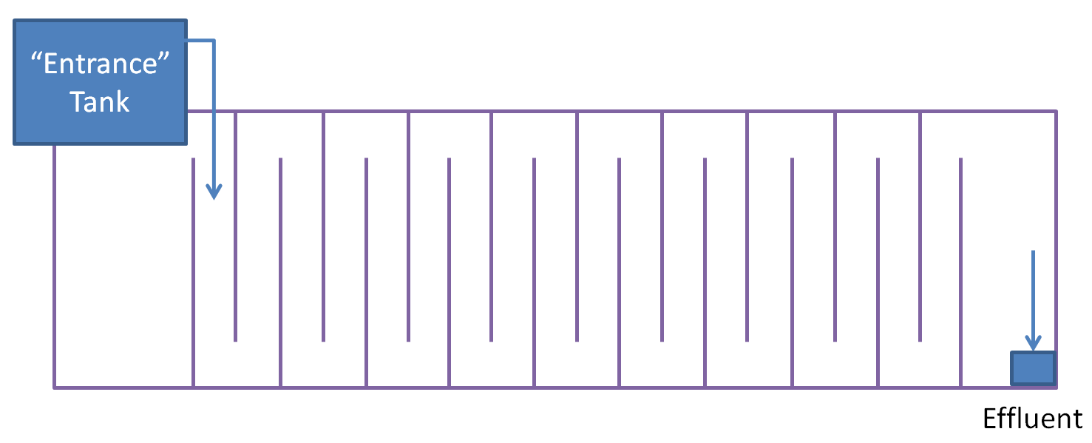
GRU in Entrance Tank:
Side View

Slide 16
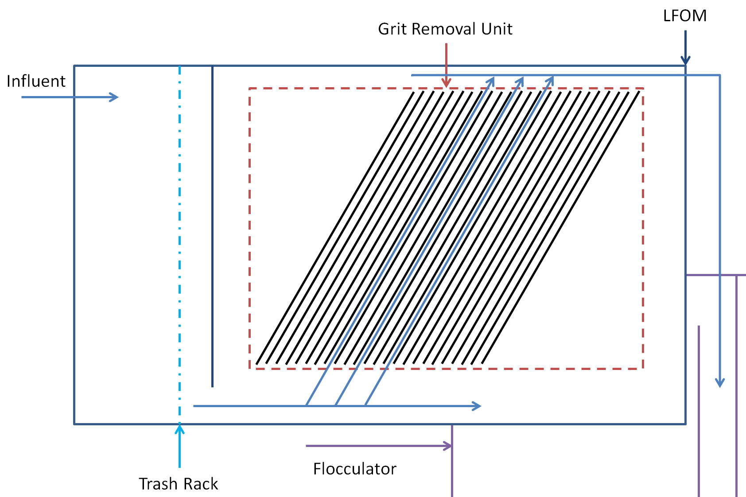
GRU in Entrance Tank:
Side View

Slide 17
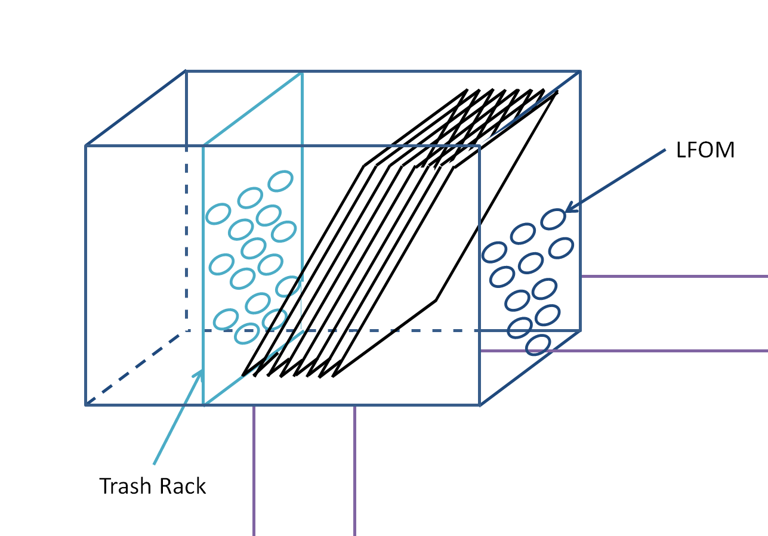
GRU in Entrance Tank:
Another View

Slide 18
Future Work
Finish evaluating design for GRF (Design #1)
Design hopper (grit removal) system for GRU in Flocculator (Design #2)
  Sloped floor to accumulate grit will impact the height of plates, which will make the unit longer, which will make the sloped floor higher…
Determine design for GRF in Entrance Tank (Design #3)

Slide 19

Questions?
Text
Picture/graph/table

