Slide 1
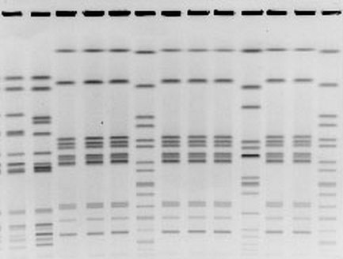
PFGE results
Lane 1 - Pepperoni sample 1
Lane 2 - Pepperoni sample 2
Lane 3 - Pepperoni slicer
Lane 4 - Pepperoni storage room
Lane 5 - Pepperoni sample 3
Lane 6 - Marker
Lane 7 - Jason Smith
Lane 8 - Silin Smith
Lane 9 - Al Smith
Lane 10 - Marker
Lane 11 - Tom Smith
Lane 12 - Deanna Smith
Lane 13 - Marker

