Slide 1
Design Team

Slide 2


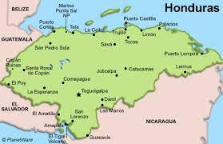

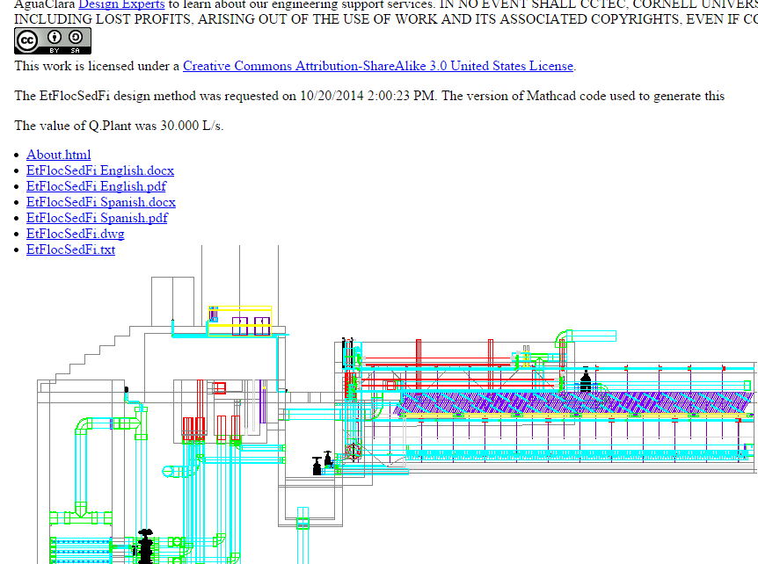
Design in general…
Research Teams
The Design Team

Slide 3

EASY TO MAKE CHANGES

Slide 4
Section Cuts
Anne Case and Corinne Kenwood, Design Subteam

Slide 5
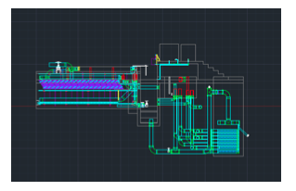
Purpose
Provide useful views of sections of plants for engineers in the field and other users worldwide
Notes:
slice of plant, no overlapping pipes

Slide 6
Challenges
Existing code called SectionPlanetoBlock, which requires user interaction with a dialog box, instead of SPTB, the dialog-free version written for AguaClara by AutoDESK
Necessary SPTB module could not be loaded into AutoCAD due to safety features
Plant as drawn by EtFlocSedFi is incorrectly oriented so section cuts are flipped

Slide 7
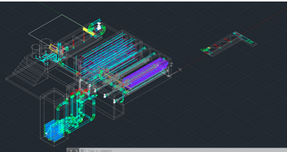
Flipped section cut of entrance tank obtained from incorrectly rotated plant

Slide 8
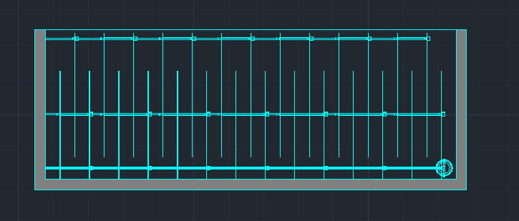
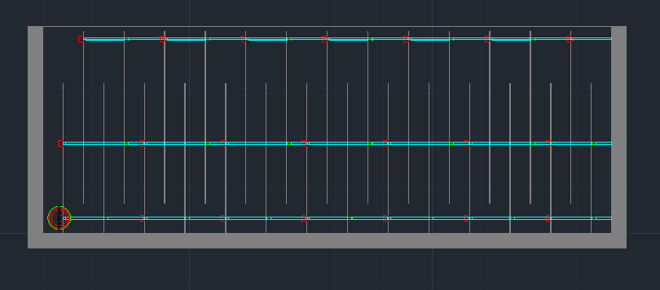
Progress
Implemented SPTB instead of SectionPlanetoBlock so that section cuts with layers preserved can be created without interaction with a dialog box

Slide 9
Progress (cont.)
Changed AutoCAD configuration to allow files downloaded from the internet to be netloaded
Corrected errors in the coordinates that define the respective section cuts

Slide 10
Future Work
Section cuts must be uploaded to server in appropriate layout view so they can be obtained by website users
    Text files for respective section cuts will be part of the EtFlocSedFi.txt file obtained for each flow rate but they will not all be displayed on the web page

Slide 11
Questions?

Slide 12
Entrance Tank Flow Control
Andrew Bales, Pei Liu

Slide 13
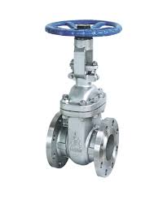
Why Flow Control?
Drain extremely turbid water that can’t be treated effectively
Reduce flow rate when excessive water is entering plant
Notes:
A flow control system is necessary in aguaclara plants for two reasons. The first is that if the water is too turbid for plant to treat effectively, it must be diverted into the drain channel.
The second is that if there is excessive raw water entering the plant it must also diverted into the drain channel to avoid damaging the plant.

Slide 14
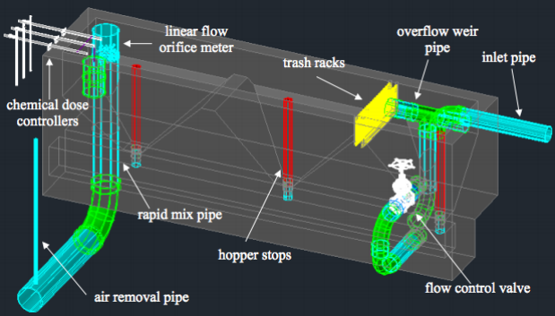
Current Design
Notes:
Current aguaclara flow control system uses a bronze gate valve, positioned on the side of the entrance tank, to control water flow into the drain channel.
The design requires water to flow into the tank prior to being diverted into the drain channel.

Slide 15
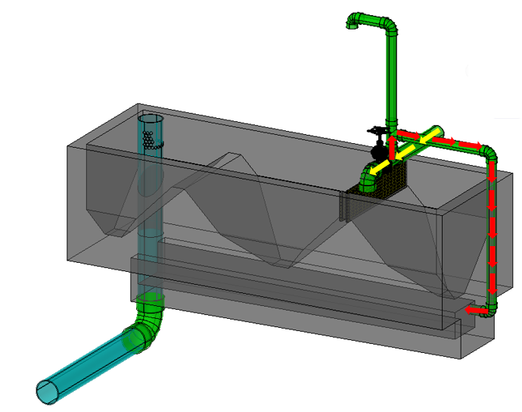
New Design Proposal
Water will follow path of yellow arrows when valve open
Water will follow path of red arrows when valve closed
One pipe as indicated by black arrow is open to atmosphere

Slide 16
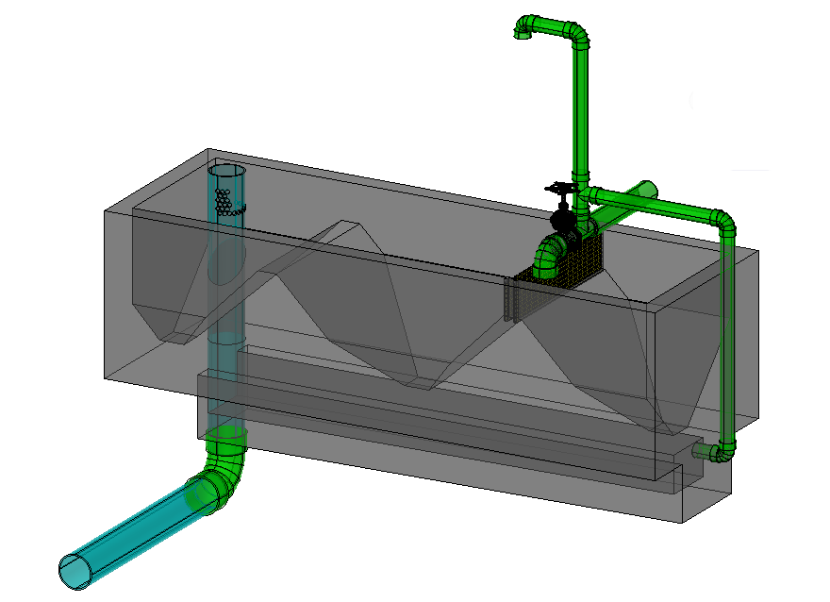
Benefits
In future plants, coagulant may be added in the entrance tank, so it would be favorable to dump excess water prior to entering tank
Simplifies construction of tank

Slide 17
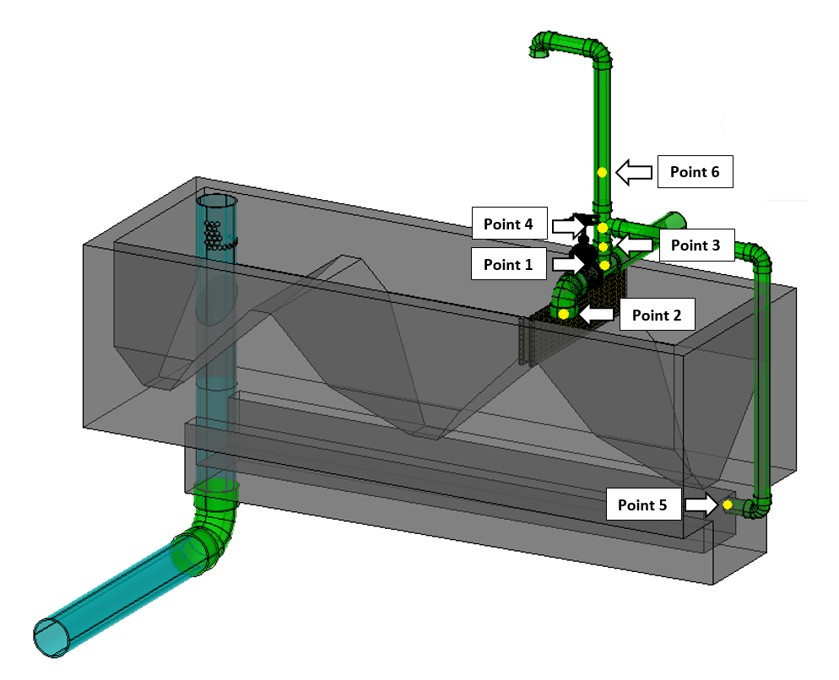
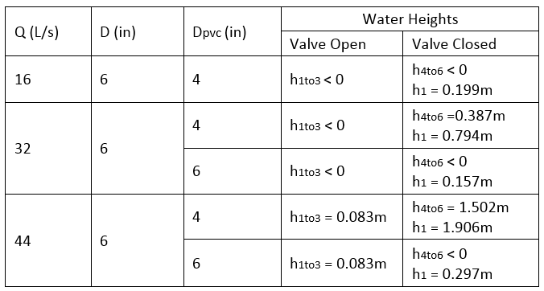
Design Constraint
Notes:
The new design requires some calculations to determine the appropriate PVC pipe dimensions. We calculated the height to which water will rise above point 1, when the gate valve was open,indicated as h1to3 in the table. We then calculated the height of the water above point 4, when the gate valve was closed, indicated as h4to6 in the table. We also calculated an instantaneous height to which water will rise immediately after the gate valve is closed, indicated as h1.
(We then repeated these calculations with a smaller PVC pipe diameter. We repeated these calculations for 3 different flow rates and the results are shown in the table. )
We calculated these heights for 3 different flowrate and entrance pipe diameter combinations. we tried different pvc pipe diameters.
The result are found to be
h1to3 is negligible compared to h4to6 h1 is ultimately not considered to be the design constraint. so h4to6 is the design constraint of PVC pipe dimension with this in mind, we were able to write the mathcad code.

Slide 18
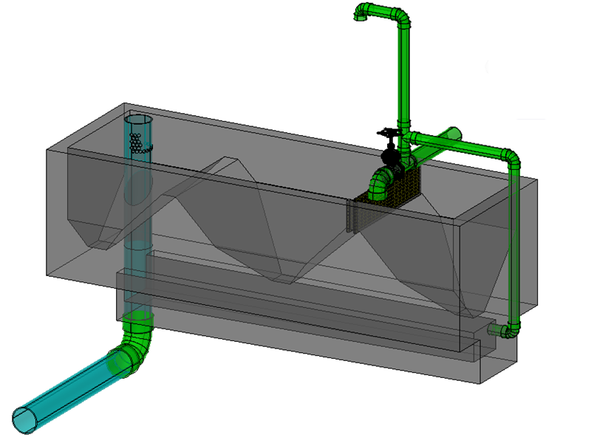
MathCAD Code
Pipe decrementing function
Minimum acceptable PVC pipe diameter function
  Requires entrance pipe diameter
AutoCAD script

Slide 19

Future Work
Reducer fitting function
Tee reducer function
Top PVC pipe orientation
Contact AguaClara engineers to evaluate design

Slide 20
Sedimentation Tank
Serena Takada
Design Subteam

Slide 21
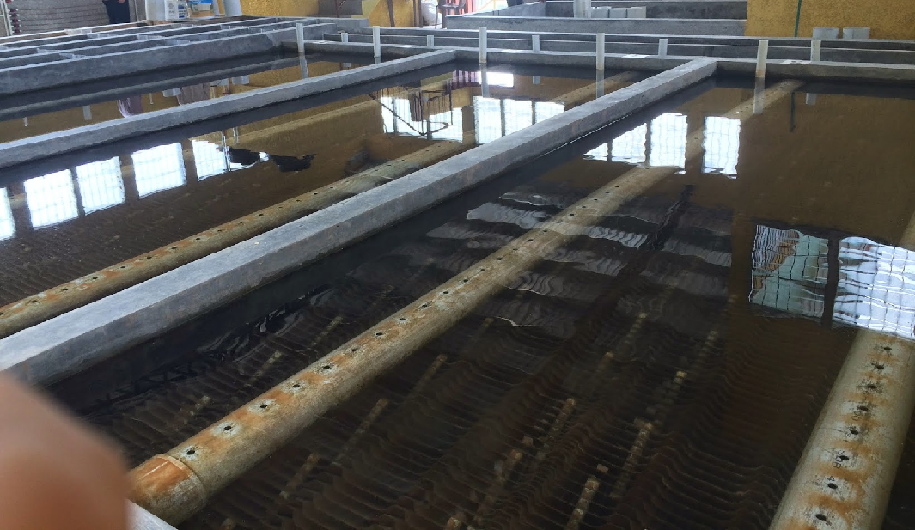
Sedimentation Tank

Slide 22

Accomplishments
Design Updates:
  Inlet Channel Floor
  Outlet to Filter
  Drain System in Exit Channel
Organize MathCAD File

Slide 23
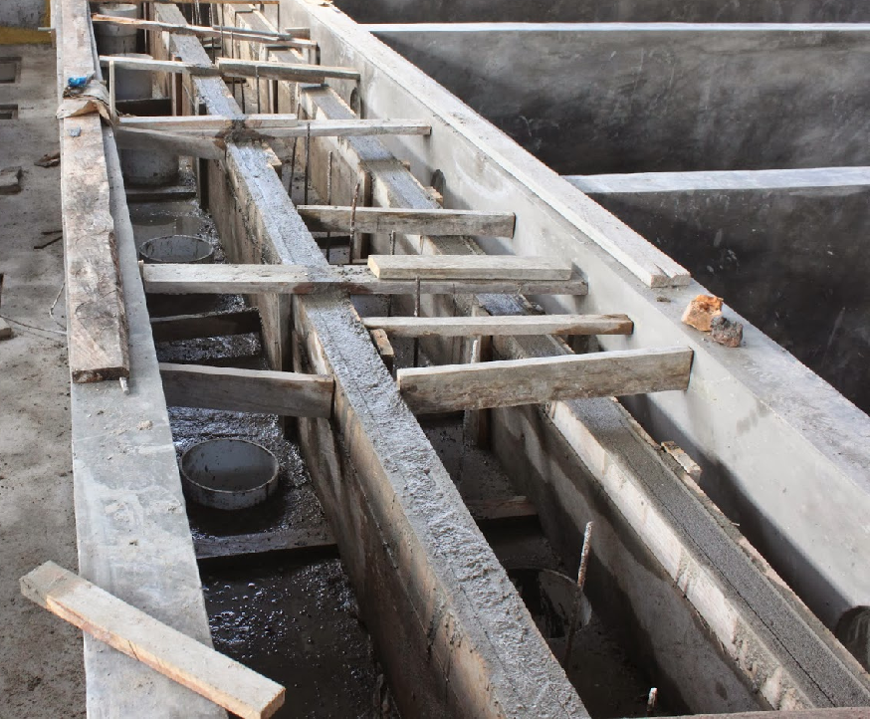
Inlet Channel Floor

Slide 24
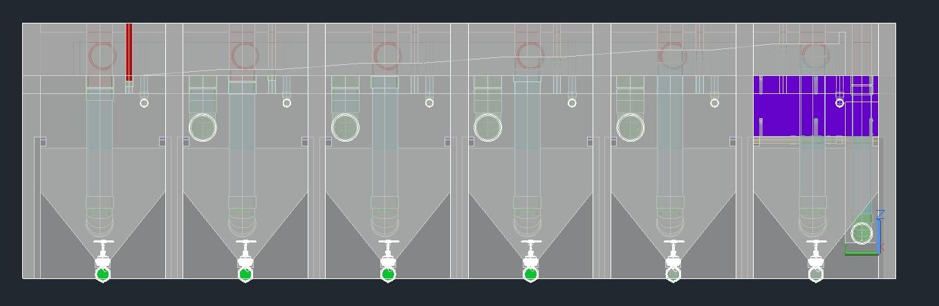
Angled Inlet Floor

Slide 25
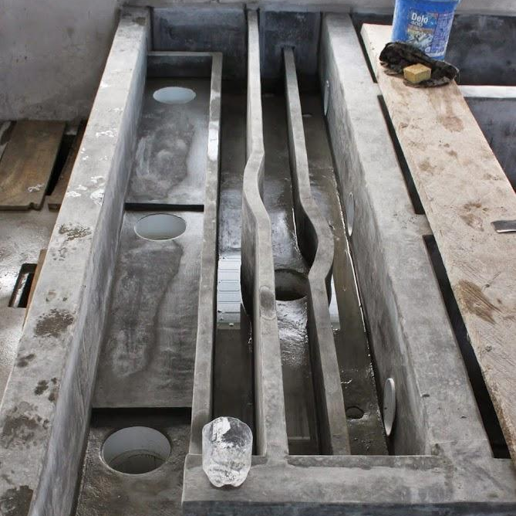
Outlet to Filter

Slide 26
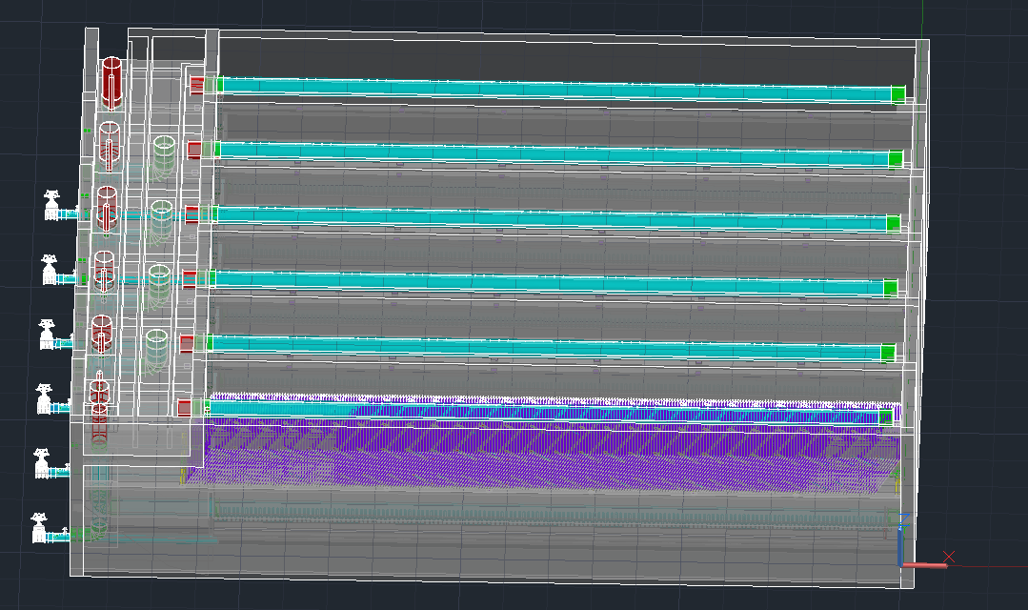
Outlet to Filter

Slide 27
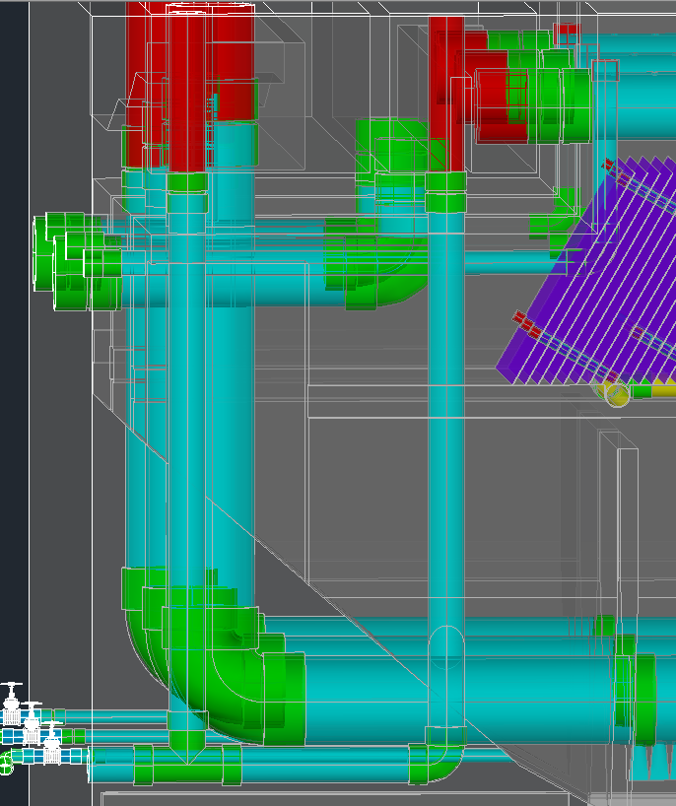
Exit Channel Drain System

Slide 28
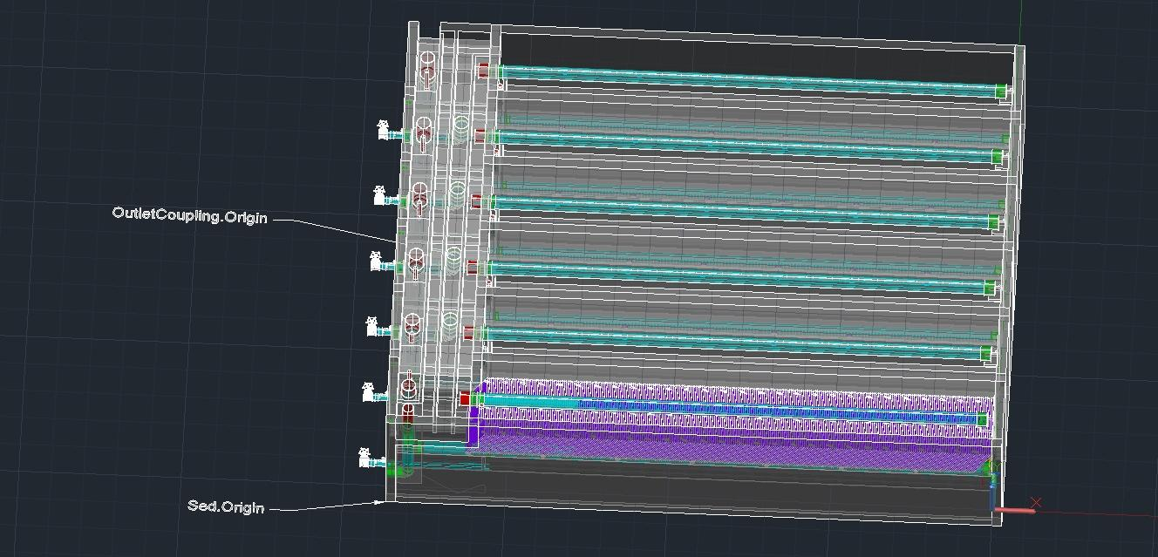
Origin Definition

Slide 29



Sedimentation
Future Work/Questions?

Slide 30
Materials List
Cinthia Kim, Serena Takada & Minty Nunez

Slide 31
Task & Mission
What do we do?
Extract and compile all the hydraulic components into a materials list for the the engineers designing and building AguaClara plants. Also for prospective investors to see what material is needed in the construction.

Slide 32
Materials Extraction Methods
Extract the materials from
the design MathCad files
the AutoCAD drawings
Notes:
There are two materials extraction methods: either extracting the materials from the design MathCad files or the AutoCAD drawings.

Slide 33
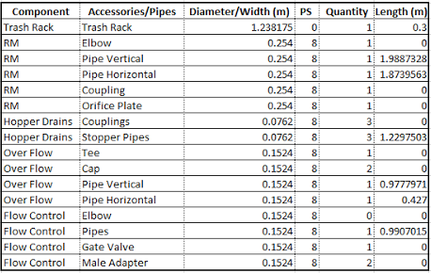
Extraction from MathCad Files
Extract the materials from the MathCad drawing scripts and functions.
Create extraction matrices inside the files.
Export the matrices to excel files.
Challenges!
The current AguaClara design engine cannot create a materials list excel file from the matrices.

Slide 34
Extraction from
AutoCAD Drawing
Accessories are drawn as objects in AutoCAD.
Objects cannot have properties:
-name, size or any specification.
Use blocks instead of objects.
Attributes can be added to blocks.
Blocks, it is!

Slide 35
  Block, Attribute &
  Copy Functions
Define the objects as blocks.
Assign attributes.
-Plant Component, name, diameter,
length and specification
Replicate the block.
  -Copy the block retaining the same attributes.
  -Insert the block into a new location.
  -etc.
Notes:
The objects must first be blocked immediately after they are drawn to ensure the correct selection of the desired object. Then attributes are assigned with the properties we want. After we complete blocking and attributing a specific object, if we want multiple copies of the same object, we replicate its block and insert into a new position. And we have the etcetera here because the copy function we coded could be extended to include scaling, which would significantly reduce the amount of necessary blocked accessories such as pipes, because the scaling would automatically update the length, retain its other attributes, and be separately counted as a different pipe.

Slide 36
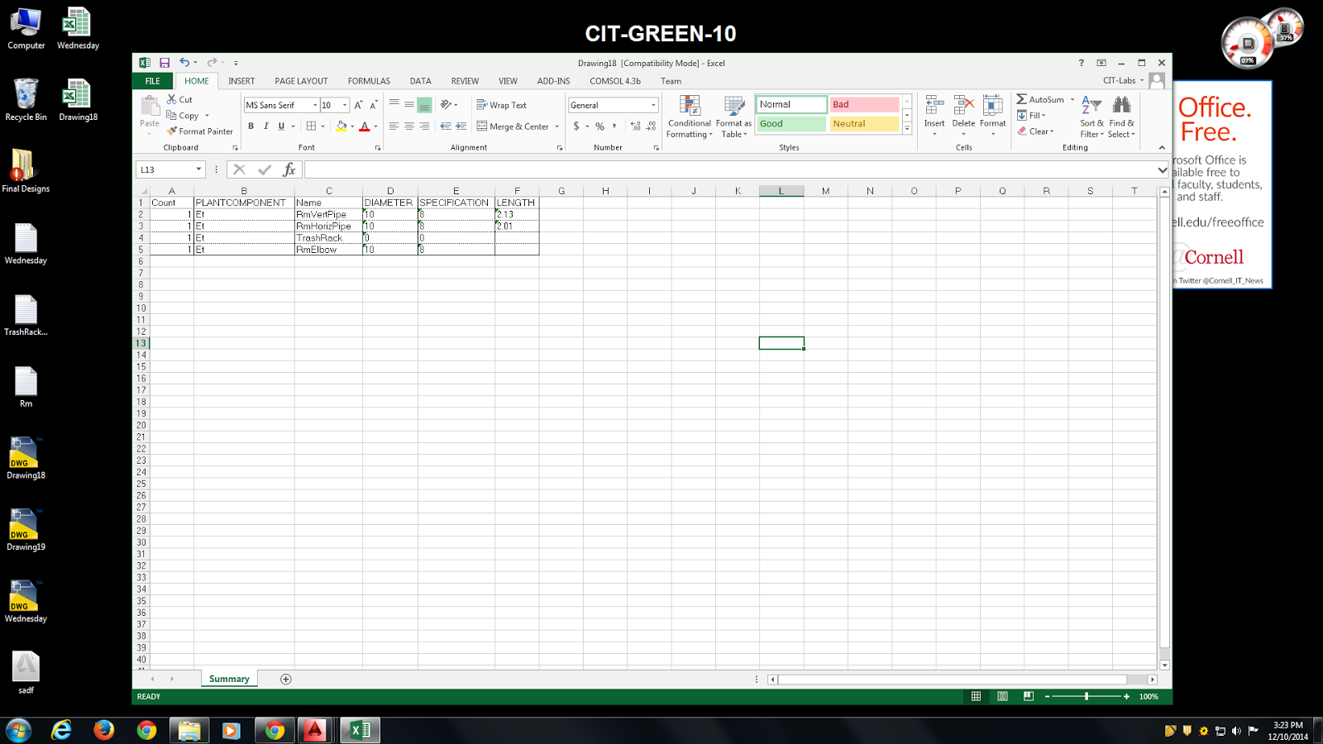
Data Extraction
Use AutoCad Command:
Dataextraction
Notes:
For data extraction in AutoCAD, we included instructions in our report on how to manually use the Dataextraction command. This part was deliberately left as a set of instructions, because essentially the command would only need to be used once as the final step after a complete water treatment plant is drawn, and most importantly, the process of Dataextraction opens dialog boxes and requires cursor clicks. The dialog boxes and the cursor clicks disrupt the command line, destroying the rest of the code written to finalize the data extraction. Anyways, if you follow the instructions, you will have access to a materials list table looking something like the one shown here. I wish we could have more time to work on this issue, but...

Slide 37

Future Work

Slide 38
Future Work
Add the blocking and attributing functions to all the accessories and pipes.
Improve the replication method of the accessories and pipes.
Produce a Materials List file with the Drawing, About, and Text file as shown on the AguaClara website.
Notes:
Putting all jokes aside, for the future, the materials list design team members should attempt to add the blocking and attributing functions to all the accessories and pipes in the design files. Phew, good luck with that!
Also, they should ameliorate how the accessories and pipes are replication, perhaps include a scaling function to use the same block after changing a particular attribute, instead of having to create new blocks every time the dimensions are different.
Lastly, we suggest finding ways to include the materials list to the AguaClara website so that anyone can have easy-access.
Thank you!

Slide 39
Materials List
Questions?

