Slide 1
Public Relations
Erika Axe and Isabella Luan Yang
Notes:
Isabella

Slide 2
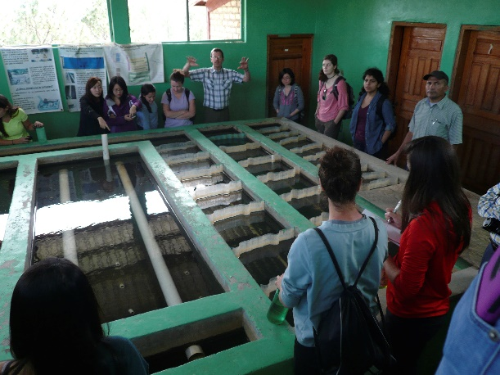
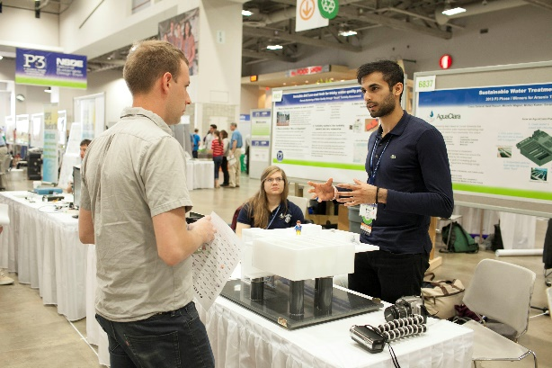
What We Do
Spreading the word: AguaClara!
Try to get new members for AguaClara
Inter-subteam Communication and Events
AguaClara Item Sales
General System Improvements
Notes:
Erika:
The work that AguaClara is doing is not only impressive, but is making a genuine difference in the world. There should be recognition for that! Make our work well known to people. We want to make our presence on campus KNOWN
How did you hear about AguaClara? Why did you join AguaClara? When? For how long have you been on the team? Knowing this would help us to best understand where our new members are coming from
One of the other things Public Relations hopes to do is to connect the subteams together and encourage intercommunication on the team. With nearly 60 people, it’s hard to communicate with everyone, but we’d like to provide those opportunities!
We make sure there’s enough AguaClara swag to go around [do NOT say swag during the presentation], whether it’s t-shirts or quarterzips or stickers, we like to see everyone showing their team pride around campus! Have an idea? Make sure to let us know!
We know everyone on the team is very busy with the research and designing that they do, part of our job is to help make that easier for people. We try to look into ways to make the website easier to navigate and understand, we try to create some kind of system for funds, we try to make the little things in the team go more smoothly

Slide 3
Semester Accomplishments
Facebook Updates and Twitter Updates
Subteam spotlight
Updated Team Media
New and old Merchandise for AguaClara
Expanding alumni relations
Posters for Hollister/Campus Buildings
Plans for Public Relations Budgeting
AguaClara presentations and event representation
Notes:
Isabella

Slide 4
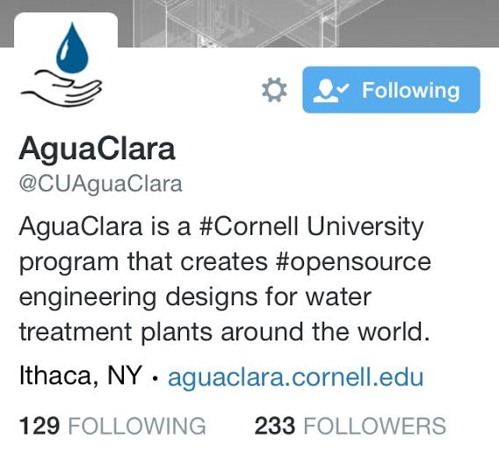
What We’ve Done…
To Spread the Word
Create posters to hang around and virtual posters for Hollister and the Engineering Quad
Contact magazines and newspapers to get articles written about our work
Facebook and Twitter Updates
Notes:
Erika

Slide 5
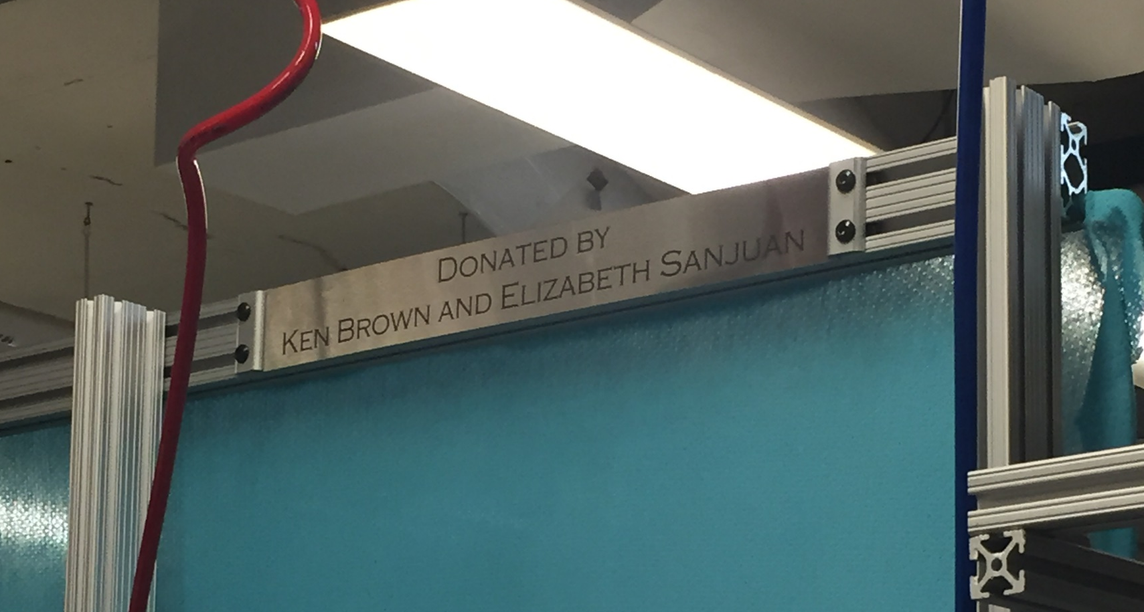
What We’ve Done…
With Alumni Relations
Alumni Newsletter
Donor Plaques for Stations in the lab
Notes:
Isabella

Slide 6
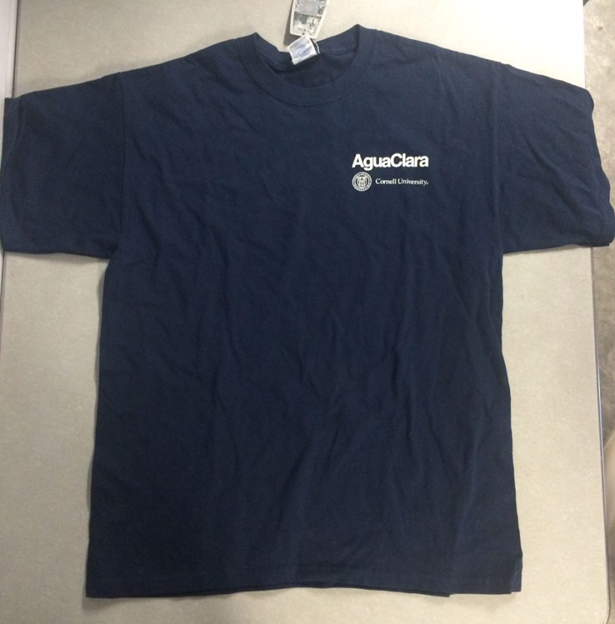
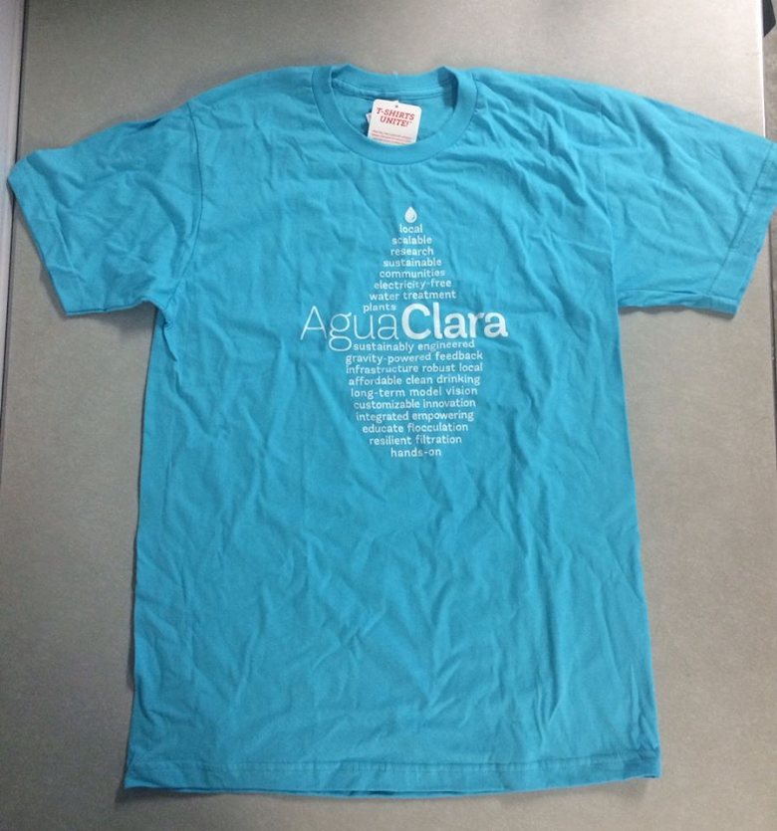


What We’ve Done…
With Team Merchandise
Merchandise:
Completed the sale of old AguaClara merchandise from previous years
Sale of new quarterzip designs
Create new designs for polo shirts and stickers for future semesters
Notes:
Erika

Slide 7
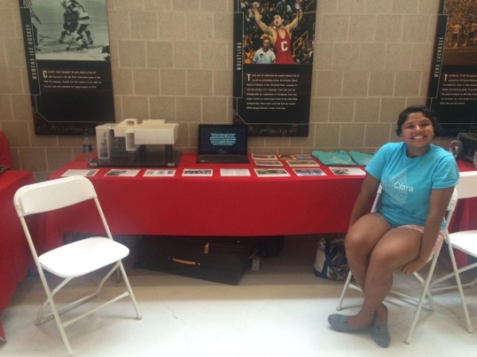
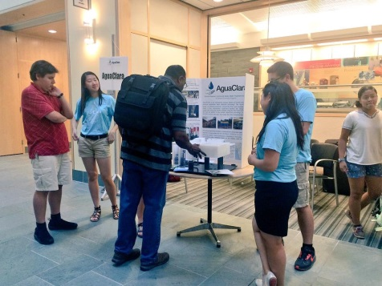
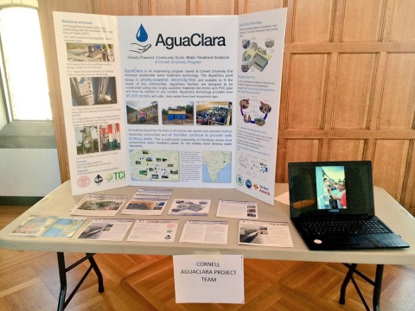
What We’ve Done…
With Events and Recruiting
1050 Presentation
Reverse Career Fair
GHSC Club Fair
Homecoming Showcase
Sesquicentennial Event
Einaudi Center Annual Reception
Notes:
Isabella

Slide 8
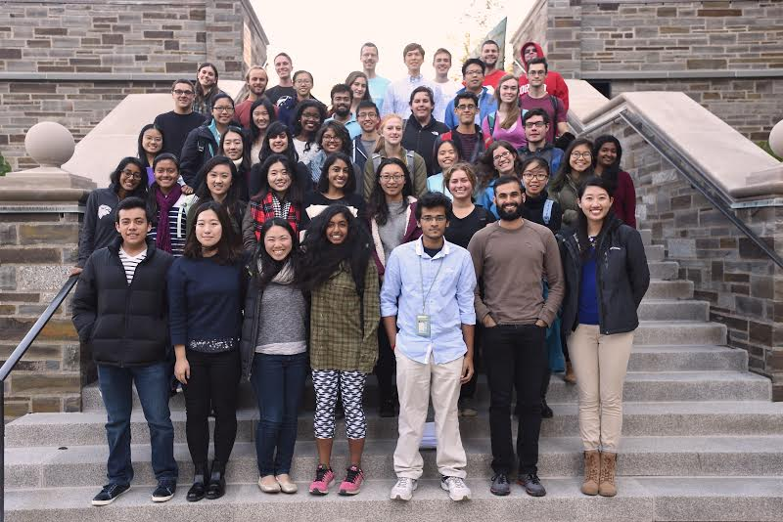
What We’ve Done…
With The Subteam Spotlights
Pictures of the Subteams
Blurbs from everyone
Posting to Facebook and Newsletter
Notes:
Erika

Slide 9

Public Relations…
Looking Forward
We would love to hear any ideas from people on the team to work in the future!
Please contact either Erika (ena7@cornell.edu) or Isabella (ly89@cornell.edu)
Any Questions?
Notes:
Isabella

