Slide 1
Village Supply System-Pump Design Subteam
Qingjing Gong
Anqi Wang Erika Axe
12/14/2014

Slide 2
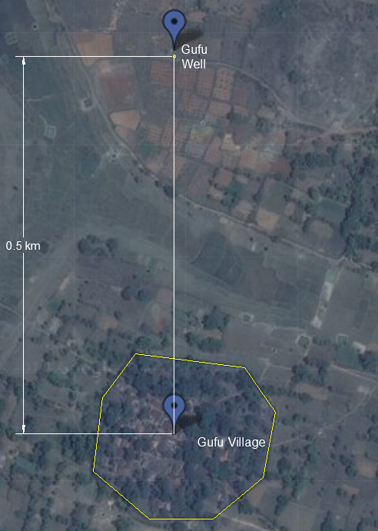
Overview of Symposium
Tasks
Basic Info for Gufu Village
Spring 2014 Design
MathCAD Code
Background Research
Evaluate the two different designs
Notes:
Tasks: Research pumps/pressure requirements, Research parameters and constraints, Research pump curves, making solar panel angles manually adjustable, Evaluate the two options
Gufu Village: -per capita demand is 100 liters per day; -village population of 500 people; -5 people per household.
Pump Availability: Power: 0.33 HP to 10 HP (or 0.25 kW to 4 kW), Pressure capacity: 0.65 bar to 160 bar, Flow rate capacity:120 L/ min to 350 L/min, Pumps are chosen in India through a detailed process, without much experimentation

Slide 3
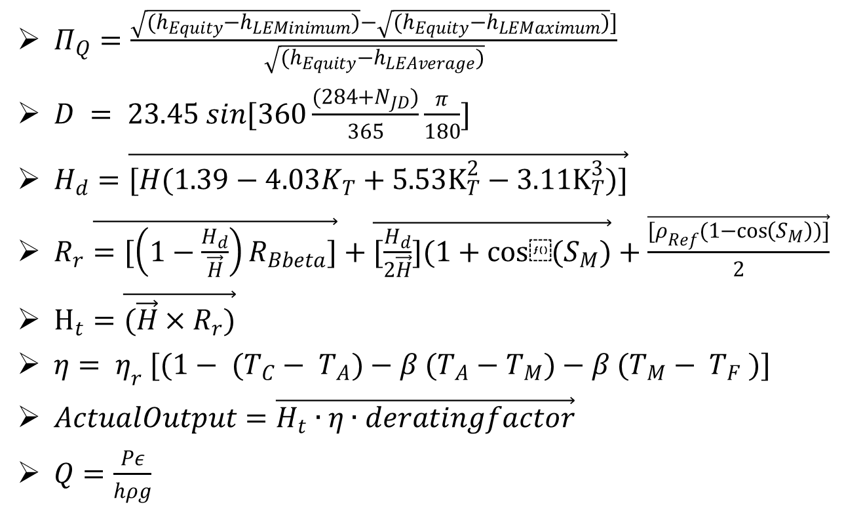
Spring 2014 Design
$Π_{Q}=\frac{\sqrt{(h_{Equity}−h_{LEMinimum})}−\sqrt{(h_{Equity}−h_{LEMaximum})}]}{\sqrt{(h_{Equity}−h_{LEAverage})}}$
$D = 23.45 sin[360\frac{(284+N_{JD})}{365}\frac{π}{180}]$
$H_{d}=\vec{[H(1.39−4.03K_{T}+5.53K_{T}^{2}−3.11K_{T}^{3})]}$
$R_{r}\vec{=[\left(1−\frac{H_{d}}{\vec{H}}\right)R_{Bbeta}]}+\vec{[\frac{H_{d}}{2\vec{H}}](1+cos⁡(S_{M})}+\frac{\vec{[ρ_{Ref}(1−\cos\left(S_{M}\right))]}}{2}$
$H_{t}=\vec{(\vec{H}×R_{r})}$
$η= η_{r} [(1− (T_{C}− T_{A})−β (T_{A}−T_{M})−β (T_{M}− T_{F} )]$
$ActualOutput=\vec{H_{t}∙η∙deratingfactor}$
$Q=\frac{Pε}{hρg}$
Notes:
Qingjing: Explain equation we will use.

Slide 4

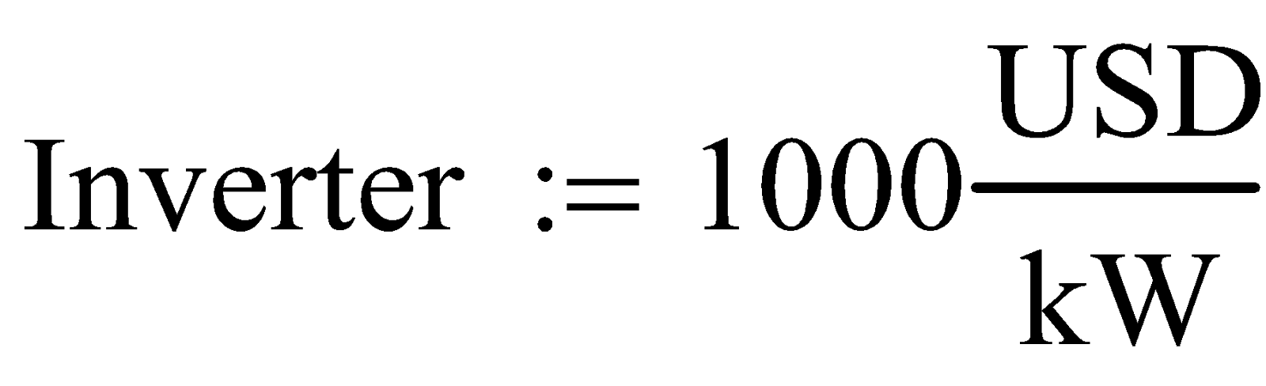


Mathcad Code Review
Power (pump has 45% of the efficiency)
Costs
Notes:
Anqi: To find the power needed for the plant, the first step is to calculate the elevation changes.

Slide 5
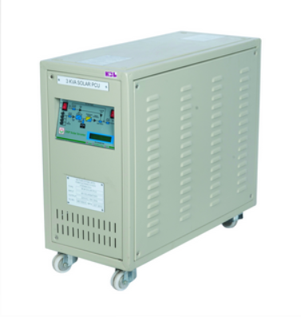
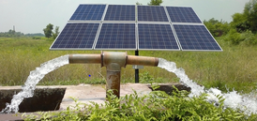
Evaluating Solar Panels
Solar Panel
Charge Controller
Notes:
Qingjing: According to Maysoon, the solar pump is paired with HBL panels in Gufu village. HBL has a wide range of solar panels.
Add an introduction of charge controller.

Slide 6
Evaluating the Two Different Pump Designs

Slide 7
New Calculations

Slide 8
Conclusion: Final Decision
What have we done?
  Background Research
What needs to do next?
  Evaluating new designs and plans
Notes:
Erika: What have we done: Laid the framework of our background research and all the factors we will need to consider as a group in order to make improvements and evaluate different designs. What to do next? Work on our different ideas for one pump versus two as well as optimization based on monsoon versus dry season as depicted by the detailed task list.

Slide 9
From PV/Pumps to the Distribution Team

Slide 10
References
Kelterborn, D., Levine, S., Parisi, N., & Whiteheart, R. (2014, May 16). Village Source to Environment. Retrieved September 15, 2014, from https://confluence.cornell.edu/
Solar Products. (n.d.). Retrieved October 10, 2014, from http://www.hbl.in/home
Pumps in Parallel or Serial Connection (n,d) Retrieved November 5, 2014, from http://www.engineeringtoolbox.com/pumps-parallel-serial-d_636.html
Basics of Solar PV System Design (2013, February 21) Retrieved November 5, 2014, from https://livingonsolarpower.wordpress.com/2013/02/21/basics-of-solar-pv-system-design/
Van Peltm, R., Weiner, C., and Waskom, R. Solar-powered Groundwater Pumping Systems. Retrieved November 5, 2014, from http://www.ext.colostate.edu/pubs/natres/06705.html
Than, K. "New Technology Could Boost Solar Cell Efficiency By 30 Percent." Llancaster. 21 July 2014. Web. 20 Nov. 2014. <http://www.insidescience.org/content/new-technology-could-boost-solar- cell-efficiency-30-percent/1816>.
"Calculate the Cost of Photovoltaic Systems (Home Solar Electricity)." Simple PV Project. Web. 21 Nov. 2014. <http://www.nmsea.org/Curriculum/7_12/Cost/calculate_solar_cost.htm>.
Lim, Yun Seng, Chin Kim, Shin Yiing Kee, Hong Tat Ewe, Abd Rahman Faidz. "Design and evaluation of passive concentrator and reflector systems for bifacial solar panel on a highly cloudy region – A case study in Malaysia." Renewable Energy 63.March (2014): n. pag. EBSCO Host. Web. 12 Nov. 2014.

