Slide 1
StaRS Backwash
Vicki Chou
Nick Farino
Chenhao Qi
Rui Zhang

Slide 2
Overview
Introduction
Semester Goals
Sand Theory
Experimental Apparatus Design
Experimentation

Slide 3
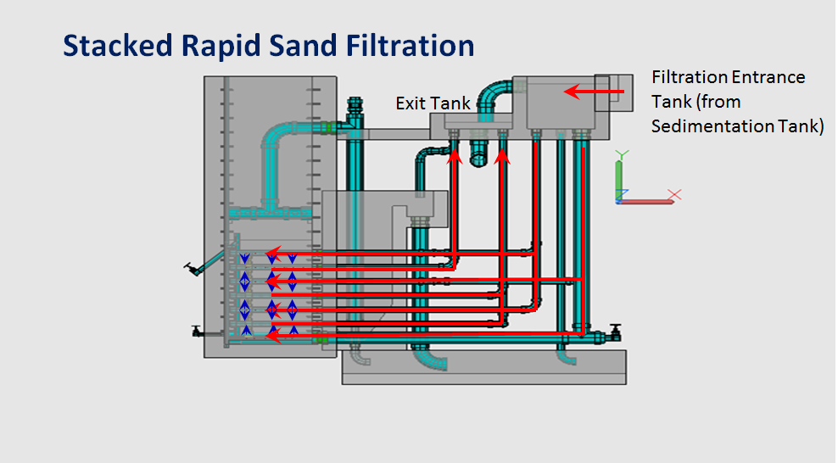
Background

Slide 4
Introduction
Filtration in the plants
Standard backwash
  Air scour
Importance of backwash

Slide 5
Goals
The goal of StaRS Backwash is to determine the sand grain sizes and distribution for the most efficient and effective backwash in the stacked rapid sand filters.
The proper amount of fluidization for efficient backwash must first be determined.
Different sand grain sizes will be tested in a small scale sand filter for proper fluidization and efficient backwashing.

Slide 6
Literature Review
Sand Size Ratio (Duris, et al., 2013)
Minimum Fluidization Velocities of Multi-component Solid Mixtures (Asif, 2013)
Measurement of size and size distribution of particles by fluidization (Obata, Watanabe, Endo, 1982)
Air Dynamics Through Filter Media During Air Scour (Hewitt, Amirtharajah, 1984)

Slide 7
Semester Timeline
Sand Theory
Fabrication/ Troubleshooting
Experimentation
Experimental Apparatus Design

Slide 8
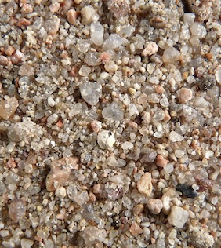
Fluidization Needs
Sand Necessities
  All sand particles must fluidize
  Sand must not segregate after fluidization
Fluidization Necessities
  Flocs must be separated from sand during fluidization

Slide 9
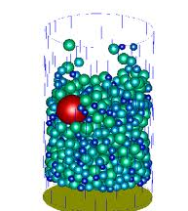
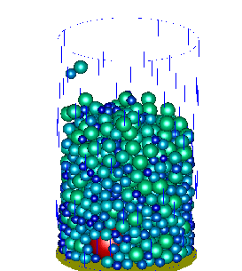
Sand Segregation
Fluidization
http://www.comphys.ethz.ch/hans/sand.html

Slide 10
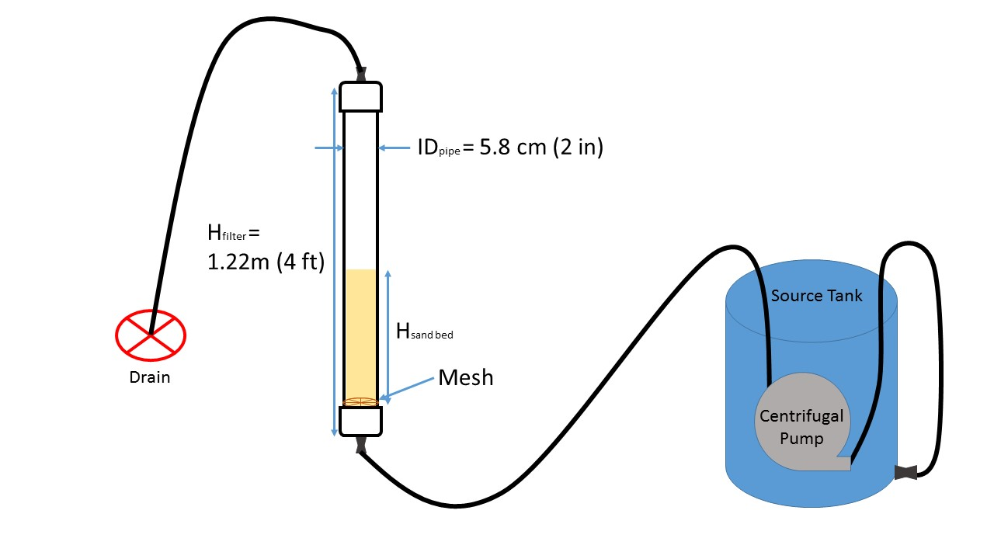
Experimental Apparatus

Slide 11
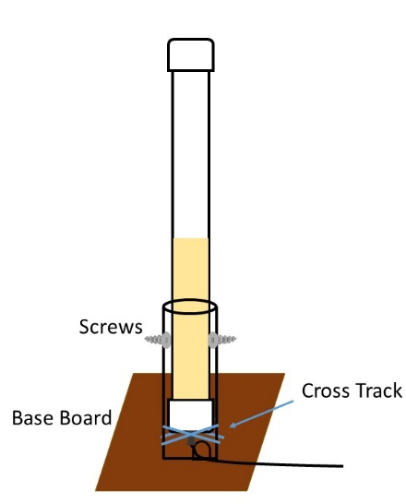
Base Support Proposal
Any other suggestions?
  How to keep aligned vertically
  Needs to be able to support the weight
  Hanging?
  Against a wall?

Slide 12
Experimentation
Filtration Experimentation
Begin running experiments with different grain sizes and ratios
The No. 30 Sieve and No. 40 Sieve: Ratio = 1.42
The No. 40 Sieve and No. 50 Sieve: Ratio = 1.41
Draw conclusions on what size sand grains are the most effective and efficient during backwash

Slide 13
Experimentation
Backwash Velocity Experimentation
Test different backwash velocities for effectiveness
Current backwash velocity of 11 mm/s may not be the best velocity so other velocities should be explored and tested

Slide 14
Experimentation
Short Sloped Baffles Experimentation
Add short sloped baffles to the experimental apparatus between the sand bed and the backwash effluent waste pipe
Test backwashing for the effectiveness of the baffles

Slide 15

Questions?

