Slide 1
StaRS Backwash
Vicki Chou
Nick Farino
Chenhao Qi
Rui Zhang

Slide 2
Outline
Introduction/ Background
Experiments
Results
Conclusions
Problems Faced
Future Work

Slide 3
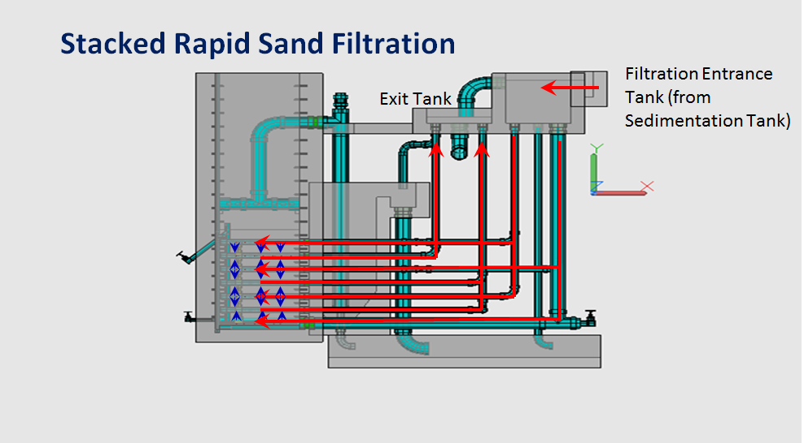
Introduction
Filtration and backwash in the plants
Problems of backwash
Standard backwash
  Air scour
  other ways?

Slide 4
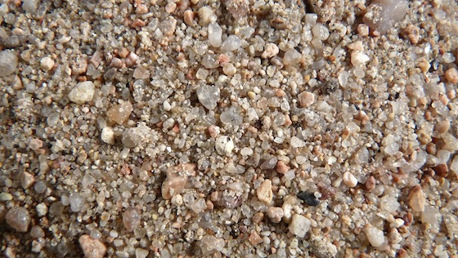
Fluidization Needs
Sand Necessities
  All sand particles must fluidize
  Sand must not segregate after fluidization
Fluidization Necessities
  Flocs must be separated from sand during fluidization

Slide 5
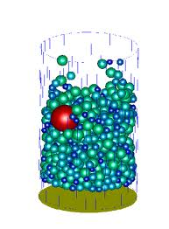
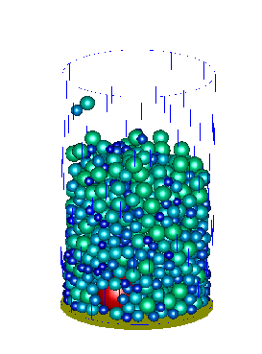
Sand Segregation
Sand size ratio < 1.5
Expansion ratio = 1.3
Fluidization
http://www.comphys.ethz.ch/hans/sand.html

Slide 6
Goal
The goal of StaRS Backwash is to determine the sand grain sizes and distribution for the most efficient and effective backwash in the stacked rapid sand filters.
  The proper fluidization velocity for efficient backwash must first be determined.
  Different sand grain sizes will be tested in a small scale sand filter for proper fluidization and efficient backwashing.

Slide 7
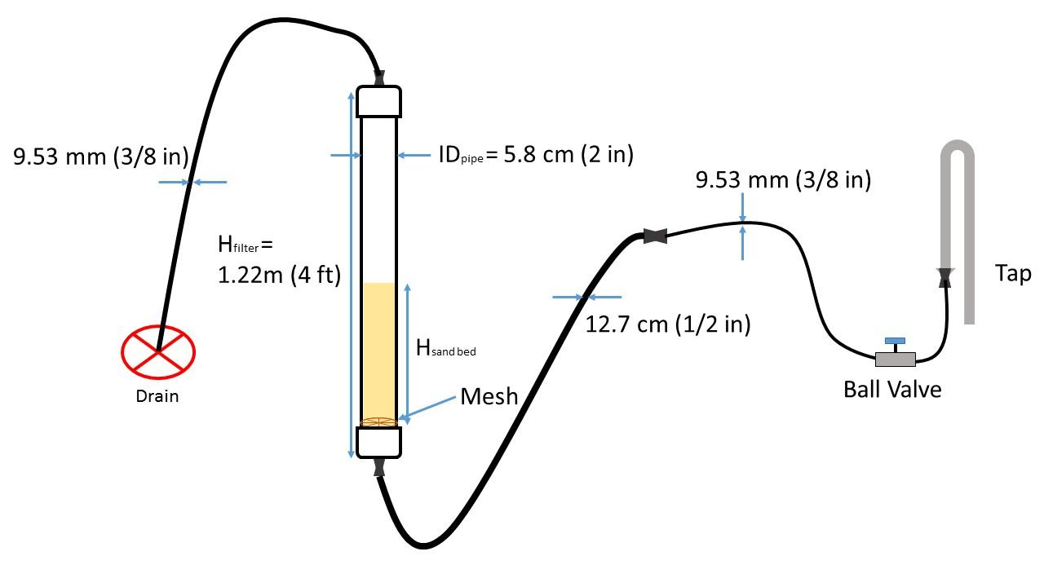
Experimental Apparatus

Slide 8
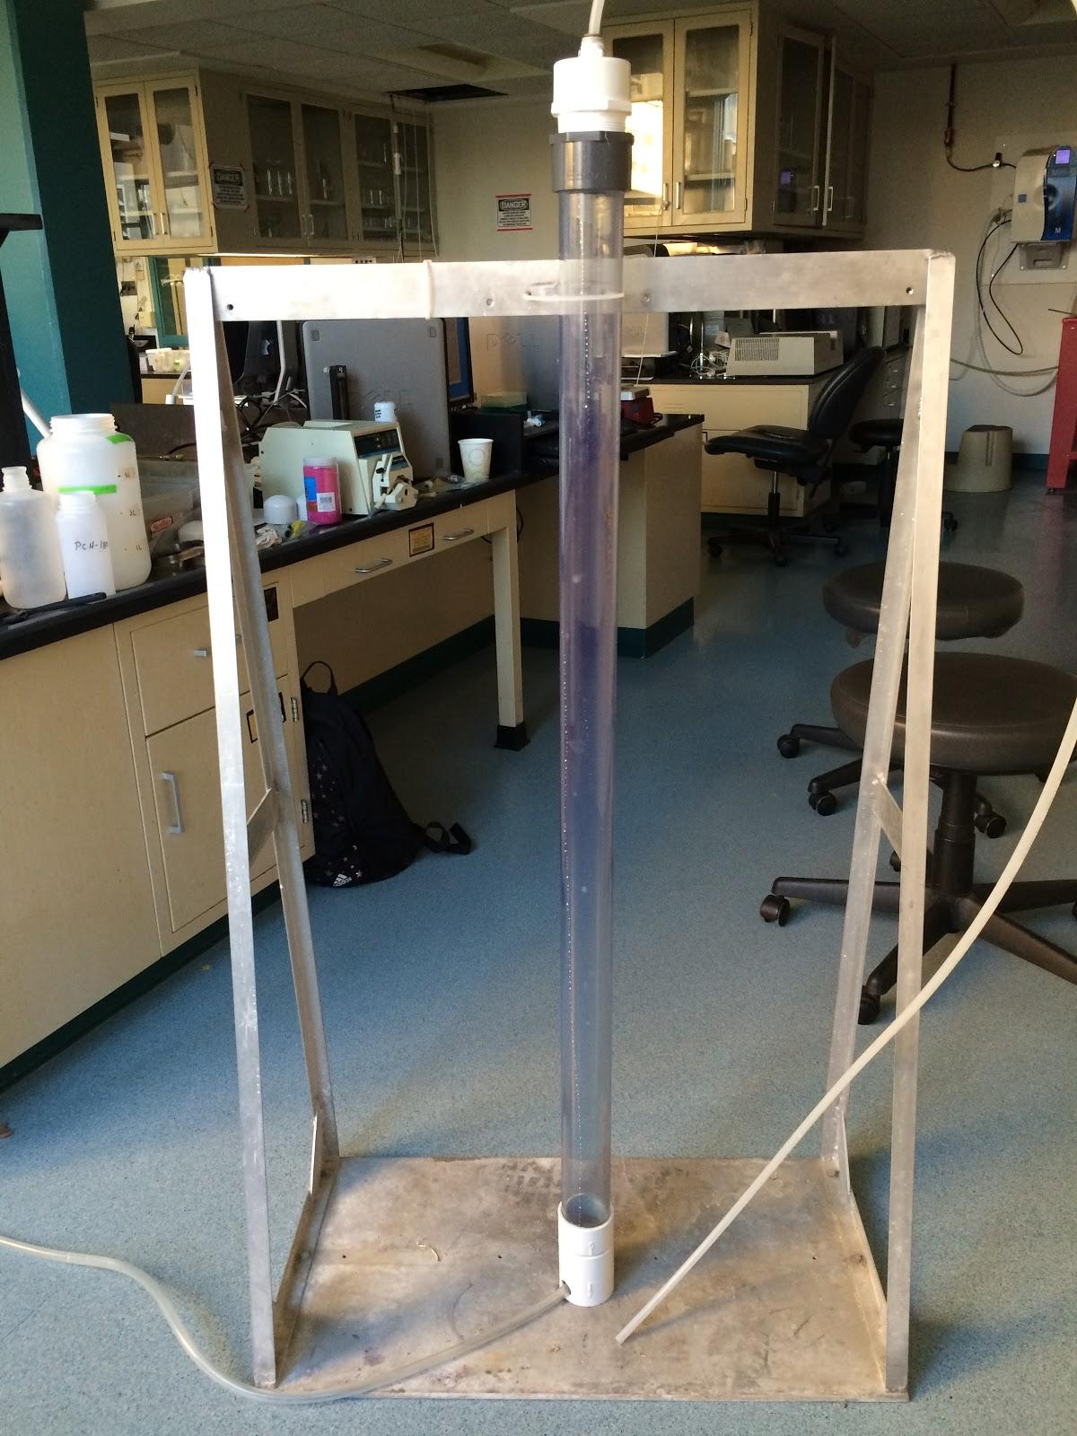
Experimentation
Fluidization
Expansion Ratio
Backwash Velocity
Sand Segregation

Slide 9
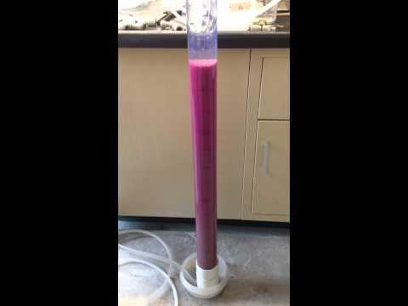
Experimentation
Sand Sizes 20-40

Slide 10
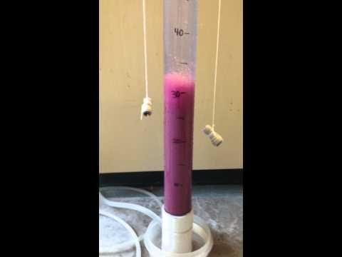
Experimentation
Sand Sizes 30-40

Slide 11
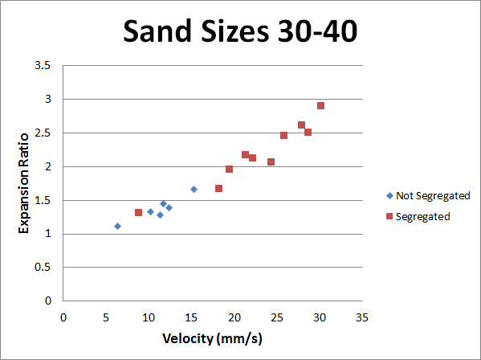
Results
The 30-40 sand size was fluidized at a backwash velocity of 11 mm/s
At expansion ratios (not to be confused by size ratio) less than 1.6, the sand bed almost never segregated

Slide 12
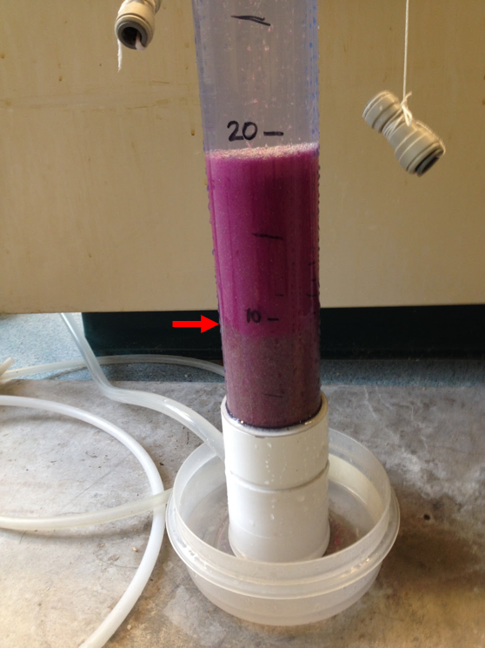
Conclusions
The 11 mm/s backwash velocity is high enough to fluidize the 30-40 sand
Contrary to our hypothesis, segregation decreased as the expansion ratio decreased

Slide 13
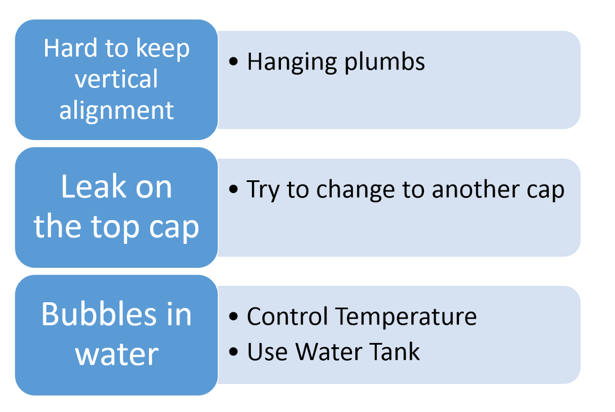
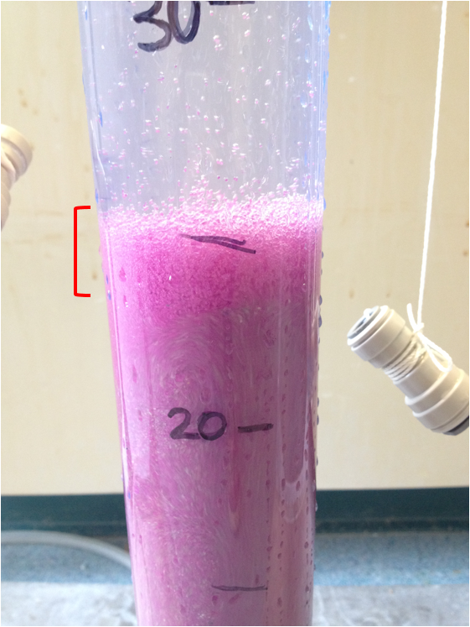
Problems Faced

Slide 14
Future Work
Try to solve the problems mentioned
Short Sloped Baffles Design
Backwash Velocity Experimentation

Slide 15

Questions?

