Slide 1
Floc Prob
Fall 2014
Larry Ge
Surya Kumar

Slide 2
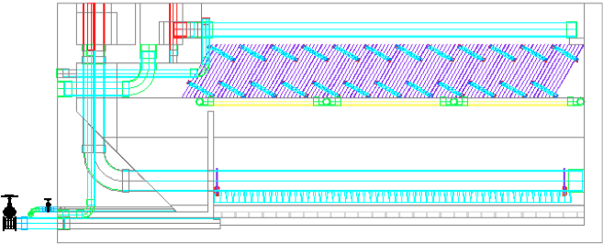
Sedimentation Tank
What Does it Do
and
How Does it Work

Slide 3
The Issue at Hand
SLUDGE
Suspended Flocs

Slide 4
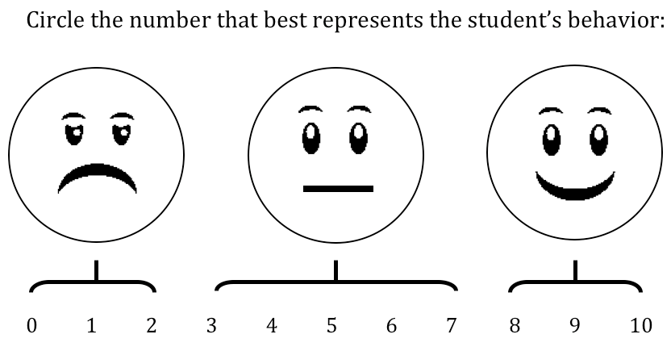

So...the Goals!
Understand the behavior of flocs in the sedimentation tank.
Find a way to detect sludge accumulation in the sedimentation tank.

Slide 5
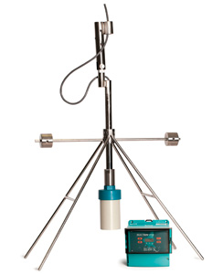
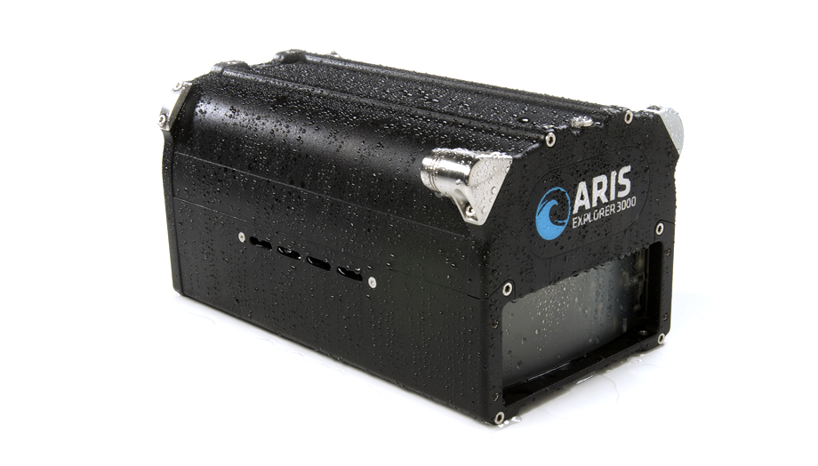
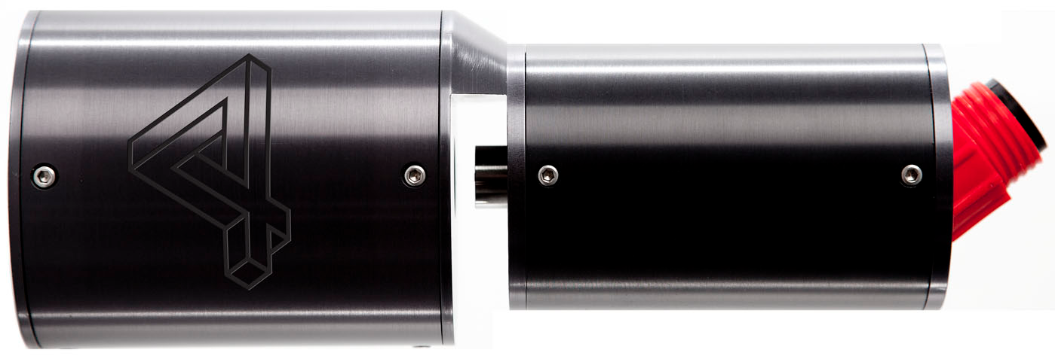
Potential Solutions Found
Underwater Sonar Video Camera
Sultan Sonar System
Submersible Microscope

Slide 6
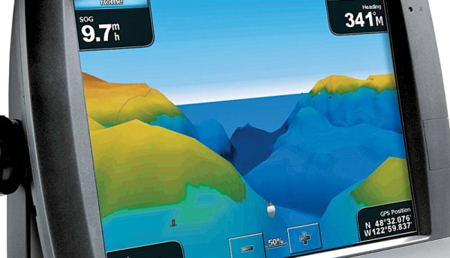
Best Solution...So Far
Sultan Sonar System
a
and

Slide 7

Future Work
To acquire a research tool.
and

Slide 8

Your Turn
Questions?
Suggestions?
Net ID’s: llg45 and sk837

Slide 9
Works Cited
Sedimentation Lecture Notes, CEE 4540, Sustainable Municipal Drinking Water Treatment, Professor Monroe Weber-Shirk
http://www.hawkmeasure.com/productdetail.asp?id=36
http://www.soundmetrics.com/Products/ARIS-Sonars
http://4-deep.com/submersible-microscope/

