Slide 1
Floc Probe: Final Presentation
Fall 2014
Larry Ge
Surya Kumar

Slide 2
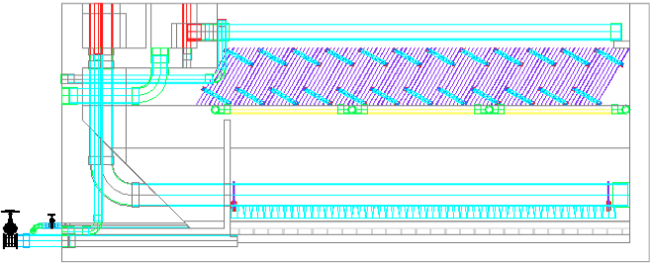
Sedimentation Tank
Our knowledge of Sedimentation Tank behavior (floc/floc blanket behavior, sludge accumulation) is theoretical and limited.

Slide 3

Sedimentation Tank
The way it might currently be operating
The way we want it to operate:
“Sediment-less Sedimentation Tank”

Slide 4
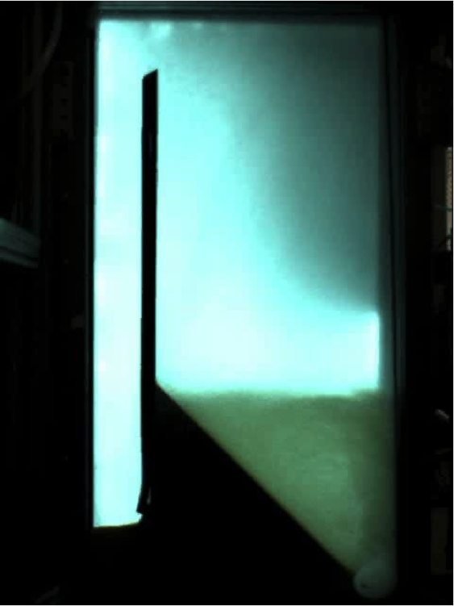
So...the Goals!
Understand the behavior of flocs in the sedimentation tank.
Find a way to detect sludge accumulation in the sedimentation tank.

Slide 5
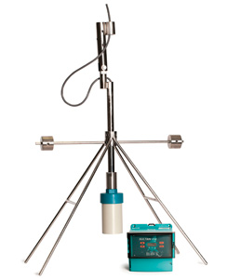
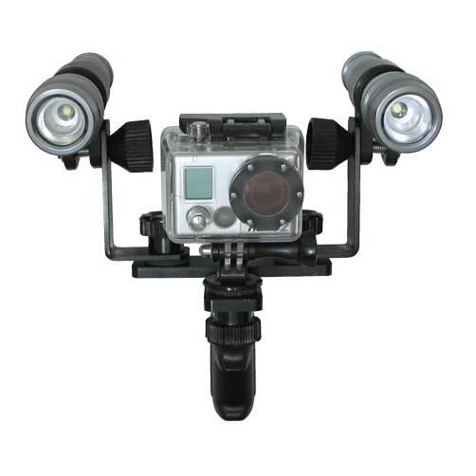
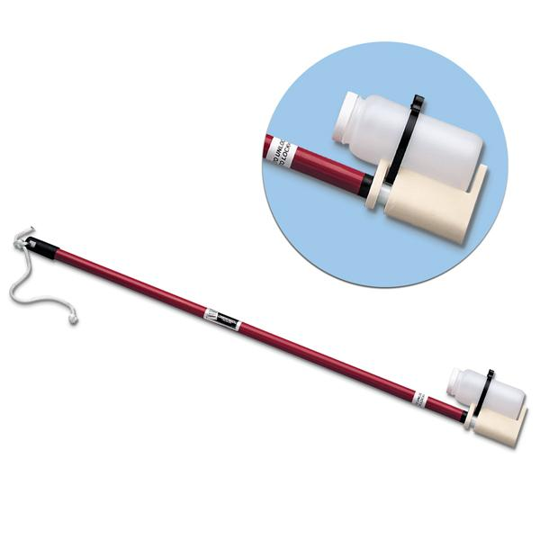
Potential Solutions Found
Underwater Video Cameras
Other (Physical Sampling)
Sonar Systems (Industry tools, fishfinders)

Slide 6
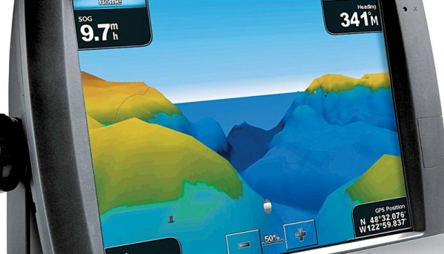
Sonar Solutions
Sultan Sonar System
Fishfinders

Slide 7
Underwater Video Cameras
Feasibility? Cost?

Slide 8

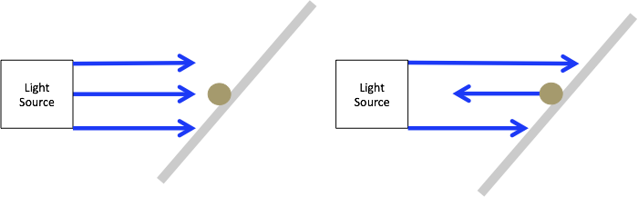
Future Work
and

Slide 9

Advice for Future Team Members
When in doubt, ask for help
Vendors and AguaClara have mutually beneficial relationship

Slide 10

Your Turn
Questions?
Suggestions?
Net ID’s: llg45 and sk837

Slide 11
Works Cited
Sedimentation Lecture Notes, CEE 4540, Sustainable Municipal Drinking Water Treatment, Professor Monroe Weber-Shirk
http://www.hawkmeasure.com/productdetail.asp?id=36
http://www.soundmetrics.com/Products/ARIS-Sonars
http://4-deep.com/submersible-microscope/

