Slide 1
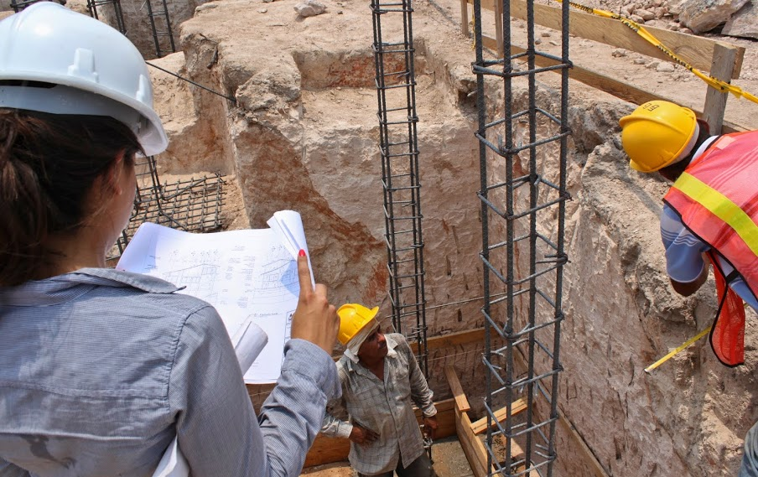

AguaClara on the ground:
Honduras

Slide 2
Overview
Agua Para el Pueblo
How AguaClara reaches the communities
Community assessment
Structural design
My experience in Moroceli

Slide 3
Agua Para El Pueblo
Honduran NG0 (Non-Government Organization)
Sustainable access to water and basic sanitation services
Promote safe use of water and hygiene
Working with AguaClara since 2005
Funding: Swiss, Spanish, Unicef, USAID, BID, Rotary International etc.

Slide 4
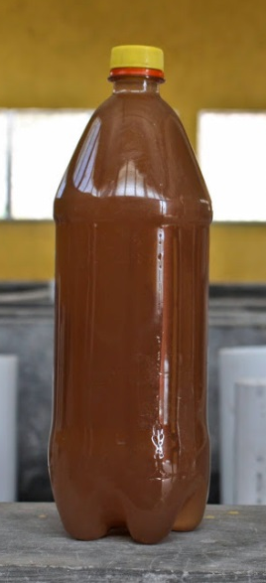
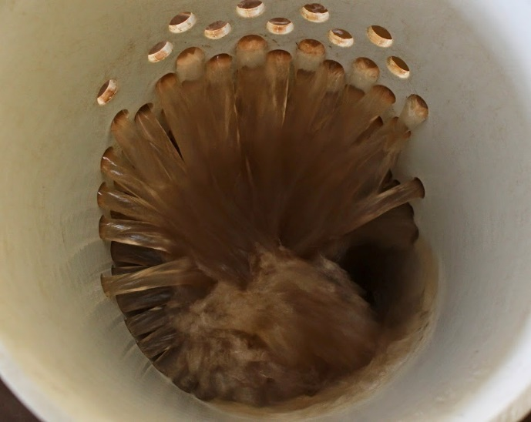
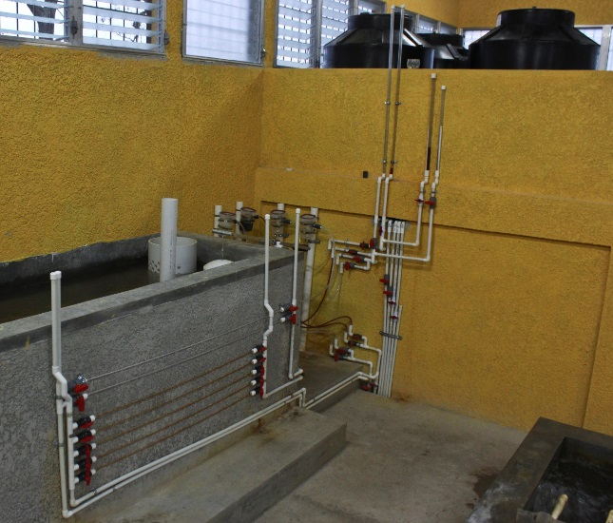
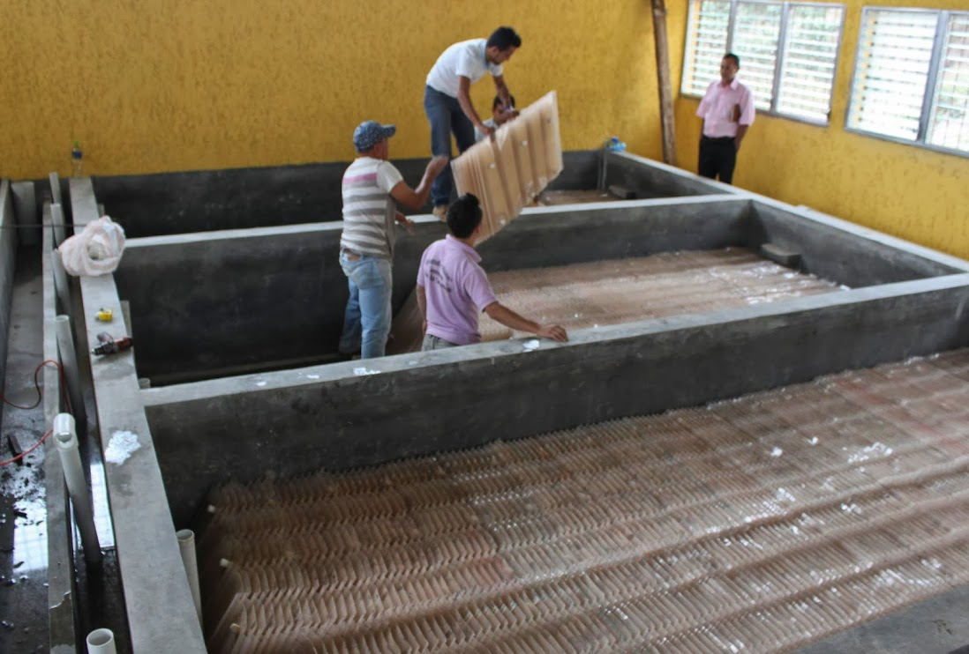
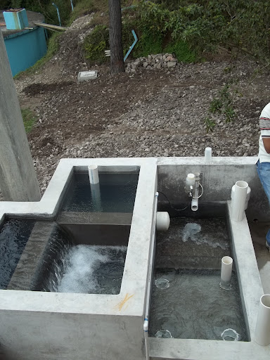
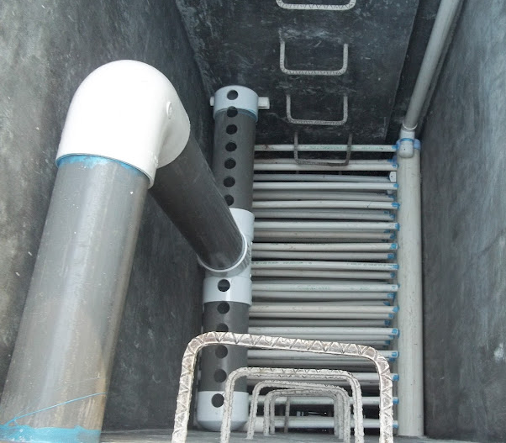
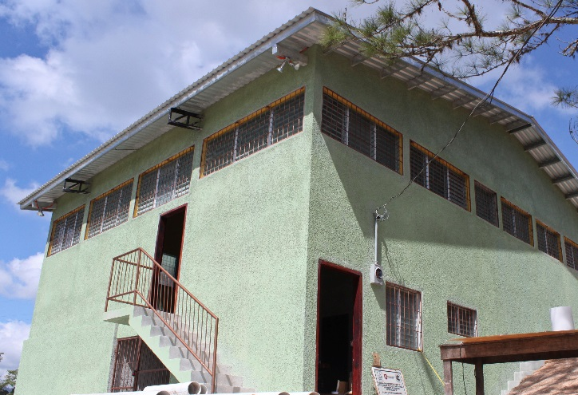

How AguaClara reaches the communities

Slide 5
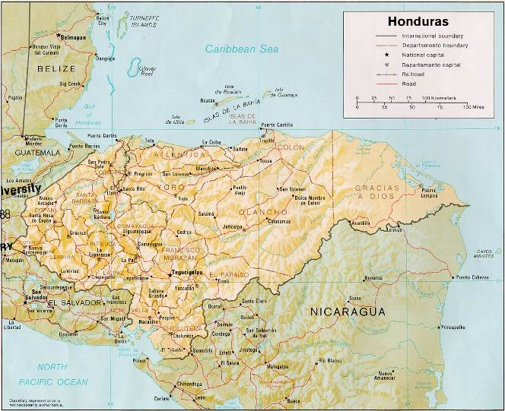
AguaClara Plants in Honduras
Las Vegas, SB
San Nicolás, SB
La Libertad,
Comayagua
Atima, SB
Agalteca, FM
Jesús de Otoro,
Intibucá
Morocelí, El Paraíso
Marcala, La Paz
Alauca, El Paraíso
Cuatro Comunidades, FM
Ojojona, FM
Támara, FM
Have a Design
Working/Underconstruction

Slide 6


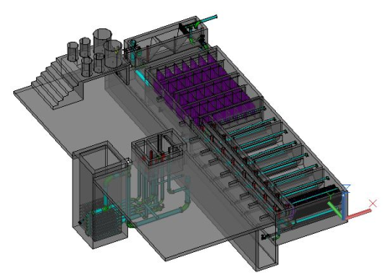
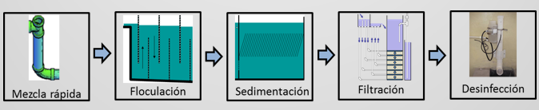
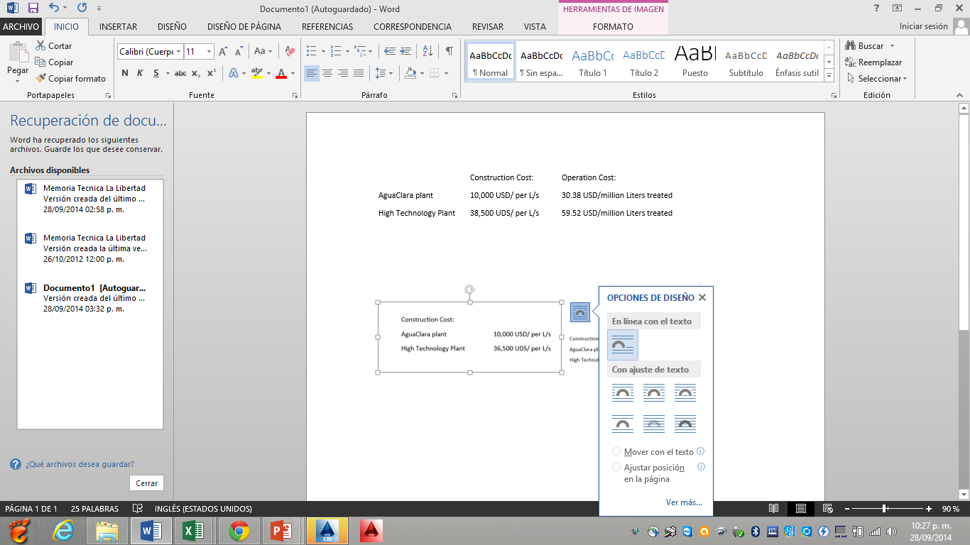
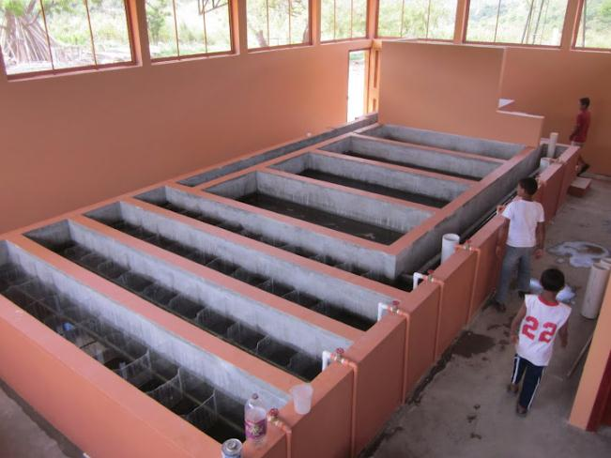
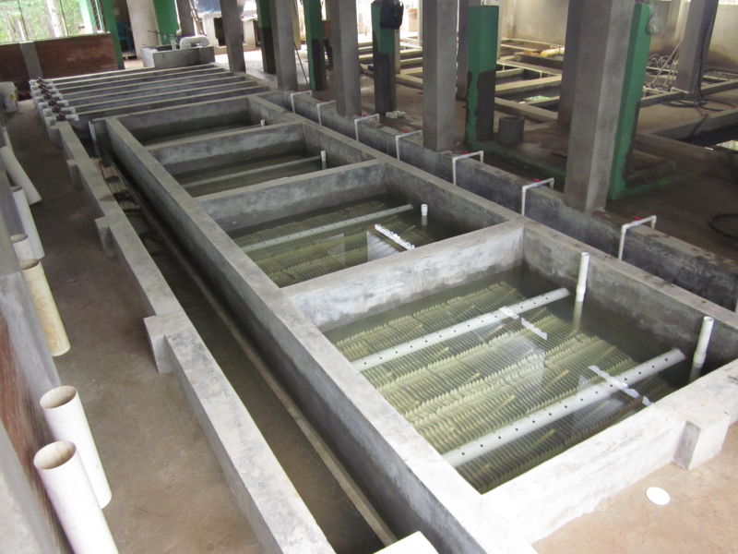

Introducing AguaClara to the Community
AguaClara program
How the plant works
Comparison with other technologies
Share communities' experiences
*The numbers for the AguaClara Plant are from this year 2014
*The numbers for the package plant are from 2004 (Ten years ago!)

Slide 7
Community assessment
Population
Water system
Water quality
Sustainability
Site for the plant

Slide 8
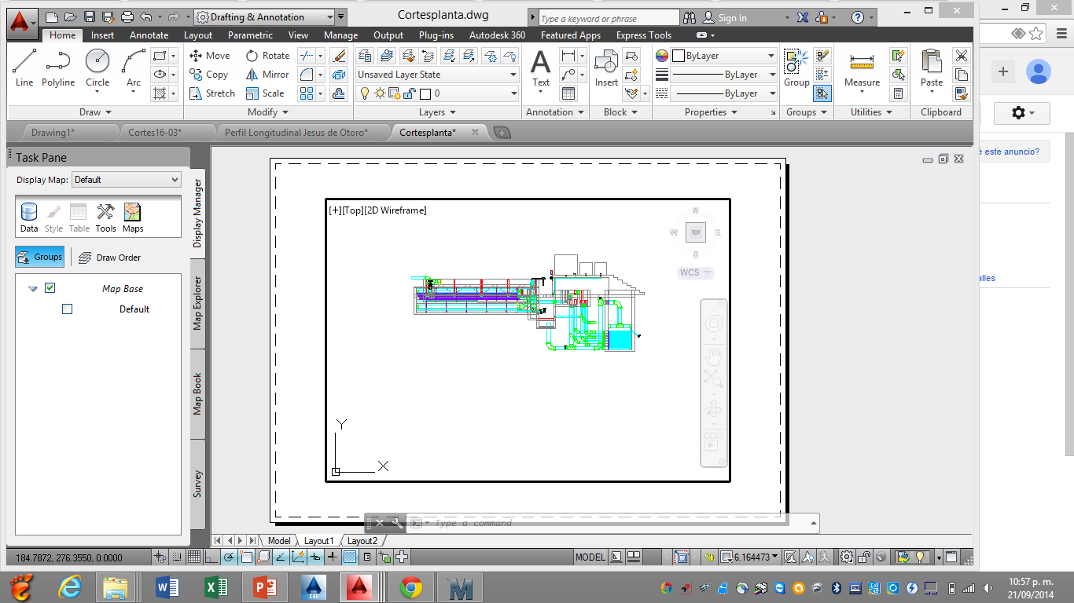
Hydraulic design
Section Cuts:

Slide 9
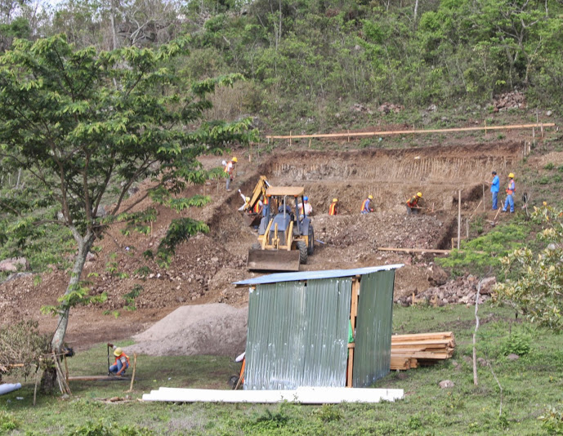
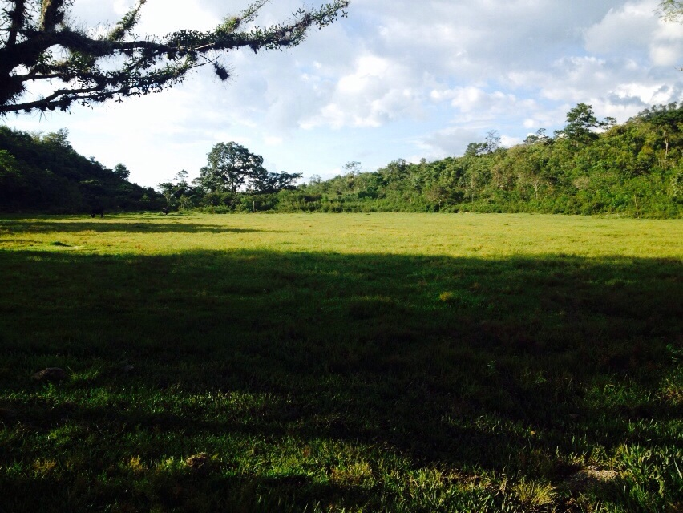
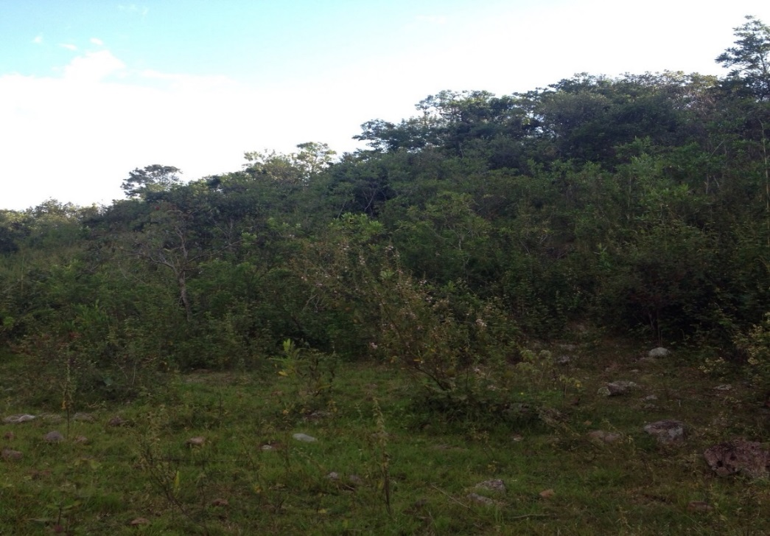
How to choose a site for the plant
Before the Storage Tank
Terrain that minimizes cut and fill

Slide 10
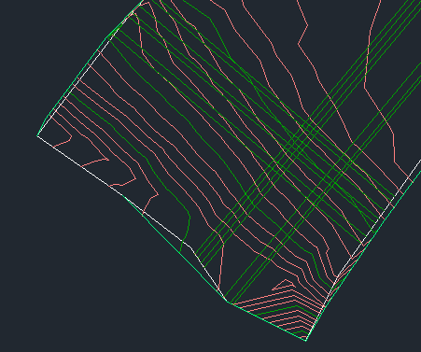
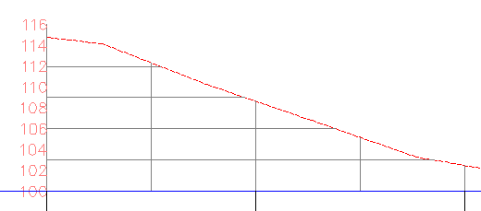
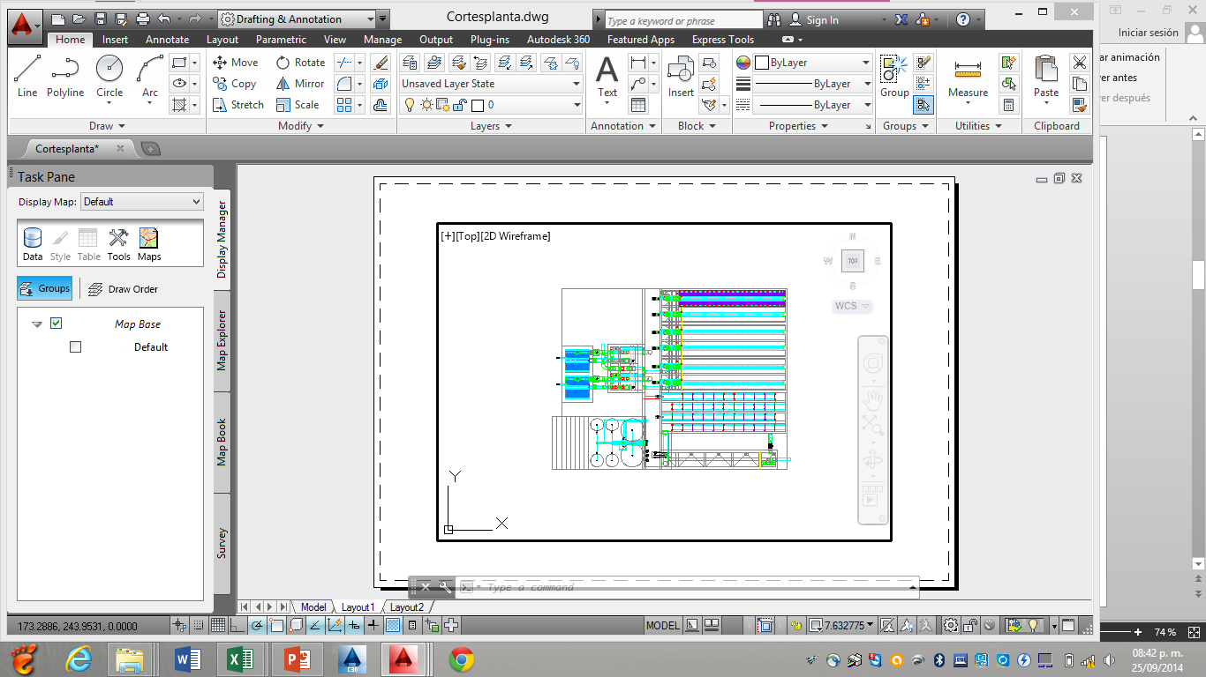
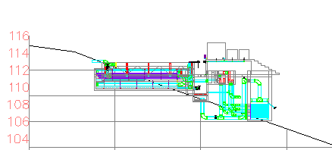
Survey

Slide 11
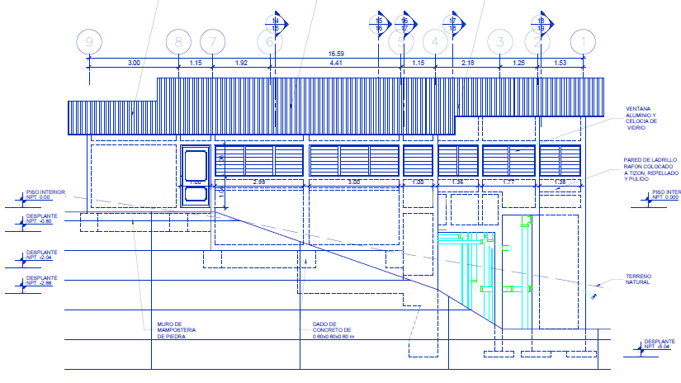
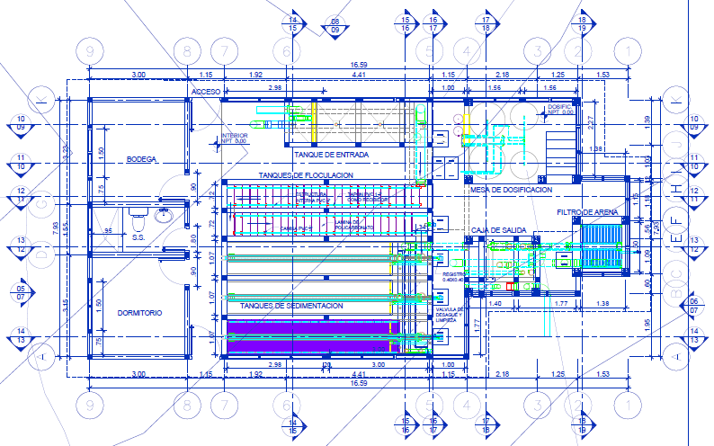
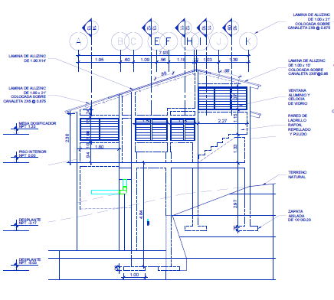
Drawings

Slide 12
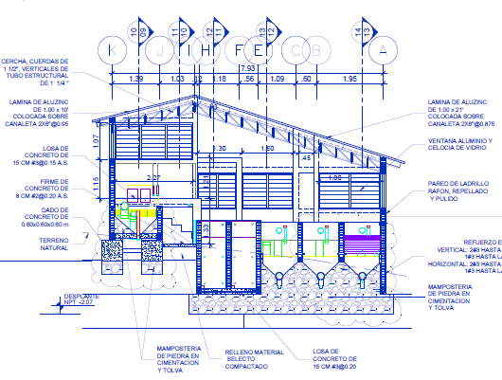
Aluzinc Roof
Joist
Concrete Piers
Brick walls
Concrete Slab
Stone and Concrete

Slide 13
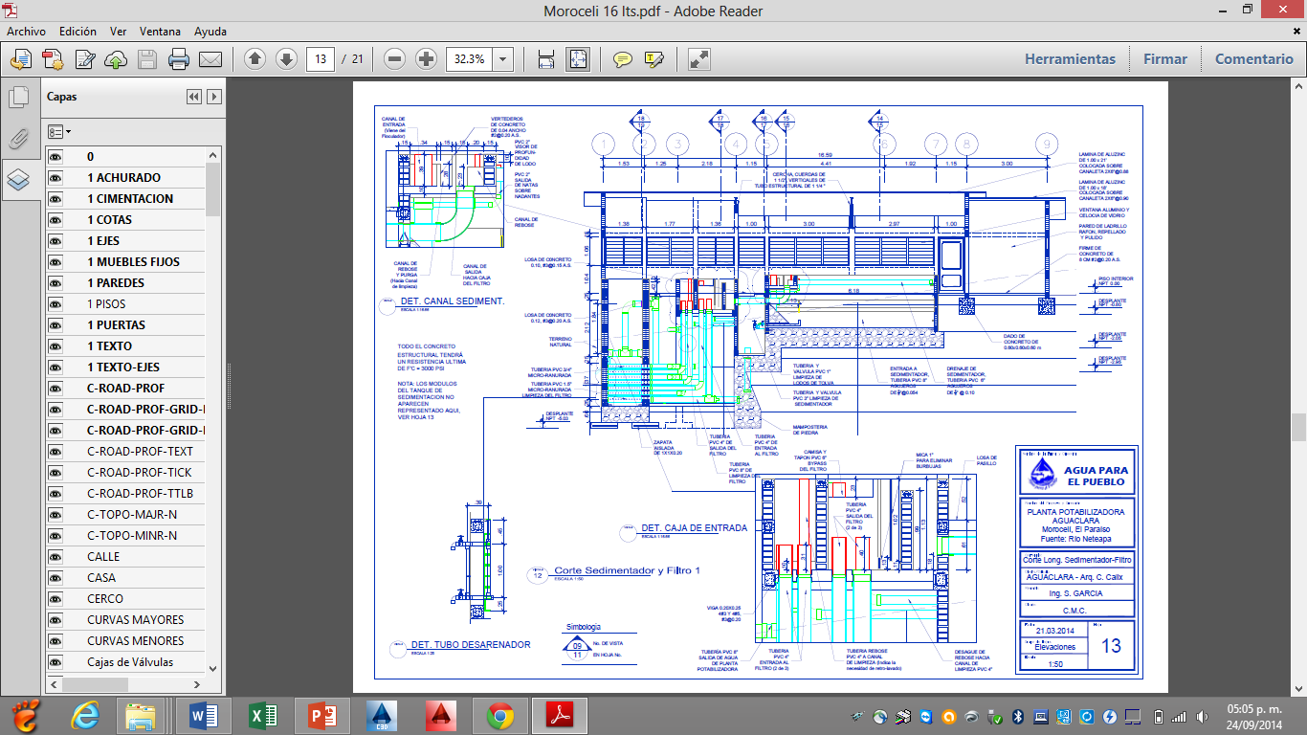

Slide 14
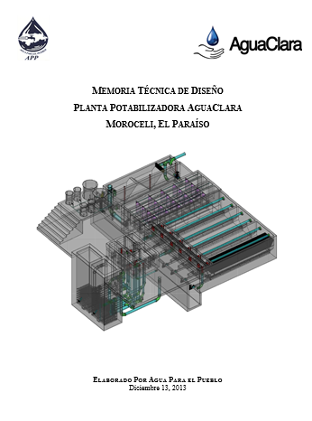
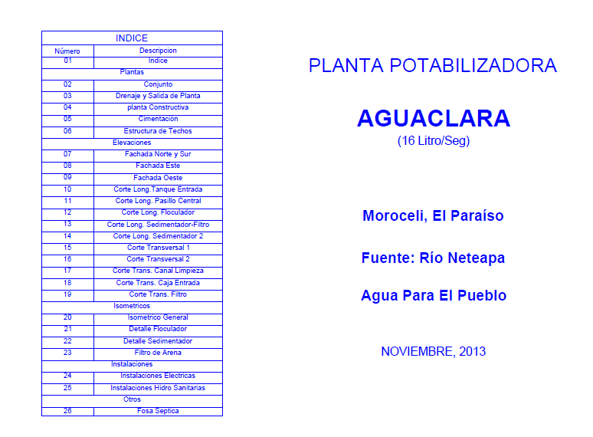
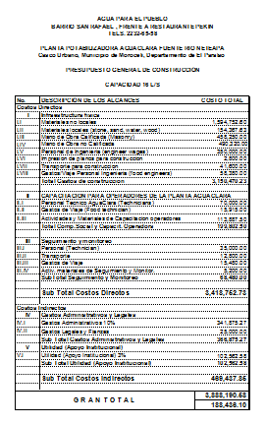
Final Document
Technical Report:
Set of Drawings:
Budget:
With this document it´s easier for the community to solicit funds

Slide 15
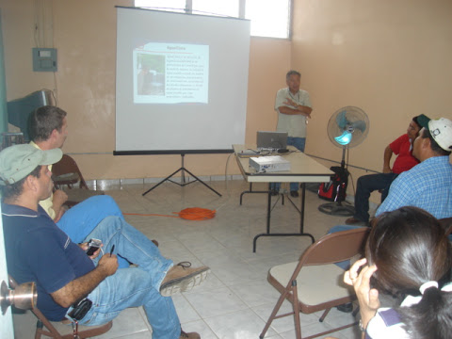
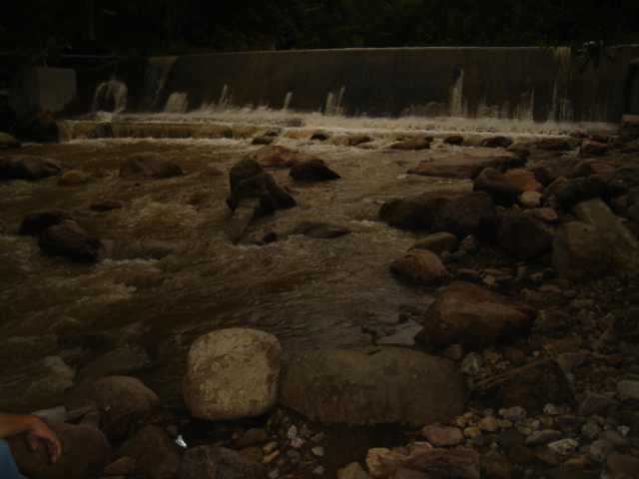
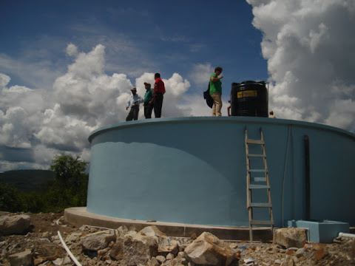
Moroceli Plant
First visit to Moroceli: 2007
Water system upgrades needed
There was no water in the tank

Slide 16


2014 Project: Improvements in water and sanitation systems for the Municipality of Moroceli
Actors involved:
Swiss Cooperation
Municipality
Swiss office in the Municipility (UEL)
Supervisor
Water board
Agua Para El Pueblo
Other constructor
Funds: Swiss Cooperation 80%
Municipality 20%
Water system upgrades
Water treatment plant AguaClara
Sewage system
Wastewater treatment plant
Sanitation solutions for schools

Slide 17
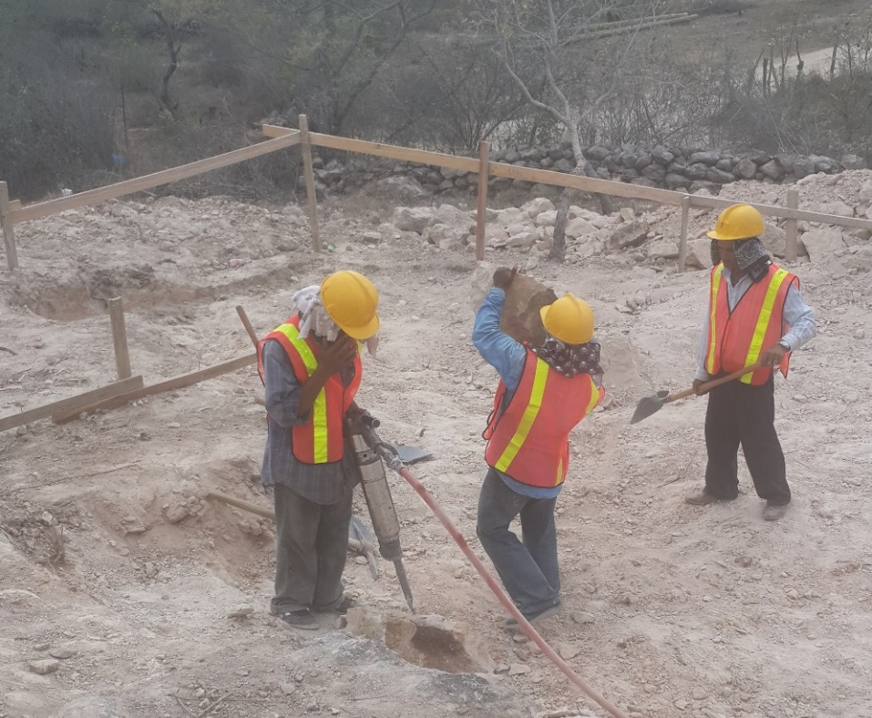
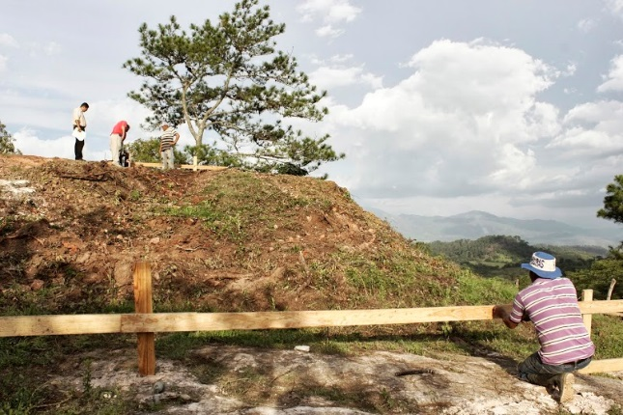
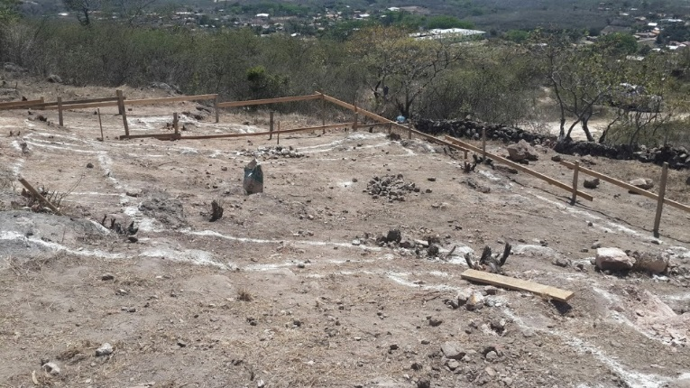
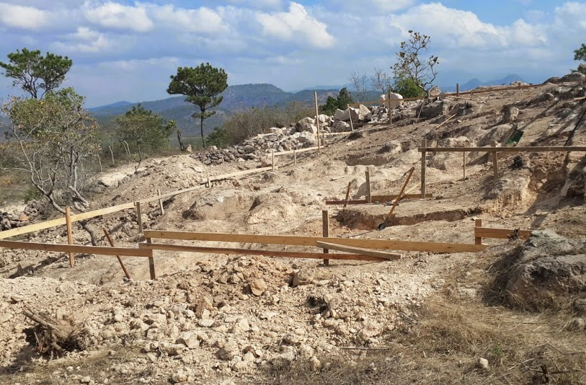
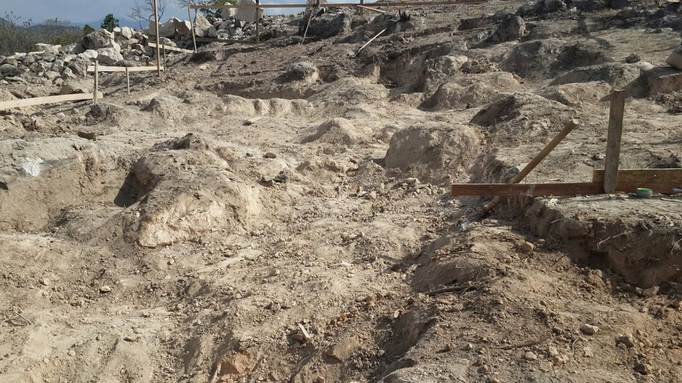
Construction
Trace of the plant
Excavation
Jack Hammer
Excavator

Slide 18
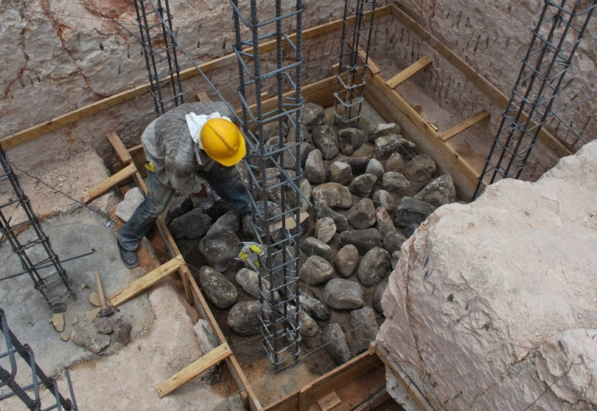
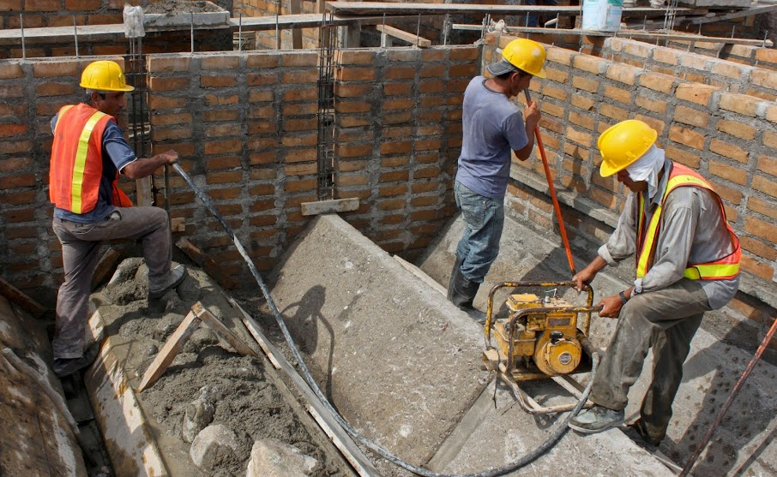
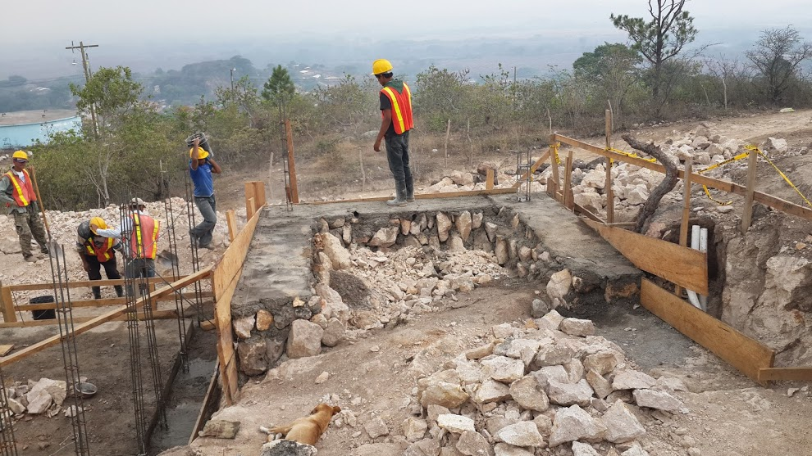
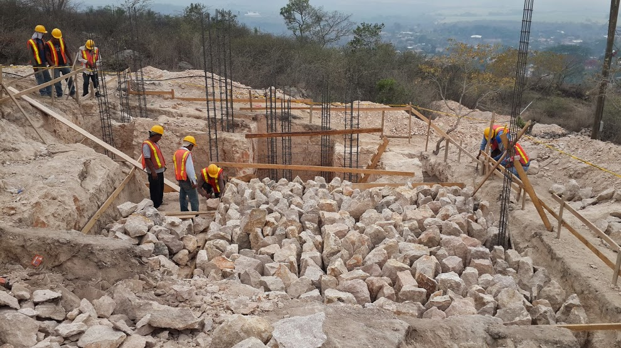
Foundation

Slide 19
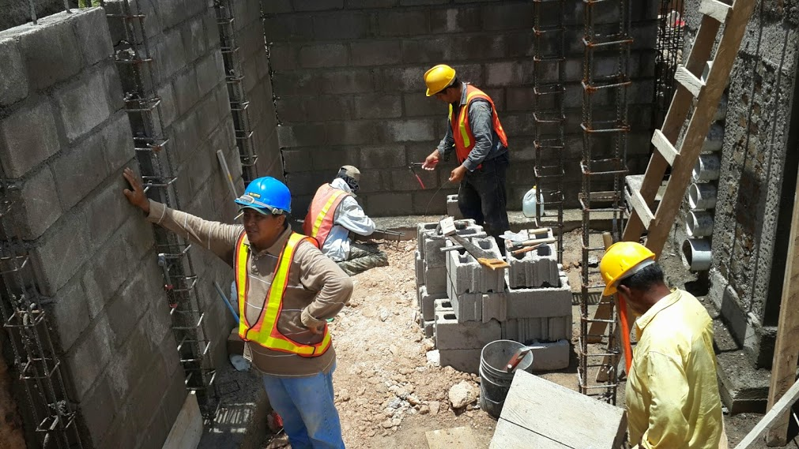
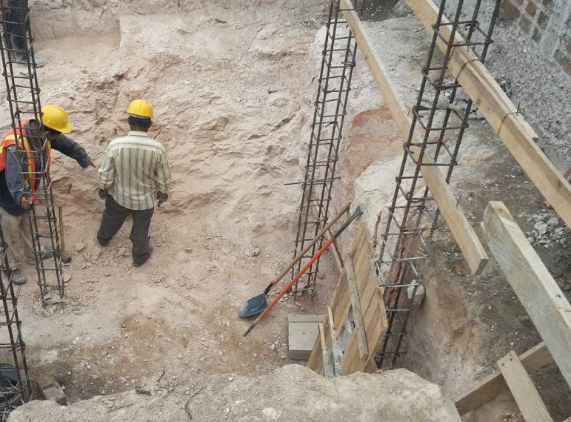
Changes to the original design
Retaining wall designed to support the lateral pressure of the soil

Slide 20
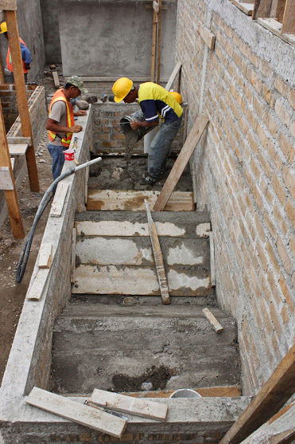
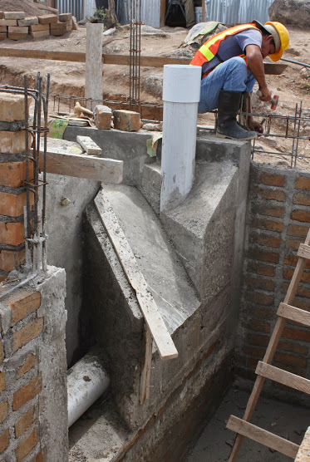
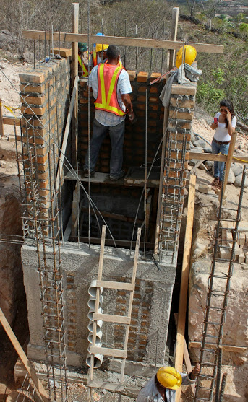

Slide 21
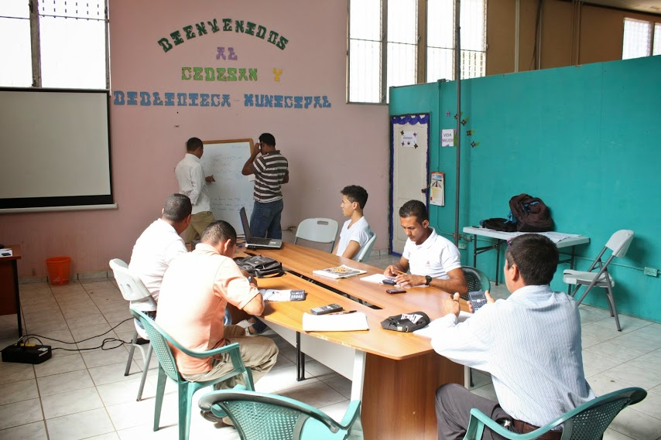
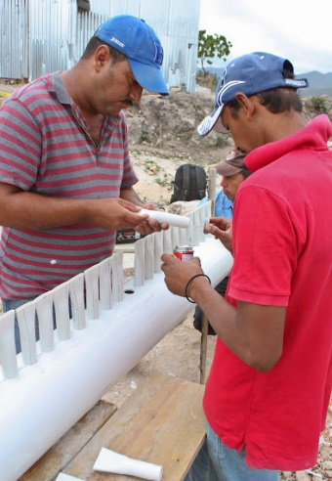
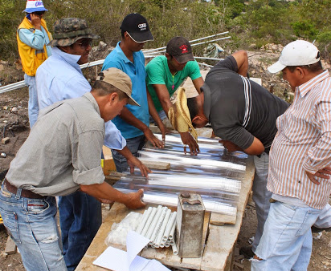



Operators Training
Theory:
Practice:

Slide 22

My last week in Moroceli

Slide 23


The plant was finished last week!

Slide 24

AguaClara's Impact
AguaClara is reaching more than 8,000 households in Honduras
That is about 48,000 people
Spread the technology not only in Honduras but in all Central America
We want to reach smaller communities (Foam Filter)

Slide 25

THANK YOU!

