Slide 1
Introduction to Teams

Slide 2
Potential Teams
Chemical Dose Controller
Ram Pump
Laminar Tube Flocculator
Turbulent Tube Flocculator
Floc Probe
Enclosed Stacked Rapid Sand Filter
Stacked Rapid Sand Filter Backwash
Foam Filtration
Village Supply System
Small Scale Plant Model
Water Treatment Technology Selection Guide
Design
Public Relations

Slide 3
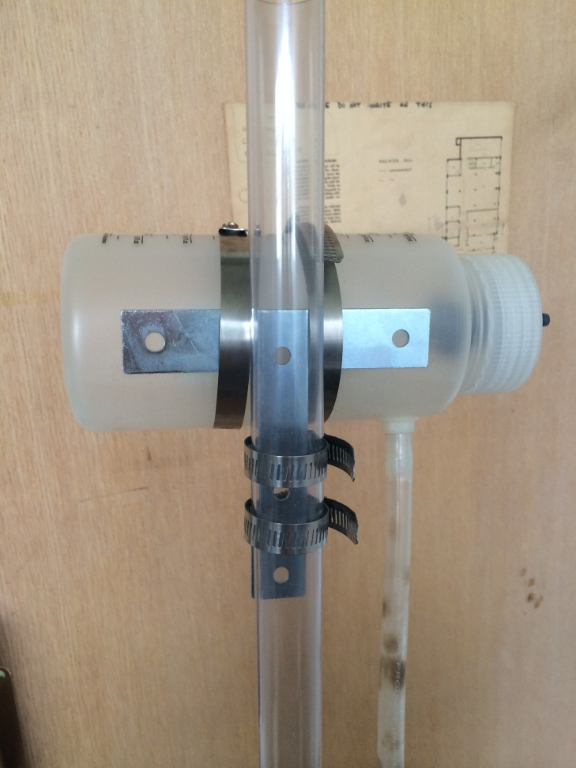
CDC (Chemical Dose Controller)
The CDC couples the plant flow rate with the flow rate of the coagulant
Objectives:
  Assemble CDC from current guidelines.
  Assemble and test dosers
  designed for different flow
  rates

Slide 4
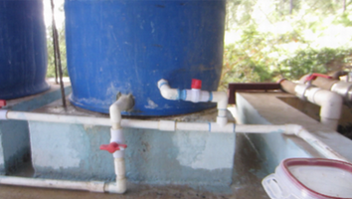
CDC (Chemical Dose Controller)
  Test units at stock concentrations used in AguaClara facilities
  Develop a set of dosers that can be shipped where needed
  Skills: Fabrication, fluids, physics

Slide 5
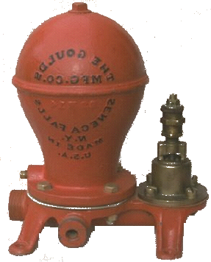
Ram Pump
There is an old technology that used hydraulic transients to lift water from a stream to a higher elevation. The device was called a “Ram Pump”and it made a rhythmic clacking noise.
High pressure pipe
Source pipe
Stream
Ram Pump

Slide 6
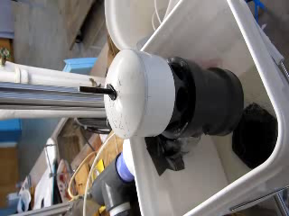
Ram pump
Objectives:
  Maintain contact with AguaClara team in Honduras to resolve issues in the field
  Design and build an effective recycling system that will make it easy to conduct extensive tests and operate without human intervention.
  Conduct extensive testing to measure reliability and efficiency.
Skills: Fabrication, fluids, physics

Slide 7
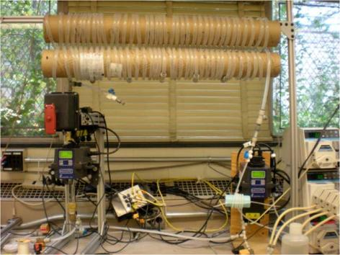
Laminar Tube Flocculator
Objectives:
  Repeat experimentation to obtain consistent results.
  Explore floc break up
  and tapered
  flocculation
  Explore alternate
  flocculator designs
  to enhance
  performance

Slide 8
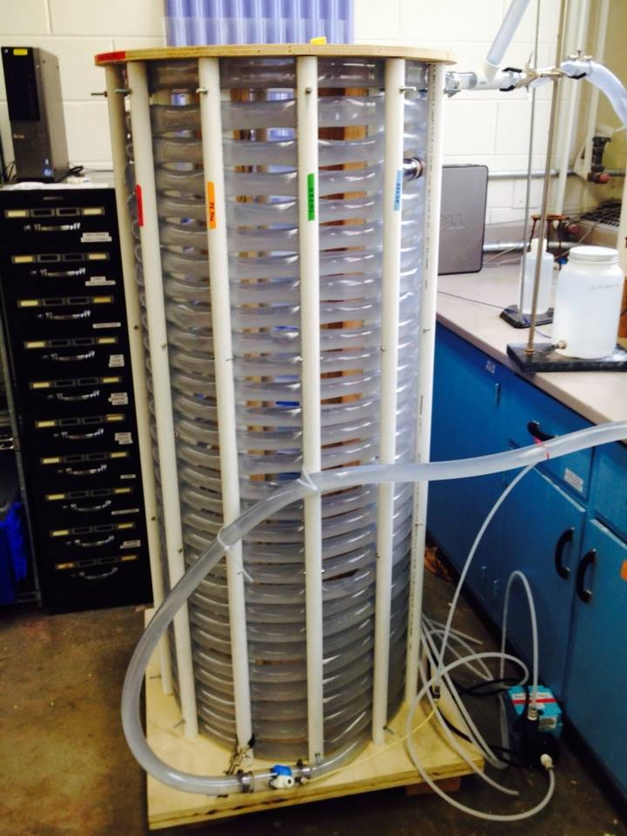
Turbulent Tube Floc
Objectives:
  Build adjustable effluent elevation to achieve target flow rates.
  Remove air from effluent
  of flocculator.
  Design for 12 hour tests
  without replacing the
  PACl stock, and use a
  target range of PACl doses.

Slide 9
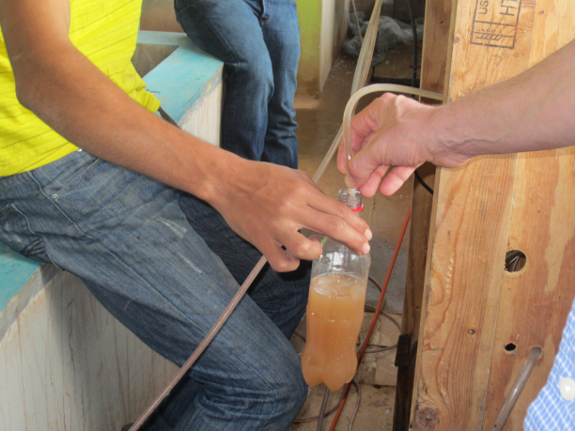
Floc Probe
Objectives: develop an easy method for operators to monitor floc blanket depth and the depth of sludge in the floc hopper
Potential options:
  Eye as detector
    Sludge judge (transparent tube with valve at bottom that can grab a column of water from within the sed tank)
    Submersible LED light
  Sensors (ultrasound, optical)
Preferable skills: fabrication of
detectors, experimentation to
measure ease of use

Slide 10
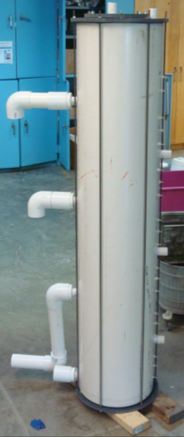
EStaRS – Enclosed Stacked Rapid Sand Filters
Objectives:
Design a filter test system that facilitates extended hydraulic and turbidity testing.
Keep in touch with AguaClara team in India to resolve technical issues
Design Improvements:
Skills: Fluids, Fabrication

Slide 11
Stacked Rapid Sand Filter Backwash
Objectives:
  Develop rational guidelines for the selection of sand for Stacked Rapid Sand Filters
  Develop an experimental apparatus that will allow measurement of sand size distribution in a fluidized sand bed
  Select the optimal expansion ratio for cleaning
  Skills: Fluids, fabrication,

Slide 12
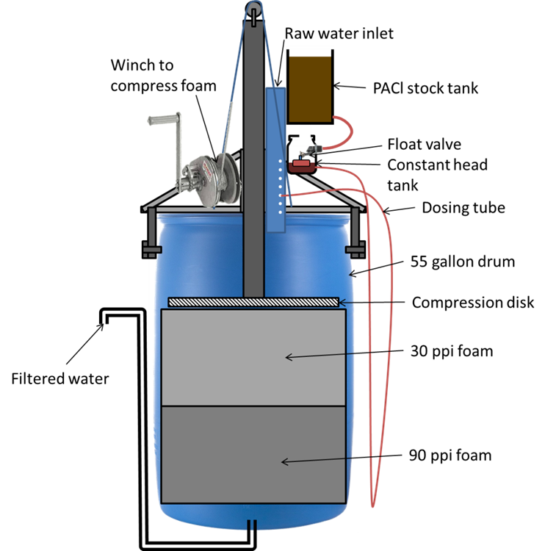
Foam Filtration
Objective: design and test a neatly packaged and portable filter
Design LFOM to be integrated
with the float valve for dose controller.
Make lever system more compact.
Test foam filter through cycles
of filtration and cleaning.
Preferable skills: fabrication,
design, fluids

Slide 13
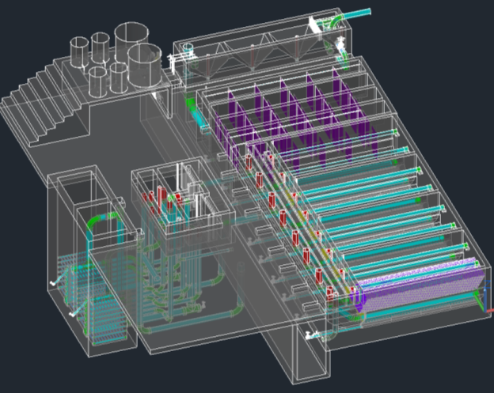
Small Scale Plant Model
Objective: Produce an updated scale model of AguaClara technologies that is easy to transport in carry on luggage.
Impact: use for teaching
about AguaClara
technology at Cornell, PR,
and conferences
Skills: Fabrication,
problem solving
Note: CEE 2550 Only

Slide 14
Water Treatment Technology Selection Guide (WTTSG)
Objective: develop a guide to indicate the constraints that determine which technology is best suited for different levels and types of contamination
Must be designed as a front end for the AguaClara design engine
Skills: Drinking water treatment, website creation online forms

Slide 15
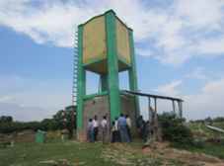
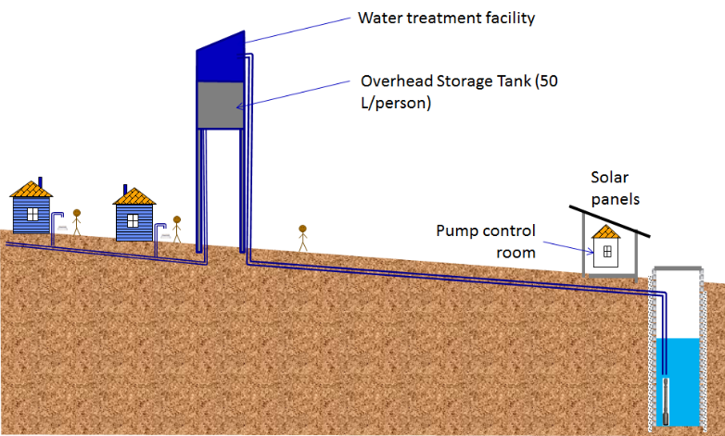
Village Supply System
Objective: Design distributed storage for a village water supply
Evaluate designs that eliminate the need for an elevated storage tank and an elevated AguaClara plant

Slide 16
Village Supply System
Design of the photovoltaic and pump system
Design of the distribution system (pipe sizes), pressure target, and flow restrictions
Design of household safe water infrastructure
Skills: Water treatment, photovoltaics, pumps, Mathcad

Slide 17

Design Tool
User Inputs
Plant
Design
LabVIEW
Design Engine
AutoCAD
Mathcad
Design
MS Word
Mathcad
Drawing Code

Slide 18
Design Tasks
  Incorporating new research progress into the design
  Designing plants for a greater range of flow rates
  Making our designs more easily understood
  Communicating with the teams in Honduras and India, and with new implementation partners, to address concerns

Slide 19

The Drawing

Slide 20



Public Relations
Objectives:
Manage all AC media forms and increase our activity/likes/tweets/connections etc.
Unit processes videos including AguaClara plant walk through
AguaClara Apparel!
Research and network with other NGO’s that could be potential implementation partners
Note: CEE 2550 Only

Slide 21
Expectations
All team members are expected to:
  Spend at least 10 hours per week working on their project (including time in class)
  Consistently meet with subteam
    Be respectful of teammates & show up to meetings on time
  Always attend full class meetings
  Submit reports on time
  Clean up after themselves in the lab

Slide 22
Interviews
Sign up on the sheet or online
Held in Hollister B60
  We can show you where this is after class if you ask
Will last approximately 15 minutes
Will determine admission onto the overall team as well as team placement

Slide 23
Pre-Interview Tasks
Review How Water Flows Through the Plant
  This will help you understand the challenges
Read the Team Challenges page
Fill out the team organization survey

Slide 24
Next Steps
https://confluence.cornell.edu/display/AGUACLARA/Syllabi

