Slide 1
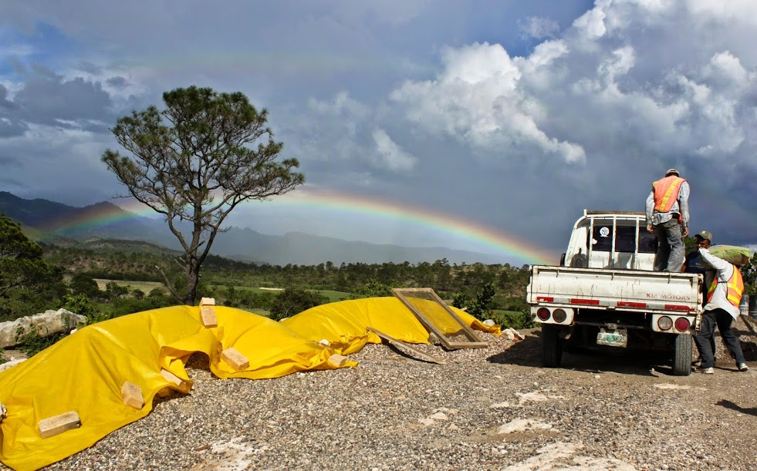

Inspire
Monroe Weber-Shirk

Slide 2
Making Connections
Motivation: Why do we do anything?
  Love and Engineering
What happens in the lab stays in the lab.
What happens in the lab goes to Honduras (and India) to provide safe drinking water for communities.
A few thoughts on Changing the World
Living with Hope
Dream and Do!

Slide 3
Engineering
1) Military, 2) Civil and 3) everything else!
Engineering (from Latin ingenium, meaning "cleverness" and ingeniare, meaning "to contrive, devise") is the application of scientific, economic, social, and practical knowledge in order to invent, design, build, maintain, and improve structures, machines, devices, systems, materials and processes.
What, How, Why???
http://en.wikipedia.org/wiki/Engineering

Slide 4
Why do I do anything?
Because they pay me
Because I want to get a good grade so I can get a good job so I can earn enough money to live well
Because it is a fun challenge
Because I feel respected by others based on my accomplishments
Because it is mindless and relaxing
Because I want to make the world a better place

Slide 5
What gives you a deep sense of satisfaction?
Do you feel pride or a sense of accomplishment from a job well done?
What brings a sense of meaning or purpose to your life?
What are you passionate about?
What do you choose to do that you don’t have to do?
Notes:
Security from knowledge, power, money, social status, community, friends?

Slide 6
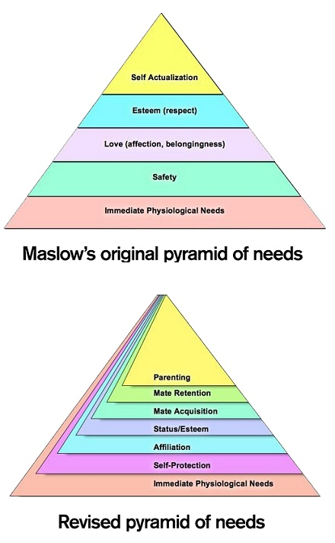
Abraham Maslow’s pyramid of needs
Where does our motivation for engineering come in?

Slide 7
Revised (Revised pyramid of needs (2010))
Where does our motivation for engineering come in?
Why do we want to make the world a better place?
Community
I am motivated to create sustainable systems that improve the lives of others
Notes:
http://psychcentral.com/news/2010/08/23/updated-maslows-pyramid-of-needs/17144.html

Slide 8
What is Love?
Love is "the movement of the self toward the Other for the Good of the Other"
the Other is persons, non-human animals, the environment.
Good is "thriving."
--Dr. Andy Fitz-Gibbon, in Love as a Guide to Morals.
Andy Fitz-Gibbon suggests "loving relationships" rather than happiness is the goal of human life.

Slide 9
What is Civil Engineering?
Creating an environment that enables humans to
  Thrive
  Meet our basic needs
  Live lives full of dignity
  Be healthy
  Be creative
  Live in community
And protecting the environment from the negative impact of humans

Slide 10
Love and Engineering!
Love is “the movement of the self toward the Other for the Good of the Other”
Engineering is co-creating the infrastructure so that humans can thrive in community
Engineering is co-creating better solutions for the Good of Others motivated by Empathy for Others
Empathy matters! Cornell received a gift of $50 million “to help people get along better”
Notes:
Through this initiative, students graduating from Cornell will enter the world as educated global citizens who practice respect and empathy; seek collaboration, cooperation and creativity; embrace differences and diversity in all aspects of their personal, professional and civic lives; and are dedicated to working together to help solve some of the world’s most intractable problems.

Slide 11
Love and Engineering from the Lab to the Field
AguaClara teams are changing the world!
Take a look!

Slide 12
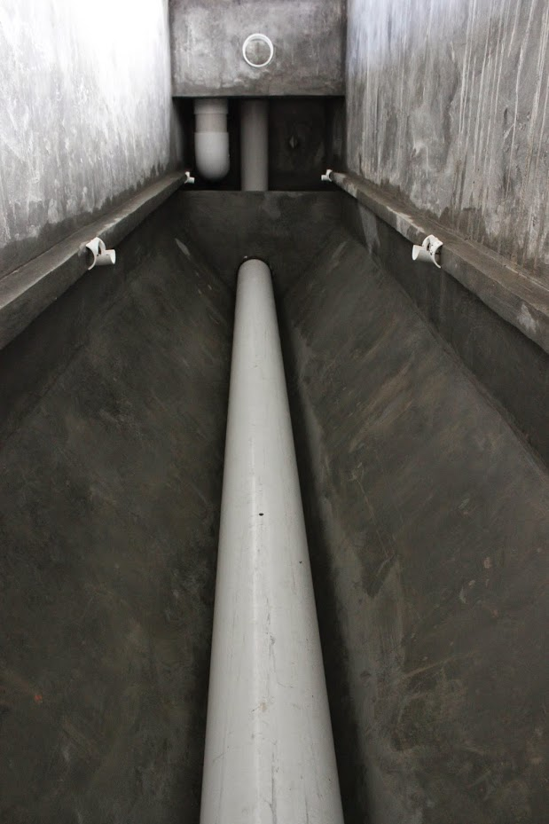
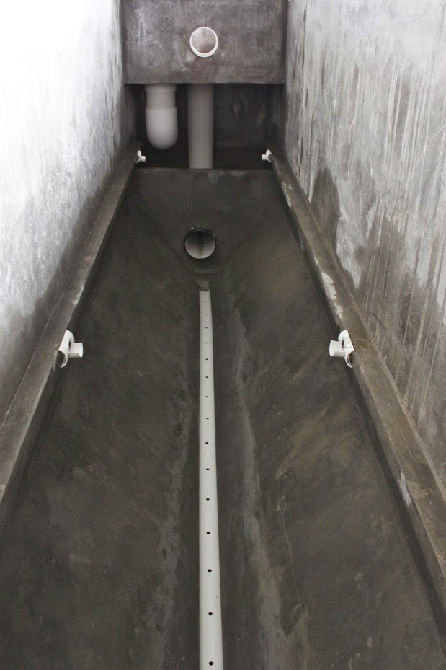
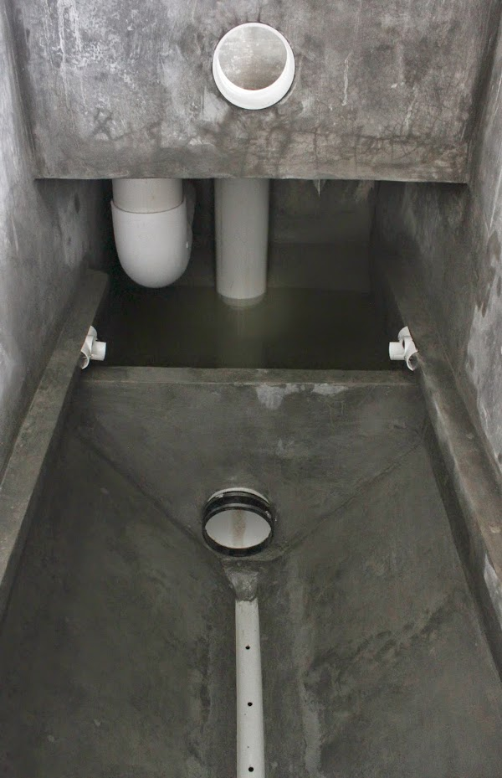
Moroceli (Fall 2014)

Slide 13
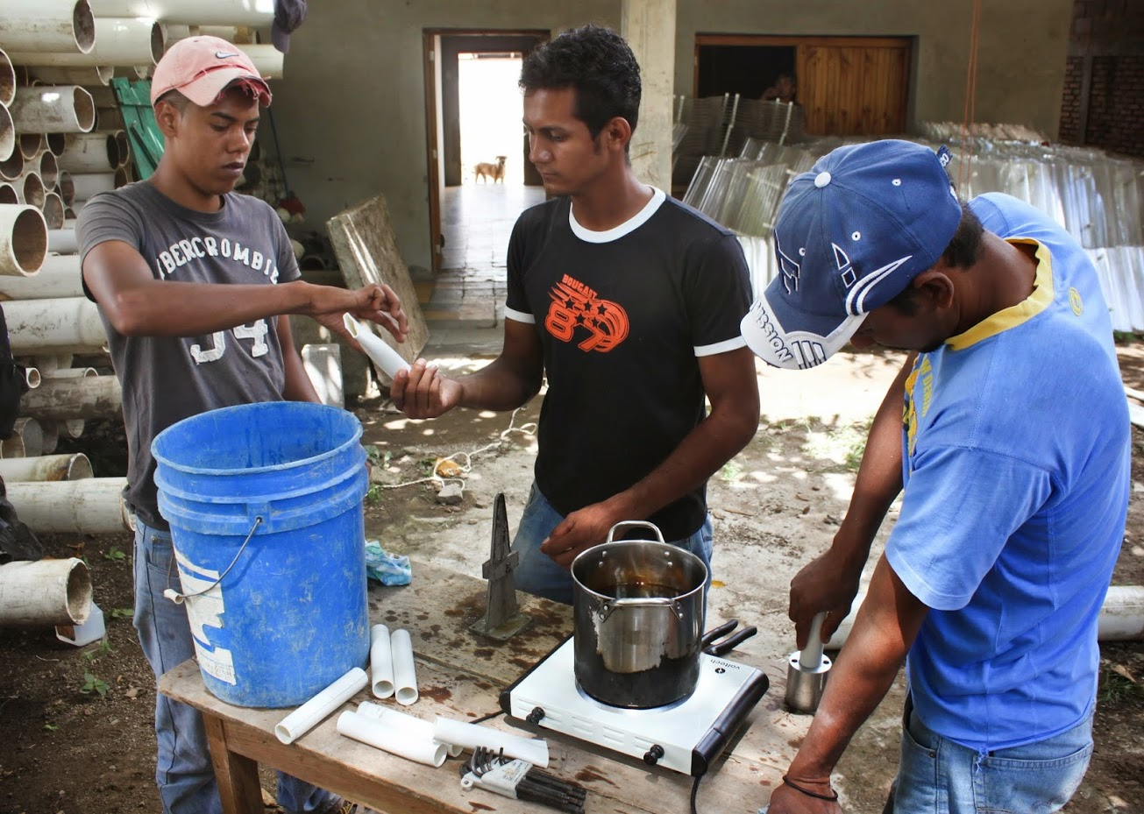

Slide 14
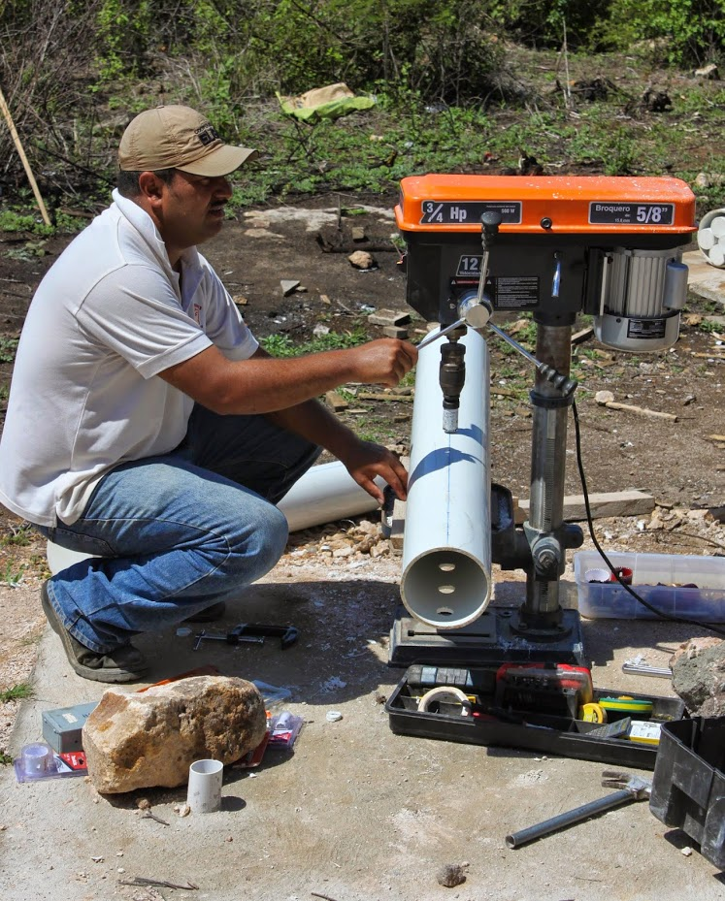
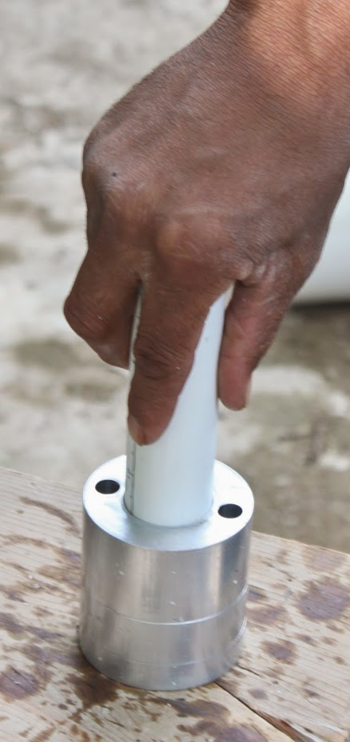

Slide 15
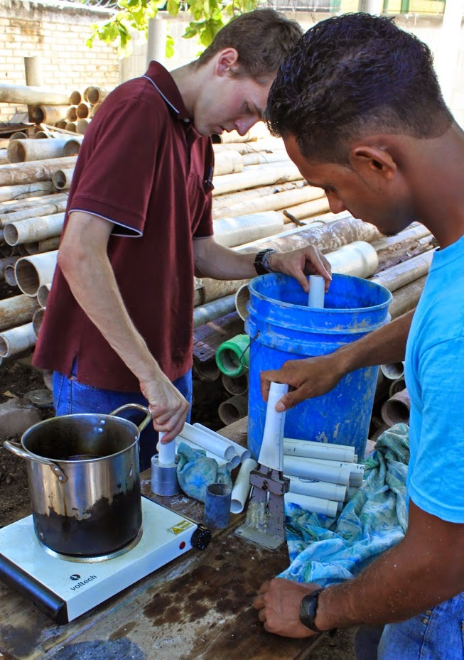
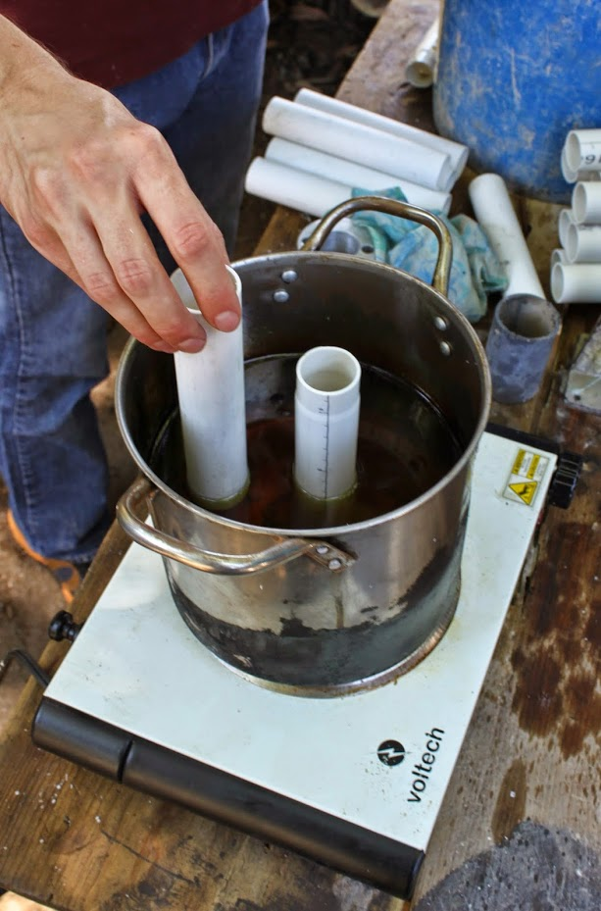

Slide 16
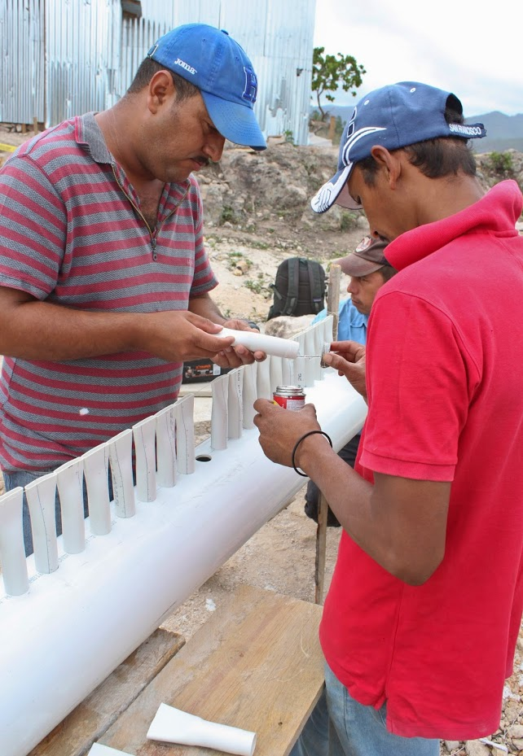

Slide 17
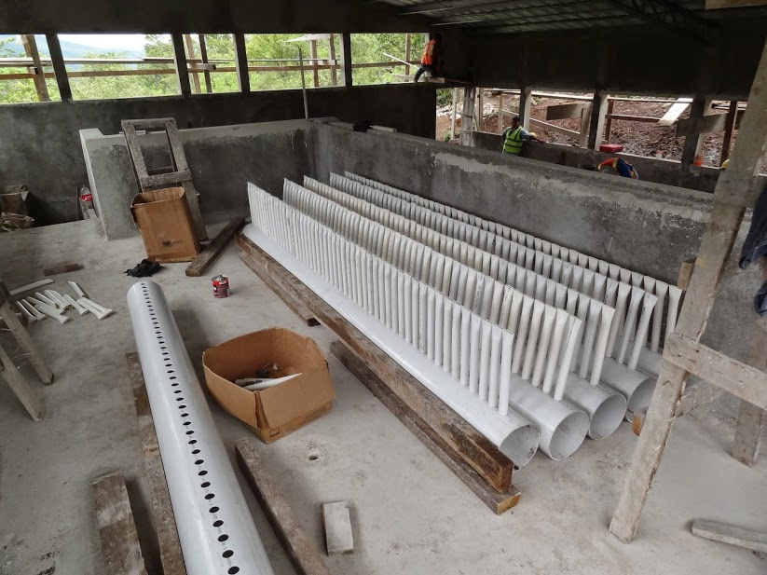

Slide 18
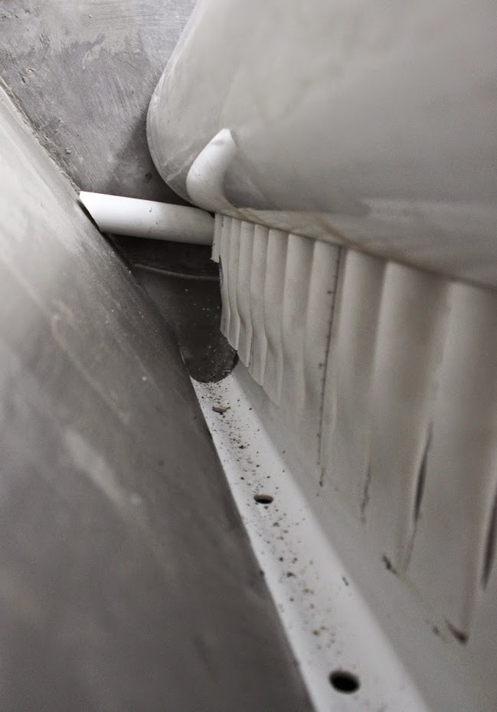
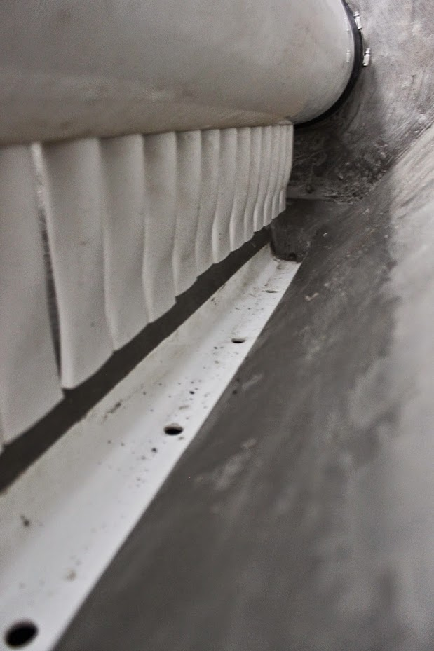

Slide 19
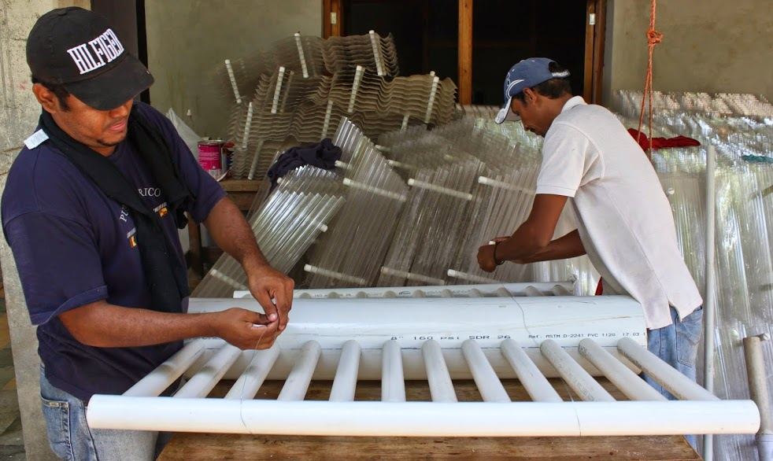
Plate Settlers and Filter manifold

Slide 20
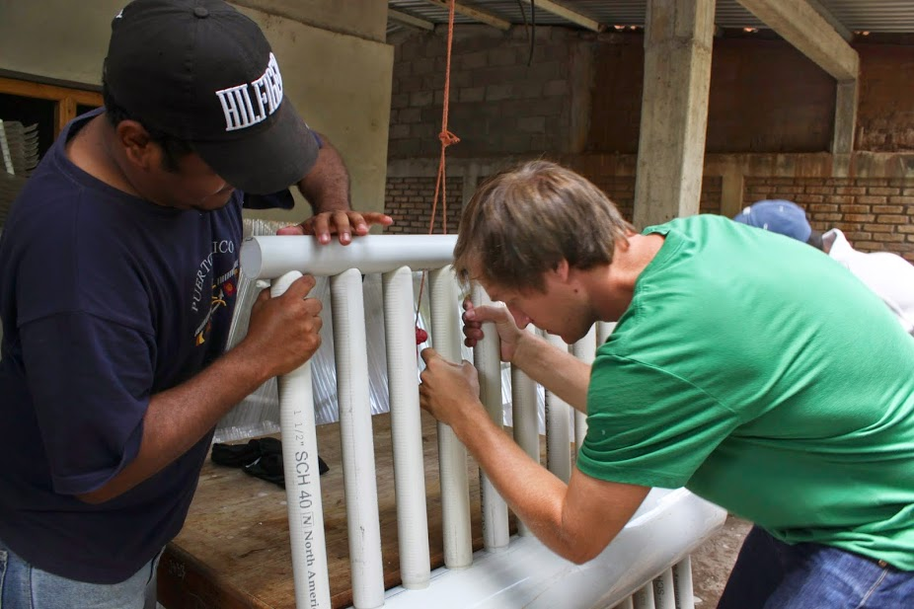

Slide 21
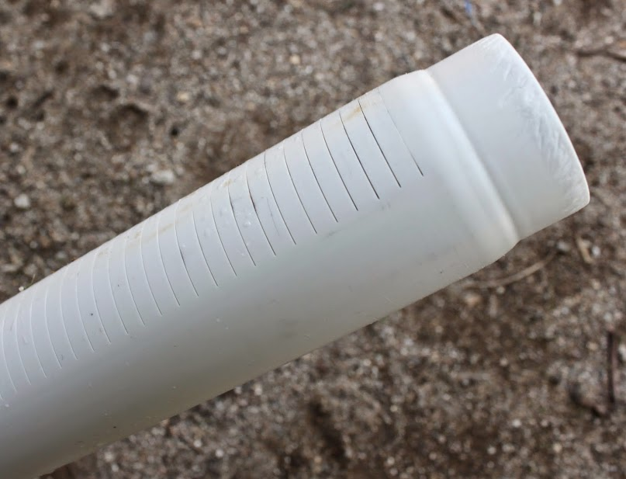

Slide 22
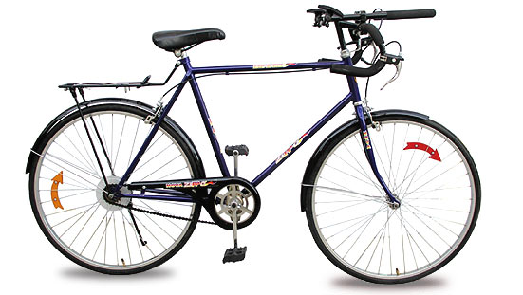
We RIDE together
We seek to understand the physics (Research)
We Invent new technologies to take advantage of the physics
We codify that understanding in our Designs
We Empower partners to use those Designs to make the world a better place (no patents!)
And we do this all in teams…
And we cycle!

Slide 23
AguaClara project courses are the most challenging courses at Cornell
Conventional courses: you learn established knowledge from an expert in the field
AguaClara project teams: you take the initiative to become the experts and to develop new knowledge
10 hrs per week of intellectually challenging work that requires initiative, creativity, engineering, taking risk, discipline, organization, and collaboration
Notes:
(not 10 hrs per week watching a team mate work!) If your normal “work” mode is to have one student on the team work while 2 others watch what is your efficiency? 33% To make up for htat you each would need to work 30 hrs per week.

Slide 24
How will you develop new knowledge?
Learn what is already known
Use your understanding of how the world works to identify the important parameters
Think deeply about the problem you are trying to understand (sketches, force balances, visualize success and failure)
Play, Make mistakes, Troubleshoot

Slide 25
Maximize your Team’s Efficiency
Divide and conquer!
Learn from each other
Use active learning
Use all of your resources

Slide 26
Learn what is already known!
Water is a fluid at room temperature and it conducts electricity (water kills electronics)
Design your apparatus layout to ensure that electronics (meters, sensors, Stamp boxes, ProCoDA) stay dry ALL THE TIME
Fix all leaks immediately using one of these methods
  Teflon tape on tapered threads
  O-ring or gasket under compression
  Hose clamp on barbed fitting

Slide 27
What should you do if lab electronics get wet?
Continue with your research (we work with water all of the time anyway)
Fix the leak
Send an email to Casey
Turn the electronics off, unplug them, and dry them immediately. Keep them turned off until they are dry (24 hours open and drying)
Figure out what went wrong and take steps to prevent it from ever happening again

Slide 28
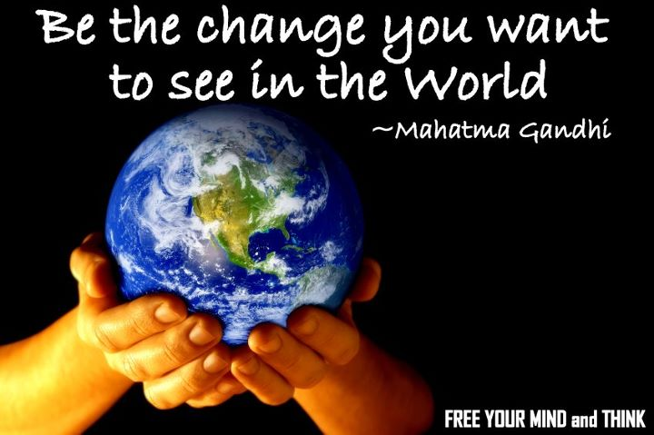
The World Needs a Change
It will require the highest performing, international, multidisciplinary, diverse, dedicated team ever
It will require a long term vision and commitment
We will need to be willing to fail
We will need to take care of each other on the journey

Slide 29
Types of Teams
High-Performing
Cooperative
members
team
Cooperative
Performance Level
Traditional
Pseudo
Types of Teams

Slide 30
High-performance Team
Outperforms all reasonable expectations, given its membership
High level of commitment
Mutual concern for each other’s personal growth
Have lots of fun together
Assign roles and multitask as a team
Action – Reflection Cycle
When you meet with your team later this week REFLECT together on how your team is performing

Slide 31
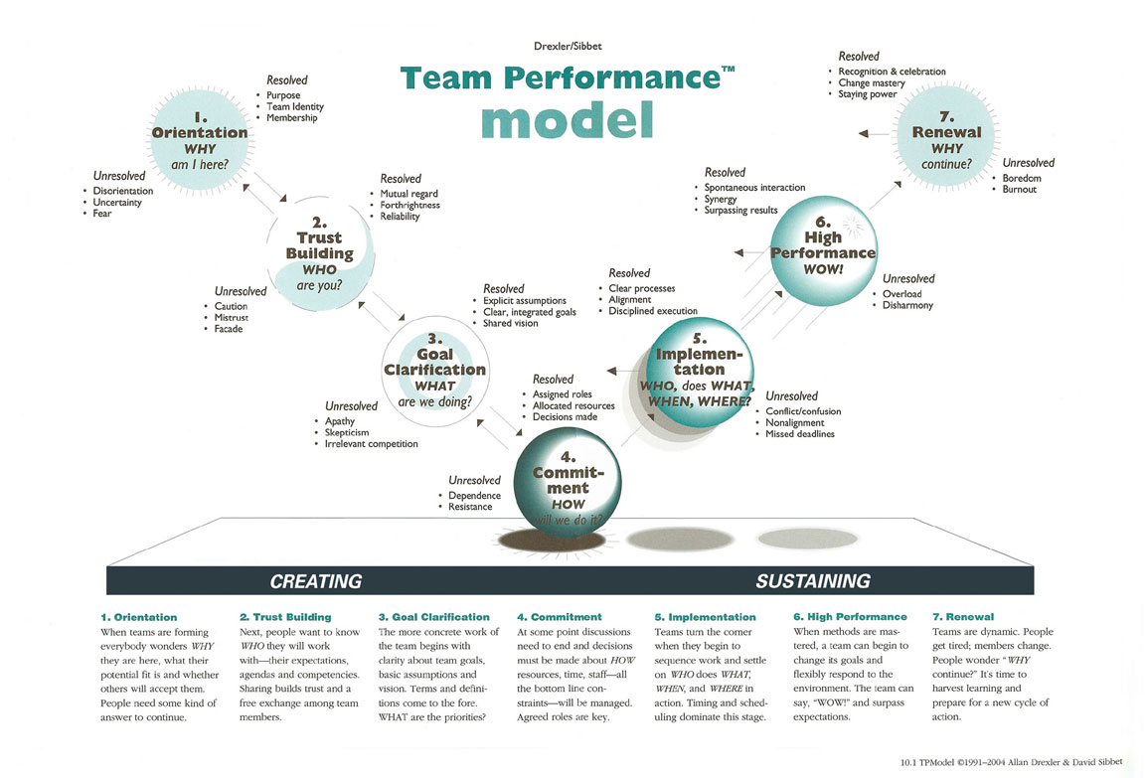
Notes:
http://hp-strategies.com/images/tpm.jpg

Slide 32

Orientation… Why am I leading AguaClara?
Seize the opportunity you have!
I learned to know and love Hondurans
I developed empathy for their struggles
Jacobo Nuñez asked me for help to bring safe water to rural towns and villages
I know what it is like to live without safe drinking water
How could I possibly say no?
Directing AguaClara is not in my job description

Slide 33
Monroe’s Philosophy – a work in progress
Useful labor leads to hope
Wisdom is in the group
Make mistakes boldly and learn from them.
Surround yourself with people who dream
Don’t burn bridges
You always have a choice – use it!
Exceed Expectations
Identify a need and then invent

Slide 34
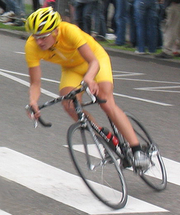
We Choose to Live with Hope that we can make a difference
The universe is like a bicycle. You have to lean in the direction you want to go!
We take the long view: changing the way engineers, policy makers, and communities think about water treatment will take time
We are less than a decade into this journey of creating the next generation of sustainable water treatment infrastructure

Slide 35
Hope, optimism, and meaning to make the world a better place
Working to improve the lives of others leads to hope
Hope motivates working to improve the lives of others
Working in teams, building community (and networks of organizations), respect for the other, and servant leadership are important elements of this cycle of hope

Slide 36
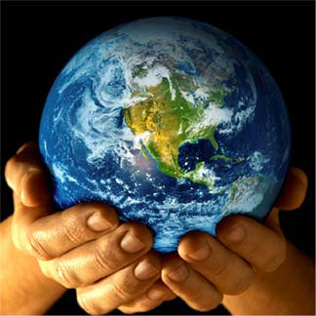
So, we want to change the world
Are we a drop in the bucket?
  One drop is 20 μL – one bucket is 20 L (factor of 1 million)
  Our goal is to improve the lives of about 3 billion
  We’ve changed the lives of 36,000
  Factor of 83,000
AguaClara is already 12 drops in a bucket!!!!!
9 years to get to 12 drops (1.3 drips per year)
999,988 drops to go… What’s our strategy?

Slide 37
Renewal
Celebrate 12 drops in a bucket! (and soon we will add Moroceli, Jesus de Otoro, Gufu, and Ronhe)
We, together, are creating a whole new engineering field of sustainable water infrastructure
Where are we going? Coming up!

Slide 38
What is AguaClara Cornell doing?
Solving a problem identified by a community
Creating a network of organizations to scale the solution globally
Patenting the technologies
Designing an appropriate technology
Preparing to have students share new technologies in January
Solving a problem identified by a development organization
Working with a community to implement a solution
Sharing the technologies
Designing the best technology
Preparing to have students build a water treatment plant in January

Slide 39
A few dreams for technology advances
A flocculator with a residence time under 3 minutes (10x faster than conventional design)
A sedimentation tank with NO sediment in the main part of the tank and no drain manifold
A stacked rapid sand filter with no slots to clog

Slide 40
Dreams for Program Advances at Cornell
Pilot facility with mechanized and hydraulic water treatment plants on the Cornell campus
A Cornell Center for Water and People

Slide 41
Dreams for AguaClara International
Shift from linear to exponential growth
Build a reputation for providing the leading technologies for drinking water treatment
Build a water treatment plant in the US

Slide 42
So where are we taking the universe?
Which direction are we going to lean?
We arrive at 2014 based on choices we made in 2006
Where do we want AguaClara to be in 2020?
  What do we want to invent?
  How shall the program evolve
  at Cornell and internationally?
  Work in groups of 2 or 3

Slide 43
Vision
AguaClara Cornell will become a global center of excellence for creating and disseminating sustainable drinking water & waste water treatment technologies and for pioneering engineering education that empowers students to engage with and solve global challenges.
Notes:
AguaClara is a program in Civil and Environmental Engineering at Cornell University that is improving drinking water quality through innovative research, knowledge transfer, Open Source Engineering and design of sustainable, replicable water treatment systems.

Slide 44
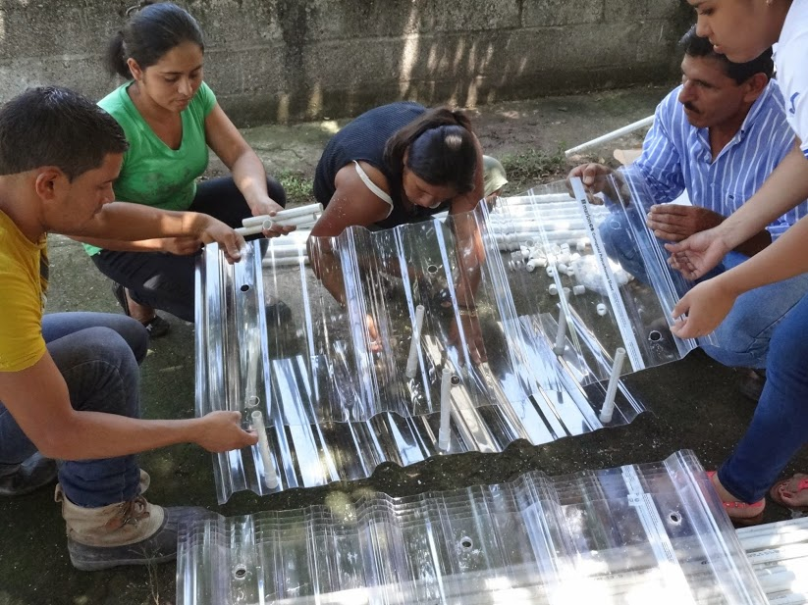
Notes:
Go forth and do good work! Celebrate that you are part of an international team dedicated to bringing safe drinking to communities everywhere!

Slide 45
Tamara with the First Stacked Rapid Sand Filter
0.3
What will happen when we combine well designed sed tank with a SRSF in San Nicolas?

Slide 46
Monroe’s Philosophy – a work in progress
Labor that improves the life of a community leads to happiness and satisfaction. (sharing is more fun)
Wisdom is in the group, power is in the community, ideas come from a network
I make mistakes. My goal is to learn from them.
Positive Energy – optimism - gratitude
  Surround yourself with people who can dream
  Dreaming makes it possible to create a new reality
Don’t burn bridges
You always have a choice – use it!
Exceed Expectations
Identify a need and then invent

Slide 47
We don’t give up easily!
“Do not lose hope. We work in India through obstacles all the time. These are not tough ones.
We shall certainly pilot AguaClara in India -- be it in [this state] or another state...”
-A senior environmental engineer in India

Slide 48
Plant Performance: without filters
5
0.3
A profound change in the well-being of a community that is self perpetuating!

Slide 49
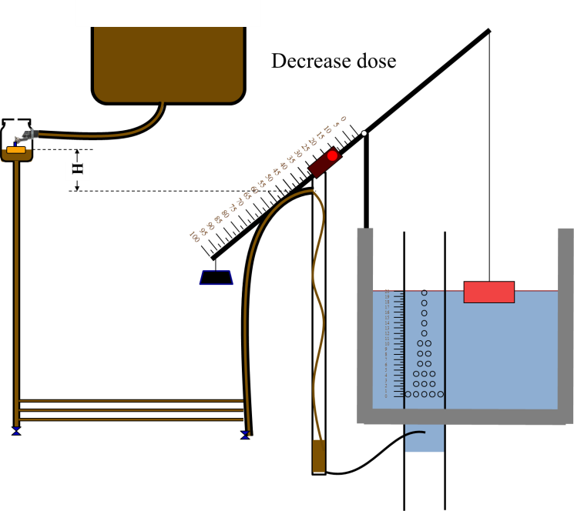
AguaClara expanded knowledge - Chemical Dose Controller
First gravity powered chemical dose controller
Easier to operate and maintain than the “high tech” computer controlled chemical pump

Slide 50
AguaClara expanded knowledge - Flocculation
New theory for why coagulants are sticky
First hydraulic flocculator design that accounts for turbulence
First predictive performance model for hydraulic flocculators
High rate flocculators with a residence time of about 10 minutes

Slide 51
AguaClara expanded knowledge - Sedimentation
First shallow sedimentation tank
First sedimentation tank designed to resuspend all particles to create a floc blanket
Reduced plate settler spacing to reduce plate settler depth by a factor of 2
Residence time in the sedimentation tank of only 30 minutes

Slide 52
AguaClara expanded knowledge - Filtration
Highest rate sand filtration system
First use of slotted pipes to inject water to be filtered into the sand bed
First use of airlock to control backwash siphon on a full scale filter

Slide 53
AguaClara expanded knowledge - Design
First automated parametric design of a water treatment plant
First web based design tool that produces customized designs based on user inputs

Slide 54
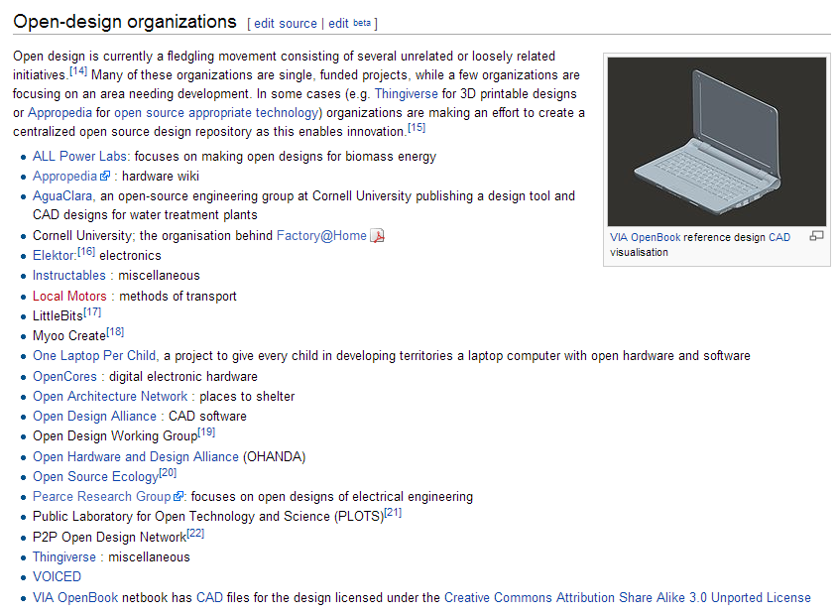
AguaClara expanded knowledge – Open Source
First engineering program that is open source

Slide 55
Mission Statement – needs to be revised!
AguaClara is a program in Civil and Environmental Engineering at Cornell University that is improving drinking water quality through innovative research, knowledge transfer, Open Source Engineering and design of sustainable, replicable water treatment systems.
^
and wastewater

Slide 56
AguaClara as a team?
I’ve always thought of teams as the subteams working on a well defined task
But we can vary the scale. Let’s zoom out…
AguaClara Cornell
AguaClara (APP-Honduras, Pradan-India, AguaClara Cornell, AguaClara LLC, Water boards, and communities)
Where is the AguaClara team?

Slide 57
Two Challenges
To become a VERY HIGH PERFORMING TEAM
AND MAKE the WORLD a BETTER PLACE

Slide 58
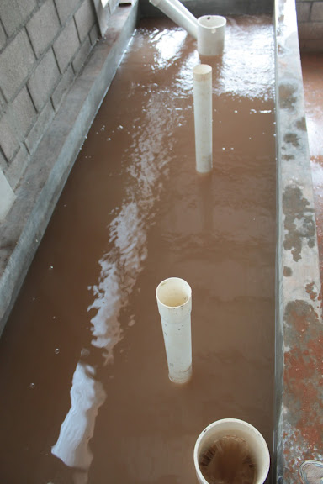
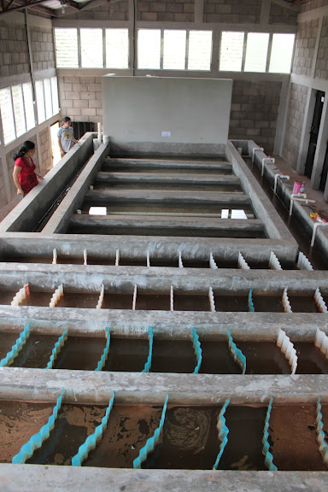
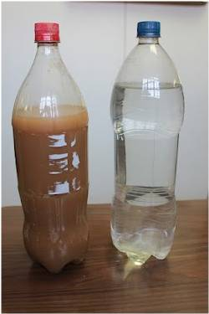
Clean that water!

Slide 59
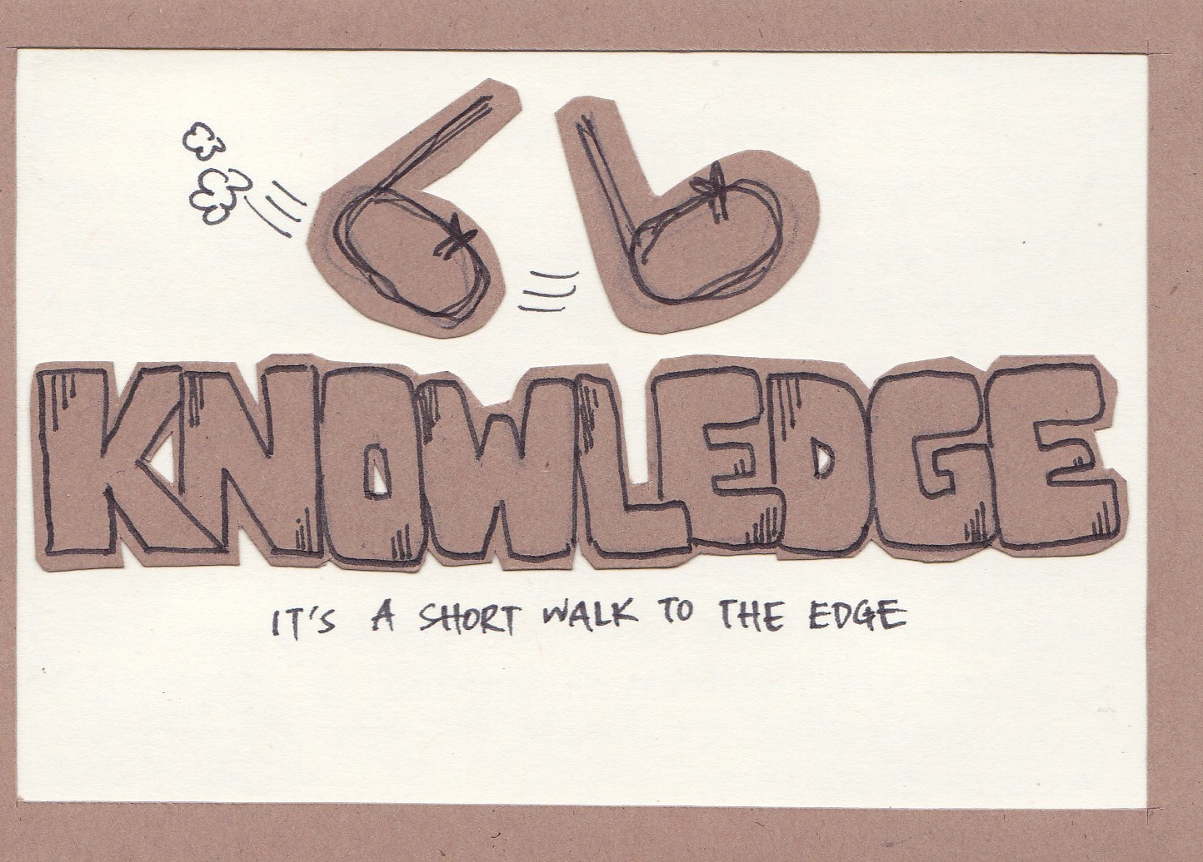

Slide 60
