Slide 1
How Water Flows Through the Plant

Slide 2
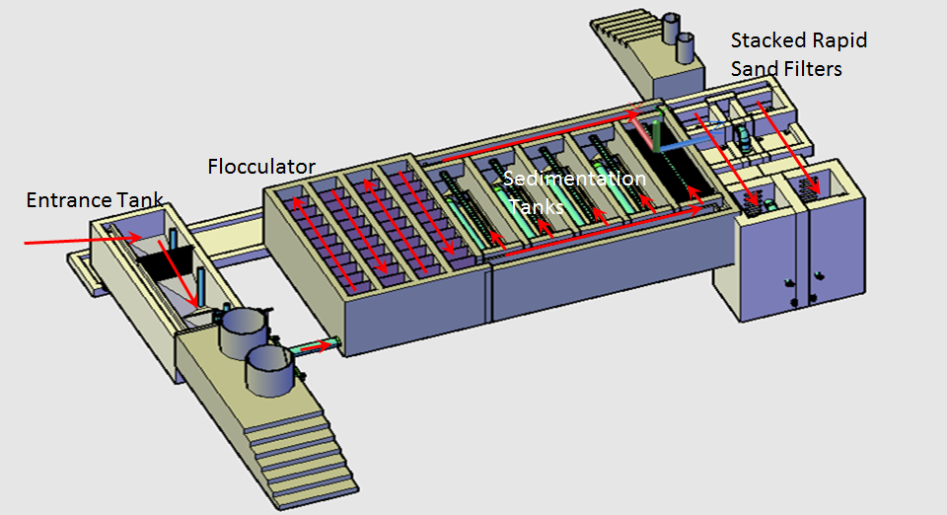
Notes:
The overall steps for how water flows through the plant: Entrance tank → Rapid Mix → Flocculation → Sedimentation → Filtration

Slide 3
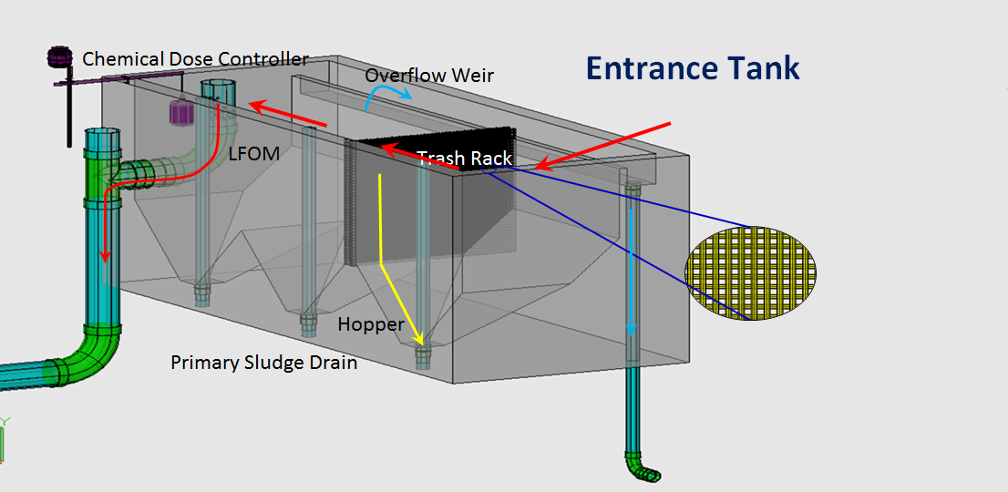

Slide 4
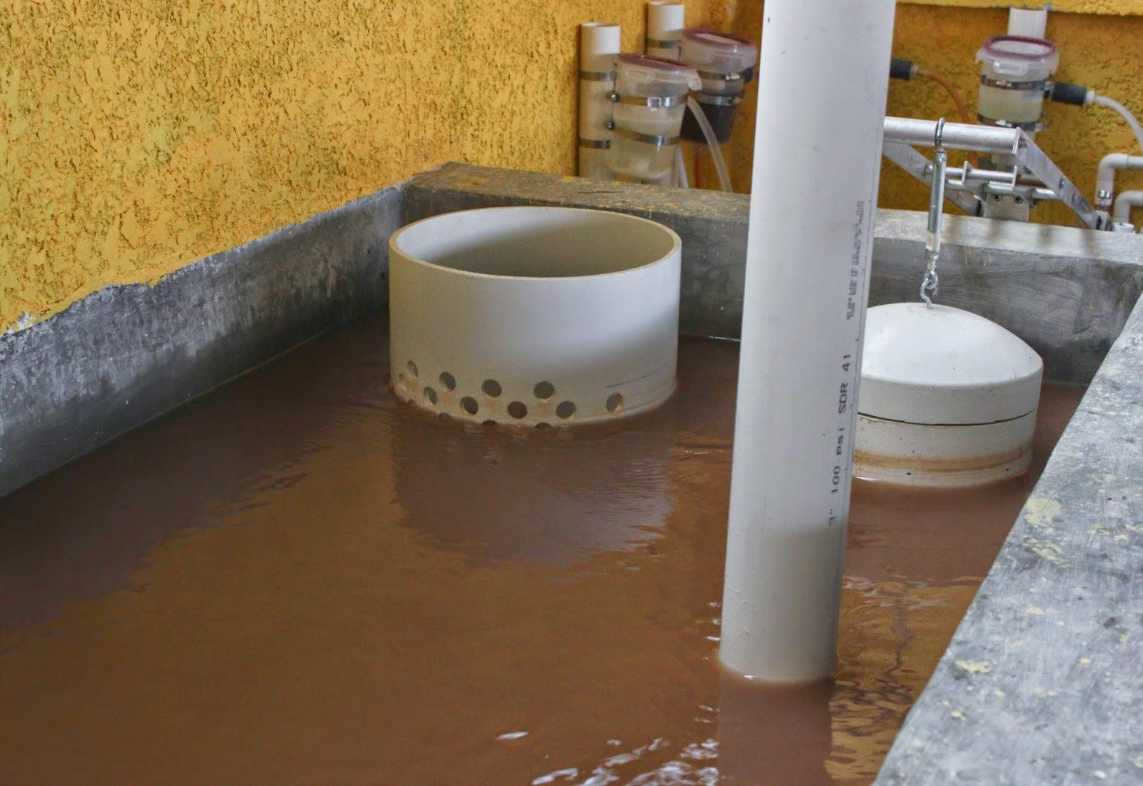
CDC Lever Arm
Float
LFOM
Notes:
The stock tank holds a stock chemical solution which is connected to a constant head tank. The constant head tank is regulated by a float valve which keeps the chemical depth constant. The plant operator sets the slider at the desired coagulant dose based upon characteristics of the influent water. The float attached to the lever changes position as flow rate into the plant changes, thus changing the elevation of the large diameter tube’s outlet, and maintaining a constant chemical dose.
LFOM: Need height in entrance tank to vary linearly with the plant flow rate → LFOM
provide a linear relationship between the flow rate through the plant and the height of water in the entrance tank. This will allow the Linear Chemical Doser to connect the plant flow rate to the flow controller via a lever to add Alum and Chlorine to the raw water as a function of flow rate through the plant.
The linear Chemical Dose Controller (LCDC) is a critical piece of the AguaClara technology which couples the plant flow rate with the flow rate of the coagulant or disinfectant stock solution. The result is a semi-automated system in which the plant operator only needs to set a dose for the chemical and it will be administered automatically as the plant flow rate varies.

Slide 5
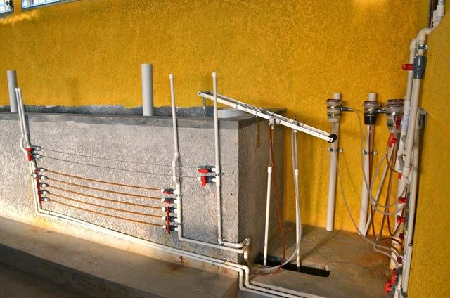
Entrance Tank and Chemical Dose Controller

Slide 6
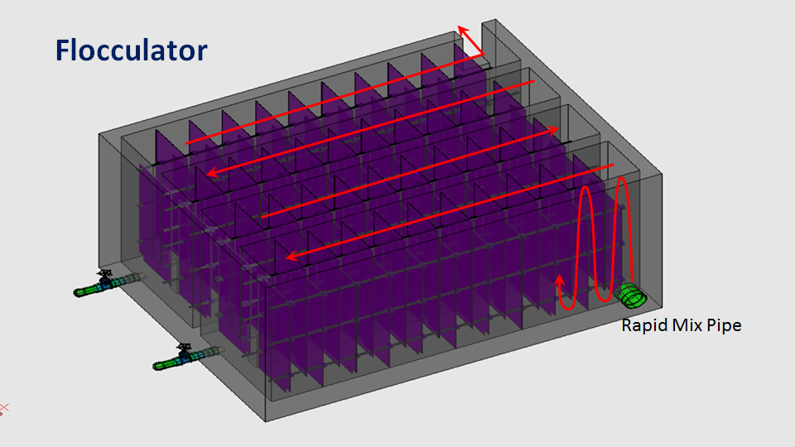
Notes:
Rapid Mix: Mix coagulant with raw water. Flow through an orifice → High Energy dissipation
Flocculation → Aggregation of particles. Water flows over and under the baffles and the particles will collide because of velocity gradients. The particles that collide can form flocs which will be settled out during sedimentation.

Slide 7
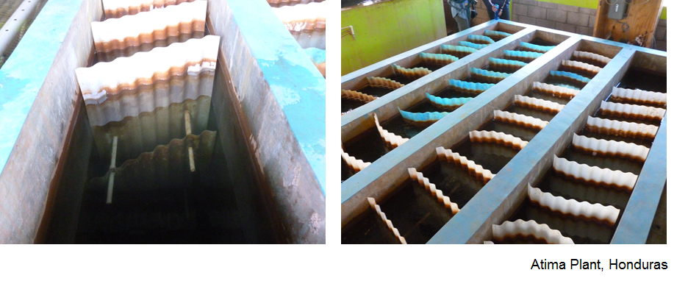
Flocculator
Notes:
These are pictures of the flocculator from the Atima plant in Honduras. The picture on the left shows the top of the upper baffle and you can see the top of the lower baffle submerged.

Slide 8
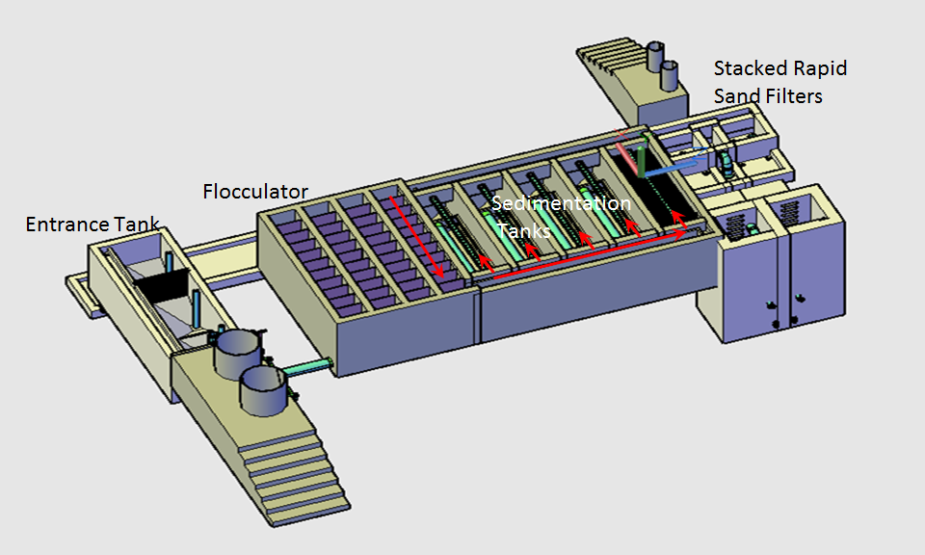
Notes:
Show what part of the plant we are at now relative to the entire plant.

Slide 9
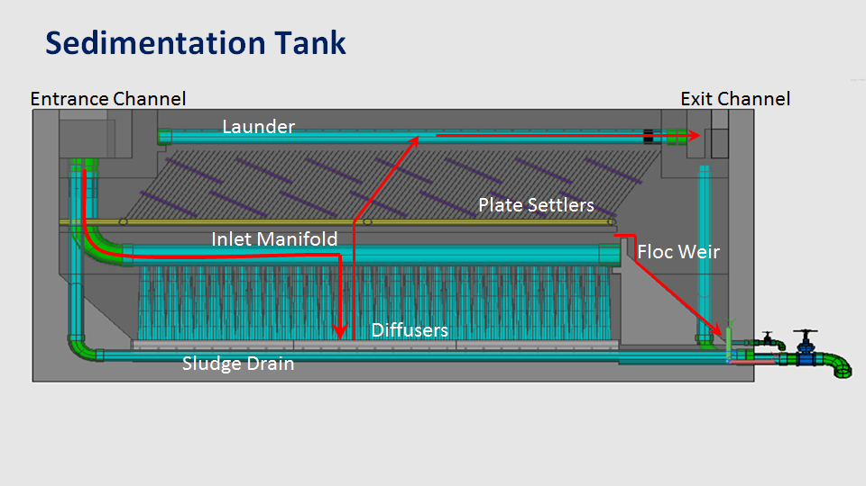
Notes:
-Floc must be able to settle unto the surface of a plate settler. It must slide down the incline to reach the lower section of the sed tank and then it must be removed from the lower section of the sed tank. Plate settlers make it possible to reduce sed tank area.
Two reasons why water accelerates when it enters the plate settlers.
1)It has less cross sectional area due to the space occupied by the plate settler material
2)It must maintained the same vertical flow velocity and it must also add a horizontal component due to the slope of the plates.
-Floc Blanket: Fluidized bed of flocs that act as a combination filter/flocculator
-Floc Weir- controls the depth of the floc blanket.

Slide 10
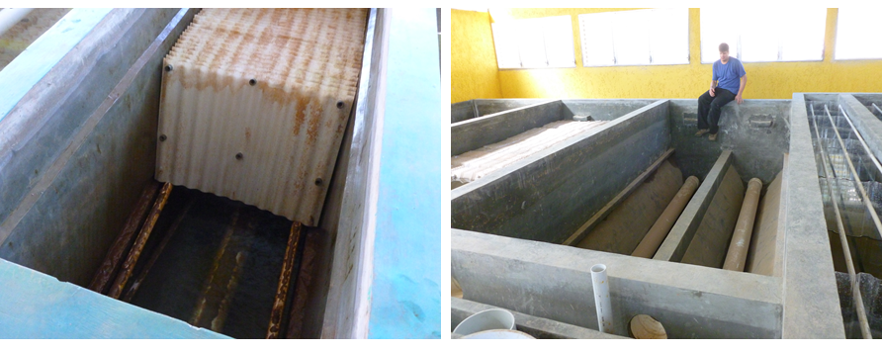
Sedimentation Tank
Plate Settlers
Plate Settlers Removed

Slide 11
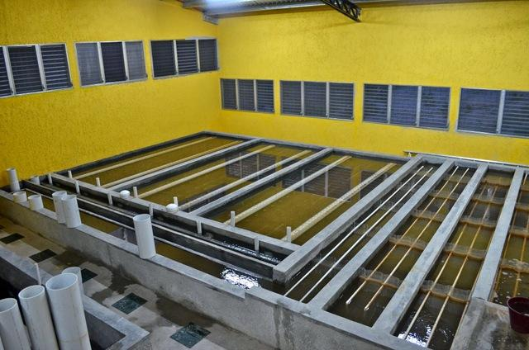
Sedimentation Tanks
Flocculation
Notes:
San Nicolas Plant in Honduras

Slide 12
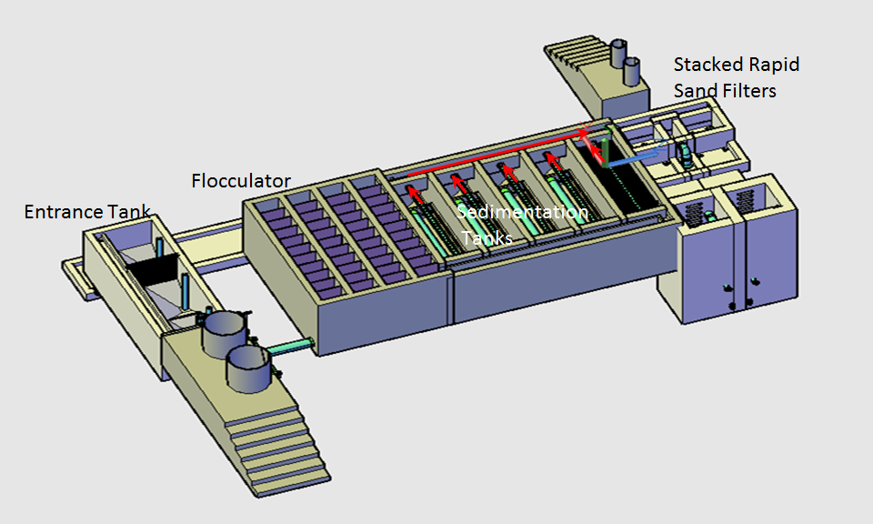
Notes:
Filters

Slide 13
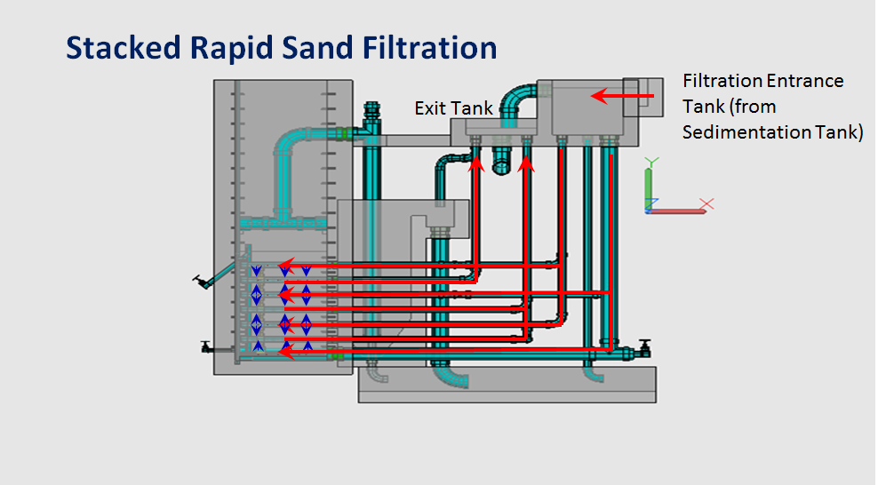
Notes:
The stacked rapid sand filter is a novel self-backwashing filter invented by the AguaClara team. Its unique stacked geometry allows it to use the same flow rate for the filtration and backwash cycles, without the expensive pumps or elevated tanks required to backwash conventional rapid sand filters. In addition, a stacked filtration system requires a much smaller footprint than a conventional filter to treat a given flow rate.

Slide 14
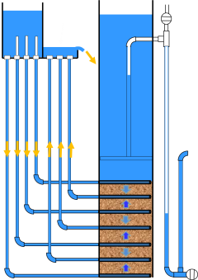
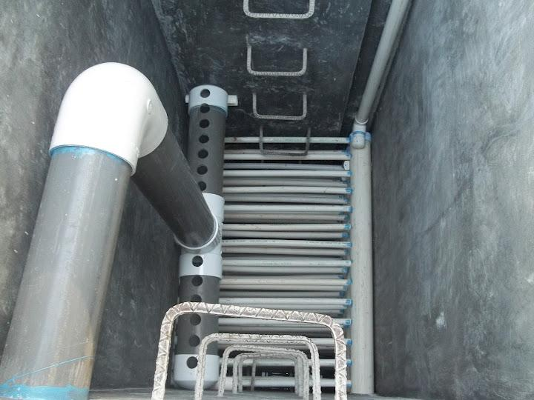
Stacked Rapid Sand Filter without sand showing slotted pipe system

