Slide 1
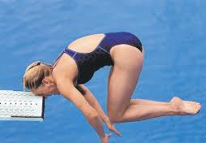
Traumatic Brain Injury
Clare Hyatt, DVM, MS
Resident, Emergency and Critical Care
Cornell University
May 5, 2015

Slide 2
Traumatic brain injury
Pathophysiology
Diagnosis
Monitoring and Treatment
Prognosis

Slide 3
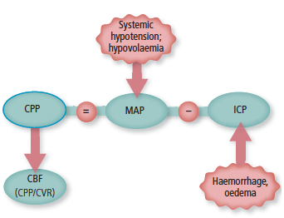
Pathophysiology
Brain – 15-20% of total cardiac output
Cerebral blood flow affected by
  Systemic arterial blood pressure
  Cerebral metabolic rate
  Blood oxygenation levels
  Carbon dioxide levels

Slide 4
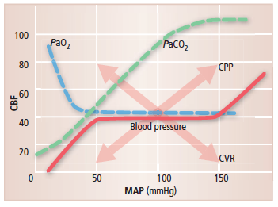
Pathophysiology
Autoregulation
  Intrinsic ability to maintain cerebral blood flow over a wide range of blood pressures or fluctuations in cerebral perfusion pressure
  MAP 50-150 mmHg
  Myogenic factors
Notes:
Myogenic factors – vascular smooth muscle tone
Chemical mech – dec O2 or inc CO2 → vasodilation; NO
Neurogenic mech: SNS/PNS innervation
Intact BBB required for proper autoregulation

Slide 5
Pathophysiology
Loss of autoregulation
  Disruption of BBB
  Decline in CPP
  Allows CBF to passively follow arterial pressure and be less responsive to changes in oxygen delivery
  CPP <40 mmHg

Slide 6
Pathophysiology math sucks
CPP = MAP – ICP
CBF = CPP/CVR
= (MAP – ICP)/CVR
  CVR depends on
    Blood viscosity
    Vessel diameter
Notes:
CVR = cerebral vascular resistance

Slide 7
Pathophysiology
Reduction in CBF
  ICP elevations
  Edema
  Hematomas
  Compression of vessels
  Vasospasm
  Shock/hypotension
  →Brain ischemia

Slide 8
Pathophysiology
Primary injury
Secondary injury
Immediate result of traumatic event
Concussion
Contusion
Laceration
Hematoma
Skull fracture
Occurs in the hours to days following trauma
Local factors
Systemic factors
Intracranial factors
Notes:
Primary: acceleration, deceleration, rotational forces. Superficial grey matter is most susceptible to forces of acceleration →contusion and hemorrhage, tearing of neuronal tissue. Rotational forces impact deeper white matter – concussive injuries and axonal injuries
Caused by complex series of events including release of inflammatory mediators and excitatory neurotransmitters, and changes in cellular permeability.

Slide 9
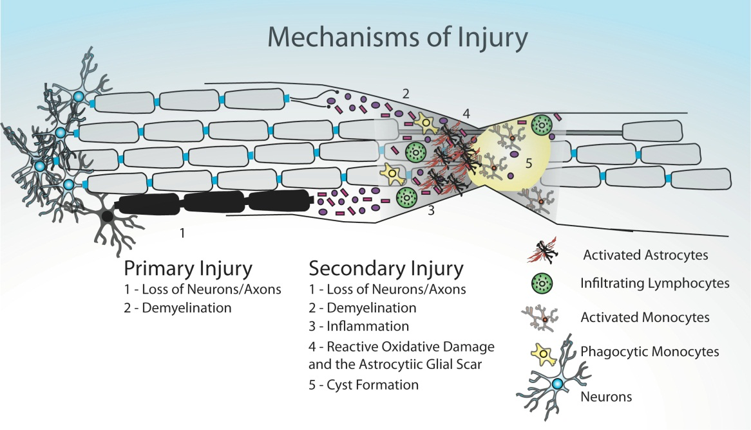

Slide 10
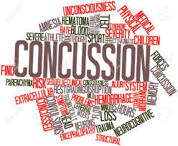
Primary injury
Concussion
  Brief loss of consciousness
  No underlying histopathologic lesion

Slide 11
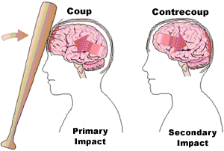
Primary injury
Contusion
  Parenchymal hemorrhage and edema
  Clinical signs mild to severe
  “Coup” – under site of impact
  “Counter-coup” – opposite hemisphere
  Result of displacement of brain within skull
Notes:
Unconciousness for more than several minutes is more likely to be contusion vs concussion

Slide 12

Primary injury
Laceration
  Most severe
  Physical disruption of the brain parenchyma
Notes:
Unconciousness for more than several minutes is more likely to be contusion vs concussion
Axial hematoma – brain
Extraaxial hematomas – subarachnoid , subdural, epidural spaces

Slide 13
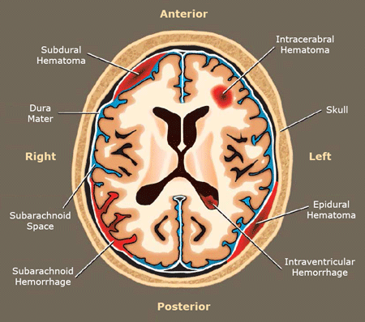
Hematoma
Axial – within brain parenchyma
Extraaxial – outside of brain parenchyma
→Subarachnoid
→Subdural
→Epidural
Notes:
Axial -
Subarachnoid – betn arachnoid and pia mater
Subdural betn dura mater and brain
Epidural – betn dura mater and skull

Slide 14
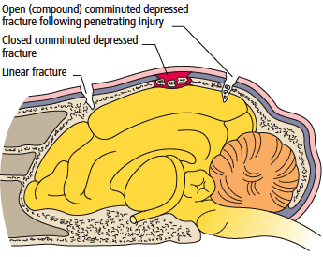
Skull fractures
Pattern
  Depressed
  Comminuted
  Linear
Location
Type
  Open
  Closed
Notes:
Depressed – most common on dorsal and lateral aspects of the skull.
Fractures on some locations difficult to evaluate
Bullae fractures- can result in vestibular signs or facial nerve/Horners issues

Slide 15
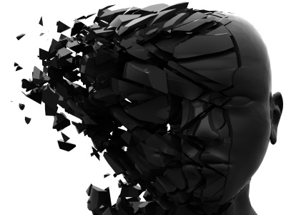
Secondary injury
Biochemical events → neuronal cell death
Local factors
Intracranial factors
Systemic factors

Slide 16
Secondary Injury
Local factors
Complex series of events leading to neuronal cell death
  Glutamate accumulation
  Sodium and calcium influx into cells
  Free radical production
  Inflammatory mediator release
  Loss of autoregulation

Slide 17
Secondary injury
Glutamate accumulation
Caused by…
Leads to…
ATP depletion
Neuronal cell injury
Positive feedback
Decreased conversion
Potentiated by low interstitial magnesium
Loss of ionic gradients
Excitotoxicity
Cytotoxic edema
  Influx of sodium and calcium into neuronal cells
Generation of free radical oxygen species

Slide 18
Secondary injury
Calcium influx
Caused by glutamate accumulation and primary injury
Leads to
  Cytotoxic edema
  Neuronal cell destruction through activation of proteases, lipases and endonucleases
  Reactive oxygen species production through calpain activation
  Inflammatory mediator release
  Mitochondrial dysfunction and ATP depletion

Slide 19
Secondary injury
Reactive oxygen species
Production favored by hypoperfusion and local tissue acidosis
Hemorrhage provides iron favoring free radical production
Catecholamines contribute to the production of free radicals by direct and indirect mechanisms
ROS oxidize lipids, proteins, DNA → further neuronal destruction
Lipid rich brain is particularly susceptible to ROS damage

Slide 20
Secondary injury
Free radical production
Secondary to:
  Glutamate accumulation
  Inflammatory mediator release
  Increased cytosolic calcium concentrations
  Ischemia-reperfusion injury
Results in neuronal cell destruction

Slide 21
Secondary Injury
Inflammatory mediator release
Loss of autoregulation
Secondary to Primary injury
Neuronal cell destruction with secondary injury
Results in:
  Activation of nitric oxide
  Inflammatory cell influx
  Coagulation cascade activation and thrombosis
Occurs secondary to primary injury
Results in Ischemia

Slide 22
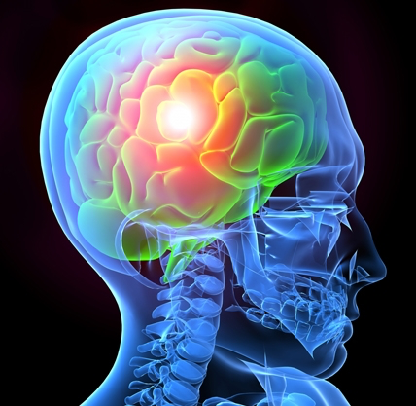
Secondary injury
Intracranial insults
Increased ICP
BBB compromise
Mass lesions
Cerebral edema
Infection
Vasospasm
Seizures

Slide 23

Secondary injury
Systemic insults
Hypotension
Hypoxemia
Systemic inflammation
Hyper/hypoglycemia
Hyper/hypocanpia
Hyperthermia
Electrolyte disturbances
Acid-base disturbances

Slide 24
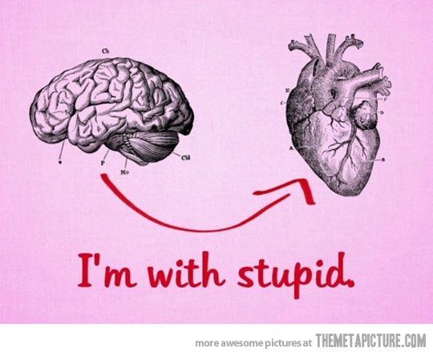
Secondary injury
Potentiated by compromise of perfusion
Cerebral perfusion pressure
Monroe Kellie Doctrine
Cushings Reflex

Slide 25
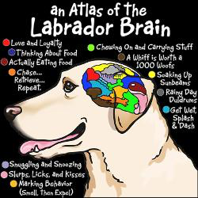
CPP = MAP – ICP
Compromised CPP
  Primary and secondary injuries
  Systemic effects of trauma
Normal ICP: 5-12 mmHg

Slide 26
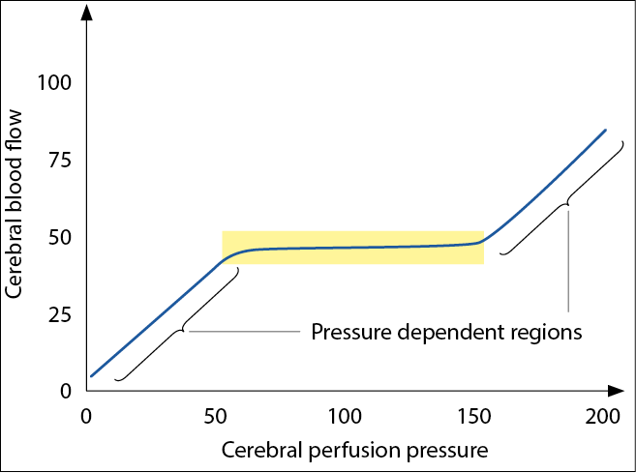
Cerebral blood flow
Cerebral blood flow (CBF)
  CBF = CPP/CVR
  = (MAP – ICP) / CVR
  MAP range 50-150 mm

Slide 27
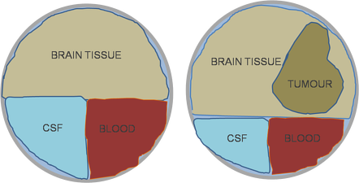
Monroe-Kellie Doctrine
Notes:
Intracranial volume = brain vol + CSF vol + blood vol + mass lesion vol

Slide 28
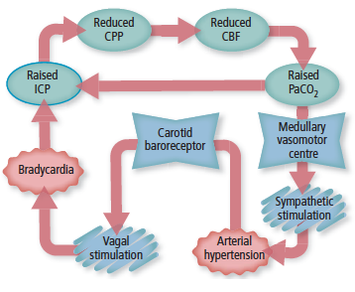
Cushing’s reflex
Central nervous system ischemic response
Rise in MAP
Reflex decrease in HR
Sign of potentially life-threatening increase in ICP

Slide 29
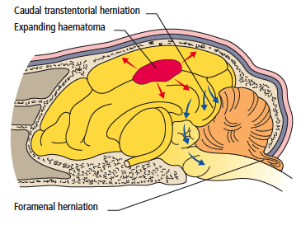
Herniation
4 types
Falcine
  One cerebral hemisphere to the falx cerebri
Transtentorial
  Parahippocampal gyrus below the tentorium cerebelli
  Compression of the midbrain →mydriatic unresponsive pupils, loss of consciousness
Foramenal
  Out the foramen magnum
Calvarial
  Out a defect in the skull
Notes:
Sign of impending transtentorial hernation is asymmetric mydriasis followed by symmetrical mydriasis as the PNS portion of the CN III nucleus is compressed

Slide 30
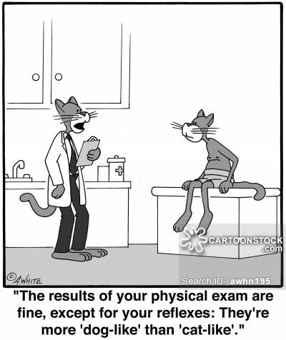
Neurologic assessment
Level of consciousness
Posture/Gait/Motor function
Cranial nerve assessment
  Eye position
  Eye movement
  Pupil size and PLR
  Oculovestibular reflexes
Pain
Reflexes/CPs
Generate MGCS score
More thorough assessment once stabilized

Slide 31
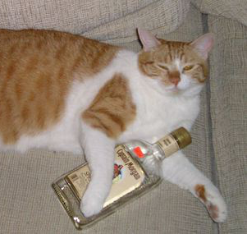
Neurologic assessment
Level of consciousness
Alert and responsive
Obtunded
  Slow or inappropriate response to sensory behavior
Stupor
  Generally responsive except to vigorous or painful stimuli
Coma
  Complete unresponsiveness to noxious stimulation
Notes:
Consciousness mechs located in rostral brainstem, ascending reticular activating system, diffusely thru cerebrum
Progression to lesser states of consciousness often caused by increases in ICP
Unconscious patients likely to have global impairment of autoregulatory responses

Slide 32
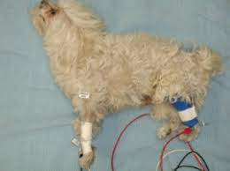
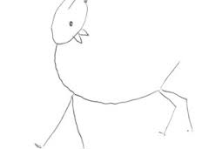
Decerebellate rigidity
Posture
Cerebellar lesion
Extensor rigidity in thoracic (+/- pelvic) limbs
Conscious

Slide 33
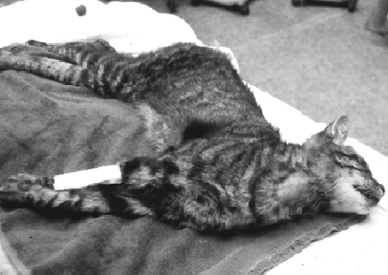
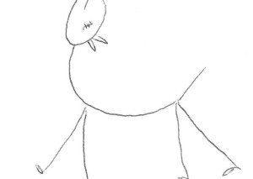
Decerebrate rigidity
Posture
Midbrain lesions
Unconsciousness
Recumbency
Opisthotonus
Rigid extension of all limbs
Grave prognosis

Slide 34


Schiff-Sherrington
Posture
Extensor rigidity thoracic limbs
Severe myelopathy hindlimbs
T3-L3 lesion
Normal brain

Slide 35
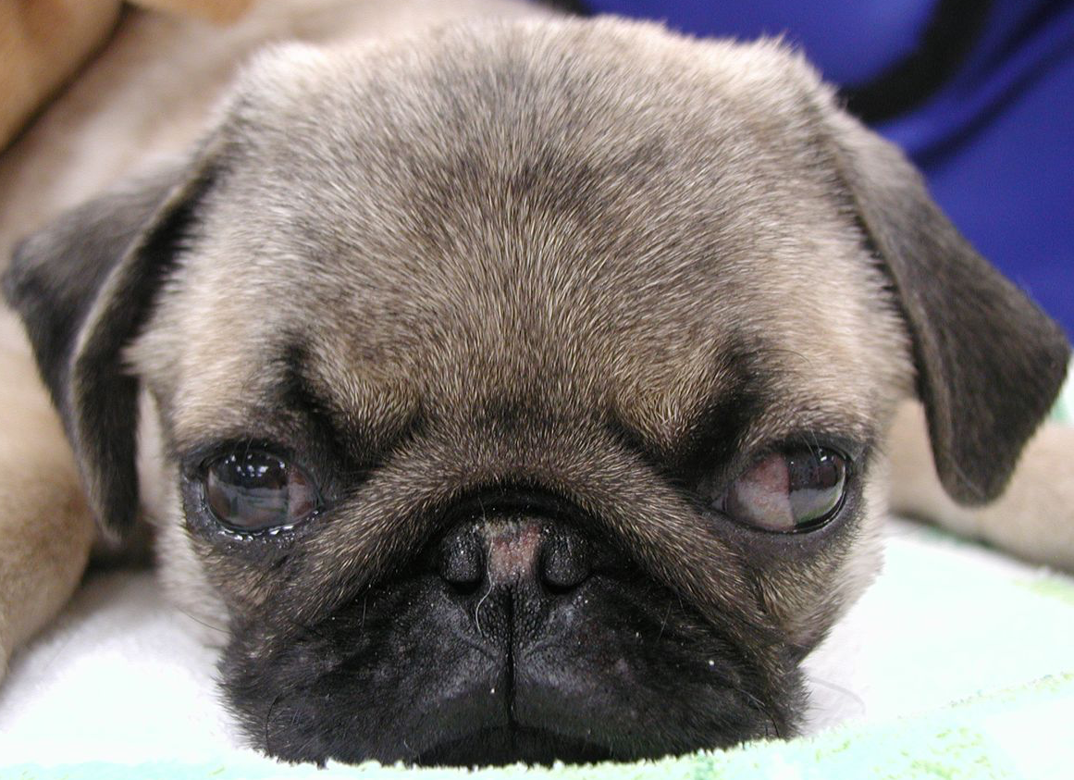
Neurologic assessment
Eye position
Abduction (lateral)
  Medial rectus paresis – CN III damage
Adduction (medial)
  Lateral rectus paresis – CN IV damage
  Damage to rostral medulla

Slide 36
Neurologic assessment
Oculocephalic reflex
Elicited by moving head side to side
Interrogates functional integrity of large areas of brainstem and CNs involved in eye movements
Brainstem pathways from cranial cervical spinal cord and medulla oblongata rostrally to the nuclei of CN III, CN IV and CN VI
Notes:
Aka oculovestibular

Slide 37
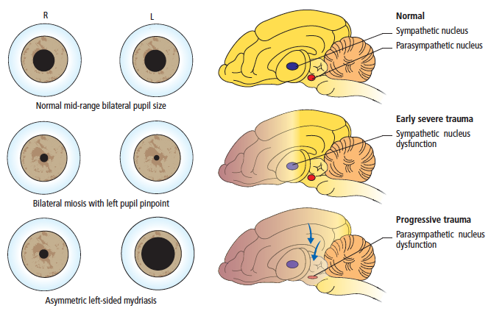

Slide 38

Pupil size
Mydriasis
Midbrain or CN III
Ipsilateral or bilateral lesion
Notes:
Pupillary constriction – midbrain and parasym fibers of CN III
In absence of eye injury → brainstem dysfunction = abnormal PLR

Slide 39
Pupil size
Miosis
Brainstem injury – severe, ipsilateral
Horner’s syndrome component – sympathetic pathway to the eye
Ocular injury, ciliary spasm
Notes:
Horners – peripheral sympathetic innervation to the eye affected – pathway includes brachial plexus, cranial mediastinum, cervical soft tissues and tympanic bulla
Third eyelid elevation, enophthalmos and ptosis.

Slide 40
Pupil size
Severe bilateral miosis
Acute extensive brain disturbance
Functional disturbance of higher centers
Release of CN III inhibition

Slide 41
Pupil size
Severe bilateral unresponsive mydriasis
Midbrain damage, herniation
  Grave prognosis
Decreased cerebral perfusion, post-ictal, trauma to iris or retina, periorbital trauma, previous ocular abnormalities

Slide 42
Pupil size
Miosis→Mydriasis
Deteriorating neurological status
Requires immediate aggressive therapy

Slide 43
Pupil size
Return of pupils to normal size and responsiveness to light is a favorable prognostic sign

Slide 44
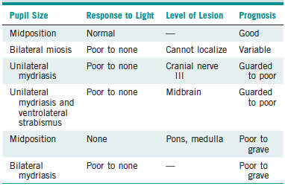
PLR/pupil size

Slide 45
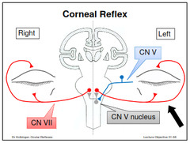
Corneal reflex
Touching cornea → bilateral eyelid closure
Absent w/ damage to:
  Trigeminal n. (CN V)
  Efferent facial nerve CN VII
  Reflex connections within pons and medulla oblongata

Slide 46
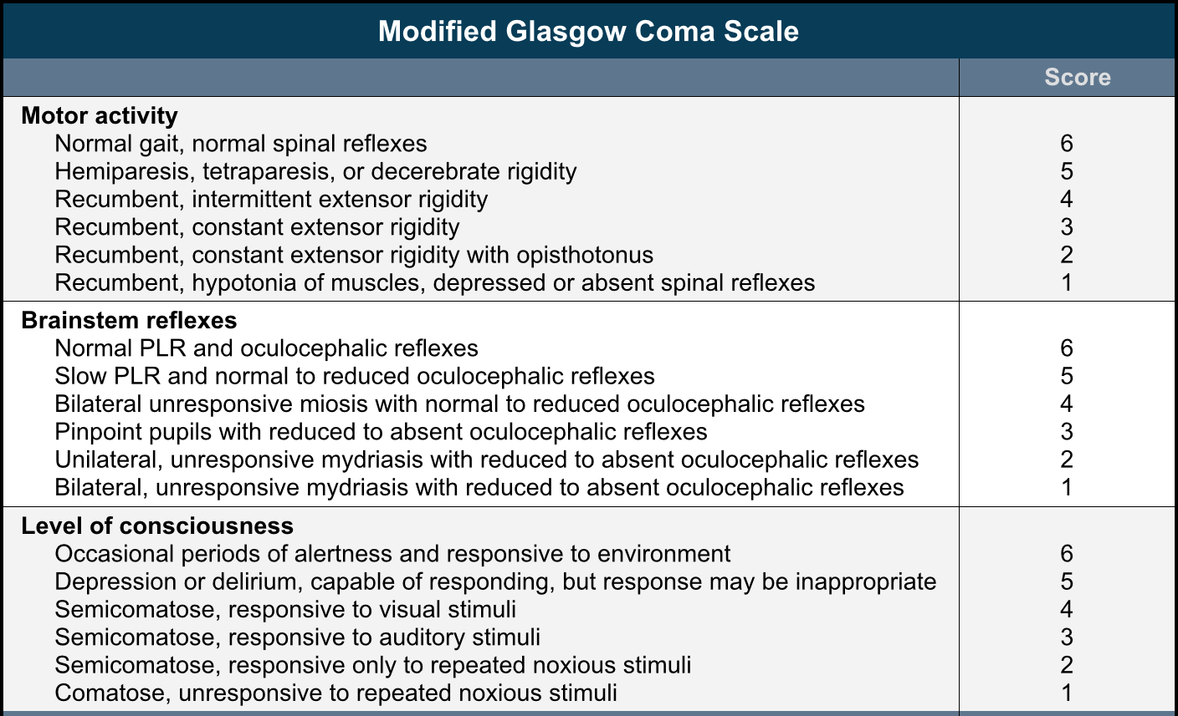
Neurologic Assessment
Modified Glasgow Coma Scale

Slide 47
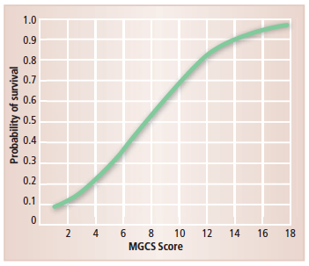
MGCS and survival

Slide 48
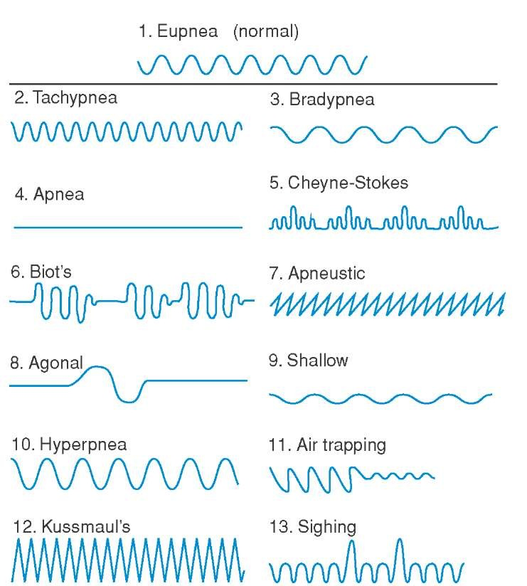
Assessment of respiration
Cheyne-Stokes
Central neurogenic hyperventilation
Neurogenic pulmonary edema
Agonal breathing

Slide 49
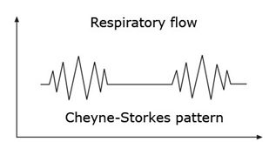
Assessment of respiration
Cheyne-Stokes
https://www.youtube.com/watch?v=VkuxP7iChYY
Notes:
Phases of hyperpnea
Regularly alternating with apnea
Implies lesion deep in the cerebral hemispheres or rostral brainstem

Slide 50
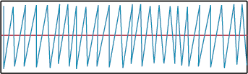
Assessment of respiration
Central neurogenic hyperventilation
Notes:
Central neurogenic hyperventilation (CNH) is an abnormal pattern of breathing characterized by deep and rapid breaths at a rate of at least 25 breaths per minute. Increasing irregularity of this respiratory rate generally is a sign that the patient will enter into coma.
CNH is the human body's response to reduced carbon dioxide levels in the blood. This reduction in carbon dioxide is caused by contraction of cranial arteries from damage caused by lesions in the brain stem. However, the mechanism by which CNH arises as a result from these lesions is still very poorly understood.

Slide 51
Assessment of ventilation
Neurogenic pulmonary edema
Seizures, head trauma, subarachnoid hemorrhage, subdural hematoma, etc.
Blast theory
  Surge of sympathetic stimulation – a “catecholamine storm” initiated by medulla
  Volume shift from systemic circulation to the pulmonary circulation
  Pulmonary and systemic hypertension →increased capillary hydrostatic pressure
  Damage to the capillary-alveolar epithelium and tight junctions →vascular leakage and pulmonary edema

Slide 52
Assessment of ventilation
Neurogenic pulmonary edema
Potential other players
  Neuropeptide Y
    Directly increases permeability of pulmonary vasculature
  Endothelin-1
    Vasoconstrictor – increases pulmonary vascular pressure

Slide 53
Assessment of ventilation
Agonal breathing
Chaotic or gasping respirations
“Last gasps”
Caudal brainstem damage
Terminal respiratory pattern of severe ICH
Strongly suggests that animal is deteriorating and mandates more aggressive medical therapy or sx
Notes:
Chaotic or gasping respirations
Caudal brainstem damage
Terminal respiratory pattern of severe ICH
Strongly suggests that animal is deteriorating and mandates more aggressive medical therapy or sx

Slide 54
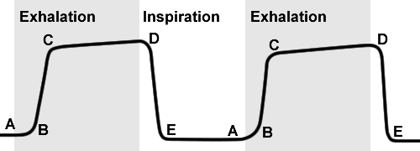
Assessment of ventilation
Arterial vs Venous PCO2 vs End tidal CO2
Hypercapnia → cerebral vasodilation → increased cerebral blood volume → worsened ICP
Maintain PaCO2 between 35-40 mmHg
Notes:
Arterial ideal, but VBG can be substituted if art not available. Venous will exceed arterial by 2-5 mmHg. Perhaps more difference if poor perfusion present.
End tidal underestimates PaCO2 by ~5mmHg.

Slide 55
Diagnosis
Imaging
Radiographs
Ultrasound
Computed tomography
Magnetic resonance imaging

Slide 56
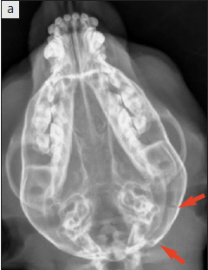
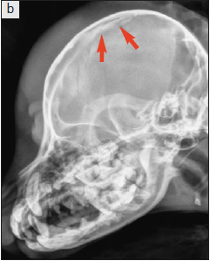
Diagnostic imaging
Radiography
Notes:
Fractures
No info regarding brain parenchyma
Anesthesia
positioning

Slide 57
Diagnostic imaging
Ultrasonography
Evaluate brain thru defect
Hemorrhage
  Hypoechoic in acute stages
  May become hyperechoic over time

Slide 58
Diagnostic imagine
Computed tomography
Superior evaluation of bone vs plain film
Inferior evaluation of brain parenchyma compared to MRI
3D reconstruction capabilities
Intracranial hemorrhage, midline shift, edema, surgical planning
Preferred in human medicine – speed
Hemorrhage –
  Hyperattenuating (hyperdense) – acute
  Hypoattenuating – resolving/chronic
Edema
  Hypoattenating

Slide 59
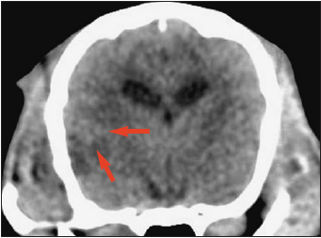
Diagnostic imaging
Computed tomography
Notes:
Soft tissue window
Large hypoattenuating lesion in temporal lobe – cystic lesion secondary to hemorrhage

Slide 60
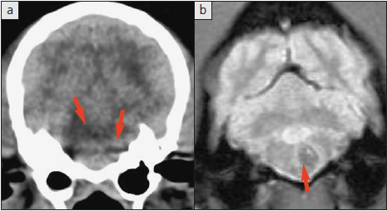
Diagnostic imaging
CT vs MR
Notes:
CT
T2 star weighted MR

Slide 61
Diagnostic imaging
Magnetic resonance imaging
Superior soft tissue detail
Preferred for parenchymal evaluation
Able to detect fractures
  STIR and gradient echo sequences

Slide 62
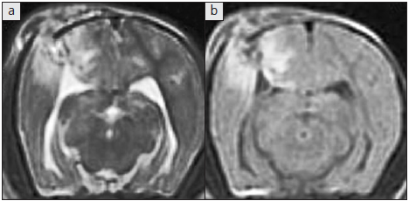
Diagnostic imaging
Magnetic resonance imaging
Notes:
Superior soft tissue detail
Transverse t2 weighted and t2 weighted FLAIR
Hyperintensity on the FLAIR image indicates edema around the skull fracture
FLAIR – more sensitive to edema lesions – can suppress CSF and other free water

Slide 63
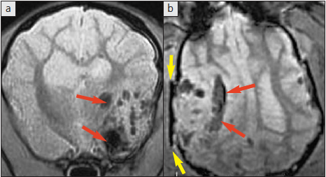
Diagnostic imaging
Magnetic resonance imaging
Notes:
Transverse and dorsal T2* gradient echo
Hypointense = black areas = hemorrhage
Yellow arrows - fracture

Slide 64
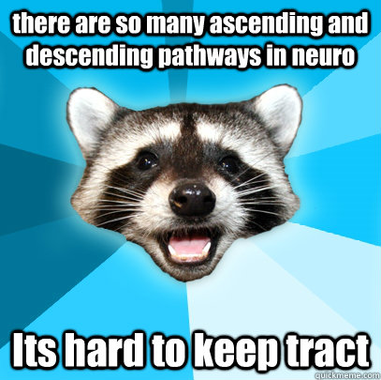
Monitoring and Treatment
Initial stabilization
Hyperosmotic agents
Corticosteroids
Furosemide
Hyperventilation
Seizure treatment/prophylaxis
Analgesics
Intracranial pressure monitoring
Etc.

Slide 65
Initial stabilization
Resuscitation of hypovolemic shock
Oxygen supplementation
  Avoid hyperoxia – may worsen reperfusion injury
Crystalloids
  0.9% NaCl recommended
    Least free water → less likely to contribute to cerebral edema
Colloid
Notes:
Colloids are not recommended over crystalloids

Slide 66
Hyperosmotic agents
Mannitol and Hypertonic saline
Mainstay of treatment for increased intracranial pressure
Impermeable to the blood-brain barrier
Affects normal tissue

Slide 67
Mannitol
Sugar alcohol
Excreted unchanged in urine
Decreased ICP, increase CPP and CBF
Free radical scavenging properties
Within minutes – rheology effect
Within 15-30 minutes – osmotic effects
0.5-1.5 g/kg.

Slide 68
Hypertonic saline
Dehydrates cerebrovascular endothelial cells
  Decreased vessel diameter
  Decreased ICP
  Enhancing delivery of O2 to brain
Saline does not cross BBB, pulls fluid from brain cells
  Similar rheologic and osmotic effects as mannitol
Improves hemodynamic status – better for hypotense patients
Immunomodulatory ffects

Slide 69

Corticosteroids
Potent anti-inflammatories
Worse outcome (CRASH trial)

Slide 70
Furosemide
Alone or with mannitol
Decrease invtravascular volume and hydrostatic pressure
Potential for intravascular volume depletion and systemic hypotension → decreased CPP
Not recommended by Brain Trauma Foundation
Should be reserved for indications other than cerebral edema

Slide 71
Seizure treatment/prophylaxis
Immediate (<24h)
Early (24h-7d)
Late (>7days) – (up to 13% of human TBI patients)
Human patients treated in the first 7 days after head trauma had lower risk of seizures

Slide 72
Seizure treatment/prophylaxis
Levetiracetam 20mg/kg (60mg/kg for loading)
Barbiturates
  Phenobarbital 2-3mg/kg; loading dose of 18-24mg/kg over 24-48 h) – significant sedation
Diazepam/Midazolam
Propofol CRI

Slide 73
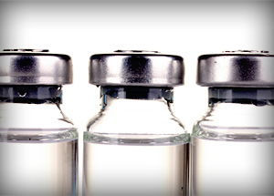
Analgesics
Opioids
Full agonist – reversible
Good analgesia
Methadone, fentanyl and friends, hydromorphone, morphine

Slide 74
Analgesics
Ketamine
Neuroprotective properties against ischemic and glutamate induced injury
Cardiovascular and respiratory sparing
Increases cerebral O2 consumption – possibly by GABA inhibition
Historically considered to increase ICP, but recent studies debunk this

Slide 75
Analgesics
Alpha-2 agonist
No effect on ICP in dogs
Decreases heart rate → changes in cerebral perfusion

Slide 76
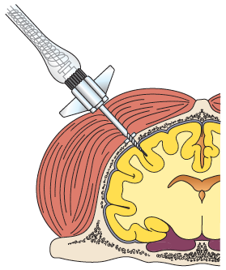
Intracranial pressure monitoring
Sounds like fun eh?
Transducer into epidural, intra-axial, intraventricular space
Surely nothing can go wrong with that
  Hemorrhage, edema, parenchymal damage, infection

Slide 77
Ancillary stuff
Head elevation – 15-30 degrees
  Increases venous drainage
  Decreases ICP
  Increases CPP e/out changes in cerebral O2
  Without kinking neck

Slide 78
Ancillary stuff
Prevent hypoventilation
  Aim for normocapnia – PacO2 – 35 – 40 mmHg
Short term hyperventilation
  Acute intracranial hypertension – 25 – 35 mmHg
  No evidence long term hyperventilation helpful
    Worsens outcome

Slide 79
Ancillary stuff
Hypothermia
  Decrease cerebral metabolic and O2 consumption rate to lessen secondary brain injury
  32-35C (89.6-95F)
  Arrhythmias, coagulopathies, electrolyte disturbances, hypovolemia, insulin resistance
  Experimental
  Avoid aggressive rewarming, allow permissive hyperthermia

Slide 80
Ancillary stuff
Surgery
  Skull fractures generally do not require surgery
    Severely comminuted or contaminated fractures
  Craniectomy for extra-axial hematomas
    May exacerbate bleeding
  Parenchymal hemorrhage generally managed conservatively

Slide 81
Prognosis
Poor prognostic indicators
  Dilated pupils
  Loss of PLR
  Deterioration in level of consciousness
  Hyperglycemia (humans)
MGCS –
  Linear correlation between score and probability of survival within first 72 hours, 1 and 6 month
  Score of 8 = ~50% chance survival

Slide 82
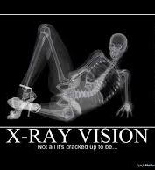
Prognosis
Worsening grade of MRI injury associated with worse outcome
Dogs without midline shift more likely to survive to 1 month

Slide 83
References
Too lazy to put them on here
Small animal neurological emergencies – good chapter on TBI
SACCM 2nd edition has several pertinent chapters (some Fletcher guy wrote some of them, so they probably suck)

