Slide 1
Pyothorax
Lung lobe torsion
Resident Board review
November 11th, 2014
Jo-Annie Letendre, DVM

Slide 2
Pyothorax
Pathophysiology
Etiology
Microbiology
Signalment
Clinical findings
Diagnosis
Treatment
Prognosis

Slide 3
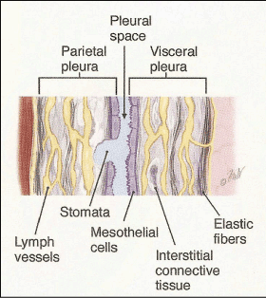
Pyothorax
Pathophysiology
Pleural anatomy
  Mediastinum separates the pleural cavity into left and right sides
    Complete or fenestrated?
    Unilateral vs bilateral pyothorax
  Visceral and parietal pleura
    Single layer of mesothelial cells
    Deep layer of elastic fibers and smooth muscle cells
    Arteries, veins, capillaries, and lymphatics

Slide 4
Pyothorax
Pathophysiology
Pleural space
    Small amount of fluid: lubricate the lungs; minimize friction
Pleural fluid dynamic
  Starling’s law
  High hydrostatic pressure within the parietal pleural capillaries
  Low oncotic pressure within the pleural space
  75% of normal pleural fluid drained via the lymphatics
    Smooth muscle contractions
    Respiratory movements

Slide 5
Pyothorax
Pathophysiology
Pyothorax = thoracic empyema
  Accumulation of septic purulent fluid within the pleural space
Exudative effusions
  Inflammatory conditions → release of cytokines and vasoactive mediators → capillary wall permeability and/or lymphatic outflow impairment
  Protein-rich fluid, cells and macromolecules
  Bacteria may enter via damage to the thoracic wall, trachea, bronchi, lung parenchyma, esophagus.

Slide 6
Pyothorax
Etiology
In dogs
Migrating foreign bodies
Penetrating or blunt trauma
Hematogenous or lymphatic spread
Esophageal perforation
Parasitic migration
Progression of discospondylitis/vertebral osteomyelitis
Parapneumonic spread
Previous thoracocentesis
Thoracic surgery
Internal cardiac massage
Neoplasia
Ruptured lung abscesses

Slide 7

Pyothorax
Etiology
In dogs
Cause is commonly not found
  Reported cause in 2-22% of cases
  Most common: migrating grass awn or plant material
    Geographical location, climate, vegetation
    Sporting, hunting or working-type breeds of dog
    Difficult to confirm underlying cause
Iatrogenic causes
  Post-operative complication in 6.5% of cases

Slide 8
Pyothorax
Etiology
In cats
Penetrating thoracic wounds
  15.6% of the 128 cases reported
Parapneumonic spread
  More common?
Foreign body migration
Parasitic migration (Aelurostrongylus abstrusus, Toxocara cati, Cuterebra)
Hematogenous or lymphatic spread
No association between pyothorax and FeLV/FIV status
No association between sex nor outdoor access and increased risk for pyothorax
Cats with pyothorax are 3.8 times more likely to live in a multiple-cat household

Slide 9
Pyothorax
Microbiology
Oral cavity and upper respiratory tract
Polymicrobial infection
Obligate anaerobes or mixture of obligate anaerobes with facultative aerobic bacteria
In dogs
Escherichia coli, Pasteurella spp., Actinomyces spp., Nocardia spp., Streptococcus spp., Staphylococcus spp. and Corynebacterium spp
Fusobacterium spp., Peptostreptococcus anaerobius, Bacteroides spp., Prevotella spp. and Porphyromonas spp
Geographical location
  Actinomyces and Nocardia spp. / inhalation of grass-awns

Slide 10
Pyothorax
Etiology
In cats
Pasteurella spp., Clostridium spp., Fusobacterium spp., Bacteroides spp., Actinomyces spp., Peptostreptococcus spp., and Prevotella spp
Uncommon: Staphylococcus spp., Rhodococcus equi, Nocardia spp., Escherichia coli, Salmonella spp., Klebsiella spp. and Proteus spp.
Kittens and immunosuppressed adults: Mycoplasma sp.

Slide 11

Pyothorax
Etiology
Fungal: uncommon
  Cryptococcus spp., Candida albicans and Blastomyces dermatitidis
  Also rare in people
  Immunosuppressed and critically ill patients
  High mortality rate in people

Slide 12
Pyothorax
Signalment
Predominantly affect younger animals, but any age can be affected
  Mean age: 3-6 years old
No sex or breed predisposition
  Male overrepresented in several studies: not significant
DSH and DLH, also described in purebred cats
Medium to large breed dogs
  Hunting/working breed dogs overrepresented
  Labrador retrievers, Springer Spaniels, Border collies, German shepherd dogs, Brittany spaniels, Golden Retrievers, Pointers, and Airedale Terriers

Slide 13

Pyothorax
Clinical findings
Insidious, non-specific clinical signs
Present acutely or after several days to months
  Late in the course of the disease
Tachypnea, dyspnea, cough, lethargy, weight loss, anorexia, poor body condition, +/- fever
  Up to 50% of cats present with normal or low body temperature
Restrictive breathing pattern
Loss of normal breath sounds, muffled heart sounds
+/- signs of sepsis
  40% of cats met the criteria for SIRS or sepsis
    Bradycardia and hypothermia

Slide 14
Pyothorax
Diagnosis
Supporting clinical history and consistent physical examination findings
Cytologic examination and/or culture of pleural fluid
Imaging

Slide 15
Pyothorax
Clinicopathological findings
CBC/chem/UA
  Neutrophilic leukocytosis, +/- left shift
    56-93% of dogs; 36-73% of cats
  Possible sepsis/neutrophil sequestration: neutropenia with a degenerative left shift
  In cats: higher total WBC in survivors, but was not significant when neutrophil counts were compared
  Mild to moderate normocytic normochromic anemia
  Hypoproteinemia, hypoglycemia or hyperglycemia, electrolyte abnormalities, elevated liver enzymes, elevated bilirubin
    No prospective studies evaluating biochemical abnormalities as prognostic markers
    In cats: cholesterol was signicantly lower in survivors – but all cats had cholesterol WNL

Slide 16
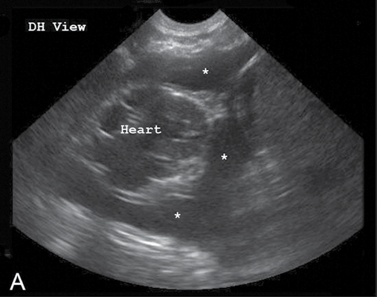
Pyothorax
Diagnostic imaging
Ultrasonography
  Estimate the size of an effusion
  Free vs loculated fluid; echogenicity
    Echogenic, fibrinous adhesions
  Abscess, masses, FB
  To guide procedures
Small animal focused ultrasound –
Gregory Lisciandro

Slide 17
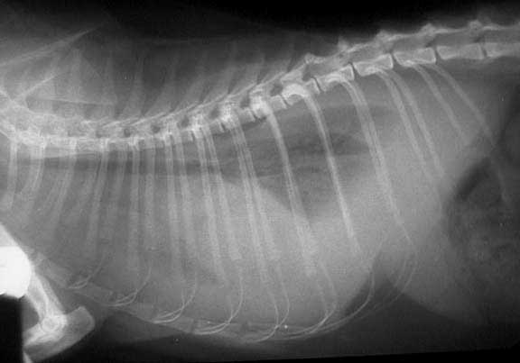
Pyothorax
Diagnostic imaging
Radiography
  Stable patient
  Retraction of lung lobes, pulmonary atelectasis, interlobar fissur lines, loss of the cardiac silhouette
  Mass, FB, pulmomary pathology
  Bilateral effusion
    70-90% cats
    50-93% dogs
    Humans: usually unilateral
http://vetbook.org/wiki/cat/index.php/Pyothorax

Slide 18
Pyothorax
Diagnostic imaging
Computed tomography
  Greater sensitivity (compared to xrays) for small pleural effusion, additional info about the extent/nature of thoracic disease
  Split pleura sign (Hn)
    Contrast enhancement of the parietal and visceral pleura and their separation by pleural fluid
  100% accuracy to differentiate empyema from lung abscess with contrast-enhanced CT
  Radiations, $, accessibility, anesthesia/sedation

Slide 19
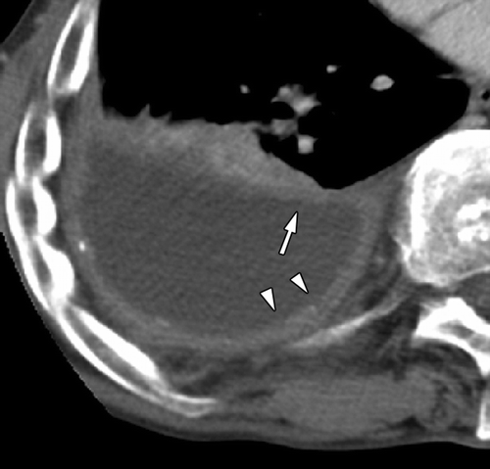
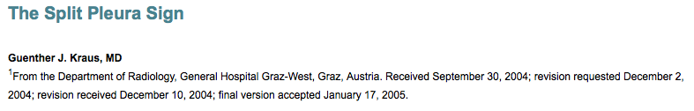

Slide 20
Pyothorax
Thoracocentesis and pleural fluid evaluation
Diagnostic/therapeutic thoracocentesis
US-guided thoracocentesis
Before beginning of antibiotic therapy
  Aerobic and anaerobic culture
  Anaerobic bacterial transport medium (BBL™, Port-A-Cul™) – do not refrigerate, within 24 hours
EDTA tube and red top tube (and/or culturette), blood culture bottles
In-house cytology: intracellular bacteria

Slide 21
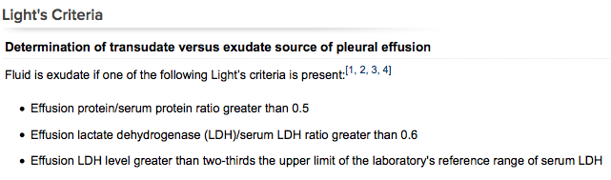
Pyothorax
Pleural fluid evaluation
Turbid or opaque, malodorous
Fluid classification/analysis: transudates, modified transudates or exudated: overlapping
  Human pleural effusions – Light criteria

Slide 22
Pyothorax
Pleural fluid analysis
Suggestive of empyema:
  Glucose < 60 mg/dL; LDH > 1000 U/L; ***pH < 7.2***
Light’s criteria and feline pleural effusion
  LDHp: > 226 IU/l as a cut-off value, sensitivity, specificity and accuracy were 100% in dividing transudates from exudates.
  TPr: > 0.56 as a cut-off value, sensitivity, specificity and accuracy were 91%, 100%, and 95%, respectively.

Slide 23

Pyothorax
Fluid analysis
Biochemial markers of sepsis – peritoneal effusion
  Differences in blood and fluid glucose and lactate found in dogs
  Fluid cytology and TNCC more reliable in cats
  Applicable to patients with septic pleural effusions?

Slide 24

Pyothorax
Pleural fluid analysis
N-terminal pro B-type natriuretic peptide
  Plasma and pleural NT-proBNP: higher in cats with pleural effusion secondary to cardiac disease
  High concentration of NT-proBNP in cats with pyothorax with no evidence of cardiac dysfunction
  Human: Serum and pleural NT-proBNP higher in patients with pleural effusion secondary to cardiac disease
  Human: TNFα, C-reactive protein and procalcitonin

Slide 25
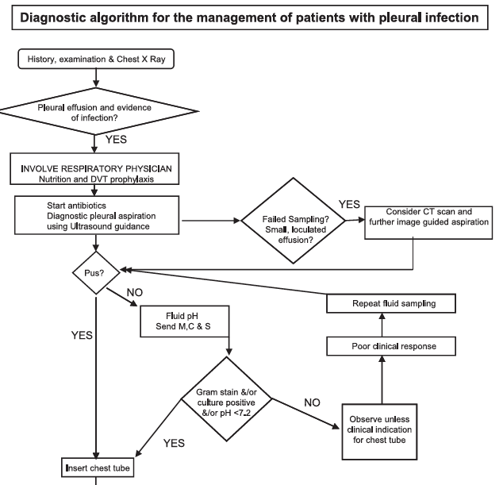

Slide 26
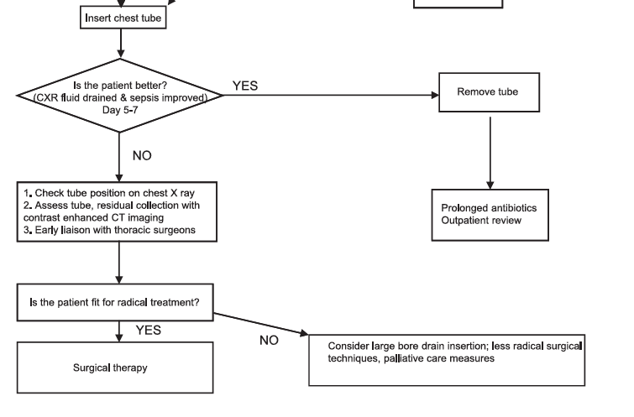

Slide 27
Pyothorax
Treatment
Medical vs surgical therapy
Evidence-based guidelines are lacking in both veterinary and human medicine
Antimicrobial therapy + thoracic drainage = mainstay of therapy
If signs of sepsis: cardiovascular stabilization with IV fluid, correction of electrolyte and acid-base abnormalities…
If hypoxemia: supplemental oxygen…

Slide 28
Pyothorax
Antimicrobial therapy
Empiric: broad-spectrum, anaerobic and aerobic coverage, based on local resistance patterns
De-escalation as needed
False negative: antibiotic use prior to culture; errors in sample handling
  Adults in children: 40-83% of pleural fluid cultures are negative
  Aerobic and anaerobic blood cultures (positive in 10-22% of patients with empyema)
Canine pyothorax
  Potentiated penicillin + fluoroquinolone
Feline pyothorax
  Monotherapy with potentiated penicillin may provide adequate coverage

Slide 29

Pyothorax
Antimicrobial therapy
Ideal route of administration: unknown
  Children: IV
  Adults: With complicated parapneumonic effusions: IV, then oral with improvement in sepsis
  IV until patient is afebrile, chest tube removed
  No evidence-based guidelines in veterinary medicine
    Generally IV until patient stable and eating
  Intrapleural antibiotics: not recommended in human medicine
  Duration of thoracostomy tube placement shorter in veterinary patients (6) that received intrapleural ATB
    4.8 days vs 6.3 days

Slide 30
Pyothorax
Antimicrobial therapy
Duration: unknown
  Different organisms, different duration of therapy?
  Medical vs surgical management vs duration?
Often long duration of therapy: lack of clinical evidence to support this recommendation (Hn and vet)
Human: minimum of 3 weeks of oral antimicrobial therapy
Often based clinical and radiographical improvement
Veterinary: oral antibiotics for 2 weeks past resoluton of pleural effusion on xrays

Slide 31
Pyothorax
Thoracic drainage
ATM alone: generally ineffective
Goal of drainage: to remove as much infected fluid as possible to improve clinical signs, to minimize the potential for subsquent procedures, to optimize post-drainage imaging
Immediately: if in respiratory distress
After stabilization: optimal strategy for continued thoracic drainage?
Single or repeated needle thoracocentesis vs chest tube
  No prospective randomized studies
Indwelling chest tube: Optimal size? Number? Dwell time?

Slide 32
Pyothorax
Thoracocentesis
Single and/or repeated needle thoracocentesis
Success depends on patient selection/underlying pathology (loculations, abscess, foreign material)
Feline pyothorax
  Needle thoracocentesis alone: low cure rate and mortality rates 50-80%
Children: repeated chest taps not recommended
Patient comfort, risk of infection, need for sedation/general anesthesia

Slide 33
Pyothorax
Thoracocentesis
Complications: pneumothorax, hemothorax, pulmonary hemorrhage, organ laceration, infection and re-expansion pulmonary edema (RPE)
Incidence of pneumothorax
  Human: 6% ;→ 34% will need chest drain insertion
  Dogs/cats: unknown
Ultrasound-guided
RPE
  0.2-14% in human ; mortality rate 20%
  Noncardiogenic pulmonary edema
  Onset of symptomes within several hours up to 24 hours
  Tachypnea, dyspnea, cough, cardiovascular instability, or asymptomatic
  Not well documented in cats/dogs: reported following treatment of chronic chylous effusions and with diaphragmatic hernia rapair
  Related to the total amount of pleural fluid removed?
    Recommendations: initial volume of pleural fluid removed <1 L (adults); 10 mlg/kg (children) – expert opinion

Slide 34
Pyothorax
Thoracocentesis
Infection
  Incidence in cats/dogs: unknown
Preoperative thoracocentesis = independent risk factor for development of postop pyothorax in dogs undergoing thoracic surgery
  Dogs with preop pyothorax were excluded from the study

Slide 35
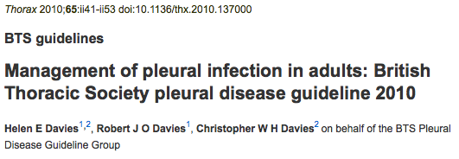
Pyothorax
Tube thoracostomy
Chest tube drainage if:
  Pleural fluid is frankly purulent
  Culture: positive
  Pleural fluid pH < 7.2
  Loculations visible with imaging
  Poor clinical progress with ATM alone

Slide 36
Pyothorax
Tube thoracostomy
Placement is generally well tolerated
Superior drainage vs needle thoracocentesis
Blunt dissection, trocar, or modified Seldinger technique
Unilateral or bilateral?
  No guidelines in veterinary medicine
  Based on volume and distribution of pleural fluid
Optimal chest tube side?
  No randomized clinical trials
  Smaller tubes obstructed by thick exudate and fibrin
  Complications rate with large-bore tube in human: 5-35%
    Pneumothorax, hemorrhage, lung laceration, arrhythmias, pain, anesthetic complications, subcutaneous fluid leaksge, infection
Notes:
As there are currently no guidelines in veterinary medicine, the decision to place unilateral versus bilateral thoracostomy tubes should be made based on the volume and distribution of pleural fluid.^{41–43,48,70}
There is currently no consensus on optimal chest tube size for drainage and there have been no randomized clinical trials evaluating clinical outcome in patients with pleural infection treated with differing sized chest drains.
Traditionally, large-bore trocar tubes have been recommended due to the belief that smaller tubes would become obstructed by thick exudate and fibrin and fail to completely drain effusion.^{6,8,30,41,127} The reported complication rate of large-bore chest tube insertion in humans varies between 5 and 35%.¹²⁷ Complications associated with large-bore thoracostomy tube insertion include pneumothorax, hemorrhage, lung laceration, arrhythmias, pain, anesthetic complications, subcutaneous fluid leakage and infection.^{2,34,42,127}

Slide 37

Pyothorax
Tube thoracostomy
Human medicine: small-bore tubes (8-16Fr) are being used with increasing frequency in human medicine
  No evidence that large-bore tubes are more efficacious
Small-bore tubes
  Easier placement
  Less traumatic
  Sedation
  Better tolerated once in place
  Fewer placement-related complications
  Regular flushing to avoid blockage?
    No evidence
    Drain obstruction was not reported in a study evaluating the use of small-bore chest tubes in dogs/cats

Slide 38
Pyothorax
Tube thoracostomy
Imaging guidance: US or CT
Post-placement thoracic xrays
Dwell time?
  Reported duration in cats in dogs: 4-8 days
Criteria for tube removal
  Clinical improvement
  Decrease in pleural fluid volume < 2 ml/kg/day
  Resolution of infection on cytologic evaluation
    No microorganisms, decreased number of neutrophils, less degenerative appearance
    Serial aerobic/anaerobic culture
  Successful drainage on xrays

Slide 39
Pyothorax
Tube thoracostomy
Intermittent vs continuous suction
  No large prospective veterinary studies
  Continuous suction (5-20 cm H₂O) often used in management of adult/pediatric empyema: little evidence
  Continuous drainage does not necessarily decrease the time needed to manage pyothorax
    Labor and equipment intensive
  Intermittent suction
    Minimal expense and less monitoring
    Frequency?
      More frequently during the initial 24-48 hours; less as volume decreases

Slide 40
Pyothorax
Thoracic lavage
No evidence-based guidelines
  Ideal lavage solution, dwell time, frequency, duration?
Frequency: often based on volume and gross characteristics of the aspirated fluid
Warm physiologic saline (LRS, Hartmann’s solution)
Benefits: reduces viscosity, facilitates drainage, prevents obstruction, dilution/reduction of bacteria/inflammatory mediators, debridement/breakdown of adhesions
Human: standard protocols do not include routine lavage

Slide 41

Pyothorax
Thoracic lavage
No randomized clinical trials
  Shorter indwelling thoracostomy tube times?
  Shorter length of hospitalization?
Pleural lavage associated with higher short and long-term survival rates in dogs
Shorter duration of thoracostomy tube placement and faster recovery in dogs/cats (but only 16% did not have pleural lavage performed)

Slide 42

Pyothorax
Thoracic lavage
In cats – routine lavage not recommended in 1 study
  Volume overload
Monitoring of “ins and outs”
  Recovery of ≥ 75% of the volume infused
Hypokalemia secondary to infusion of 50 ml/kg of physiologic saline reported in a cat

Slide 43
Pyothorax
Intrapleural fibrinolytics
Inflammation → fibrin deposition, adhesions, loculations of pleural fluid → difficult to drain
MIST1: no improvement in mortality, the rate of surgery, or the length of hospitalization -streptokinase
In children: recommended in the treatment of complicated parapneumonic effusion/empyema: one small multicentre randomised placebo controlled trial – urokinase - and several case series

Slide 44

Pyothorax
Intrapleural fibrinolytics
Side effects: hypersensitivity reaction, fever, bleeding, discomfort
Other intrapleural agents: tPA, DNAse
  In combination with fibrinolytics
  Improve drainage, reduce the need for surgery and length of hospitalization
  tPA or DNAse alone: ineffective
    DNAse: decreases viscosity and biofilm formation → necessary for fibrinolytics to clear pleural fluid

Slide 45
Pyothorax
Intrapleural fibrinolytics
In cats and dogs
  Use of fibrinolytics has been described, but no study to evaluate their efficacy, insufficient data to support their routine use
  Other agent: heparin
    10 U/ml of heparin added to lavage fluid improved short-term but not long-term survival in dogs

Slide 46

Pyothorax
Surgical management
No large clinical trials comparing surgical vs medical therapy (human and veterinary medicine)
No objective evidence based criteria to define the point at which surgery is required
Initial treatment or only for cases that fail to medical management?
Surgery associated with better long-term outcome
  78% vs 25% of dogs disease free after 1 year
  Medical therapy: 5.4 times more likely to fail

Slide 47
Pyothorax
Surgical management
Surgery associated with better short-term but not long-term outcome
Surgery associated with higher survival rate (100% vs 62.9%)
  5 cats failed to respond to medical therapy; surgery was curative
  Length of hospitalization was longer
  Long-term outcome?

Slide 48
Pyothorax
Surgical management
BTS guidelines
  Adults and children: surgery with persistently septic after 5-7 days of medical therapy (with antibiotics and chest tube drainage)
Subjective criteria for failure of medical therapy in animals
  Persistence of effusion
  Persistence of infection
    Despite appropriate ATM therapy
    Despite chest tube drainage
  Absence of clinical improvement after 3-7 days
Loculations and/or purulent fluid: more likely to require surgery
  May recovered without surgery

Slide 49
Pyothorax
Surgical management
Early surgical intervention (cats/dogs)
  Evidence of pulmonary or mediastinal lesions
  Evidence of foreign material
  Isolation of Actinomyces spp
    Frequently associated with grass awns migration?
    Can also resolve without surgery…
Surgical options
  Video-assisted thoracoscopic surgery and thoracotomy
  Age, comobordities, surgeon’s preference, availability of equipment
Goals of surgery
  Identification and removal of any inciting cause
  Removal of grossly abnormal or necrotic tissue
  Breakdown of fibrous ahesions
  Lavage of the pleural cavity/decrease bacterial load
  Placement of bilateral thoracotomy tubes

Slide 50
Pyothorax
Thoracotomy
Median sternotomy
  85% of dogs treated for pyothorax
Unilateral: intercostal lateral thoracostomy
Wound complications more common with median sternotomy (71% vs 23%)
Surgical procedures
  Subtotal pericardectomy
  Mediastinectomy
  Lung lobectomy
  Pneumonectomy
    Reported in cats with chronic pneumothorax – well tolerated
  Decortication: removal of the thick fibrinous peel on the pleural surfaces
    Generally not recommended in small animals (complications and difficult procedure)
Histopathology, culture/sensitivity
Inspection of the thoracic cavity and excised tissues
Unilateral or bilateral tubes placement
Post-op: systemic antibiotic therapy, thoracic drainage, analgesia

Slide 51
Pyothorax
VATS
Video-assisted thoracoscopic surgery (VATS)
Little evidence to support its use over open thoracotomy
VATS in small animals:
  Pericardectomy, vascular-ring anomalies division, lung lobectomy, thoracic duct ligation, mediastinal mass resection, biopsy, foreign body removal
  1 case report describes its use for the management of pyothorax in a dog
Advantages:
  Shorter operation times
  Decreased tissue trauma
  Decreased post-op pain
  Fewer wound complications
  Reduced hospital stay
Disadvantages
  Specific and expensive instrumentation/video equipment
  Expertise

Slide 52
Pyothorax
VATS
Human medicine: need for conversion to open thoracotomy: 5.6-61% of cases
  Delayed referral and surgical intervention
  Pleural thickening
  Infection with gram-negative organisms
  Fever
Complications (small animals)
  Hemorrhage
  Pneumothorax
  Pleural adhesions
  Anesthetic complications
  Inability to complete the intended procedure

Slide 53
Pyothorax
Analgesia, nutrition, monitoring
Intrapleural analgesia – controversial
  Bupivacaine
  Absorption may be unreliable
  Risk for diaphragmatic paralysis
Systemic opioid: safe and efficacious
Continuous monitoring
Sterile gloves to handle chest drain
Insertion site(s) checked at least BID
Skin kept clean and dry – light bandage
E-collar
Record volume of fluid lavaged and aspirated
Daily evaluation of electrolytes, acid-base, albumin, blood glucose, PCV/TP
Body weight

Slide 54
Pyothorax
Analgesia, nutrition, monitoring
Malnutrition in humans with pyothorax has been associated with a poor outcome
Provide nutrition as soon as possible
Early enteral nutrition
Feeding tube

Slide 55
Pyothorax
Prognosis
Cats/dogs: variable but can be good with appropriate treatment
Lack of standard therapy, multiple etiologies, multiple patient populations: confound survival data
Respiratory decompensation or sepsis
  Worse outcome
Literature review (since 2000)
  Survival rate of 83% in dogs (29-100%)
  62% in cats (8-100%)

Slide 56
Pyothorax
Prognosis
Cats: most non-survivors die/are euthanized within the first 48 hours
Recurrence rates: 0-14%
  Dogs: associated with high mortality rate; Nocardia or Actinomyces, inhalation/migration of plant material = risk factors
No reliable clinical, radiological, pleural fluid characteristics to accurately determine patient outcome/long-term survival
Early diagnosis/intervention
Management can be expensive and prolonged

Slide 57
Pyothorax
Summary
Life-threatening condition
Septic purulent exudate within the pleural space
Many potential causes – not always identified
Dx: history, clinical signs, laboratory findings, pleural fluid analysis, imaging
Tx: ATM therapy with thoracic drainage
Research needed
  Specific therapies vs outcome
  Biochemical markers vs outcome
  Patient risk factors/epidemiology vs outcome/need for surgery
  Indications for thoracostomy tube placement, optimal size/number/dwell time/management
  Duration of ATM
  Pleural lavage/suction/intrapleural fibrinolytics
  Surgery vs medical therapy
  VATS vs open thoracotomy

Slide 58


Coming soon!
Jenefer Stillion, DVM, DACVECC
Jo-Annie Letendre, DVM

Slide 59
Lung lobe torsion
Pathophysiology/Etiology
Signalment
Clinical findings
Diagnosis
Treatment
Prognosis

Slide 60
Lung lobe torsion
Pathophysiology/Etiology
Most commonly: right middle and left cranial lobes
  Reported in all lung lobes
  Right middle: long and narrow shape
Proposed mechanisms
  Conditions that lead to mobility of a lung lobe
    Pneumothorax
    Pleural effusion
    Previous thoracic surgery
    Thoracic trauma
  Pathologic changes of the lobe(s)
  **Change in the spatial relationship among the lobes in the chest**

Slide 61
Lung lobe torsion
Pathophysiology/Etiology
Precise etiology: unknown
In humans: thoracic surgery, blunt trauma, spontaneously
  Deflation of the lung and division of the pulmonary ligaments
In dogs&cats:
  Atelectasis
  Lobar consolidation
  Pleural effusion
  Increased air or fluid around the lobe, may predispose it to rotate around its axis
  Spontaneous cases, no predisposing factors

Slide 62
Lung lobe torsion
Pathophysiology/Etiology
Rotates about its bronchovascular pedicle
→ thin-walled veins and airway collapse, more muscular artery continues to allow blood flow
→ severe congestion, swelling and consolidation (fluid moves into the interstitial tissue and airways)
→ pleural effusion (not always)
  Hemorrhagic or chylous pleural effusion

Slide 63
Lung lobe torsion
Pathophysiology/Etiology
→ atelectasis of the affected lung lobe
  Secondary to pleural effusion
  Progressive resorption of alveolar gases (resorption atelectasis)
    →lower tidal volume
→Hypoxemia
  V/Q mismatch
  intrapulmonary shunting
  Alveolar hypoventilation

Slide 64

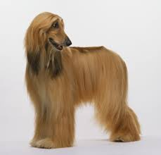
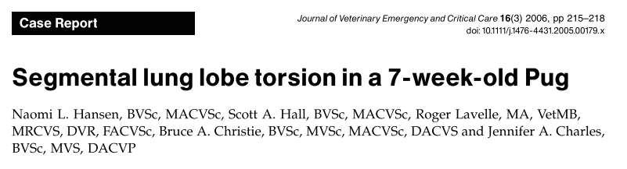
Lung lobe torsion
Signalment
Mature large deep-chested dogs
Afghans are overrepresented
  5/22 cases (23%) – 133 times more likely to develop LLT

Slide 65

Lung lobe torsion
Signalment
Also reported in cats & small dogs: Min Poodle, Dachshund, Pekingese, Yorshire, Shih Tzu, Pug, Whippet
Young male Pugs may be predisposed
  7/23 dogs were Pugs – overrepresented
  Left cranial lung lobe
  Famous Pug diagnosed with LLT…

Slide 66
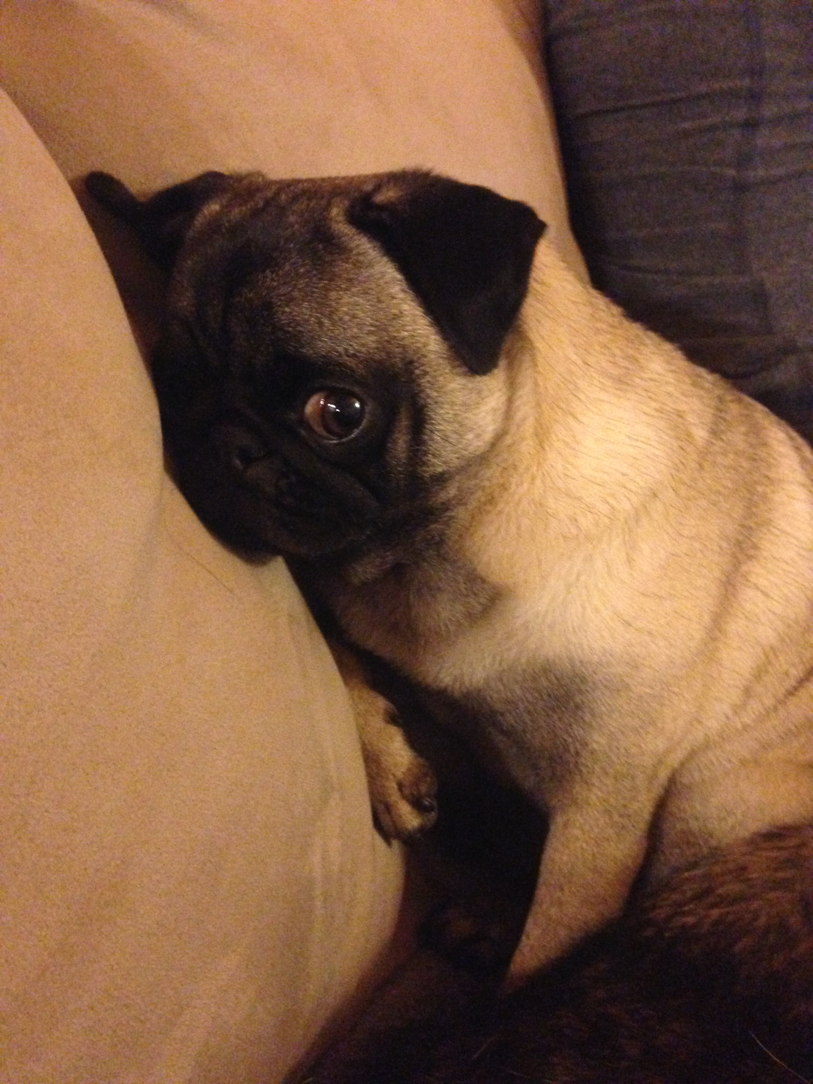
Famous Pug diagnosed with LTT
Waffle Madden

Slide 67



Lung lobe torsion
Signalment
In cats
  Diaphragmatic hernia, chronic asthma, chylothorax, spontaneous
  Right middle lung lobe*, left cranial lobe and right cranial lobe

Slide 68
Lung lobe torsion
History/Clinical findings
Previous history of respiratory disease, trauma, thoracic surgery
Nonspecific: anorexia, vomiting, diarrhea, depression, fever
Tachypnea/respiratory distress
Coughing
Hemoptysis
Epistaxis
Dull heart and lung sounds, signs of shock, cyanosis
Signs of pain (abdominal palpation)

Slide 69
Lung lobe torsion
Differential diagnosis
Atelectasis
Pneumonia
Neoplasia
Pulmonary contusion
Pulmonary thromboembolism
Diaphragmatic hernia
Hemothorax
Pyothorax

Slide 70
Lung lobe torsion
Diagnosis
CBC/chem
  Normal or unspecific changes
tFAST
  Pleural effusion
  Therapeutic thoracocentesis as needed
  Fluid analysis
    Hemorrhagic*, chylous, exudate, modified transsudate

Slide 71

Lung lobe torsion
Diagnosis
Thoracic radiography
  Pleural effusion
  Increased lobar opacity
  Lobar vesicular gas pattern*
    Small dispersed air bubbles
  Irregular, focally narrowed, blunted or displaced lobar bronchi*
  Mediastinal shift
  Curved and dorsally displaced trachea
  Axial rotation of the crania

Slide 72
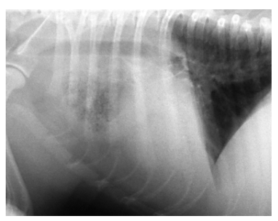
Lung lobe torsion
Thoracic radiography
d’Anjou, M.-A., Tidwell, A. S., & Hecht, S. (n.d.). Radiographic diagnosis of lung lobe torsion. Veterinary Radiology & Ultrasound : The Official Journal of the American College of Veterinary Radiology and the International Veterinary Radiology Association, 46(6), 478–84

Slide 73
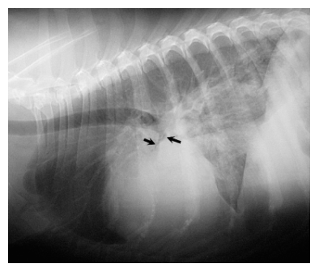
Lung lobe torsion
Thoracic radiography
d’Anjou, M.-A., Tidwell, A. S., & Hecht, S. (n.d.). Radiographic diagnosis of lung lobe torsion. Veterinary Radiology & Ultrasound : The Official Journal of the American College of Veterinary Radiology and the International Veterinary Radiology Association, 46(6), 478–84

Slide 74
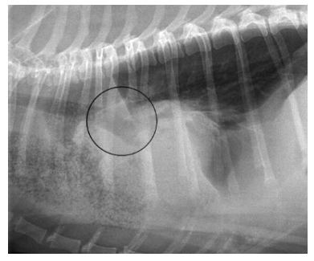
Lung lobe torsion
Thoracic radiography
d’Anjou, M.-A., Tidwell, A. S., & Hecht, S. (n.d.). Radiographic diagnosis of lung lobe torsion. Veterinary Radiology & Ultrasound : The Official Journal of the American College of Veterinary Radiology and the International Veterinary Radiology Association, 46(6), 478–84

Slide 75
Lung lobe torsion
Diagnosis
Ultrasonography
  Generally useful, variable signs can be observed
  Hypoechoic and rounded
  Pleural effusion
  Lobar consolidation → hepatization
  Abnormal orientation of the lobe
  Lack of venous flow return
    Color or power Doppler imaging

Slide 76
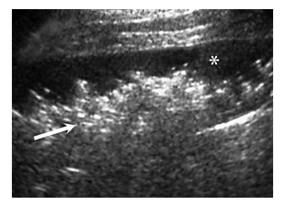
Lung lobe torsion
Ultrasonography
d’Anjou, M.-A., Tidwell, A. S., & Hecht, S. (n.d.). Radiographic diagnosis of lung lobe torsion. Veterinary Radiology & Ultrasound : The Official Journal of the American College of Veterinary Radiology and the International Veterinary Radiology Association, 46(6), 478–84

Slide 77
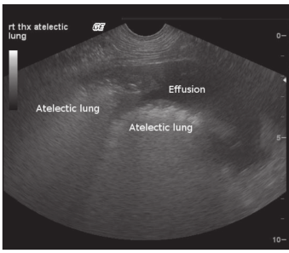
Lung lobe torsion
Gicking, J., & Aumann, M. (2011). Lung lobe torsion. Compendium (Yardley, PA), 33(4)

Slide 78

Lung lobe torsion
Diagnosis
Bronchoscopy
  Partial or complete occlusion of the affected bronchus
  Folding/twisting of the bronchial mucosa
Positive-contrast bronchography
  Viscous propyliodone
  Supplanted by bronchoscopy
Computed tomography (with or without angiography)
  Abrupt ending bronchi
  Abnormal lung lobe position
  Lack of contrast enhancement
  Enlarged lobe
  Emphysema
  Lobe consolidation
  Pleural effusion
  Mediastinal shift
MRI

Slide 79
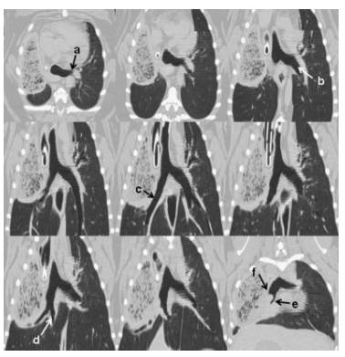
Lung lobe torsion
Computed tomography
SEILER, G., SCHWARZ, T., VIGNOLI, M., & RODRIGUEZ, D. (2008). COMPUTED TOMOGRAPHIC FEATURES OF LUNG LOBE TORSION
. Veterinary Radiology & Ultrasound, 49(6), 504–508. doi:10.1111/j.1740-8261.2008.00435.x

Slide 80
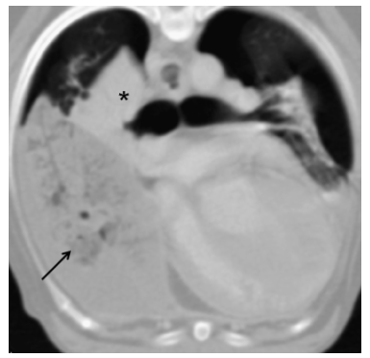
Lung lobe torsion
Computed tomography
SEILER, G., SCHWARZ, T., VIGNOLI, M., & RODRIGUEZ, D. (2008). COMPUTED TOMOGRAPHIC FEATURES OF LUNG LOBE TORSION
. Veterinary Radiology & Ultrasound, 49(6), 504–508. doi:10.1111/j.1740-8261.2008.00435.x

Slide 81
Lung lobe torsion
Treatment -Medical stabilization
Thoracocentesis: needle or chest tube(s)
Oxygen therapy
Fluid resuscitation
IV antibiotics as needed
Pain medications

Slide 82
Lung lobe torsion
Treatment - Surgery
Lobectomy of the affected lung lobe
Lateral thoracotomy or median sternotomy
Derotation: ischemia-reperfusion injury
  Generally damage to the lung lobe too advanced for the lobe to be saved
Dogs and cats can tolerate removal of 50% of their lung mass
  Complete left pneumonectomy
  NOT complete right pneumonectomy

Slide 83
Lung lobe torsion
Treatment - Surgery
Stapling equipement
  Lobectomy with the lobe in its torsed position
Or the pedicle of the lobe is clamped with noncrushing forceps before the lobe is untwisted
  To prevent the release of ROS
Biopsy/culture & sensitivity

Slide 84
Lung lobe torsion
Postoperative care
Analgesia
Antibiotics
Oxygen
IV fluid
Chest tube(s) care

Slide 85
Lung lobe torsion
Prognosis
Fair to guarded
  21/22 had surgery
  11/21 (52%) had uncomplicated surgery and were discharged
    3/11: died of recurrent thoracic disease (6 mo – 6 years)
  2/21 (10%) died within 24 hours post-surgery
    ARDS, CPA
  4/21 (19%) were euthanized or died within 14 days after surgery
    Chylothorax, pneumonia, septic shock, pneumothorax
  4/21 (19%) survived to discharge but then developed complications
  5/5 toy-breed dogs had a successful outcome

Slide 86
Lung lobe torsion
Prognosis
Analysis of 25 published case reports
  Survival rate of 48%
14/23 (61%) dogs survived
6/7 (86%) of Pugs survived
  Fair to guarded in general
  Excellent for Pugs!
  Associated with chylothorax, generally poor
    Afghan hounds

Slide 87



Lung lobe torsion
Prognosis
Recurrence
  Doberman - 4.5 months
  Pug - > 2 years

Slide 88
Lung lobe torsion
Prognosis
Prognosis in cats is unknown
Case reports
  All survived

Slide 89
Lung lobe torsion
Summary
LLT: rotation of a lung lobe along its long axis, with twisting of the bronchus and pulmonary vessels at the hilus
Deep, narrow chests dogs, Afghan hounds and Pugs
Rare in cats
Secondary to pleural effusion/pneumothorax/thoracic surgery or trauma; or spontaneous
Imaging
Surgical condition: lung lobectomy
Prognosis: fair to guarded, good in cats/Pugs
Recurrence is possible

Slide 90

QUESTIONS?

Slide 91
Questions
What is the most common bacterial isolate in cats with pyothorax?
A. E. coli
B. Pasteurella spp.
C. Staphylococcus spp.
D. Streptococcus spp.
Notes:
Pasteurella

Slide 92
Questions
What are the 2 microorganisms commonly associated with inhalation of grass awns?
  ______________ & ______________
Notes:
Actinomyces and Nocardia spp.

Slide 93
Questions
Which of the following anaerobic bacteria is NOT commonly isolated in canine pyothorax?
A. Fusobacterium spp.
B. Clostridium spp.
C. Bacteroides spp.
D. Peptostreptococcus anaerobius
E. Prevotella spp.
F. Porphyromonas spp.
Notes:
Clostridium spp.

Slide 94
Questions
What percentage of pleural fluid is drained by lymphatics from the pleural space?
A. 25%
B. 35%
C. 55%
D. 75%
E. 85%
Notes:
75%

Slide 95
Questions
Which clinical signs are most likely to be seen in dogs and cats with pyothorax?
  Anorexia and polyuria
  Cough and nasal discharge
  Tachypnea and weight loss
  Fever and bradycardia
  Hypothermia and tachycardia
Notes:
Common clinical signs in dogs and cats with pyothorax include tachypnea, dyspnea, cough, lethargy, weight loss and anorexia. Answer C

Slide 96
Questions
Which of the following is not a suspected route of infection in canine pyothorax?
  Migrating foreign body
  Parapneumonic spread
  Extension of diskospondylitis
  Esophageal perforation
  Abdominal surgery
Notes:
E. Abdominal surgery

Slide 97
Questions
TRUE or FALSE. Aminoglycosides are a good choice to treat pyothorax because they have a good penetration into the pleural space.
Notes:
Aminoglycosides should be avoided as they have poor penetration into the pleural space

Slide 98
Questions
What breed of dog is most commonly affected by lung lobe torsion?
A. Afghan hound
B. Golden Retriever
C. Labrador
D. German Shepherd
E. Saint-Bernard
Notes:
A. Afghan Hound

Slide 99
Questions
LLT is most commonly reported in which lung lobes?
  A. Left caudal and right caudal
  B. Left cranial and right caudal
  C. Left cranial and right cranial
  D. Left caudal and right cranial
  E. Left caudal and right middle
  F. Left cranial and right middle
Notes:
F. Left cranial and right middle

Slide 100
Questions
Which of these radiographic findings should be considered as highly specific signs of LLT – (choose 2)
  A. Lobar vesicular gas pattern
  B. Pleural effusion
  C. Lung lobe consolidation
  D. Narrowed bronchus
  E. Displaced trachea
Notes:
Among these signs the presence of a lobar vesicular gas pattern and the visualization of a displaced or proximally narrowed bronchus should be considered as highly specific signs of LLT – A and D

Slide 101
Questions
Which lung can be entirely removed in dogs and cats?
Notes:
Left

Slide 102
Questions
Ultrasonographically, a torsed lung lobe may appear
A. Hyperechoic, rounded, and surrounded by air
B. Hypoechoic, rounded, and surrounded by pleural effusion
C. Hypoechoic, tapered, and surrounded by pleural effusion
D. Hyperechoic, tapered, and surrounded by air
Notes:
B. Hypoechoic, rounded, and surrounded by pleural effusion

